Slide 1
ELECTRICAL ENGINEERING | ELE
Slide X
HARDWARE IMPLEMENTATION
& TROUBLESHOOTING
Presented by ;
Abdelmalek Ibrahim
ELE Systems
Engineering
SS2026
Notes:
This part is about the hardware implementation and the troubleshooting behind our robot. The software gets a lot of attention, but what we learned is that the hardware — the wiring, and even where a sensor physically sits — decides whether the code has any chance of working. I'll show you two real examples from our build: how moving the IR sensors transformed the robot's speed, and how a tiny potentiometer cost us hours of debugging in the wrong place — and how we used AI properly to get out of problems like that.

Slide 2
ELECTRICAL ENGINEERING | ELE
Slide X
WHY HARDWARE COMES FIRST
1
Wiring is the contract between code and reality
Every pin was deliberate — PWM on D5/D10, direction on D6–D9, IR on D2/D3, ultrasonics on D12/D11 and A0/A1. One swapped wire and the “bug” lives outside the code.
2
Sensor position defines what the robot can know
Software only reacts to what the sensors see. Where the IR sensors sit — their spacing and height over the floor — sets the robot’s behaviour before a single line of code runs.
3
Small physical details decide if it moves at all
Removing the L298N jumpers enabled speed control; the sensitivity potentiometer decides whether the line is even detected. Millimetres and quarter-turns matter.
Notes:
Three reasons hardware comes first. One — wiring is the contract between the code and reality. Every pin on our robot was deliberate: PWM speed on D5 and D10, direction on D6 to D9, the IR sensors on D2 and D3, the ultrasonics on D12, D11, A0 and A1. If one wire is swapped, the bug lives outside the code and no amount of programming will find it. Two — sensor position defines what the robot can know. The software can only react to what the sensors see, so their physical placement sets the behaviour before any code runs. Three — small details decide everything: removing the driver jumpers is what enabled speed control, and a tiny potentiometer decides whether the line is detected at all.

Slide 3
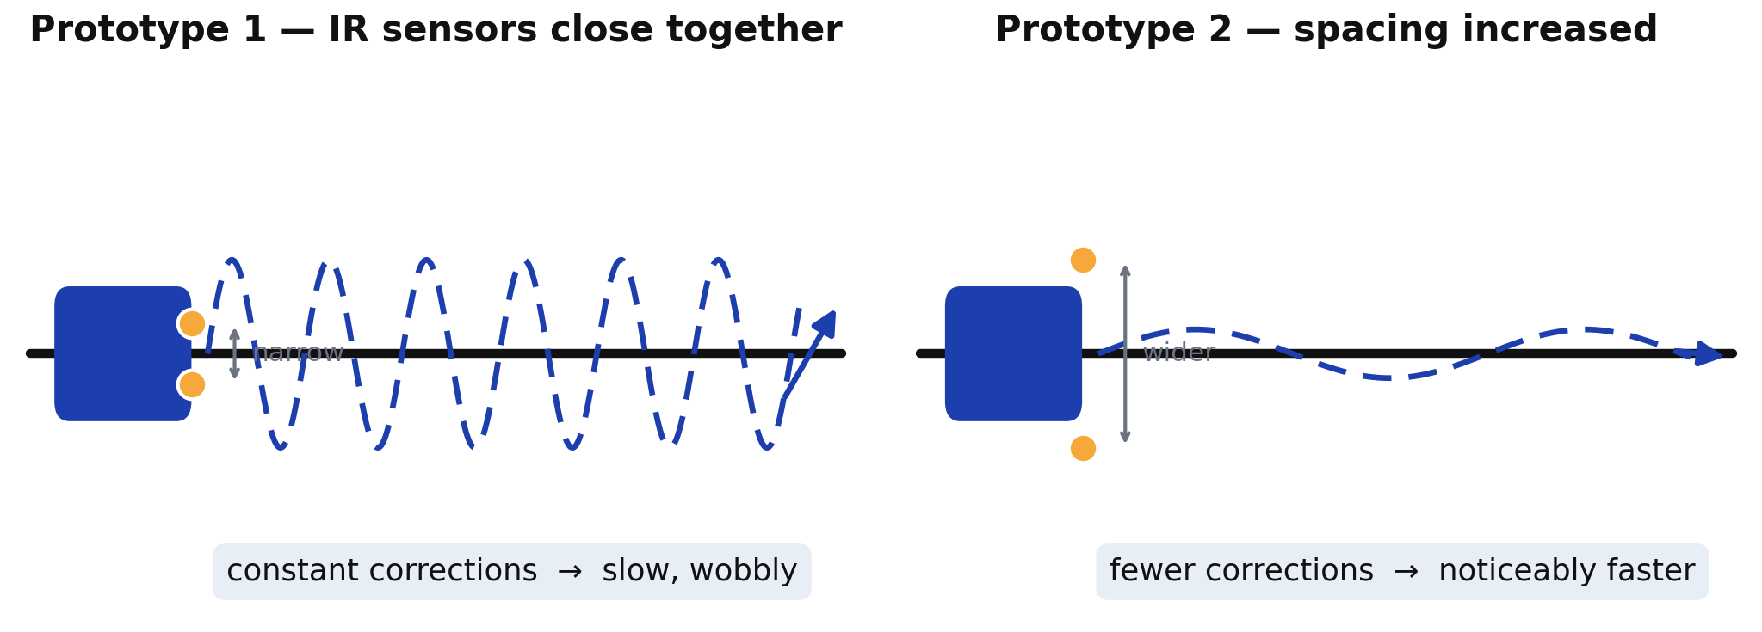
ELECTRICAL ENGINEERING | ELE
Slide X
SENSOR PLACEMENT: FROM SLOW TO FAST
The first prototype worked — but it was slow.
With the IR sensors close together, the robot saw the line edges constantly and corrected non-stop — it crawled along, wobbling.
The fix was physical: we increased the distance between the IR sensors — wider corridor, fewer corrections, and the car got noticeably faster.
Notes:
Here's the clearest example of hardware shaping behaviour. Our first prototype worked — but it was slow and wobbly. The IR sensors were mounted close together, so the robot saw the edge of the line constantly. It corrected left, right, left, right — non-stop — and all that correcting meant it crawled along the track. We didn't fix this in software. We physically increased the distance between the two IR sensors. That gave the robot a wider corridor where it considers itself on the line, so it corrects far less often, drives straighter — and it immediately became noticeably faster. Same code, different sensor position, completely different robot.

Slide 4
ELECTRICAL ENGINEERING | ELE
Slide X
TROUBLESHOOTING:
THE POTENTIOMETER TRAP
1
2
3
4
SYMPTOM
WHERE WE LOOKED
REAL CAUSE
LESSON
→
→
→
The car suddenly wouldn’t move, or ignored the line — with no obvious reason.
In the code. Again and again — re-reading logic, re-uploading, tweaking values. Hours lost.
The IR sensitivity potentiometer. A minor turn shifts the detection threshold — the “bug” was a screw.
Verify the hardware first. A 30-second sensor check beats hours of debugging correct code.
Minor changes on a tiny screw — major changes in behaviour.
Notes:
Now the troubleshooting story that cost us the most time. The symptom: the car suddenly wouldn't move, or ignored the line completely — with no obvious reason. Where did we look? In the code. Again and again — re-reading the logic, re-uploading, changing values — convinced the bug was in software. We wasted a lot of time there. The real cause was the sensitivity potentiometer on the IR sensors. It's a tiny screw, and a minor turn shifts the detection threshold enough that the sensor stops seeing the line — so the code was fine all along. The lesson we took away: verify the hardware first. A thirty-second sensor check can save hours of debugging code that was never broken.

Slide 5
ELECTRICAL ENGINEERING | ELE
Slide X
AI AS A TEAMMATE — IF YOU BRIEF IT RIGHT
AI played a big role — but only when we described the robot’s exact behaviour, not just the goal.
1
Describe the behaviour precisely
“it stalls below a certain speed”, “it turns the wrong way” — not just “it doesn’t work”.
DESCRIBE
↓
2
Give it the hardware facts
pin map, inverted motor wiring, the dead-zone — so solutions fit our robot, not a generic one.
TEST ON THE FLOOR
↓
3
Feed test results back
every floor test refined the next suggestion — kick-start, ramped pivot, the V-dogleg.
REFINE
↺ repeat until it behaves
Notes:
Finally — AI played a big role in this project, but we learned it only helps if you brief it right. Three habits made the difference. First, describe the exact behaviour: ‘it stalls below a certain speed’ or ‘it turns the wrong way’ — not just ‘the car doesn't work’. Second, give it the hardware facts — our pin map, the inverted motor wiring, the dead-zone — so the solutions fit our robot and not some generic one. Third, feed the test results back. Every run on the floor refined the next suggestion, and that loop — describe, test, refine — is what produced the kick-start, the ramped steering, and the V-dogleg avoidance. So the takeaway from our hardware journey: respect the wiring, question the sensors before the code, and treat AI like a teammate who's only as good as your description of the problem. Thank you.

