Slide 1
CS x476 Project 6
Anbang Ye
aye42@gatech.edu
903716351

Slide 2
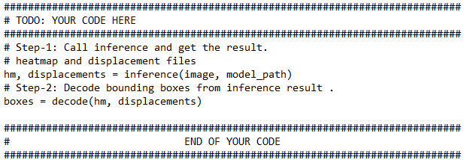
detect_3d_box(): Code (10 points)
Please screenshot your “detect_3d_box()” here (only the two steps you implemented, not the whole function)

Slide 3
Part 1: (8 points)
The network use a modified MobileNetv2 backbone. The decoder is composed by a deconvolution layer and two inverted residual blocks. A detection header and a regression header is after the decoder. The detection header generates a heatmap which simulate the probability distribution of each object. The regression head estimates displacement fields of bounding box vertices. Each bbox is then assigned with an instance (center of Gaussian distribution) from the heatmap given by the detection header. The model also use skip connections and is trained with high-resolutional shape features to improve its quality.
Input: the image to detect
Outputs: the bounding box on image (2d)
Briefly describe your understanding about the pipeline of mediapipe’s Objectron detection. Describe the stages and their required input/outputs
<text answer here>

Slide 4
Part 1: (4 points)
Is it possible to recover a single 3D point from a 2D point of a monocular image (which means a single image taken by a single camera)?
<text answer here>
If depth of that point is not known, No. (If depth of that point is known, yes)

Slide 5
Part 1: (4 points)
Assumptions: knowing the estimated 3d size of the object (XYZ), the bounding box on image (bbox), the transformation matrix of the object with respect to the world frame (T), the intrinsic matrix of the camera (K).
With T and XYZ, we can get an estimated position of each vertices (Pos) on the bounding box in 3d. With K, Pos and bbox, we can calculate projection matrix and estimate the camera’s position
Why is it possible to estimate a 3D object from a monocular image (like mediapipe’s Objectron)? What other assumptions or data is needed to accomplish this.
<text answer here>

Slide 6
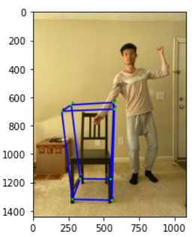
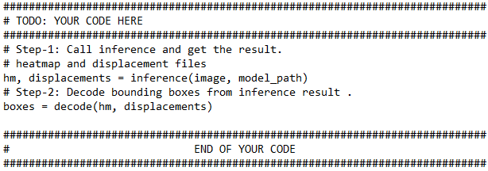
Part 1: (4 points)
Copy and paste the code you fill in “detect_3d_box()” in “my_objectron.py()”
Note: Only paste the code you fill. Do not add the whole function
Put your annotated picture generated from part 1 here

Slide 7

Part 2: (5 points)
After you did camera calibration, you get a more accurate K, the intrinsic matrix of the camera, can you describe what is the meaning of the five non-zero parameter in K?
<text answer here>
cx,cy – optical center in pixel
fx, fy is the focal length in world unit. px, py is the size of pixel in world unit
gamma is the skew coefficient

Slide 8
Part 2: (5 points)
In the K (intrinsic matrix), there is one value representing fx and another one representing fy, what is the unit of those two values? Why? In practice, when fx is not equal to fy, what does this imply?
<text answer here>

Slide 9
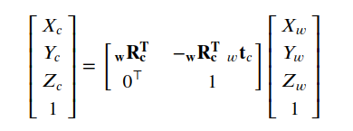

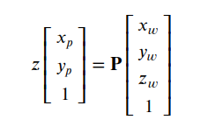
Part 2: (6 points)
You also performed the transformation from world to camera by using the equations below.
1) Previously what we did was from world coordinate to camera coordinate. If we perform the inverse, which is from camera coordinate to world coordinate, will also have a similar equation1, but the w and c will change. Then there will be a ctw in the change equation, what does ctw represent?
2)Using the equation2 and equation3 below, can we describe why the P matrix can project 3D points in world coordinate to 2D points on image plane? (Hint: the P matrix achieves two coordinate transform)
eq.1
eq.1
<text answer here>
eq.2
eq.3

Slide 10
Part 2: (4 points)
According to the box and camera plot at the end of Part 2. Where is the camera? Where is it facing?
<text answer here>

Slide 11
hand_pose_img(): Code (10 points)
Please screenshot your “hand_pose_img()” here (only the two steps you implemented, not the whole function)

Slide 12
Part 3: (4 points)
Please describe an application for pose estimation and explain why it is useful.

Slide 13
Part 3: (4 points)
If you are going to do a pose detection project, what kind of pose do you want to detect and explain why these pose are important for you.

Slide 14
Part 3: (6 points)
What are the two main steps associated with pose detection used in mediapipe (Hints, read the blog post of mediapipe's pose detection)?

Slide 15
Part 3: (4 points)
Copy and paste the code you fill in “hand_pose_img()” in “pose_estimate.py”
Note: Only paste the code you fill. Do not add the whole function
Put your annotated picture after pose detection here

Slide 16
Part 4: (6 points)
How would you estimate depth information from a 2D image, given that the person’s feet and the chair are on the same floor and are both visible in the image?

Slide 17
check_hand_inside_bounding_box(): Code (10 points)
Please screenshot your “check_hand_inside_bounding_box()” here (only the steps you implemented, not the whole function)

Slide 18
Part 5: (6 points)
Given the 3D coordinates of eight vertices of a box in space, and one 3D point, describe how do you detect whether this point is inside or outside the box?

Slide 19
Screenshot the result of running “pytest” on this page:

Slide 20
Extra Credit (for all): Your own image
Insert your picture before interacting with the object and other picture after the interaction happens (the bounding box changes color)

Slide 21
Extra Credit (for grad students): Interaction Video
<Screenshot the code you implemented in process_video() here>

Slide 22
Extra Credit (for grad students): Interaction Video
<Tell us where to access your final video of part 1 or 2, Discuss what you found out. If you have a two-chair video, you don’t have to record the one-chair video again. >

Slide 23
Extra Credit (for grad students): Interaction Video
< What kind of factors determined how accurate the intersection detection was?>

