Slide 1
Engineering
at The Kinetic Group
Brad Daugherty
Wesley Siharth
Go 4th Fridays
October 23, 2026
Engineering Team Lead, Remington
Engineer
Notes:
Brad opens. Introduce Wesley Siharth as an engineer who helped start Remington Vision. Wesley was first tasked with the project as an intern and carried it into his engineering role. Both Brad and Wesley will speak.

Slide 2
Writing the next rules
1816
1969
Next
Remington
Lonoke
Remington + TKG
Our ambition: write the rules for decades to come.
02
Notes:
Remington traces its history to 1816: https://www.remington.com/about-us.html . Remington says Lonoke operations began in 1969: https://www.remington.com/big-green-blog/labor-day-special.html . Honor that history. The world has changed, and our ambition is for Remington and The Kinetic Group to keep writing the rules for manufacturing for decades to come. This is an aspiration, not a claim that a new standard already exists.

Slide 3
Engineering across TKG
Small teams across TKG. Primarily at Remington.
Machines
Controls
Software + data
Equipment built for real production
Sensing, motion, and response
Information people can act on
Build. Test. Improve.
03
Notes:
Explain that the work crosses machines, controls, and software. These capabilities meet on the factory floor. Use one approved example to show how an engineering idea becomes something people can actually use.

Slide 4
Why we love this work
Variety
Visible results
A different problem every day
Work you can see on the floor
Learning
Ownership
Across engineering disciplines
We stay with what we build
04
Notes:
Wesley speaks. Remington Vision was first assigned to him as an intern, and he carried the work into his role as an engineer. Explain why both presenters love the variety, visible results, learning, and ownership in this work.

Slide 5
Live demonstration
Camera → AI → action
Gatorade bottles · on-screen sorting
05
Notes:
Wesley leads the live demonstration. Show the camera image, Gatorade bottle detection, and on-screen sorting result. The demonstration program carries the explanation. This is a demonstration setup, not a production sorting line.

Slide 6
The hard problems
The factory floor changes. Our systems must keep working.
Variation
Timing
Reliability
Conditions keep changing
Decisions at production pace
Results people can trust
The next era is built here.
06
Notes:
Wesley explains the engineering difficulty after the demo: conditions vary, decisions have to happen at the right pace, and results need to be reliable enough for people to trust. The on-screen sorting decision does not actuate production hardware.

Slide 7
Come fight for what’s next
We’re looking for talent across Remington + TKG.
Mechanical
Controls
Software
Testing
Equipment that lasts
Reliable response
Tools for the floor
Proof in real conditions
Help build the next generation of manufacturing.
07
Notes:
Brad resumes. Invite people who want to take on these challenges. Opportunities span Remington and The Kinetic Group. Point employment interest to the official careers page.

Slide 8
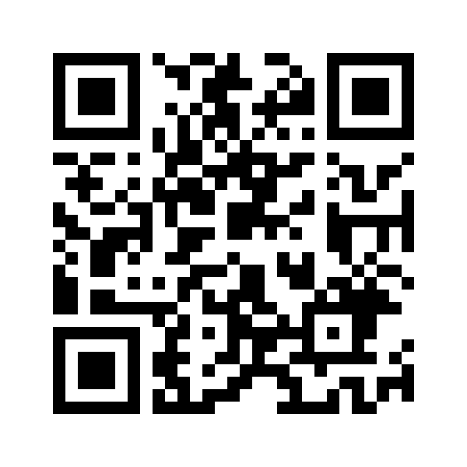
Try it yourself
Draw. Test. Change.
EVENT PIN
4founders.dev/demo/ai-in-action/
877262
08
Notes:
Invite the audience into the separate 4Founders interactive challenge. Ask them to scan the QR code or use the displayed link and PIN. Distinguish this independent project platform from The Kinetic Group careers process.

Slide 9
Bring us your idea
BEYOND THE ROLES YOU’VE SEEN
What do you want to pursue?
If there’s a fit, let’s explore it together.
We could even become your first customer.
09
Notes:
Students may have interests beyond the fields just listed. Ask what they want to pursue. If there is a genuine fit, you would be interested in exploring it together, and your organization might even become an early or first customer. Present this as a possibility that depends on the idea and appropriate follow-up, not a commitment.

Slide 10
Let’s connect
Let’s continue the conversation.
BRAD
4FOUNDERS
bdaugherty@tkghunt.com
4founders.dev
Independent project platform
CAREERS
thekineticgroup.com/careers.html
10
Notes:
Brad closes. Invite follow-up with both Brad and Wesley. Brad’s email is on screen; company jobs use the official careers page, while 4Founders is an independent project platform.

