Slide 1
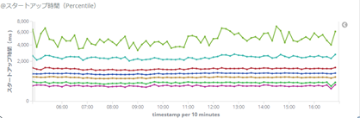
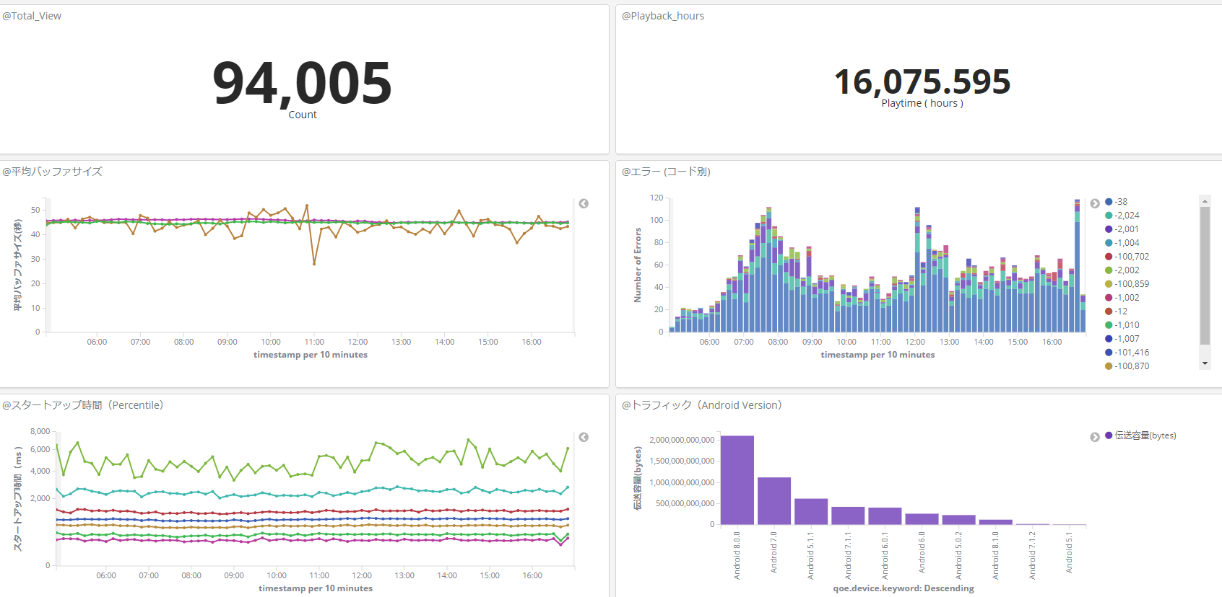
[TBD] QoE Evaluation on Analytics Dashboard
would like to add
@QoE Score (average)
@QoE Score (percentile)
5
4
3
2
1
4.32

