Slide 1


Slide 2
Chapter 10
Estimation:
Describing a single population

Slide 3
Chapter outline
10.1 Concepts of estimation
10.2 Estimating the population mean μ when the population variance σ² is known
10.3 Estimating the population mean μ when the population variance σ² is unknown
10.4 Estimating the population proportion p
10.5 Determining the required sample size
10.6 Applications in marketing: Market segmentation

Slide 4
Learning Objectives
LO1 Understand the fundamental concept of estimation
LO2 Understand the difference between a point estimator and an interval estimator
LO3 Understand the t distribution
LO4 Determine when to use the z-distribution and the t-distribution in estimation
LO5 Develop an interval estimate of a population mean when the population variance is known
LO6 Develop an interval estimate of a population mean when the population variance is unknown
LO7 Develop an interval estimate of a population proportion
LO8 Interpret interval estimates
LO9 Determine the minimum sample size required for estimating a population mean and a population proportion

Slide 5
Where we have been so far…
10.5
In Chapters 1 and 2, we discussed the various data types and various methods of collecting data.
In Chapters 3, 4 and 5, we learnt about the graphical and numerical descriptive measures to summarize data in a meaningful way.
In Chapters 6, 7 and 8, we learnt about methods of assigning probabilities to events and the central and variability measures of discrete and continuous random variables.
In Chapter 9, we learnt how, when and why statistical inference is used, considered the sampling distributions of the sample mean and sample proportion, and made probability statements about the sample statistics.

Slide 6
Where we are going now?
10.6
When making such probability statements, we use some knowledge about the population parameter and the shape of the distribution of the population.
However, in almost all realistic situations population parameters are unknown.
Therefore, from now onwards, we will use the sampling distribution to draw inferences about the unknown population parameters.

Slide 7
Statistical Inference: Introduction
10.7
Statistical inference is the process by which we acquire information about populations from samples.
There are two procedures for making inferences:
Estimation
Hypothesis testing

Slide 8
Statistical Inference
10.8
In this chapter, we utilise the approach developed previously for making statistical inferences about populations:
identify the parameter to be estimated
specify the parameter’s estimator and its sampling distribution
construct an interval estimator.

Slide 9
Statistical Inference
10.9
We will develop techniques to estimate three population parameters:
the population mean μ (for numerical data)
the population variance σ² (for numerical data)
the population proportion p (for nominal data).

Slide 10
Statistical Inference
10.10
Examples
A bank conducts a survey to estimate the number of times customer will actually use ATM machines.
A random sample of processing times is taken to estimate the mean production time and the variance of production time on a production line.
A survey of eligible voters is conducted to gauge support for the federal government’s new carbon emissions reforms.

Slide 11
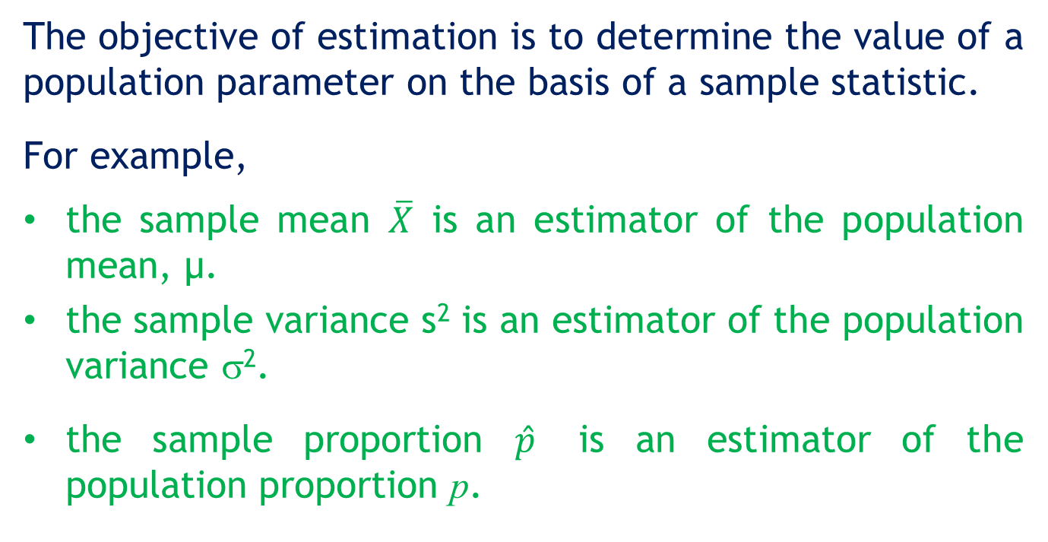
10.1 Concepts of estimation
10.11
The objective of estimation is to determine the value of a population parameter on the basis of a sample statistic.
For example,
the sample mean $\overline{X}$ is an estimator of the population mean, μ.
the sample variance s² is an estimator of the population variance σ².
the sample proportion $\hat{p}$ is an estimator of the population proportion p.

Slide 12
Concepts of estimation
10.12
There are two types of estimators:
Point estimator
Interval estimator

Slide 13
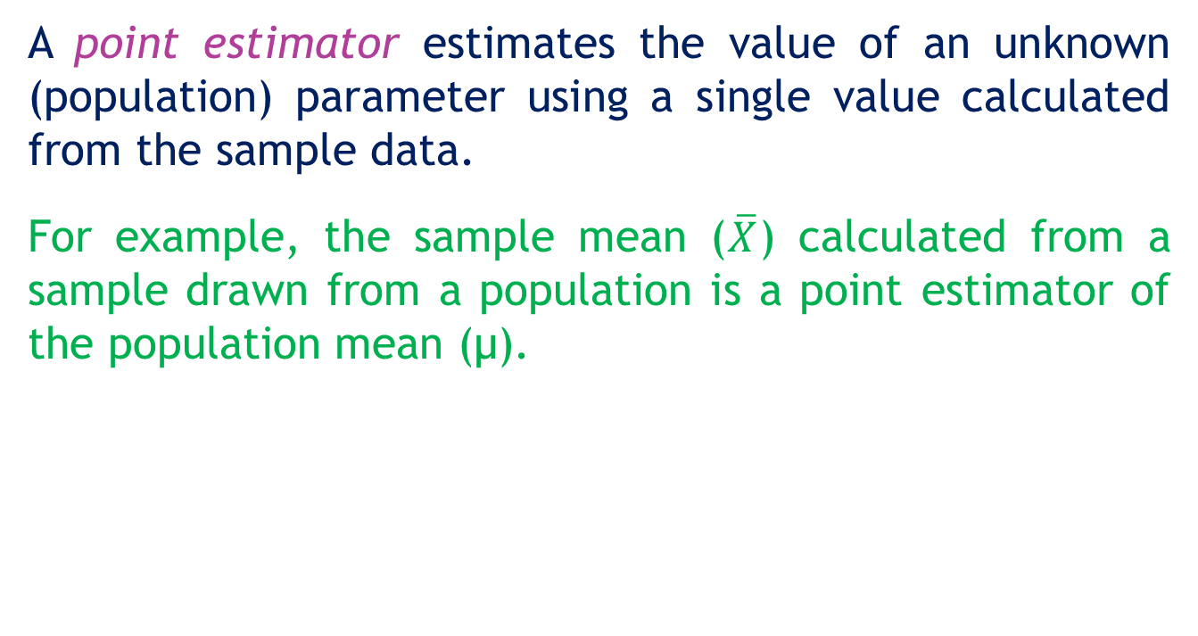
Point Estimator
10.13
A point estimator estimates the value of an unknown (population) parameter using a single value calculated from the sample data.
For example, the sample mean ($\overline{X}$) calculated from a sample drawn from a population is a point estimator of the population mean (μ).

Slide 14
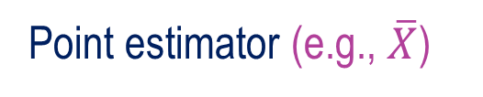

10.14
Point Estimator
Parameter (e.g., μ)
Population distribution
(of X)
?
Sample distribution
(of $\overline{X}$)
Point estimator (e.g., $\overline{X}$)

Slide 15
Interval Estimator
10.15
An interval estimator draws inferences about a population by estimating the value of an unknown population parameter using an interval.
The interval estimator is affected by the sample size.
Population distribution
Parameter
Sampling distribution
Interval estimator

Slide 16
Desirable characteristics
10.16
Desirable characteristics of an estimator are
Unbiasedness: an unbiased estimator is one whose expected value is equal to the parameter it estimates.
Consistency: an unbiased estimator is said to be consistent if the difference between the estimator and the parameter grows smaller as the sample size increases.
Relative efficiency: if there are two unbiased estimators available, the one with a smaller variance is said to be relatively efficient.

Slide 17
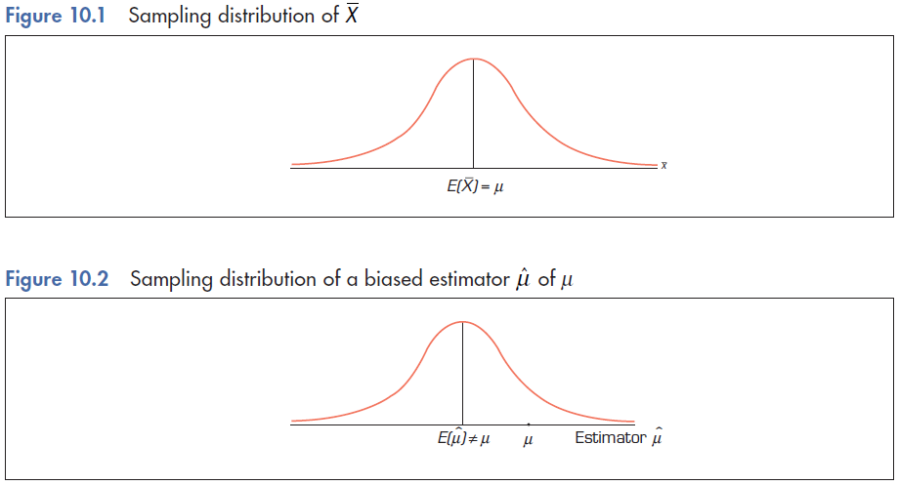
Unbiased Estimators
10.17
An unbiased estimator of a population parameter is an estimator whose expected value is equal to that parameter.

Slide 18
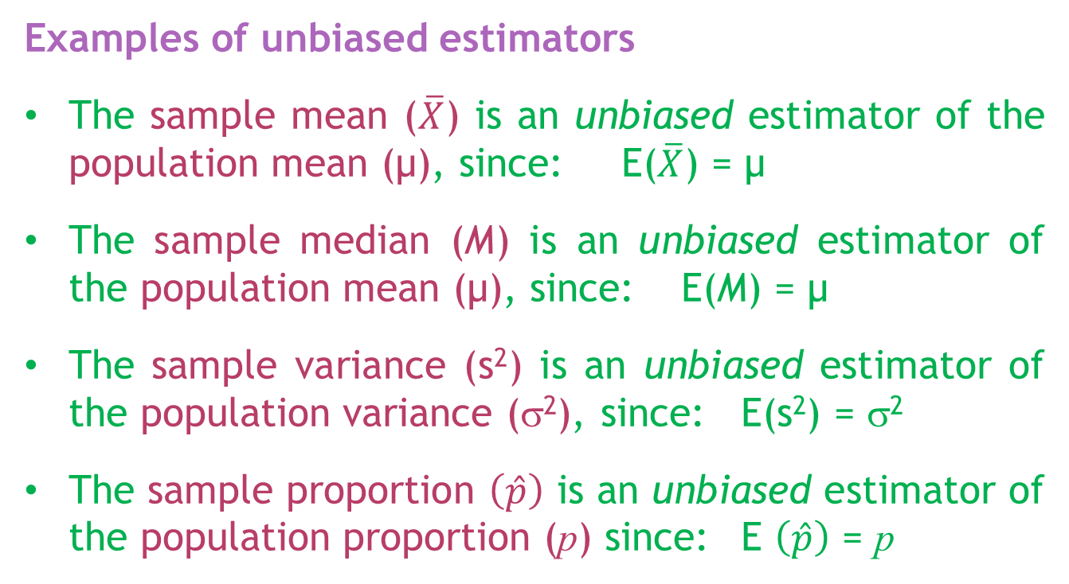
Unbiased Estimators…
10.18
Examples of unbiased estimators
The sample mean ($\overline{X}$) is an unbiased estimator of the population mean (μ), since: E($\overline{X}$) = μ
The sample median (M) is an unbiased estimator of the population mean (μ), since: E(M) = μ
The sample variance (s²) is an unbiased estimator of the population variance (σ²), since: E(s²) = σ²
The sample proportion $\left(\hat{p}\right)$ is an unbiased estimator of the population proportion (p) since: E $\left(\hat{p}\right)$ = p

Slide 19
Consistent estimators
10.19
An unbiased estimator is said to be consistent if the difference between the estimator and the parameter grows smaller as the sample size grows larger.

Slide 20
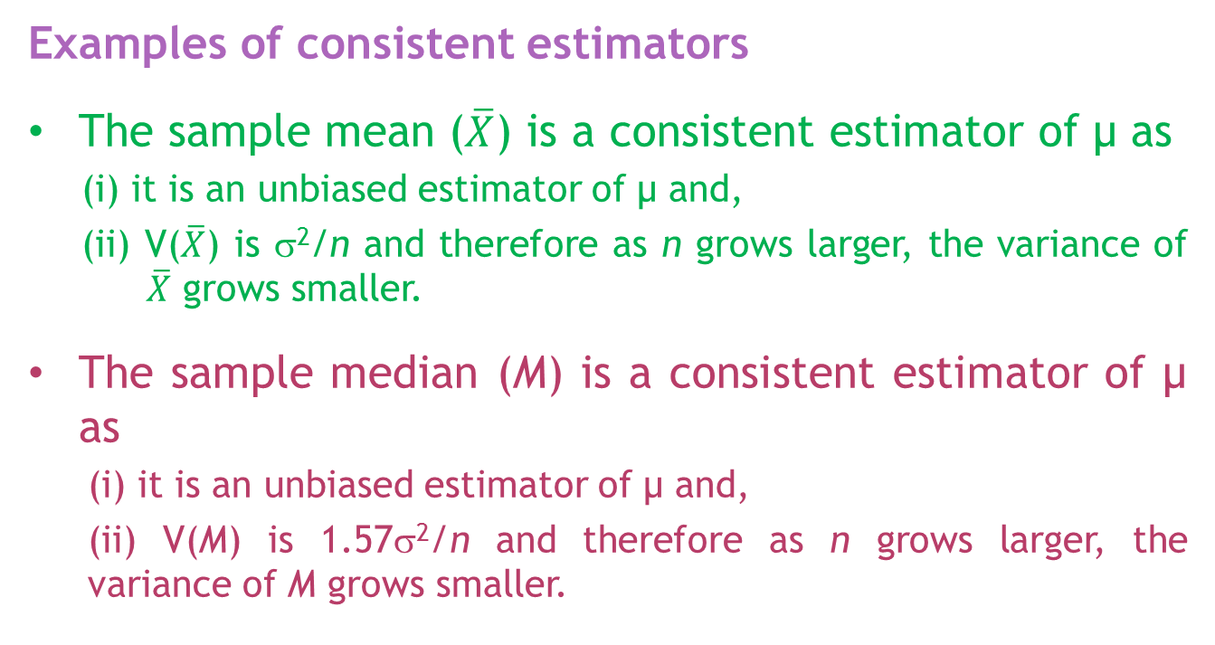
Consistent estimators…
10.20
Examples of consistent estimators
The sample mean ($\overline{X}$) is a consistent estimator of μ as
(i) it is an unbiased estimator of μ and,
(ii) V($\overline{X}$) is σ²/n and therefore as n grows larger, the variance of $\overline{X}$ grows smaller.
The sample median (M) is a consistent estimator of μ as
(i) it is an unbiased estimator of μ and,
(ii) V(M) is 1.57σ²/n and therefore as n grows larger, the variance of M grows smaller.

Slide 21
Efficient estimators
10.21
If there are two unbiased estimators of a (population) parameter, the one whose variance is smaller is said to be relatively efficient.

Slide 22
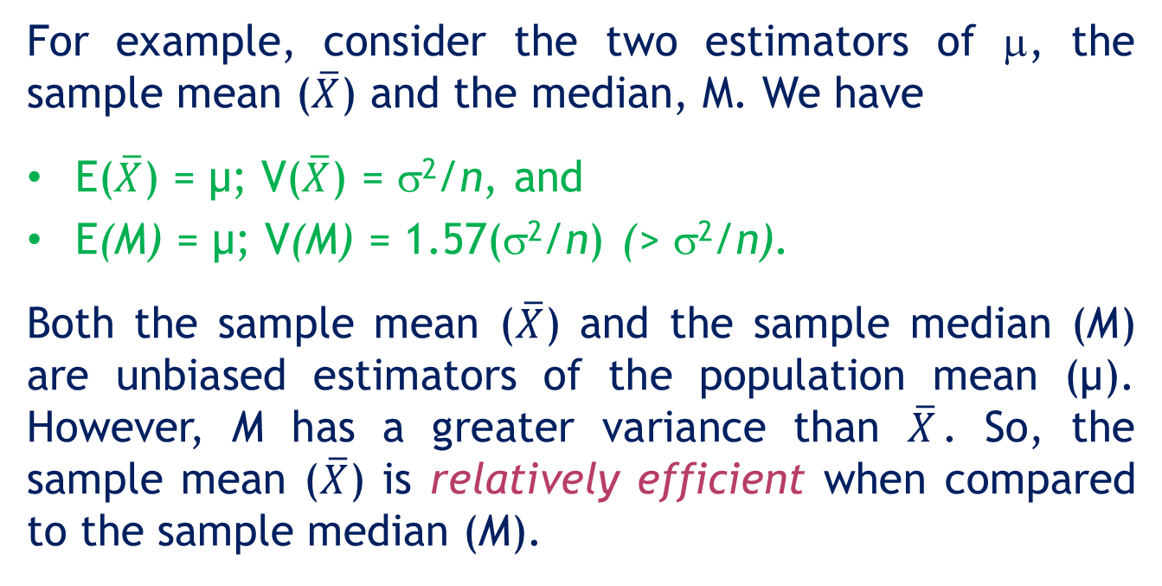
Efficient estimators…
10.22
For example, consider the two estimators of μ, the sample mean ($\overline{X}$) and the median, M. We have
E($\overline{X}$) = μ; V($\overline{X}$) = σ²/n, and
E(M) = μ; V(M) = 1.57(σ²/n) (> σ²/n).
Both the sample mean ($\overline{X}$) and the sample median (M) are unbiased estimators of the population mean (μ). However, M has a greater variance than $\overline{X}$. So, the sample mean ($\overline{X}$) is relatively efficient when compared to the sample median (M).

Slide 23
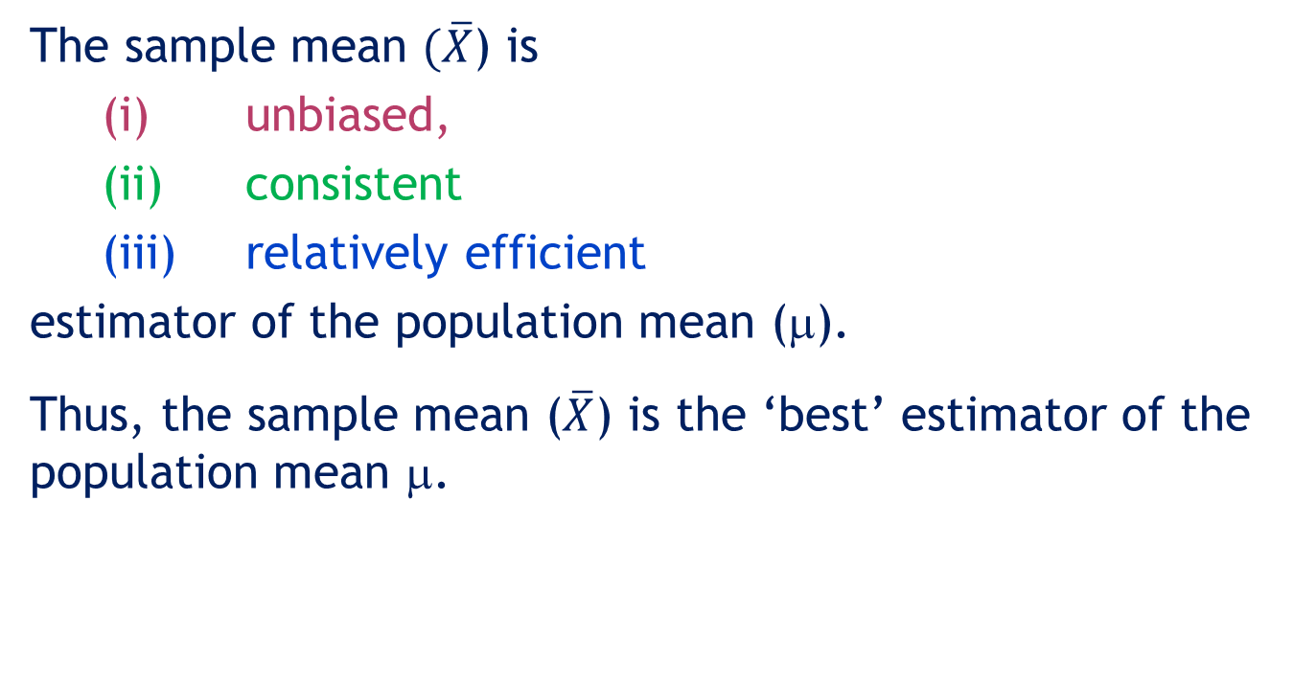
'Best' estimator
10.23
The sample mean $(\overline{X}$) is
(i) unbiased,
(ii) consistent
(iii) relatively efficient
estimator of the population mean (μ).
Thus, the sample mean ($\overline{X}$) is the ‘best’ estimator of the population mean μ.

Slide 24
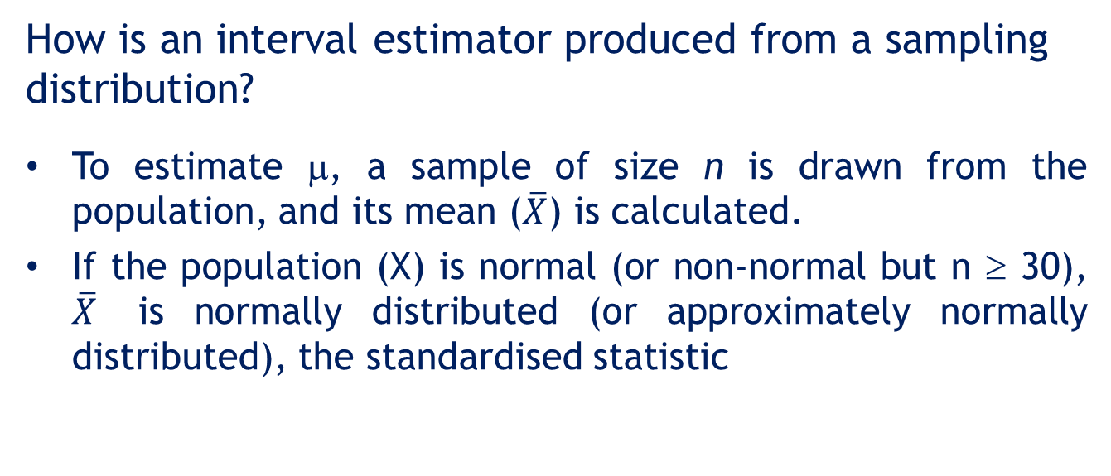
10.2 Estimating the population mean μ when the population variance σ² is known
10.24
How is an interval estimator produced from a sampling distribution?
To estimate μ, a sample of size n is drawn from the population, and its mean ($\overline{X}$) is calculated.
If the population (X) is normal (or non-normal but n ≥ 30), $\overline{X}$ is normally distributed (or approximately normally distributed), the standardised statistic

Slide 25
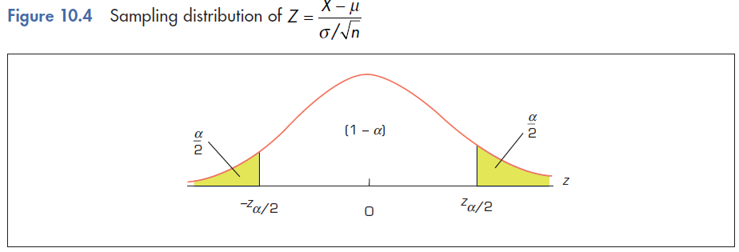
Estimating μ when σ² is known…
10.25

Slide 26
Estimating μ when σ² is known…
10.26
For example, for α = 0.05, the symmetry of the normal distribution with the sampling distribution of the sample mean leads to:
- z0.025
z0.025
Notes:
26

Slide 27


10.27
Estimating μ when σ² is known…
Standard normal distribution Z
0.95
Normal distribution of $\overline{X}$
0.025
0.025
-1.96
-1.96
0
Z
0.025
0.95
0.025
μ
$$\overline{X}$$

Slide 28
10.28
Estimating μ when σ² is known…
In general,
This leads to the relationship

Slide 29
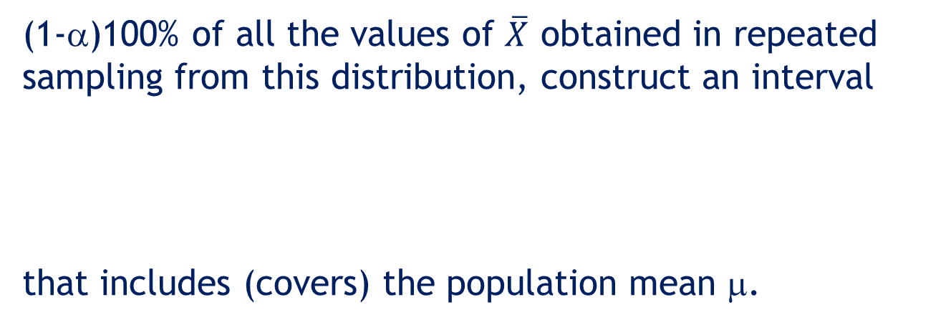
10.29
Estimating μ when σ² is known…
(1-α)100% of all the values of $\overline{X}$ obtained in repeated sampling from this distribution, construct an interval
that includes (covers) the population mean μ.

Slide 30
10.30
Estimating μ when σ² is known…
Confidence level
1 – α
Lower confidence limit
Upper confidence limit

Slide 31
10.31
Estimating μ when σ² is known…
The probability (1 − α) is called the level of confidence.
is called the lower confidence limit (LCL).
is called the upper confidence limit (UCL).

Slide 32
10.32
Estimating μ when σ² is known…
(1-α)100% confidence interval for μ:
or
This can also be written as
or , where
B is half the width of the confidence interval.
That is, 2B is the width of the confidence interval.

Slide 33
10.33
Estimating μ when σ² is known…
Three commonly used confidence levels, (1 – α)

Slide 34
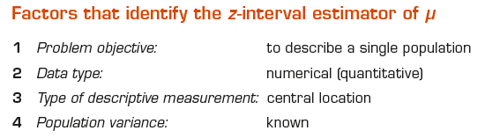
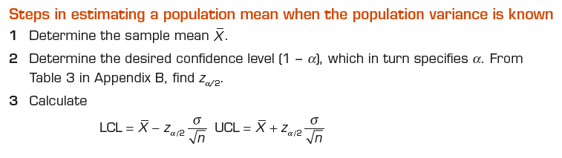
10.34
Estimating μ when σ² is known…

Slide 35
Example 1
10.35
(Example 10.1, page 375)
XM10-01 The sponsors of television shows targeted at children wanted to know the amount of time children spend watching television, since the types and number of programs and commercials presented are greatly influenced by this information. As a result, a survey was conducted to estimate the average number of hours Australian children spend watching television per week. From past experience, it is known that the population standard deviation σ is 8.0 hours.
The following are the data gathered from a sample of 100 children. Find the 95% confidence interval estimate of the average number of hours Australian children spend watching television.

Slide 36
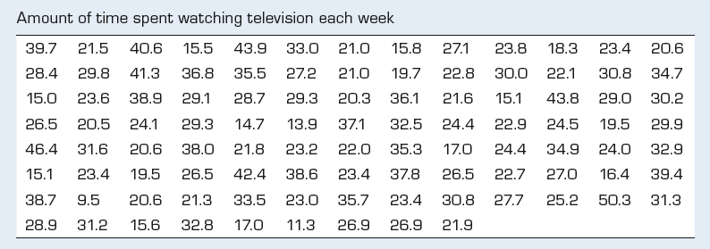
Example 1
10.36

Slide 37
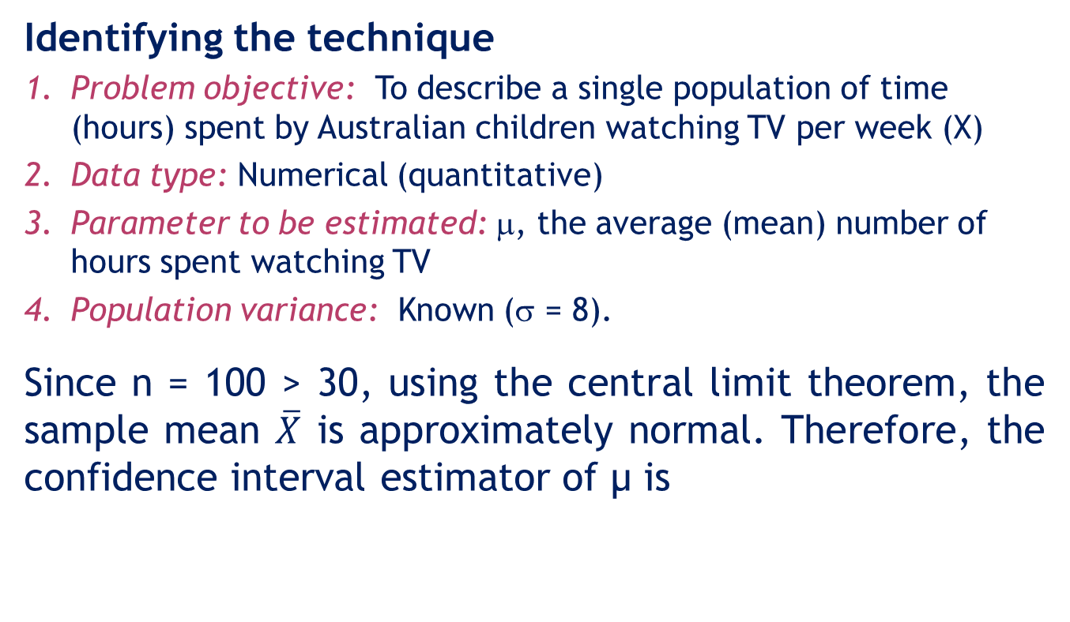
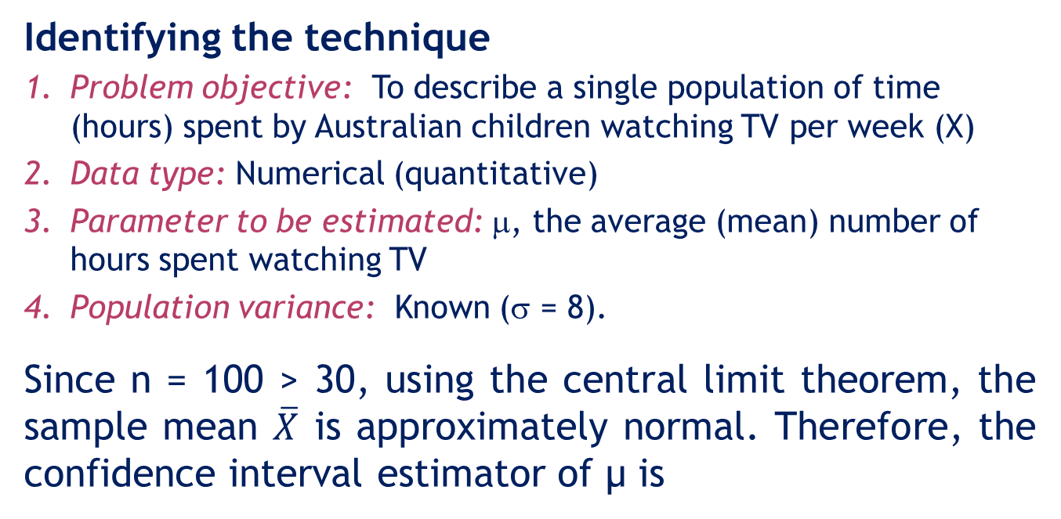
Example 1: Solution
10.37
IDENTIFY
Identifying the technique
Problem objective: To describe a single population of time (hours) spent by Australian children watching TV per week (X)
Data type: Numerical (quantitative)
Parameter to be estimated: μ, the average (mean) number of hours spent watching TV
Population variance: Known (σ = 8).
Since n = 100 > 30, using the central limit theorem, the sample mean $\overline{X}$ is approximately normal. Therefore, the confidence interval estimator of μ is

Slide 38
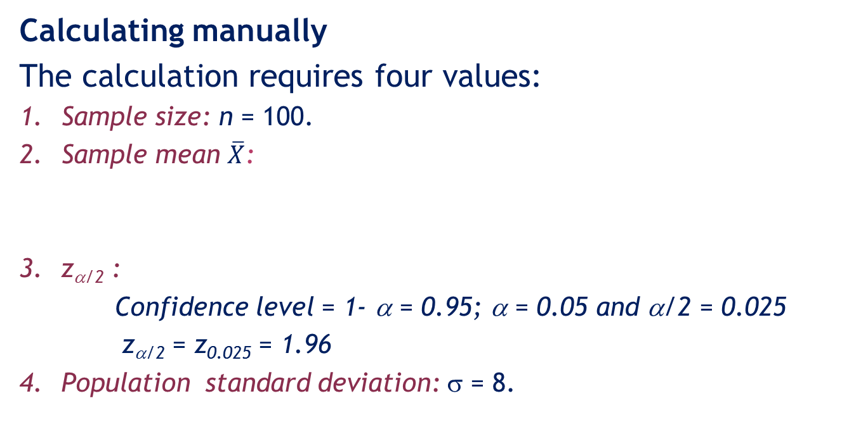
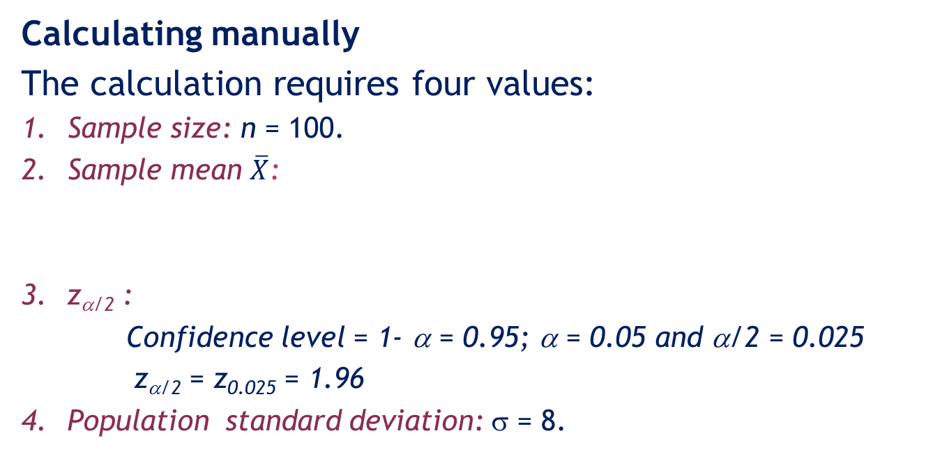
Example 1: Solution
10.38
CALCULATE
Calculating manually
The calculation requires four values:
Sample size: n = 100.
Sample mean $\overline{X}$:
z_{α/2} :
Confidence level = 1- α = 0.95; α = 0.05 and α/2 = 0.025
z_{α/2} = z_{0.025} = 1.96
4. Population standard deviation: σ = 8.

Slide 39
Example 1: Solution
10.39
Calculating manually
Therefore, a 95% confidence interval estimator of μ is
We therefore estimate that the average number of hours children spend watching television each week lies somewhere between
LCL = 25.62 hours and UCL = 28.76 hours

Slide 40
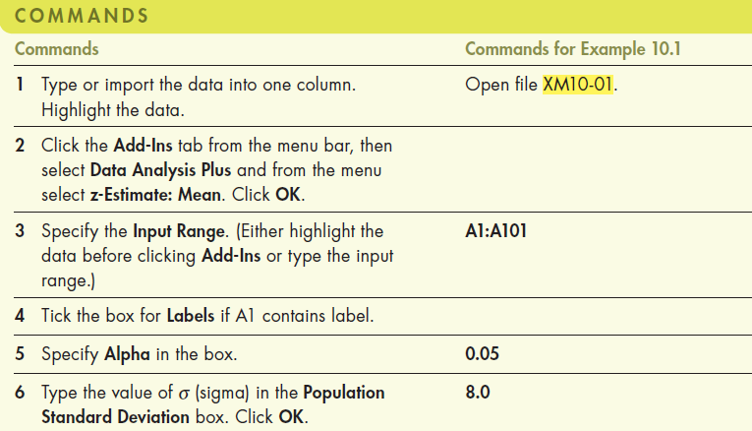
Example 1: Solution
10.40
Using Excel (Data Analysis Plus™)

Slide 41
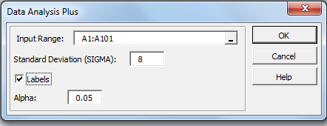
Example 1: Solution
10.41
Using Excel (Data Analysis Plus™)
In the Data Analysis Plus dialogue box (shown below), enter the input and the output is presented in the next slide.

Slide 42
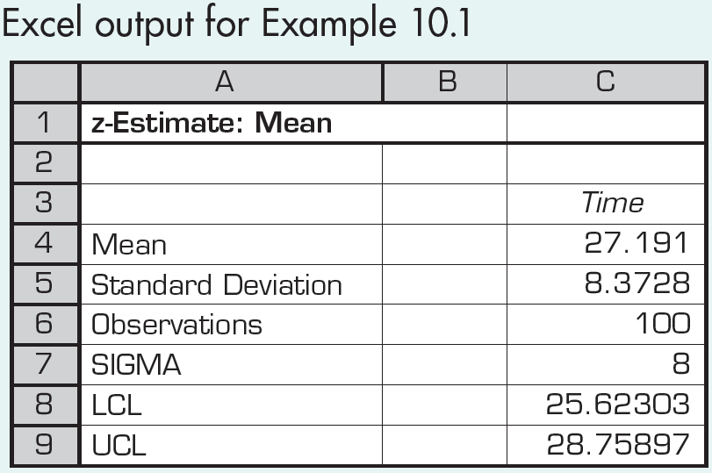
Example 1: Solution
10.42
Using Excel (Data Analysis Plus™)
95% confidence interval output from Data Analysis Plus

Slide 43
Interpreting the results
10.43
INTERPRET
That is, the average time spent watching TV by Australian children is between 25.6 hours and 28.8 hours. This type of estimate is correct 95% of the time.
As a consequence, a network executive may decide (for example) that, since the average child watches at least 25.6 hours of television per week, the number of commercials children see is sufficiently high to satisfy the programs’ sponsors.
Incidentally, the media often refer to the 95% confidence interval as ’19 out of 20 times’, which emphasises the long-run aspect of a confidence interval.

Slide 44
Interpreting the interval estimator
10.44
Some people erroneously interpret the confidence interval estimate in this example (Example 1) to mean that there is a 95% probability that the population mean of the number of hours Australian children watch television lies between 25.623 and 28.759.
This interpretation is wrong because it implies that the population mean is a variable about which we can make probability statements.
In fact, the population mean is a fixed but unknown quantity. Consequently, we cannot interpret the confidence interval estimate of µ as a probability statement about µ.

Slide 45
Interpreting the interval estimator
10.45
To translate the confidence interval estimate properly, we must remember that the confidence interval estimator was derived from the sampling distribution of the sample mean.
We used the sampling distribution to make probability statements about the sample mean.
Although the form has changed, the confidence interval estimator is also a probability statement about the sample mean.

Slide 46
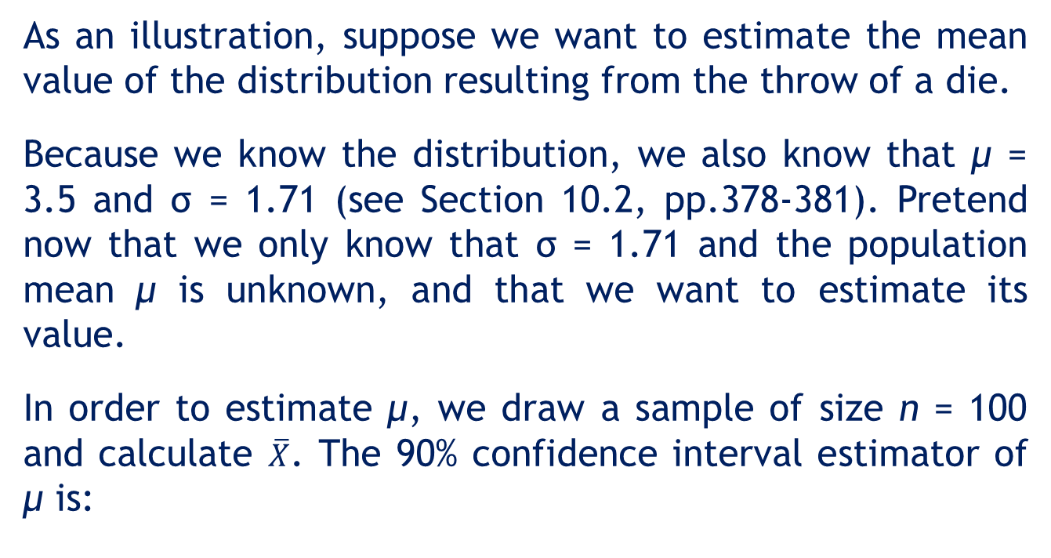
An illustrative application
10.46
As an illustration, suppose we want to estimate the mean value of the distribution resulting from the throw of a die.
Because we know the distribution, we also know that μ = 3.5 and σ = 1.71 (see Section 10.2, pp.378-381). Pretend now that we only know that σ = 1.71 and the population mean μ is unknown, and that we want to estimate its value.
In order to estimate μ, we draw a sample of size n = 100 and calculate $\overline{X}$. The 90% confidence interval estimator of μ is:

Slide 47
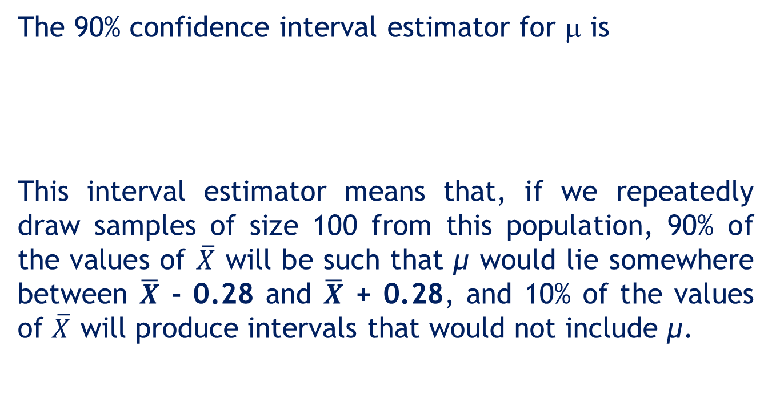
An illustrative application
10.47
The 90% confidence interval estimator for μ is
This interval estimator means that, if we repeatedly draw samples of size 100 from this population, 90% of the values of $\overline{X}$ will be such that μ would lie somewhere between $\overline{X}$ - 0.28 and $\overline{X}$ + 0.28, and 10% of the values of $\overline{X}$ will produce intervals that would not include μ.

Slide 48
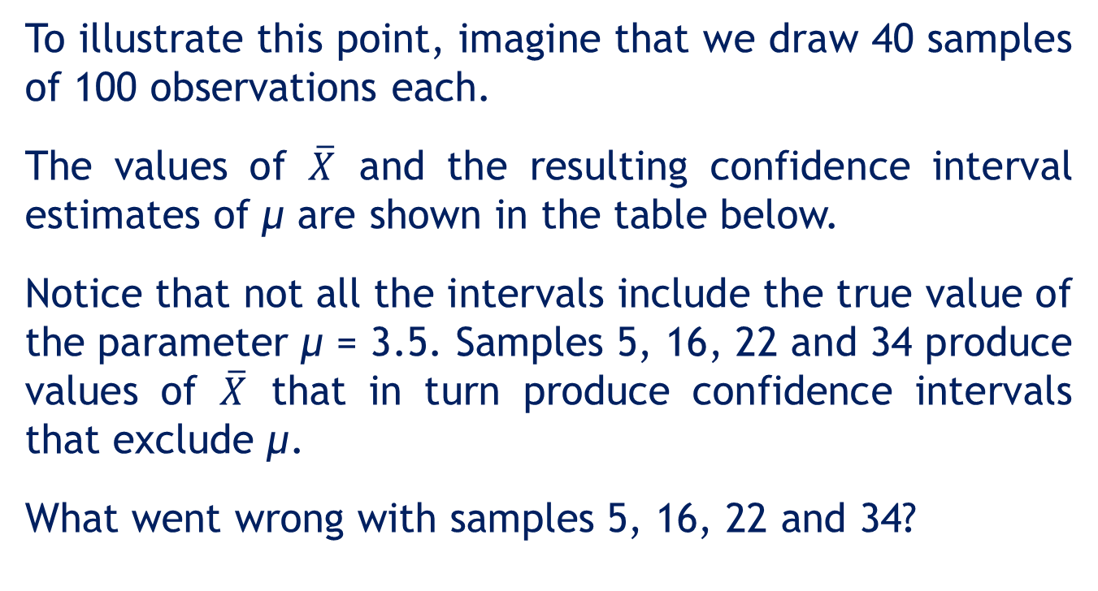
An illustrative application
10.48
To illustrate this point, imagine that we draw 40 samples of 100 observations each.
The values of $\overline{X}$ and the resulting confidence interval estimates of μ are shown in the table below.
Notice that not all the intervals include the true value of the parameter μ = 3.5. Samples 5, 16, 22 and 34 produce values of $\overline{X}$ that in turn produce confidence intervals that exclude μ.
What went wrong with samples 5, 16, 22 and 34?

Slide 49
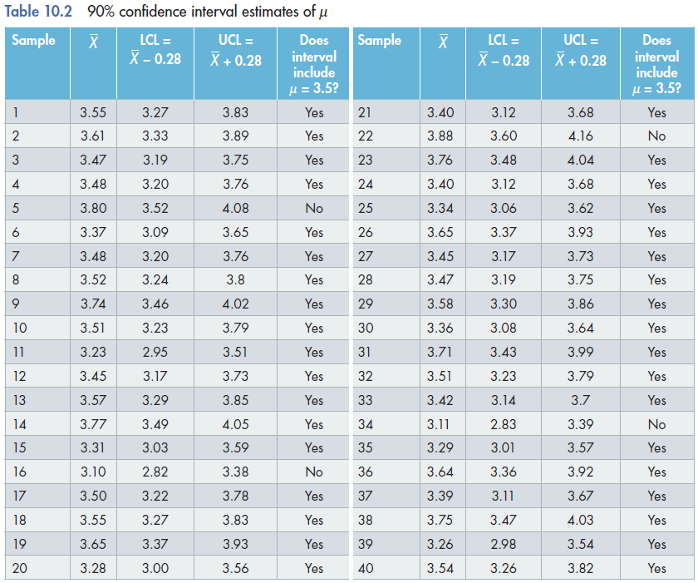
An illustrative application
10.49

Slide 50
An illustrative application
10.50
What went wrong with samples 5, 16, 22 and 34?
The answer is nothing. Statistics does not promise 100% certainty. In fact, in this illustration, we expected 90% of the 40 intervals to include μ and 10% to exclude μ.
Since we produced 40 confidence intervals, we expected that 4 (10% of 40) intervals would not contain μ = 3.5.

Slide 51
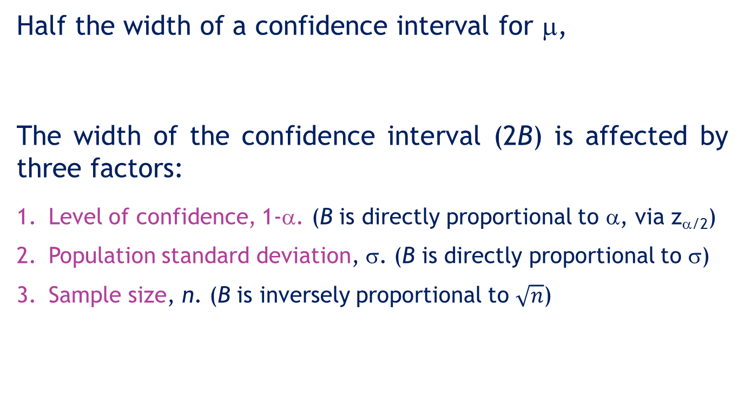
Factors that determine the width of a confidence interval for μ
10.51
Half the width of a confidence interval for μ,
The width of the confidence interval (2B) is affected by three factors:
Level of confidence, 1-α. (B is directly proportional to α, via z_{α/2})
Population standard deviation, σ. (B is directly proportional to σ)
Sample size, n. (B is inversely proportional to $\sqrt{n}$)

Slide 52
Factors that determine the width of a confidence interval for μ…
10.52
Level of confidence, 1-α. (B is directly proportional to α, via z_{α/2})
As the level of confidence (1-α) increases from 0.90 to 0.99, z_{α/2} also increases (from 1.645 to 2.575). Therefore, in general, when the level of confidence increases, the width also increases.

Slide 53
Factors that determine the width of a confidence interval for μ…
10.53
Population standard deviation, σ.
B is directly proportional to σ and when σ increases, the width (2B) also increases. For example, if σ is doubled, then the width would also be doubled or if σ is halved, then the width would be halved as well.
Sample size, n.
B is inversely proportional to √n. When n increases, the width (2B) decreases. For example, if n increases by 4 times, the width would be halved.

Slide 54
The width of the confidence interval
10.54
A larger confidence level (1-α) produces a wider interval.
Larger values of standard deviation (σ) produce wider confidence intervals.
Larger sample sizes (n) produces narrower confidence intervals.

Slide 55
The width of the confidence interval
10.55
A wide interval provides little information.
For example, suppose we estimate with 95% confidence that an accountant’s average starting salary is between $15 000 and $100 000.
Contrast this with: a 95% confidence interval estimate of starting salaries between $42 000 and $45 000.
The second estimate is much narrower, providing accounting students more precise information about starting salaries.

Slide 56
10.56
10.3 Estimating the population mean μ when the population variance σ² is unknown
Recall that when σ is known, the statistic
is (standard) normally distributed
assuming that the sample is drawn from a normal population, or if the population is not normal but the sample size is sufficiently large (n ≥ 30).

Slide 57
10.57
Estimating μ when σ² is unknown…
When σ is unknown, in place of σ we use its point estimator s and the z-statistic is no longer standard normally distributed, but becomes a t-statistic
If the sample is drawn from a normal population, the t-statistic is Student t distributed with (n-1) degrees of freedom.

Slide 58
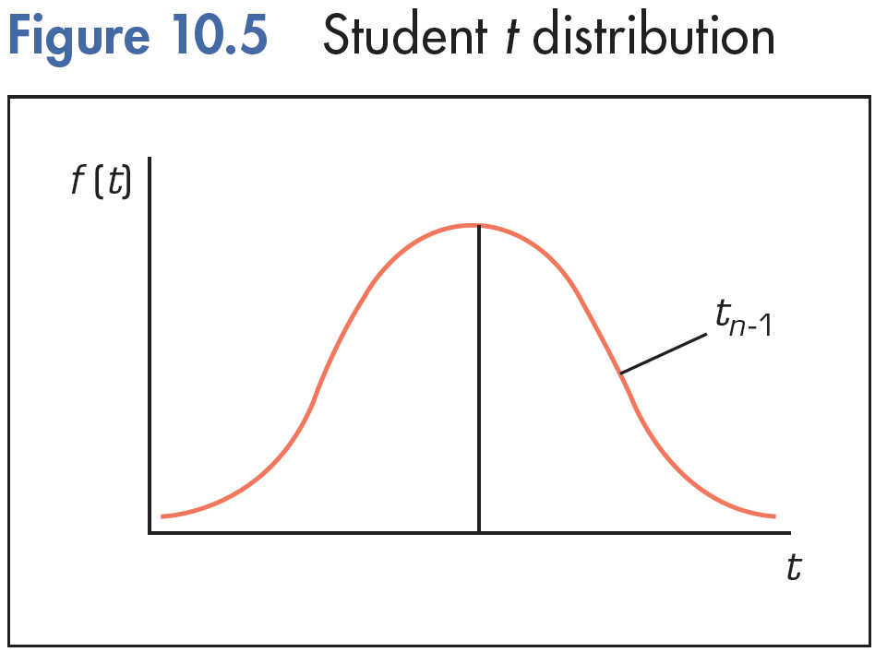
10.58
The t-distribution
The t distribution is mound-shaped and symmetrical around zero.
The ‘degrees of freedom’, n-1, a function of the sample size, determines how spread the distribution is (compared to normal distribution).

Slide 59
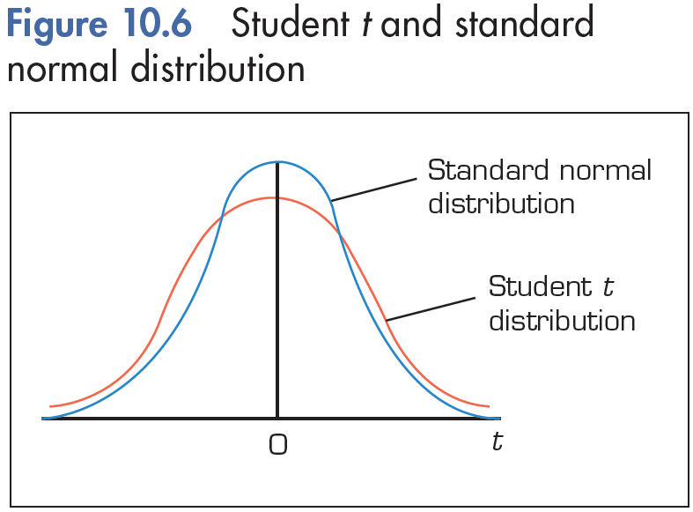
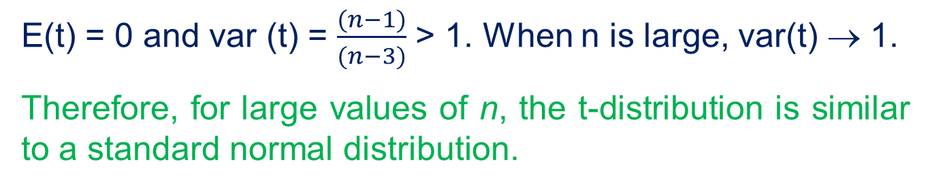
10.59
The t-distribution
E(t) = 0 and var (t) = $\frac{(n−1)}{(n−3)}$ > 1. When n is large, var(t) → 1.
Therefore, for large values of n, the t-distribution is similar to a standard normal distribution.

Slide 60
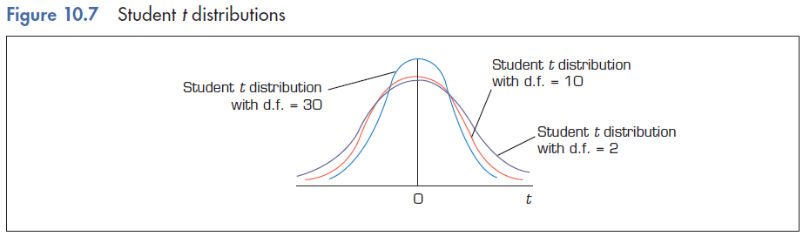
10.60
The t-distribution
d.f. = n2
n1 < n2
d.f. = n1
0

Slide 61
Probability Calculations for the t Distribution
10.61
Like the z table, the t table provides critical values for various probabilities of interest but slightly in a different way.
The form of the (tail) probabilities that appear in Table 4, Appendix B, are:
P(t > t_{α,d.f.}) = α
For a given degree of freedom, and for a predetermined right-hand tail probability α, the entry in the table is the corresponding t_{α}.
These values are used in computing interval estimates and performing hypothesis tests when σ is unknown.

Slide 62
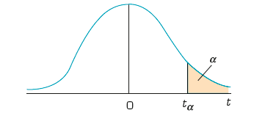
10.62
t20
t0.05,20 = 1.725
=0.05
t.100
t.05
t.025
t.01
t.005

Slide 63
10.3 Estimating the population mean μ when population variance σ² is unknown
10.63
When σ is unknown and if the population (X) is normally distributed, then a 100(1-α)% confidence interval estimator of μ is
Note that we can approximate t_{α/2,n-1} by z_{α/2} for large values of n (n > 200).

Slide 64
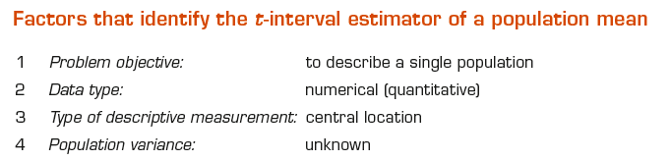
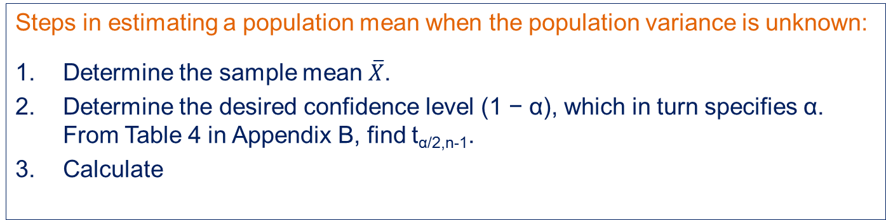
Estimating μ when σ² is unknown…
10.64
Steps in estimating a population mean when the population variance is unknown:
Determine the sample mean $\overline{X}$.
Determine the desired confidence level (1 − α), which in turn specifies α. From Table 4 in Appendix B, find t_{α/2,n-1}.
Calculate

Slide 65
Example 2
10.65
(Example 10.2, page 393)
XM10-02 As you are probably aware, a taxi fare is determined by distance travelled as well as the amount of time taken for the trip. In preparing to apply for a rate increase, the general manager of a fleet of taxis wanted to know the distance customers travel by taxi on an average trip. She organised a survey in which she asked taxi drivers to record the number of kilometres (to the nearest one-tenth) travelled by randomly selected customers. A sample of 41 customers was produced.
The results appear below. The general manager wants to estimate the mean distance travelled with 95% confidence.

Slide 66
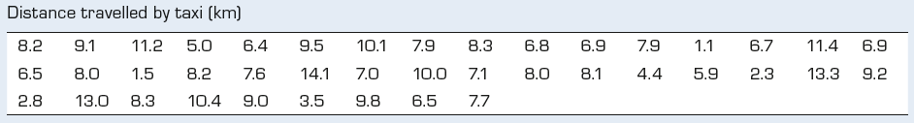
Example 2
10.66

Slide 67
Example 2: Solution
10.67
IDENTIFY
Identifying the technique
Problem objective: To describe a single population of distance travelled by taxi customers (X)
Data type: Numerical (quantitative)
Parameter to be estimated: μ, the average (mean) distance travelled by taxi customers
Population variance: Unknown (Replace σ by s)
Assume that the distance travelled by taxi customers is normally distributed. Therefore, the confidence interval estimator of μ is

Slide 68
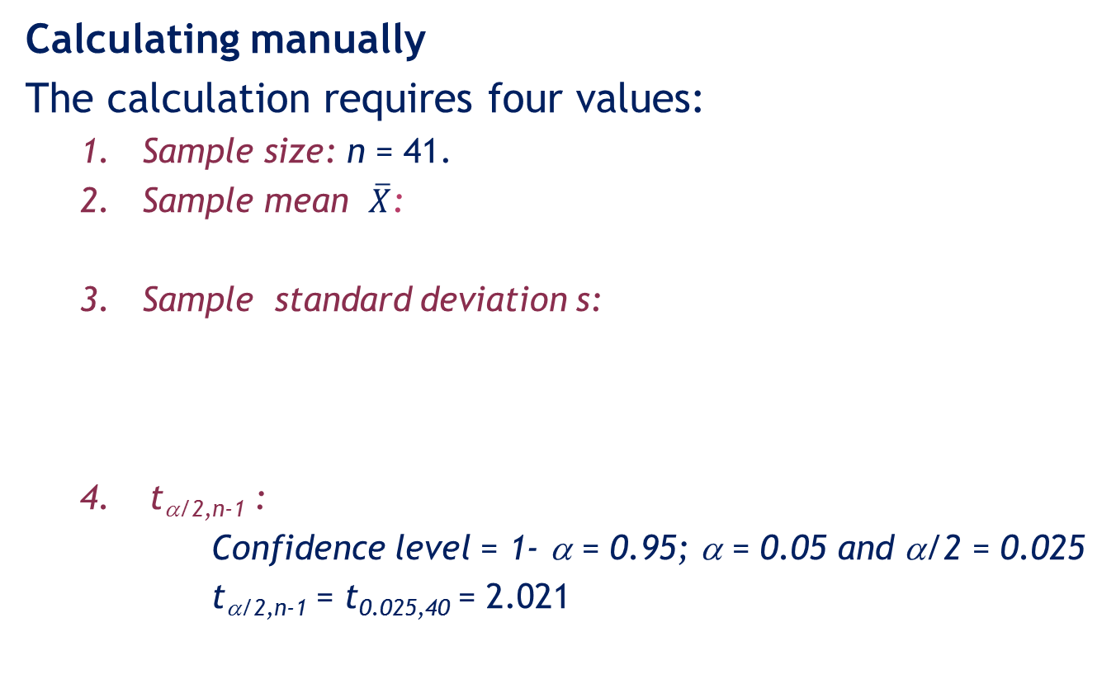
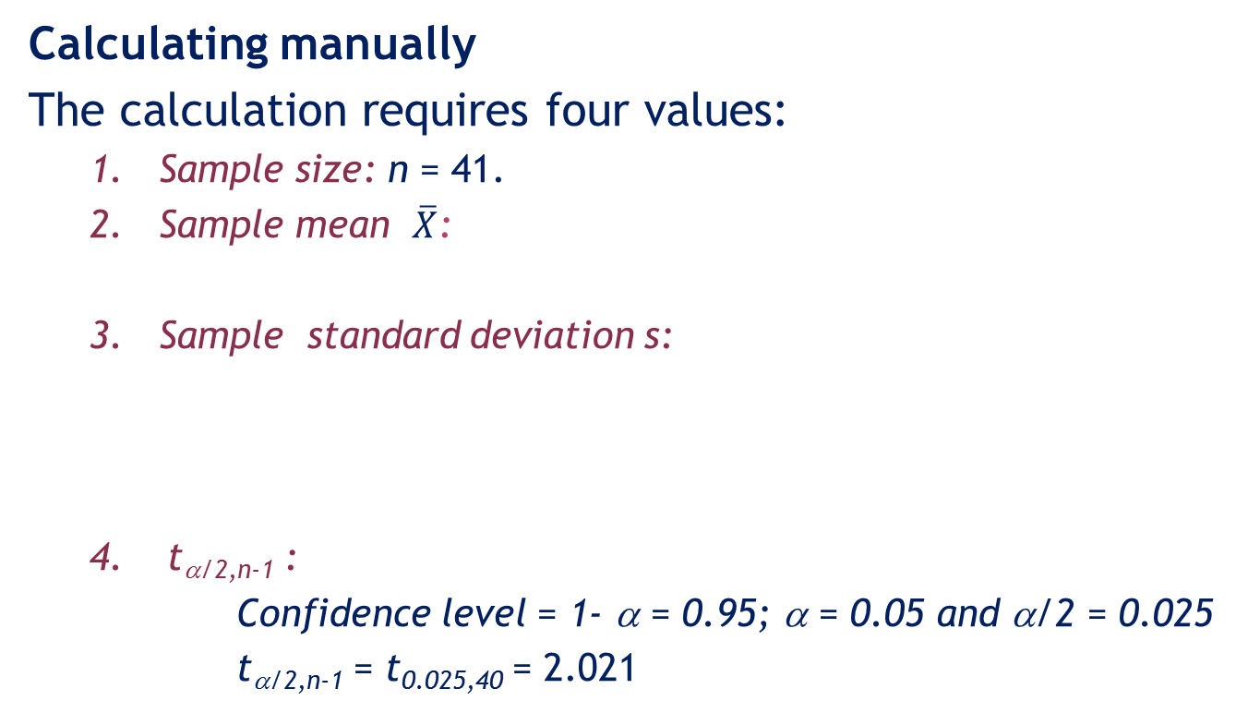
Example 2: Solution…
10.68
CALCULATE
Calculating manually
The calculation requires four values:
Sample size: n = 41.
Sample mean $\overline{X}$:
Sample standard deviation s:
4. t_{α/2,n-1} :
Confidence level = 1- α = 0.95; α = 0.05 and α/2 = 0.025
t_{α/2,n-1} = t_{0.025,40} = 2.021

Slide 69
Example 2: Solution…
10.69
Calculating manually
Therefore, a 95% confidence interval estimator of μ is
We therefore estimate that the mean distance travelled by taxi lies between
LCL = 6.77kms and UCL = 8.62kms

Slide 70
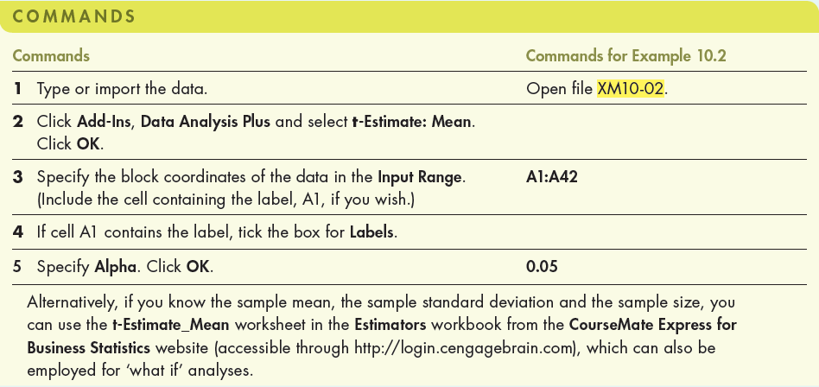
Example 2: Solution…
10.70
Using Excel (Data Analysis Plus™)

Slide 71
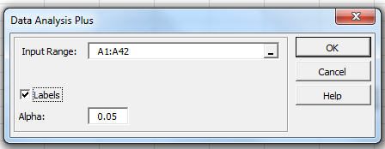
Example 2: Solution…
10.71
Using Excel (Data Analysis Plus™)
In the Data Analysis Plus dialogue box (shown below), enter the input and the output is presented in the next slide.

Slide 72
Example 2: Solution…
10.72
Using Excel
95% confidence interval Output from Data Analysis Plus:

Slide 73
Interpreting the results
10.73
INTERPRET
We estimate that the mean distance travelled by taxi lies between 6.77 and 8.62 kilometres.
The general manager can use the estimate to determine the effect of different pricing policies on her company.
It is worth noting that the accuracy of the interval estimate is dependent upon the validity of the sampling process and the distribution of the distances (they are required to be normal). If the distribution is extremely non-normal, the inference may be invalid.

Slide 74
Checking the required conditions
10.74
At the beginning of the solution for Example 2 earlier, to be able to use the t-distribution, we assumed that the population is normally distributed.
Now, we need to check that the population is normally distributed, or at least not extremely non-normal.
We plot the histogram of the data set using Excel to see the shape of the distribution.
The histogram below suggests that the variable may be normally distributed or at least not extremely non-normal.

Slide 75
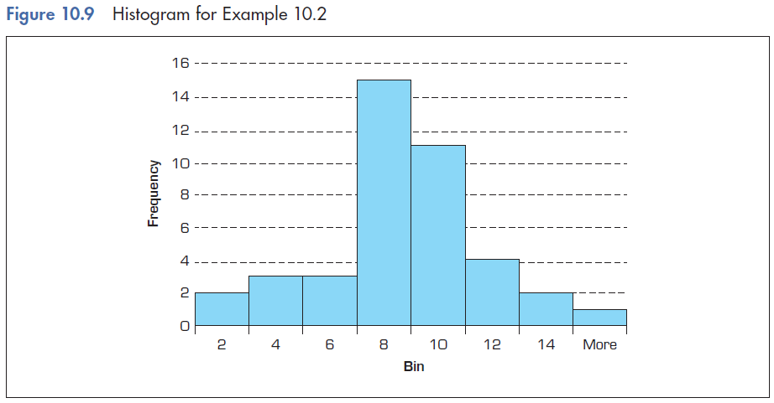
10.75
Checking the required conditions

Slide 76
10.4 Estimating the population proportion p
10.76
When the population consists of nominal (categorical) data, the only inference we can make is about the proportion of occurrence of a certain value.
The population proportion parameter p was used before to calculate probabilities using the binomial distribution.

Slide 77
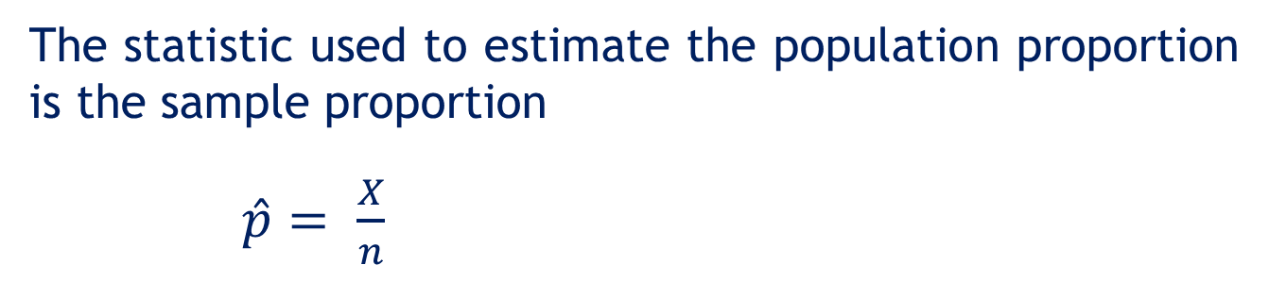

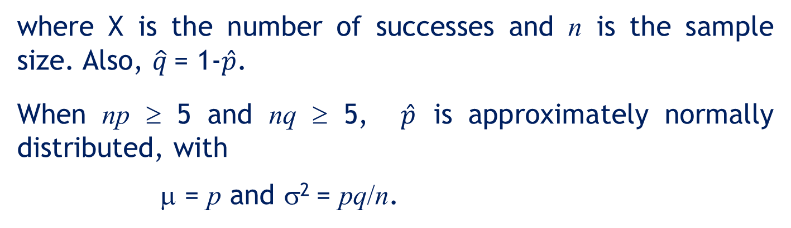
Sample statistic and sampling distribution of the sample proportion $\hat{p}$
10.77
where X is the number of successes and n is the sample size. Also, $\hat{q}$= 1-$\hat{p}$.
When np ≥ 5 and nq ≥ 5, $\hat{p}$ is approximately normally distributed, with
μ = p and σ² = pq/n.

Slide 78
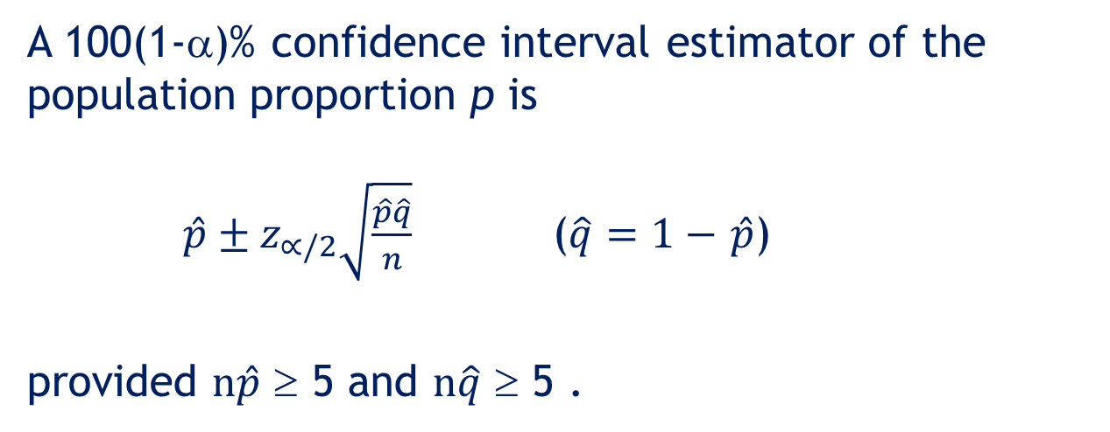
Estimating p
10.78
A 100(1-α)% confidence interval estimator of the population proportion p is
$\hat{p}±z_{∝/2}\sqrt{\frac{\hat{p}\hat{q}}{n}}$ ($\hat{q}=1−$ $\hat{p}$)
provided $n\hat{p}$ ≥ 5 and $n\hat{q}$ ≥ 5 .

Slide 79
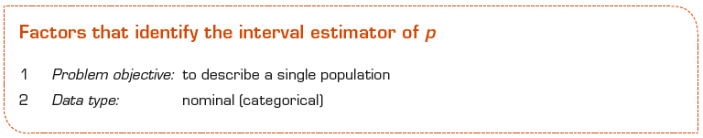
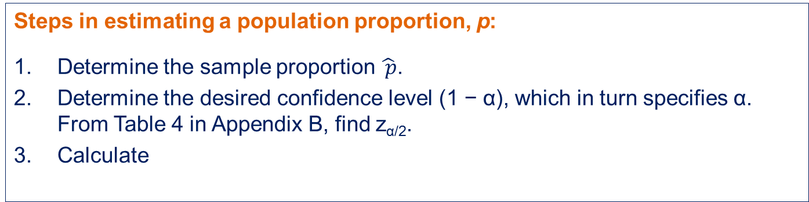
Estimating p
10.79
Steps in estimating a population proportion, p:
Determine the sample proportion $\hat{ p}$.
Determine the desired confidence level (1 − α), which in turn specifies α. From Table 4 in Appendix B, find z_{α/2}.
Calculate

Slide 80
Example 3
10.80
(Example 10.4, page 402)
XM10-04 In late December 2010 and January 2011, Queensland suffered the worst floods in recent history. … It caused disruption to not only the Queensland businesses but also business nationally. The survey, which was conducted among 1500 medium or large businesses with more than 50 employees nationwide, found that 10 per cent of businesses had experienced some disruption or closed. … The data with 1 (affected) and 0 (not affected) were recorded. Estimate with 99% confidence the proportion of all nation-wide businesses that experienced disruption or closure due to the floods.

Slide 81
Example 3: Solution
10.81
IDENTIFY
Identifying the technique
Problem objective: To describe a single population of Australian businesses affected by the 2010–11 Queensland floods
Data type: Nominal (categorical)
Parameter to be estimated: p, proportion of Australian businesses affected by the 2010–11 Queensland floods
Required condition: np ≥ 5 and nq ≥ 5.
The confidence interval estimator of p is

Slide 82
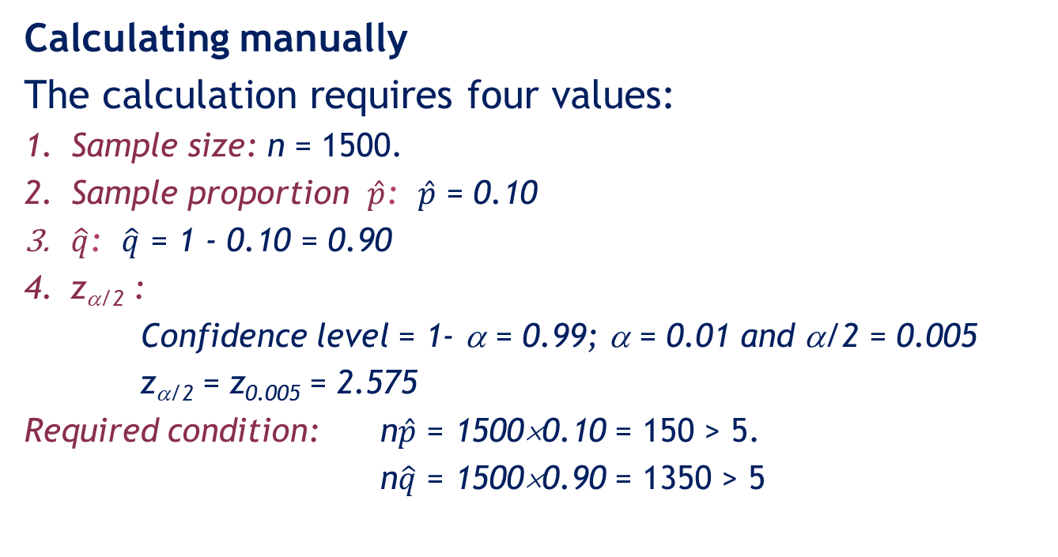
Example 3: Solution…
10.82
CALCULATE
Calculating manually
The calculation requires four values:
Sample size: n = 1500.
Sample proportion $\hat{p}$: $\hat{p}$ = 0.10
$\hat{q}$: $\hat{q}$ = 1 - 0.10 = 0.90
z_{α/2} :
Confidence level = 1- α = 0.99; α = 0.01 and α/2 = 0.005
z_{α/2} = z_{0.005} = 2.575
Required condition: n$\hat{p}$ = 1500×0.10 = 150 > 5.
n$\hat{q}$ = 1500×0.90 = 1350 > 5

Slide 83
Example 3: Solution…
10.83
Calculating manually
Therefore, a 95% confidence interval estimator of p is
We therefore estimate, at the 99% confidence level, that the proportion of Australian businesses affected by the 2010–11Queensland floods is estimated to lie somewhere between
LCL = 8% and UCL = 12%

Slide 84
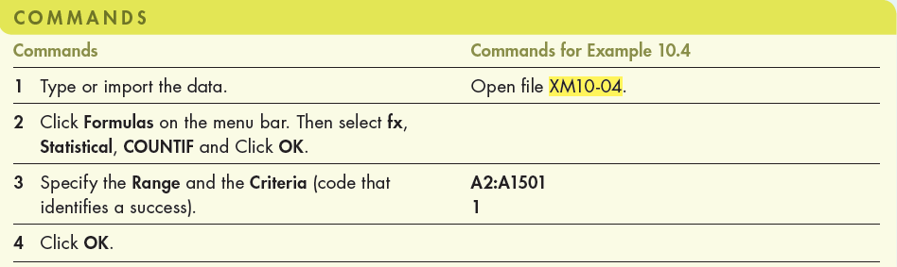
Example 3: Solution…
10.84
Using Excel (Data Analysis Plus™)

Slide 85
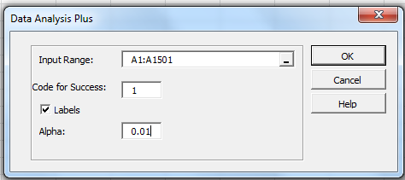
Example 3: Solution…
10.85
Using Excel (Data Analysis Plus)
In the Data Analysis Plus dialogue box (shown below), enter the input and the output is presented in the next slide.

Slide 86
Example 3: Solution…
10.86
Using Excel
99% confidence interval for p Output from Data Analysis Plus:

Slide 87
Interpreting the results
10.87
INTERPRET
We estimate that between 8% and 12% of all businesses in Australia were affected after the 2010–11 Queensland floods. This type of estimation is correct 99% of the time.
We can use this estimate in a variety of ways.
First, the estimate provides us with a measure of the magnitude of the effect on the Australian business sector. For example, we can say that at least 8% of the businesses were closed or disrupted.
Second, we can use the interval estimate to estimate the cost of repairs.

Slide 88
10.88
10.5 Determining the required sample size
Information and the width of the interval
A wide-interval estimator provides little information.
A narrower interval provides more meaningful information.

Slide 89
Determining the sample size for estimating a population mean
10.89
We can control the width of the interval estimate by changing the sample size.
Thus, we determine the interval width first, and derive the required sample size.
The phrase ‘estimate the mean to within B units’ translates to an interval estimate of the form
where

Slide 90
Determining the sample size for estimating a population mean
10.90
By rearrangement, the required sample size to estimate the mean can be written as
Note:
As n is proportional to z_{α/2}, higher confidence level (1-α) requires a larger sample size.
As n is proportional to σ, larger values of the standard deviation (σ) requires a larger sample size.
As n is inversely proportional to B, narrower confidence intervals (B) requires a larger sample size.

Slide 91
Example 4
10.91
To estimate the amount of lumber that can be harvested in a tract of land, the mean diameter of trees in the tract must be estimated to within 1 cm with 99% confidence. What sample size should be taken? Assume that diameters are normally distributed with standard deviation σ = 6 cm.

Slide 92
Example 4: Solution
10.92
The estimate accuracy is ±1 cm. That is, B = 1.
The confidence level 99% leads to α = 0.01, thus
z_{α/2} = z_{0.005} = 2.575.
The population standard deviation σ is 6.
We compute

Slide 93
Determining the sample size for estimating a population proportion
10.93
The interval estimator for the proportion is
Thus, if we wish to estimate the proportion to within B, we can write
The required sample size is

Slide 94
Example 5
10.94
Suppose we want to estimate the proportion of customers who prefer our company’s brand to within 0.03 with 95% confidence. Find the sample size needed to guarantee that this requirement is met.

Slide 95
Example 5: Solution
10.95
B = 0.03; 1 – α = 0.95, therefore α/2 = 0.025, so
z_{0.025} = 1.96.
Required sample size is given by
Since the sample has not yet
been taken, the sample
proportion is still unknown.
We proceed using either of the
following two methods:

Slide 96
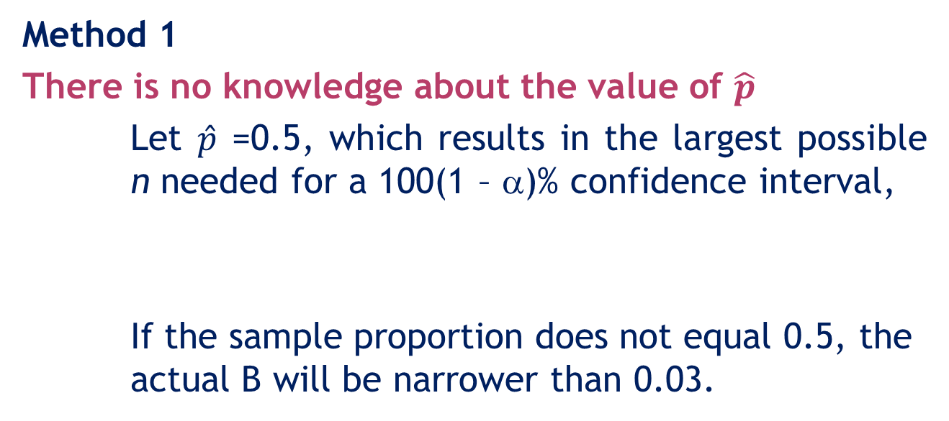
Example 5: Solution…
10.96
Method 1
There is no knowledge about the value of $\hat{p}$
Let $\hat{p}$ =0.5, which results in the largest possible n needed for a 100(1 – α)% confidence interval,
If the sample proportion does not equal 0.5, the actual B will be narrower than 0.03.

Slide 97
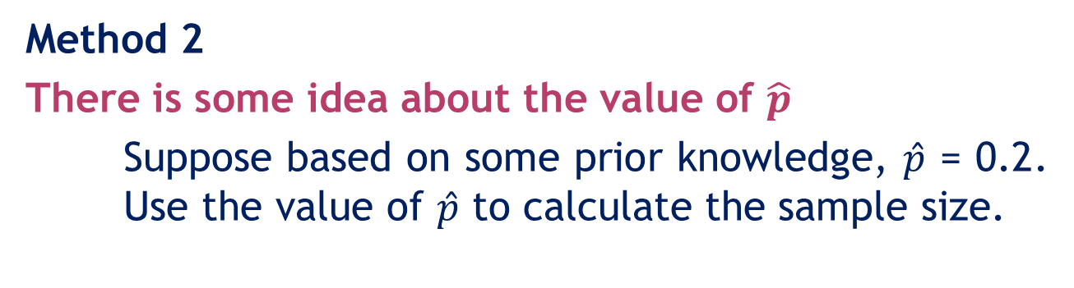
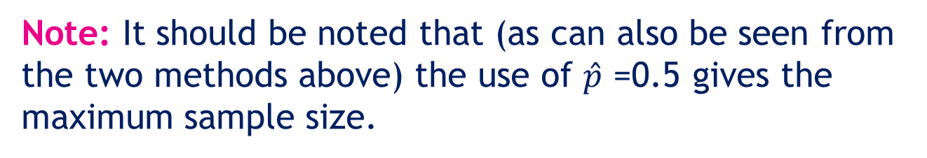
Example 5: Solution…
10.97
Note: It should be noted that (as can also be seen from the two methods above) the use of $\hat{p}$ =0.5 gives the maximum sample size.

Slide 98

Summary of techniques –Single population parameter estimation
10.98

