Slide 1


Slide 2
Chapter 11
Estimation:
Comparing two populations

Slide 3
Chapter outline
11.1 Estimating the difference between two population means μ₁ − μ₂ when the variances σ₁² and σ₂² are known: Independent samples
11.2 Estimating the difference between two population means μ₁ − μ₂ when the variances σ₁² and σ₂² are unknown: Independent samples
11.3 Matched pairs experiments: Dependent samples
11.4 Estimating the difference between two population proportions p₁ − p₂

Slide 4
Learning objectives
LO1 Recognise when the parameter of interest is the difference between two population means or proportions
LO2 Estimate the difference between two population means when the population variances are known
LO3 Estimate the difference between two population means when the population variances are unknown
LO4 Recognise when the samples were independently drawn from two populations and when they were taken from a matched pairs experiment
LO5 Estimate the difference between two population means in a matched pairs experiment

Slide 5
Learning objectives
LO6 Estimate the difference between two population proportions
LO7 Calculate the minimum sample size required to estimate the difference between two population means and between two population proportions.

Slide 6
Introduction
11.6
In Chapter 10 we looked at techniques to estimate parameters of a single population, namely,
population mean μ and
population proportion p.
In this chapter, a variety of techniques are presented; their objective is to compare the parameters of two populations, namely,
the difference between two population means, μ₁ – μ₂
the difference between two population proportions, p₁ – p₂.

Slide 7
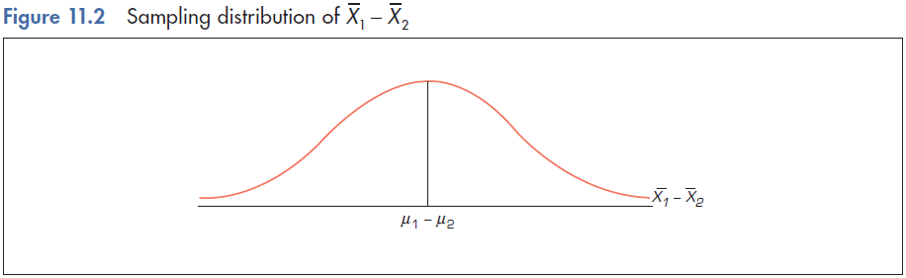
Difference between two means
11.7
In order to test and estimate the difference between two population means, we draw random samples from each of two populations.
Initially, we will consider independent samples, that is, samples that are completely unrelated to one another.

Slide 8
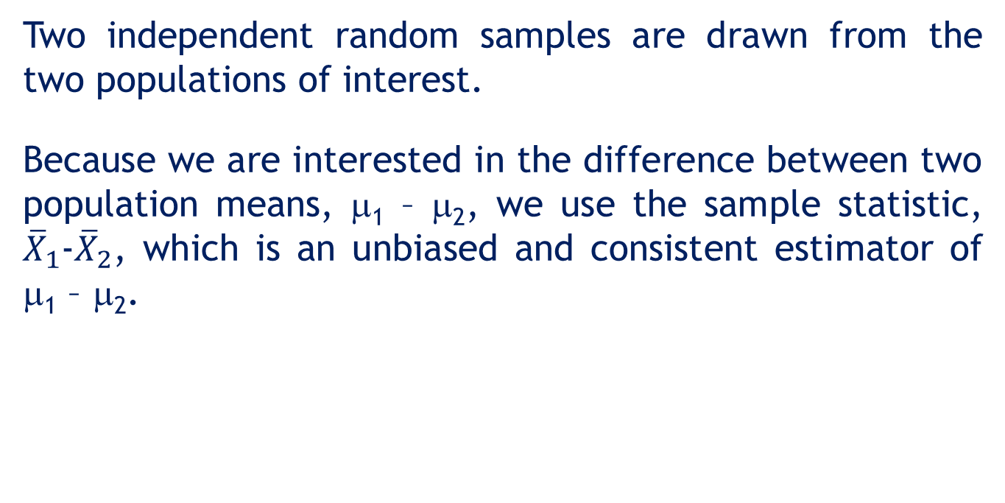
Point Estimator for (μ₁ – μ₂)
11.8
Two independent random samples are drawn from the two populations of interest.
Because we are interested in the difference between two population means, μ₁ – μ₂, we use the sample statistic, ${\overline{X}}_{1}$-${\overline{X}}_{2}$, which is an unbiased and consistent estimator of μ₁ – μ₂.

Slide 9

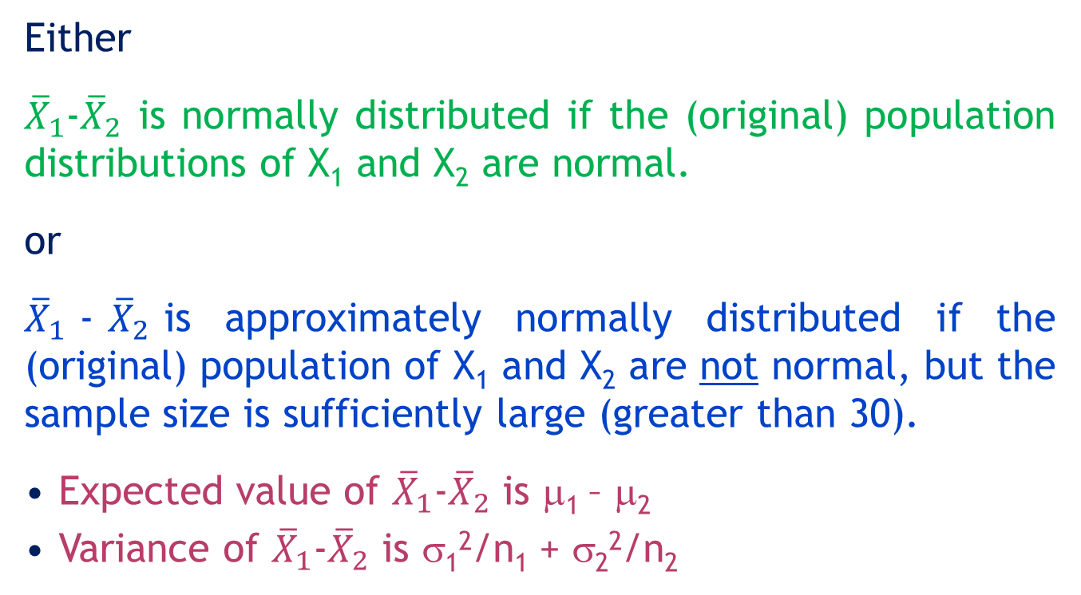
The sampling distribution of ${\overline{X}}_{1}$-${\overline{X}}_{2}$
11.9
Either
${\overline{X}}_{1}$-${\overline{X}}_{2}$ is normally distributed if the (original) population distributions of X₁ and X₂ are normal.
or
${\overline{X}}_{1}$-${\overline{X}}_{2}$is approximately normally distributed if the (original) population of X₁ and X₂ are not normal, but the sample size is sufficiently large (greater than 30).
Expected value of ${\overline{X}}_{1}$-${\overline{X}}_{2}$ is μ₁ – μ₂
Variance of ${\overline{X}}_{1}$-${\overline{X}}_{2}$ is σ₁²/n₁ + σ₂²/n₂

Slide 10
The sampling distribution of ${\overline{X}}_{1}$-${\overline{X}}_{2}$
11.10

Slide 11
11.1 Estimating (μ₁ – μ₂) when σ₁² and σ₂² are known
11.11
We use the z-statistic for statistical inference.
We construct a standardised z-statistic using known population variances , σ₁² and σ₂².
However, the z-statistic is hardly used in many practical applications, because the population variances are not usually known.

Slide 12
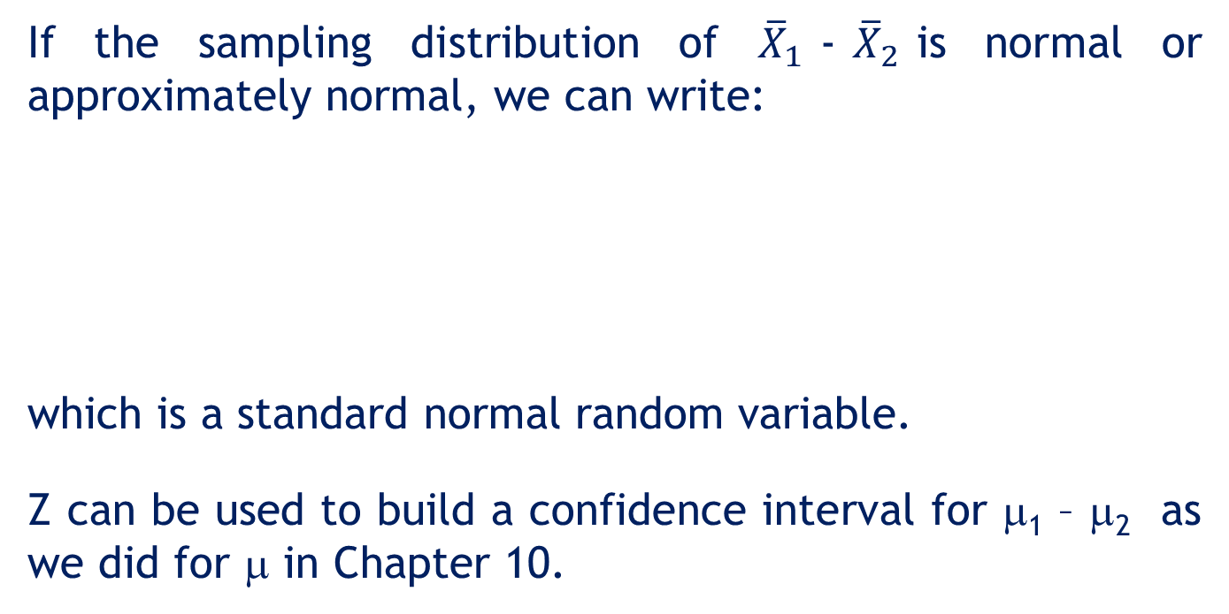
Standardised z-statistic when σ₁² and σ₂² are known
11.12
If the sampling distribution of ${\overline{X}}_{1}$-${\overline{X}}_{2}$is normal or approximately normal, we can write:
which is a standard normal random variable.
Z can be used to build a confidence interval for μ₁ – μ₂ as we did for μ in Chapter 10.

Slide 13
Estimating (μ₁ – μ₂) when σ₁² and σ₂² are known…
11.13
The confidence interval estimator of μ₁ – μ₂ when the population variances σ₁² and σ₂² are known is:

Slide 14
Estimating (μ₁ – μ₂) when σ₁² and σ₂² are known…
11.14

Slide 15
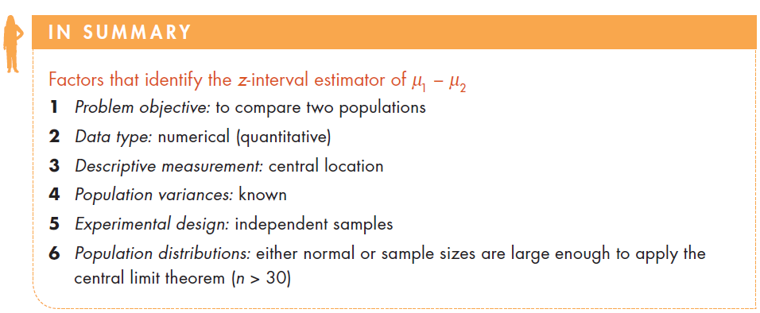
Factors that identify
11.15

Slide 16
Example 1
11.16
A supermarket chain which offers two different types of discount coupons for its own brand of bread wants to estimate with 99% confidence the relative selling power of the two coupons.
The average number of bread loaves sold during a 14-day period using Coupon 1 was 153, and the average sold during another 14-day period using Coupon 2 was 142. Assuming that the population standard deviation for both periods was 10 loaves per day and that the number of loaves sold per day is normally distributed, estimate with 99% confidence the difference in mean daily sales under the two coupon plans.

Slide 17
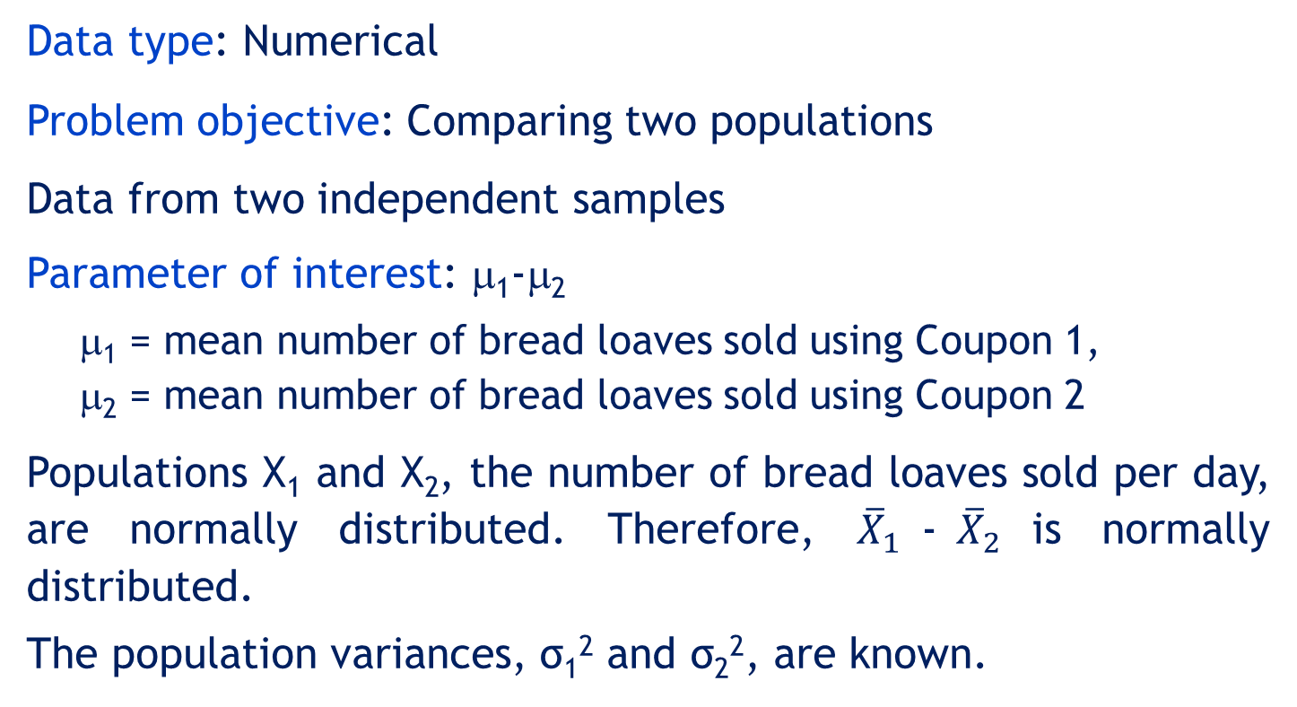
11.17
Example 1: Solution
IDENTIFY
Data type: Numerical
Problem objective: Comparing two populations
Data from two independent samples
Parameter of interest: μ1-μ2
μ1 = mean number of bread loaves sold using Coupon 1,
μ2 = mean number of bread loaves sold using Coupon 2
Populations X1 and X2, the number of bread loaves sold per day, are normally distributed. Therefore, ${\overline{X}}_{1}$-${\overline{X}}_{2}$is normally distributed.
The population variances, σ1² and σ2², are known.

Slide 18
11.18
Example 1: Solution…
COMPUTE
Solving by hand
A 99% z-interval estimator for the difference between two means is
LCL = 1.3 and UCL = 20.7

Slide 19
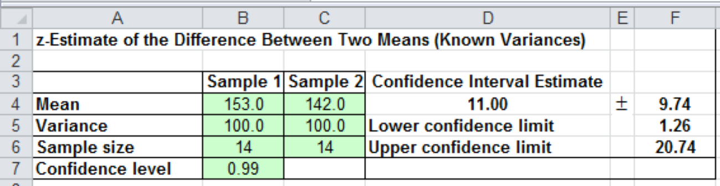
11.19
Example 1: Solution…
COMPUTE
Using Excel workbook
(Estimators.xls, z-Estimate_2 Means worksheet)

Slide 20
Selecting the sample sizes to estimate μ₁ − μ₂
11.20
Using a simple extension to the formula used for the required sample size for a single population in Chapter 10, the required sample sizes to estimate μ₁ - μ₂ is

Slide 21
Example 2
11.21
The manager of a major clothing manufacturer wants to compare the annual expenditure on clothing of men with that of women. She decides to estimate the difference in mean annual expenditure to within $100 with 95% confidence. How large should the two sample sizes be, if we assume that the range of expenditure is $800 for males and $1200 for females and the populations of male and female expenditures on clothing are normal?

Slide 22
Example 2: Solution
11.22
The estimate accuracy is ± $100. That is, B = 100.
σ₁= Range/4 = 800/4 = $200 (for males)
σ₂= Range/4 = 1200/4 = $300 (for females)
The confidence level 95% leads to α = 0.05, thus z_{α/2} = z_{0.025} = 1.96.
We compute

Slide 23
11.23
11.2 Estimating (μ1 – μ2) when σ1² and σ2² are unknown
Practically, the z-statistic is hardly used, because the population variances are not usually known.
Instead, we construct a t-statistic using the sample ‘variances’ (s₁² and s₂²).
Samples are independent.

Slide 24
t-statistic when σ₁² and σ₂² are unknown
11.24
When the population variances σ₁² and σ₂² are unknown, we estimate them by s₁² and s₂², then the standardised statistic becomes:
which follows a t-distribution provided the two populations are normally distributed.
The t-statistic can be used to construct confidence intervals for µ₁-µ₂.
t
?
?
S1²
S2²

Slide 25
Two cases when σ₁² and σ₂² are unknown
11.25
Two cases are considered when producing the confidence interval.
Case I: The two unknown population variances are equal, σ₁² = σ₂².
Case II: The two unknown population variances are not equal, σ₁² ≠ σ₂².

Slide 26
Case I: The two variances are unknown but equal (σ₁² = σ₂²)
11.26
First calculate the pooled variance estimate by:
n2 = 16
n1 = 11
Example: s1² = 25; s2² = 30; n1 = 11; n2 = 16. Then,

Slide 27
11.27
Case I: The two variances are unknown but equal (σ1² = σ2²)…
Construct an interval estimator as follows:
where (1 – α) is the confidence level and the degrees of freedom, d.f. = n1 + n2 – 2.

Slide 28
Case II: The two variances are unknown and unequal (σ₁² ≠ σ₂²)
11.28
Construct an interval estimate as follows:
where (1 - α) is the level of confidence, and

Slide 29
Which case to use: equal variance or unequal variance?
11.29
Whenever there is sufficient evidence that the variances are equal, it is preferable to perform the equal variances t-test.
This is so because, for any two given samples,
the number of degrees
of freedom for the
equal variances case
≥
the number of degrees of freedom for the unequal variances case

Slide 30
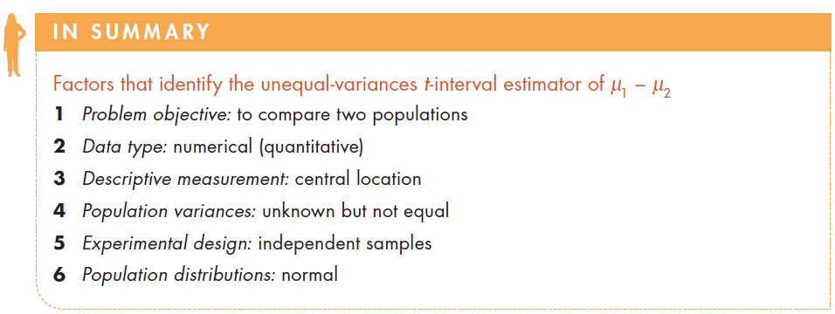
Factors that identify
11.30

Slide 31
Example 3 (Example 11.3, p432)
11.31
XM11-03 Despite some controversy, scientists generally agree that high-fibre cereals reduce the likelihood of various forms of cancer. However, one scientist claims that people who eat high-fibre cereal for breakfast will consume, on average, fewer kilojoules for lunch than people who don’t eat high-fibre cereal for breakfast. If this is true, high-fibre cereal manufacturers will be able to claim another advantage of eating their product – potential weight reduction for dieters.
As a preliminary test of the claim, 30 people were randomly selected and asked what they regularly eat for breakfast and lunch. Each person was identified as

Slide 32
Example 3…
11.32
Kilojoules consumed at lunch
A consumer or a non-consumer of high fibre breakfast cereal, and the number of kilojoules consumed at lunch was measured and recorded. These data are listed below.
Estimate with 95% confidence the difference between the mean kilojoule intake of consumers and non-consumers, assuming that the two consumption populations are normally distributed.

Slide 33
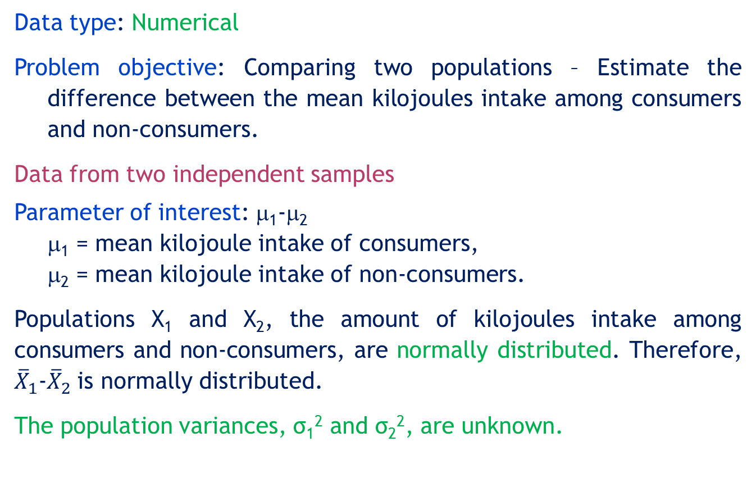
11.33
Example 3: Solution
IDENTIFY
Data type: Numerical
Problem objective: Comparing two populations – Estimate the difference between the mean kilojoules intake among consumers and non-consumers.
Data from two independent samples
Parameter of interest: μ1-μ2
μ1 = mean kilojoule intake of consumers,
μ2 = mean kilojoule intake of non-consumers.
Populations X1 and X2, the amount of kilojoules intake among consumers and non-consumers, are normally distributed. Therefore, ${\overline{X}}_{1}$-${\overline{X}}_{2}$is normally distributed.
The population variances, σ1² and σ2², are unknown.

Slide 34
11.34
Example 3: Solution…
IDENTIFY
Identifying the technique
The parameter to be estimated is (μ1 – μ2).
The population variances are unknown. To check whether the variances are equal, calculate the values of s1 and s2.
From the data,
It appears that the variances are unequal.
We use the unequal variance t-interval estimator of (μ1 – μ2) assuming that both populations are normally distributed.

Slide 35
11.35
Example 3: Solution…
COMPUTE
Solving by hand
The unequal variance t-interval estimator for the difference between two means (μ₁ – μ₂) is

Slide 36
11.36
Example 3: Solution…
COMPUTE
A 95% confidence interval estimator for the difference between the two means (μ₁ – μ₂) is
LCL = -493.65, UCL = -28.75

Slide 37
11.37
Example 3: Solution…
INTERPRET
Interpretation of the results
The difference in mean kilojoule intake between consumers and non-consumers is estimated to fall between −493.65 and −28.75.
That is, we estimate that non-consumers of high-fibre cereal eat an average of between 29 and 494 kilojoules more than do consumers.

Slide 38
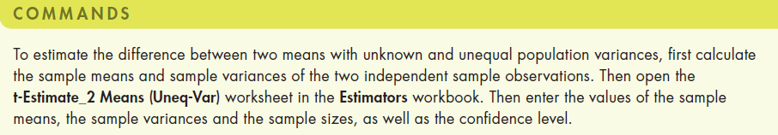
11.38
Example 3: Solution…
COMPUTE
Using EXCEL Workbook
(Estimators.xls, t-Estimate_2 Means(Uneq-Var) worksheet)

Slide 39
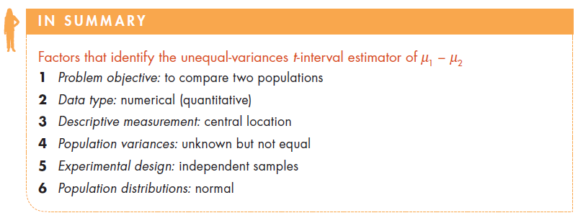
11.39
Factors that identify…

Slide 40
11.40
Example 4
Two job designs are being considered for the production of a new computer desk.
Two samples are randomly and independently selected from the two population designs which are normally distributed.
A sample of 25 workers assembled a desk using design A.
A sample of 25 workers assembled the desk using design B.
The assembly times were recorded.
Estimate with 95% confidence the difference between the average assembly times of the two designs.

Slide 41
11.41
Example 4…
Assembly times in minutes

Slide 42
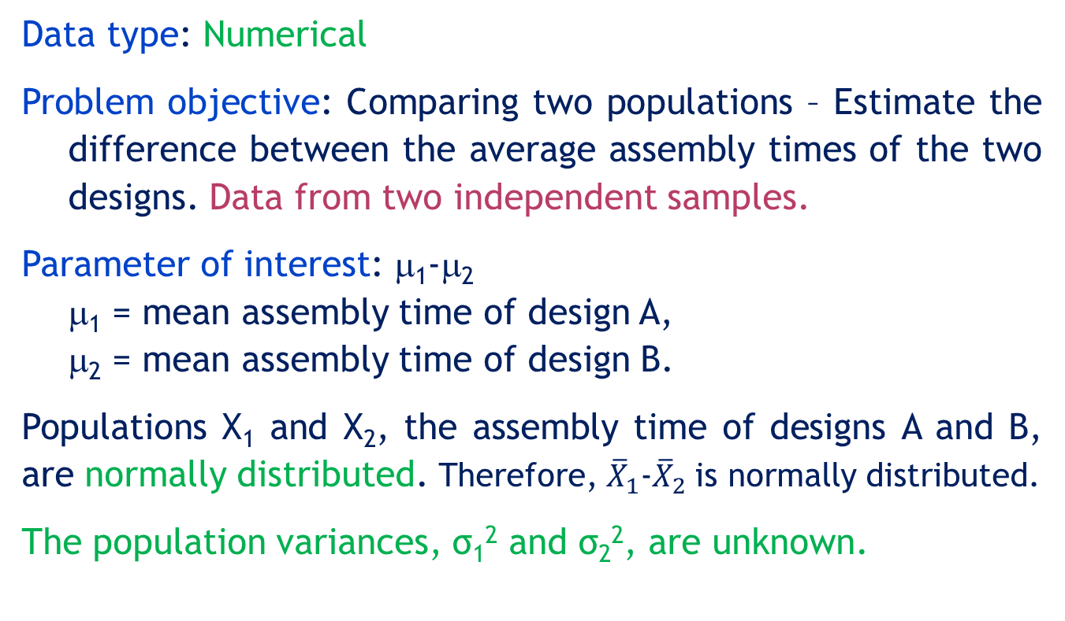
11.42
Example 4: Solution
IDENTIFY
Data type: Numerical
Problem objective: Comparing two populations – Estimate the difference between the average assembly times of the two designs. Data from two independent samples.
Parameter of interest: μ1-μ2
μ1 = mean assembly time of design A,
μ2 = mean assembly time of design B.
Populations X1 and X2, the assembly time of designs A and B, are normally distributed. Therefore, ${\overline{X}}_{1}$-${\overline{X}}_{2}$is normally distributed.
The population variances, σ1² and σ2², are unknown.

Slide 43
11.43
Example 4: Solution…
IDENTIFY
Identifying the technique
The parameter to be estimated is (μ1 – μ2).
The population variances are unknown. To check whether the variances are equal, calculate the values of s1 and s2.
From the data,
Since s1 and s2 are very close, we can safely assume that the variances are equal.
The two population assembly times are distributed normal.
We use the equal variances t-interval estimator of (μ1 – μ2)

Slide 44
11.44
Example 4: Solution…
COMPUTE
The equal variance t-interval estimator for the difference between two means (μ1 – μ2) is
Calculating the pooled variance:

Slide 45
11.45
Example 4: Solution…
COMPUTE
A 95% confidence interval for (μ1 – μ2) is calculated as follows:
LCL = -0.3176, UCL = 0.8616

Slide 46
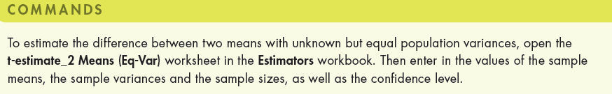
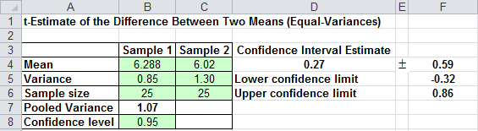
11.46
Example 4: Solution…
COMPUTE
Using Excel:
(Estimators.xls, t-Estimate_2 Means(Eq-Var) worksheet)

Slide 47
11.47
Example 4: Solution…
INTERPRET
Interpretation:
The difference in mean assembly times of design A and B is estimated to fall between −0.32 and 0.86 hrs at the 95% confidence level.

Slide 48
Checking the required conditions - Normality
11.48
Design A
The distributions are not bell-shaped, but they seem to be approximately normal. Since the technique is robust, we can be confident about the results.
Design B

Slide 49
11.3 Matched pairs experiments
11.49
What is a matched pair experiment?
Why are matched pairs experiments needed?
How do we deal with data produced in this way?
The following example demonstrates a situation where a matched pairs experiment is the correct approach to estimate the difference between two population means.

Slide 50
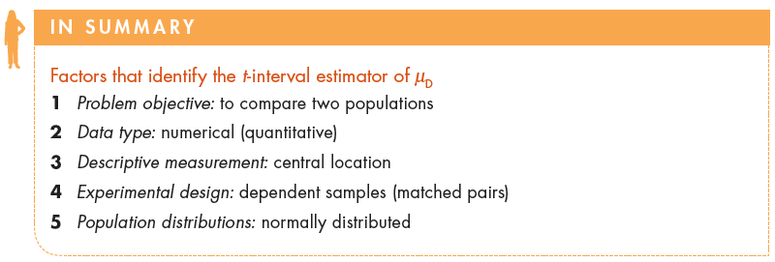
11.50
Factors that identify…

Slide 51
11.51
Example 5
A manufacturer wishes to estimate with 95% confidence the difference between the average distances driven before worn-out by cars fitted with the new steel-belted radial tyres and those fitted with the existing model. The manufacturer designs the following experiment.
One tyre of each type is installed on the rear wheel of 20 randomly-selected cars (each car is sampled twice, thus creating a pair of observations).
Drivers drive in their usual way until the tyres wear out. The number of kilometres driven by each driver is recorded. See data next.

Slide 52
11.52
Example 5…
Estimate with 95% confidence the difference between the average distances driven before worn-out by cars fitted with the new steel-belted radial tyres and those fitted with the existing model. Assume that the two population distances are normally distributed.

Slide 53
11.53
Example 5: Solution
IDENTIFY
Data type: Numerical
Problem objective: Comparing two populations – Estimate the difference between the mean distance driven before wear out for the new and existing design tyres
Data are from two dependent samples
Parameter of interest: μD= μ1-μ2
μ1 = Mean distance driven before wear out occurs for new-design tyres,
μ2 = Mean distance driven before wear out occurs for existing-design tyres

Slide 54
11.54
Example 5: Solution…
IDENTIFY
Identifying the technique
Assume that the differences xD = x1 – x2 (difference in the distance driven before wear out for the new and existing design tyres) are normally distributed.
The population variances, σ1² and σ2², are unknown.
As each car is sampled twice, the observations are paired. We use the matched pairs experiment.
xD = x1 – x2, and μD = μ1 – μ2.

Slide 55
11.55
Example 5: Solution…
COMPUTE
Solving by hand
Calculate the difference for each x_{D} = x₁ – x₂.
Calculate the average differences and the standard deviation of the differences.
The statistic:
has a t distribution with n_{D} – 1 degrees of freedom.
Construct a confidence interval for μ_{D} = μ₁ – μ₂ as follows:

Slide 56
11.56
Example 5: Solution…
COMPUTE
Solving by hand
Confidence interval for μ_{D} = μ₁ – μ₂ is:
From the data,
A 95% confidence interval for the difference in means is
LCL = 1.17, UCL = 7.93

Slide 57
11.57
Example 5: Solution…
INTERPRET
Interpretation
It is estimated that the mean difference in the distance driven before wear out for the new and existing design tyres μ_{D} = μ₁ – μ₂ will lie between 1.17kms and 7.93kms at the 95% confidence level.

Slide 58
Checking the required conditions for the paired observations case
11.58
The validity of the results depends on the normality of the differences, X₁ – X₂.
The distribution is close to a bell-shaped and can be considered to be approximately normal

Slide 59
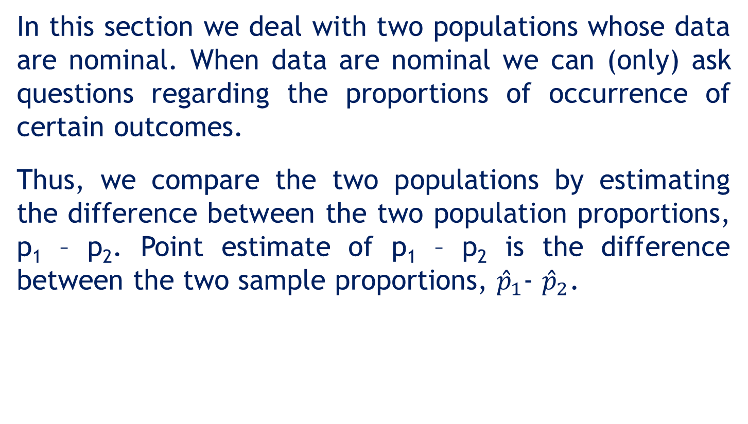
11.4 Estimating the difference between two population proportions, p₁ – p₂
11.59
In this section we deal with two populations whose data are nominal. When data are nominal we can (only) ask questions regarding the proportions of occurrence of certain outcomes.
Thus, we compare the two populations by estimating the difference between the two population proportions, p₁ – p₂. Point estimate of p₁ – p₂ is the difference between the two sample proportions, ${\hat{p}}_{1}$- ${\hat{p}}_{2}$.

Slide 60
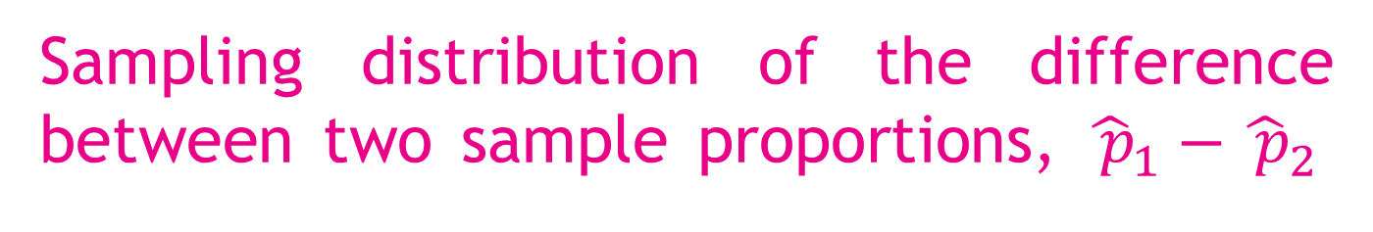
Sampling distribution of the difference between two sample proportions, ${\hat{ p}}_{1}−{\hat{ p}}_{2}$
11.60
Two random samples are drawn from two populations.
The number of successes in each sample is recorded.
The sample proportions are computed.
Sample 1
Sample size n1
Number of successes x1
Sample proportion
Sample 2
Sample size n2
Number of successes x2
Sample proportion
x
ˆ
=
p
1
1
n
1

Slide 61
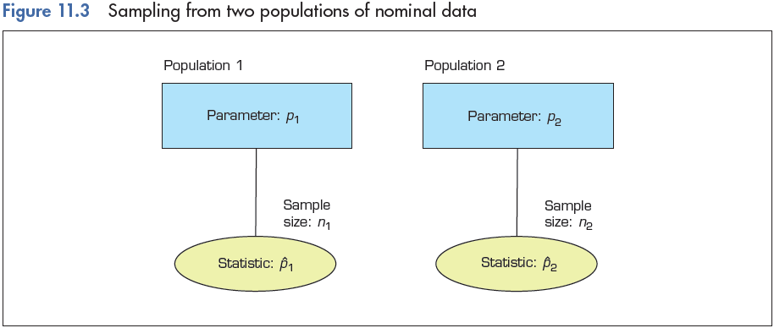
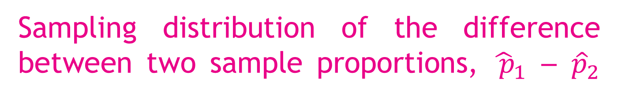
Sampling distribution of the difference between two sample proportions, ${\hat{ p}}_{1}$ − ${\hat{p}}_{2}$
11.61

Slide 62
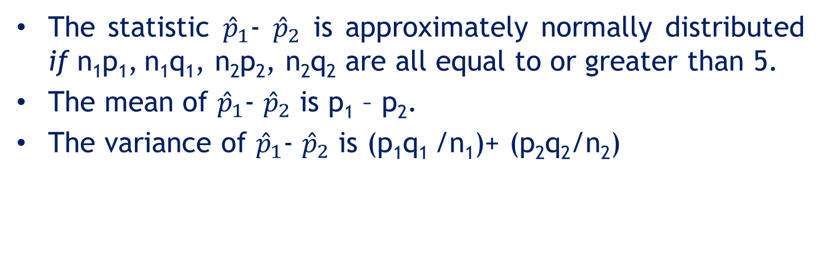

Sampling statistic, ${\hat{ p}}_{1}$ − ${\hat{p}}_{2}$
11.62
The statistic ${\hat{p}}_{1}$- ${\hat{p}}_{2}$ is approximately normally distributed if n₁p₁, n₁q₁, n₂p₂, n₂q₂ are all equal to or greater than 5.
The mean of ${\hat{p}}_{1}$- ${\hat{p}}_{2}$ is p₁ – p₂.
The variance of ${\hat{p}}_{1}$- ${\hat{p}}_{2}$ is (p₁q₁ /n₁)+ (p₂q₂/n₂)
Because p1, p2, are unknown,
we use their estimates instead. Thus,
are all equal to or greater than 5.

Slide 63
11.63
Estimating the difference between two population proportions
The confidence interval for the difference between two population proportions, p1 – p2, is given by
provided n1p1, n1q1, n2p2, n2q2 are all equal to or greater than 5, where (1 – α) is the confidence level.

Slide 64
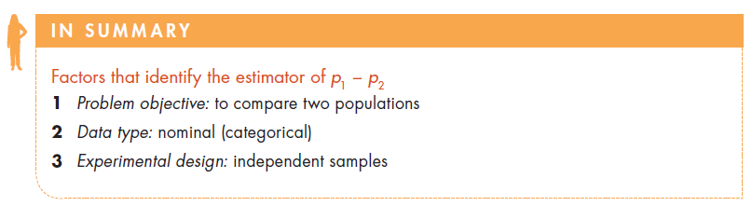
11.64
Factors that identify…

Slide 65
11.65
Example 6
(Example 11.6, p448)
In a study that was highly publicised, doctors discovered that aspirin seems to help prevent heart attacks.
The research project, which was scheduled to last for five years, employed 22 000 patients (all male). Half took an aspirin tablet three times per week, while the other half took a placebo on the same schedule. After three years, researchers determined that 104 of those who took aspirin and 189 of those who took the placebo had had heart attacks.
Estimate with 95% confidence the proportion of men who would avoid a heart attack if they started taking aspirin regularly. If 1 million men adopt the practice of the regular use of aspirin, estimate the number of men who would avoid heart attacks.

Slide 66
11.66
Example 6: Solution
IDENTIFY
Identifying the technique
Data type: Nominal (take/do not take) from two independent samples
Parameter of interest: p₁ - p₂
Problem objective: Comparing two populations - estimate the difference between population proportion (p₁ − p₂) of regular aspirin takers who had a heart attack (p₁) and the proportion of regular placebo takers who had a heart attack (p₂) .
95% confidence interval for p₁-p₂:

Slide 67
11.67
Example 6: Solution…
COMPUTE
Calculating manually
From the data,
A 95% confidence interval for p1-p2:
LCL = -0.0108, UCL = -0.0047

Slide 68
11.68
Example 6: Solution…
COMPUTE
Using Excel
(Estimators.xls, z-Estimate_2 Proportions worksheet)

Slide 69
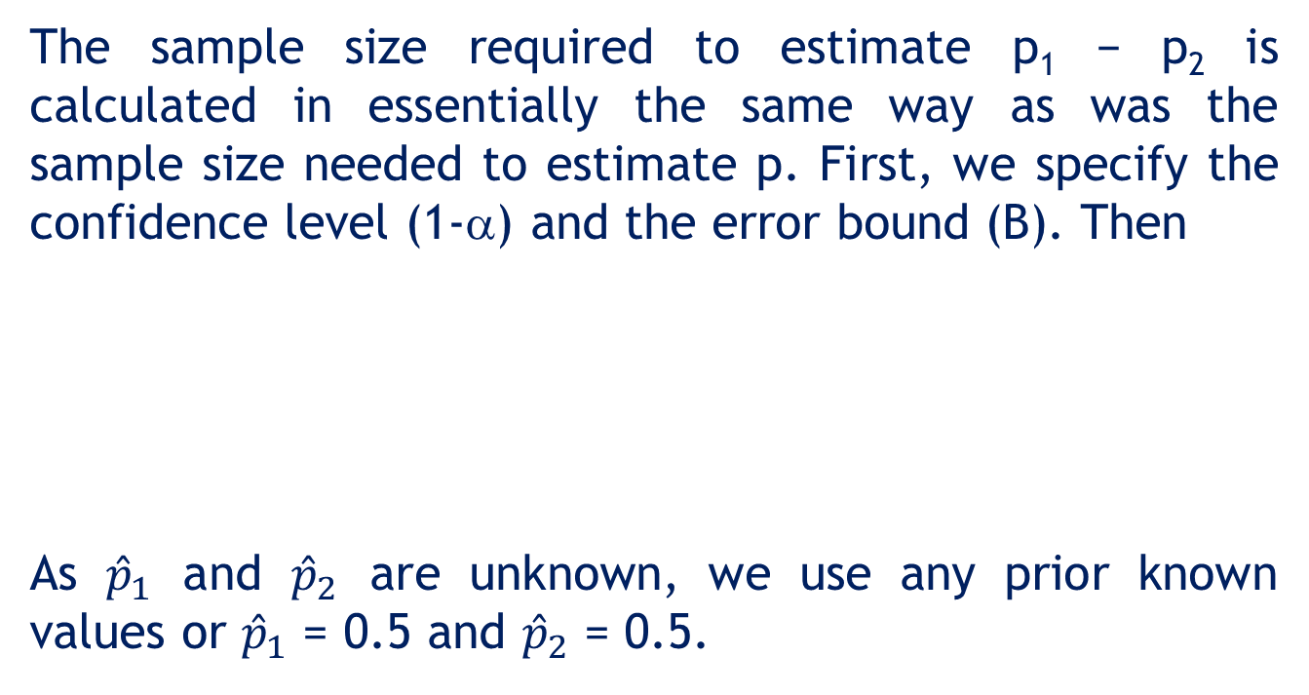
Selecting the sample sizes to estimate p₁ − p₂
11.69
The sample size required to estimate p₁ − p₂ is calculated in essentially the same way as was the sample size needed to estimate p. First, we specify the confidence level (1-α) and the error bound (B). Then
As ${\hat{p}}_{1}$ and ${\hat{p}}_{2}$ are unknown, we use any prior known values or ${\hat{p}}_{1}$ = 0.5 and ${\hat{p}}_{2}$ = 0.5.

Slide 70
Example 7 (Example 11.7, p451)
11.70
A market surveyor wants to estimate the difference in the proportion of male and female car owners who have their oil changed by a national chain of no-wait service centres. The surveyor wishes to estimate the difference in proportions to within 0.04, with 90% confidence. If she believes that the proportion of men who regularly use the service centre is no more than 20% and that the proportion of women who regularly use it is no more than 30%, how large should the samples be?

Slide 71
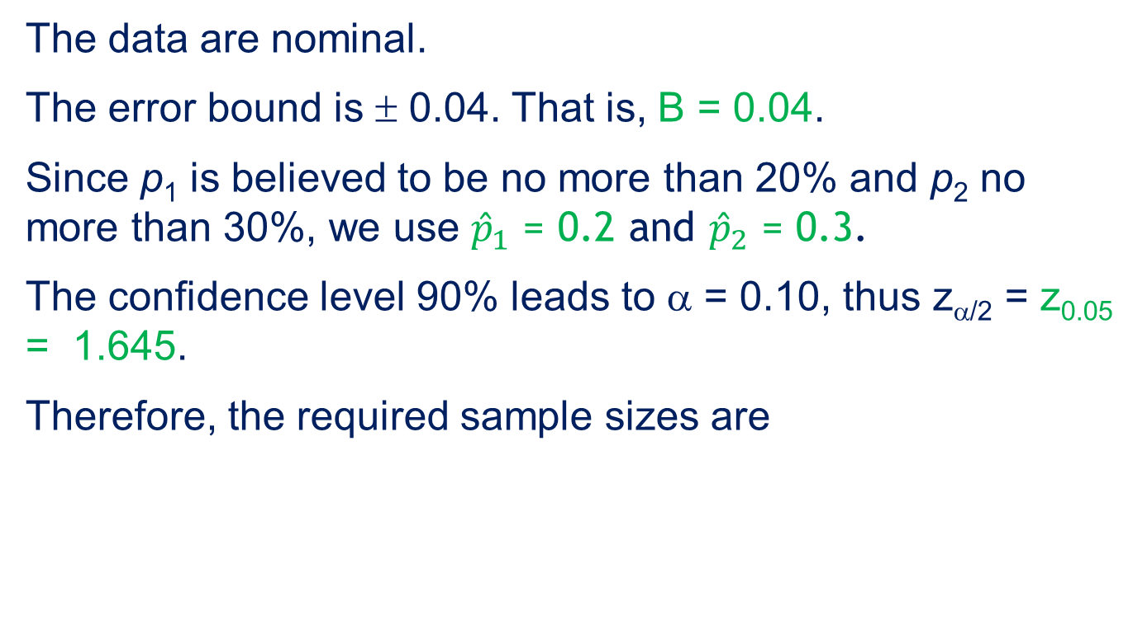
Example 7: Solution
11.71

Slide 72
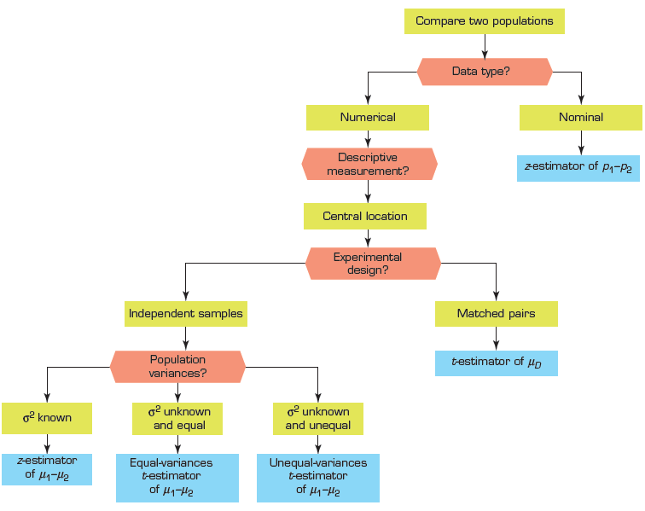
Summary of techniques – Difference between two population parameters estimation
11.72

