Slide 1


Slide 2
Chapter 13
Hypothesis testing: Comparing two populations

Slide 3
Chapter outline
13.1 Testing the difference between two population means: Independent samples
13.2 Testing the difference between two population means: Dependent samples – matched pairs experiment
13.3 Testing the difference between two population proportions

Slide 4
Learning objectives
LO1 Test hypotheses comparing two population means with independent samples and known population variances
LO2 Test hypotheses comparing two population means with independent samples and unknown and unequal population variances
LO3 Test hypotheses comparing two population means with independent samples and unknown but equal population variances
LO4 Test hypotheses comparing two population means with dependent samples
LO5 Test hypotheses comparing two population proportions.

Slide 5
Introduction
13.5
Previously in Chapter 12 we looked at testing parameters (μ and p) of a single population.
In this chapter, a variety of techniques are presented; their objective is to compare two populations parameters.
This chapter presents techniques to test hypothesis of
the difference between two population means (μ₁ – μ₂)
the difference between two population proportions (p₁ – p₂)

Slide 6
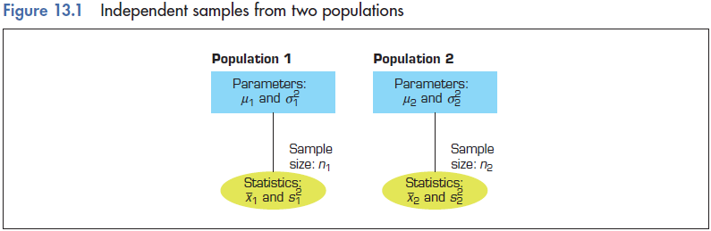
13.1 Testing the difference between two population means: Independent samples
13.6

Slide 7
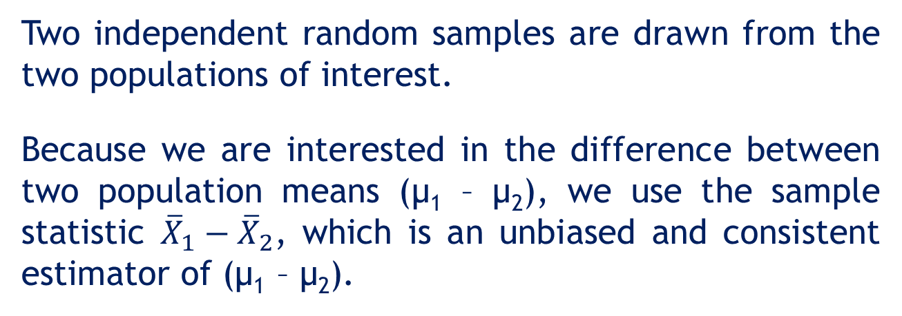
Testing the difference between two population means: Independent samples…
13.7
Two independent random samples are drawn from the two populations of interest.
Because we are interested in the difference between two population means (μ₁ – μ₂), we use the sample statistic ${\overline{X}}_{1}−{\overline{X}}_{2}$, which is an unbiased and consistent estimator of (μ₁ – μ₂).

Slide 8

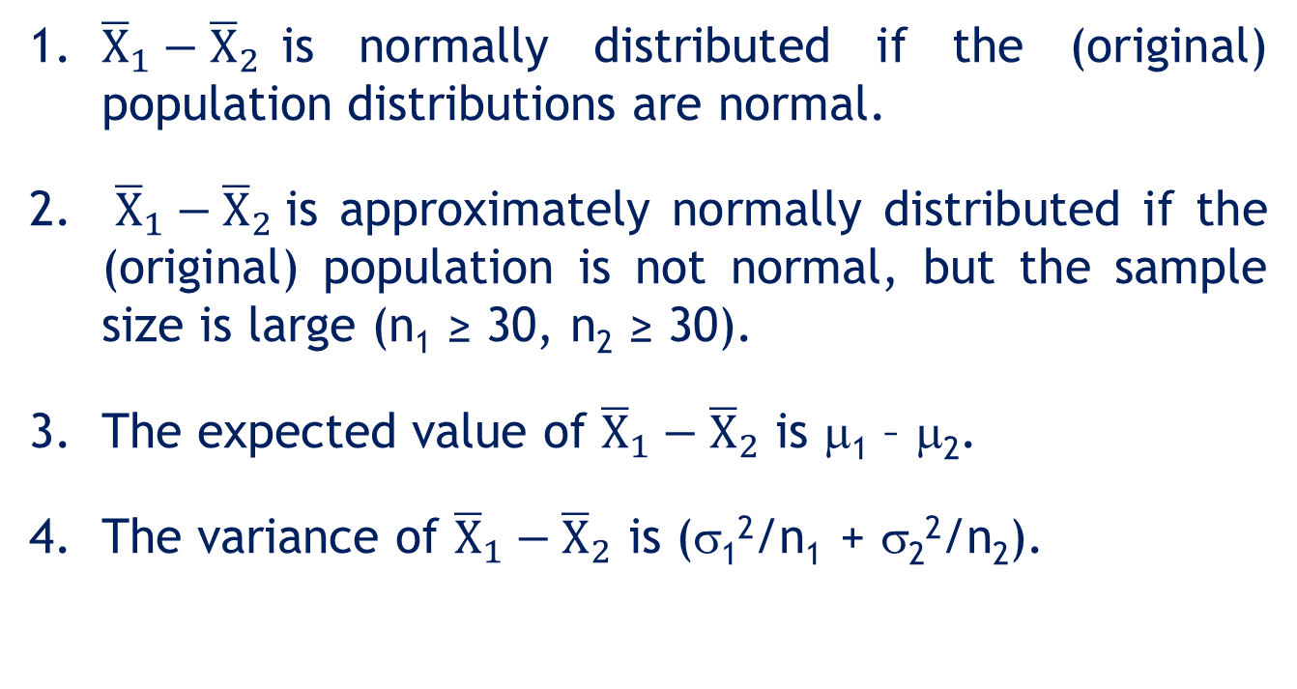
The Sampling Distribution of ${\overline{X}}_{1}−{\overline{X}}_{2}$
13.8
1. ${\overline{X}}_{1}−{\overline{X}}_{2}$is normally distributed if the (original) population distributions are normal.
2. ${\overline{X}}_{1}−{\overline{X}}_{2}$is approximately normally distributed if the (original) population is not normal, but the sample size is large (n₁ ≥ 30, n₂ ≥ 30).
3. The expected value of ${\overline{X}}_{1}−{\overline{X}}_{2}$ is μ₁ – μ₂.
4. The variance of ${\overline{X}}_{1}−{\overline{X}}_{2}$ is (σ₁²/n₁ + σ₂²/n₂).

Slide 9

Case 1: Testing a hypothesis about μ₁ – μ₂ when the population variances are known
13.9
If the sampling distribution of ${\overline{X}}_{1}−{\overline{X}}_{2}$ is normal or approximately normal, we can write
which follows a standard normal distribution. z can be used as a test statistic for μ₁ – μ₂.

Slide 10
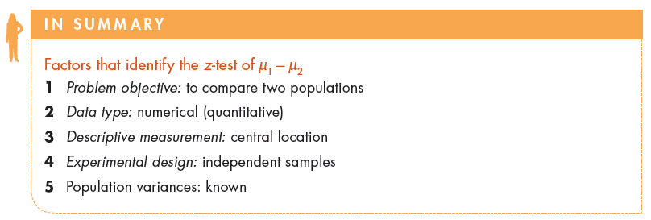
Factors that identify…
13.10

Slide 11
6 steps of hypothesis testing…
13.11
As before in Chapter 12, we follow the 6 steps to perform hypothesis testing when comparing two populations:
Specify the null and alternative hypotheses
Determine the test statistic
Specify the significance level
Define the decision rule
Calculate the value of the test statistic
Make your conclusions

Slide 12
Example 1 (Example 13.1, p522)
13.12
XM13-01 The selection of a new shop location depends on many factors, one of which is the level of household income in areas around the proposed site. Suppose that a large department-store chain in Queensland is trying to decide whether to build a new store in Logan City or in Ipswich. Building costs are lower in Ipswich, and the company decides it will build there unless the average household income is higher in Logan City. A survey of 100 residences in each of the areas found that the mean annual household income was $54 180 in Logan City and $45 340 in Ipswich. From other sources, it is known that the population standard deviations of annual household incomes are $5365 in Logan City and $7440 in Ipswich. At the 5% significance level, can it be concluded that the mean household income in Logan City exceeds that of Ipswich?

Slide 13
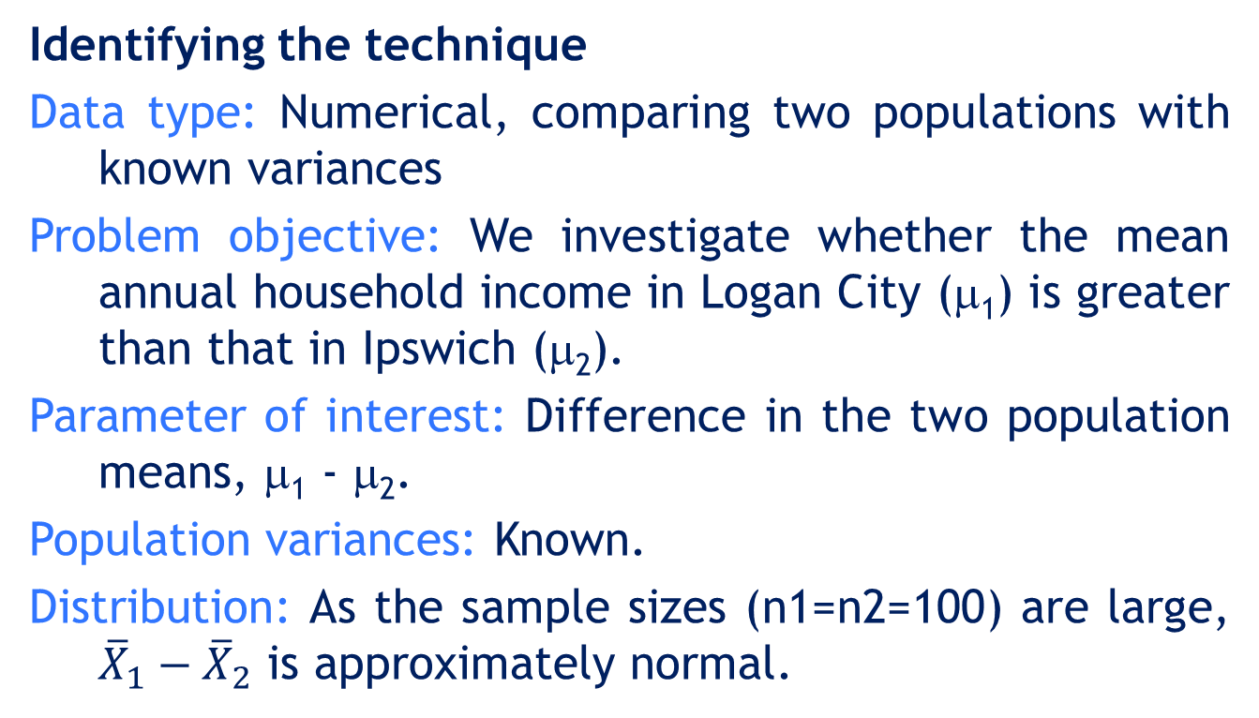
Example 1: Solution
13.13
IDENTIFY
Identifying the technique
Data type: Numerical, comparing two populations with known variances
Problem objective: We investigate whether the mean annual household income in Logan City (μ₁) is greater than that in Ipswich (μ₂).
Parameter of interest: Difference in the two population means, μ₁ - μ₂.
Population variances: Known.
Distribution: As the sample sizes (n1=n2=100) are large, ${\overline{X}}_{1}−{\overline{X}}_{2}$ is approximately normal.

Slide 14
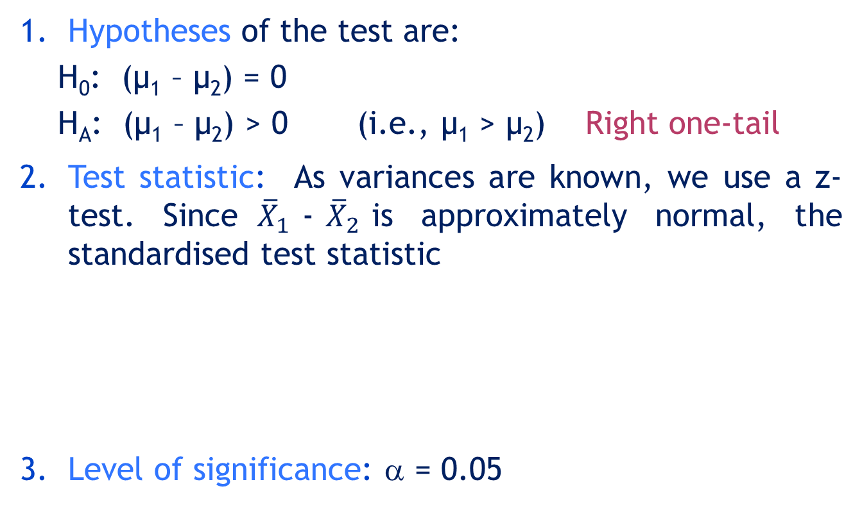
Example 1: Solution…
13.14
IDENTIFY
1. Hypotheses of the test are:
H₀: (μ₁ – μ₂) = 0
H_{A}: (μ₁ – μ₂) > 0 (i.e., μ₁ > μ₂) Right one-tail
Test statistic: As variances are known, we use a z-test. Since${\overline{X}}_{1}$-${\overline{X}}_{2}$is approximately normal, the standardised test statistic
Level of significance: α = 0.05

Slide 15
Example 1: Solution…
13.15
CALCULATE
Critical value: z_{α} = z_{0.05} = 1.645
Decision rule:
Reject H₀ if z > 1.645; otherwise do not reject H₀.
OR Reject H₀ if p-value < α = 0.05.
5. Sample value of the test statistic:
From the data,

Slide 16
Example 1: Solution…
13.16
INTERPRET
Conclusion:
t-value method
As z₀ = 9.637 > 1.645, reject H₀.
p-value method
From the output below,
p-value = 0.000 < 0.05 = α, reject H₀.
There is enough evidence to conclude that mean household income for Logan City (μ₁) exceeds that of Ipswich (μ₂). Therefore the management may decide to build a new department-store at Logan City.

Slide 17
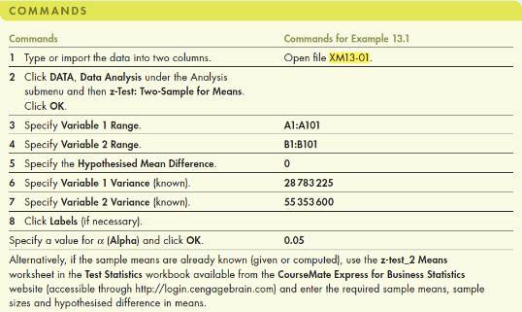
13.17
Example 1: Solution…
Using Excel (Data Analysis)
Alternatively, if the sample means are already known (given or computed), use the z-test_2 Means worksheet in the Test Statistics workbook to produce the results.

Slide 18
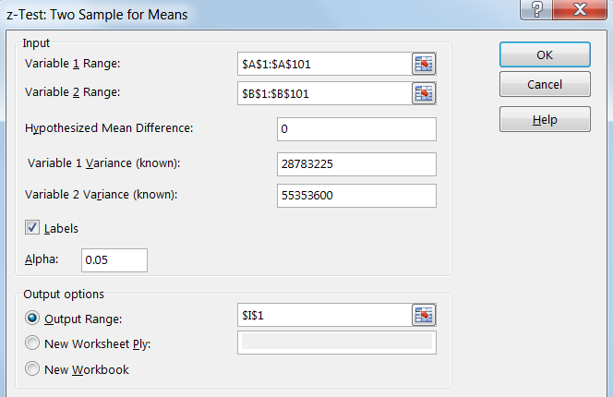
13.18
Example 1: Solution…
Using Excel (Data Analysis)
In the Data Analysis dialogue box (shown below), enter the input and the output is presented in the next slide.

Slide 19
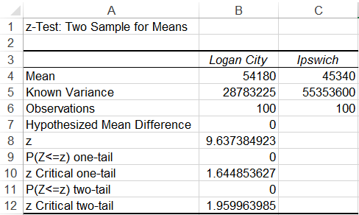
13.19
Example 1: Solution…
Using Excel (output)
p-value method:
As p-value = 0 < 0.05, at the 5% significance level, there is sufficient evidence to reject the null hypothesis.
Therefore, there is enough evidence to infer that the mean annual household income of Logan City (μ1) exceeds that of Ipswich (μ2).

Slide 20
Cases 2 & 3: Testing a hypothesis about μ₁ – μ₂ when the population variances are unknown
13.20
Practically, the z-statistic is hardly used, because the population variances, σ₁² and σ₂², are usually not known and estimated by sample variances, s₁² and s₂².
Instead of a z-statistic, we construct a t-statistic using the sample ‘variances’ (s₁² and s₂²).
t
?
?
s1²
s2²

Slide 21
Cases 2 & 3: Testing a hypothesis about μ₁ – μ₂ when the population variances are unknown
13.21
Two cases are considered when producing the t-statistic:
Case 2: The two unknown population variances are equal.
Case 3: The two unknown population variances are not equal.

Slide 22
Case 2: Unknown but equal variances
13.22
Calculate the pooled variance estimate by:
The pooled
variance
estimator
n2 = 16
n1 = 11
Example: s1² = 25; s2² = 30; n1 = 11; n2 = 16. Then,

Slide 23
13.23
Construct the equal-variances t-statistic as follows:
Perform an equal-variances t-test of μ1 – μ2
H0: μ1 - μ2 = 0
HA: μ1 - μ2 > 0;
or < 0;
or ≠ 0

Slide 24
Case 3: Unknown and unequal variances
13.24
Construct the unequal-variances t-statistic as follows:

Slide 25
13.25
Perform an unequal-variances t-test of μ1 - μ2:
H0: μ1 - μ2 = 0
HA: μ1 - μ2 > 0;
or < 0;
or ≠ 0

Slide 26
Which case to use: Equal variance or unequal variance?
13.26
Whenever there is sufficient evidence that the variances are equal, it is preferable to perform the equal variances t-test.
This is because for any two given samples:
the number of degrees of freedom for the equal variances case
the number of degrees of freedom for the unequal variances case
≥

Slide 27
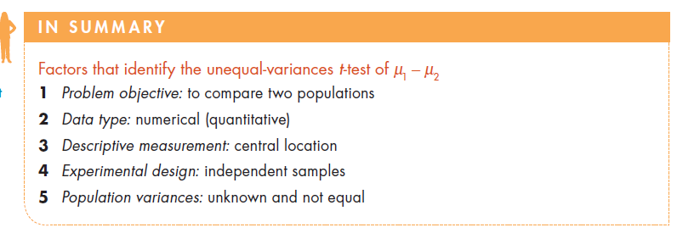
Factors that identify…
13.27

Slide 28
Example 2 (Example 13.2, p.525)
13.28
A scientist claims that people who eat high-fibre cereal for breakfast consume, on average, fewer kilojoules for lunch than people who do not eat high-fibre cereal for breakfast.
A sample of 30 people was randomly drawn. Each person was identified as a consumer or non-consumer of high-fibre cereal.
For each person, the number of kilojoules consumed at lunch was recorded. At the 5% level of significance, investigate the scientist’s claim.

Slide 29
Example 2: Solution
13.29
Kilojoules consumed at lunch
Problem objective: compare two population means using two independent samples.
Population variances are unknown.
The data are numerical.
The parameter to be tested is the difference between two means, μ₁ - μ₂.
The claim to be tested is that the mean kilojoule intake of consumers (μ₁) is less than that of non-consumers (μ₂).

Slide 30
Example 2: Solution…
13.30
Identifying the technique
The hypotheses are:
H₀: (μ₁ - μ₂) = 0
H_{A}: (μ₁ - μ₂) < 0 (i.e., μ₁ < μ₂) Left one-tail
The population variances are unknown. To check whether the variances are equal, we compare the samples’ standard deviations. We have s₁ = 142.75 and s₂ = 462.61. It appears that the variances are unequal. Therefore, we use the t-test for unequal variances.

Slide 31
Example 2: Solution…
13.31
IDENTIFY
Solving manually
1. Hypotheses of the test are:
H₀: (μ₁ – μ₂) = 0
H_{A}: (μ₁ – μ₂) < 0 (i.e., μ₁ > μ₂) Left one-tail
Test statistic: For t-test for unequal variances, the t-test statistic
Based on the above formula, d.f. = 25.
3. Level of significance: α = 0.05

Slide 32
Example 2: Solution…
13.32
CALCULATE
Critical value: -t_{α,d.f.} = -t_{0.05,25} = -1.71
Decision rule:
Reject H₀ if t < -1.71; otherwise do not reject H₀.
OR Reject H₀ if p-value < α = 0.05.
5. Sample value of the test statistic:
From the data,

Slide 33
Example 2: Solution…
13.33
INTERPRET
Conclusion:
t-value method
As t₀ = -2.31 < -1.71, reject H₀.
p-value method
From the output below,
p-value = 0.015 < 0.05 = α, reject H₀.

Slide 34
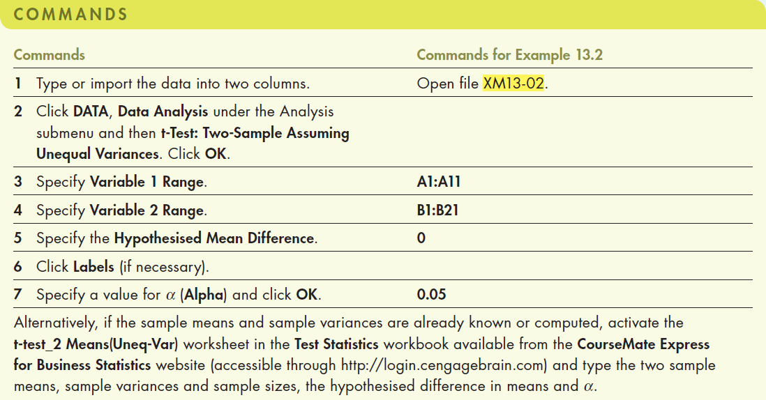
Example 2: Solution…
13.34
CALCULATE
Using Excel (Data Analysis)
Alternatively, if the sample means and sample variances are already known or computed, activate the t-test_2 Means(Uneq-Var) worksheet in the Test Statistics workbook.

Slide 35
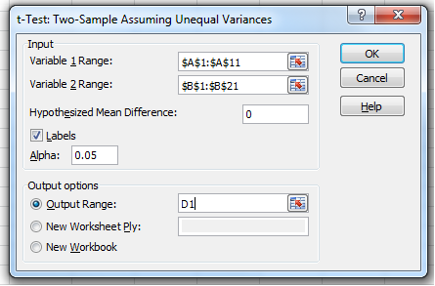
Example 2: Solution…
13.35
CALCULATE
Using Excel (Data Analysis)
In the Data Analysis dialogue box (shown below), enter the input and the output is presented in the next slide.

Slide 36
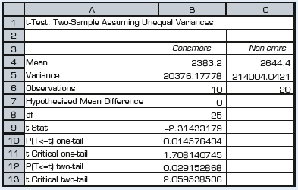
Example 2: Solution…
13.36
INTERPRET
Using Excel (output)
As p-value = 0.015 < 0.05 at the 5% significance level there is sufficient evidence to reject the null hypothesis.
Therefore, the data provide enough evidence to infer that consumers who consume high-fibre cereal for breakfast do consume fewer calories for lunch that non-consumers.

Slide 37
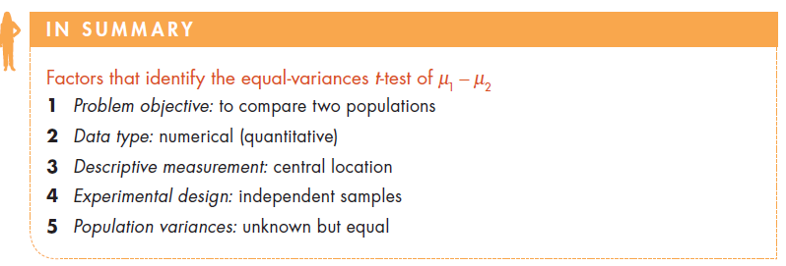
Factors that identify…
13.37

Slide 38
Example 3 (Example 13.3, p529)
13.38
Does job design (referring to worker movements) affect workers’ productivity?
Two job designs are being considered for the production of a new computer desk. Two samples are randomly and independently selected:
A sample of 25 workers assembled a desk using design A.
A sample of 25 workers assembled the desk using design B.
The assembly times were recorded. Do the assembly times of the two designs differ? Use α = 0.05.

Slide 39
13.39
Example 3: Solution
Problem objective: comparing two population means using two independent samples.
Population variances are unknown.
The data are numerical.
The parameter of interest is the difference between two population means, μ1 - μ2.
The claim to be tested is whether a difference between the two designs exists.

Slide 40
Example 3: Solution…
13.40
Solving manually
The hypothesis test is:
H0: (μ1 - μ2) = 0 HA: (μ1 - μ2) ≠ 0 Two tail test
The variances are unknown. To check whether the variances are equal, we compare the samples’ standard deviations. We have s1= 0.92 and s2 =1.14. We can assume that the two variances are equal and use the t-test for equal variances.
The t-test statistic is given by:

Slide 41
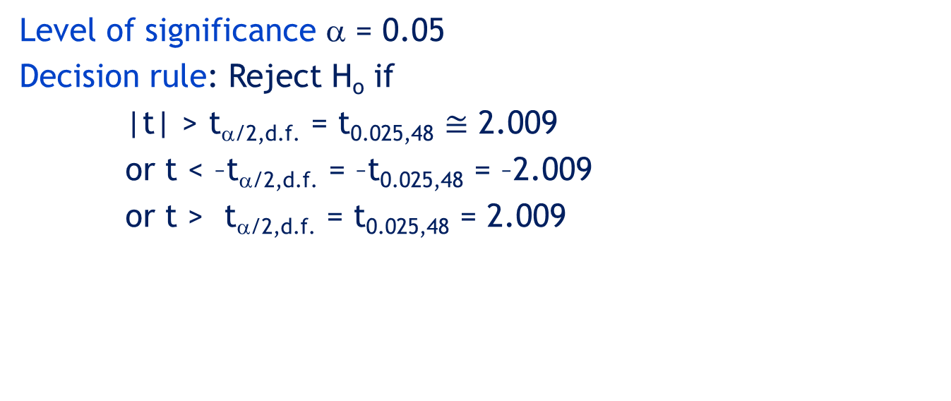
Example 3: Solution…
13.41
Level of significance α = 0.05
Decision rule: Reject H_{o} if
|t| > t_{α/2,d.f.} = t_{0.025,48} $≅$ 2.009
or t < –t_{α/2,d.f.} = –t_{0.025,48} = –2.009
or t > t_{α/2,d.f.} = t_{0.025,48} = 2.009
Rejection region
Rejection region
–2.009
0.093
2.009

Slide 42
Example 3: Solution…
13.42
Value of the test statistic (equal-variances t-statistic):
Pooled variance:

Slide 43
Example 3: Solution…
13.43
Conclusion: Since –2.009 < t = 0.93 < 2.009, we do not reject H₀. That is, there is insufficient evidence to support the alternative hypothesis.
There is no evidence to infer, at the 5% significance level, that the two assembly methods are different in terms of assembly time.

Slide 44
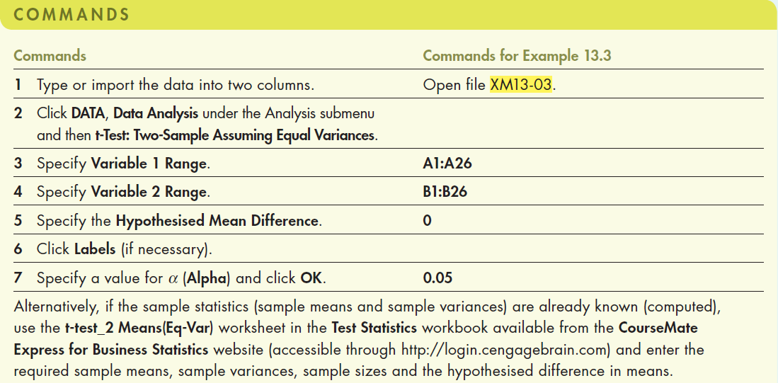
Example 3: Solution…
13.44
Using Excel (Data Analysis)
Alternatively, if the sample statistics (sample means and sample variances) are already known (computed), use the t-test_2 Means(Eq-Var) worksheet in the Test Statistics workbook.

Slide 45
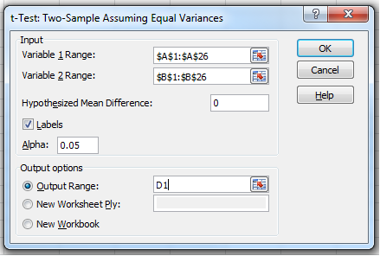
Example 3: Solution…
13.45
Using Excel (Data Analysis)
In the Data Analysis dialogue box (shown below), enter the input and the output is presented in the next slide.

Slide 46
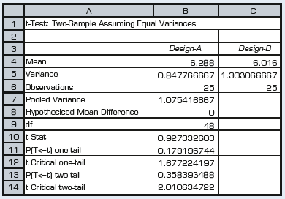
Example 3: Solution…
13.46
Using Excel (Output)
p-value method:
As p-value = 0.36 > 0.05 = α, we do not reject H0.

Slide 47
Example 3: Solution…
13.47
Checking the required condition
Both the equal-variances and unequal-variances techniques require that the populations are normally distributed. As before, we can check to see if the requirement is satisfied by drawing the histograms of the data. Although the histograms are not bell shaped, it appears that the assembly times are at least approximately normal. Because this technique is robust, we can be confident in the validity of the results.

Slide 48
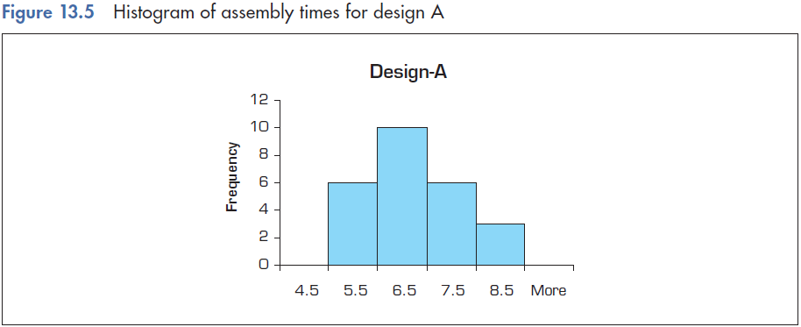
Example 3: Solution…
13.48
Checking the required condition

Slide 49
13.2 Testing the difference between two population means: Dependent samples – matched pairs experiment
13.49
The following example demonstrates a situation
where a matched pair experiment is the correct
approach to testing the difference between two
population means.

Slide 50
Example 4 (Example 13.4, p540)
13.50
To determine whether a new steel-belted radial tyre lasts longer than a current model, the manufacturer designs the following experiment.
A pair of newly-designed tyres is installed on the rear wheels of 20 randomly-selected cars.
A pair of currently-used tyres is installed on the rear wheels of another 20 cars.
Drivers drive in their usual way until the tyres are worn out.
The number of kilometres driven by each driver are recorded. See data next.
Can the manufacturer infer that the new design tyre will last longer on average than their existing design? Assume that the two populations of tyre lifetimes are normal.

Slide 51
Example 4: Solution
13.51
Problem objective: compare two population
means using independent samples
Population variances are unknown
Data are numerical data
The parameter of interest is μ₁ – μ₂
μ₁ = mean distance driven before wear out occurs for new-design tyres.
μ₂ = mean distance driven before wear out occurs for existing-design tyres.
The hypotheses are:
H0: (μ1 – μ2) = 0
HA: (μ1 – μ2) > 0

Slide 52
Example 4: Solution…
13.52
Calculating manually
Since s₁² = 243.4 and s₂² = 226.8, we consider σ₁² ≈ σ₂².
The test statistic is
We use level of significance α = 0.05
Decision rule: Reject H₀ if t_{cal} < t_{crit} = t_{0.05,38} = 1.69
or Reject H₀ if p-value < α.
Otherwise, do not reject H_{o}.

Slide 53
Example 4: Solution…
13.53
Value of the test statistic:
Conclusion:
t-value method: Since t_{cal} = 0.91 < t_{crit} = 1.69, we do not reject H₀
p-value method: From the Excel output below, p-value = 0.185. As p-value = 0.185 > 0.05 = α. We do not reject H₀.
At the 5% level, there is not enough evidence to conclude that the new design tyres last longer than the existing design tyres.

Slide 54
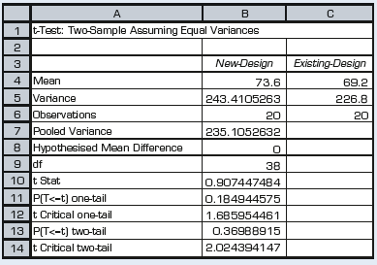
Example 4: Solution…
13.54
Using Excel (Data Analysis)
(The commands are the same as that for Example 3.)
As p-value = 0.1849 > 0.05, we conclude that there is insufficient evidence to reject H0. That is, at the 5% level, there is not enough evidence to conclude that the new design tyres last longer than the current type.

Slide 55
Checking for the required conditions
13.55
Existing design
New design
12
7
10
6
8
5
6
4
3
4
2
2
1
0
0
45
60
75
90
105
More
45
60
75
90
105
More
While the sample mean of the new design is larger than the sample mean of the existing design, the variability within each sample is large enough for the sample distributions to overlap and cover about the same range. It is therefore difficult to argue that one expected value is different from the other.

Slide 56
13.56
The range of observations
sample A
So what really
happened here?
The values each sample consists of might vary markedly ...
The range of observations
sample B

Slide 57
13.57
Differences
… but the differences between pairs of observations might be quite close to one another, resulting in a small amount of variability.
the range of the
differences
0

Slide 58
13.58
Observe the statistic t shown in the next example, and notice how a small amount of variability between the differences (small sD) helps in rejecting the null hypothesis.

Slide 59
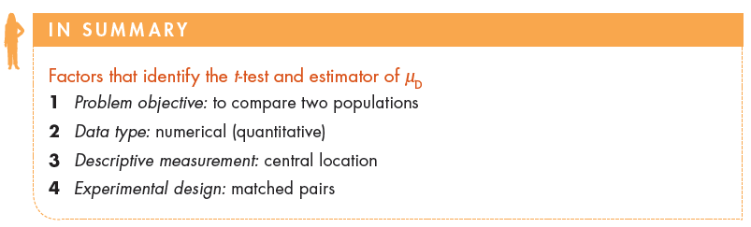
Factors that identify…
13.59

Slide 60
Example 4… (Example 13.4, p541)
13.60
To eliminate variability between observations within each sample, the experiment was redone.
One tyre of each type was installed on the rear wheel of 20 randomly-selected cars.
Each car was sampled twice, thus creating a pair of observations.
The number of kilometres until wear out was recorded.

Slide 61
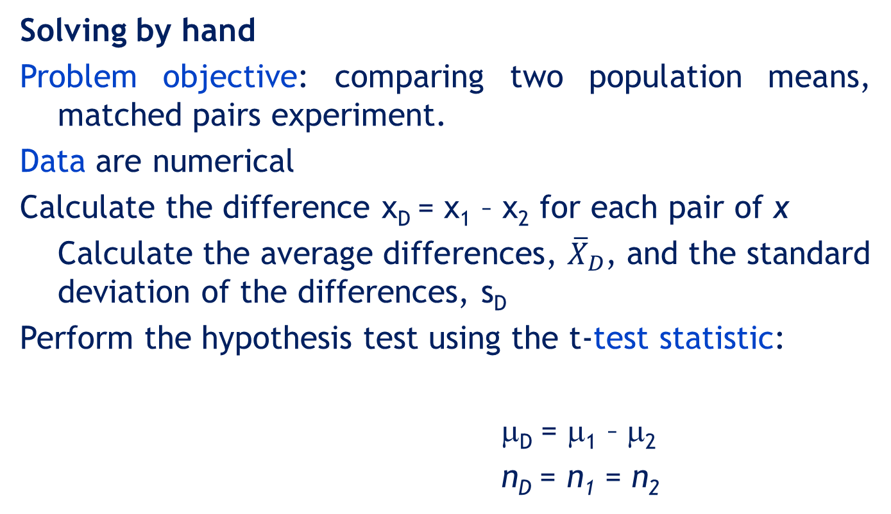
Example 4: Solution…
13.61
Solving by hand
Problem objective: comparing two population means, matched pairs experiment.
Data are numerical
Calculate the difference x_{D} = x₁ – x₂ for each pair of x
Calculate the average differences, ${\overline{X}}_{D}$, and the standard deviation of the differences, s_{D}
Perform the hypothesis test using the t-test statistic:
μ_{D} = μ₁ – μ₂
n_{D} = n₁ = n₂

Slide 62
Example 4: Solution…
13.62
Solving manually
Problem objective: comparing two population means, matched pairs experiment.
The hypotheses test for this problem is
H₀: μ_{D} = 0
H_{A}: μ_{D} > 0
The test statistic is
n_{D} = n₁ = n₂
Level of significance: α = 0.05
Decision rule: Reject H₀ if t > t_{0.05,19} = 1.729
or reject H₀ if p-value < α.
Right one-tail test

Slide 63
Example 4: Solution…
13.63
Value of the test statistic:
Since t = 2.817 > 1.729 (or p-value = 0.0055 < α = 0.05), there is sufficient evidence in the data to reject the null hypothesis in favour of the alternative hypothesis.
Conclusion: At the 5% significance level, the new tyres last longer than the current type.

Slide 64
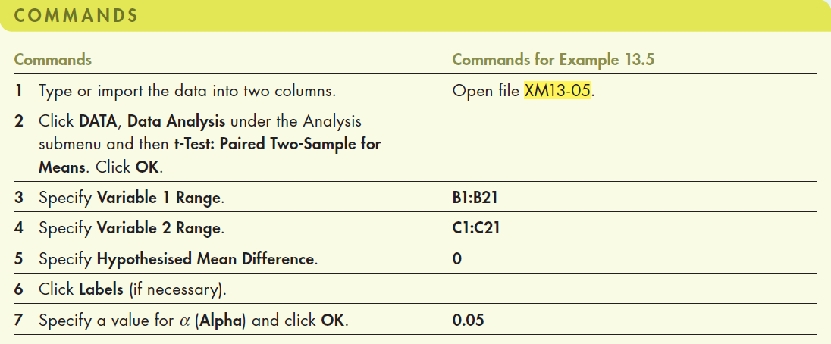
Example 4: Solution…
13.64
Using Excel (Data Analysis)

Slide 65
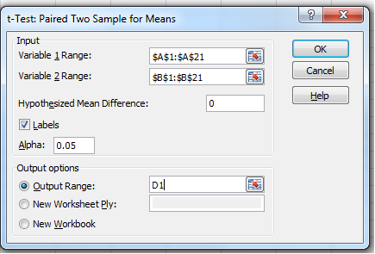
Example 4: Solution…
13.65
Using Excel (Data Analysis)
In the Data Analysis dialogue box (shown below), enter the input and the output is presented in the next slide.

Slide 66
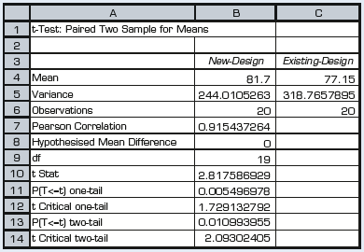
Example 4: Solution…
13.66
Using Excel (Data Analysis)

Slide 67
13.4 Testing the difference between two population proportions
13.67
In this section we deal with two populations whose data are nominal.
When data are nominal, we can (only) ask questions regarding the proportions of occurrence of certain outcomes.
Thus, we hypothesise on the difference p₁ – p₂ and draw an inference from the hypothesis test.

Slide 68
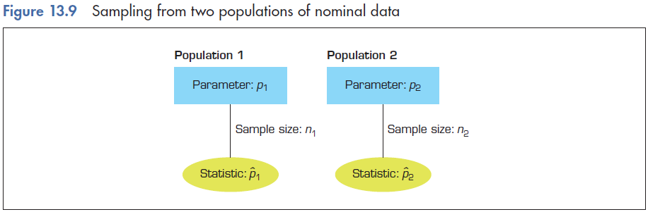
Testing the difference between two population proportions…
13.68

Slide 69

Sampling distribution of the difference between two sample proportions, ${\hat{ p}}_{1}$- ${\hat{p}}_{2}$
13.69
Two random samples are drawn from two populations.
The number of successes in each sample is recorded.
The sample proportions are computed.
Sample 1
Sample size n1
Number of successes x1
Sample proportion
Sample 2
Sample size n2
Number of successes x2
Sample proportion
x
ˆ
=
p
1
1
n
1

Slide 70
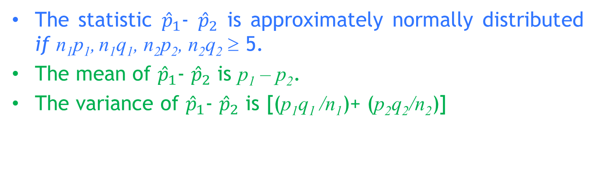

Sampling statistic, ${\hat{ p}}_{1}$- ${\hat{p}}_{2}$
13.70
The statistic ${\hat{p}}_{1}$- ${\hat{p}}_{2}$ is approximately normally distributed if n₁p₁, n₁q₁, n₂p₂, n₂q₂ ≥ 5.
The mean of ${\hat{p}}_{1}$- ${\hat{p}}_{2}$ is p₁ – p₂.
The variance of ${\hat{p}}_{1}$- ${\hat{p}}_{2}$ is [(p₁q₁ /n₁)+ (p₂q₂/n₂)]
Because p1, p2, are unknown,
we use their estimates instead. Thus, ≥ 5.

Slide 71
Testing the difference between two population proportions, p₁ – p₂
13.71
We hypothesise on the difference between the two proportions, p₁ – p₂. There are two cases to consider.
Case 1
H0: p1 – p2 = 0
Calculate the pooled proportion
Case 2
H0: p1 – p2 = D (D is not equal to 0)
Do not pool the data
Then
Then

Slide 72
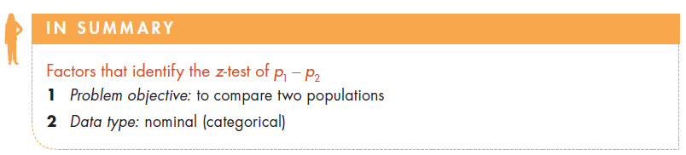
Factors that identify…
13.72

Slide 73
Example 5 (Example 13.6, p551)
13.73
A research project employing 22 000 patients was conducted to discover whether aspirin can prevent heart attacks.
Half the participants in the research took aspirin and half took a placebo.
In a three-year period, 104 of those who took aspirin and 189 of those who took the placebo had heart attacks.
Is aspirin effective in preventing heart attacks?

Slide 74
Example 5: Solution
13.74
Identifying the technique
Problem objective is to compare the populations of those who take aspirin with those who do not.
The data are nominal (take/do not take aspirin).
The hypotheses are
H₀: p₁ – p₂ = 0
H_{A}: p₁ – p₂ < 0
We identify here Case 1 so
where
Population 1 – aspirin takers
Population 2 – placebo takers

Slide 75
Example 5: Solution…
13.75
Solving manually
Level of significance: α = 0.05
Decision rule: Reject H₀ if Z < –z_{α} = –z_{0.05} = –1.645
(or Reject H₀ if p-value < α)
Value of the test statistic:
The sample proportions are
The pooled proportion is

Slide 76
Example 5: Solution…
13.76
Value of the z test statistic:
Conclusion: Since z = – 5.00 < –1.645, there is sufficient evidence to reject the null hypothesis in favour of the alternative hypothesis.

Slide 77
Example 5: Solution…
13.77
Using Excel
(z-test_2Proportions(Case 1) worksheet, Test Statistics Excel workbook)
Since p-value = 0.00 < α = 0.05, there is sufficient evidence to reject the null hypothesis in favour of the alternative hypothesis.

Slide 78
Example 5: Solution…
13.78
At the 5% significance level, we infer that aspirin reduces the incidence of heart attacks among men.

Slide 79
Example 6 (Example 13.7, p554)
13.79
XM14-07 The process that is used to produce a complex component used in medical instruments typically results in defect rates in the 40% range. Recently, two innovative processes have been developed to replace the existing process. Process 1 appears to be more promising, but it is considerably more expensive to purchase and operate than process 2. After a thorough analysis of the costs, management decides that it will adopt process 1 only if the proportion of defective components produced by process 2 is more than 8% more than that produced by process 1. In a test to guide the decision, both processes were used to produce 300 components. Of the 300 components produced by process 1, 33 were found to be defective, while 84 out of the 300 produced by process 2 were defective. Using a significance level of 10%, conduct a test to help management make a decision.

Slide 80
Example 6: Solution
13.80
Identifying the technique
The problem objective is to compare two populations (components produced by the two processes)
Data are nominal. We need to test p₁ – p₂.
The hypotheses to test are
H₀: p₁ – p₂ = -0.08
H_{A}: p₁ – p₂ < -0.08
We have to perform Case 2 of the test for difference in proportions (the difference is not equal to zero).

Slide 81
Example 6: Solution…
13.81
Solving manually
Test statistic:
Level of significance: α = 0.10
Decision rule: Reject H₀ if z < -z_{α} < -z_{0.10} = -1.645
(or reject H₀ if p-value < α)
Value of the test statistic:

Slide 82
Example 6: Solution…
13.82
Solving by manually
Value of the test statistic:
Since z = − 2.85 < z_{critical} = − 1.645, we reject H₀.
Conclusion: There is sufficient evidence to conclude that the proportion of defective components produced by process 2 is more than 8% more than the proportion of defective components produced by process 1.

Slide 83
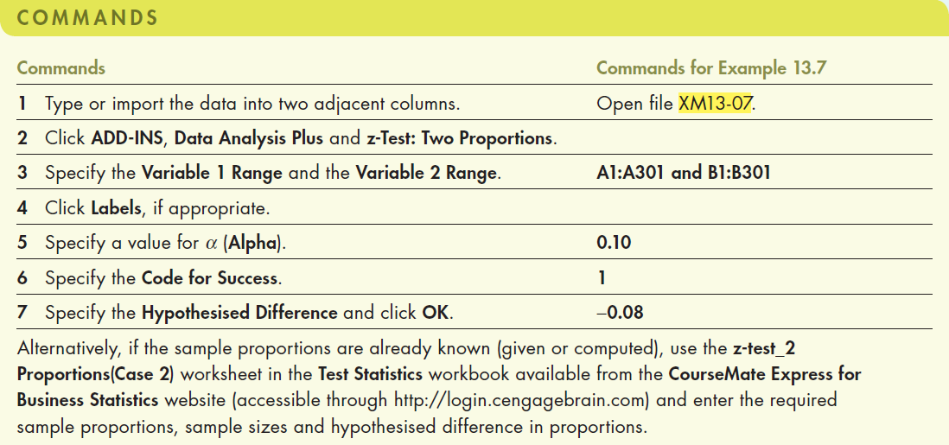
Example 6: Solution…
13.83
Using Excel (Data Analysis Plus)
Alternatively, if the sample proportions are already known (given or computed), use the z-test_2 Proportions(Case 2) worksheet in the Test Statistics workbook.

Slide 84
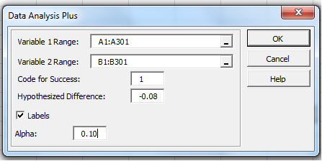
Example 6: Solution…
13.84
Using Excel (Data Analysis Plus)
We could easily use Data Analysis Plus to address this problem. The data are 1s (successes) and 0s (failures) stored in columns 1 (sample 1) and 2 (sample 2).

Slide 85
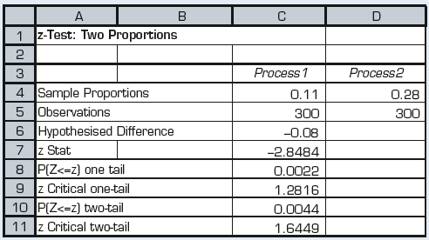
Example 6: Solution…
13.85
Using the computer
The value of the test statistic is −2.8484 and its p-value is 0.0022.

Slide 86
Example 6: Solution…
13.86
There is sufficient evidence to conclude that the proportion of defective components produced by process 2 is more than 8% more than the proportion of defective components produced by process 1.
Judging from the magnitude of the p-value, it appears that the evidence is overwhelming. It follows that the firm should adopt innovation 1.

Slide 87
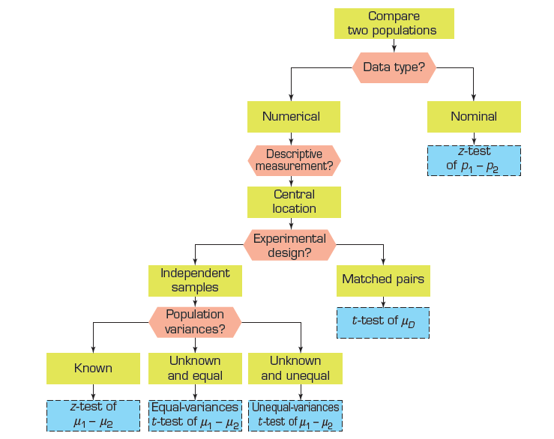
Summary of techniques – Comparing two populations tests
13.87

