Slide 1


Slide 2
Chapter 14
Inference about population variances

Slide 3
Chapter outline
14.1 Inference about σ²
14.2 Inference about σ₁²/σ₂²

Slide 4
Learning objectives
LO1 Understand the chi-squared distribution and the F-distribution
LO2 Identify the sampling distribution of the sample variance and derive an interval estimate for the population variance
LO3 Test hypotheses regarding population variance
LO4 Identify the sampling distribution of the ratio of two sample variances and derive an interval estimate for the ratio of two population variances
LO5 Test hypotheses comparing two population variances.

Slide 5
Introduction
14.5
In this chapter we make inferences about population variance (s) by utilising the approach developed previously for making statistical inference about population parameters such as population mean μ and population proportion p.
As before, this can be achieved in 3 steps:
Step 1: Identify the parameter to be estimated or tested.
Step 2: Specify the parameter’s estimator and its sampling distribution.
Step 3: Construct an interval estimator or perform a test.

Slide 6
Inference about population variances
14.6
For a single population, to draw inferences about variability, the parameter of interest is the population variance σ².
To compare the variability of two populations, the parameter of interest is the ratio of the two variances σ₁²/σ₂².
Inference about σ₁²/σ₂² is important as, noted earlier, the inference about the population mean difference μ₁ - μ₂ depends on whether the variances are equal (σ₁² = σ₂²) or unequal (σ₁² ≠ σ₂²).

Slide 7
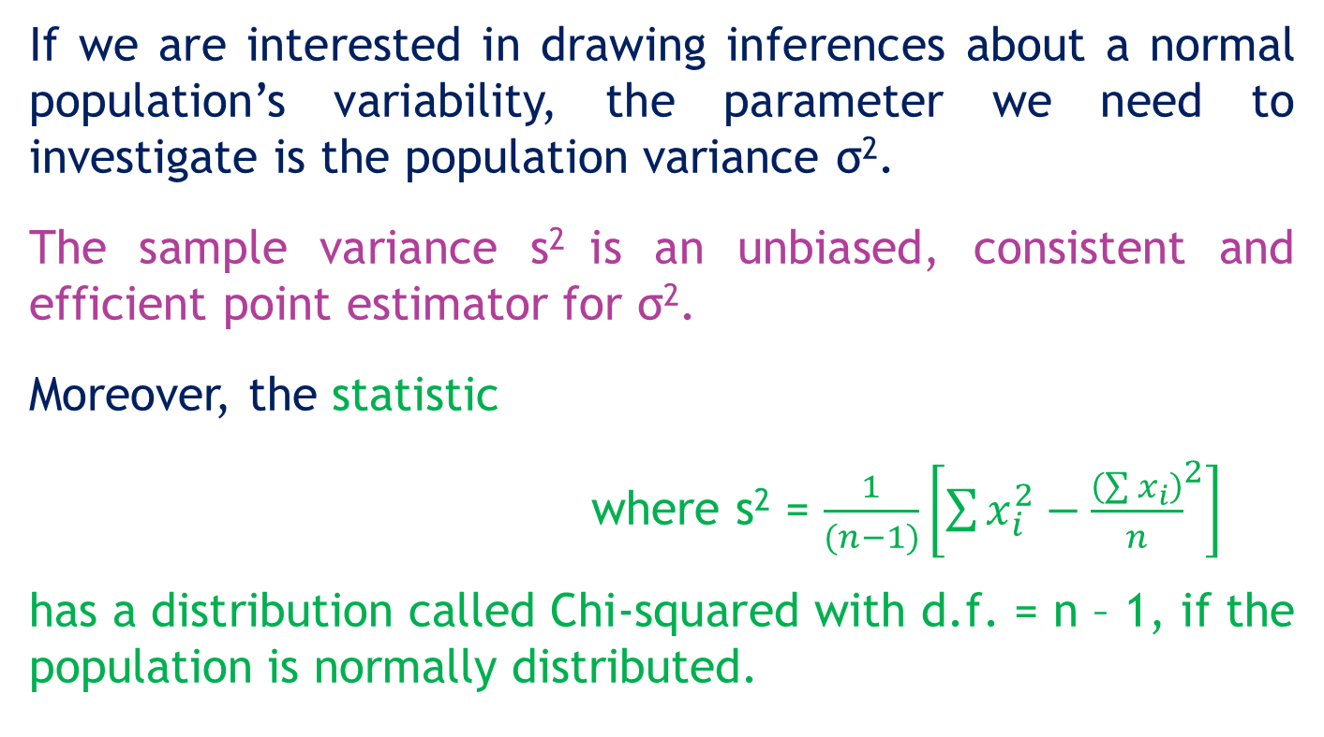
14.1 Inference about σ²
14.7
If we are interested in drawing inferences about a normal population’s variability, the parameter we need to investigate is the population variance σ².
The sample variance s² is an unbiased, consistent and efficient point estimator for σ².
Moreover, the statistic
where s² = $\frac{1}{(n−1)}\left[\sum{x_{i}^{2}−{\frac{\left(\sum{x_{i}}\right)}{n}}^{2}}\right]$
has a distribution called Chi-squared with d.f. = n – 1, if the population is normally distributed.

Slide 8
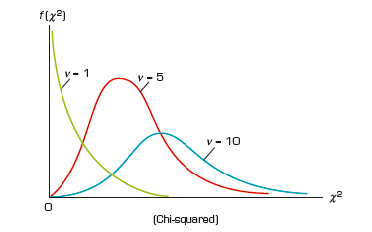
Inference about σ²…
14.8

Slide 9
The χ² table
14.9
A
=0.01
d.f. = 10
A
=0.01
χ²1-A
χ²Α
.990
.010
χ².01,10 = 23.2093
χ².995 χ².990 χ².975 χ².010 χ².005

Slide 10
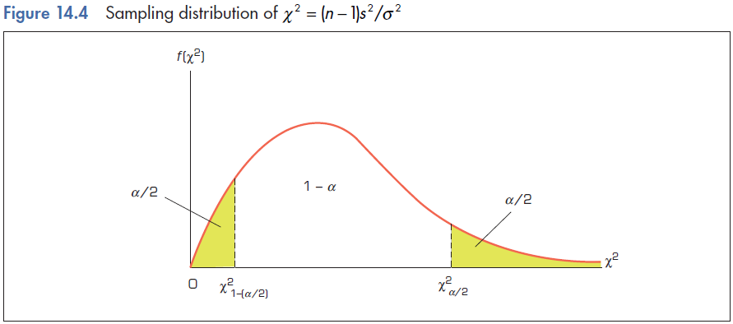
Estimating the population variance σ²
14.10

Slide 11
Estimating the population variance σ²
14.11
From the following probability statement P(χ²_{1-α/2} < χ² < χ²_{α/2}) = 1 – α we have (by substituting χ² = [(n – 1)s²]/σ²)

Slide 12
Estimating the population variance σ²
14.12
The confidence interval for σ² is
where (1 – α) is the confidence level.

Slide 13
Testing the population variance σ²
14.13
Our hypotheses:
Null hypothesis H₀: σ² = σ₀²
Alternative hypothesis is then
H_{A}: σ² ≠ σ₀² or H_{A}: σ² > σ₀² or H_{A}: σ² < σ₀²
Test statistic is
The test statistic has a χ² distribution with d.f. = n – 1.

Slide 14
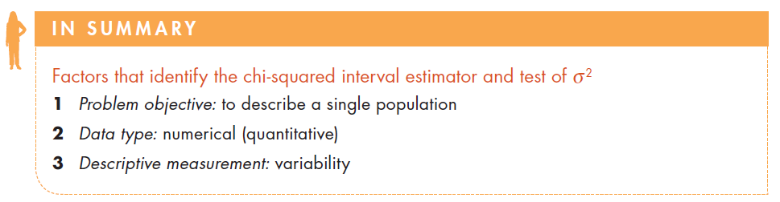
Identifying factors
14.14

Slide 15
Example 1 – Consistency of fills from a container filling machine (Example 14.2, p577)
14.15
XM14-02 A container-filling machine is believed to fill 1-litre containers so consistently that the variance of the filling will be less than 1 cc (0.001 litre). A random sample of 25 1-litre fills was taken and the results recorded.
Construct a 95% confidence interval for the population variance σ².
Do these data support the belief that the variance is less than 1cc at a 5% significance level?

Slide 16
Example 1(a) – Solution
14.16
Identifying the technique
Problem objective: To describe the population of 1-litre fills from a filling machine.
Data type: The data are numerical
Parameter of interest: Variability of the fills σ².
Assume that the population is normally distributed.
The (1-α)100% confidence interval for σ² is

Slide 17
Example 1(a) – Solution
14.17
Solving manually
Note that (n – 1)s² = Σx_{i}² – (Σx_{i})²/n
From the sample (data is presented in units of cc-1000 to avoid rounding) we can calculate
Σx_{i} = 24,996.4 and Σx_{i}² = 24,992,821.3, n=25.
Then (n – 1)s² = 24 992 821.3 – ((24996.4)²/25) = 20.8.
95% confidence interval for σ²

Slide 18
Example 1(b) – Solution
14.18
Solving manually
1. The hypotheses: H₀: σ² = 1
H_{A}: σ² < 1
2. The test statistic is
3. Level of significance: α = 0.05
4. Decision rule: Reject H₀ if
(or Reject H₀ if p-value < α = 0.05)
5. Value of the test statistic:

Slide 19
14.19
Example 1(b) – Solution
α = 0.05
1 - α = 0.95
Rejection
region
13.8484
20.8
Conclusion: Since χ² = 20.8 > 13.8484, do not reject the null hypothesis.
There is insufficient evidence to support the hypothesis that the variance is less than 1cc.

Slide 20
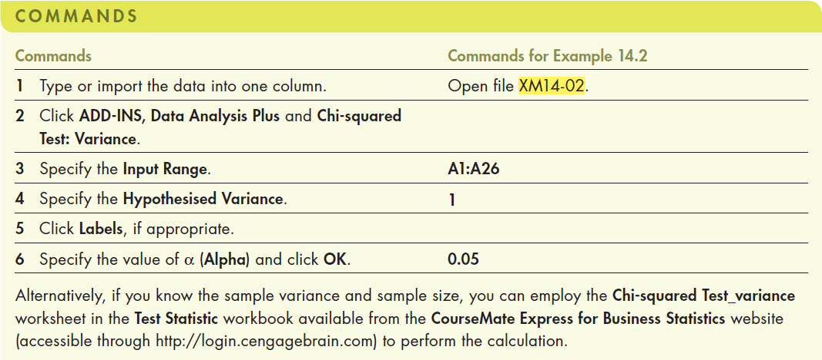
14.20
Example 1(b) – Solution
Using Excel (Data Analysis Plus)

Slide 21
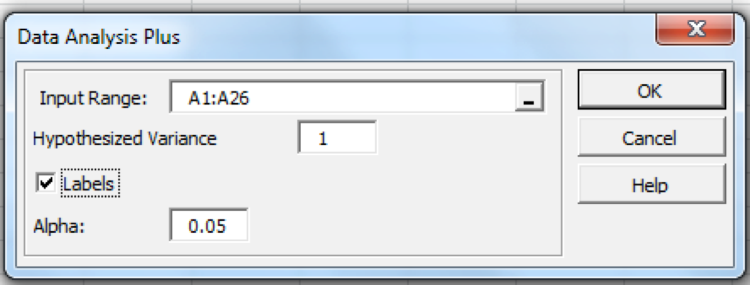
14.21
Example 1(b) – Solution
Using Excel (Data Analysis Plus)
In the Data Analysis Plus dialogue box (shown below), enter the input and the output is presented in the next slide.

Slide 22
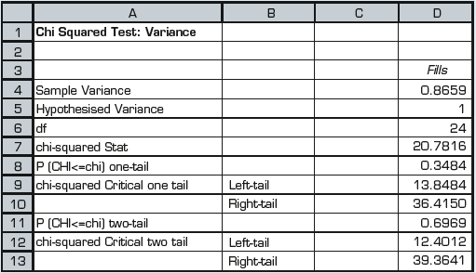
14.22
Example 1(b) – Solution
Using Excel (Data Analysis Plus)
The Excel output is presented below.
Conclusion: As p-value = 0.3484 > 0.05 = α, we do not reject Ho (σ² = 1).
There is not enough evidence to support the hypothesis that the variance is less than 1cc.

Slide 23
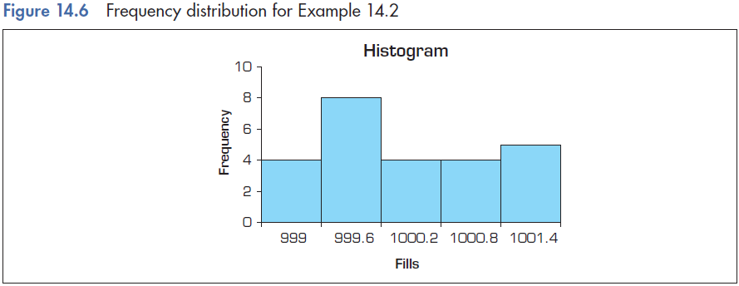
Checking the required condition
14.23
The fills do not appear to be extremely non-normal, which supports the validity of the conclusions drawn in Example 1.

Slide 24
14.2 Inference about σ₁²/σ₂²
14.24
In this section we discuss how to compare the variability of two normal populations.
In particular, we draw inference about the ratio of two population variances.
This question is interesting because:
Variances can be used to evaluate the consistency of processes.
The relationships between variances determine the technique to be used to test the difference between two population means (μ₁-μ₂).

Slide 25
Inference about σ₁²/σ₂²
14.25
Point estimator of σ₁²/σ₂²
Recall that s² is an unbiased estimator of σ².
Therefore, it is not surprising that we estimate σ₁²/σ₂² by s₁²/s₂².
Sampling distribution of s₁²/s₂²
We have [s₁²/σ₁²] is distributed as χ²(ν₁) and [s₂²/σ₂²] is distributed as χ²(ν₂). Therefore the ratio F = [s₁²/σ₁²]/[s₂²/σ₂²] is distributed as an F(ν₁,ν₂) distribution, where ν₁=n₁-1, ν₂=n₂-1.
The test statistic for σ₁²/σ₂², F = [s₁²/σ₁²]/[s₂²/σ₂²], follows an F- distribution.

Slide 26
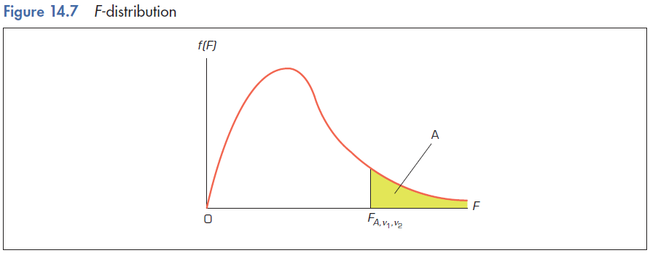
F-distribution
14.26

Slide 27
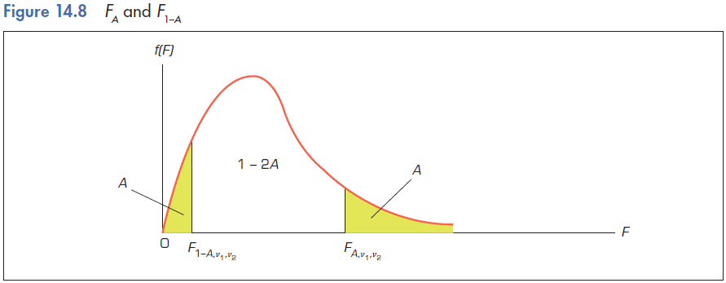
F-distribution…
14.27

Slide 28
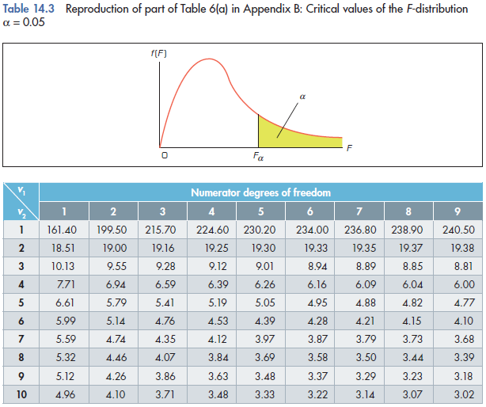
Reading F-values from the F-table
14.28
Example:
F_{0.05, 4, 8} = 3.84
F_{0.05, 8, 4} = 6.04
Note: The table gives only right-tail values.

Slide 29
Reading F-values from the F-table
14.29
F-tables provide only right-tail values. If we need left-tail values, we use the transformation:
For example,

Slide 30
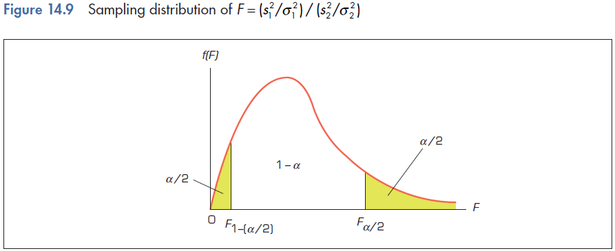
Estimating the ratio of two population variances
14.30
From the following probability statement:
P(F_{1-(α/2)} < F < F _{α/2}) = 1 – α

Slide 31
Estimating the ratio of two population variances
14.31
By substituting the statistic F = [s₁²/σ₁²]/[s₂²/σ₂²] we can isolate σ₁²/σ₂² and build the following interval estimator:
Here we have also used that:

Slide 32
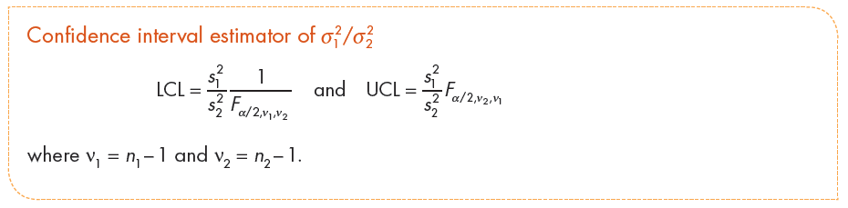
Estimating the ratio of two population variances
14.32

Slide 33
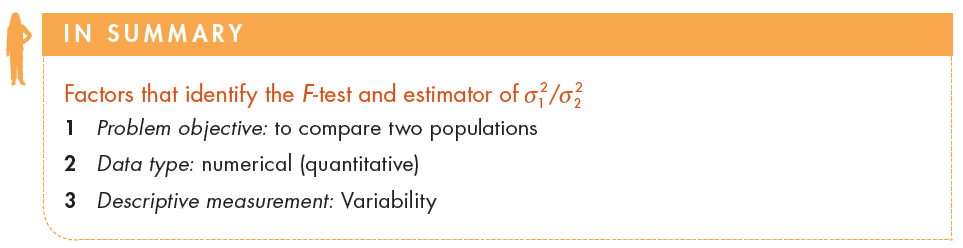
Factors that identify…
14.33

Slide 34
Example 2
14.34
Two independent samples drawn from two normal populations provide the following information:
n₁ = 10 s₁²= 20376.2
n₂ = 20 s₂²= 214004
Determine the 90% confidence interval estimate of the ratio of the two population variances.

Slide 35
Example 2 – Solution
14.35
We find F_{α/2,v1,v2} = F_{0.05,9,19} = 2.42 and F_{α/2,v2,v1} = F_{0.05,19,9} = 2.94
LCL = (s₁²/s₂²)[1/F_{α/2,v1,v2} ]
= (s₁²/s₂²)[1/F_{0.05,9,19} ]
= (20376.2/214004)[1/2.42] = 0.04
UCL = (s₁²/s₂²)[ F_{α/2,v2,v1} ]
= (s₁²/s₂²)[ F_{0.05,19,9} ]
= (20376.2/214004)[2.94] = 0.28
95% confidence interval estimate for σ₁²/σ₂² is [0.04,0.28].

Slide 36
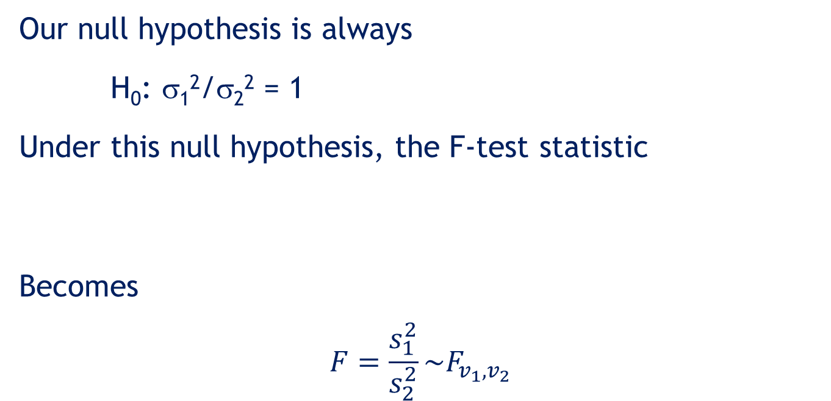
Testing the equality of two population variances
14.36
Our null hypothesis is always
H₀: σ₁²/σ₂² = 1
Under this null hypothesis, the F-test statistic
Becomes
$$F=\frac{s_{1}^{2}}{s_{2}^{2}}\sim F_{v_{1},v_{2}}$$
s1²/σ1²
F =
s2²/σ2²
Where d.f.: v1 = n1-1, v2 = n2-1,

Slide 37
Testing the equality of two population variances…
14.37
In comparing two population variances, we will almost always test the null hypothesis specifying that the population variances are equal, σ₁² = σ₂². That is,
H₀: σ₁²/σ₂² = 1
As was the case in all other tests, we can formulate any of the three possible alternative hypotheses and the corresponding decision rule based on an F-test.
H_{A}: σ₁²/σ₂² ≠ 1, where the rejection region is F > F_{α/2}
or F < F_{1-(α/2)}
2 H_{A}: σ₁²/σ₂² > 1, where the rejection region is F > F_{α}
3 H_{A}: σ₁²/σ₂² < 1, where the rejection region is F < F_{1- α}

Slide 38
Example 3 (Example 14.5, p591)
14.38
XM14-05 In Example 13.2, we applied the unequal-variances t-test of μ₁ – μ₂. We chose that test statistic after calculating the standard deviation of the sample of consumers of high-fibre cereal to be 142.75 and the standard deviation of the sample of non-consumers of high-fibre cereal to be 462.61. The difference between the two sample standard deviations appears to indicate that the population standard deviations (and, of course, variances) differ. We can make this process more formal by conducting an F-test of σ₁²/σ₂².

Slide 39
Example 3 – Solution
14.39
Solving manually
The null and alternative hypotheses: H₀: σ₁²/σ₂² = 1
H_{A}: σ₁²/σ₂² ≠ 1
2. The test statistic under Ho is
3. Level of significance: α = 0.05
Decision rule:
Reject H₀ if
OR if p-value < α = 0.05
Otherwise, do not reject H₀.

Slide 40
Example 3 - Solution…
14.40
Solving manually
5. Value of the test statistic: F = s₁²/s₂² = 0.0952
Conclusion: As F = 0.0952 < 0.272, we reject H_{o} in favour of the alternative (σ₁²/σ₂² ≠ 1).
There is sufficient evidence in the data to conclude at the 5 percent level of significance that the two variances differ.

Slide 41
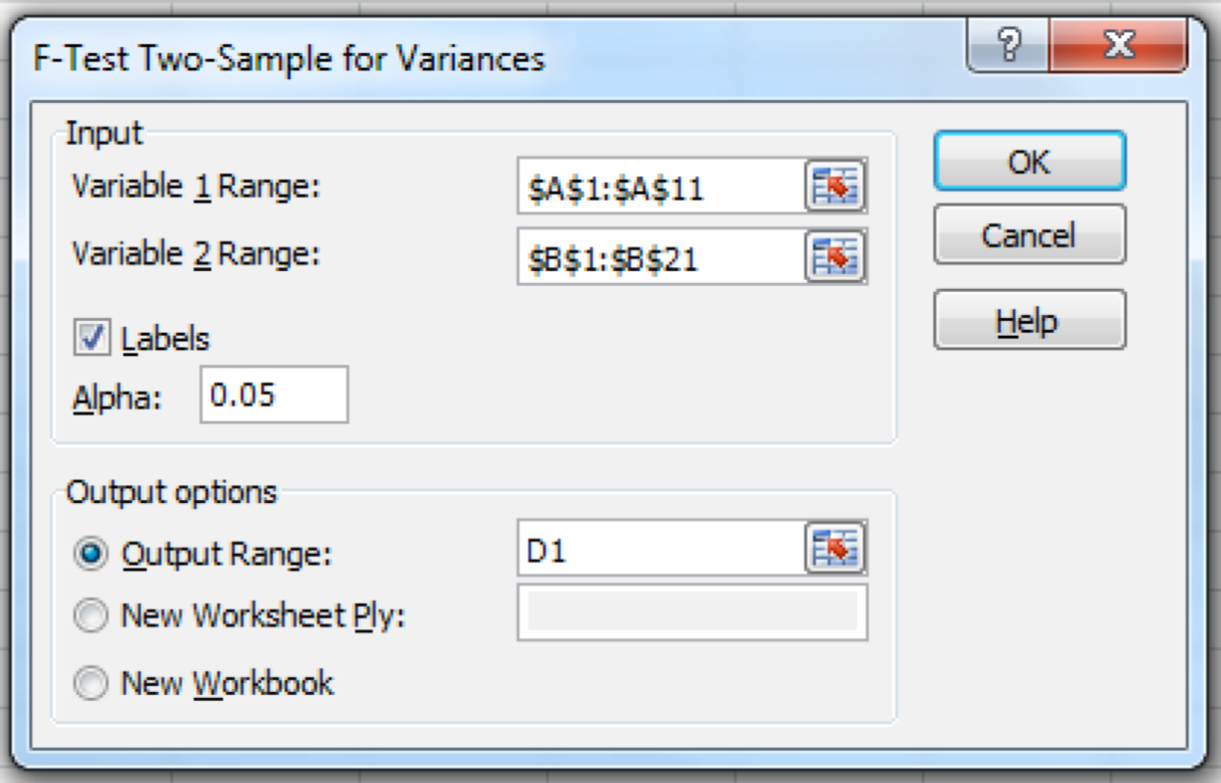
Example 3 - Solution…
14.41
Using Excel (Data Analysis)
In the F-Test Two Sample for Variances dialogue box (shown below), in Data Analysis, enter the input and the output is presented in the next slide.

Slide 42
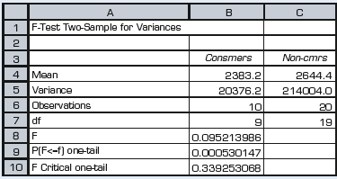
Example 3 - Solution…
14.42
Using Excel (Data Analysis)
The Excel output is presented below.
Conclusion: As p-value = 2× 0.0005 = 0.001 < 0.05 = α, we reject Ho in favour of the alternative (σ1²/σ2² ≠ 1).
There is sufficient evidence in the data to conclude at the 5 percent level of significance that the two variances differ.

Slide 43
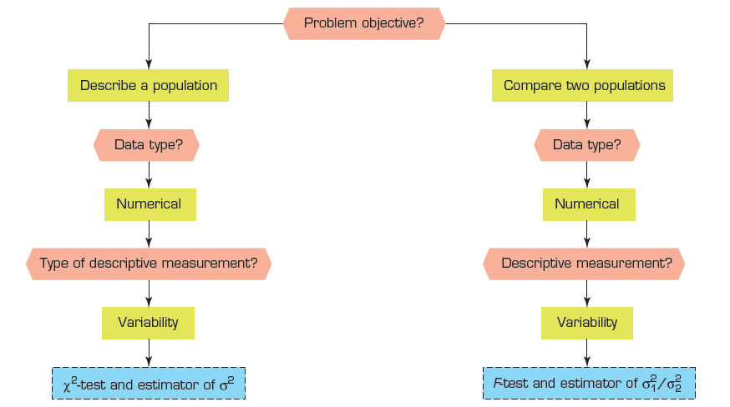
Summary of techniques – Inference about population variances
14.43

