Slide 1


Slide 2
Chapter 15
Analysis of variance

Slide 3
Chapter outline
15.1 Single-factor analysis of variance: Independent samples (one-way ANOVA)
15.2 Multiple comparisons
15.3 Analysis of variance: Experimental designs
15.4 Single-factor analysis of variance: Randomised blocks (two-way ANOVA)
15.5 Two-factor analysis of variance

Slide 4
Learning objectives
LO1 Recognise when the analysis of variance is to be employed
LO2 Interpret the analysis of variance (ANOVA) table
LO3 Recognise when the experiment is completely randomised and when it is a randomised block
LO4 Perform and interpret a single-factor (one-way) analysis of variance for independent samples
LO5 Perform multiple comparisons when the data have been drawn from independent samples (single-factor design)
LO6 Perform and interpret a single-factor (two-way) analysis of variance for randomised blocks
LO7 Perform and interpret a two-factor analysis of variance for randomised blocks.

Slide 5
Introduction
In Chapter 12, we tested hypotheses about the mean of a single population, and in Chapter 13, we tested the equality of means of two populations.
Analysis of variance (ANOVA), presented in this chapter, helps compare two or more population means of numerical data.
Analysis of variance is a procedure that tests to determine whether differences exist between two or more population means.
To do this, the technique analyses the sample variance of the data.

Slide 6
15.1 Single-factor analysis of variance: Independent samples (one-way ANOVA)
Independent samples are drawn from k populations. Each population is called a treatment.
1
2
k
First observation,
first sample
x11
x12
.
.
.
xn₁,1
x21
x22
.
.
.
xn₂,1
xk1
xk2
.
.
.
xn_{k},1
Second observation,
second sample
Sample size
Sample mean
X is the ‘response variable’ and its values are called ‘responses’.

Slide 7
Single-factor analysis of variance: Independent samples (one-way ANOVA)
Terminology
x is the response variable, and its values are responses.
xij refers to the i^{th} observation in the j^{th} sample.
e.g. x35 is the 3rd observation of the 5th sample.
The populations are referred to as treatments.
Population classification criterion is called a factor.
Each population is a factor level.

Slide 8
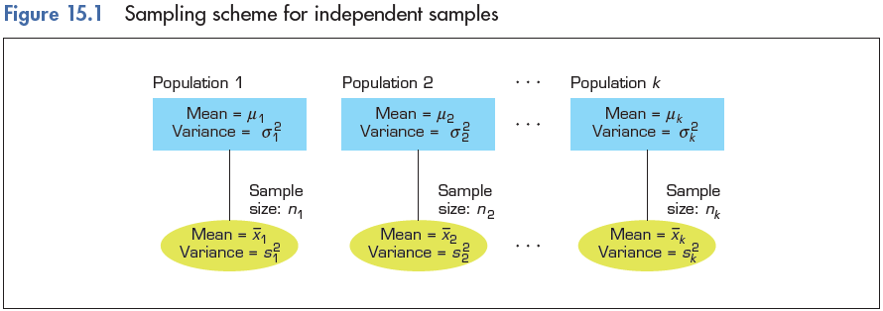
Single-factor analysis of variance: Independent samples (one-way ANOVA)
It is not a requirement that n1 = n2 = … = nk.

Slide 9
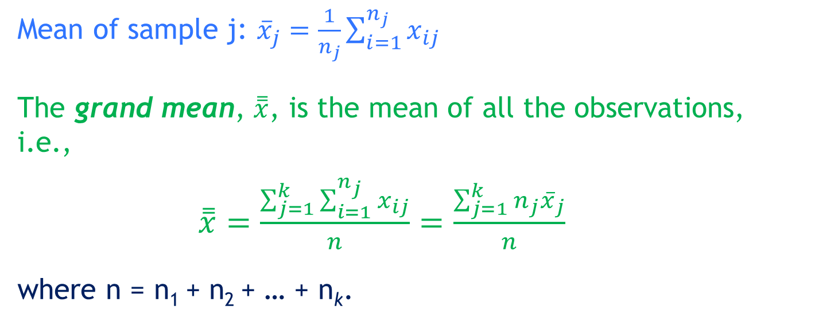
Single-factor analysis of variance: Independent samples (one-way ANOVA)
Mean of sample j: ${\overline{x}}_{j}=\frac{1}{n_{j}}\sum_{i=1}^{n_{j}}{x_{ij}}$
The grand mean, $\overset{̿}{x}$, is the mean of all the observations, i.e.,
$\overset{̿}{x}=\frac{\sum_{j=1}^{k}{\sum_{i=1}^{n_{j}}{x_{ij}}}}{n}=\frac{\sum_{j=1}^{k}{n_{j}{\overline{x}}_{j}}}{n}$
where n = n1 + n2 + … + nk.

Slide 10
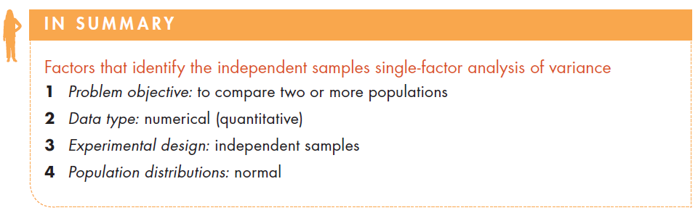
Factors that identify…

Slide 11
Example 1 (Example 15.1, p602)
An apple juice manufacturer is planning to develop a new product, a liquid concentrate. The marketing manager has to decide how to market the new product. Three strategies are considered:
emphasise convenience of using the product
emphasise quality of the product
emphasise product’s low price.

Slide 12
Example 1…
An experiment was conducted as follows:
In three cities an advertising campaign was launched.
In each city only one of the three characteristics (convenience, quality, and price) was emphasised.
The weekly sales were recorded for twenty weeks following the beginning of the campaigns.

Slide 13
Example 1 – Solution
IDENTIFY
The data are numerical.
Our problem objective is to compare sales in three cities.
We hypothesise on the relationships between the three mean weekly sales:
H0: µ1 = µ2= µ3
HA: At least two means differ.
To perform the analysis of variance we need to build an F-statistic.

Slide 14
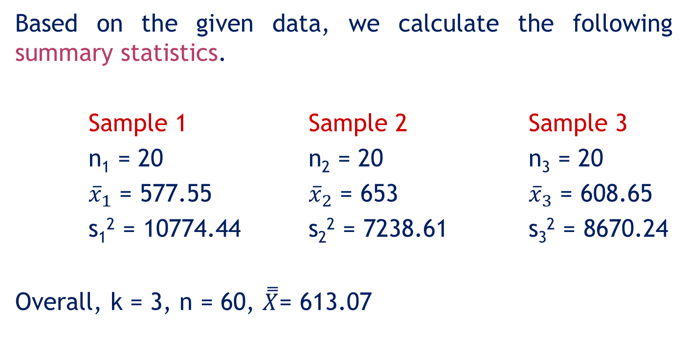
Example 1 – Solution…
IDENTIFY
Based on the given data, we calculate the following summary statistics.
Sample 1 Sample 2 Sample 3
n1 = 20 n2 = 20 n3 = 20
${\overline{x}}_{1}$ = 577.55 ${\overline{x}}_{2}$ = 653 ${\overline{x}}_{3}$ = 608.65
s1² = 10774.44 s2² = 7238.61 s3² = 8670.24
Overall, k = 3, n = 60, $\overset{̿}{X}$= 613.07

Slide 15
Example 1 – Solution…
IDENTIFY
In the context of Example 1:
Response variable – weekly sales
Responses – actual sale values
Experimental unit – weeks in the three cities when we record sales figures.
Factor – the criterion by which we classify the populations (the treatments). In this problems the factor is the marketing strategy.
Factor levels – the population (treatment) names. In this example, factor levels are the three marketing strategies, namely convenience, quality and price.

Slide 16
The rationale behind the test statistic
IDENTIFY
Two types of variability are employed when testing for the equality of the population means.

Slide 17
15.17
Graphical demonstration:
Employing two types of variability

Slide 18
30
25
20
20
19
16
15
14
12
11
10
9
10
9
7
A small variability within
the samples makes it easier
to draw a conclusion about the
population means.
The sample means are the same as
before, but the larger within-sample
variability makes it harder to draw a
conclusion about the population means.
1
Treatment 1
Treatment 2
Treatment 3
Treatment 1
Treatment 2
Treatment 3

Slide 19
The rationale behind the test statistic…
IDENTIFY
If the null hypothesis is true (that is, μ₁ = μ₂ = μ₃), we would expect all the sample means to be close to one another (and as a result, close to the grand mean).
If the alternative hypothesis is true, at least some of the sample means would differ.
To measure the proximity of the sample means to each other, we could use the statistic called ‘sum of squares for treatments (SST)’, which measures the variability between sample means.

Slide 20
Variability between sample means
IDENTIFY
Variability between the sample means is measured as the sum of squared distances between each mean and the grand mean.
This sum is called the
Sum of Squares for Treatments
SST
In our example, treatments are represented by the different advertising strategies.

Slide 21
Sum of squares for treatments (SST)
IDENTIFY
there are k treatments
Grand mean
the size of sample j
the mean of sample j
Note: When the sample means are close to one another, their distance from the grand mean is small, leading to a small SST, which supports H0. Thus, large SST indicates large variation between sample means, which supports HA. The question is: how large is “large enough”?

Slide 22
Example 1 – Solution…
COMPUTE
Calculate Sum of Squares for Treatments (SST )
The grand mean is calculated as
= 20(577.55 – 613.07⁾² +
+ 20(653.00 – 613.07)² +
+ 20(608.65 – 613.07)² =
= 57 512.23

Slide 23
Example 1 – Solution…
COMPUTE
Is SST = 57,512.23 large enough to reject H₀ in favour of H_{A}?
See next slide.

Slide 24
The rationale behind the test statistic…
Large variability within the samples weakens the ‘ability’ of the sample means to represent their corresponding population means.
Therefore, even though sample means may markedly differ from one another, SST must be judged relative to the ‘within-sample variability’.

Slide 25
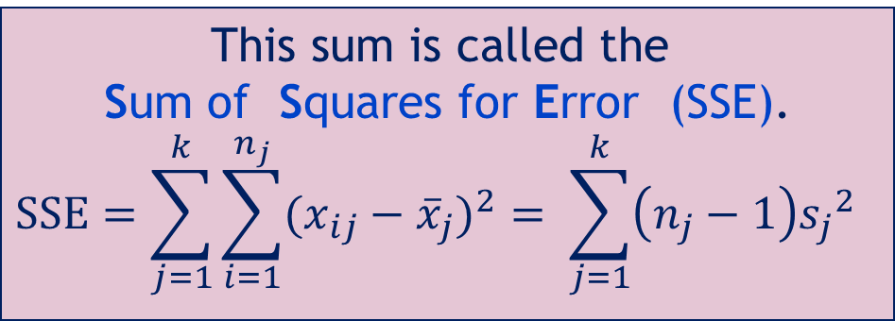
Within-samples variability
COMPUTE
The variability within samples is measured by adding all the squared distances between observations and their sample means.
This sum is called the
Sum of Squares for Error (SSE).
$$SSE=\sum_{j=1}^{k}{\sum_{i=1}^{n_{j}}{{(x_{ij}−{\overline{x}}_{j})}^{2}}}= \sum_{j=1}^{k}{\left(n_{j}−1\right){s_{j}}^{2}}$$
In our example, this is the sum of all squared differences between sales in city j and the sample mean of city j (over all three cities).

Slide 26
Example 1 – Solution…
COMPUTE
Calculate SSE
= (n1 – 1)s1² + (n2 – 1)s2² + (n3 –1)s3²
= (20 – 1)10774.44 + (20 – 1)7238.61 + (20 – 1)8670.24
= 506983.50

Slide 27
Example 1 – Solution…
COMPUTE
Is SST = 57512.23 large enough relative to SSE = 506983.50 to reject the null hypothesis that specifies that all the means are equal?

Slide 28
Example 1 – Solution…
COMPUTE
Calculate Mean Sum of Squares
To perform the test we need to calculate the mean squares as follows:
Calculation of MST
Mean Square for Treatments
Calculation of MSE
Mean Square for Error

Slide 29
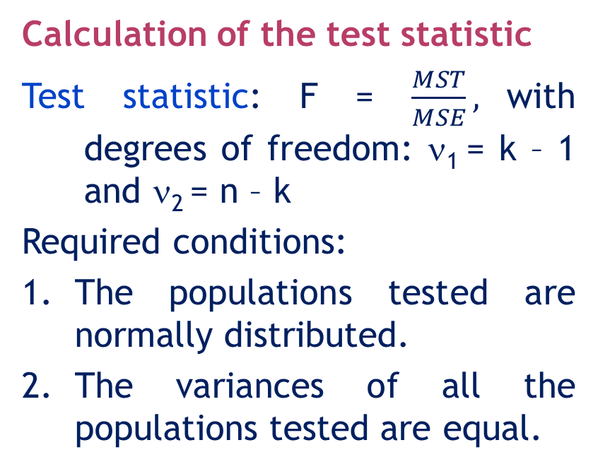
15.29
Example 1 – Solution…
COMPUTE
Calculation of the test statistic
Test statistic: F = $\frac{MST}{MSE},$with degrees of freedom: ν1 = k – 1 and ν2 = n – k
Required conditions:
1. The populations tested are normally distributed.
2. The variances of all the populations tested are equal.

Slide 30
15.30
Example 1 – Solution…
COMPUTE
The F-test rejection region:
And finally, the hypothesis test:
Hypotheses:
H0: μ1 = μ2 = …=μk
HA: At least two means differ
Test statistic:
Decision rule: Reject H0 if F > Fα,k-1,n-k or reject H0 if p-value < α.

Slide 31
15.31
Example 1 – Solution…
COMPUTE
The F-test:
Ho: µ 1 = µ 2= µ 3
HA: At least two means differ
Test statistic: F= MST/ MSE ~ Fk-1,n-k
Decision rule:
Reject H0 if F > Fα,k-1,n-k = F0.05,3-1,60-3 ≈ 3.15
Value of the test statistic: F = MST/ MSE= 3.23
Conclusion: Since 3.23 > 3.15, there is sufficient evidence to reject Ho in favour of HA and argue that at least one of the mean sales is different than the others.

Slide 32
Example 1 – Solution…
IDENTIFY
Since the purpose of calculating the F-statistic is to determine whether the value of SST is large enough to reject the null hypothesis, if SST is large, F will be large.
Note:
Alternative method:
p-value = P(F > F_{calculated})
Decision rule: Reject H_{o} if p-value < α

Slide 33
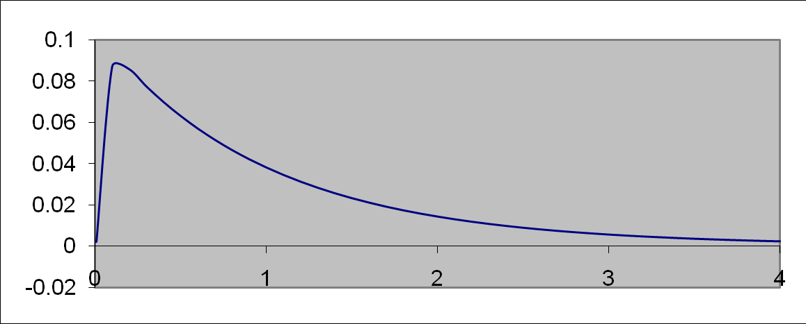
Example 1 – Solution…
COMPUTE
The F-test p-value
Use Excel to find the p-value
f_{x} Statistical FDIST(3.23, 2, 57) = 0.0467
p-value = P(F > 3.23) = 0.0467
3.23

Slide 34
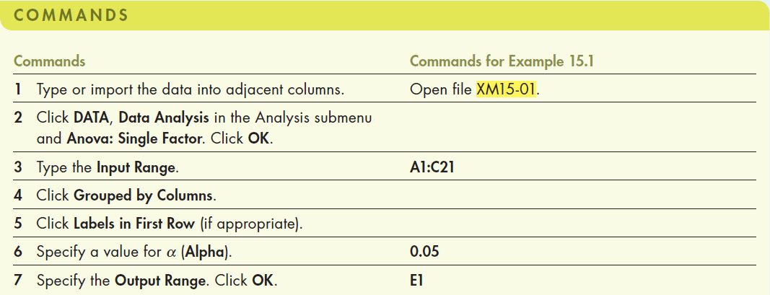
Example 1 – Solution…
COMPUTE
Using Excel (Data Analysis)

Slide 35
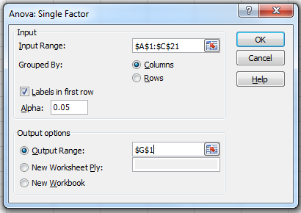
Example 1 – Solution…
COMPUTE
Using Excel (Data Analysis)…
In the Data Analysis dialogue box (shown below), enter the input and the output is presented in the next slide.

Slide 36
Example 1 – Solution…
15.36
Single Factor ANOVA
SST
SSE
SS(Total) = SST + SSE
SS(Total)

Slide 37
Example 1 – Solution…
INTERPRET
Since the p-value = 0.0468 < 0.05 = α, which is small, we reject the null hypothesis (H₀:µ₁ = µ₂ = µ₃ = µ₄) in favour of the alternative hypothesis (H_{A}: at least two population means differ).
That is: there is enough evidence to infer that the mean sales in at least in two of the three cities [based on convenience (City 1), quality (City 2) and price (City 3)] are different.

Slide 38
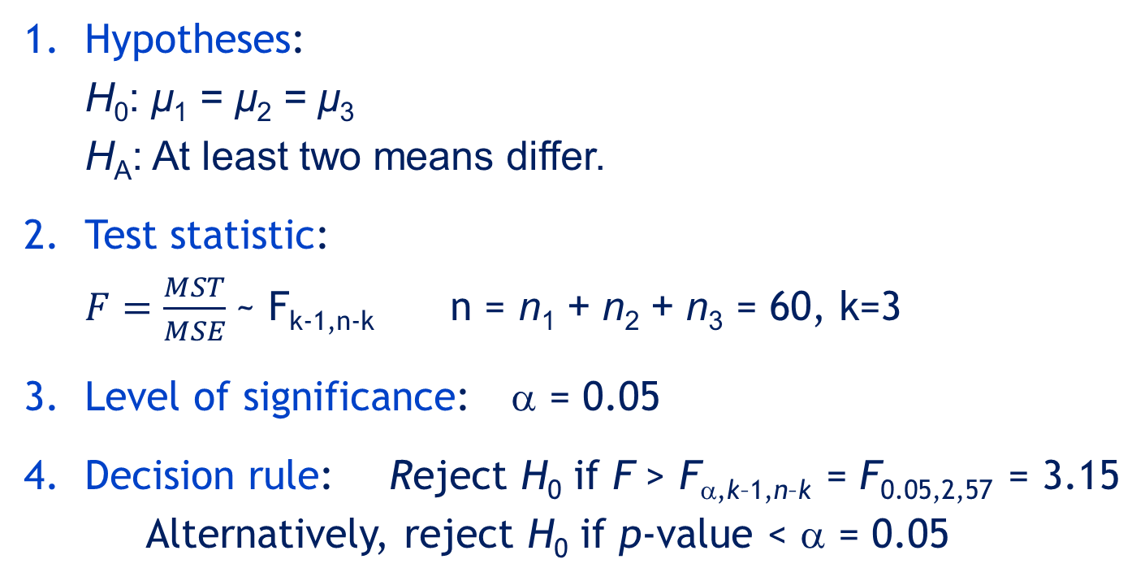
Example 1 – Solution… Summary
IDENTIFY
Hypotheses:
H₀: μ₁ = μ₂ = μ₃
H_{A}: At least two means differ.
Test statistic:
$F=\frac{MST}{MSE}$~ F_{k-1,n-k} n = n₁ + n₂ + n₃ = 60, k=3
Level of significance: α = 0.05
Decision rule: Reject H₀ if F > F_{α,k–1,n–k} = F_{0.05,2,57} = 3.15
Alternatively, reject H₀ if p-value < α = 0.05

Slide 39
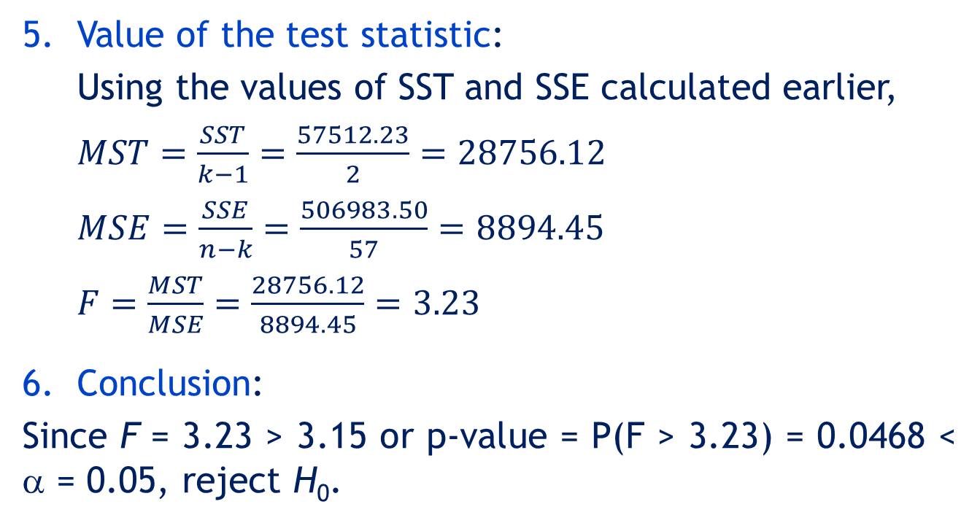
Example 1 – Solution… Summary
CALCULATE
Value of the test statistic:
Using the values of SST and SSE calculated earlier,
$MST=\frac{SST}{k−1}=\frac{57512.23}{2}=28756.12$
$MSE=\frac{SSE}{n−k}=\frac{506983.50}{57}=8894.45$
$F=\frac{MST}{MSE}=\frac{28756.12}{8894.45}=3.23$
Conclusion:
Since F = 3.23 > 3.15 or p-value = P(F > 3.23) = 0.0468 < α = 0.05, reject H₀.

Slide 40
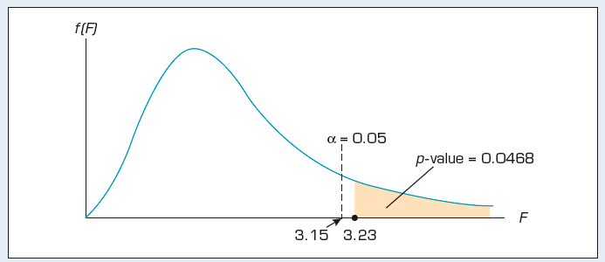
Example 1 – Solution… Summary
INTERPRET
Thus, we conclude that there is enough evidence to infer that the mean weekly sales differ for the three cities.
The figure below depicts the sampling distribution of this test.

Slide 41
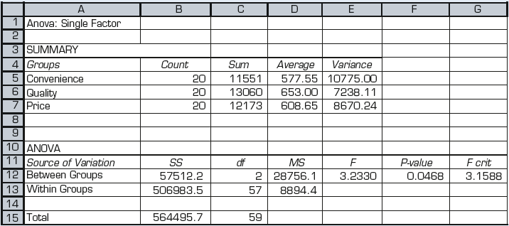
Example 1 – Solution…
Using Excel (Data Analysis): Output

Slide 42
Example 1 – Solution…
INTERPRET
Interpreting the results
The p-value is 0.0468, which means there is evidence to infer that mean weekly sales of the apple juice concentrate are different between at least two of the cities at the 5% level of significance.
Can we conclude that the effects of the advertising approaches differ?
In this example, the marketing manager randomly assigned an advertising approach to each city. Thus, the data are experimental. As a result, we are quite confident that the approach used to advertise the product will produce different sales figures.

Slide 43
Example 1 – Solution…
Checking the required conditions
The F-test requires that the populations are normally distributed with equal variance.
The equality of variances is examined by printing the sample standard deviations or variances. The similarity of sample variances allows us to assume that the population variances are equal.
From the Excel printout we compare the sample variances: 10775, 7238, 8670. It seems the variances are equal.
To check the normality observe the histogram of each sample (see next slide).

Slide 44
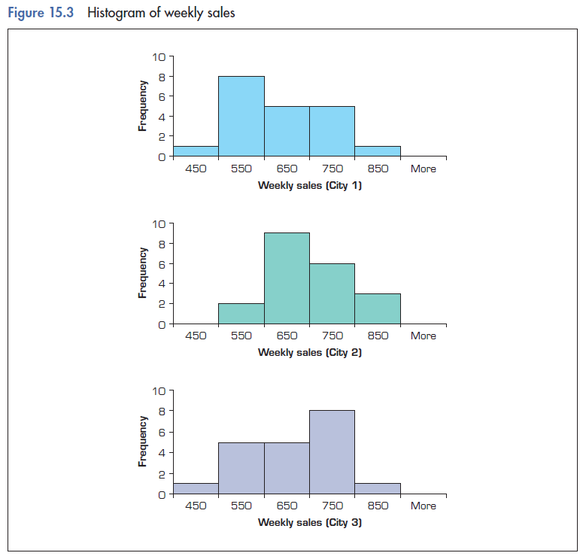
Example 1 – Solution…
Checking the required conditions…
All three distributions appear to be normal

Slide 45
Violation of the required conditions
If the data are not normally distributed we can replace the one-way analysis of variance with its nonparametric counterpart, which is the Kruskal-Wallis test (See Section 20.3).
If the population variances are unequal, we can use several methods to correct the problem.
However, these corrective measures are beyond the level of this book.

Slide 46
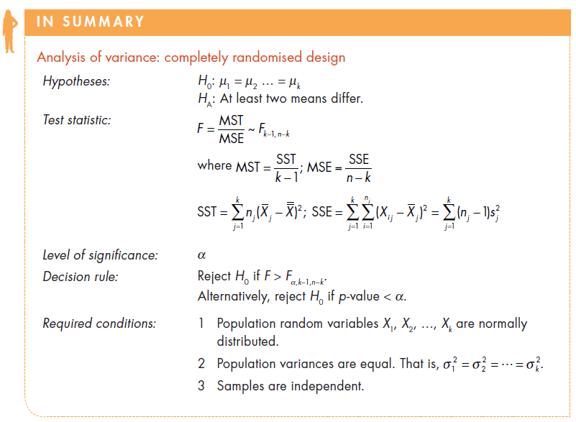
ANOVA table

Slide 47
ANOVA table
The results of analysis of variance are usually reported in an ANOVA table…
Source of variation | Degrees of freedom | Sum of squares | Mean square
Treatments | k–1 | SST | MST=SST/(k–1)
Error | n–k | SSE | MSE=SSE/(n–k)
Total | n–1 | SS(Total)
F-stat=MST/MSE

Slide 48
ANOVA and t-tests of two means
Why do we need the analysis of variance? Why not test every pair of means?
For example, say k = 6. There are C₂⁶ = 6(5)/2= 14 different pairs of means.
1&2 1&3 1&4 1&5 1&6
2&3 2&4 2&5 2&6
3&4 3&5 3&6
4&5 4&6
5&6
If we test each pair with α = 0.05, we increase the probability of making a Type I error. If there are no differences, then the probability of making at least one Type I error is 1 – (0.95)¹⁴ = 1 – 0.463 = 0.537

Slide 49
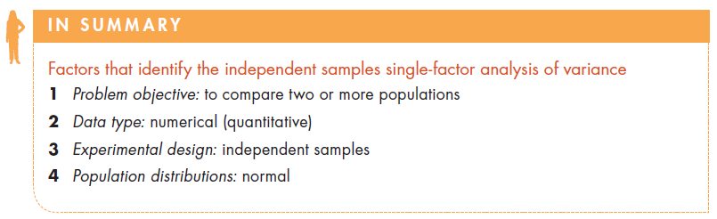
Identifying factors

Slide 50
15.2 Multiple comparisons
When we conclude from the one-way analysis of variance that at least two treatment means differ (i.e. we reject the null hypothesis that H₀: μ₁ = μ₂ = … = μ_{k}), we often need to know which treatment means are responsible for these differences.
We will examine three statistical inference procedures that allow us to determine which population means differ:
• Fisher’s least significant difference (LSD) method
• Bonferroni adjustment
• Tukey’s multiple comparison method.

Slide 51
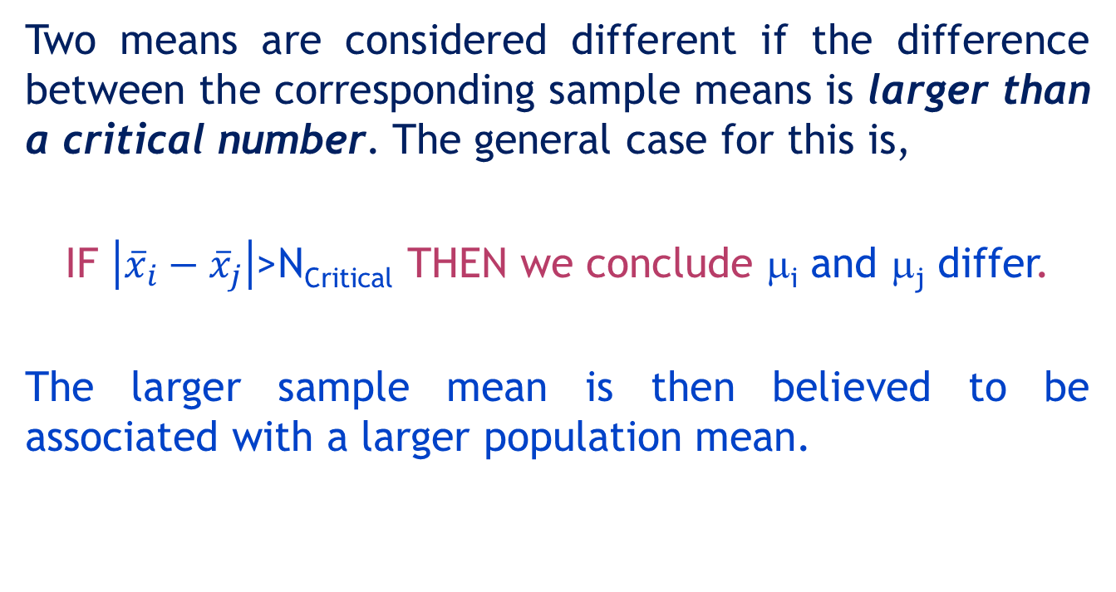
Multiple comparisons
Two means are considered different if the difference between the corresponding sample means is larger than a critical number. The general case for this is,
IF $\left|{\overline{x}}_{i}−{\overline{x}}_{j}\right|$>N_{Critical} THEN we conclude μ_{i} and μ_{j} differ.
The larger sample mean is then believed to be associated with a larger population mean.

Slide 52
Fisher’s Least Significant Difference
What is this critical number, N_{Critical}? Recall that in Chapter 11 we had the confidence interval estimator of µ₁-µ₂
If the interval excludes 0 we can conclude that the population means differ. So another way to conduct a two-tail test is to determine whether
is greater than

Slide 53
Fisher’s Least Significant Difference
However, we have a better estimator of the pooled variances. It is MSE. We substitute MSE in place of S_{p}². Thus we compare the difference between means to the Least Significant Difference LSD, given by:
LSD will be the same for all pairs of means if all k sample sizes are equal. If some sample sizes differ, LSD must be calculated for each combination.

Slide 54
Example 2 (Example 15.3, page 624)
XM15-03 Automobile manufacturers have become more concerned with quality because of foreign competition.
One aspect of quality is the cost of repairing damage caused by accidents. A manufacturer is considering several new types of bumpers.
To test how well they react to low-speed collisions, 10 bumpers of each of four different types were installed on mid-size cars, which were then driven into a wall at 8 kilometres per hour.

Slide 55
Example 2…
The cost of repairing the damage in each case was assessed.
a Is there sufficient evidence to infer that the bumpers differ in their reactions to low-speed collisions?
b If differences exist, which bumpers differ?

Slide 56
Example 2 – Solution (LSD method)
The problem objective is to compare four populations, the data are interval, and the samples are independent. The correct statistical method is the one-way analysis of variance.
F = 4.06, p-value = 0.0139. There is enough evidence to infer that a difference exists between the four bumpers. The question is now, which bumpers differ?

Slide 57
Example 2 – Solution… (LSD method)
The sample means are
and MSE = 12,399. Thus

Slide 58
Example 2 – Solution… (LSD method)
We calculate the absolute value of the differences between means and compare them to LSD = 101.09.
Hence, µ₁ and µ₂, µ₁ and µ₃, µ₂ and µ₄, and µ₃ and µ₄ differ.
The other two pairs µ₁ and µ₄, and µ₂ and µ₃ do not differ.

Slide 59
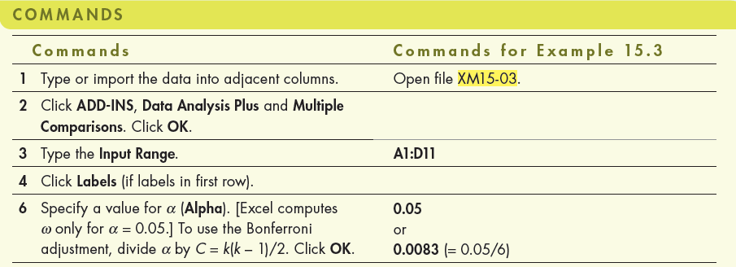
Example 2 – Solution… (LSD method)
Using Excel

Slide 60
Example 2 – Solution… (LSD method)
Using Excel (Data Analysis Plus)
In the Data Analysis Plus dialogue box (shown below), enter the input and the output is presented in the next slide.

Slide 61
Example 2 – Solution… (LSD method)
Using Excel (Data Analysis Plus)
Hence, µ₁ and µ₂, µ₁ and µ₃, µ₂ and µ₄, and µ₃ and µ₄ differ. The other two pairs µ₁ and µ₄, and µ₂ and µ₃ do not differ.

Slide 62
Bonferroni Adjustment to LSD Method
Fisher’s method may result in an increased probability of committing a Type I error.
We can adjust Fisher’s LSD calculation by using the “Bonferroni adjustment”.
Where we used alpha (α), say 0.05, previously, we now use and adjusted value for alpha:
where C=k(k-1)/2.

Slide 63
Example 2 – Solution… (Bonferroni adjustment to LSD)
If we perform the LSD procedure with the Bonferroni adjustment the number of pairwise comparisons is 6 (calculated as C = k(k − 1)/2 = 4(3)/2).
We set α = 0.05/6 = 0.0083. Thus, t_{α/2,36} = 2.794 (available from Excel and difficult to approximate manually) and
.

Slide 64
Example 2 – Solution… (Bonferroni adjustment to LSD)
Using Excel
Click Add-Ins > Data Analysis Plus > Multiple Comparisons

Slide 65
Example 2 – Solution… (Bonferroni adjustment to LSD)
Using Excel
Now, none of the six pairs of means differ.

Slide 66


Tukey’s multiple comparison method
As before, we are looking for a critical number to compare the differences of the sample means against. In this case:
Critical value of the Studentized range
with n–k degrees of freedom
Table 7 - Appendix B
harmonic mean of the sample sizes

Slide 67
Example 2 – Solution… (Tukey’s Multiple Comparison)
k = number of treatments
n = Number of observations ( n = n₁+ n₂ + . . . + n_{k} )
ν = Degrees of freedom associated with MSE
n_{g} = Number of observations in each of k samples
α = Significance level
q_{α}(k,ν) = Critical value of the Studentized range

Slide 68
Example 2 – Solution… (Tukey’s Multiple Comparison)
k = 4
n₁ = n₂ = n₃ = n₄ = n_{g} = 10
Ν = 40 – 4 = 36
MSE = 12,399
q_{0.05}(4,37) ≈ q_{0.05}(4,40) = 3.79
Thus,

Slide 69
Example 2 – Solution… (Tukey’s Multiple Comparison)
Using Tukey’s method µ₂ and µ₄, and µ₃ and µ₄ differ.

Slide 70
Which method to use?
If you have identified two or three pairwise comparisons that you wish to make before conducting the analysis of variance, use the Bonferroni method.
If you plan to compare all possible combinations, use Tukey’s comparison method.

Slide 71
15.3 Analysis of variance: Experimental designs
Several elements may distinguish between one experimental design and others.
The number of factors
Each characteristic investigated is called a factor.
Each factor has several levels.
Independent samples or blocks
Groups of matched observations are formed into blocks in order to remove the effects of ‘noise’ variability.
By doing so we improve the chances of detecting the variability of interest.

Slide 72
Analysis of variance: Experimental designs…
Experimental design determines which analysis of variance technique we use.
In the previous example, we compared three populations on the basis of one factor – advertising strategy.
One-way analysis of variance is only one of many different experimental designs of the analysis of variance.

Slide 73
Analysis of variance: Experimental designs…
A multifactor experiment is one where there are two or more factors that define the treatments.
For example, if instead of just varying the advertising strategy for our new apple juice product we also varied the advertising medium (e.g. television or newspaper), then we have a two-factor analysis of variance situation.
The first factor, advertising strategy, still has three levels (convenience, quality and price) while the second factor, advertising medium, has two levels (TV or print).

Slide 74
One-way ANOVA
Response
Two-way ANOVA
Response
Treatment 3
Treatment 2
Treatment 1
Level 3
Level 2
Level 1
Factor A
Level 2
Level 1
Factor B

Slide 75
Independent samples and blocks
Similar to the ‘matched pairs experiment’, a randomised block design experiment reduces the variation within the samples, making it easier to detect differences between populations.
The term block refers to a matched group of observations from each population.
We can also perform a blocked experiment by using the same subject for each treatment in a ‘repeated measures’ experiment.

Slide 76
Models of fixed and random effects
Fixed effects
If all possible levels of a factor are included in our analysis we have a fixed-effect ANOVA.
The conclusion of a fixed-effect ANOVA applies only to the levels studied.
Random effects
If the levels included in our analysis represent a random sample of all the possible levels, we have a random-effect ANOVA.
The conclusion of the random-effect ANOVA applies to all the levels (not only those studied).

Slide 77
Models of fixed and random effects…
In some ANOVA models, the test statistic of the fixed-effects case may differ from the test statistic of the random-effect case.
Fixed and random effects – examples
Fixed effects
The advertisement (Example 15.1): All levels of the marketing strategies were included.
Random effects
To determine if there is a difference in the production rate of 50 machines, four machines are randomly selected and their production recorded.

Slide 78
Independent samples and blocks
The randomised block experiment is also called the two-way analysis of variance, not to be confused with the two-factor analysis of variance.

Slide 79
15.4 Single-factor analysis of variance: Randomised blocks (two-way ANOVA)
The purpose of designing a randomised block experiment is to reduce the within-treatments variation, thus increasing the between-treatments variation.
This helps in detecting differences between the treatment means more easily.

Slide 80
Randomised block analysis of variance
Block all the observations with some commonality across treatments.
Treatment 4
Treatment 3
Treatment 2
Treatment 1
Block 3
Block 2
Block 1

Slide 81
Partitioning the total variability
Under randomised block analysis of variance, the sum of square total is partitioned into three sources of variation:
Treatments, SST
Blocks, SSB
Within samples, SSE (error)
SSB measures the variation between the blocks.
Recall. For the independent samples design we have:
SS(Total) = SST + SSE
SS(Total) = SST + SSB + SSE
Sum of square for treatments
Sum of square for blocks
Sum of square for error

Slide 82
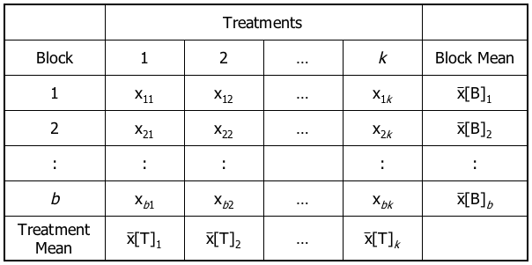
Randomised blocks…
In addition to k treatments, we introduce notation for b blocks in our experimental design.
Mean of the observations of the 1st block
In addition to k treatments, we introduce notation for b blocks in our experimental design…
Mean of the observations of the 2nd treatment

Slide 83
Sums of squares: Randomised block
Calculating the sums of squares:

Slide 84
Calculating the sums of squares
Formula for the calculation of the sums of squares:

Slide 85
Mean squares
15.85
To perform hypothesis tests for treatments and blocks we need:
mean square for treatments
mean square for blocks
mean square for error.

Slide 86
Test statistics for the randomised block design ANOVA
Ho: Treatment means are all equal
HA: At least two treatment means differ
Test statistic for treatments:
Ho: Block means are all equal
HA: At least two block means differ
Test statistic for blocks:
~ Fk-1,n-k–b+1
~ Fb-1,n-k–b+1

Slide 87
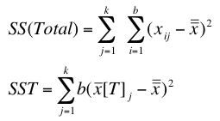
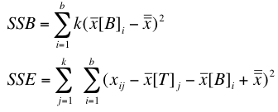
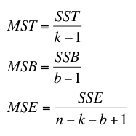
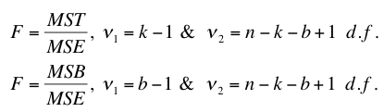
Sum of Squares : Randomized Block…
Squaring the ‘distance’ from the grand mean, leads to the following set of formulae…
test statistic for treatments
test statistic for blocks

Slide 88
ANOVA table…
We can summarise this new information in an analysis of variance (ANOVA) table for the randomised block analysis of variance as follows…
Source of variation | d.f.: | Sum of squares | Mean square | F statistic
Treatments | k–1 | SST | MST=SST/(k–1) | F=MST/MSE
Blocks | b–1 | SSB | MSB=SSB/(b-1) | F=MSB/MSE
Error | n–k–b+1 | SSE | MSE=SSE/(n–k–b+1)
Total | n–1 | SS(Total)

Slide 89
The F-test rejection regions and decision rule
Testing the mean responses for treatments
Reject H₀ if F > F_{α,k-1,n-k-b+1}
Testing the mean response for blocks
Reject H₀ if F > F_{α,b-1,n-k-b+1}

Slide 90
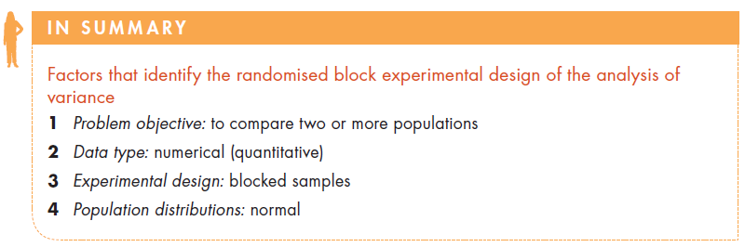
Identifying factors….

Slide 91
Example 3 – Time spent listening to radio by teenagers
A radio station manager wants to know if the amount of time his listeners spent listening to a radio per day is about the same every day of the week. To check this, 200 teenagers were asked to record how long they spend listening to a radio each day of the week.
Can the manager conclude that on certain days the mean listening time is greater than on other days?
Can the manager conclude that differences in listening time exist among the teenagers.

Slide 92
Example 3 – Solution
IDENTIFY
Response variable: The amount of time spent listening to FM radio
The data are numerical
The problem objective is to compare seven populations (Time spent listening to the radio music by all listeners of the FM radio station during each day of the week).
Experimental design: Randomised block design (because listening times for each day of the week for each teenager is recorded)

Slide 93
Example 3 – Solution…
IDENTIFY
5. Each day of the week can be considered a treatment.
6. Each seven data points (per person) can be blocked because they belong to the same person. The blocks are the 200 teenagers.
7. This procedure eliminates the variability in the radio-listening times between teenagers and helps detect differences in the mean times teenagers listen to the radio between the days of the week.

Slide 94
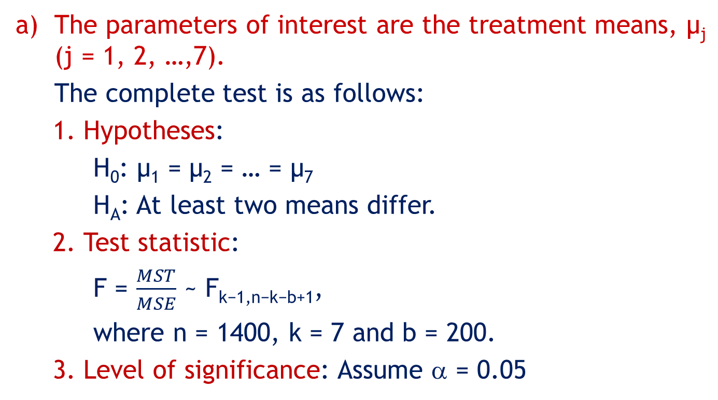
Example 3 – Solution…
The parameters of interest are the treatment means, μ_{j} (j = 1, 2, …,7).
The complete test is as follows:
Hypotheses:
H₀: μ₁ = μ₂ = … = μ₇
H_{A}: At least two means differ.
Test statistic:
F = $\frac{MST}{MSE}$ ~ F_{k−1,n−k−b+1},
where n = 1400, k = 7 and b = 200.
Level of significance: Assume α = 0.05

Slide 95
Example 3 – Solution…
Decision rule: Reject H₀ if F > F_{α,k−1,n−k−b+1} = F_{0.05,6,1194} = 2.10.
Alternatively, reject H₀ if p-value < α = 0.05.
Value of the test statistic:
From the complete output below, F = 11.91, p-value = 0
Conclusion:
Since F = 11.91 > 2.10 (alternatively, as p-value = 0 < α = 0.05), reject H₀.
Therefore, we conclude that there is strong evidence of differences in treatment (day of the week) means.

Slide 96
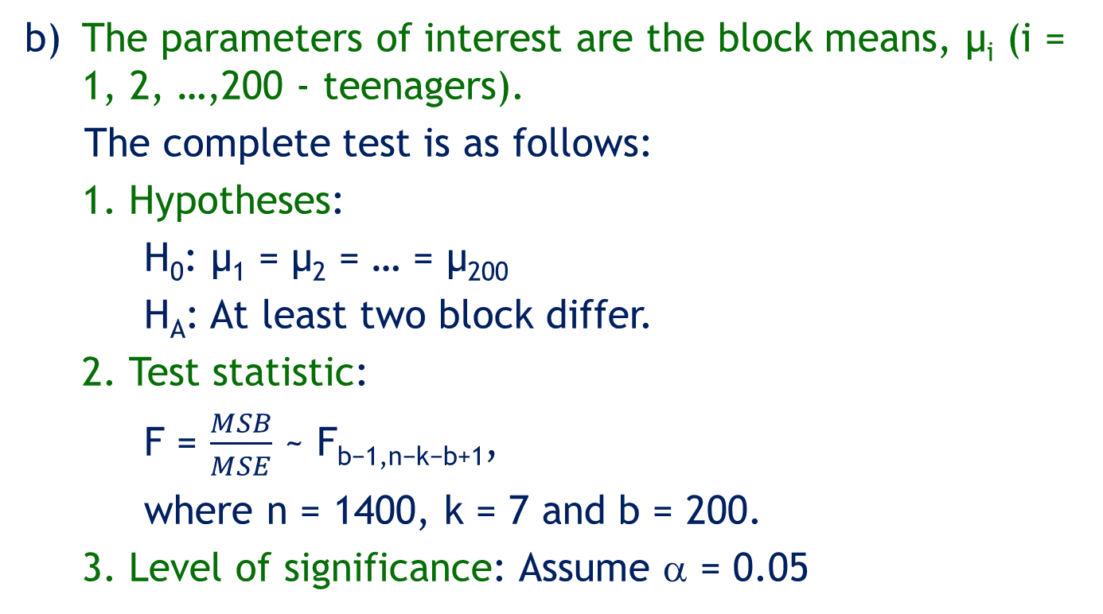
Example 3 – Solution…
b) The parameters of interest are the block means, μ_{i} (i = 1, 2, …,200 - teenagers).
The complete test is as follows:
Hypotheses:
H₀: μ₁ = μ₂ = … = μ₂₀₀
H_{A}: At least two block differ.
Test statistic:
F = $\frac{MSB}{MSE}$ ~ F_{b−1,n−k−b+1},
where n = 1400, k = 7 and b = 200.
Level of significance: Assume α = 0.05

Slide 97
Example 3 – Solution…
Decision rule:
Reject H₀ if F > F_{α,b−1,n−k−b+1} = F_{0.05,199,1194} = 1.19.
Alternatively, reject H₀ if p-value < α = 0.05.
Value of the test statistic:
From the complete output below, F = 2.63
p-value = 0
Conclusion:
Since F = 2.63 > 1.19 (alternatively, as p-value = 0 < α = 0.05), reject H₀.
Therefore, we conclude that there is strong evidence of differences in block (teenagers) means.

Slide 98
Example 3 – Solution…
COMPUTE
Using Excel (Data Analysis)
Click Data, Data Analysis, Anova: Two Factor Without Replication
a.k.a. Randomised Block

Slide 99
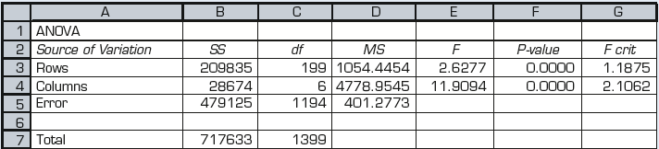
Example 3 – Solution…
COMPUTE
Using Excel (Data Analysis) Output
b – 1
k – 1
MST/MSE
Treatments
Blocks
MSB/MSE
Conclusion: at 5% significance level there is sufficient evidence to reject the null hypothesis, and infer that (a) mean radio time is different in at least one of the week days, and (b) mean listening time differs among the 200 teenagers.

Slide 100
Example 3 – Solution…
INTERPRET
Interpreting the results
There is very strong evidence to infer that on certain days the mean listening time is greater than on other days. An examination of the results reveals that on Fridays and Saturdays, teenagers usually spend more time listening to radio music. The top hits should be played more frequently on those days.
The value of the F-statistic to determine if differences exist among teenagers (rows) is 2.63. Its p-value is 0. This indicates that differences among the teenagers (rows) also exist.

Slide 101
Example 3 – Solution…
Checking the required conditions
The F-test of the randomised block design of the analysis of variance has the same requirements as the independent samples design. That is, the random variable must be normally distributed and the population variances must be equal.
The histograms (see below) appear to support the validity of our results; the reductions appear to be normal.
The equality of variances requirement also appears to be met (see below).

Slide 102
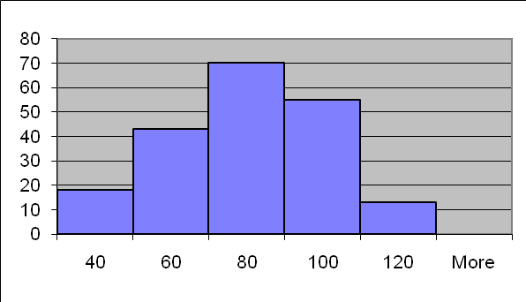
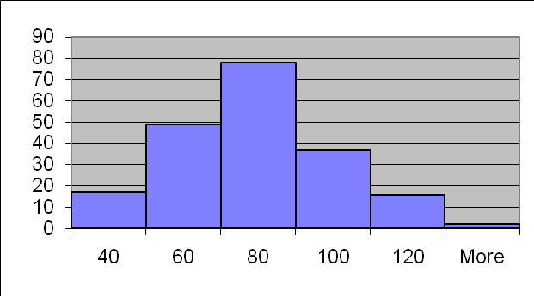
Checking the required conditions
Observing the histograms of the seven populations, we can assume that all the distributions are approximately normally distributed.
Sunday
Monday
The population variances seem to be equal. See the sample variances:

Slide 103
Violation of the required conditions
When the response is not normally distributed, we can replace the randomised block analysis of variance with the Friedman test, which is introduced in Section 20.3.

Slide 104
Developing an understanding of statistical concepts
As we explained previously, the randomised block experiment is an extension of the matched pairs experiment discussed in Section 13.2.
In the matched pairs experiment, we simply remove the effect of the variation caused by differences between the experimental units.
The effect of this removal is seen in the decrease in the value of the standard error (compared to the standard error in the test statistic produced from independent samples) and the increase in the value of the t-statistic.

Slide 105
Developing an understanding of statistical concepts
In the randomised block experiment of the analysis of variance, we actually measure the variation between the blocks by computing SSB.
The sum of squares for error is reduced by SSB, making it easier to detect differences between the treatments.
Additionally, we can test to determine whether the blocks differ – a procedure we were unable to perform in the matched pairs experiment.

Slide 106
Identifying factors

Slide 107
15.5 Two-factor analysis of variance
In Section 15.1, we addressed problems where the data were generated from single-factor experiments.
In Example 1, the treatments were the characteristics categories. Thus, there were three levels of a single factor. In this section, we address the problem where the experiment features two factors.
The general term for such data-gathering procedures is factorial experiment.

Slide 108
Two-factor analysis of variance…
In factorial experiments, we can examine the effect on the response variable of two or more factors, although in this book we address the problem of only two factors.
We can use the analysis of variance to determine whether the levels of each factor are different from one another.

Slide 109
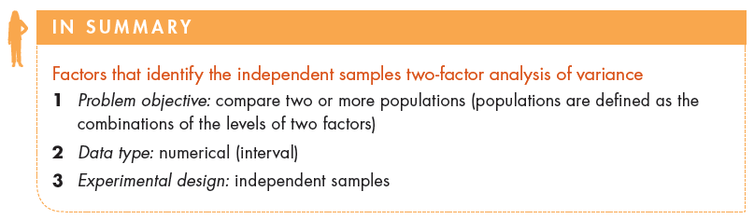
Identifying factors…

Slide 110
Example 4 – Comparing the lifetime number of jobs by educational level
(Example 15.6, p647)
One measure of the health of a nation’s economy is how quickly it creates jobs.
One aspect of this issue is the number of jobs individuals hold.
As part of a study on job tenure, a survey was conducted in which a random sample of 80 people aged between 37 and 45 were asked how many jobs they have held in their lifetimes. Also recorded were gender and educational attainment.

Slide 111
Example 4…
The categories are
Less than high school (E1)
High school (E2)
Some college/university but no degree (E3)
At least one university degree (E4)
The data were recorded for each of the eight categories of gender and education. [XM16-07]
Can we infer that differences exist between genders and educational levels?

Slide 112
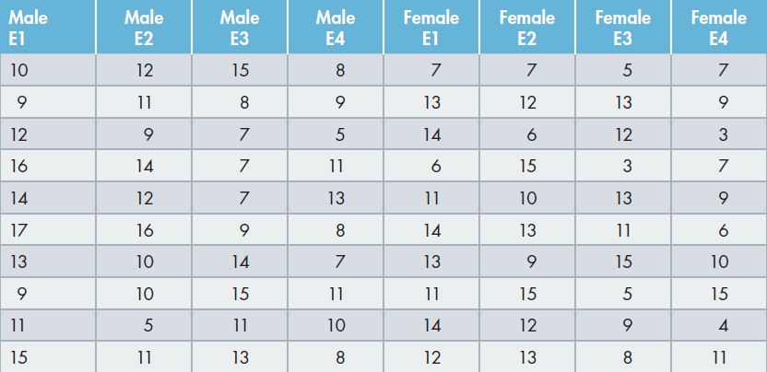
Example 4 – Solution

Slide 113
Example 4 – Solution…
IDENTIFY
We begin by treating this example as a one-way analysis of variance with eight treatments.
However, the treatments are defined by two different factors.
One factor is gender, which has two levels (male, female).
The second factor is educational attainment, which has four levels (E1, E2, E3, E4).

Slide 114
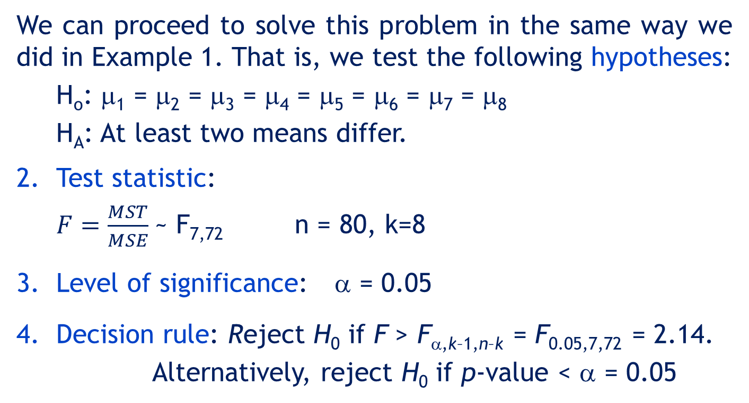
Example 4 – Solution…
IDENTIFY
We can proceed to solve this problem in the same way we did in Example 1. That is, we test the following hypotheses:
H_{o}: μ₁ = μ₂ = μ₃ = μ₄ = μ₅ = μ₆ = μ₇ = μ₈
H_{A}: At least two means differ.
Test statistic:
$F=\frac{MST}{MSE}$~ F_{7,72} n = 80, k=8
Level of significance: α = 0.05
Decision rule: Reject H₀ if F > F_{α,k–1,n–k} = F_{0.05,7,72} = 2.14.
Alternatively, reject H₀ if p-value < α = 0.05

Slide 115
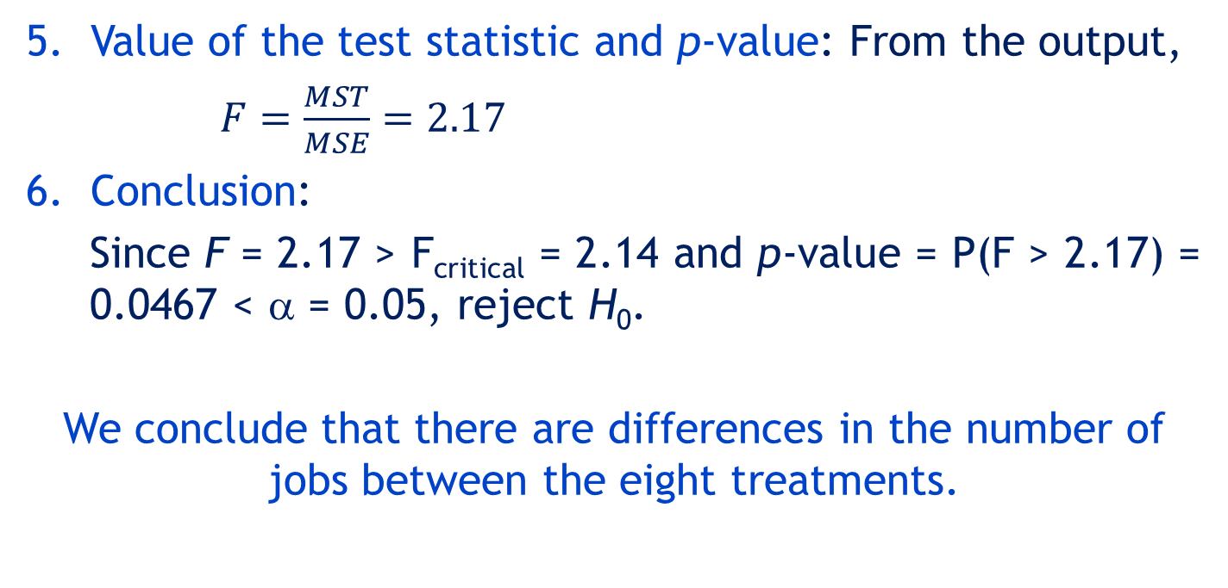
Example 4 – Solution…
COMPUTE
INTERPRET
Value of the test statistic and p-value: From the output,
$F=\frac{MST}{MSE}=2.17$
Conclusion:
Since F = 2.17 > F_{critical} = 2.14 and p-value = P(F > 2.17) = 0.0467 < α = 0.05, reject H₀.
We conclude that there are differences in the number of jobs between the eight treatments.

Slide 116
Example 4 – Solution…
COMPUTE

Slide 117
Example 4 – Solution…
This statistical result raises more questions.
Namely, can we conclude that the differences in the mean number of jobs are caused by differences between males and females?
Or are they caused by differences between educational levels?
Or, perhaps, are there combinations, called interactions of gender and education that result in especially high or low numbers?

Slide 118
Terminology
A complete factorial experiment is an experiment in which the data for all possible combinations of the levels of the factors are gathered. This is also known as a two-way classification.
The two factors are usually labelled A and B, with the number of levels of each factor denoted by a and b respectively.
The number of observations for each combination is called a replicate, and is denoted by r. For our purposes, the number of replicates will be the same for each treatment, that is, they are balanced.

Slide 119
Terminology…
Thus, we use a complete factorial experiment where the number of treatments is ab with r replicates per treatment.
In Example 4, a = 2, b = 4, and r = 10.
As a result, we have 10 observations for each of the eight treatments.

Slide 120
Example 4 – Solution…
If you examine the ANOVA table, you can see that the
Total variation is SS(Total) = 879.55
Sum of squares for treatments is SST = 153.35
Sum of squares for error is SSE = 726.20.
The variation caused by the treatments is measured by SST.
In order to determine whether the differences are due to factor A, factor B, or some interaction between the two factors, we need to partition SST into three sources. These are SS(A), SS(B), and SS(AB).

Slide 121
ANOVA Table
Source of variation | d.f.: | Sum of squares | Mean square | F Statistic
Factor A | a-1 | SS(A) | MS(A)=SS(A)/(a-1) | F=MS(A)/MSE
Factor B | b–1 | SS(B) | MS(B)=SS(B)/(b-1) | F=MS(B)/MSE
Interaction | (a-1)(b-1) | SS(AB) | MS(AB) = SS(AB) [(a-1)(b-1)] | F=MS(AB)/MSE
Error | n–ab | SSE | MSE=SSE/(n–ab)
Total | n–1 | SS(Total)

Slide 122
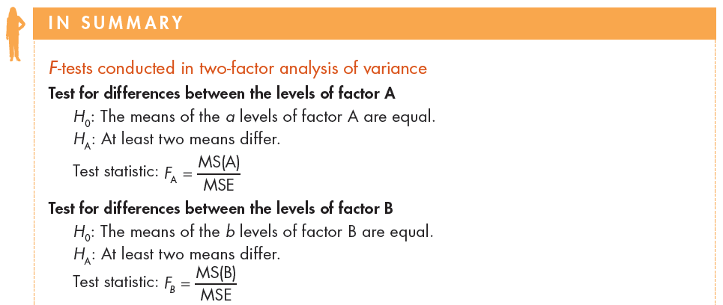
F-test for two factor ANOVA

Slide 123
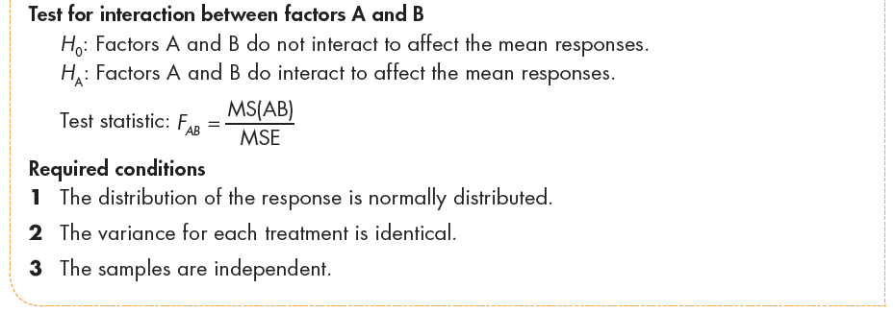
F-test for two factor ANOVA…

Slide 124
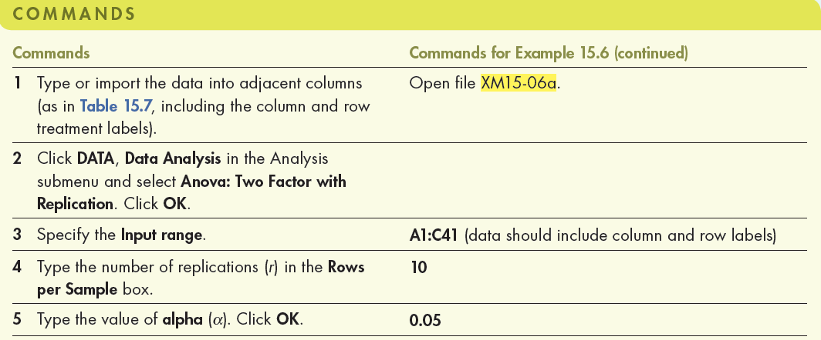
Example 4 - Solution…
Using Excel (Data Analysis)

Slide 125
Example 4 - Solution…
COMPUTE
Using Excel (Data Analysis)
In the Data Analysis dialogue box (shown below), enter the input and the output is presented in the next slide.

Slide 126
Example 4 - Solution…
COMPUTE
Using Excel (Data Analysis)
ANOVA table part of the output

Slide 127
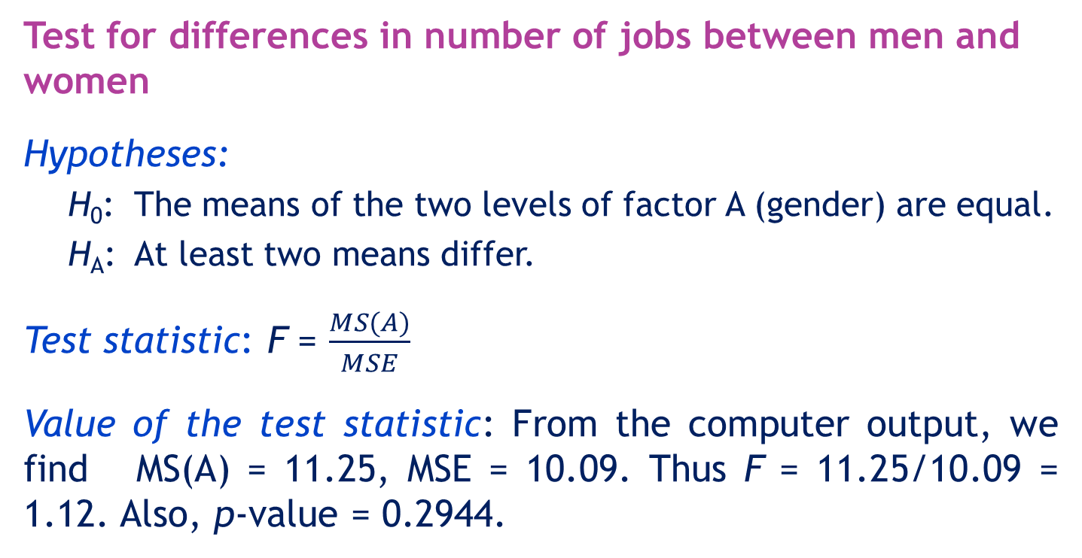
Example 4 - Complete Solution
Test for differences in number of jobs between men and women
Hypotheses:
H₀: The means of the two levels of factor A (gender) are equal.
H_{A}: At least two means differ.
Test statistic: F = $\frac{MS(A)}{MSE}$
Value of the test statistic: From the computer output, we find MS(A) = 11.25, MSE = 10.09. Thus F = 11.25/10.09 = 1.12. Also, p-value = 0.2944.

Slide 128
Example 4 - Complete Solution…
Test for differences in number of jobs between men and women…
Conclusion:
As p-value = 0.2944 > α = 0.05, do not reject H₀.
There is not enough evidence at the 5% significance level to infer that differences in the number of jobs exist between men and women.

Slide 129
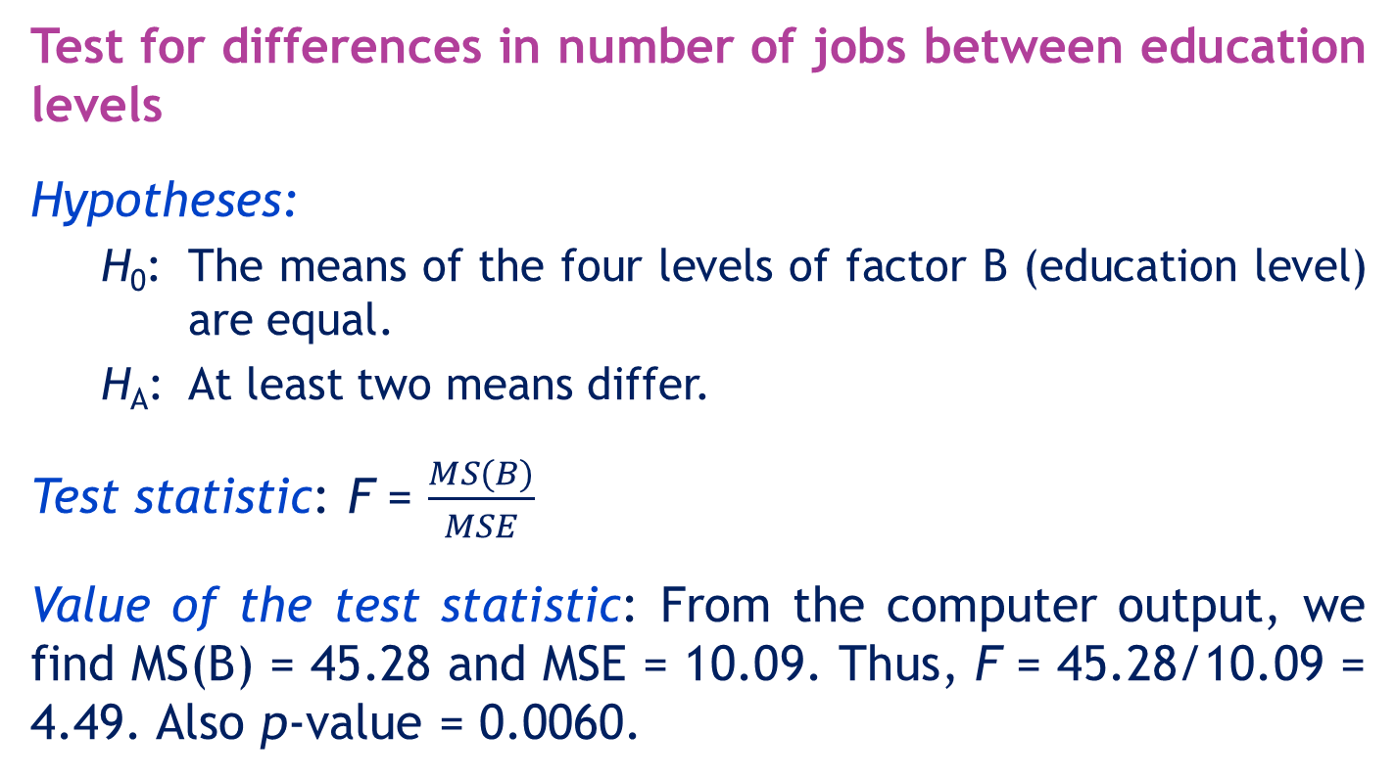
Example 4 - Complete Solution…
Test for differences in number of jobs between education levels
Hypotheses:
H₀: The means of the four levels of factor B (education level) are equal.
H_{A}: At least two means differ.
Test statistic: F = $\frac{MS(B)}{MSE}$
Value of the test statistic: From the computer output, we find MS(B) = 45.28 and MSE = 10.09. Thus, F = 45.28/10.09 = 4.49. Also p-value = 0.0060.

Slide 130
Example 4 - Complete Solution…
Test for differences in number of jobs between education levels …
Conclusion:
As p-value = 0.006 < α = 0.05, reject H₀.
There is sufficient evidence at the 5% significance level to infer that differences in the number of jobs exist between educational levels.

Slide 131
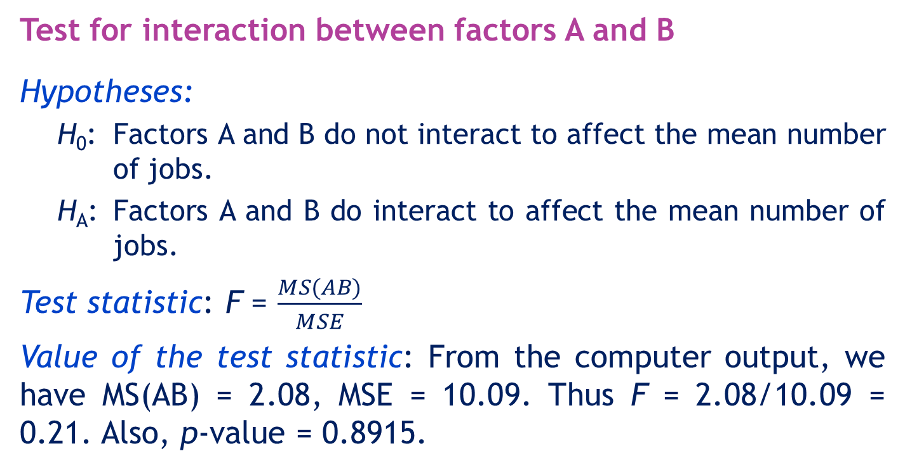
Example 4 - Complete Solution…
Test for interaction between factors A and B
Hypotheses:
H₀: Factors A and B do not interact to affect the mean number of jobs.
H_{A}: Factors A and B do interact to affect the mean number of jobs.
Test statistic: F = $\frac{MS(AB)}{MSE}$
Value of the test statistic: From the computer output, we have MS(AB) = 2.08, MSE = 10.09. Thus F = 2.08/10.09 = 0.21. Also, p-value = 0.8915.

Slide 132
Example 4 Complete Solution…
Test for interaction between factors A and B…
Conclusion:
As p-value = 0.8915 > α = 0.05, do not reject H₀.
There is not enough evidence to conclude that there is interaction between gender and education.

Slide 133
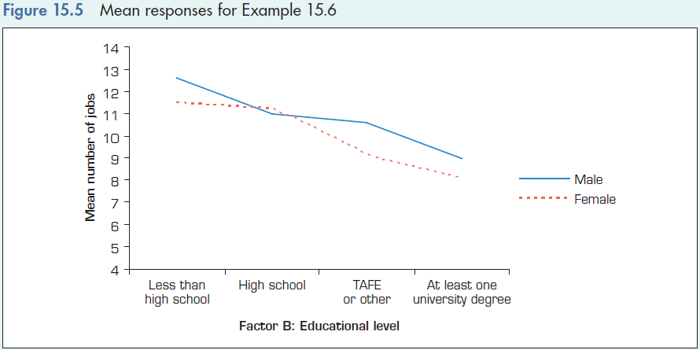
Example 4 - Complete Solution…
INTERPRET
Interpreting the results
Figure 15.5 is a graph of the mean responses for each of the eight treatments. As you can see, there are small (not significant) differences between males and females. There are significant differences between males and females with different educational backgrounds. Finally, there is no interaction.

Slide 134
Example 4 – Solution…
INTERPRET
There are significant differences between the mean number of jobs held by people with different educational backgrounds.
There is no difference between the mean number of jobs held by men and women.
Finally, there is no interaction.

Slide 135
Order of testing in the two-factor analysis of variance
In the two versions of Example 4, we conducted the tests of each factor and then the test for interaction.
However, if there is evidence of interaction, the tests of the factors are irrelevant.
There may or not be differences between the levels of factor A and of the levels of factor B.
Accordingly, we change the order of conducting the F-Tests.

Slide 136
Order of testing in the two-factor analysis of variance…
Test for interaction first.
If there is enough evidence to infer that there is interaction, do not conduct the other tests.
If there is not enough evidence to conclude that there is interaction proceed to conduct the F-tests for factors A and B.

Slide 137

Identifying factors…

Slide 138
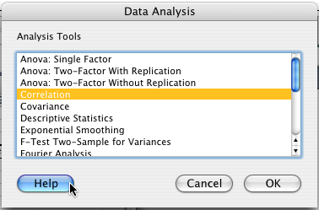
Summary of ANOVA…
Two-factor analysis of variance
One-way analysis of variance
Two-way analysis of variance
a.k.a. randomised blocks

Slide 139
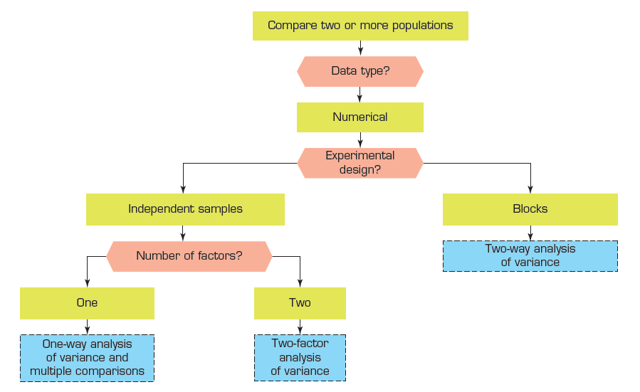
Summary of techniques – Comparing two or more populations - ANOVA

