Slide 1


Slide 2
Chapter 16
Additional tests for nominal data: Chi-squared tests

Slide 3
Chapter outline
16.1 Chi-squared test of a multinomial experiment
16.2 Chi-squared test of a contingency table
16.3 Chi-squared test for normality
16.4 Summary of tests on nominal data

Slide 4
Learning objectives
LO1 Conduct the chi-squared test of goodness-of-fit for a multinomial experiment
LO2 Conduct the chi-squared test of independence on data arranged in a contingency table to determine whether two classifications of nominal data are statistically independent
LO3 Perform the chi-squared test for normality.

Slide 5
Introduction
16.5
Two statistical techniques are presented, to analyse nominal (categorical) data,
a goodness-of-fit test for the multinomial experiment
a contingency table test of independence.
Both tests use the χ² as the sampling distribution for the test statistic.

Slide 6
16.6
Tests of nominal data
What to do? | Data Type? | Number of Categories? | Statistical Technique:
Describe a population | Nominal | Two or more | χ² goodness of fit test
Compare two populations | Nominal | Two or more | χ² test of a contingency table
Compare two or more populations | Nominal | -- | χ² test of a contingency table
Analyse relationship between two variables | Nominal | -- | χ² test of a contingency table
One data type…
…two techniques.

Slide 7
Two Techniques…
16.7
The first is a goodness-of-fit test applied to data produced by a multinomial experiment, a generalisation of a binomial experiment and is used to describe one population of data.
The second uses data arranged in a contingency table to determine whether two classifications of a population of nominal data are statistically independent; this test can also be interpreted as a comparison of two or more populations.
In both cases, we use the chi-squared (χ²) distribution.

Slide 8
16.1 Chi-squared test of a multinomial experiment
16.8
Unlike a binomial experiment which only has two possible outcomes (e.g. heads or tails), a multinomial experiment:
Consists of a fixed number, n, of trials.
Each trial can have one of k outcomes, called cells.
Each probability p_{i} remains constant.
Our usual notion of probabilities holds, namely:
p₁ + p₂ + … + p_{k} = 1
Each trial is independent of the other trials.
Naturally, the multinomial experiment is an extension of a binomial experiment. The hypothesis test involves single population of nominal data and the values of p_{i.}

Slide 9
Chi-squared goodness-of-fit test
16.9
We test whether there is sufficient evidence to reject a specified set of values for p_{i}.
To illustrate, our null hypothesis is:
H₀: p₁ = a₁, p₂ = a₂, …, p_{k} = a_{k}
where a₁, a₂, …, a_{k} are the specified values we want to test.
The alternative hypothesis is:
H_{A}: At least one p_{i} is not equal to its specified value

Slide 10
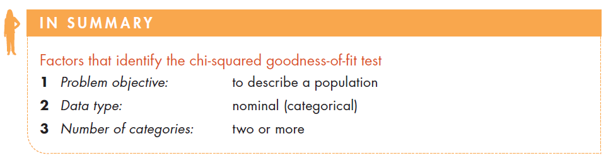
16.10
Factors that identify the chi-squared goodness-of-fit test

Slide 11
Example 1
16.11
Two competing companies A and B have conducted aggressive advertising campaigns. Market shares before the campaigns were:
Company A = 45%; Company B = 40%; Others = 15%.
To study the effects of the campaigns on the market shares, 200 customers were asked to indicate their preference regarding the product advertised. Among those surveyed, 102 customers preferred Company A’s product, 82 customers preferred Company B’s product, 16 customers preferred the other competitors’ products.
Is there sufficient evidence to infer that the proportions have changed since the advertising campaigns were implemented.

Slide 12
Example 1 - Solution
16.12
IDENTIFY
The population investigated is the brand preferences.
The data are nominal (A, B or other).
This is a multinomial experiment, with three categories.
The question of interest is: Are p₁, p₂ and p₃ different after the campaign from their values before the campaign?

Slide 13
Example 1 – Solution…
16.13
IDENTIFY
We compare market share before and after an advertising campaign to see if there is a difference (i.e. if advertising was effective in improving market share). We hypothesize values for the parameters equal to the before-market share. That is,
H₀: p₁ = 0.45, p₂ = 0.40, p₃ = 0.15
H_{A}: At least one p_{i} is not equal to its specified value

Slide 14
16.14
Example 1- Solution…
IDENTIFY
Test statistic
If the null hypothesis is true, we would expect the number of customers selecting brand A, brand B, and other to be 200 times the proportions specified under the null hypothesis. That is,
e₁ = 200(0.45) = 90
e₂ = 200(0.40) = 80
e₃ = 200(0.15) = 30
In general, the expected frequency for each cell is given by
e_{i} = np_{i}
This expression is derived from the formula for the expected value of a binomial random variable, introduced in Section 7.6.

Slide 15
16.15
Example 1- Solution…
IDENTIFY
If the expected frequencies and the observed frequencies are quite different, we would conclude that the null hypothesis is false, and we would reject it.
However, if the expected and observed frequencies are similar, we would not reject the null hypothesis.
The test statistic measures the similarity of the expected and observed frequencies.
15

Slide 16
Chi-squared goodness-of-fit test…
16.16
IDENTIFY
What sample frequency would you expect for each category if the null hypothesis is true?
Our Chi-squared goodness of fit test statistic is given by:
This statistic is approximately chi-squared with k-1 degrees of freedom provided the sample size is large. The rejection region is
Observed frequency
Expected frequency

Slide 17
Chi-squared goodness-of-fit test…
16.17
COMPUTE
Calculating manually
In order to calculate our test statistic, we lay out the data in a tabular fashion for easier calculation by hand:
Company | Observed frequency | Expected frequency | Delta | Summation component
 | o_{i} | e_{i} | (o_{i} – e_{i}) | (o_{i} – e_{i})²/e_{i}
A | 102 | 90 | 12 | 1.60
B | 82 | 80 | 2 | 0.05
Others | 16 | 30 | –14 | 6.53
Total | 200 | 200 |  | χ²= 8.18
Check that these are equal.

Slide 18
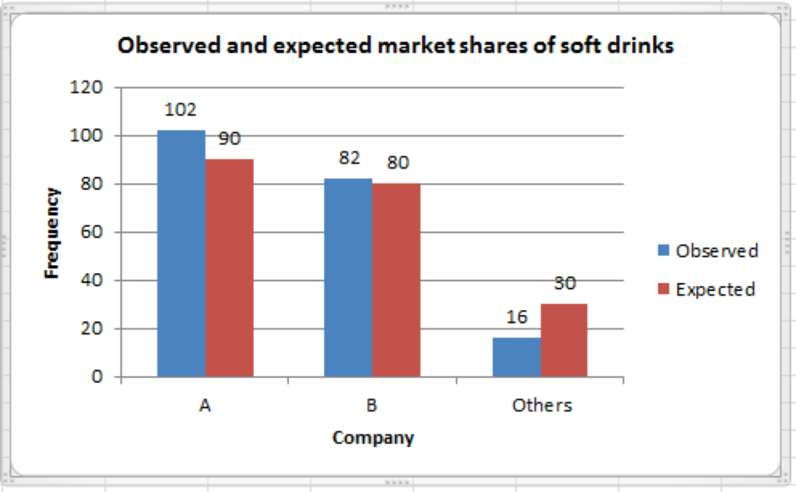
Chi-squared goodness-of-fit test…
16.18
COMPUTE
Observed and expected frequencies for A, B and others:

Slide 19

Example 1- Solution…
16.19
COMPUTE
Test statistic is:
Level of significance: α = 0.05
Decision rule:
Reject H_{o} if
or Reject H_{o} if p-value < α
In our example,
Value of the test statistic:

Slide 20
Example 1- Solution…
16.20
INTERPRET
Conclusion:
Since our test statistic is 8.18, which is greater than our critical value for Chi-squared, 5.99, we reject H₀ in favour of H_{A}, that is,
‘There is sufficient evidence to infer that the proportions have changed since the advertising campaigns were implemented.’

Slide 21
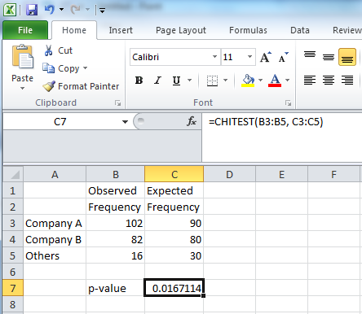
Example 1 – Solution…
16.21
COMPUTE
Using Excel
Conclusion: As the p-value = 0.017 < 0.05 = α, there is sufficient evidence to reject the null hypothesis. That is, at the 5% significance level, at least one of the probabilities pi is different. Thus, at least two market shares have changed.

Slide 22
Rule of Five
16.22
The test statistic used to perform the test is only approximately Chi-squared distributed.
For the approximation to apply, the expected cell frequency has to be at least five (i.e., np_{i} ≥ 5 for any cell i).
If the expected frequency in a cell is less than five, combine it with other cells.

Slide 23
Identifying Factors…
16.23
Parameters of interest: p1, p2, …, pk
Test statistic: ei = npi
Required condition: ei ≥ 5

Slide 24
16.2 Chi-squared test of a contingency table
16.24
The Chi-squared test of a contingency table is used to:
determine whether there is enough evidence to infer that two nominal variables are related, and
to infer that differences exist among two or more populations of nominal variables.
In order to use these techniques, we need to classify the data according to two different criteria.

Slide 25
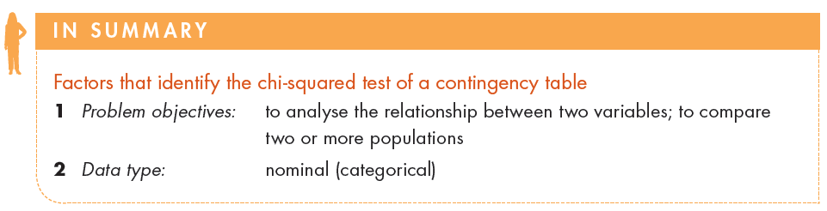
Factors that identify…
16.25

Slide 26
Example 2
16.26
The MBA program was experiencing problems scheduling their courses. The demand for the program’s optional courses and majors was quite variable from one year to the next.
In desperation the dean of the business school turned to a statistics professor for assistance.
The statistics professor believed that the problem may be the variability in the academic background of the students and that the undergraduate degree affects the choice of major.

Slide 27
16.27
Example 2…
As a start he took a random sample of last year’s MBA students and recorded the undergraduate degree and the major selected in the graduate program.
The undergraduate degrees were BA, BEng, BBA and several others.
There are three possible majors for the MBA students, accounting, finance and marketing. Can the statistician conclude that the undergraduate degree affects the choice of major?

Slide 28
16.28
Example 2…
The data are stored in two columns. The first column consists of integers i =1, 2, 3 and 4 representing the undergraduate degree where:
1 = BA
2 = BEng
3 = BBA
4 = other
The second column consists of integers j =1, 2 and 3 representing lists the MBA major where:
1= Accounting
2 = Finance
3 = Marketing

Slide 29
16.29
Example 2 - Solution
IDENTIFY
The problem objective is to determine whether two variables (undergraduate degree and MBA major) are related. Both variables are nominal. Thus, the technique to use is the chi-squared test of a contingency table. The alternative hypotheses specifies what we test. That is,
H_{A}: The two variables are dependent.
H₀: The two variables are independent.

Slide 30
Test Statistic
16.30
IDENTIFY
The test statistic is the same as the one used to test proportions in the goodness-of-fit-test. That is, the test statistic is
Note, however, that there is a major difference between the two applications. In this one the null does not specify the proportions, pij (the probability for cell (i,j)), from which we compute the expected values eij, which we need to calculate the χ² test statistic. That is,
eij = npij, where n is the total number of observations
Because we don’t know pij (they are not specified by the null hypothesis), it is necessary to estimate pij from the data.

Slide 31
16.31
Example 2 - Solution…
IDENTIFY
The first step is to count the number of students in each of the 12 combinations. The result is called a. cross-classification (or contingency) table.
 | MBA Major (j=1,2,3)
Undergrad degree (i=1,2,3,4) | Accounting | Finance | Marketing | Total
BA | 31 | 13 | 16 | 60
BEng | 8 | 16 | 7 | 31
BBA | 12 | 10 | 17 | 39
Other | 10 | 5 | 7 | 22
Total | 61 | 44 | 47 | 152

Slide 32
16.32
Example 2 - Solution…
IDENTIFY
 | MBA Major
Undergrad degree | Accounting | Finance | Marketing | Total
BA | 31 | 13 | 16 | 60
BEng | 8 | 16 | 7 | 31
BBA | 12 | 10 | 17 | 39
Other | 10 | 5 | 7 | 22
Total | 61 | 44 | 47 | 152
There are two ways to address the problem:
If each classification is considered
a nominal variable, are these two
variables dependent?
If each undergraduate degree
is considered a population, do
these populations differ?

Slide 33
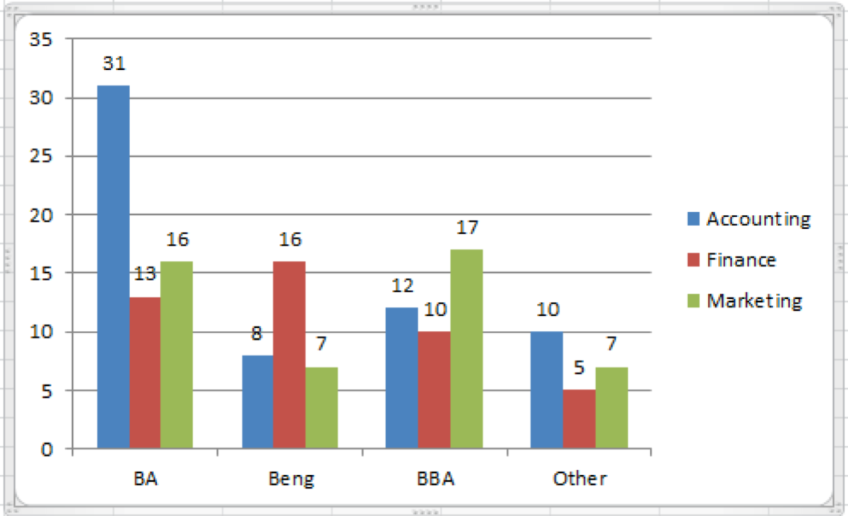
16.33
Example 2 - Solution…
IDENTIFY

Slide 34
16.34
Example 2 - Solution…
IDENTIFY
The hypotheses are:
H₀: the two variables are independent
H_{A}: the two variables are dependent.
The test statistic:
The rejection region
Since eij = npij, we need to estimate the unknown probability from the data, assuming H0 is true.
df

Slide 35
16.35
Example 2 - Solution…
COMPUTE
If the null hypothesis is true, the two nominal variables are independent. Then, for example:
P(BA and Accounting) = [P(BA)] [P(Accounting)]
Since we don’t know the values of P(BA) or P(Accounting), we need to use the data to estimate the probabilities.

Slide 36
16.36
Example 2 - Solution…
COMPUTE
There are 152 students, of which 61 have chosen accounting as their MBA major. Thus, we estimate the probability of accounting as:
P(Accounting)
Similarly:
P(BA)

Slide 37
16.37
Example 2 - Solution…
COMPUTE
If the null hypothesis is true (the two variables are independent):
P(BA and Accounting) = (60/152)(61/152)
Now that we have the probability we can calculate the expected value. That is,
E[BA and Accounting] = 152(60/152)(61/152)
= (60)(61)/152 = 24.08
We can do the same for the other 11 cells.

Slide 38
16.38
Example 2 - Solution…
COMPUTE
Alternatively,
Expected frequency for a contingency table
(column j total)(row i total)
sample size
eij =

Slide 39

16.39
Example 2 - Solution…
COMPUTE
We can now compare observed with expected frequencies…
and calculate our test statistic:
 | MBA Major
Undergrad degree | Accounting |  | Finance |  | Marketing
BA | 31 | 24.08 | 13 | 17.37 | 16 | 18.55
BEng | 8 | 12.44 | 16 | 8.97 | 7 | 9.59
BBA | 12 | 15.65 | 10 | 11.29 | 17 | 12.06
Other | 10 | 8.83 | 5 | 6.37 | 7 | 6.80

Slide 40
16.40
Example 2 - Solution…
IDENTIFY
Level of significance: α = 0.05
r = 4; c = 3.
Decision rule: Reject H₀ if
= χ²_{0.05,(4–1)(3–1)} = 12.5916
or Reject H₀ if p-value < α
Value of the test statistic: χ² = 14.70.
Conclusion: Since χ² = 14.70 > 12.5916, we reject the null hypothesis in favour of the alternative. That is, there is sufficient evidence to infer that the two variables are dependent. Therefore, we can conclude that the MBA major and the undergraduate degree are related.

Slide 41
16.41
Example 2 – Solution…
COMPUTE
Using Excel (Data Analysis Plus):
Click Add-Ins, Data Analysis Plus, Contingency Table [if the table has already been prepared] or Contingency Table (Raw Data) [if the table has not been completed].

Slide 42
16.42
Example 2 – Solution…
COMPUTE
The printout below was produced using the Data Analysis Plus’ Contingency Table (Raw Data) command.

Slide 43
16.43
Example 2 - Solution…
INTERPRET
Using the alternative p-value method:
Decision rule: Reject H_{o} if p-value < α = 0.05.
Conclusion: As the p-value = 0.0227 < 0.05 = α, there is enough evidence to infer that the MBA major and the undergraduate degree are related.

Slide 44
Required condition: Rule of Five
16.44
The χ² distribution provides an adequate approximation to the sampling distribution under the condition that e_{ij} = np_{ij} ≥ 5 for all the cells.
When e_{ij} < 5, rows or columns must be added such that the condition is met.

Slide 45
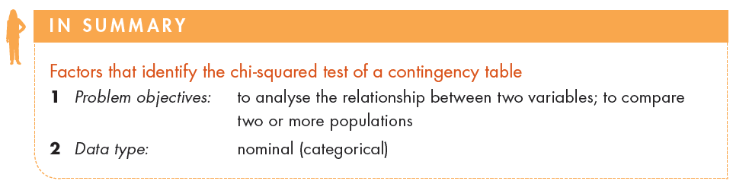

Identifying factors…
16.45
Parameters of interest: p_{ij}, i=1,..,r; j=1,..,c.
Test statistic:
Required condition: e_{ij} ≥ 5

Slide 46
16.3 Chi-squared test for normality
16.46
The goodness-of-fit Chi-squared test can be used to determine if data were drawn from any distribution.
The multinomial experiment produces the test statistic.
Testing goodness-of-fit
for normal distribution.
Select values of zi such that the expected frequency in each
interval (zi, zi+1) is at least 5.
For example:
P(z1<Z<z2)=p2
np3 > 5
np3 > 5
np2 > 5
np2 > 5
Test the hypotheses:
H0: P1 = p1, …, Pk = pk
HA: At least one proportion differs
from its specified value.
p3
p3
np1 > 5
p2
p2
np1 > 5
p1
p1
z1
z2
z3
z4

Slide 47
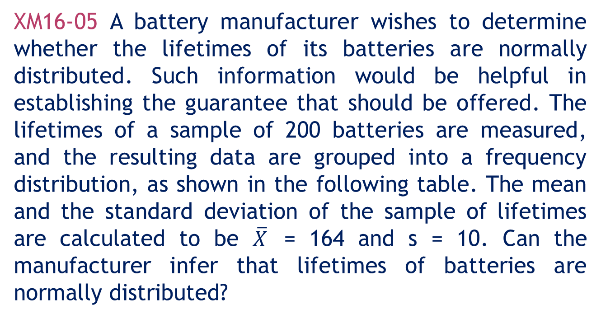
16.47
Example 3
XM16-05 A battery manufacturer wishes to determine whether the lifetimes of its batteries are normally distributed. Such information would be helpful in establishing the guarantee that should be offered. The lifetimes of a sample of 200 batteries are measured, and the resulting data are grouped into a frequency distribution, as shown in the following table. The mean and the standard deviation of the sample of lifetimes are calculated to be $\overline{X}$ = 164 and s = 10. Can the manufacturer infer that lifetimes of batteries are normally distributed?

Slide 48
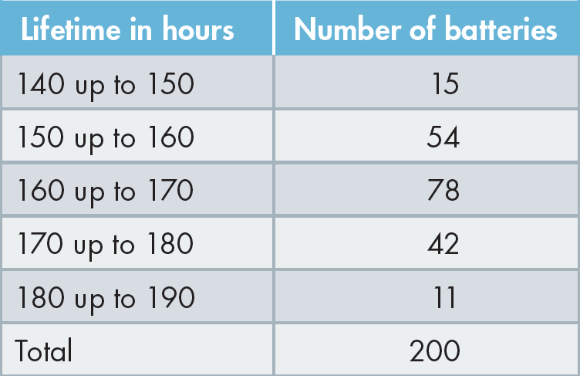
16.48
Example 3…
Solution:
The hypotheses are
H0: The data are normally distributed.
HA: The data are not normally distributed.

Slide 49
Example 3 - Solution
16.49
COMPUTE
Test statistic is:
d.f.=k-m-1, k=Number of classes (= 5); m = Number of parameters for normal distribution to be estimated (= 2)
Level of significance: α = 0.10
Decision rule:
Reject Ho if
or Reject Ho if p-value < α

Slide 50
Example 3 - Solution
16.50
COMPUTE
Value of the test statistic:
We need to calculate the expected frequencies (e_{i}) for each class interval. The probability that a lifetime falls between 160 and 170 hours is
The expected frequency for this category is therefore (200)(0.3811) = 76.22. Similarly, the expected number of lifetimes falling below 150 hours is (200)(0.0808) = 16.16.

Slide 51
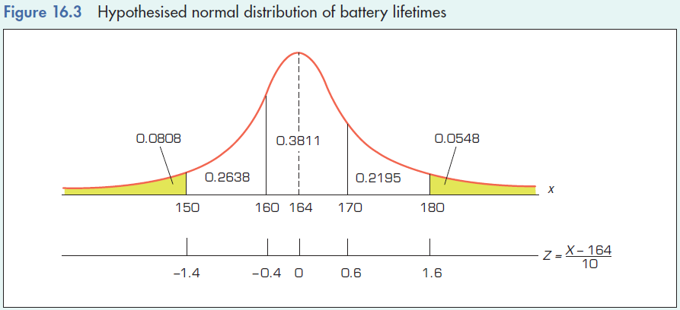
Example 3 - Solution
16.51
COMPUTE
Value of the test statistic:
The remaining expected frequencies are calculated in a similar manner and recorded in the following table, which also contains the calculation of the chi-squared test statistic.

Slide 52
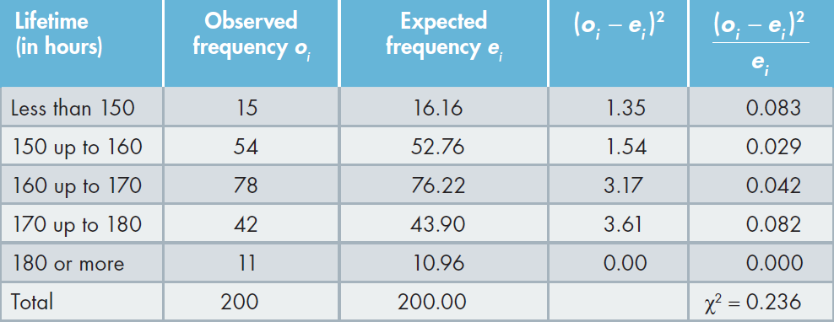
Example 3 - Solution
16.52
COMPUTE
Value of the test statistic:
Calculation of χ² for 200 lifetimes

Slide 53
Example 3 - Solution
16.53
INTERPRET
Conclusion:
Since the calculated value of χ² = 0.236 does not exceed the critical value of 4.60517, we cannot reject the null hypothesis.
Interpreting the results:
The test results reveal that there is some support for the null hypothesis at the 10% level of significance that the lifetimes of the manufacturer’s batteries are normally distributed.

Slide 54
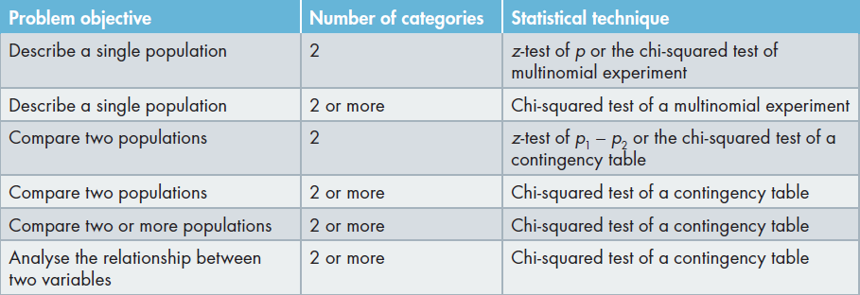
16.54
Statistical techniques for nominal data
Table 16.1 Statistical Techniques for Nominal Data

Slide 55
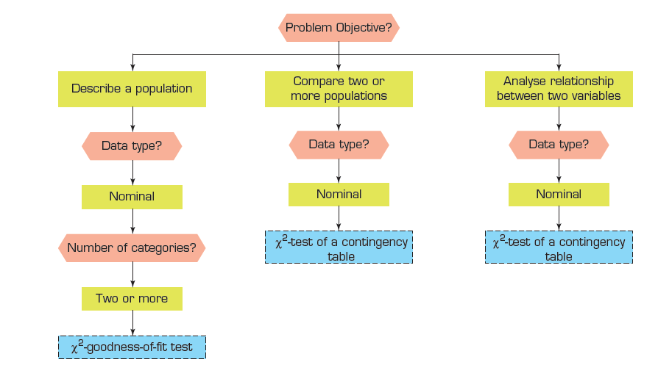
16.55
Summary of techniques – Nominal data

