Slide 1


Slide 2
Chapter 2
Types of data, data collection and sampling

Slide 3
Chapter outline
2.1 Types of data
2.2 Methods of collecting data
2.3 Sampling
2.4 Sampling plans
2.5 Sampling and non-sampling errors

Slide 4
Learning objectives
LO1 Describe different types of data
LO2 Understand the primary and secondary sources of statistical data
LO3 Explain the various methods of collecting data
LO4 Explain the basic sampling plans
LO5 Identify the appropriate sampling plan for data collection in a particular experiment
LO6 Understand the main types of errors involved in sampling.

Slide 5
Introduction and re-cap…
2.5
Descriptive statistics
involves arranging, summarising, and presenting a set of data in such a way that useful information is produced.
Its methods make use of graphical techniques and numerical descriptive measures (such as averages) to summarise and present the data.
Descriptive
Statistics
Data
Information

Slide 6
Populations and samples
2.6
Population
Sample
Subset
The graphical and tabular methods presented here apply to both entire populations and samples drawn from populations.

Slide 7
2.1 Types of data
2.7
Definitions
A variable is some characteristic of a population or sample.
E.g. student marks.
A variable is typically denoted with a capital letter: X, Y, Z…
The values of the variable are the range of possible values for a variable.
E.g. student marks (0,…,100)
Data are the observed values of a variable.
E.g. student marks: {67, 74, 71, 83, 93, 55, 48}

Slide 8
Types of data…
2.8
Data (at least for purposes of Statistics) fall into three main groups:
Numerical data
Nominal Data
Ordinal Data

Slide 9
Numerical data
2.9
Numerical data
The values of numerical data are real numbers.
E.g. heights, weights, prices, waiting time at a medical practice, etc.
Arithmetic operations can be performed on numerical data, thus its meaningful to talk about 2*Height, or Price + $1, and so on.
Numerical data are also called quantitative or interval.

Slide 10
Nominal data
2.10
Nominal Data
The values of nominal data are categories.
E.g. Responses to questions about marital status are categories, coded as:
Single = 1, Married = 2, Divorced = 3, Widowed = 4
These data are categorical in nature; arithmetic operations don’t make any sense (e.g. does Married ÷ 2 = Divorced?!)
Nominal data are also called qualitative or categorical.

Slide 11
Ordinal data
2.11
Ordinal Data
Ordinal data appear to be categorical in nature, but their values have an order; a ranking to them:
E.g. University course evaluation system:
Poor = 1, fair = 2, good = 3, very good = 4, excellent = 5
While its still not meaningful to do arithmetic on this data (e.g. does 2*fair = very good?!), we can say things like:
excellent > poor or fair < very good
That is, order is maintained no matter what numeric values are assigned to each category.
Ordinal data are also called ranked.

Slide 12
Types of data – Examples
2.12
Numerical data
Nominal data
Ordinal data
age income
55 75 000
42 68 000
. .
. .
person married
1 yes
2 no
3 no
. .
. .
exam grade
HD
D
C
P
F
weight gain
+10
+5
.
.
With nominal data, all we can calculate is the proportion of data that falls into each category.
computer brand
1 IBM
2 Dell
3 Compaq
4 IBM
. .
With ordinal data, all we can use is computations involving the ordering process.
Food quality
Excellent
Good
Satisfactory
Poor
IBM Dell Compaq other total
25 11 8 6 50
50% 22% 16% 12%

Slide 13
Calculations for types of data
2.13
As mentioned above,
All calculations are permitted on numerical data.
No calculations are allowed for nominal data, except counting the number of observations in each category and calculating their proportions.
Only calculations involving a ranking process are allowed for ordinal data.
This lends itself to the following ‘hierarchy of data’…

Slide 14
Hierarchy of data
2.14
Numerical
Values are real numbers.
All calculations are valid.
Data may be treated as ordinal or nominal.
Nominal
Values are the arbitrary numbers that represent categories.
Only calculations, such as proportions, based on the frequencies of occurrence are valid.
Data may not be treated as ordinal or numerical.
Ordinal
Values must represent the ranked order of the data.
Calculations based on an ordering process are valid.
Data may be treated as nominal but not as numerical.

Slide 15
Other forms of data
2.15
Cross-sectional data is collected at a certain point in time across a number of units of interest
marketing survey (observe preferences by gender, age)
students’ marks in a statistics course exam in semester 2 2016
starting salaries of graduates of an MBA program in a particular year.
Time-series data is collected over successive points in time
weekly closing price of gold
monthly tourist arrivals in Australia.

Slide 16
2.2 Methods of collecting data
2.16
Recall,
Statistics is a tool for converting data into useful information:
Statistics
Data
Information
But where then does data come from? How is it gathered? How do we ensure its accuracy? Is the data reliable? Is it representative of the population from which it was drawn?
Now we explore some of these issues.

Slide 17
Data quality
2.17
The reliability and accuracy of the data affect the validity of the results of a statistical analysis.
The reliability and accuracy of the data depend on the method of data collection.
There are many methods used to collect or obtain data for statistical analysis.

Slide 18
Sources of data
2.18
Four of the most popular sources of statistical data are:
Published data
Data collected from observational studies (Observational data)
Data collected from experimental studies (Experimental data)
Data collected from surveys

Slide 19
Published data
2.19
This type of data has already been collected by an organization or by a statistical agency and made available for others to use.
This is often a preferred source of data due to low cost and convenience.
Published data is found as printed material, tapes, disks, and on the Internet.
Types of published data
Primary data
Secondary data.

Slide 20
Published data…
2.20
Primary data
Data published by the organisation that has collected it is called primary data.
E.g. Data published by the Australian Bureau of Statistics (ABS).
Secondary data
Data published by an organisation different from the one that was originally collected and published is called secondary data.
E.g. 1. The Yearbook of National Accounts Statistics (United Nations, New York), compiles data from primary sources of various country departments of statistics, like ABS in Australia;
2. Compustat sells a variety of financial data tapes compiled from several primary sources.

Slide 21
Observational and experimental data
2.21
When published data is unavailable, one needs to conduct a study to generate the data.
Observational study is one in which measurements representing a variable of interest are observed and recorded, without controlling any factor that might influence their values
e.g. measuring the height of a tree in the rainforest over time.
Experimental study is one in which measurements representing a variable of interest are observed and recorded, while controlling factors that might influence their values
e.g. measuring the yield of different type of rice using a certain amount of fertilizer (control factor).

Slide 22
Surveys
2.22
A survey solicits information from survey participants;
e.g. Gallup polls; pre-election polls; marketing surveys.
The response rate (i.e. the proportion of selected participants who completed the survey) is a key survey parameter.
Surveys may be administered in a variety of ways,
e.g.
Personal interview
Telephone interview
Self-administered questionnaire.

Slide 23
Questionnaire design
2.23
Over the years, a lot of thought has been put into the science of the design of survey questions. Key design principles:
Keep the questionnaire as short as possible.
Ask short, simple and clearly worded questions.
Start with demographic questions to help respondents get started comfortably.
Use dichotomous and multiple choice questions.
Use open-ended questions cautiously.
Avoid using leading questions.
Pretest a questionnaire on a small number of people.
Think about the way you intend to use the collected data when preparing the questionnaire.

Slide 24
2.3 Sampling
2.24
If the data are collected from the whole population, it is called a census.
For example, ABS conducts a census every 5 years in Australia.
Recall that statistical inference permits us to draw conclusions about a population based on a sample.
Sampling (i.e. selecting a sub-set of a whole population) is often done instead of a census for a number of reasons including
cost
For example, it’s less expensive to sample 1000 television viewers than 20 million TV viewers
practicality
For example, performing a crash test on every automobile produced is impractical.

Slide 25
Sampling…
2.25
Target population
The population about which we want to draw inferences.
Sampled population
The actual population from which the sample has been drawn.
In any case, the sampled population and the target population should be similar to one another. Otherwise the sample selected may become self-selected.

Slide 26
Sampling…
2.26
Example:
A survey of opinion on a radio talk-back show topic
Target population: All radio listeners who listen to the talk-back show.
Sample selected: Those listeners who are interested in the topic and managed to contact the radio station.
Sampled population: Those listeners who are interested in the topic.

Slide 27
2.4 Sampling plans
2.27
A sampling plan is just a method or procedure for specifying how a sample will be taken from a population.
Most commonly used sampling plans,
Simple random sampling
Stratified random sampling
Cluster sampling.

Slide 28
Simple random sampling
2.28
A simple random sample is a sample selected in such a way that every possible sample of the same size is equally likely to be chosen.
For example, drawing three names from a hat containing all the names of the students in a class of 200 is an example of a simple random sample: any group of three names is as equally likely as picking any other group of three names.

Slide 29
Simple random sampling…
2.29
To conduct simple random sampling…
assign a number to each element of the chosen population (or use already given numbers),
e.g. Medicare card number of each Australian resident
randomly select the sample numbers (members) using a random numbers table, or a software package.

Slide 30
Example 1
2.30
A government income-tax auditor is responsible for 1000 tax returns. The auditor will randomly select 30 returns to audit. Use Excel’s random number generator to select the returns.
Solution:
We generate 50 numbers between 1 and 1000 (we need only 30 numbers, but the extra numbers might be used if duplicate numbers are generated.)

Slide 31
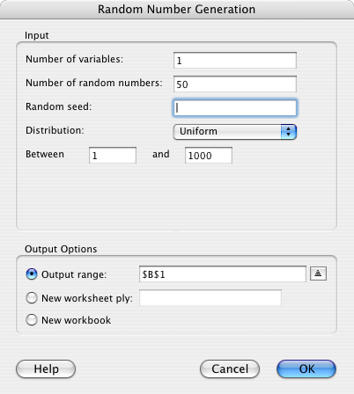
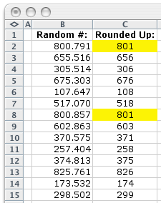
2.31
Example 1: Solution
Use Excel to generate 50 random numbers between 1 and 1000.
50 random uniformly distributed whole-
numbers between 1 and 1000.
Extra #’s may be used if duplicate random numbers are generated.

Slide 32
Stratified random sampling
2.32
A stratified random sample is obtained by dividing the population into mutually exclusive sets (or strata), and then drawing simple random samples from each stratum.
Population 2
Population 1
Age
Under 20
20–30
31–40
41–50
51–60
> 60
Population 3
Occupation
Professional
Clerical
Blue-collar
Other
Sex
Male
Female

Slide 33
Stratified random sampling…
2.33
With this procedure we can acquire information or make inferences about
the whole population
each stratum
the relationships among strata.

Slide 34
Stratified random sampling…
2.34
There are several ways to build a stratified random sample. For example, one could keep the proportion of each stratum in the population to decide how many units from each stratum are to be taken.
A sample of size 1000 is to be drawn
Stratum Income Population proportion
(from previous census)
Stratum size
1 under $25 000 25% (0.25 x 1000) 250
2 25 000-39 999 40% (0.40 x 1000) 400
3 40 000-60 000 30% (0.30 x 1000) 300
4 over $60 000 5% (0.05 x 1000) 50
Total 1000

Slide 35
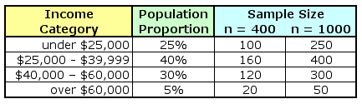
Stratified random sampling…
2.35
After the population has been stratified, we can use simple random sampling to generate the complete sample:
If we only have sufficient resources to sample 400 people in total,
we would draw 20 of them from the high income group…
…if we are sampling 1000 people, we’d draw 50 of them from the high income group.

Slide 36
Cluster sampling
2.36
Cluster sample is a simple random sample of groups or clusters of elements (vs. a simple random sample consists of individual objects).
This procedure is useful when
it is difficult and costly to develop a complete list of the population members (making it difficult to develop a simple random sampling procedure).
the population members are widely dispersed geographically.

Slide 37
Cluster sampling…
2.37
Cluster sampling may increase sampling error, because of probable similarities among cluster members.
For example, to draw a cluster sample of residents in the Brisbane city area, first select a number of streets in the Brisbane city area using a simple random sampling method and then include all residents in those selected streets to form the cluster sample.

Slide 38
Sample size
2.38
Numerical techniques for determining sample sizes will be described later, but it is sufficient to say that the larger the sample size, the more accurate we can expect the sample estimates to be. That is, the closer the sample estimate to the unknown population parameter we wish to estimate.

Slide 39
2.5 Sampling and non-sampling errors
2.39
Two major types of errors can arise when a sampling procedure is performed.
Sampling error
Non-sampling error

Slide 40
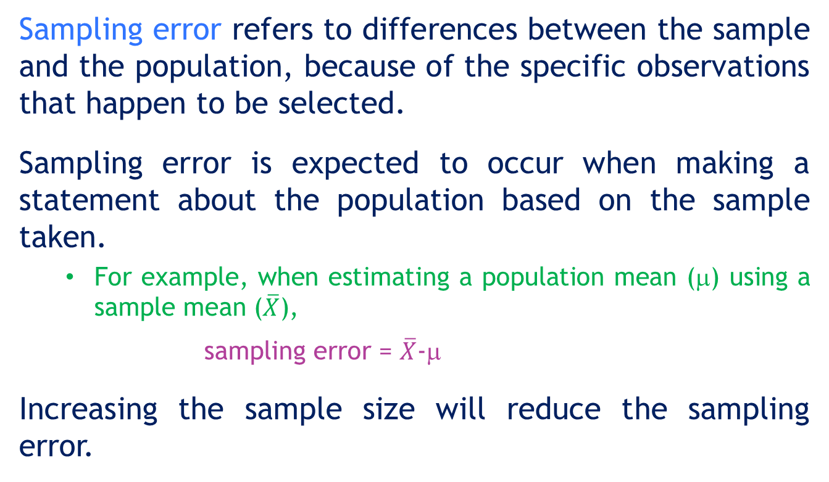
Sampling errors
2.40
Sampling error refers to differences between the sample and the population, because of the specific observations that happen to be selected.
Sampling error is expected to occur when making a statement about the population based on the sample taken.
For example, when estimating a population mean (μ) using a sample mean ($\overline{X}$),
sampling error = $\overline{X}$-μ
Increasing the sample size will reduce the sampling error.

Slide 41
Sampling errors…
2.41
Population income distribution
μ ( population mean)
Sampling error
The sample mean falls here only because
certain randomly selected observations
were included in the sample.

Slide 42
Non-sampling errors
2.42
Non-sampling errors occur due to:
Mistakes made along the process of data acquisition
Sample observations being selected improperly.

Slide 43
Three types of non-sampling errors
2.43
There are three types of non-sampling errors:
Errors in data acquisition,
Non-response errors,
Selection bias.
Increasing the sample size will not reduce this type of error.

Slide 44
Errors in data acquisition
2.44
Errors in data acquisition arises from the recording of incorrect responses, due to:
incorrect measurements being taken because of faulty equipment,
mistakes made during transcription from primary sources,
inaccurate recording of data due to misinterpretation of terms,
inaccurate responses to questions concerning sensitive issues, or
clerical mistakes when transferring/recording data.

Slide 45
2.45
Non-response error
Non-response error refers to error (or bias) introduced when responses are not obtained from some members of the sample surveyed due to refusal by them to respond for some reason, i.e. the sample observations that are collected may not be representative of the target population.
As mentioned earlier, the Response Rate (i.e. the proportion of all people selected who complete the survey) is a key survey parameter and helps in the understanding in the validity of the survey and sources of non-response error.

Slide 46
Selection bias
2.46
Selection bias occurs when the sampling plan is such that some members of the target population cannot possibly be selected for inclusion in the sample.
For example, selecting a sample of households in NSW using telephone numbers listed in NSW White Pages, as not every NSW household telephone number is listed in the White Pages.

Slide 47
Data acquisition error
Non-sampling errors…
2.47
Population
If this observation…
Sample
Sampling error + Data acquisition error
…is wrongly recorded here…
…then the sample mean is affected.

Slide 48
Non-response error
2.48
Non-sampling errors…
Population
No response here...
…may lead to biased results here.
Sample

Slide 49
Selection bias
2.49
Non-sampling errors…
Population
When parts of the population cannot be selected...
Sample
…the sample cannot represent
the whole population.

