Slide 1


Slide 2
Chapter 4
Graphical descriptive techniques – Numerical data

Slide 3
Chapter outline
4.1 Graphical techniques to describe numerical data
4.2 Describing time-series data
4.3 Describing the relationship between two numerical variables
4.4 Graphical excellence and deception

Slide 4
Learning objectives
LO1 Tabulate and construct charts and graphs to summarise numerical data
LO2 Use graphs to analyse time-series data
LO3 Use various graphical techniques to analyse the relationships between two numerical variables
LO4 Understand deception in graphical presentation
LO5 Understand how to present statistics in written reports and oral presentations

Slide 5
4.1 Graphical techniques to describe numerical data
4.5
Chapter 3 introduced graphical techniques to summarise nominal data. This chapter introduces graphical techniques to summarise numerical data.
These techniques for a single variable include frequency distributions, histograms, stem and leaf displays and line charts. To display the relationship between two numerical variables, this chapter introduces scatter plots.

Slide 6
Introduction
4.6
There are several graphical methods that are used when the data are numerical (or quantitative, interval).
The most important of these graphical methods is the histogram.
The histogram is not only a powerful graphical technique used to summarise numerical data, but it is also used to help explain probabilities.

Slide 7
Example 1 (Example 4.1, page 85)
4.7
XM04-01 As part of a larger study, an electricity provider wanted to acquire information about the monthly electricity bills of new subscribers in the first month after signing with the company. The company’s marketing manager conducted a survey of 200 new residential subscribers wherein the first month’s bills were recorded. The general manager planned to present his findings to senior executives. What information can be extracted from these data?

Slide 8
4.8
Example 1…
In Example 3.1, for the magazine readership survey, we created a frequency distribution for the 6 categories. In this example we also create a frequency distribution by counting the number of observations that fall into a series of intervals, called classes.
The justification for the classes chosen will be discussed below.

Slide 9
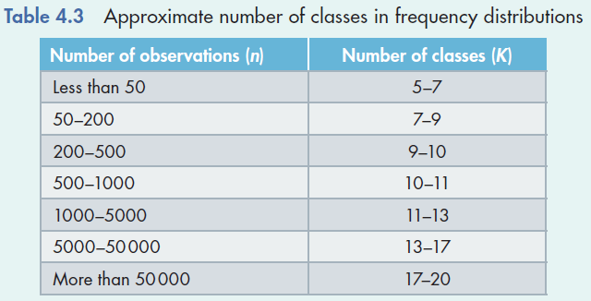
Building a Histogram…
4.9
Collect the data
Create a frequency distribution for the data… How?
Determine the number of classes to use… How?
Refer to Table 4.3:
With 200 observations, we should have between 7 & 10 classes…
Alternatively, we could use Sturges’ formula: Number of class intervals K = 1 + 3.3 log(n) For our example, K = 1+ 3.3 log(200) ≈ 9

Slide 10
Building a Histogram…
4.10
Class width
It is generally best to use equal class widths, but sometimes unequal class widths are called for.
Unequal class widths are used when the frequency associated with some classes is too low. Then,
several classes are combined together to form a wider and ‘more populated’ class
it is possible to form an open-ended class at the higher or lower end of the histogram.

Slide 11
Building a Histogram…
4.11
Assuming equal class width
Class width =
Largest value = $470.50
Smallest value = $59.50
Therefore,
Class width =
For convenience, we round this number to 50.

Slide 12
4.12
Example 1…
We have chosen nine classes, with class width 50, defined in such a way that each observation falls into one and only one class. These classes are defined as follows:
Classes
Amounts that are more than 50 but less than or equal to 100
Amounts that are more than 100 but less than or equal to 150
Amounts that are more than 150 but less than or equal to 200
Amounts that are more than 200 but less than or equal to 250
Amounts that are more than 250 but less than or equal to 300
Amounts that are more than 300 but less than or equal to 350
Amounts that are more than 350 but less than or equal to 400
Amounts that are more than 400 but less than or equal to 450
Amounts that are more than 450 but less than or equal to 500

Slide 13
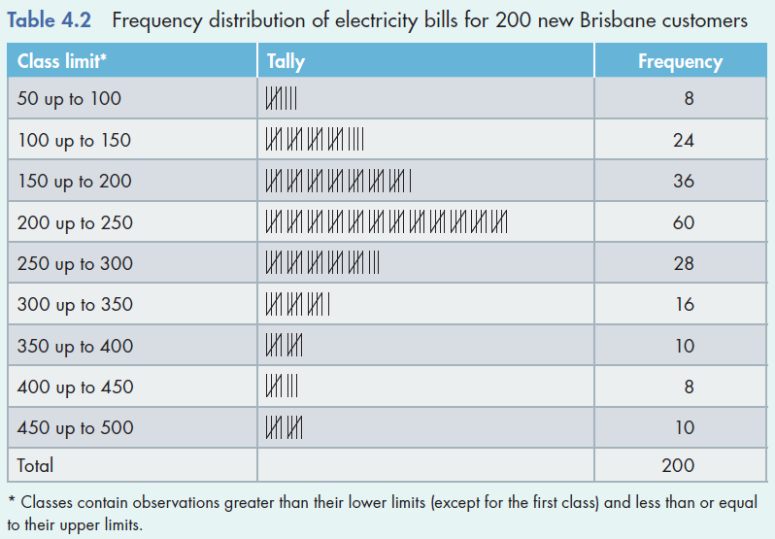
Building a Histogram…
4.13
Specify the class intervals and construct the frequency distribution as in Table 4.2.

Slide 14
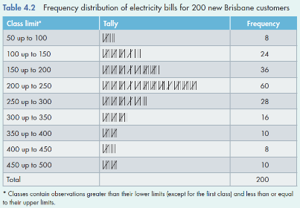
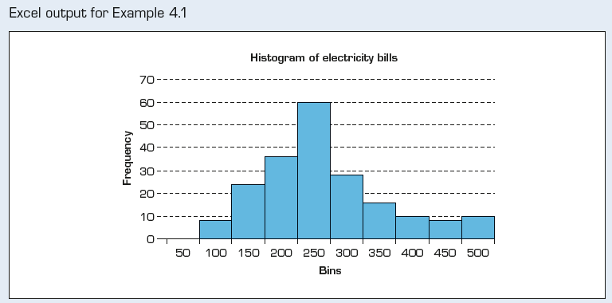
Building a Histogram…
4.14
Draw a histogram of rectangle bars using the class intervals and the corresponding frequencies.

Slide 15
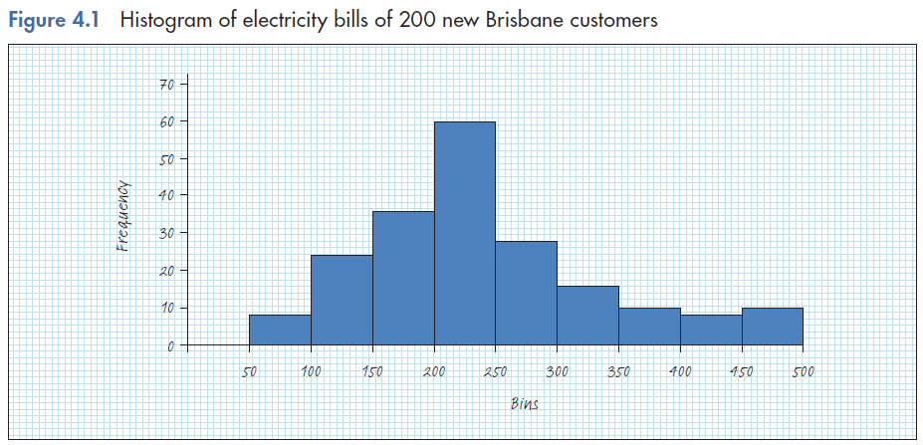
4.15
Example 1…
INTERPRET
Sixteen percent (32) of the bills are ‘small’, i.e. less than $150.
Fourteen percent (28) of the electricity bills are ‘large’ i.e., $350 or more.
Seventy percent (140) of the
Electricity bills are in the ‘middle range’,
i.e. between $150 and $350

Slide 16
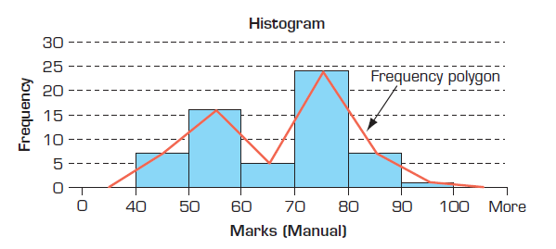
Frequency Polygon
4.16
A frequency polygon is obtained by plotting the frequency of each class above the midpoint of that class and then joining the points with a straight line.

Slide 17
4.17
Stem and Leaf Display…
Retains information about individual observations that would normally be lost in the creation of a histogram.
Split each observation into two parts, a stem and a leaf:
e.g.
Observation value: 3.8, 4.1
There are several ways to split it up…
We could split it at the decimal point.
Stem | Leaf
3 | 8
4 | 1

Slide 18
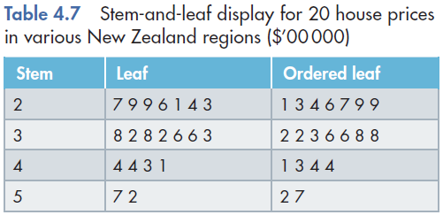
4.18
Stem and Leaf Display…
Continue this process for all the observations. Then, use the ‘stems’ for the classes and each leaf becomes part of the histogram (based on Table 4.6 data) as follows…
Thus, we still have access to our original data point’s value!

Slide 19
4.19
Histogram and Stem and Leaf Display…
Compare the overall shapes of the figures…

Slide 20
4.20
Shapes of Histograms…
Symmetry
A histogram is said to be symmetric if, when we draw a vertical line down the center of the histogram, the two sides are identical in shape and size:
Frequency
Frequency
Frequency
Variable
Variable
Variable

Slide 21
4.21
Shapes of Histograms…
Bell Shape
A special type of symmetric unimodal histogram is one that is bell shaped:
Many statistical techniques require that the distribution of the population be bell-shaped.
Drawing the histogram helps verify the shape of the population distribution in question.
Frequency
Variable
Bell Shaped

Slide 22
4.22
Shapes of Histograms…
Skewness
A skewed histogram is one with a long tail extending either to the right or to the left:
Frequency
Frequency
Variable
Variable
Positively (right) skewed
Negatively (left) skewed

Slide 23
4.23
Shapes of Histograms…
Modality
A unimodal histogram is one with a single peak, while a bimodal histogram is one with two peaks:
Bimodal
Unimodal
Frequency
Frequency
Variable
Variable
A modal class is the class with
the largest number of observations

Slide 24
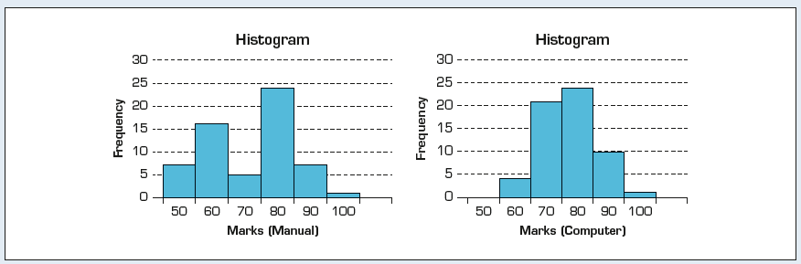
4.24
Comparison of Histograms…
Compare and contrast the following histograms based on data from Example 4.3:
The marks from the computer-based statistics course and the manual statistics course have very different histograms…
Unimodal vs. bimodal
Marks (computer course)
Marks (manual course)
Spread of the marks (narrower | wider)

Slide 25
Relative frequency
4.25
It is often preferable to show the relative frequency (proportion) of observations falling into each class, rather than the absolute frequency itself.
Class frequency
Total number of observations
Class relative frequency =

Slide 26
Relative frequencies…
4.26
Relative frequencies should be used when comparing two or more histograms, each with different numbers of observations.

Slide 27
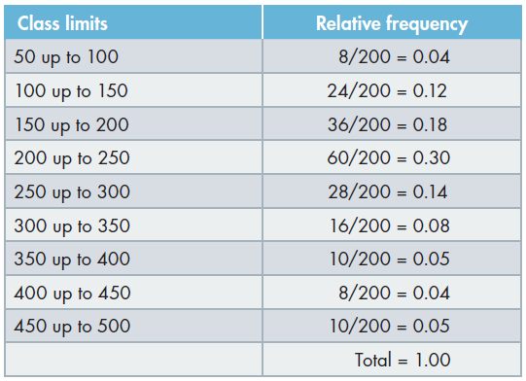
Relative frequencies…
4.27
In Example 1, we had 8 observations in our first class (electricity bills from $50 to $100). Thus, the relative frequency for this class is 8÷200 (the total number of electricity bills) = 0.04 (or 4%). The relative frequencies for the remaining classes can be calculated as shown in the table below.

Slide 28
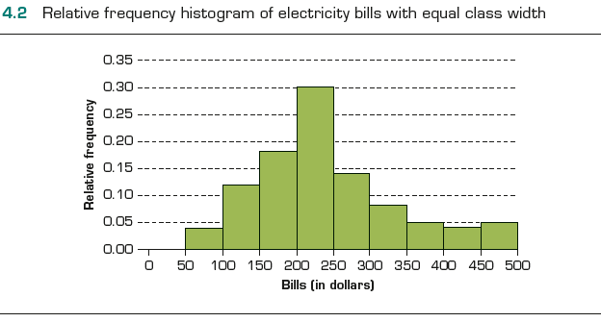
Relative frequencies…
4.28
INTERPRET
Sixteen percent
of the bills are less than $150.
Fourteen percent
of the electricity bills
are $350 or more.
Seventy percent of the electricity
bills are between $150 and $350.

Slide 29
Cumulative frequency of a class
4.29
Cumulative frequency of a class is the number of measurements less than the upper limit of that class.
To obtain the cumulative frequency of a class, we add the frequency of that class with the frequencies of all previous classes.
The cumulative relative frequency of a particular class is the proportion of measurements that are less than the upper limit of that class.

Slide 30
Ogive
4.30
Ogive is a graph of a cumulative relative frequency distribution.
We create an ogive in three steps…
Calculate relative frequencies.
Calculate cumulative relative frequencies by summing the current and all previous relative frequencies. (For the first class, its cumulative relative frequency is just its relative frequency.)
Graph the cumulative relative frequencies.

Slide 31
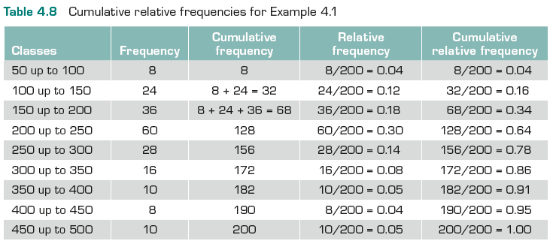
Ogive…
4.31
Calculate the cumulative relative frequencies by adding the current class’ relative frequency to the previous class’ cumulative relative frequency. (For the first class, its cumulative relative frequency is just its relative frequency.)
First class…
Next class: 0.04+0.12=0.16
:
:
Last class: 0.95.+0.05=1.00

Slide 32
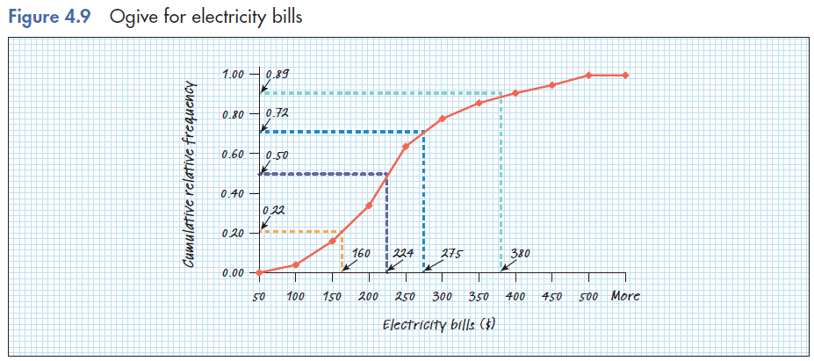
Ogive…
4.32
Graph the cumulative relative frequencies…

Slide 33
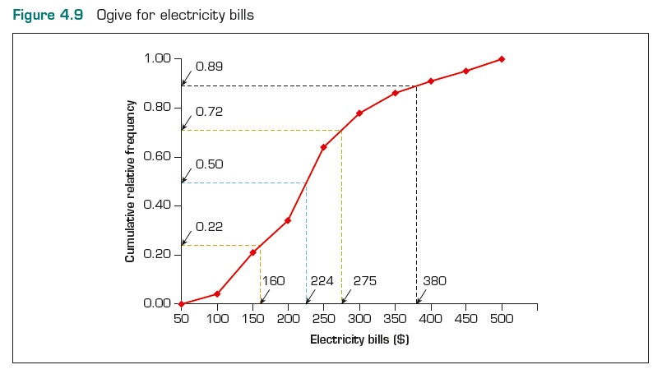
Ogive…
4.33
INTERPRET
The ogive can be used to answer questions like:
What electricity bill value is at the 50th percentile?
We can estimate the electricity bill value that is at the 50th percentile as approximately $224.

Slide 34
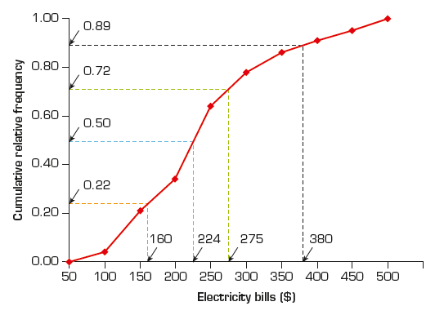
Ogive…
4.34
INTERPRET
What proportion of the electricity bills are less than $380?
around 89%
From the Ogive, we estimate the proportion of electricity bills that are:
less than $380 is 89%
greater than $380 is 11%
less than $275 is 72%
less than $160 is 22%
less than $224 is 50%

Slide 35
4.2 Describing Time Series Data
4.35
Observations measured at the same point in time across individual units are called cross-sectional data.
Observations measured at successive points in time on a single unit are called time-series data.
Time-series data are graphed on a line chart, which plots the value of the variable on the vertical axis against the time periods on the horizontal axis.
Time series data graphed on a line chart is alternatively known as a time-series chart.

Slide 36
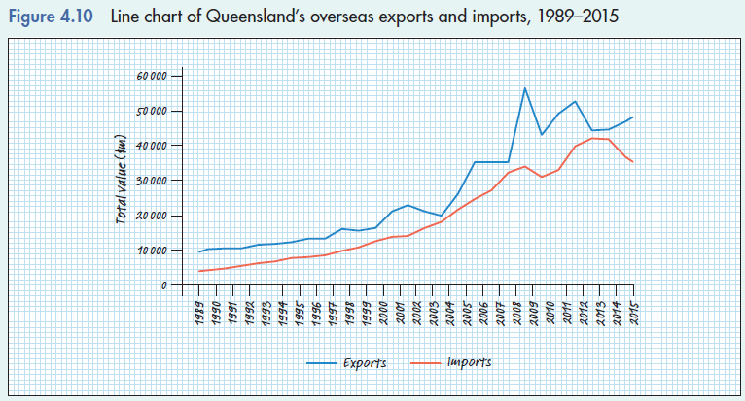
4.36
Line Chart
Line chart showing change in Queensland’s overseas exports and imports over time
Queensland’s exports have had a slow but steady increase from 1989 to 2004. After 2004, exports have been increasing steadily at a much higher rate but with a number of peaks and falls. Queensland’s imports have had a steady increase throughout but has been declining since 2013.

Slide 37
4.3 Describing the relationship between two numerical variables…
4.37
So far we’ve looked at tabular and graphical techniques for one numerical variable
Now we will look at the relationship between two numerical variables using either tabular or graphical techniques.

Slide 38
Describing the relationship between two numerical variables…
4.38
Often we are interested in the relationships between two numerical variables.
For example,
Advertising and sales
Rate of unemployment and rate of inflation
Yield of crops and amount of fertilizer

Slide 39
Example 2
4.39
A small-business owner wants to assess the effects of advertising on sales levels.
Paired observation data were collected.
Each pair consisted of monthly
advertising expenditure and monthly
sales levels (both in millions of dollars).

Slide 40
Scatter diagram
4.40
A scatter diagram can describe the relationship between advertising expenditure and sales.
Sales
Excel scatter diagram
Advertising expenditure and sales
Have ‘positive relationship’.
Advertising expenditure and sales
appear to have linear relationship.

Slide 41
Patterns of Scatter Diagrams…
4.41
Linearity and direction are two concepts we are interested in.
Positive linear relationship
Negative linear relationship
Weak or non-linear relationship

Slide 42
Typical patterns
4.42
Positive linear relationship
No relationship
Negative linear relationship
Negative nonlinear relationship
Nonlinear (concave) relationship

Slide 43
Chapter-Opening Example
4.43
WERE OIL COMPANIES GOUGING MELBOURNE CUSTOMERS?
XM04-00 In October 1999, the average retail price of petrol was A$0.74 per litre in Melbourne and the price of oil (Dubai Fetch Crude) was US$34.06 per barrel (1 barrel = 159.18 litres).
Over the next 16 years, the price of both substantially increased. Many drivers complained that the oil companies were guilty of price gouging.
That is, they believed that when the price of oil increased the price of petrol also increased, but when the price of oil decreased, the decrease in the price of petrol seemed to lag behind.
To determine whether this perception is accurate we determined the monthly figures for both commodities. Graphically depict these data and describe the findings.

Slide 44
Chapter-Opening Example - Solution
4.44

Slide 45
Chapter-Opening Example - Solution
4.45
Interpreting the results:
The scatter diagram reveals that the two prices are strongly related linearly.
As the world crude oil price increases, petrol price also increases.
When the price of crude oil was below A$120, the relationship between the two variables was stronger than when the price of oil exceeded A$120.

Slide 46
Summary I
4.46
Factors That Identify When to Use Frequency and Relative Frequency Tables, Bar and Pie Charts
1. Objective: Describe a single set of data.
2. Data type: Nominal.
Factors That Identify When to Use a Histogram, Ogive, or Stem-and-Leaf Display
1. Objective: Describe a single set of data.
2. Data type: Numerical.
Factors that Identify When to Use a Cross-classification Table
1. Objective: Describe the relationship between two variables.
2. Data type: Nominal.
Factors that Identify When to Use a Scatter Diagram
1. Objective: Describe the relationship between two variables.
2. Data type: Numerical.

Slide 47
Summary II
4.47
 | Numerical data | Nominal data
Single set of data | Histogram Stem and Leaf Ogive | Frequency and relative frequency tables, bar and pie charts
Relationship between two variables | Scatter diagram | Cross-classification table, bar charts

Slide 48
4.4 Graphical excellence and deception
4.48
Graphical excellence deals with the effective use of graphical techniques.
Effective graphical techniques are
informative
concise
and give a clear presentation of the data to the viewer.
How can we achieve graphical excellence?

Slide 49
Graphical excellence
4.49
Graphical excellence is achieved when
the graph presents large data sets concisely and coherently.
the ideas and concepts to be delivered are clearly understood by the viewer.
the graph encourages the viewer to compare variables.
the display induces the viewer to address the substance of the data, not the form of the graph.
there is no distortion of the data and findings.

Slide 50
Graphical excellence…
4.50
Edward Tufte of Yale describes graphical excellence as…
the well-designed presentation of interesting data – a matter of substance, of statistics and of design;
that gives the viewer the greatest number of ideas in the shortest time with the least ink in the smallest space;
which is nearly always multivariate; and
which requires telling the truth about the data.

Slide 51
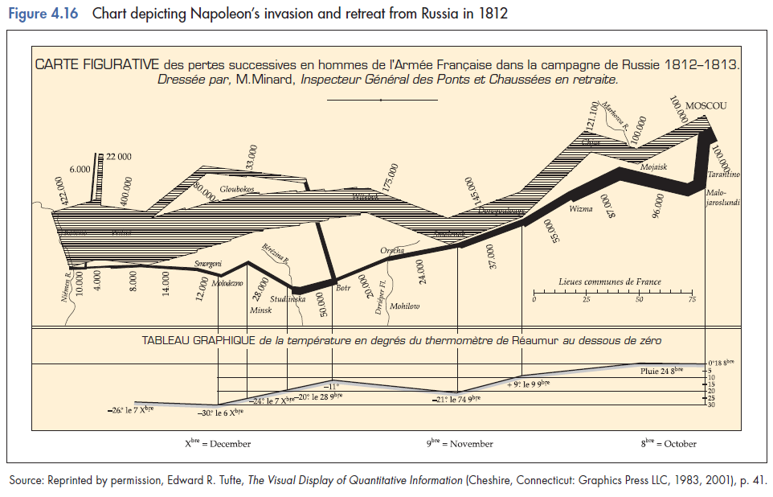
Graphical excellence…
4.51

Slide 52
Graphical excellence…
4.52
Many consider Charles Joseph Minard’s original time series chart to be the best statistical graphic ever drawn. Why?
He took a two dimensional space and managed to accurately depict five data variables:
size of invading army,
size of retreating army,
geographic location,
temperature, and
time.
The multivariate data is presented in such a way as to provide an intriguing narrative as to the fate of Napoleon’s army.

Slide 53

When should graphs be used?
4.53
Graphical techniques should be used when there is a large amount of data…
The bar chart for the data above in the table is unnecessary because:
only three numbers are represented.
there is no analysis associated with the data.

Slide 54
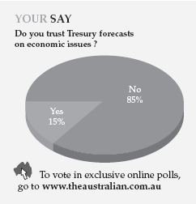
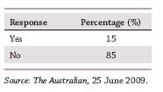
When should graphs be used?
4.54
Graphical techniques should be used when there is reasonable comparisons to be made…
This is a pie chart that contains only 2 responses. Here the table would easily suffice.

Slide 55
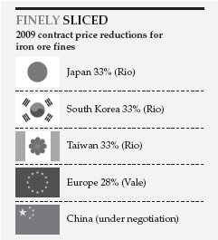
When should graphs be used?
4.55
The chart on the left contains only information on 5 countries and 5 numbers…
Even if we remove the flags, the numbers still speak for themselves. Flags are unnecessary, other than being colourful and eye-catching. Here, a table would suffice.

Slide 56
When should graphs be used?
4.56
Here is a pie chart that represent only 3 numbers…
…it catches your eye, but provides no useful information.

Slide 57
Graphical Deception…
4.57
Graphical techniques create a visual impression, which is easy to distort, therefore…
It is more important than ever to be able to critically evaluate the graphically presented information.
Be wary of graphs without a scale on one axis.
Understand the information being presented: absolute values? relative values (e.g. percentages)?
Are the horizontal or vertical axes distorted in any way?

Slide 58
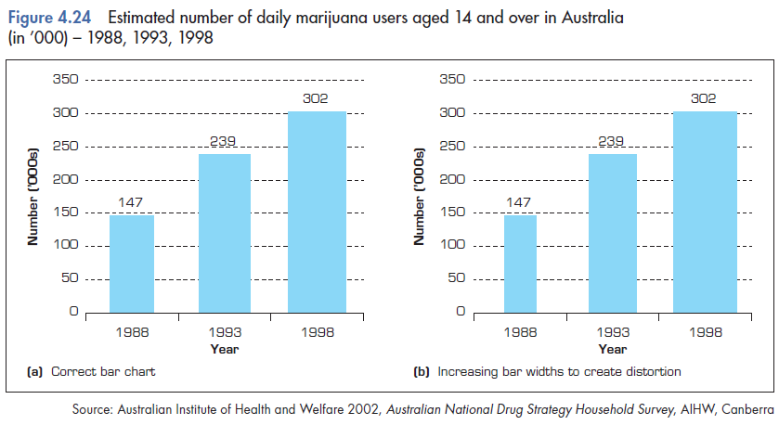
Some examples of graphical deception
4.58

Slide 59
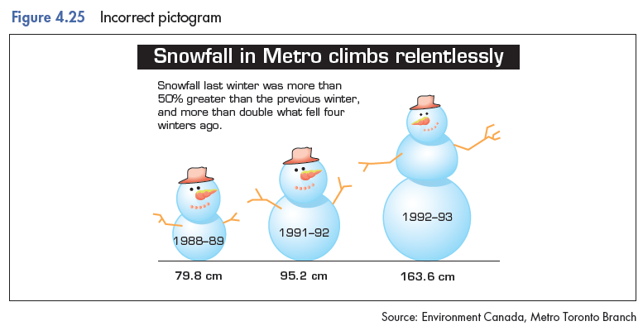
Some examples of graphical deception…
4.59

Slide 60
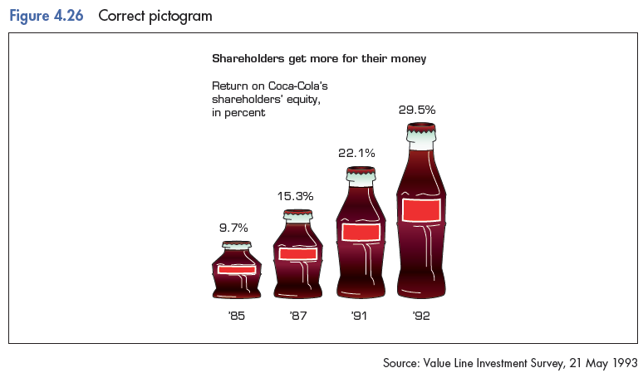
Some examples of graphical deception…
4.60

Slide 61
Written Reports
4.61
Here is one suggested method for structuring a report that presents statistical information and analysis to other users. Include:
Objective statements
Description of the experiment
Results
Describe using words, tables, and charts.
Discussion of limitations
Discuss problems with the analysis
Include violations of required conditions, assumptions, etc.

Slide 62
Oral Presentation…
4.62
Again, here are some general guidelines for presenting your statistical findings to others in a presentation setting…
1. Know your audience
What kind of information will they be expecting?
What is their level of statistical knowledge?
2. Restrict your points to the main study objectives
Don’t go into the details of your analysis
3. Stay within time limits
Respect your audience
4. Use graphs
Use the graphical excellence ideas here to explain complex ideas
Provide well-prepared handouts
For example, a copy of your PowerPoint presentation

