Slide 1


Slide 2
Chapter 5
Numerical descriptive measures

Slide 3
Chapter outline
5.1 Measures of central location
5.2 Measures of variability
5.3 Measures of relative standing and box plots
5.4 Approximating descriptive measures for grouped data
5.5 Measures of association
5.6 General guidelines on the exploration of data

Slide 4
Learning objectives
LO1 Calculate mean, median and mode, and explain the relationships between them
LO2 Calculate range, variance, standard deviation and coefficient of variation
LO3 Interpret the use of standard deviation through empirical rule and Chebyshev’s theorem
LO4 Explain the concepts of percentiles, deciles, quartiles and interquartile range, and show their usefulness through the application of a box plot
LO5 Calculate the mean and variance when the data are already in grouped form
LO6 Obtain numerical measures to calculate the direction and strength of the linear relationship between two variables
LO7 Understand the use of graphical methods and numerical measures to present summary information about a data set.

Slide 5
Introduction
5.5
In Chapter 4, we considered graphical descriptive techniques to summarize numerical data. In this chapter, we present a number of numerical measures to summarise numerical data.

Slide 6
Introduction
5.6
Popular Numerical Descriptive Measures
Measures of central location
Mean, median, mode
Measures of variability
Range, standard deviation, variance, coefficient of variation
Measures of relative standing and box plots
Percentiles, quartiles
Measures of linear relationship
Covariance, correlation, coefficient of determination, least squares regression line

Slide 7
5.1 Measures of central location
5.7
Three main types of measures of central location are:
Arithmetic mean (or average)
Median
Mode

Slide 8
Arithmetic Mean (or Average)
5.8
The mean is the most popular and useful measure of central location.
Sum of measurements
Number of measurements
Mean =
Sample mean
Population mean
Sample size
Population size

Slide 9
Example 1
5.9
Find the mean of a sample of six measurements
1, 3, 5, 2, 4, 3
Solution:
1
3
5
2
4
3
3.0

Slide 10
5.10
Example 2
When many of the measurements have the same value, the measurement can be summarised in a frequency table. Suppose the numbers of children in a sample of 20 families were recorded below. Calculate the average number of children in a family.
NUMBER OF CHILDREN 0 1 2 3 4
NUMBER OF FAMILIES 3 4 7 2 4
Solution:
20 families
Average number of children in a family is

Slide 11
5.11
The arithmetic mean…
The average or the arithmetic mean is appropriate for describing measurement data, e.g. heights of people, marks of student exams, etc.
The mean is seriously affected by extreme values called ‘outliers’. E.g. as soon as a billionaire moves into a neighborhood, the average household income for the neighbourhood increases beyond what it was previously!

Slide 12
Median
5.12
Another most commonly used measure of central location is the median.
The median of a set of measurements is the value that falls in the middle when the measurements are arranged in order of magnitude.

Slide 13
Example 3
5.13
The median is calculated by placing all the observations in order; the observation that falls in the middle is the median.
Data: {0, 7, 12, 5, 14, 8, 0, 9, 22} N=9 (odd)
Sort them bottom to top, find the middle:
0 0 5 7 8 9 12 14 22
Median = 8
Data: {0, 7, 12, 5, 14, 8, 0, 9, 22, 33} N=10 (even)
Sort them bottom to top, the middle is the
simple average between 8 & 9:
0 0 5 7 8 9 12 14 22 33
Median = (8+9)÷2 = 8.5
Sample and population medians are computed the same way.

Slide 14
Impact of an outlier on the Mean and Median
5.14
Example 4
Seven employee salaries were recorded (in ‘000s):
42, 45, 40, 46, 44, 40, 43.
Find the median salary.
Suppose the director’s salary of $200 000 was added to the group recorded before. Find the median salary.
Compare the mean and the median values for the data in parts a and b.

Slide 15
Example 4: Solution
5.15
a. Odd number of observations
b. Even number of observations
First, sort the salaries.
Then, locate the value in the middle.
First, sort the salaries.
Then, locate the values in the middle.
There are two middle values!
40,40,42,43,44,45,46,200
40,40,42,43, 44,45,46,200
40,40,42,43,44,45,46
40,40,42,43, 44,45,46,200
43.5,

Slide 16
Example 4: Solution…
5.16
For the data in (a) and (b),
(a) Without the outlier (b) With the outlier
As can be seen, the median did not change that much (43 vs 43.5), even with the outlier (200). However, the mean has changed from 42.8 to 62.5.
Mean is affected by the outlier, whereas the median is not.

Slide 17
5.17
Mode
Another commonly used measure of central location is the mode.
The mode of a set of observations is the value that occurs most frequently.
A set of data may have one mode (or modal class), or two or more modes.
Mode is useful for all data types, though mainly used for nominal data.
For large data sets, the modal class is much more relevant than a single-value mode.

Slide 18
5.18
Mode
For large data sets
the modal class is
much more relevant
than the a single-
value mode.
The modal class
Sample and population modes are computed the same way.

Slide 19
5.19
Example 5
(Example 5.4, page 134)
XM05-04 The manager of a menswear store observed the waist size (in centimeters) of trousers sold yesterday: 77, 85, 90, 85, 82, 70, 85, 75, 85, 80, 77, 100, 85, 70. Suggest a suitable size of trousers to be ordered more with the next order.
Solution:
The mode, the size with the highest sales, for this data set, is 85 cm.
Mean = 81.9
Median = 83.5
This information seems valuable (for example, for the design of a new display in the store), much more than ‘the median is 83.5 cm’.

Slide 20
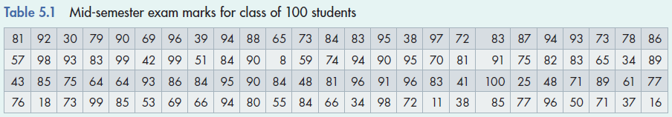
5.20
Example 6
(Example 5.6, page 136)
XM05-06 A statistician wants to report the results of a mid-semester exam, taken by 100 students. Find the mean, median and mode, and describe the information they provide.

Slide 21
5.21
Example 6: Solution
The mean provides information about the over-all performance level of the class. It can serve as a tool for making comparisons with other classes and/or other exams.
Excel Output
The Median indicates that half of the class received a grade below 81%, and half of the class received a grade above 81%.
The mode must be used when data is nominal. If marks are classified by letter grade, the frequency of each grade can be calculated. Then, the mode becomes a logical measure to compute.
Note: If your data is multi-modal, then Excel prints the smallest one or N/A.

Slide 22
Excel Histogram for Example 6
5.22
The histogram is skewed to the left
Modal class

Slide 23
Relationship between Mean, Median and Mode
5.23
If a distribution is symmetrical, the mean, median and mode coincide.
A symmetric distribution
Mean=Median=Mode
If the distribution is symmetrical, then
Mean = Median = Mode.

Slide 24







Relationship between Mean, Median and Mode
5.24
If a distribution is not symmetrical, and skewed to the right (positively skewed), the three measures differ.
A positively skewed distribution
(‘skewed to the right’)
Mode
Mean
Median
If the distribution is positively skewed, then
Mean > Median > Mode.

Slide 25





Relationship between Mean, Median and Mode
5.25
If a distribution is not symmetrical, and skewed to the left (negatively skewed), the three measures differ.
A negatively skewed distribution
(‘skewed to the left’)
Mean
Mode
Median
If the distribution is negatively skewed, then
Mean < Median < Mode.

Slide 26
5.26
Mean, Median, Mode: Which is best?
With three measures from which to choose, which one should we use?
The mean is generally our first selection. However, there are several circumstances when the median is better (for example, if there are outliers in the dataset).
The mode is seldom the best measure of central location.
One advantage the median holds is that it not as sensitive to extreme values as is the mean.

Slide 27
5.27
Mean, Median, Mode: Which is best?...
To illustrate, consider the data the following example.
The number of hours of Internet use in the previous month among 10 primary school children were 13, 11, 12, 10, 13, 14, 11, 7, 9, 10.
The mean was 11.0 and the median was 8.5.
Now suppose that the child who reported 14 hours actually reported 114 hours (obviously an Internet addict). The data now is 13, 11, 12, 10, 13, 114, 11, 7, 9, 10.
The new mean is 21.0 and the median is 8.5.
The median is not affected much by this outlier, but the mean is.

Slide 28
5.28
Mean, Median, Mode: Which is best?...
This value is only exceeded by only one of the ten observations in the sample, making this statistic (mean) a poor measure of central location.
The median stays the same.
When there is a relatively small number of extreme observations (either very small or very large, but not both), the median usually produces a better measure of the center of the data.
28

Slide 29
Mean, Median and Mode for Ordinal and Nominal Data
5.29
For ordinal and nominal data, the calculation of the mean is not valid.
Median is appropriate for ordinal data.
For nominal data, a mode calculation is useful for determining highest frequency, but not ‘central location’.

Slide 30
Measures of Central Location – Summary
5.30
Compute the mean to
Describe the central location of a single set of numerical (or interval) data.
Compute the median to
Describe the central location of a single set of numerical or ordinal (ranked) data.
Compute the mode to
Describe a single set of nominal (or categorical) data.

Slide 31
5.2 Measures of variability
5.31
Measures of central location fail to tell the whole story about the distribution.
A question of interest still remains unanswered:
How typical is the average value of all
the measurements in the data set?
or
How spread out are the measurements
around the average value?

Slide 32
Observe Two Hypothetical Data Sets
5.32
Low variability data set
The average value provides
a good representation of the
values in the data set.
High variability data set
This is the previous
data set. It is now
changing to ...
The same average value does not provide as good presentation of the values in the data set as before.

Slide 33
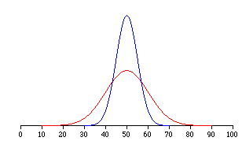
Measures of Variability…
5.33
Measures of central location fail to tell the whole story about the distribution; that is, how much are the observations spread out around the mean value?
For example, two sets of class grades are shown. The mean (=50) is the same in each case…
But, the red class has greater variability than the blue class.

Slide 34
Range
5.34
The range is the simplest measure of variability, calculated as:
Range = Largest observation – Smallest observation
E.g.
Data: {4, 4, 4, 4, 50} Range = 46
Data: {4, 8, 15, 24, 39, 50} Range = 46
The range is the same in both cases, but the data sets have very different distributions…

Slide 35
Range…
5.35
Its major advantage is the ease with which it can be computed.
Its major shortcoming is its failure to provide information on the dispersion of the observations between the two end points.
Hence we need a measure of variability that incorporates all the data and not just two end point observations. Hence…

Slide 36
Range…
5.36
But how do all the measurements spread out?
The range cannot assist in answering this question.
Range
?
?
?
Smallest
measurement
Largest
measurement

Slide 37
Variance
5.37
Variance and its related measure, standard deviation, are arguably the most important statistics used to measure variability. They also play a vital role in almost all statistical inference procedures.
Population variance is denoted by σ²
(lower case Greek letter ‘sigma’ squared).
Sample variance is denoted by s²
(lower case ‘S’ squared).

Slide 38
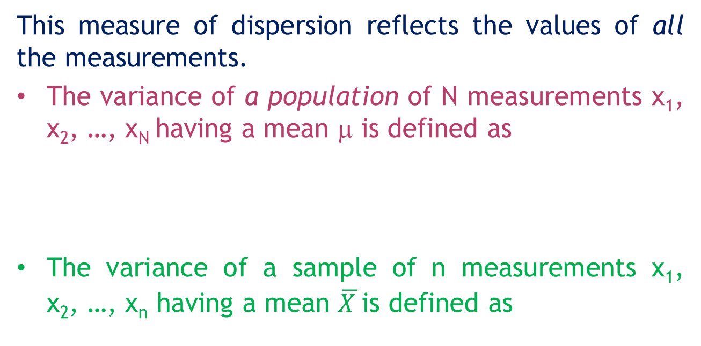
Variance…
5.38
This measure of dispersion reflects the values of all the measurements.
The variance of a population of N measurements x₁, x₂, …, x_{N} having a mean μ is defined as
The variance of a sample of n measurements x₁, x₂, …, x_{n} having a mean $\overline{X }$is defined as

Slide 39
5.39
Consider two small populations:
Population A: 8, 9, 10, 11, 12
Population B: 4, 7, 10, 13, 16
9–10= –1
11–10= +1
8–10= –2
12–10= +2
Thus, a measure of dispersion
is needed that agrees with this
observation.
Sum = 0
Let us start by calculating
the sum of deviations
The sum of deviations
is zero in both cases,
therefore another
measure is needed.
A
8
9
10
11
12
… but measurements in B
are much more dispersed
then those in A.
The mean of both
populations is 10...
4–10 = –6
B
16–10 = +6
7–10 = –3
13–10 = +3
4
7
10
13
16
Sum = 0

Slide 40
5.40
9–10= –1
The sum of squared deviations
is used in calculating the variance.
See example next.
11–10= +1
8–10= –2
12–10= +2
Sum = 0
The sum of deviations
is zero in both cases,
therefore another
measure is needed.
A
8
9
10
11
12
4–10 = – 6
B
16–10 = +6
7–10 = –3
13–10 = +3
4
7
10
13
16
Sum = 0

Slide 41
5.41
Variance…
Let us calculate the variance of the two populations.
Why is the variance defined as
the average squared deviation?
Why not use the sum of squared
deviations as a measure of
dispersion instead?
After all, the sum of squared
deviations increases in
magnitude when the dispersion
of a data set increases!

Slide 42
5.42
Which data set has a larger dispersion?
Let us calculate the sum of squared deviations for both data sets.
However, when calculated on a ‘per observation’ basis (variance), the data set dispersions are properly ranked.
1
3
1
3
Data set B is more dispersed around the mean.
1
3
A
1
3
B
1
3
1
5
1
2
3
1
3
5
SumA = (1–2)² +…+(1–2)² +(3–2)² +… +(3–2)² = 10
σA² = SumA/N = 10/10 = 1
5 times
5 times
!
SumB = (1–3)² + (5–3)² = 8
σB² = SumB/N = 8/2 = 4

Slide 43
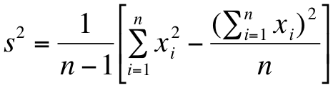
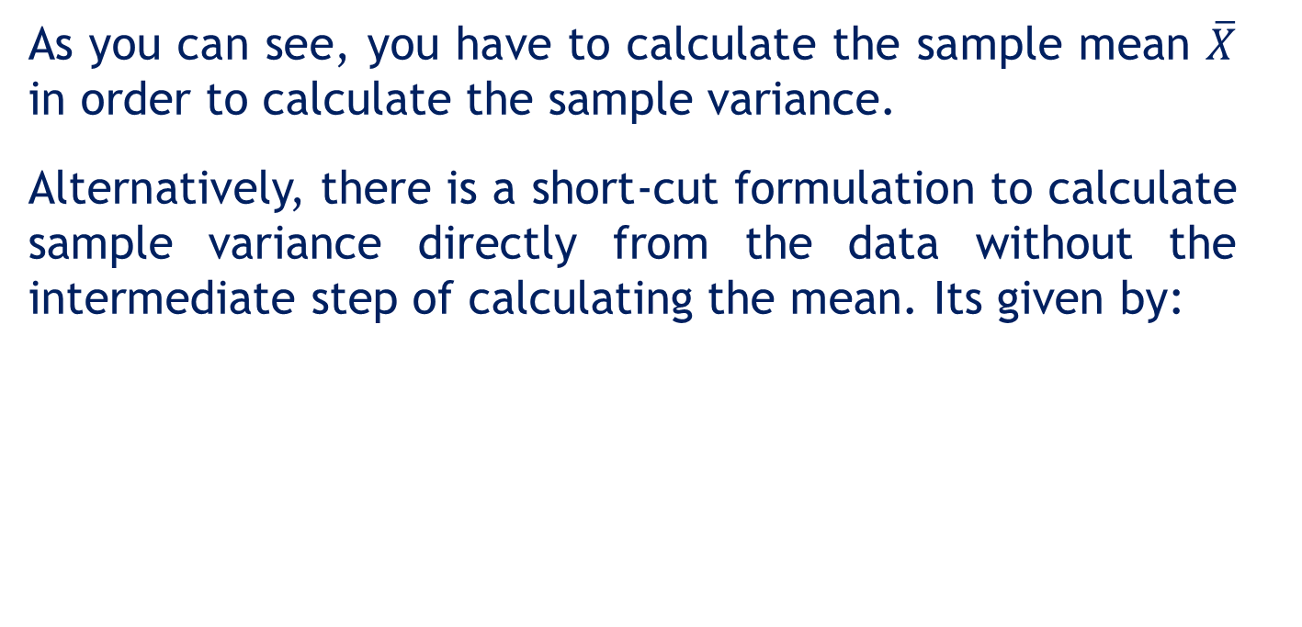
5.43
Variance…
As you can see, you have to calculate the sample mean $\overline{X}$ in order to calculate the sample variance.
Alternatively, there is a short-cut formulation to calculate sample variance directly from the data without the intermediate step of calculating the mean. Its given by:

Slide 44

Example 7
5.44
The following sample consists of the number of jobs six students applied for: 17, 15, 23, 7, 9, 13. Finds its mean and variance.
Solution:
Sample Mean
…as opposed to μ or σ²

Slide 45


Example 7: Solution…
5.45
Sample Variance
Sample Variance (shortcut method)

Slide 46
Standard deviation
5.46
The standard deviation of a set of measurements is the square root of the variance of the measurements.

Slide 47
Example 8 (Example 5.8, page 149)
5.47
XM05-08 Rates of return over the past 10 years for two unit trusts are shown below. Which one has a higher level of risk?
Trust A: 12.3, –2.2, 24.9, 1.3, 37.6, 46.9, 28.4, 9.2, 7.1, 34.5
Trust B: 15.1, 0.2, 9.4, 15.2, 30.8, 28.3, 21.2, 13.7, 1.7, 14.4

Slide 48
Example 8: Solution
5.48
Using Data > Data Analysis > Descriptive Statistics in Excel, we produce the following tables for interpretation…
Even though Trust A has a higher average return, it should be considered riskier because its standard
deviation is larger.

Slide 49
Interpreting Standard Deviation
5.49
The standard deviation can be used to compare the variability of several distributions and make a statement about the general shape of a distribution.
If the histogram is bell shaped, we can use the Empirical Rule, which states:
Approximately 68% of all observations fall within one standard deviation of the mean.
Approximately 95% of all observations fall within two standard deviations of the mean.
Approximately 99.7% of all observations fall within three standard deviations of the mean.

Slide 50
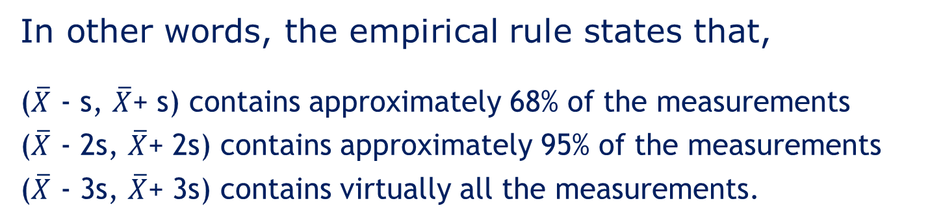
Empirical rule
5.50
In other words, the empirical rule states that,
($\overline{X}$ - s, $\overline{X}$+ s) contains approximately 68% of the measurements
($\overline{X}$ - 2s, $\overline{X}$+ 2s) contains approximately 95% of the measurements
($\overline{X}$ - 3s, $\overline{X}$+ 3s) contains virtually all the measurements.
50
Notes:
50

Slide 51
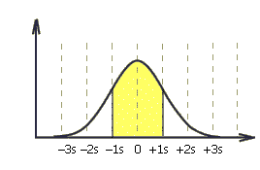
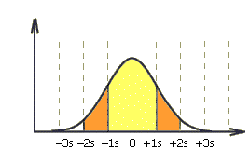

Empirical rule…
5.51
Approximately 68% of all observations fall within one standard deviation of the mean.
Approximately 95% of all observations fall within two standard deviations of the mean.
Approximately 99.7% of all observations fall within three standard deviations of the mean.

Slide 52
Example 9
5.52
A statistician wants to describe the way returns on investment are distributed.
The mean return = 10%
The standard deviation of the return = 3%
The histogram is bell-shaped.
How can the statistician use the mean and the standard deviation to describe the distribution?

Slide 53
Example 9: Solution
5.53
The empirical rule can be applied (bell-shaped histogram).
Describing the return distribution:
Approximately 68% of the returns lie between 7% and 13% [10 – 1(3), 10 + 1(3)]
Approximately 95% of the returns lie between 4% and 16% [10 – 2(3), 10 + 2(3)]
Approximately 99.7% of the returns lie between 1% and 19% [10 – 3(3), 10 + 3(3)]

Slide 54
Example 10 (Example 5.10, page 152)
5.54
XM05-10 The duration of 30 long-distance telephone calls (in minutes) are shown below. Check the empirical rule for this set of measurements.

Slide 55
Example 10: Solution
5.55
1. First check if the histogram has an approximate mound-shape:

Slide 56
5.56
Example 10: Solution…
2. Calculate the mean and the standard deviation:
mean = 10.26; standard deviation = 4.29.
3. Calculate the intervals:
k Interval Empirical Actual
rule percentage
1 = [ 5.97, 14.55] 68% 70%
2 = [ 1.68, 18.84] 95% 96.7%
3 = [–2.61, 23.13] 100% 100%

Slide 57
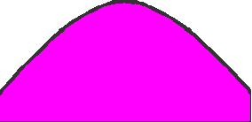
5.57
Approximate standard deviation
By the empirical rule, approximately 95% of the area under a mound-shaped histogram lies within
Therefore, range can be approximated by 4s. In other words,
95%
of the area
For Example 8, for Trust B returns, the range is 30.8 - 0.2 = 30.6 percent.
Actual standard deviation of Trust B returns is 9.97%

Slide 58
5.58
Chebyshev’s theorem
Given any set of measurements and a number k (greater than 1), the fraction of these measurements that lie within k standard deviations around the mean is at least 1–1/k².
This theorem is valid for any set of measurements (sample, population) of any shape.
k Interval Chebyshev Empirical rule
1 approx 68%
2 at least 75% approx 95%
3 at least 89% approx 100%
1–1/2²=3/4 or 75%
1–1/3²=8/9 or 89%

Slide 59
Interpreting Standard Deviation
5.59
Suppose that the mean and standard deviation of last year’s mid-semester exam marks are 70 and 5, respectively.
If the histogram is bell-shaped, then we know that approximately 68% of the marks fell between 65 and 75, approximately 95% of the marks fell between 60 and 80, and approximately 99.7% of the marks fell between 55 and 85.
If the histogram is not at all bell-shaped we can say that at least 75% of the marks fell between 60 and 80, and at least 89% of the marks fell between 55 and 85. (We can use other values of k.)

Slide 60
Coefficient of Variation
5.60
The coefficient of variation of a set of measurements is the standard deviation divided by the mean value.

Slide 61
Coefficient of Variation
5.61
This coefficient provides a proportionate measure of variation.
A standard deviation of 10 may be perceived as large when the mean value is 100, but only moderately large when the mean value is 500.

Slide 62
5.3 Measures of relative standing and box plots
5.62
Measures of relative standing are designed to provide information about the position of particular values relative to the entire data set.
Percentile: the p^{th} percentile is the value for which p percent are less than that value and (100-p)% are greater than that value.
Suppose you scored in the 60th percentile on your final exam, that means 60% of the other students’ scores were below yours, while 40% of scores were above yours.

Slide 63
Percentiles
5.63
The p^{th} percentile of a set of measurements is the value for which
at most p% of the measurements are less than that value
at most (100-p)% of all the measurements are greater than that value.
For example, suppose 77 is the 68th percentile of a statistics exam score. Then
68% of all the scores lie here
Other 32%
0
77
100

Slide 64
Quartiles
5.64
We have special names for the 25th, 50th and the 75th percentiles, namely quartiles.
First (lower) quartile, Q₁ = 25th percentile (p₂₅)
Second (middle) quartile, Q₂ = 50th percentile (p₅₀) (which is also the median)
Third (upper) quartile, Q₃ = 75th percentile (p₇₅)
We can also convert percentiles into quintiles (fifths) and deciles (tenths).

Slide 65
Commonly Used Percentiles…
5.65
First (lower) decile = 10th percentile
First (lower) quartile, Q₁ = 25th percentile
Second (middle)quartile,Q₂ = 50th percentile
Third quartile, Q₃, = 75th percentile
Ninth (upper) decile = 90th percentile
For example, if your exam mark places you in the 80th percentile, that doesn’t mean you scored 80% on the exam – it means that 80% of your peers scored lower than you and 20% scored higher than you in the exam. It is about your position relative to others, not the actual mark.
65

Slide 66
Example 11
5.66
Find the quartiles of the following set of measurements
7, 18, 12, 17, 29, 18, 4, 27, 30, 2, 4, 10, 21, 5, 8

Slide 67
Example 11: Solution
5.67
First sort the measurements
2, 4, 4, 5, 7, 8, 10, 12, 17, 18, 18, 21, 27, 29, 30
15 measurements
The first quartile
At most (0.25)(15) = 3.75 measurements
should appear below the first quartile.
Check the first 3 measurements on the
left hand side.
At most (0.75)(15)=11.25 measurements
should appear above the first quartile.
Check 11 measurements on the
right hand side.
If the number of measurements is even, two measurements will remain unchecked. In this case choose the midpoint between these two measurements.

Slide 68
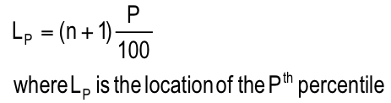
Location of Percentiles
5.68
Find the location of any percentile using the formula

Slide 69
Example 12
5.69
Calculate the 25th, 50th, and 75th percentile of the data:
0, 7, 12, 5, 33, 14, 8, 0, 9, 22

Slide 70
Example 12: Solution
5.70
After sorting the data we have
0, 0, 5, 7, 8, 9, 12, 14, 22, 33.
Location (1) (2) (3) (4) (5) (6) (7) (8) (9) (10)
Values
0 5
0
3.75
2.75
Location
2 3
Location
1
Location 3
The 2.75th location translates to the value
p25 = 0 + (.75)(5 – 0) = 3.75
2nd observation
3rd observation
2nd observation

Slide 71
Example 12: Solution…
5.71
The 50th percentile is halfway between the fifth and sixth observations (in the middle between 8 and 9), that is 8.5. That is,
p₅₀ = 8 + (0.5)(9 – 8) = 8.5
5th observation
6th observation

Slide 72
Example 12: Solution…
5.72
The 75th percentile is one quarter of the distance between the eighth and ninth observation. That is
p₇₅ = 14+.25(22 – 14) = 16.
8th
observation
9th
observation

Slide 73
Location of Percentiles…
5.73
Please remember…
position
2.75
value
16
0 0 | 5 7 8 9 12 14 | 22 33
value
3.75
position
8.25
Lp determines the position in the data set where the percentile value lies, not the value of the percentile itself.

Slide 74
Quartiles and Variability
5.74
Quartiles can provide an idea about the shape of a histogram.
Q1 Q2 Q3
Q1 Q2 Q3
Positively skewed
histogram
Negatively skewed
histogram

Slide 75
Interquartile Range…
5.75
The quartiles can be used to create another measure of variability, the interquartile range, which is defined as follows:
Interquartile Range (IQR) = Q₃ – Q₁
The interquartile range measures the spread of the middle 50% of the observations.
Large values of this statistic mean that the 1st and 3rd quartiles are far apart, indicating a high level of variability.

Slide 76
Box Plots
5.76
Box Plot is a pictorial display that graphs five main descriptive measures of the measurement set:
L – The largest measurement
Q₃ – The upper quartile
Q₂ – The median
Q₁ – The lower quartile
S – The smallest measurement
An adjustment to this general
description of a box plot may
be needed in the presence of
outliers. See the next example.
S
Q1
Q2
Q3
L

Slide 77
Box Plots…
5.77
The box plot is a technique that graphs five statistics:
• the minimum and maximum observations, and
the first, second, and third quartiles.
Whisker
(1.5×IQR)
Q1 Q2 Q3
Whisker (1.5×IQR)

Slide 78
Box Plots…
5.78
The lines extending to the left and right are called whiskers.
Any points that lie outside the whiskers are called outliers.
The whiskers extend outward to the smaller of 1.5 times the interquartile range or to the most extreme point that is not an outlier.

Slide 79
Example 13
5.79
Create a box plot for the data regarding the number of customers who purchased petrol in an Independent petrol station each day in the last 200 days.
The following are the relevant summary statistics for the data:
smallest number = 410
Q1 = 530
Q2 = 560
Q3 = 590
largest number = 700

Slide 80

5.80
Example 13: Solution
440
680
S
410
Q1
530
Q2
560
Q3
590
L
700
IQR = Q3 – Q1 = 590 – 530 = 60
Fences ={Q1 – 1.5(IQR), Q3 + 1.5(IQR)} = {440, 680}
The outliers are 700 and 410.
Therefore, the whiskers will extend to the two extreme
values that are not outliers (440 and 680).

Slide 81
5.81
Example 13: Solution…
440
680
S
410
Q1
530
Q2
560
Q3
590
L
700
25%
50%
25%
Interpreting the box plot results
The number of customers range from 410 to 700.
About half the days, the number of customers are less than 560, and about half are greater than 560.
About half the days, the number of customers lie between 530 and 590.
About a quarter lies below 530 and a quarter above 590.

Slide 82
5.82
S
410
Q1
530
Q2
560
Q3
590
L
700
25%
50%
25%
The distribution is very symmetrical.
50%
25%
25%
410
700

Slide 83
5.4 Approximating Descriptive Measures for Grouped Data
5.83
Approximating descriptive measures for grouped data may be needed when approximated values satisfy the needs when only secondary grouped data are available.
midpoint of class i
number
of classes
fimi is approx. equal
to the sum of
measurements
in class i
frequency of class i
n = f1+f2+…+ fk

Slide 84
5.84
Example 14
(Example 5.15, page 169)
Approximate the mean and standard deviation of the telephone call durations problem, represented by the frequency distribution.

Slide 85
5.85
Example 14: Solution
Class Class Frequency Midpoint
i limits fi mi fimi fimi²
1 2–5 3 3.5 10.5 36.75
2 5–8 6 6.5 39.0 253.5
3 8–11 8 9.5 76.0 722.0
4 11-14 7 12.5 87.5 1093.75
5 14-17 4 15.5 62.0 962.0
6 17–20 2 18.5 37.0 684.5 n = 30 312.0 3,751.5
3.5
6.5

Slide 86
5.5 Measures of Association
5.86
Two numerical measures are presented, for the description of linear relationship between two variables depicted in the scatter diagram.
Covariance (is there any pattern to the way two variables move together?)
Correlation coefficient (how strong is the linear relationship between two variables?)

Slide 87
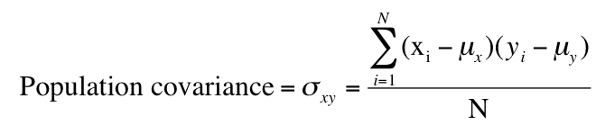
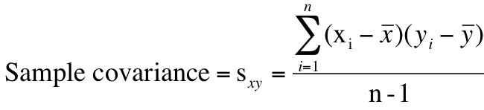
Covariance…
5.87
population mean of variable X, variable Y
sample mean of variable X, variable Y
Note: divisor is n-1, not n as you may expect.
87

Slide 88
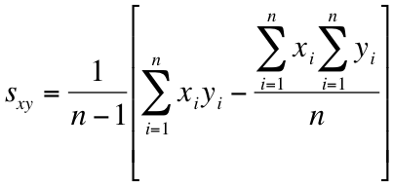
Covariance…
5.88
In much the same way there was a ‘shortcut’ for calculating sample variance without having to calculate the sample mean, there is also a shortcut for calculating sample covariance without having to first calculate the means:

Slide 89
Covariance…
5.89
When two variables move in the same direction (both increase or both decrease), the covariance will be a large positive number.
When two variables move in opposite directions, the covariance is a large negative number.
When there is no particular pattern, the covariance is a small number.
However, it is often difficult to determine whether a particular covariance is large or small. The next parameter/statistic addresses this problem.

Slide 90


Coefficient of Correlation…
5.90
The coefficient of correlation is defined as the covariance divided by the standard deviations of the variables:
Greek letter ‘rho’

Slide 91
Coefficient of Correlation…
5.91
The coefficient of correlation answers the question:
How strong is the association between X and Y?
The coefficient of correlation can take positive or negative values.
It can take only values between –1 and +1.

Slide 92
5.92
Coefficient of Correlation…
r → +1
+1
0
–1
Strong positive linear relationship
COV(X,Y)>0
ρ or r =
No linear relationship
r = 0
COV(X,Y)=0
Strong negative linear relationship
COV(X,Y)<0
r → -1

Slide 93
Coefficient of Correlation…
5.93
Strong positive linear relationship
If the two variables are very strongly positively linear related, the coefficient value is close to +1.
Strong negative linear relationship
If the two variables are very strongly negatively linear related, the coefficient value is close to –1.
No linear relationship
No linear (straight line) relationship is indicated by a coefficient value close to zero.

Slide 94
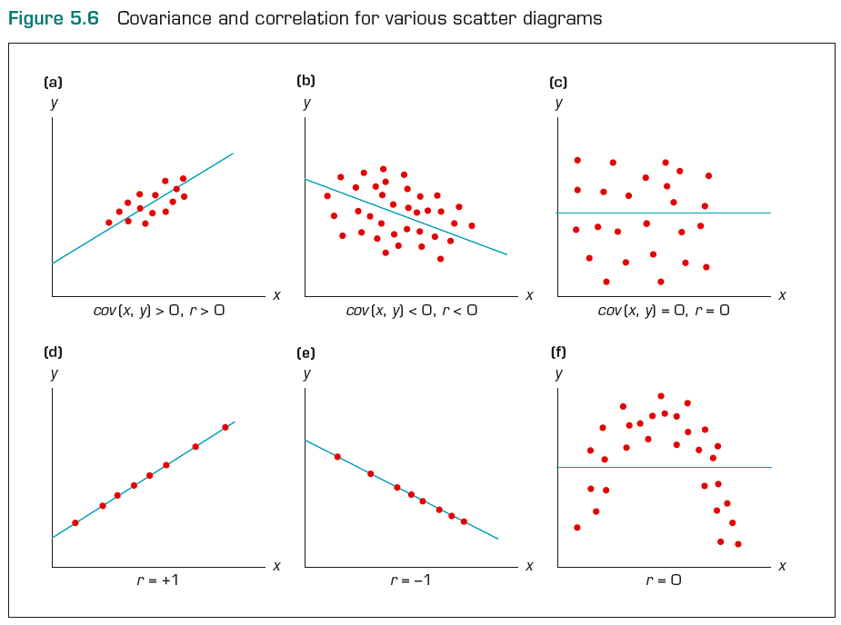
Coefficient of Correlation…
5.94

Slide 95
5.95
Example 15
Compute the covariance and the coefficient of correlation between advertising expenditure and sales level and discuss the strength and direction of the relationship between them. Base your calculation on the data (in millions) provided below.

Slide 96
5.96
Example 15: Solution
Use the short-cut formulae below to obtain the required covariance and the coefficient of correlation.

Slide 97
5.97
x
y
xy
x²
y²
Similarly, sy = 8.839

Slide 98
5.98
Excel output
Interpretation
The covariance (10.2679) indicates that advertisement expenditure and sales level are positively related
The coefficient of correlation (0.797) indicates that there is a strong positive linear relationship between advertisement expenditure and sales level.
Covariance matrix
Correlation matrix

Slide 99
The Least Squares Method
5.99
The objective of the scatter diagram is to measure the strength and direction of the linear relationship.
Both can be more easily judged by drawing a straight line through the data.
We need an objective method of producing a straight line.
Such a method has been developed; it is called the least squares method.
99

Slide 100
The Least Squares Method…
5.100
Recall, the slope-intercept equation for a line is expressed in these terms:
y = mx + b
where:
m is the slope of the line
b is the y-intercept.
If we’ve determined that there is a linear relationship between two variables using the covariance and the coefficient of correlation, can we determine a linear function of the relationship?

Slide 101

The Least Squares Method
5.101
…produces a straight line drawn through the points so that the sum of squared deviations between the points and the line is minimised. This line is represented by the equation:
(‘beta’ naught hat) is the y-intercept,
(‘ (beta’ one hat) is the slope, and
(‘y’ hat) is the value of y determined by the line.

Slide 102
The Least Squares Method
5.102
The coefficients and are given by:

Slide 103
Fixed and Variable Costs
5.103
Fixed costs are costs that must be paid whether or not any units are produced.
These costs are ‘fixed’ over a specified period of time or range of production.
Variable costs are costs that vary directly with the number of products produced.

Slide 104
Fixed and Variable Costs
5.104
There are some expenses that are mixed.
There are several ways to break the mixed costs in its fixed and variable components. One such method is the least squares line. That is, we express the total costs of some component as
y = β₀ + β₁x
where y = total mixed cost, β₀ = fixed cost and β₁ = variable cost, and x is the number of units.

Slide 105
5.105
Example 16
(Example 5.18, page 181)
XM05-18 A tool and die maker operates out of a small shop making specialised tools. He is considering increasing the size of his business and needs to know more about his costs.
One such cost is electricity, which he needs to operate his machines and lights. (Some jobs require that he turn on extra bright lights to illuminate his work.) He keeps track of his daily electricity costs and the number of tools that he made that day. Determine the fixed and variable electricity costs.

Slide 106
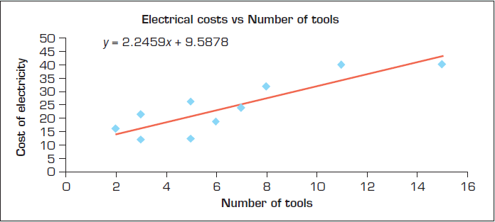
5.106
Example 16: Solution
The slope is defined as rise/run, which means that it is the change in y (rise) for a 1-unit increase in x (run).
Electrical cost = 9.587 + 2.245 (Number of tools)

Slide 107
5.107
Example 16: Solution
The slope measures the marginal rate of change in the dependent variable. The marginal rate of change refers to the effect of increasing the independent variable by one additional unit.
In this example, the slope is 2.245, which means that for each 1-unit increase in the number of tools, the marginal increase in the electricity cost 2.245. Thus, the estimated variable cost is $2.25 per tool.

Slide 108
5.108
Example 16: Solution
The y-intercept is 9.587.
That is, the regression line strikes the y-axis at 9.587. This is simply the value of when x = 0.
However, when x = 0, we are producing no tools and hence the estimated fixed cost of electricity is $9.59 per day.

Slide 109
5.109
Coefficient of Determination
When we introduced the coefficient of correlation we pointed out that except for −1, 0, and +1 we cannot precisely interpret its meaning.
We can judge the coefficient of correlation in relation to its proximity to −1, 0, and +1 only.
Fortunately, we have another measure that can be precisely interpreted. It is the coefficient of determination, which is calculated by squaring the coefficient of correlation. For this reason we denote it R².

Slide 110
5.110
Coefficient of Determination
The coefficient of determination measures the amount of variation in the dependent variable that is explained by the variation in the independent variable.

Slide 111
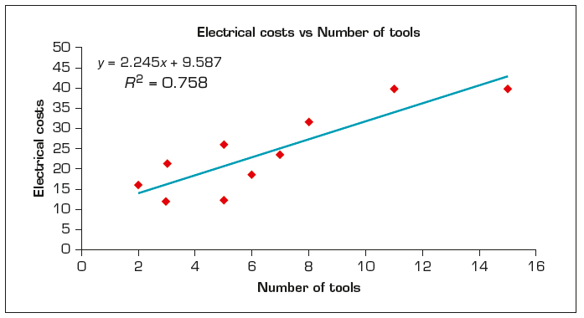
5.111
Example 16: Solution…

Slide 112
5.112
Example 16: Solution…
The coefficient of determination is
R² = 0.758
This tells us that 75.8% of the variation in electrical costs is explained by the number of tools. The remaining 24.2% is unexplained.

Slide 113
Interpreting Correlation
5.113
Because of its importance we remind you about the correct interpretation of the analysis of the relationship between two numerical variables. That is, if two variables are linearly related, it does not mean that X is causing Y. It may mean that another variable is causing both X and Y or that Y is causing X. Remember
‘Correlation is not Causation’

Slide 114
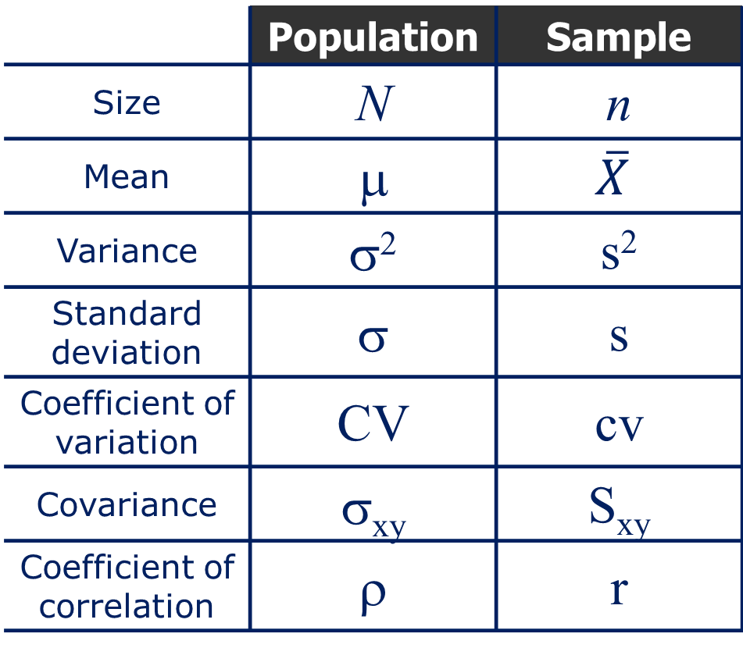
Parameters and Sample Statistics
5.114
 | Population | Sample
Size | N | n
Mean | μ
Variance | σ² | s²
Standard deviation | σ | s
Coefficient of variation | CV | cv
Covariance | σ_{xy} | S_{xy}
Coefficient of correlation | ρ | r

