Slide 1


Slide 2
Chapter 7
Random variables and discrete probability distributions

Slide 3
Chapter outline
7.1 Random variables and probability distributions
7.2 Discrete probability distributions
7.3 Expected value and variance
7.4 Bivariate distributions
7.5 Applications in finance: Portfolio diversification and asset allocation
7.6 Binomial distribution
7.7 Poisson distribution

Slide 4
Learning objectives
LO1 Explain the importance of probability distributions
LO2 Discuss the concept of a random variable and its probability distribution
LO3 Compute the mean and standard deviation of a discrete probability distribution, and apply the laws of expected value and variance
LO4 Explain the bivariate distribution and compute joint probabilities, covariances and correlations
LO5 Understand the Bernoulli trial and binomial distribution, and calculate the mean and the variance

Slide 5
Learning objectives…
LO6 Recognise when it is appropriate to use a binomial distribution, and understand how to use the table of binomial probabilities
LO7 Understand the Poisson distribution, recognise when it is appropriate to use a Poisson distribution and understand how to use the table of Poisson probabilities.

Slide 6
7.1 Random variables and probability distributions
A random variable is a function or a rule that assigns a numerical value to each outcome of an experiment.
Alternatively, the value of a random variable is a numerical event.
There are two types of random variables:
discrete random variables
continuous random variables

Slide 7
Two Types of Random Variables…
Discrete random variable
One that takes on a countable number of values
E.g. sum of values on the roll of two dice: 2, 3,…, 12.
Continuous random variable
One whose values are not discrete, not countable
E.g. time (30 mins, …, 30.01 mins, …, 30.02 mins, …)
Analogy:
Integers are discrete, while real numbers are continuous.

Slide 8
Discrete and Continuous Random Variables
A random variable is discrete if it can assume only a countable number of values.
A random variable is continuous if it can assume an uncountable number of values.
Discrete random variable
Continuous random variable
After the first value is defined the second value, and any value thereafter, are known.
After the first value is defined, any number can be the next one.
0
1
2
3 ...
0
1/16
1/4
1/2
1
Therefore, the number of values is countable.
Therefore, the number of values is uncountable.

Slide 9
Probability Distributions
A probability distribution is a table, formula, or graph that describes the values of a random variable and the probability associated with these values.
Since we’re describing a random variable (which can be discrete or continuous) we have two types of probability distributions:
discrete probability distributions (this chapter) and
continuous probability distributions (Chapter 8).

Slide 10
Probability Notation
An upper-case letter will represent the name of the random variable, usually X.
Its lower-case counterpart will represent the value of the random variable.
The probability that the random variable X will equal x is:
P(X = x), or more simply p(x)

Slide 11
7.2 Discrete probability distributions
A table, formula or graph that lists all possible values a discrete random variable can assume, together with their associated probabilities, is called a discrete probability distribution.
To calculate P(X = x), the probability that the random variable X assumes the value x, add the probabilities of all the simple events for which X is equal to x.

Slide 12
Example 1
Find the probability distribution of the random variable describing the number of heads that turn up when a coin is flipped twice.

Slide 13
Example 1: Solution
Possible outcomes: {HH, HT, TH, TT}
X = Number of heads = {0, 1, 2}
x p(x)
Simple event x Probability
HH 2 1/4
HT 1 1/4
TH 1 1/4
TT 0 1/4
0 1/4
1 1/2
2 1/4
1/4 if x = 0 or 2
p(x) =
1/2 if x = 1
X
0
1
2

Slide 14
7.14
The probability distribution can be used to calculate probabilities of different events.
Example 1 continued

Slide 15
Requirements of a Discrete Probability Distribution
7.15
If a discrete random variable can take values X = x_{i}, then the following must be true:
Probabilities as relative frequencies
In practice, probabilities are often estimated from relative frequencies.

Slide 16
Example 2
The number of cars a dealer is selling daily was recorded over the last 200 days. The data are summarised as follows:
Estimate the probability distribution.
State the probability of selling more than 2 cars a day.
Daily sales Frequency
0 10
1 30
2 70
3 50
4 40
200

Slide 17
Solution
From the table of frequencies we can calculate the relative frequency, which becomes our estimated probability distribution.
b. The probability of selling more than 2 cars a day is
P(X>2) = P(X=3) + P(X=4) = 0.25 + 0.20 = 0.45.
0.35
Daily sales Relative frequency
0 10/200 = 0.05
1 30/200 = 0.15
2 70/200 = 0.35
3 50/200 = 0.25
4 40/200 = 0.20
1.00
0.25
0.20
0.15
0.05
0 1 2 3 4
X

Slide 18
Developing a Probability Distribution
Probability calculation techniques can be used to develop probability distributions.
Example 3
A mutual fund salesperson knows that there is a 20% chance of closing a sale on each call she makes.
What is the probability distribution of the number of sales if she plans to call three customers?

Slide 19
Solution
Use probability rules and trees.
Define event S = {a sale is made}.
X = number of sales from 3 calls
(0.2)(0.2)(0.8) = 0.032
P(S) = 0.2
S S S
S S S^{C}
S S^{C} S
S S^{C} S^{C}
S^{C} S S
S^{C} S S^{C}
S^{C} S^{C} S
S^{C} S^{C} S^{C}
P(S) = 0.2
X P(x)
0.2³ = 0.008
3(.032) = 0.096
3(.128) = 0.384
0 0.8³ = 0.512
1.000
P(S^{C}) = 0.8
P(S) = 0.2
P(S) = 0.2
P(S^{C}) = 0.8
P(S^{C}) = 0.8
P(S) = 0.2
P(S^{C}) = 0.8
P(S) = 0.2
P(S^{C}) = 0.8
P(S) = 0.2
P(S^{C}) = 0.8
P(S^{C}) = 0.8

Slide 20
7.3 Expected value and variance
The discrete probability distribution represents a population.
In Example 2, the population of number of cars sold per day, and in Example 3, the population of sales call outcomes.
Since we have populations, we can describe them by computing various parameters.
E.g. the population mean and population variance.

Slide 21
The Population Mean (or Expected Value)
Population mean μ is also known as the expected value of X, denoted by E(X).
The expected value of a random variable X is the weighted average of the possible values it can assume, where the weights are the corresponding probabilities of each x_{i}.
Given a discrete random variable X with values x_{i}, that occur with probabilities p(x_{i}), the expected value of X is

Slide 22
Variance
The population variance is calculated in a similar manner.
The variance is the weighted average of the squared deviations of the values of X from their mean μ, where the weights are the corresponding probabilities of each x_{i}.
Let X be a discrete random variable with possible values x_{i} that occur with probabilities p(x_{i}), and let the mean E(X) = μ. The variance of X is defined to be

Slide 23
Short cut formula for σ²

Slide 24
Standard Deviation
The standard deviation of a random variable X, denoted σ, is the positive square root of the variance of X.

Slide 25
Example 4
The total number of cars to be sold next week is described by the following probability distribution.
Determine the expected value and standard deviation of X, the number of cars sold.
x 0 1 2 3 4
p(x) 0.05 0.15 0.35 0.25 0.20

Slide 26
Example 4: Solution
x 0 1 2 3 4
p(x) 0.05 0.15 0.35 0.25 0.20

Slide 27
Laws of Expected Value and Variance
Let X be a random variable and c and b are constants.
Laws of expected value
E(c) = c
E(X + c) = E(X) + c
E(cX) = cE(X)
E(cX + b) = cE(X) + b
Laws of variance
V(c) = 0
V(X + c) = V(X)
V(cX) = c²V(X)
V(cX + b) = c²V(X)

Slide 28
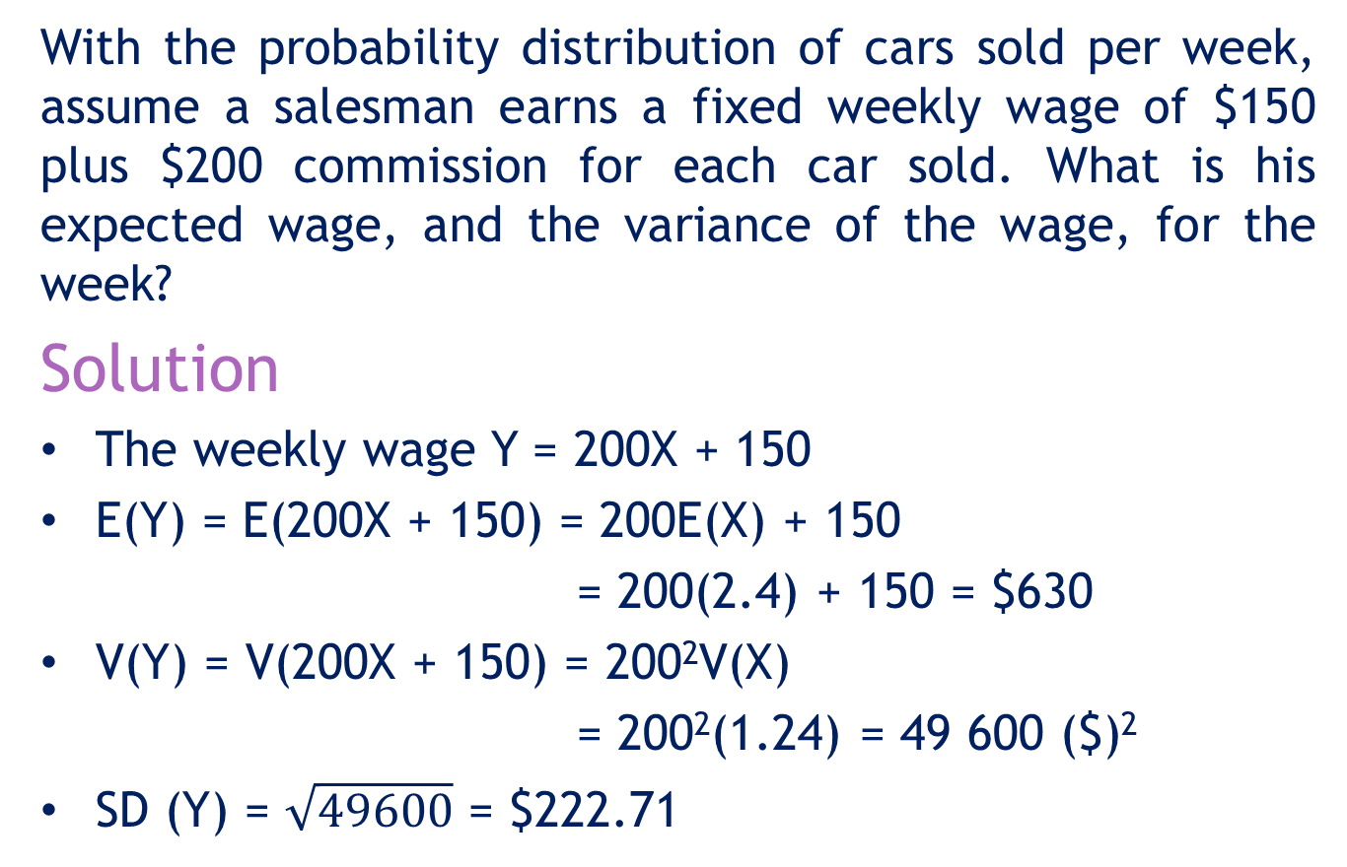
Example 4…
With the probability distribution of cars sold per week, assume a salesman earns a fixed weekly wage of $150 plus $200 commission for each car sold. What is his expected wage, and the variance of the wage, for the week?
Solution
The weekly wage Y = 200X + 150
E(Y) = E(200X + 150) = 200E(X) + 150
= 200(2.4) + 150 = $630
V(Y) = V(200X + 150) = 200²V(X)
= 200²(1.24) = 49 600 ($)²
SD (Y) = $\sqrt{49600}$ = $222.71
E(cX + b) = cE(X) + b
V(cX+b) = c²V(X)

Slide 29
Example 5
The monthly sales at a computer store have a mean of $25,000 and a standard deviation of $4,000. Profits are 30% of the sales less fixed costs of $6,000.
Find the mean and standard deviation of the monthly profit.
Solution
E(Sales) = $25000
SD(Sales) = $4000
V(Sales) = (4000)² ($)²
Profit = 0.30(Sales) – 6000

Slide 30

Example 5: Solution
Profit = 0.30(sales) – 6000
E(Profit) = E[0.30(Sales) – 6000] = E[0.30(Sales)] – 6000 = 0.30 E(Sales) – 6000 = (0.30)(25000) – 6000 = $1 500
E(X + c) = E(X) + c
E(cX) = cE(X)
V(Profit) = V(0.30(Sales) – 6000] = V[(0.30)(Sales)] = (0.30)² V(Sales)
= (0.30)²(4000)²
= 1 440 000 ($)²
V(X + c) = V(X)
V(cX) = c²V(X)
σProfit = $\sqrt{\text{1 440 000}}$= $1 200

Slide 31
7.4 Bivariate distributions
The bivariate (or joint) distribution is used when the relationship between two random variables is studied.
The joint probability that X assumes the value x, and Y assumes the value y is denoted
p(x,y) = P(X=x and Y = y)

Slide 32
Discrete Bivariate Distributions
7.32
The joint probability function satisfies the following conditions:

Slide 33
Example 6
Xavier and Yvette are two real estate agents. Let X and Y denote the number of houses that Xavier and Yvette, respectively, will sell in a month. An analysis of their past monthly performances has the following joint probabilities.
The bivariate probability distribution of (x,y)
X
Y 0 1 2
0 .12 .42 .06
1 .21 .06 .03
2 .07 .02 .01

Slide 34
Example 6: Solution
7.34
p(x,y)
0.42
X
Y 0 1 2
0 .12 .42 .06
1 .21 .06 .03
2 .07 .02 .01
0.21
0.12
0.06
0.06
y=0
X
0.07
0.03
0.02
y=1
0.01
Y
y=2
X=0
X=1
X=2

Slide 35
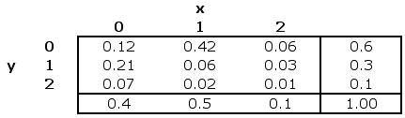


Marginal Probabilities
0
As before, we can calculate the marginal probabilities by summing across rows and down columns to determine the probabilities of X and Y individually:
E.g the probability that Xavier sells 1 house = P(X=1) =0.50

Slide 36
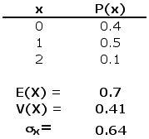
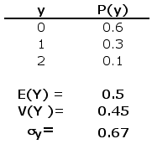
Describing the Bivariate Distribution
0
We can describe the mean, variance, and standard deviation of each variable in a bivariate distribution by working with the marginal probabilities…
same formulae as for univariate distributions…

Slide 37
Describing the Bivariate Distribution…
To describe the relationship between the two variables we compute the covariance and the coefficient of correlation.
Covariance: COV(X,Y) = ΣΣ(X – μ_{x})(Y- μ_{y})p(x,y)
Coefficient of correlation
where μ_{X} = E(X), μ_{Y} = E(Y), σ_{X}² = Var(X) and σ_{Y}² = Var(Y).
ρ =

Slide 38
Example 7
Calculate the covariance and coefficient of correlation between the number of houses sold by the two agents in Example 6.
Solution
From previous calculations in Example 6, we have
μx= 0.7; μy= 0.5;
COV(X,Y) = σxy = Σ(x–μ_{x})(y–μ_{y})p(x,y)
= (0–0.7)(0–0.5)p(0,0)+…+(2–0.7)(2–0.5)p(2,2)
= –0.15

Slide 39
Example 7…
0
COV (X,Y)
There is a weak, negative relationship between the two variables.

Slide 40
Conditional Probability
Example 7 – continued
X
Y 0 1 2 p(y)
0 .12 .42 .06 .60
1 .21 .06 .03 .30
2 .07 .02 .01 .10
p(x) .40 .50 .10 1.00

Slide 41
Example 7…
The sum is
equal to 1.0

Slide 42
Conditions for Independence
Two random variables are said to be independent when
This leads to the following relationship for independent variables
P(X=x|Y=y) = P(X=x) or P(Y=y|X=x) = P(Y=y).
P(X=x and Y=y) = P(X=x) ∙ P(Y=y)

Slide 43
Example 7…
P(X=0|Y=1)= 0.7
But P(X=0)=0.4
The condition for independence is not satisfied.
The variables X and Y are not independent.

Slide 44
Sum of Two Variables
The probability distribution of X + Y is determined by
Determining all the possible values that X+Y can assume.
For every possible value C of X + Y, adding the probabilities of all the combinations of X and Y for which X + Y = C.

Slide 45
Example 7…
Find the probability distribution of the total number of houses sold per week by Xavier and Yvette.
Solution
X + Y is the total number of houses sold.
X + Y can have the values 0, 1, 2, 3, 4.
X
Y 0 1 2 p(y)
0 .12 .42 .06 .60
1 .21 .06 .03 .30
2 .07 .02 .01 .10
p(x) .40 .50 .10 1.00

Slide 46
The Probability Distribution of X+Y
P(X+Y=0) = P(X=0 and Y=0) =0.12
P(X+Y=1) = P(X=0 and Y=1)+ P(X=1 and Y=0) =0.21 + 0.42 = 0.63
P(X+Y=2) = P(X=0 and Y=2)+ P(X=1 and Y=1)+ P(X=2 and Y=0)
= 0.07 + 0.06 + 0.06 = .19
X
Y 0 1 2 p(y)
0 .12 .42 .06 .60
1 .21 .06 .03 .30
2 .07 .02 .01 .10
p(x) .40 .50 .10 1.00
The probabilities P(X+Y)=3 and P(X+Y) =4 are calculated the same way. The distribution follows.

Slide 47
The Probability Distribution of X+Y
The distribution of X + Y
x + y 0 1 2 3 4
p(x+y) 0.12 0.63 0.19 0.05 0.01

Slide 48
The Expected Value and Variance of X + Y
The distribution of X + Y
The expected value and variance of X + Y can be calculated from the distribution of X + Y.
E(X+Y)=0(0.12)+ 1(0.63)+2(0.19)+3(0.05)+4(0.01)
=1.2
V(X+Y)=(0-1.2)²(0.12)+(1-1.2)²(0.63)+…+(4-1.2)²(0.01)
=0.56
x + y 0 1 2 3 4
p(x+y) 0.12 0.63 0.19 0.05 0.01

Slide 49
The Expected Value and Variance of X + Y
The following relationship can assist in calculating E(X+Y) and V(X+Y)
E(X+Y) =E(X) + E(Y);
V(X+Y) = V(X) +V(Y) +2COV(X,Y)
When X and Y are independent
COV(X,Y) = 0, and
V(X+Y) = V(X)+V(Y).

Slide 50
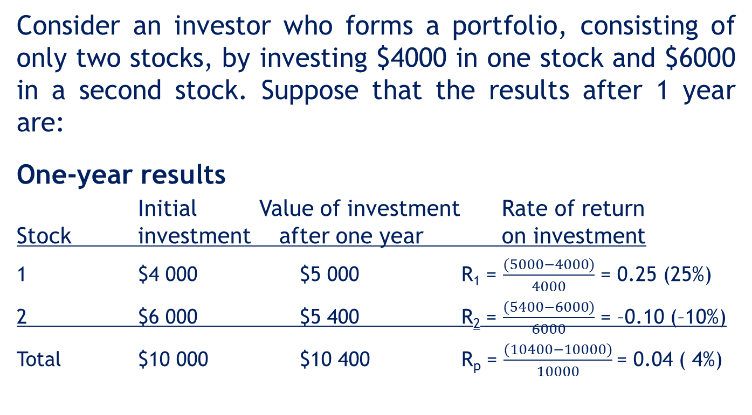
7.5 Portfolio diversification and asset allocation
0
Consider an investor who forms a portfolio, consisting of only two stocks, by investing $4000 in one stock and $6000 in a second stock. Suppose that the results after 1 year are:
One-year results
Initial Value of investment Rate of return
Stock investment after one year on investment
1 $4 000 $5 000 R₁ = $\frac{(5000−4000)}{4000}$ = 0.25 (25%)
2 $6 000 $5 400 R₂ = $\frac{(5400−6000)}{6000}$ = –0.10 (–10%)
Total $10 000 $10 400 R_{p} = $\frac{(10400−10000)}{10000}$= 0.04 ( 4%)

Slide 51
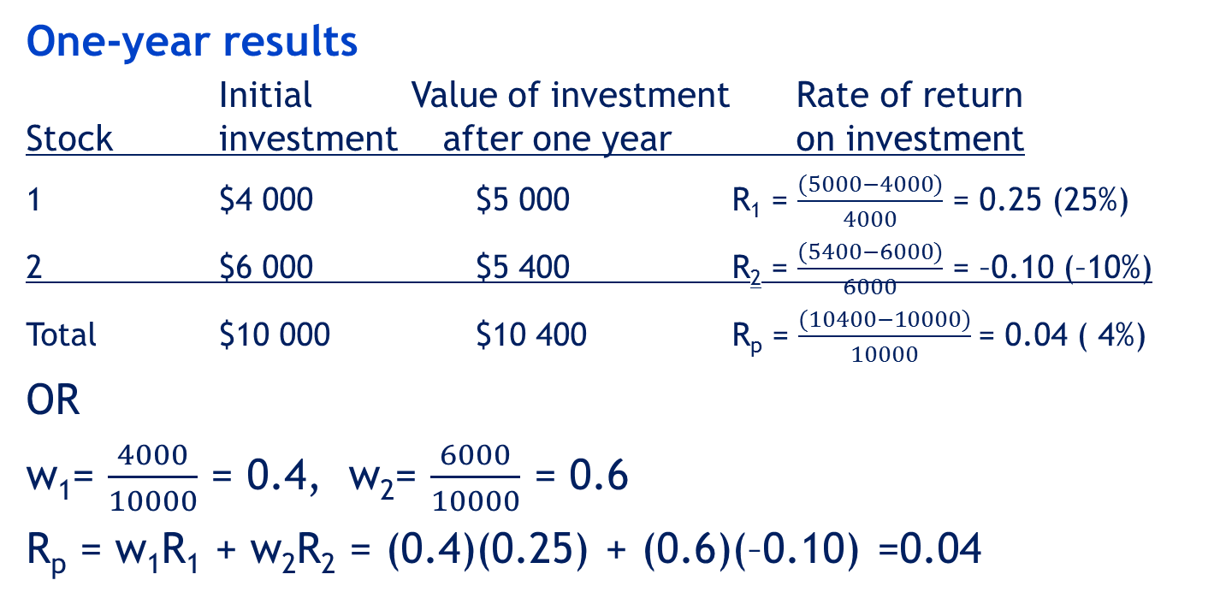
Portfolio diversification and asset allocation…
0
One-year results
Initial Value of investment Rate of return
Stock investment after one year on investment
1 $4 000 $5 000 R₁ = $\frac{(5000−4000)}{4000}$ = 0.25 (25%)
2 $6 000 $5 400 R₂ = $\frac{(5400−6000)}{6000}$ = –0.10 (–10%)
Total $10 000 $10 400 R_{p} = $\frac{(10400−10000)}{10000}$= 0.04 ( 4%)
OR
w₁= $\frac{4000}{10000}$ = 0.4, w₂= $\frac{6000}{10000}$ = 0.6
R_{p} = w₁R₁ + w₂R₂ = (0.4)(0.25) + (0.6)(–0.10) =0.04

Slide 52
0
Portfolio diversification and asset allocation…
Mean and variance of a portfolio of two stocks
E(R_{p}) = w₁ E(R₁) + w₂ E(R₂)
V(R_{p}) = w₁² V(R₁) + w₂² V(R₂) + 2w₁w₂COV(R₁, R₂)
= w₁²σ₁² + w₂²σ₂² + 2w₁w₂ρσ₁σ₂
where
w₁ and w₂ are the proportions or weights of investments 1 and 2,
E(R₁) and E(R₂) are their expected values,
σ₁ and σ₂ are their standard deviations, and
ρ is the coefficient of correlation.

Slide 53
Example 8
0
An investor has decided to form a portfolio by putting 25% of his money into McDonald’s stock and 75% into Cisco Systems stock. The investor assumes that the expected returns will be 8% and 15%, respectively, and that the standard deviations will be 12% and 22%, respectively.
a. Find the expected return on the portfolio.
b. Compute the standard deviation of the returns on the portfolio assuming that
(i) the two stocks’ returns are perfectly positively correlated
(ii) the coefficient of correlation is .5
(iii) the two stocks’ returns are uncorrelated.

Slide 54
Example 8: Solution
0
a. The expected values of the two stocks are
E(R₁) = 0.08 and E(R₂) = 0.15
The weights are w₁ = 0.25 and w₂ = 0.75.
Thus,
E(R₂) = w₁E(R₁) + w₂E(R₂)
= 0.25(0.08) + 0.75(0.15)
= 0.1325

Slide 55
Example 8: Solution
0
b. The standard deviations are σ₁ = .12 and σ₂ = .22.
Thus,
V(R_{p}) = w₁²σ₁² + w₂²σ₂² + 2w₁w₂ρσ₁σ₂
= (.25²)(.12²) + (.75²)(.22²) + 2(.25)(.75)ρ (.12)(.22)
= .0281 + .0099 ρ
When ρ = 1, V(R_{p}) = .0281 + .0099(1) = 0.0380
When ρ = .5, V(R_{p}) = .0281 + .0099(.5) = 0.0331
When ρ = 0, V(R_{p}) = .0281 + .0099(0) = 0.0281

Slide 56
Portfolio Diversification in Practice
0
The formulas introduced in this section require that we know the expected values, variances, and covariance (or coefficient of correlation) of the investments we’re interested in. The question arises, How do we determine these parameters? (Incidentally, this question is rarely addressed in finance textbooks!) The most common procedure is to estimate the parameters from historical data, using sample statistics.

Slide 57
Portfolios with More Than Two Stocks
0
We can extend the formulas that describe the mean and variance of the returns of a portfolio of two stocks to a portfolio of any number of stocks.
Mean and variance of a portfolio of k stocks
E(R_{p} ) =
V(R_{p} ) =
where R_{i} is the return of the i^{th} stock, w_{i} is the proportion of the portfolio invested in stock i, and k is the number of stocks in the portfolio.

Slide 58
0
Portfolios with More Than Two Stocks
When k is greater than 2 the calculations can be tedious and time-consuming. For example, when k = 3, we need to know the values of the three weights, three expected values, three variances, and three covariances. When k = 4, there are four expected values, four variances and six covariances. [The number of covariances required in general is k(k–1)/2.] To assist you we have created an Excel worksheet to perform the computations when k =2, 3, or 4. (For larger values of k, see the reference at the end of the chapter.) This is demonstrated in the problem described in the opening example of this chapter.

Slide 59
7.6 Binomial distribution
A binomial experiment can result in only one of two outcomes.
Typical cases where a binomial experiment applies:
a coin flipped results in heads or tails
an election candidate wins or loses
an employee is male or female
a car is manual or auto-transmission

Slide 60
Binomial Experiment
There are n trials (n is finite and fixed).
Each trial can result in success or failure.
The probability p of success is the same for all the trials.
All the trials are independent.
Binomial random variable
The binomial random variable counts the number of successes in n trials of the binomial experiment.
By definition, this is a discrete random variable.

Slide 61
Developing the Binomial Probability Distribution
P(S3) = p
S3
P(SSS) = p³
S2
P(S2) = p
S1
P(S2|S1)
P(F3) = 1 – p
F3
P(SSF) = p²(1 – p)
P(S3) = p
S3
P(F2|S1)
P(SFS) = p(1 – p)p
P(S1) = p
P(F2) = 1 – p
P(F3)=1 - p
F2
F3
P(SFF)=p(1-p)²
P(S3)=p
S3
P(FSS)=(1-p)p²
S2
P(F1) = 1 – p
P(S2) = p
P(S2|F1)
P(F3) = 1 – p
F3
P(FSF) = (1 – p)p(1 – p)
F1
P(S3) = p
S3
P(FFS) = (1 – p)²p
P(F2|F1)
P(F2) = 1 – p
P(F3) = 1 – p
F2
P(FFF) = (1 – p)³
F3

Slide 62
Developing the Binomial Probability Distribution
P(SSS) = p³
Let X be the number of successes
in three trials. Then,
SSS
P(SSF) = p²(1 – p)
SS
P(X = 3) = p³
X = 3
X =2
X = 1
X = 0
S S
P(SFS) = p(1 – p)p
P(X = 2) = 3p²(1 – p)
P(SFF) = p(1 – p)²
P(X = 1) = 3p(1 – p)²
P(FSS) = (1 – p)p²
SS
P(X = 0) = (1 – p)³
P(FSF) = (1 – p)p(1 – p)
This multiplier is calculated using the following formula.
P(FFS) = (1 – p)²p
P(FFF) = (1 – p)³

Slide 63
Calculating Binomial Probability
In general, binomial probability is calculated by:

Slide 64
Calculating Binomial Probability
For n = 3

Slide 65
Example 9
5% of an electric bulb production run is defective. A sample of 3 bulbs is drawn. Find the probability distribution of the number of defectives.
Solution
A bulb can be either defective or good.
There is a fixed finite number of trials (n = 3)
We assume the states of the bulbs are dependent on each other.
The probability of a bulb being defective does not change from bulb to bulb (p = 0.05).
The conditions required for a binomial experiment are met.

Slide 66
Example 9: Solution
Let X be the binomial random variable indicating the number of defectives.
Define a ‘success’ as ‘a bulb is found to be defective’.
X P(X)
0 0.8574
1 0.1354
2 0.0071
3 0.0001
Total 1.0000

Slide 67
Example 10: Pat Statsdud (Examples 7.9–7.10)
0
Pat Statsdud is a (not good) student taking a statistics course. Pat’s exam strategy is to rely on luck for the next quiz. The quiz consists of 10 multiple-choice questions. Each question has five possible answers, only one of which is correct. Pat plans to guess the answer to each question.
What is the probability that Pat gets no answers correct?
What is the probability that Pat gets two answers correct?

Slide 68
Example 10: Pat Statsdud…
0
Pat Statsdud is a (not good) student taking a statistics course, whose exam strategy is to rely on luck for the next quiz. The quiz consists of 10 multiple-choice questions. Each question has five possible answers, only one of which is correct. Pat plans to guess the answer to each question.
Algebraically then:
n=10, and P(success) = 1/5 = 0.20

Slide 69
Example 10: Pat Statsdud…
0
Is this a binomial experiment?
Check the conditions:
✓ There is a fixed finite number of trials (n=10).
✓ An answer can be either correct or incorrect.
✓ The probability of a correct answer, p= 0.20, does not change from question to question.
✓ Each answer is independent of the others.

Slide 70
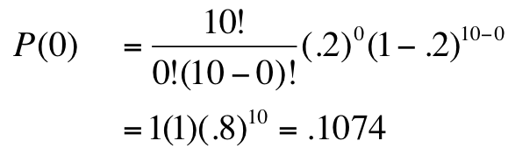
Example 10: Pat Statsdud…
0
n=10, and P(success) = 0.20
i. What is the probability that Pat gets no answers correct?
Number of successes, X= 0; hence we want to know P(X=0)
Pat has about an 11% chance of getting no answers correct using the guessing strategy.

Slide 71
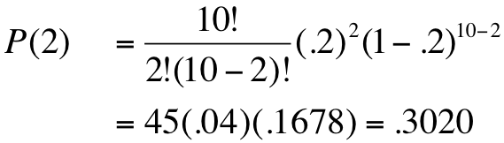
Example 10: Pat Statsdud…
0
n=10, and P(success) = .20
ii. What is the probability that Pat gets two answers correct?
Number of successes, X = 2; hence we want to know P(X=2)
Pat has about a 30% chance of getting exactly two answers correct using the guessing strategy.

Slide 72
Cumulative Probability…
0
Thus far, we have been using the binomial probability distribution to find probabilities for individual values of x. To answer the question:
‘Find the probability that Pat fails the quiz’
requires a cumulative probability, that is, P(X ≤ x).
If a grade on the quiz is less than 50% (i.e. 5 questions out of 10), that’s considered a failed quiz.
Thus, we want to know what is: P(X ≤ 4) to answer.

Slide 73
Example 10: Pat Statsdud…
0
iii. Find the probability that Pat fails the quiz.
P(X ≤ 4) = P(0) + P(1) + P(2) + P(3) + P(4)
We already know, P(0) = 0.1074 and P(2) = 0.3020. Using the binomial formula to calculate the others:
P(1) = 0.2684 , P(3) = 0.2013, and P(4) = 0.0881
We have
P(X ≤ 4) = 0.1074 + 0.2684 + … + 0.0881 = 0.9672
Thus, its about 97% probable that Pat will fail the quiz using the luck strategy and guessing answers…

Slide 74
Binomial Table…
0
Calculating binomial probabilities by hand is tedious and error prone. There is an easier way. Refer to Table 1 in Appendix B.
For the Pat Statsdud example, n=10, so the first important step is to get the correct table!

Slide 75
Binomial Table…
0
The probabilities listed in the tables are cumulative,
i.e. P(X ≤ k), k is the row index; the columns of the table are organised by P(success) = p.

Slide 76
Example 10 – Pat Statsdud…
0
i. What is the probability that Pat gets no answers correct?
i.e. what is P(X = 0), given P(success) = 0.20 and n=10?
P(X = 0) = P(X ≤ 0) = 0.1074

Slide 77
Example 10 – Pat Statsdud…
0
ii. What is the probability that Pat gets two answers correct?
i.e. what is P(X = 2), given P(success) = 0.20 and n=10 ?
P(X = 2) = P(X≤2) – P(X≤1) = 0.6778 – 0.3758 = 0.3020
Remember, the table shows cumulative probabilities…

Slide 78
Example 10 – Pat Statsdud…
0
iii. What is the probability that Pat fails the quiz?
i.e. what is P(X ≤ 4), given P(success) = 0.20 and n=10 ?
P(X ≤ 4) = 0.9672

Slide 79
0
Binomial Table…
The binomial table gives cumulative probabilities for P(X ≤ k), but as we’ve seen in the last example,
P(X = k) = P(X ≤ k) – P(X ≤ [k–1])
Likewise, for probabilities given as P(X ≥ k), we have:
P(X ≥ k) = 1 – P(X ≤ [k–1])

Slide 80
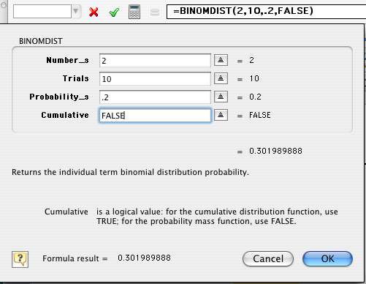
Using Excel: =BINOMDIST() Excel Function
0
There is a binomial distribution function in Excel that can also be used to calculate these probabilities. For example:
What is the probability that Pat gets two answers correct?
Number of successes
Number of trials
P(success)
cumulative
(i.e. P(X≤x)?)
P(X=2)=0.3020

Slide 81
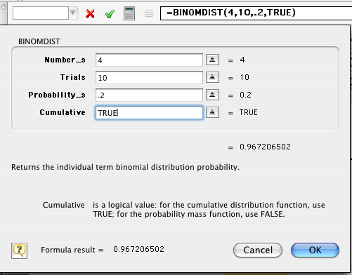
Using Excel: =BINOMDIST() Excel Function
0
There is a binomial distribution function in Excel that can also be used to calculate these probabilities. For example:
What is the probability that Pat fails the quiz?
Number of successes
Number of trials
P(success)
cumulative
(i.e. P(X≤x)?)
P(X≤4)=0.9672

Slide 82
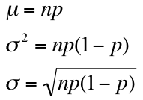
Binomial Distribution…
0
As you might expect, statisticians have developed general formulas for the mean, variance, and standard deviation of a binomial random variable. They are:

Slide 83
Example 11
Records show 30% of customers in a shoe store make payments using a credit card. This morning 20 customers purchased shoes. Use Table 1 of Appendix B to answer the following questions.
What is the expected number of customers who used a credit card?
What is the standard deviation of the number of customers who used a credit card?

Slide 84
Example 11: Solution
E(X) = np = 20(0.30) = 6
V(X) = np(1-p)
= 20(0.30)(0.70) = 4.2
SD(X) = √4.2 = 2.04

Slide 85
7.7 Poisson distribution
The Poisson experiment typically fits cases of rare events that occur over a fixed amount of time or within a specified region.
Examples of typical cases:
the number of errors a typist makes per page
the number of customers entering a service station per hour
the number of telephone calls received by a switchboard per hour.

Slide 86
Poisson Experiment
Properties of the Poisson experiment
The number of successes (events) that occur in a certain time interval is independent of the number of successes that occur in another time interval.
The probability of a success in a certain time interval is
the same for all time intervals of the same size
proportional to the length of the interval.
The probability that two or more successes will occur in an interval approaches zero as the interval becomes smaller.

Slide 87
Poisson random variable
The Poisson random variable
The Poisson variable indicates the number of successes that occur during a given time interval, or in a specific region, in a Poisson experiment.
Probability distribution of the Poisson random variable is given by

Slide 88
Calculating Poisson probability
Poisson probability distribution with μ = 1
The X axis in Excel
starts with x = 1!
0 1 2 3 4 5

Slide 89
Poisson probability
distribution with μ =2
0 1 2 3 4 5 6
Poisson probability
distribution with μ =5
0 1 2 3 4 5 6 7 8 9 10
Poisson probability
distribution with μ =7
0 1 2 3 4 5 6 7 8 9 10 11 12 13 14 15

Slide 90
Example 12
Cars arrive at a tollbooth at a rate of 360 cars per hour.
What is the probability that only 2 cars will arrive during a specified one-minute period? (Use the formula.)
What is the probability that only 2 cars will arrive during a specified one-minute period? (Use Table 2, Appendix B.)
What is the probability that at least 4 cars will arrive during a one-minute period? (Use Table 2, Appendix B.)

Slide 91
Example 12: Solution
a) What is the probability that only 2 cars will arrive during a specified one-minute period? (Use the formula.)
Cars arrive at a tollbooth at a rate of 360 cars per hour. The probability distribution of arriving cars for any one-minute period is Poisson with μ = 360/60 = 6 cars per minute. Let X denote the number of arrivals during a one-minute period.

Slide 92
What is the probability that only 2 cars will arrive during a specified one-minute period? (Use Table 2, Appendix B.)
Using the Poisson table,
P(X = 2) = P(X ≤ 2) – P(X ≤ 1)
= 0.062 – 0.017 = 0.045
The following table provides the P(X ≤ k) for selected values of μ.

Slide 93
c) What is the probability that at least 4 cars will arrive during a one-minute period? (Use Table 2, Appendix B.)
P(X ≥ 4) = 1 – P(X ≤ 3) = 1 – 0.151 = 0.849

Slide 94
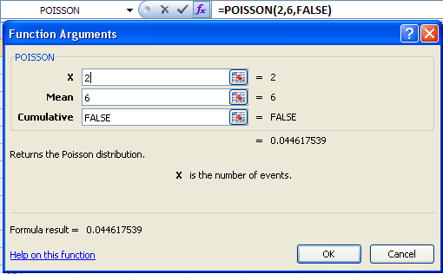
Using Excel: =POISSON() Excel Function
0
There is a Poisson distribution function in Excel that can also be used to calculate these probabilities. For example:
(a) What is the probability that two cars will arrive in a one-minute period?
Number of cars
Average number of cars per minute
Cumulative
(i.e. P(X≤x)?)
P(X=2)=0.0446

Slide 95
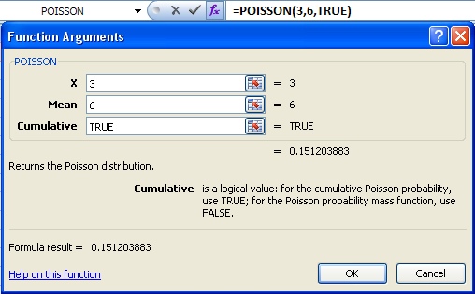
Using Excel: =POISSON() Excel Function
0
(b) What is the probability that at least four cars will arrive in a one-minute period? [ie P(X ≥ 4) = 1 – P(X ≤ 3)]
Number of cars
Average number of cars per minute
Cumulative
(i.e. P(X≤x)?)
P(X ≤ 3)=0.1512
P(X ≥ 4) = 1 – P(X ≤ 3)] = 1-0.1512 = 0.8488

Slide 96
Poisson Approximation of the Binomial
When n is very large, binomial probability table may not be available.
If p is very small (p < 0.05), we can approximate the binomial probabilities using the Poisson distribution.
Use μ = np and make the following approximation:
With parameters n and p
With μ = np

Slide 97
Example 13
A warehouse has a policy of examining 50 sunglasses from each incoming lot, and accepting the lot only if there are no more than two defective pairs. What is the probability of a lot being accepted if, in fact, 2% of the sunglasses are defective?
Solution
This is a binomial experiment with n = 50, p = 0.02.
Tables for n = 50 are not available; p < 0.05; thus, a Poisson approximation is appropriate with
μ = np = (50)(0.02) =1
P(X_{Poisson} ≤ 2) = 0.920
(True binomial probability = 0.922)

