Slide 1


Slide 2
Chapter 8
Continuous probability distributions

Slide 3
Chapter outline
8.1 Probability density functions
8.2 Uniform distribution
8.3 Normal distribution
8.4 Exponential distribution

Slide 4
Learning objectives
LO1 Discuss the basic differences between discrete and continuous random variables
LO2 Identify and calculate probabilities using a uniform distribution
LO3 Convert a normal random variable into a standard normal random variable, and know how to use the table of standard normal probabilities
LO4 Approximate binomial probabilities using a normal distribution
LO5 Recognise when it is appropriate to use an exponential distribution, and understand how to compute exponential probabilities.

Slide 5
Introduction
A continuous random variable is one that can assume an uncountable number of values in an interval [a,b].
We cannot list all possible values because there is an infinite number of them in the range [a,b].
Because there is an infinite number of values and all individual probabilities corresponding to those should sum to 1, the probability of each individual value is virtually 0.

Slide 6
Point Probabilities are Zero
Thus, we can determine the probability of a range of values only.
Note: With a discrete random variable like tossing a die, it is meaningful to talk about P(X=5), say.
In a continuous setting (e.g. with time as a random variable), the probability the random variable of interest, say task length, takes exactly 5 minutes is infinitesimally small, hence P(X=5) = 0.
It is meaningful to talk about P(X ≤ 5).

Slide 7
8.1 Probability density function
A function f(x) is called a probability density function (over the range a ≤ x ≤ b if it meets the following requirements:
f(x) ≥ 0 for all x between a and b, and
The total area under the curve between a and b is 1.0.
f(x)
Area=1
a
b
x

Slide 8
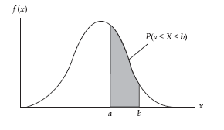
Probability density function…
The probability that x falls between a and b is found by calculating the area under the graph of f(x) between a and b.
Shaded area is P(a ≤ X ≤ b)

Slide 9

8.2 Uniform distribution
A random variable X is said to be uniformly distributed in the interval [a, b] if its density function is
f(x)
a
b
x
Area = width x height = (b – a) x = 1

Slide 10
Uniform distribution…
The expected value and the variance of the uniform distribution is

Slide 11
Example 1
The time elapsing between the placement of an order and the delivery time is uniformly distributed between 100 and 180 minutes.
  Define the graph and the density function.
  What proportion of orders takes between 2 and 2.5 hours to be delivered?
x
10

Slide 12
Example 1: Solution
Let X = The time elapsing between the placement of an order and the delivery time.
i.
f(x) = 1/80 100 ≤ x ≤ 180
ii. P(120 ≤ x ≤ 150) = (150-120)(1/80) = 0.375
f(x)
1/80
x
100
120
150
180

Slide 13
8.3 Normal distribution
This is the most important continuous distribution considered here.
Many random variables can be properly modelled as normally distributed.
Many distributions can be approximated by a normal distribution.
Normal distribution is the cornerstone distribution of statistical inference.

Slide 14
Normal distribution…
The normal distribution is fully defined by two parameters:
its mean μ
its variance σ²
If a random variable X is normally distributed:
  Mean = E(X) = μ
  Variance = V(X) = σ²

Slide 15
Normal distribution…
A random variable X with mean μ and variance σ² is normally distributed if its probability density function is given by
Unlike the range of the uniform distribution (a ≤ x ≤ b), normal distributions range from minus infinity to plus infinity.

Slide 16
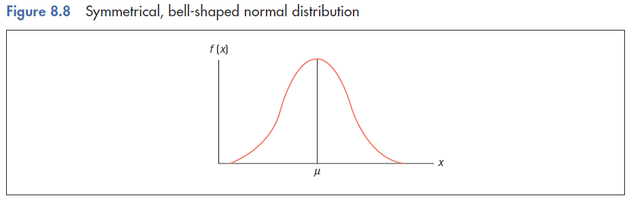
The shape of the normal distribution
A bell-shaped distribution, symmetrical around μ.

Slide 17
The shape of the normal distribution…
8.17
Normal distribution is bell-shaped, and
symmetrical around μ.
f(μ+x)=f(μ−x)
90
μ
110
Why symmetrical? Let μ = 100. Suppose x = 110.
Now suppose x = 90.
Therefore, f(110)=f(90).

Slide 18
How does the expected value affect the location of f(x)?
μ = 10
μ = 11
μ = 12
Increasing the mean shifts the curve to the right…

Slide 19
How does the standard deviation affect the location of f(x)?
σ = 2
σ = 3
σ = 4
Increasing the standard deviation ‘flattens’ the curve…

Slide 20
Calculating Normal Probabilities
Two facts help calculate normal probabilities:
Normal distribution is symmetrical.
Any normal distribution can be transformed into a specific normal distribution called the
`STANDARD NORMAL DISTRIBUTION’.

Slide 21
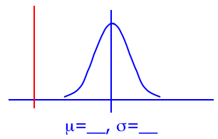
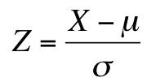
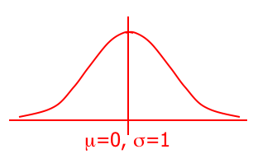
Calculating Normal Probabilities…
We can use the following function to convert any normal random variable to a standard normal random variable…
0
Some advice: always draw a picture!

Slide 22
Calculating Normal Probabilities…
We can use the following function to convert any normal random variable to a standard normal random variable…
This shifts the mean of X to zero…
0

Slide 23
Calculating Normal Probabilities…
We can use the following function to convert any normal random variable to a standard normal random variable…
0
This changes the shape of the curve…

Slide 24
Calculating Normal Probabilities…
If we know the mean and standard deviation of a normally distributed random variable, we can always transform the probability statement about X into a probability statement about Z.
Consequently, we need only one table, Table 3 in Appendix B, the standard normal probability table.

Slide 25
Table 3: Standard Normal Distribution
This standard normal table is similar to the ones we used for the binomial and Poisson distributions.
That is, this table lists cumulative probabilities
P(Z < z) or equivalently P(-∞ < Z < z)
for values of z ranging from −3.09 to +3.09

Slide 26
Calculating Standard Normal Probabilities
Suppose we want to determine the following probability: P(Z < −1.52)
We first find −1.5 in the left margin. We then move along this row until we find the probability under the .02 column heading. Thus,
P(Z < −1.52) = 0.0643

Slide 27
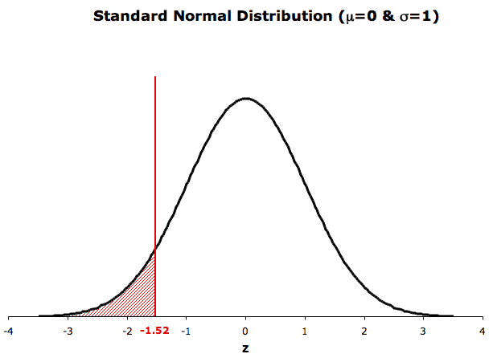
Calculating Standard Normal Probabilities
P(Z < −1.52) = 0.0643
0.0643

Slide 28
Calculating Standard Normal Probabilities
As was the case with Tables 1 and 2 we can also determine the probability that the standard normal random variable is greater than some value of z.
For example, we can find the probability that Z is greater than 1.80, P(Z > 1.80). This probability can be obtained by determining the probability that Z is less than 1.80 and subtracting that value from 1.
P(Z > 1.80) = 1- (P(Z < 1.80)
This is depicted in graphical form below.

Slide 29
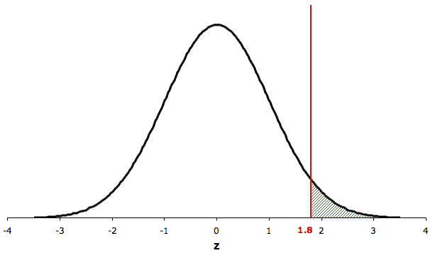
Calculating Standard Normal Probabilities
P(Z > 1.80) = 1 – P(Z < 1.80) = 1 − .9641 = .0359
0.9641
1- 0.9641 = 0.0359

Slide 30
Calculating Standard Normal Probabilities
Applying the complement rule we get
P(Z > 1.80) = 1 – P(Z < 1.80)
= 1 – 0.9641 = 0.0359
Alternatively, using symmetry,
P(Z > 1.80) = P(Z < -1.80) = 0.0359

Slide 31
Calculating Standard Normal Probabilities
We can also easily determine the probability that a standard normal random variable lies between two values of z. For example, we want to find the probability
P(−1.30 < Z < 2.10).
This can be obtained by finding the two cumulative probabilities and calculating their difference,
P(−1.30 < Z < 2.10) = P(Z < 2.10) − P(Z < −1.30)

Slide 32
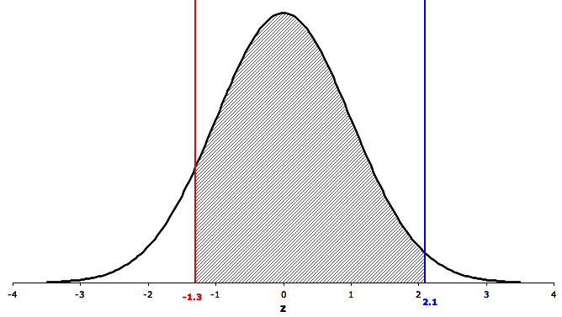
Calculating Standard Normal Probabilities

Slide 33
Calculating Standard Normal Probabilities
From the z table,
P(Z < −1.30) = 0.0968
and P(Z < 2.10) = 0.9821
Hence,
P(−1.30 < Z < 2.10) = P(Z < 2.10) − P(Z < −1.30)
= 0.9821 −0.0968
= 0.8853

Slide 34
Table 3: Standard Normal Distribution
Notice that the largest value of z in the table is 3.09, and that P( Z < 3.09) = 0.9990. This means that
P(Z > 3.09) = 1 − 0.9990 = 0.0010
However, because the table lists no values beyond 3.09, we approximate any area beyond 3.10 as 0. That is,
P(Z > 3.10) = P(Z < −3.10) ≈ 0

Slide 35
Table 3: Standard Normal Distribution
Recall that in Tables 1 and 2 we were able to use the table to find the probability that X is equal to some value of x, but that we won’t do the same with the normal table.
Remember that the normal random variable is continuous and the probability that a continuous random variable X equal to any single value x is 0.
35

Slide 36
Example 2
8.36
Suppose that at a country town petrol station, the daily demand for regular petrol is normally distributed with a mean of 1,000 litres and a standard deviation of 100 litres.
The station manager has just opened the station for business and notes that there is exactly 1,100 litres of regular petrol in storage. The next delivery is scheduled later today at the close of business. The manager would like to know the probability that he will have enough regular petrol to satisfy today’s demands.

Slide 37
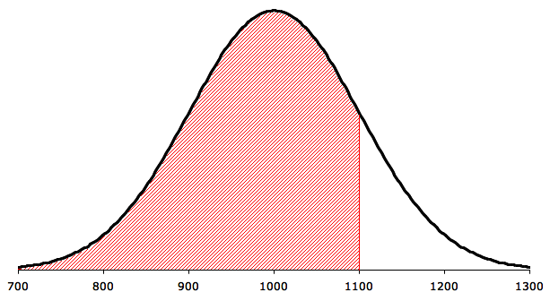
Example 2: Solution
The demand for petrol is normally distributed with mean µ = 1,000 and standard deviation σ = 100. We want to find the probability
P(X < 1,100)
Graphically we want to calculate the shaded area:

Slide 38
Example 2: Solution…
The first step is to standardize X. However, if we perform any operations on X, we must perform the same operations on 1,100. Thus,
P(X < 1,100) =
= P(Z < 1.00)

Slide 39
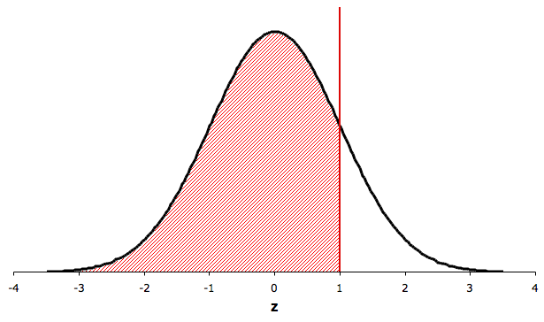
Example 2: Solution…
The figure below graphically depicts the probability we seek.
P(X < 1,100) = P( Z < 1.00) = .8413

Slide 40
Example 2: Solution…
The values of Z specify the location of the corresponding value of X. A value of Z = 1 corresponds to a value of X that is 1 standard deviation above the mean. Notice as well that the mean of Z, which is 0 corresponds to the mean of X.
The probability that we seek is
P(X < 1,100) = P( Z < 1.00) = 0.8413

Slide 41
Example 2: Solution…
0.8413

Slide 42
Applications in Finance: Measuring risk
In Section 7.5 we developed an important application in finance where the emphasis was placed on reducing the variance of the returns on a portfolio. However, we have not demonstrated why risk is measured by the variance and standard deviation. The following example corrects this deficiency.

Slide 43
Example 3
Consider an investment whose return is normally distributed with a mean of 10% and a standard deviation of 5%.
a. Determine the probability of losing money.
b. Find the probability of losing money when the standard deviation is equal to 10%.

Slide 44
Example 3: Solution
a. The investment loses money when the return is negative. Thus we wish to determine
P(X < 0)
The first step is to standardize both X and 0 in the probability statement.
P(X < 0) = = P(Z < –2.00)

Slide 45
Example 3: Solution…
From Table 3 we find
P(Z < − 2.00) = 0.0228
Therefore, the probability of losing money is 0.0228.

Slide 46
Example 3: Solution…
b. If we increase the standard deviation to 10% the probability of suffering a loss becomes
P(X < 0) =
= P(Z < –1.00)
= 0.1587

Slide 47
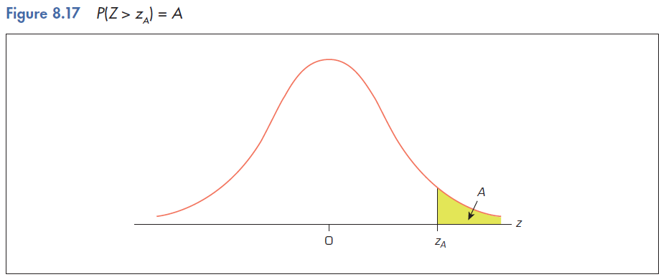
Finding the Value of z
Often we’re asked to find some value of z for a given probability, i.e. given an area (A) under the curve, what is the corresponding value of z (z_{A}) on the horizontal axis that gives us this area? That is:
For given A, find z_{A} such that
P(Z > z_{A}) = A

Slide 48
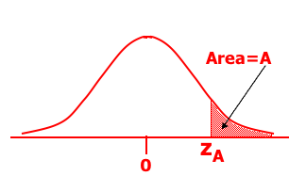
Finding the Value of z…
What value of z corresponds to an area under the curve of 2.5%? That is, what is z_{A} such that P(Z > z_{A}) = 0.025?
(1 – A) = (1–.025) = .9750
Area = .025
If you do a ‘reverse look-up’ on Table 3 for
0.9750, you will get the corresponding zA = 1.96.
Since P(z > 1.96) = 0.025, we say: z.025 = 1.96.

Slide 49
Example 4
  If Z is a standard normal variable, determine the value z for which P(Z < z) = 0.6331.
  Solution:
0.6331
0
z
z = 0.34
[Using Table 3, Appendix B]

Slide 50
Appendix 8.A Normal Approximation to the Binomial Distribution
Normal approximation to the binomial distribution works best when
the number of experiments (sample size) is large, and
the probability of success p is close to 0.5.
For the approximation to provide good results:
  np ≥ 5; nq ≥ 5
The parameters of the normal distribution used to approximate the binomial are:
μ = np; σ² = npq

Slide 51
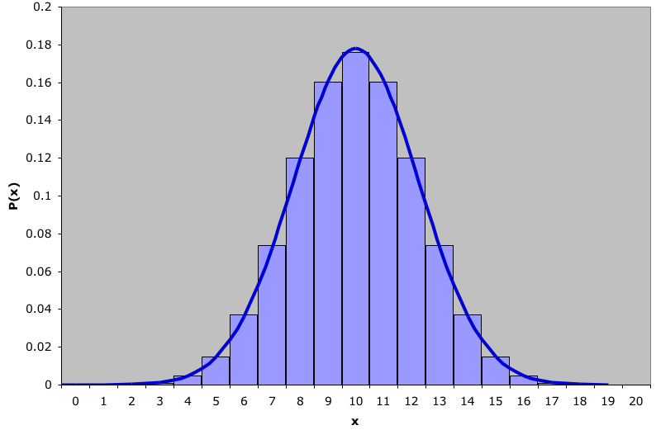
Normal Approximation to the Binomial…
8.51
Binomial distribution with n=20 and p=.5 with a normal approximation superimposed (µ=10 and σ =2.24)

Slide 52
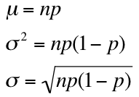


Normal Approximation to the Binomial…
Binomial distribution with n=20 and p=.5 with a normal approximation superimposed (µ =10 and σ =2.24).
where did these values come from?!
From Section 7.6 we saw that:
Hence:
and

Slide 53
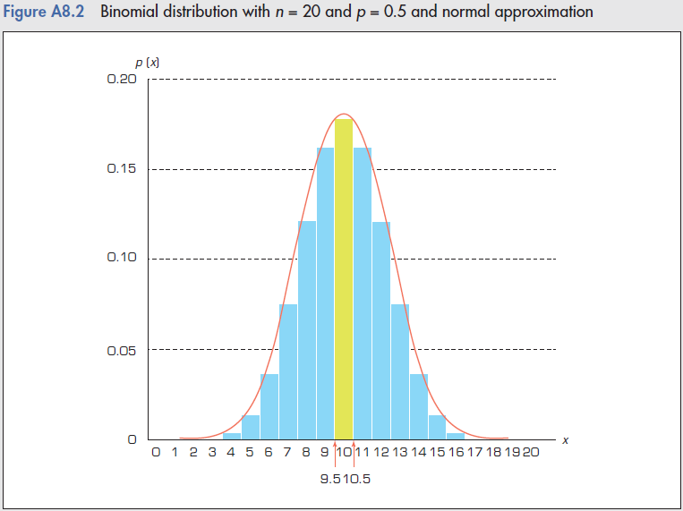
Normal Approximation to the Binomial…
To calculate P(X=10) using the normal distribution, we can find the area under the normal curve between 9.5 and 10.5
P(X = 10) ≈ P(9.5 < Y < 10.5)
where Y is a normal random variable approximating the binomial random variable X.

Slide 54
Normal Approximation to the Binomial…
8.54
In fact:
P(X = 10) = 0.176
while
P(9.5 < Y < 10.5) = 0.1742
the approximation is quite good.
P(X = 10) ≈ P(9.5 < Y < 10.5)
where Y is a normal random variable approximating
the binomial random variable X.

Slide 55
More Normal Approximation Exercises
P(X ≤ 8) = P(Y < 8.5)
8
8.5
P(X ≥ 14) = P(Y > 13.5)
For large n the effect of the
continuity correction factor is
very small and will be omitted.
13.5
14

Slide 56
8.4 Exponential distribution
Exponential distribution can be used to model
the length of time between telephone calls
the length of time between arrivals at a service station
the lifetime of electronic components.
When the number of occurrences of an event follows the Poisson distribution, the time between occurrences follows the exponential distribution.

Slide 57
Exponential distribution…
A random variable X is exponentially distributed if its probability density function is given by
f(x) = λe^{-λx}, x ≥ 0.
where λ is the parameter of the distribution (λ > 0), and
E(X) = 1/λ
V(X) = 1/λ
P(X > a) =e^{-λa}.

Slide 58
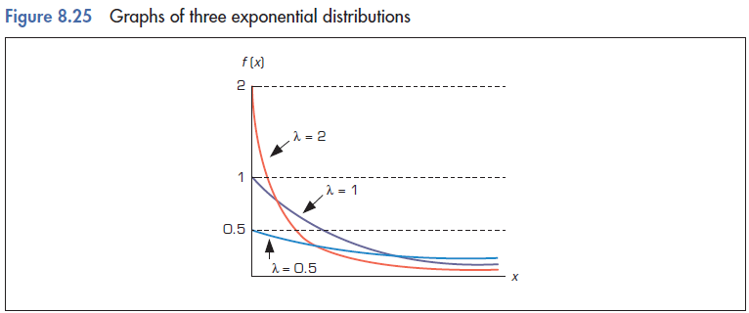
Exponential distribution…
Exponential distribution for λ = 0.5, 1, 2
P(a < x < b) = e^{-λa} – e^{-λb}
a
b

Slide 59
Example 6
The lifetime of an alkaline battery (in hours) is exponentially distributed, with λ = 0.05.
  What are the mean and standard deviation of the battery’s lifetime?
  What is the probability that the battery will last between 10 and 15 hours?

Slide 60
Example 6: Solution
Let X denote the lifetime of an alkaline battery (in hours).
X is exponentially distributed with λ=0.05.
a. Mean = 1/λ = 20 hours.
Standard deviation = 1/λ = 20 hours.
b. P(10 < X < 15) = e^{-(0.05)(10)} – e^{-(0.05)(15)} = 0.1341.

Slide 61
Example 7
Cars arrive randomly and independently at a tollbooth at an average of 360 cars per hour.
  Use the exponential distribution to find the probability that the next car will not arrive within half a minute.
  What is the probability that no car will arrive within the next half a minute?

Slide 62
Example 7: Solution
Let X denote the time (in minutes) that elapses before the next car arrives.
X is exponentially distributed with λ = 360/60 = 6 cars per minute.
  P(X > 0.5) = e^{-6(0.5)} = 0.0498.
  If Y is the number of cars that will arrive in the next half a minute, then Y is a Poisson variable with μ = (0.5)(6) = 3 cars per half a minute.
  P(Y = 0) = e⁻³(3⁰)/0! = 0.0498.

Slide 63
Example 7: Solution
    Comment: if the first car will not arrive within the next half a minute, then no car will arrive within the next half a minute. Therefore, not surprisingly, the probability found in part (b) is the same as the probability found in part (a).

