Slide 1


Slide 2
Chapter 12
Hypothesis testing:
Describing a single population

Slide 3
Chapter outline
12.1 Concepts of hypothesis testing
12.2 Testing the population mean when the variance σ² is known
12.3 The p-value of a test of hypothesis
12.4 Testing the population mean when the variance σ² is unknown
12.5 Calculating the probability of a Type II error
12.6 Testing the population proportion

Slide 4
Learning objectives
LO1 Understand the fundamental concepts of hypothesis testing
LO2 Set up the null and alternative hypotheses, and be familiar with the steps involved in hypothesis testing
LO3 Test hypotheses regarding the population mean when the population variance is known
LO4 Test hypotheses regarding the population mean when the population variance is unknown
LO5 Understand the p-value approach to testing hypotheses and calculate the p-value of a test

Slide 5
Learning objectives…
LO6 Interpret the results of a test of hypothesis
LO7 Calculate the probability of a Type II error and interpret the results
L08 Test hypothesis regarding the population proportion
LO9 Understand the consequences of the violation of the required conditions of each test.

Slide 6
Introduction
12.6
The purpose of hypothesis testing is to determine whether there is enough statistical evidence in favour of a certain belief about a population parameter.

Slide 7
Introduction…
12.7
Examples
In a criminal trial, a jury must decide whether the defendant is innocent or guilty based on the evidence presented at the court.
Is there statistical evidence in a random sample of potential customers, that supports the hypothesis that more than 20% of potential customers will purchase a new product?
Is a new drug effective in curing a certain disease? A sample of patients is randomly selected. Half of them are given the drug, and the other half a placebo. The improvement in the patients’ conditions is then measured and compared.

Slide 8
12.1 Concepts of hypothesis testing
12.8
Five components of a hypothesis test
1. Null hypothesis (H₀)
Alternative hypothesis (H_{A})
Test statistic
Rejection region
Decision rule

Slide 9
In a criminal trial
12.9
A criminal trial is an example of hypothesis testing without the statistics.
In a criminal trial, a jury must decide whether the defendant is innocent or guilty based on the evidence presented at the court.
In a trial a jury must decide between two hypotheses, the null hypothesis H₀ is
H₀: The defendant is innocent.
The alternative hypothesis H_{A} is
H_{A}: The defendant is guilty.

Slide 10
12.10
In a criminal trial…
The jury does not know which hypothesis is true. They must make a decision on the basis of evidence presented.
In the language of statistics convicting the defendant is called
rejecting the null hypothesis (the defendant is innocent) in favor of the alternative hypothesis (the defendant is guilty).
That is, the jury is saying that there is enough evidence to conclude that the defendant is guilty (i.e., there is enough evidence to support the alternative hypothesis).

Slide 11
12.11
In a criminal trial…
If the jury acquits it is stating that
there is not enough evidence to support the alternative hypothesis.
Notice that the jury is not saying that the defendant is innocent, only that there is not enough evidence to support the alternative hypothesis. That is why we never say that ‘we accept the null hypothesis’ (that the defendant is innocent).

Slide 12
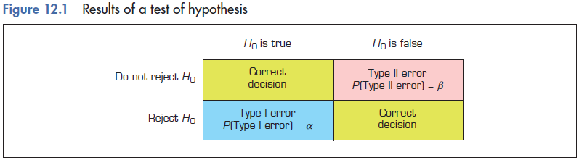
12.12
Four possible outcomes from a hypothesis test
Four possible outcomes Decision
1. Do not reject H₀ when H₀ is true Correct
Reject H₀ when H₀ is true Incorrect
Do not reject H₀ when H₀ is false Incorrect
Reject H₀ when H₀ is false Correct

Slide 13
12.13
Type I and Type II errors
Two possible errors can be made in any test.
A Type I error occurs when we reject a true null hypothesis (i.e. reject H₀ when H₀ is true). In the criminal trial, a Type I error occurs when the jury convicts an innocent person.
A Type II error occurs when we don’t reject a false null hypothesis (i.e. do not reject H₀ when H₀ is false). In a criminal trial, a Type II error occurs when a guilty defendant is acquitted.

Slide 14
12.14
Type I and Type II errors…
The probability of a Type I error is denoted as α (Greek letter alpha). The probability of a Type II error is β (Greek letter beta).
P (making Type I error) = α
P (making Type II error) = β
α is called the level of significance.
The two probabilities are inversely related. Decreasing one increases the other.

Slide 15
12.15
In a criminal trial…
In our judicial system, Type I errors are regarded as more serious. We try to avoid convicting innocent people (think about capital punishment!). Therefore, we are more willing to acquit a guilty person.
We arrange to make α small by requiring the prosecution to prove its case and instructing the jury to find the defendant guilty only if there is ‘evidence beyond a reasonable doubt’.

Slide 16
Concepts of hypothesis testing…
12.16
Null and alternative hypotheses
There are two hypotheses. One is called the null hypothesis and the other the alternative hypothesis. The usual notation is:
H₀: — the ‘null’ hypothesis
H_{A}: — the ‘alternative’ hypothesis
The null hypothesis (H₀) will always state that the parameter equals the value specified in the alternative hypothesis (H_{A}).
pronounced
H ‘nought’

Slide 17
Concepts of hypothesis testing…
12.17
Null and alternative hypotheses
Test on population means:
H₀: μ = μ₀ (μ₀ is a given value for μ)
H_{A}: μ ≠ μ₀ or H_{A}: μ < μ₀ or H_{A}: μ > μ₀
Test on population proportions:
H₀: p = p₀ (p₀ is a given value for p)
H_{A}: p ≠ p₀ or H_{A}: p < p₀ or H_{A}: p > p₀

Slide 18
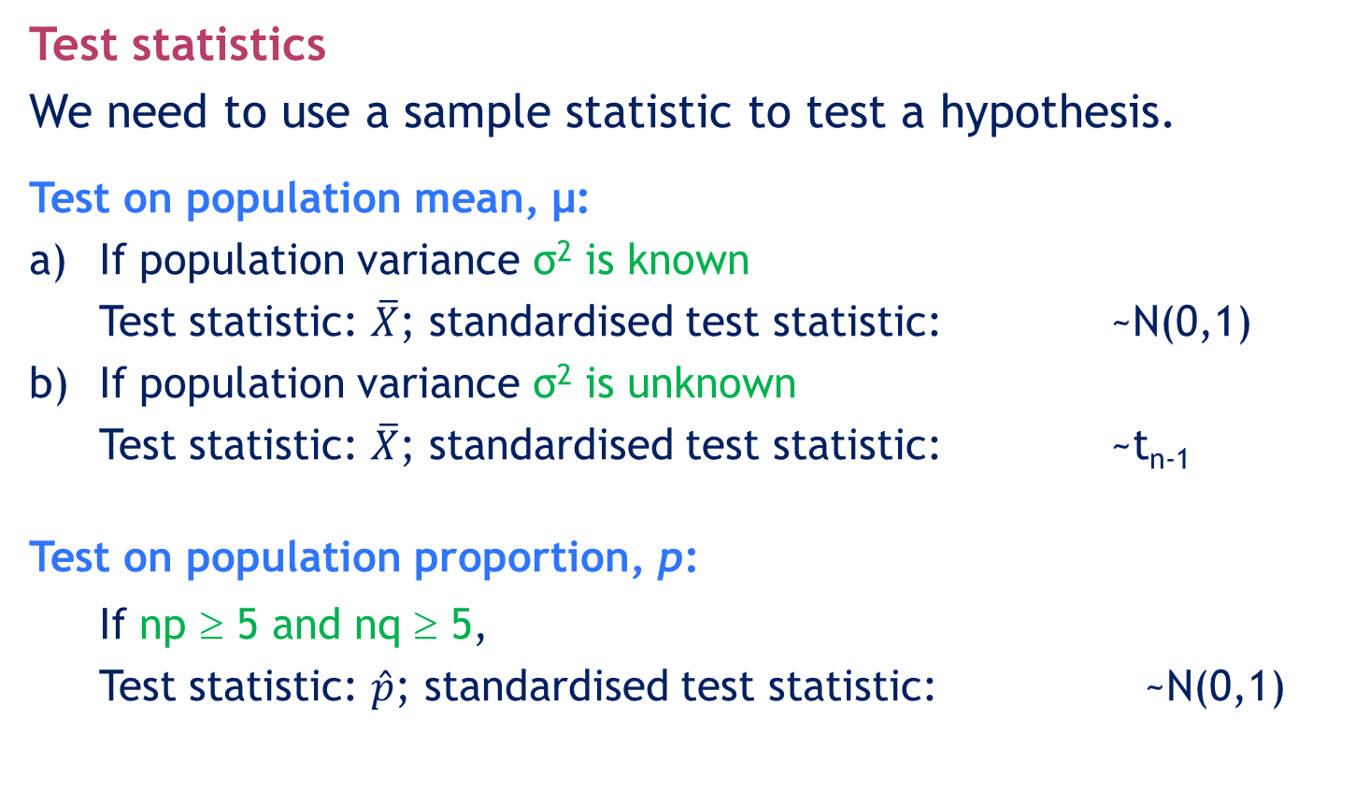
Concepts of hypothesis testing…
12.18
Test statistics
We need to use a sample statistic to test a hypothesis.
Test on population mean, μ:
a) If population variance σ² is known
Test statistic: $\overline{X}$; standardised test statistic: ~N(0,1)
b) If population variance σ² is unknown
Test statistic: $\overline{X}$; standardised test statistic: ~t_{n-1}
Test on population proportion, p:
If np ≥ 5 and nq ≥ 5,
Test statistic: $\hat{p}$; standardised test statistic: ~N(0,1)

Slide 19
Concepts of hypothesis testing…
12.19
A rejection region of a test consists of all values of the test statistic for which H₀ is rejected.
An acceptance region of a test consists of all values of the test statistic for which H₀ is not rejected.
The critical value is the value that separates the acceptance and rejection region.
The decision rule defines the range of values of the test statistic for which H₀ is rejected in favour of H_{A}.

Slide 20
12.20
Concepts of hypothesis testing: A summary
1. There are two hypotheses, the null and the alternative hypotheses.
2. The procedure begins with the assumption that the null hypothesis is true.
3. The goal is to determine whether there is enough evidence to infer that the alternative hypothesis is true.

Slide 21
Concepts of hypothesis testing…
12.21
4. There are two possible decisions:
Conclude that there is enough evidence to support the alternative hypothesis.
Conclude that there is not enough evidence to support the alternative hypothesis.
5. Two possible errors can be made.
Type I error: Reject a true null hypothesis.
Type II error: Do not reject a false null hypothesis.
P(making a Type I error) = α = level of significance
P(making a Type II error) = β

Slide 22
Concepts of hypothesis testing…
12.22
Consider an example where we want to know whether the population mean is different from 130 units. We can rephrase this request into a test of the hypothesis:
H₀: µ = 130
Thus, our alternative hypothesis becomes:
H_{A}: µ ≠ 130
This is what we are interested in determining…

Slide 23
12.23
Concepts of hypothesis testing…
The testing procedure begins with the assumption that the null hypothesis is true.
Thus, until we have further statistical evidence, we will assume:
H₀: μ = 130 (assumed to be TRUE)

Slide 24
12.24
Concepts of hypothesis testing…
The goal of the process is to determine whether there is enough evidence to infer that the alternative hypothesis is true.
That is, is there sufficient statistical information to determine if this statement is true?
H_{A}: µ ≠ 130
This is what we are interested in determining…

Slide 25
12.25
Concepts of hypothesis testing…
There are two possible decisions that can be made:
Conclude that there is enough evidence to support the alternative hypothesis (also stated as: rejecting the null hypothesis in favour of the alternative).
Conclude that there is not enough evidence to support the alternative hypothesis (also stated as: not rejecting the null hypothesis in favour of the alternative).
NOTE: we do not say that we accept the null hypothesis…

Slide 26
12.26
Concepts of hypothesis testing…
Once the null and alternative hypotheses are stated, the next step is to select a random sample from the population and calculate a test statistic (in this example, the sample mean).
If the test statistic’s value is inconsistent with the null hypothesis we reject the null hypothesis and infer that the alternative hypothesis is true.

Slide 27
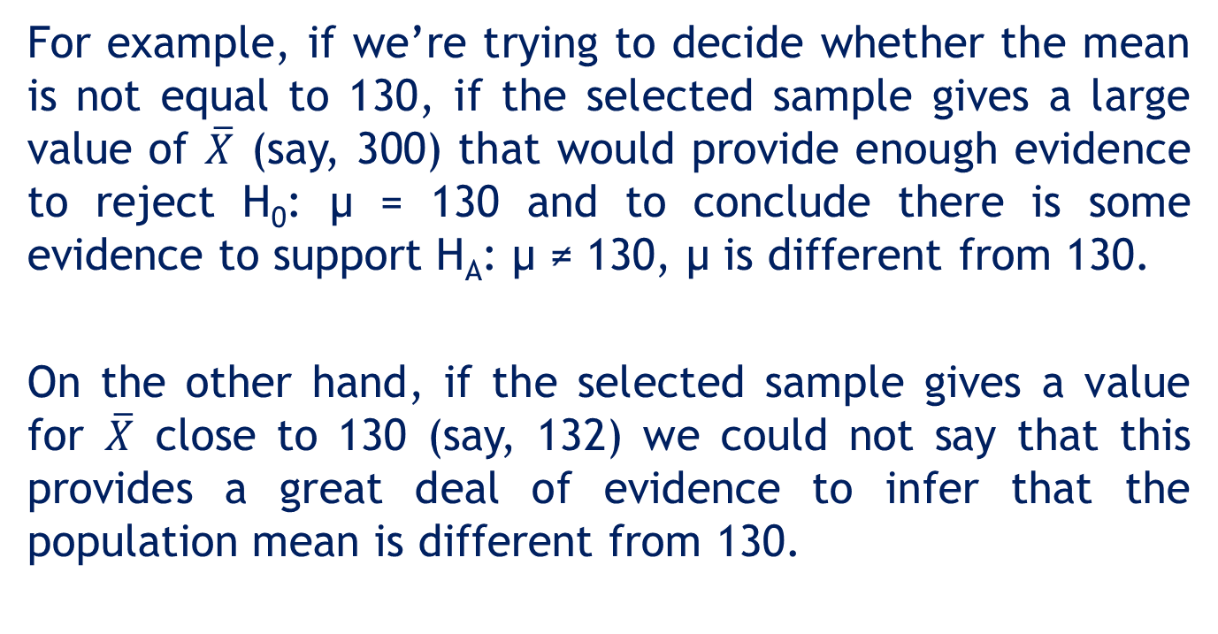
12.27
12.2 Testing the population mean when the variance σ² is known

Slide 28
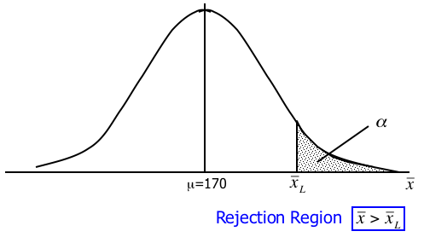
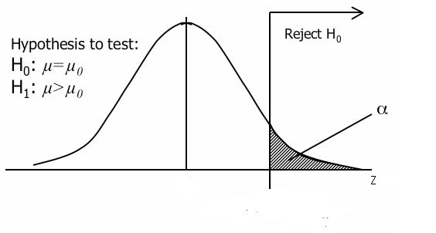
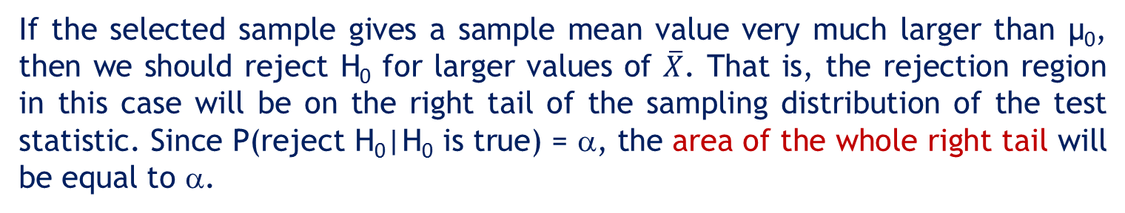
Right-tail test
12.28
Hypothesis to test:
H0: μ=μ0
HA: μ>μ0
Level of significance = α
μ=μ0
0
zα
If the selected sample gives a sample mean value very much larger than μ0, then we should reject H0 for larger values of $\overline{X}$. That is, the rejection region in this case will be on the right tail of the sampling distribution of the test statistic. Since P(reject H0|H0 is true) = α, the area of the whole right tail will be equal to α.

Slide 29
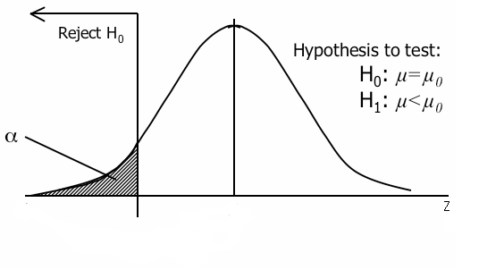
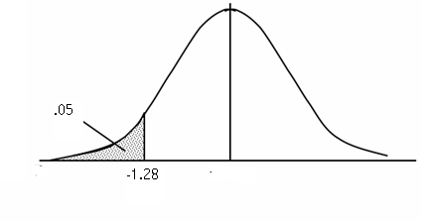
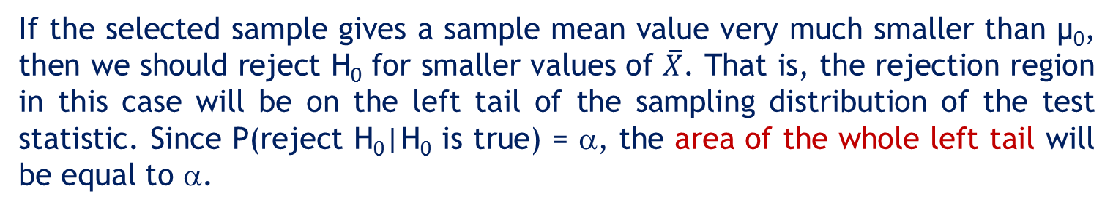
Left-tail test
12.29
Hypothesis to test:
H0: μ=μ0
HA: μ<μ0
Level of significance = α
α
μ=μ0
-zα
0
If the selected sample gives a sample mean value very much smaller than μ0, then we should reject H0 for smaller values of $\overline{X}$. That is, the rejection region in this case will be on the left tail of the sampling distribution of the test statistic. Since P(reject H0|H0 is true) = α, the area of the whole left tail will be equal to α.

Slide 30
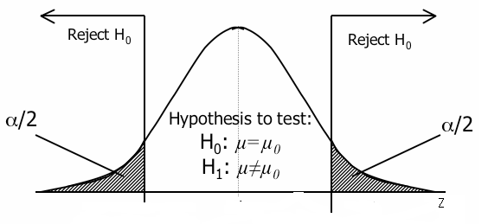
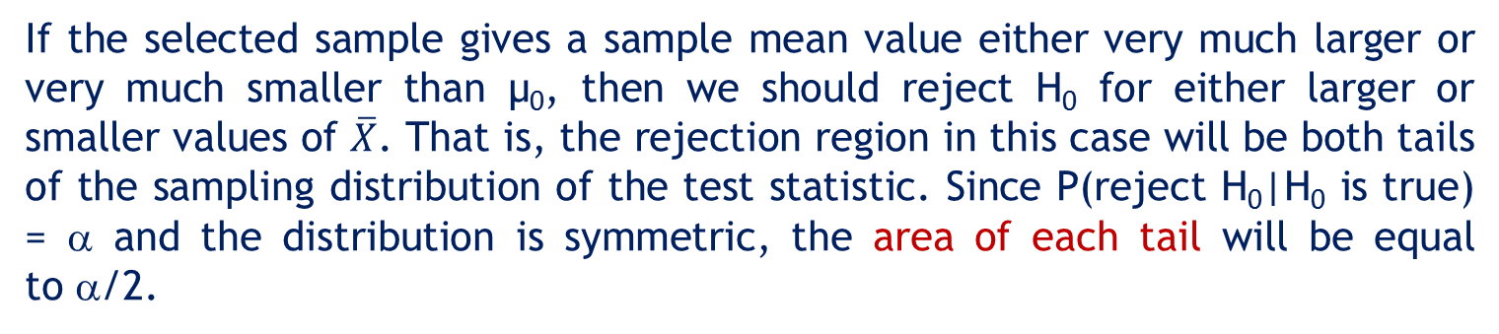
Two-tail test
12.30
Hypothesis to test:
H0: μ=μ0
HA: μ≠μ0
Level of significance = α
H0: μ=μ0
HA: μ≠μ0
H0: μ=μ0
HA: μ≠μ0
-zα/2
0
zα/2
If the selected sample gives a sample mean value either very much larger or very much smaller than μ0, then we should reject H0 for either larger or smaller values of $\overline{X}$. That is, the rejection region in this case will be both tails of the sampling distribution of the test statistic. Since P(reject H0|H0 is true) = α and the distribution is symmetric, the area of each tail will be equal to α/2.

Slide 31
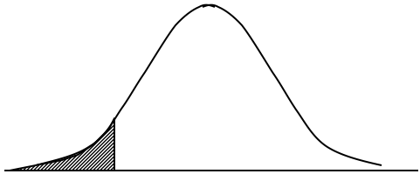
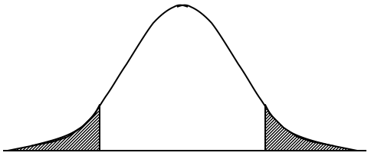
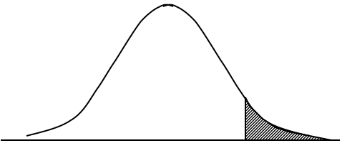
One- and two-tail tests: A summary
12.31
One-Tail Test (left tail) | Two-Tail Test | One-Tail Test (right tail)
H_{o}: μ = μ_{o} H_{A}: μ < μ_{o} | H_{o}: μ = μ_{o} H_{A}: μ ≠ μ_{o} | H_{o}: μ = μ_{o} H_{A}: μ > μ_{o}

Slide 32
Six-step process for testing hypothesis
12.32
Step 1: Set up the null and alternative hypotheses.
Note: Since the alternative hypothesis answers the question, set this one up first. The null hypothesis will automatically follow.
Step 2: Determine the test statistic and its sampling distribution.
Step 3: Specify the significance level.
Note: We usually set α = 0.01, 0.05 or 0.10, but other values are possible.

Slide 33
Six-step process for testing hypothesis…
12.33
Step 4: Define the decision rule.
Note: This involves using the appropriate statistical table from Appendix B to determine the critical value(s) and the rejection region.
Step 5: Calculate the value of the test statistic.
Note: Non-mathematicians need not fear. Only simple arithmetic is needed.
Step 6: Make a decision and answer the question.
Note: Remember to answer the original question. Making a decision about the null hypothesis is not enough.

Slide 34
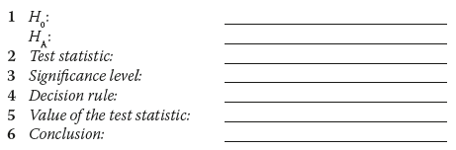
Six-step process for testing hypothesis…
12.34

Slide 35
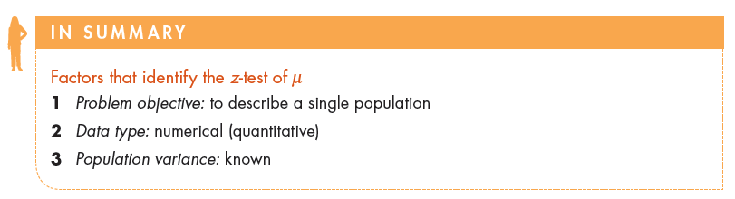
Factors that identify…
12.35

Slide 36
Example 1: Time required to complete an assembly line
12.36
The mean of the amount of time required to complete a critical part of a production process on an assembly line is believed to be 130 seconds. To test if this belief is correct, a sample of 100 randomly selected assemblies is drawn and the processing time recorded. The sample mean is 126.8 seconds. If the process time is normally distributed with a standard deviation of 15 seconds, can we conclude that the belief regarding the mean is incorrect?

Slide 37
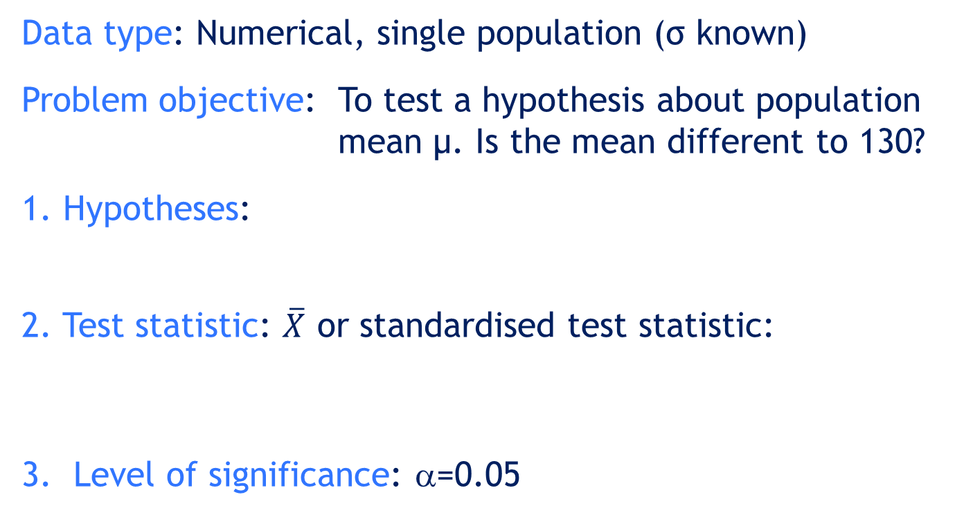
Example 1: Solution
12.37
IDENTIFY
Data type: Numerical, single population (σ known)
Problem objective: To test a hypothesis about population mean μ. Is the mean different to 130?
1. Hypotheses:
2. Test statistic: $\overline{X}$ or standardised test statistic:
3. Level of significance: α=0.05
H0: μ = 130
HA: μ ≠ 130
Two-tailed test

Slide 38
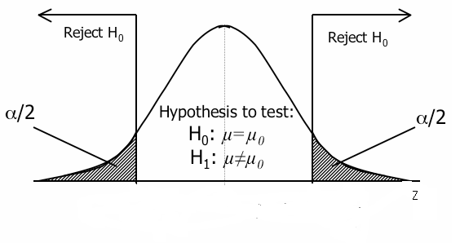
Example 1: Solution…
12.38
IDENTIFY
4. Decision rule
The rejection region is set up so we can reject the null hypothesis when the test statistic is large or when it is small.
That is, we set up a two-tail rejection region. The total area in the rejection region must sum to α, so we divide this probability by 2.
Stat is ‘very small’
Stat is ‘very large’

Slide 39
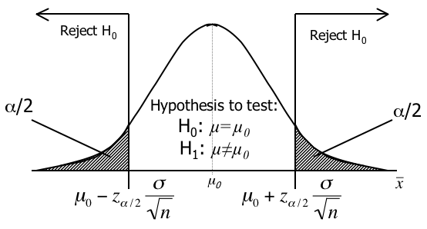
Example 1: Solution…
12.39
IDENTIFY
As α = 0.05, we have α/2 = 0.025 and z_{0.025} = 1.96 and our rejection region is z < –1.96 or z > 1.96.
=0.025
=0.025
-z.025
= -1.96
+z.025
= 1.96
z
0
Decision rule (z-value method):
Do not reject H0 if -1.96 ≤ z ≤ 1.96. Otherwise, reject H0.

Slide 40

Example 1: Solution…
12.40
COMPUTE
Value of the test statistic
From the sample data, $\overline{X}$ = 126.8.
Conclusion
Since z = –2.13 < –1.96, we reject Ho.

Slide 41
12.3 The p-value of a test of hypothesis
12.41
The p-value of a test is the minimum level of significance that is required to reject the null hypothesis.
In Example 1, we obtained
z = -2.13
Since it was a two-tail test,
p-value = P(Z < -2.13) + P(Z >2.13)
= 2(0.0166) = 0.0332

Slide 42
The p-value of a test of hypothesis…
12.42
½ p-value
=0.0166
½ p-value
=0.0166
-2.13
2.13
z
0

Slide 43
The p-value of a test of hypothesis…
12.43
Therefore, if we select a level of significance larger than 0.0332 (3.32%), the conclusion would be to reject H₀.
For example, if α = 0.05 (5%), p-value = 0.0332 < α = 0.05, so the conclusion is to reject H₀ in favour of H_{A}: μ ≠ 130.
On the other hand, if we choose α = 0.03 (3%), p-value = 0.0332 > α = 0.03, so the conclusion would be do not reject H₀.

Slide 44
The p-value of a test of hypothesis…
12.44
p-value calculation
In general:
For a right tail test (H_{A}: μ > μ₀), p-value = P(z > z₀)
For a left tail test (H_{A}: μ < μ₀), p-value = P(z < -z₀)
For a two-sided test (H_{A}: μ ≠ μ₀), p-value = 2P(z >|z₀|)
Decision rule
If p-value < α, we reject H₀.
If p-value > α, we do not reject H₀.

Slide 45
12.45
Interpreting the p-value
The smaller the p-value, the more statistical evidence exists to support the alternative hypothesis.
If the p-value is less than 1%, there is overwhelming evidence that supports the alternative hypothesis.
If the p-value is between 1% and 5%, there is strong evidence that supports the alternative hypothesis.
If the p-value is between 5% and 10% there is weak evidence that supports the alternative hypothesis.
If the p-value exceeds 10%, there is no evidence that supports the alternative hypothesis.
In Example 1, we observed a p-value of 0.0332, hence there is strong evidence to support H_{A}: μ ≠ 130.

Slide 46
12.46
Interpreting the p-value…
Overwhelming evidence
(highly significant)
Strong evidence
(significant)
Weak evidence
(not significant)
No evidence
(not significant)
0 0.01 0.05 0.10
p-value=0.0332

Slide 47
12.47
Interpreting the p-value…
Compare the p-value with the selected value of the significance level:
If the p-value is less than α, we judge the p-value to be small enough to reject the null hypothesis.
If the p-value is greater than α, we do not reject the null hypothesis.
In Example 1, since p-value = 0.0332 < α = .05, we reject H₀ in favour of H_{A} at the 5 percent level of significance.

Slide 48
Example 1: Solution…
12.48
COMPUTE
In summary, in Example 1, given α=0.05,
p-value = P(Z < –2.13) + P(Z > 2.13)
= 2(0.0166) = 0.0332
α/2 = 0.025
α/2 = 0.025
–2.13
0
2.13
–zα/2 = –1.96
zα/2 = 1.96
Conclusion: As p-value = 0.0332 < 0.05 = α, we reject Ho.

Slide 49
12.49
Since the value of the test statistic falls in the rejection region, we reject the null hypothesis in favour of the
alternative hypothesis.
OR (alternatively)
Since the p-value=0.0332 is less than the level of significance α = 0.05, we reject the null hypothesis in favour of the alternative hypothesis.
INTERPRET
There is sufficient evidence to infer that
the mean is not 130.

Slide 50
12.50
Testing the population mean when σ² is known
Using Excel (Data Analysis Plus or workbook)
If raw data are available, we can use Data Analysis Plus.
Add-Ins > Data Analysis Plus > z-test: Mean
If only summary data are available, we can use the t-test_Mean worksheet of the Test Statistics Excel workbook.

Slide 51
12.51
Example 1: Solution…
Using Excel
(t-test_Mean worksheet, Test Statistics Excel workbook)

Slide 52
Conclusions of a test of hypothesis
12.52
If we reject the null hypothesis, we conclude that there is enough evidence to infer that the alternative hypothesis is true.
If we do not reject the null hypothesis, we conclude that there is not enough statistical evidence to infer that the alternative hypothesis is true.
Remember! The alternative hypothesis is the more important one. It represents what we are investigating.

Slide 53
Example 2: Is the product label acceptable?
12.53
XM12-02 There are a variety of government agencies devoted to ensuring that food producers package their products in such a way that the weight or volume of the contents listed on the label is correct. Recently, a number of customer complaints were received regarding the weight of the 500g garlic packs imported from overseas by a particular wholesale distributor, Ausvege Ltd. For example, garlic packs whose labels state that the contents have a net weight of 500g must have a net weight of at least 500g. However, it is impossible to check all garlic packs sold in the country. As a result, statistical techniques are used. A random sample of the product is selected and its contents measured. If the mean of the sample provides sufficient evidence to infer that the mean weight of all 500g

Slide 54

Example 2…
12.54
Ausvege garlic packs is less than 500g, the product label is deemed to be unacceptable. Suppose that a government inspector weighs the contents of a random sample of 25 garlic packs labelled ‘Net weight: 500 grams’ distributed by Ausvege Ltd and records the measurements below. Using a 5% significance level, can the inspector conclude that the product label is unacceptable? (Assume that the inspector knows from previous experiments that the weight of all 500g garlic packs distributed by Ausvege Ltd is normally distributed with a standard deviation of 10g.)

Slide 55
Example 2: Solution
12.55
Data type: Numerical, single population (σ known)
Problem objective: To draw a conclusion about the mean weights of 500g garlic packs.
We investigate whether the mean weight is less than 500 grams (that is, whether the product label is unacceptable).
H0: μ = 500
Then
HA: μ < 500
Left one-tail test
Based on the given data, sample mean $\overline{X}$ = 499.76.

Slide 56
Example 2: Solution…
12.56
Our hypotheses
2. The test statistic is:
5. Value of the test statistic under H_{o}:
3. Level of significance: α = 0.05
H0: μ = 500
HA: μ < 500
4. Decision rule
Left one-tail test
Reject Ho if Z < – zα = -1.645
(or Reject Ho if p-value < α = 0.05)

Slide 57
12.57
Example 2: Solution…
z-value method:
α = 0.05
Do not reject H0
500
A sample mean far below 500
should be a rare event if μ = 500.
α = 0.05
Do not reject H0
Rejection region
–0.12
–zα = –1.645
0
Conclusion:
As z = -0.12 > -1.645 = zcritical, we do not reject Ho.

Slide 58
12.58
p-value Method
p-value = P(Z < – 0.12) = 0.4522
α = 0.05
Rejection region
–0.12
–zα = –1.645
0
Conclusion: As p-value = P(Z < – 0.12) = 0.4522 > 0.05, we do not reject Ho.

Slide 59
12.59
INTERPRET
Since the value of the test statistic does not fall in the rejection region,
we do not reject the null hypothesis
in favour of the alternative hypothesis.
OR (alternatively)
Since the p-value is greater than the level of significance, we do not reject the null hypothesis in favour of the alternative hypothesis.
There is insufficient evidence to infer
that the mean is less than 500 grams.

Slide 60
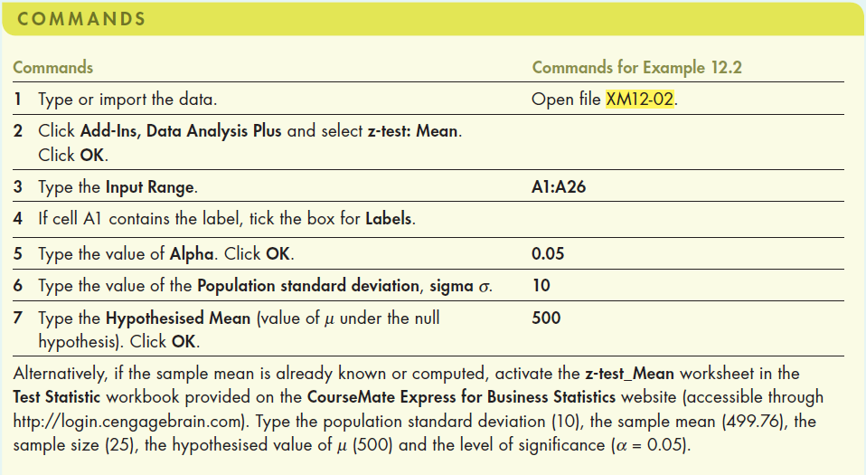
12.60
Example 2: Solution…
Using Excel (Data Analysis Plus™)

Slide 61
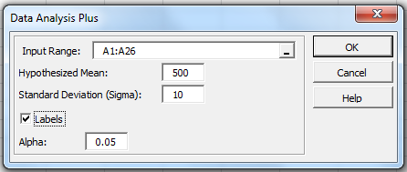
12.61
Example 2: Solution…
Using Excel (Data Analysis Plus™)
In the Data Analysis Plus dialogue box (shown below), enter the input and the output is presented in the next slide.

Slide 62
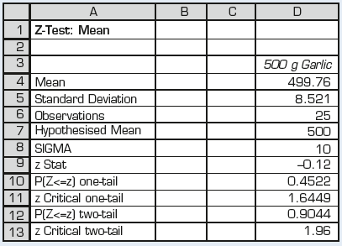
12.62
Example 2: Solution…
Using Excel (Data Analysis Plus™)
Output from Data Analysis Plus

Slide 63
12.4 Testing the population mean when the variance σ² is unknown
12.63
Recall that when σ is known, the test statistic
is normally distributed
if the sample is drawn from a normal population, or
if the population is not normal but the sample is sufficiently large.
When σ is unknown, we estimate σ by its point estimator s, and the z test statistic is replaced by the t-statistic.

Slide 64


Inference with variance unknown
12.64
When σ is unknown, we use its point estimator s and the z-statistic is replaced by the t-statistic, where the number of “degrees of freedom” ν, is n–1.

Slide 65
Testing the population mean when the variance σ² is unknown…
12.65
If the population is normally distributed, the test statistic for μ when σ is unknown is t.
This statistic is Student t-distributed with (n–1) degrees of freedom.

Slide 66
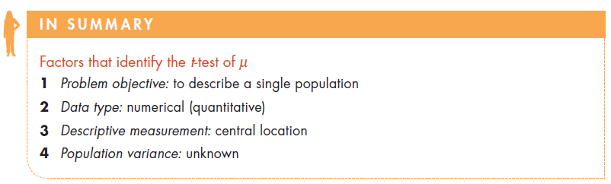
Factors that identify…
12.66

Slide 67
Example 3 – Has production declined due to new government regulations? (Example 12.5, p496)
12.67
XM12-05 A manufacturer of television picture tubes has a production line that used to produce an average of 100 tubes per day. because of recently introduced government regulations, a new safety device is installed, which the manufacturer believes will reduce the average daily output. After installation of the safety device, a random sample of 15 days’ production was recorded, as follows:
93 103 95 101 91 105 96 94 101 88 98 94 101 92 95
Assuming that the daily output is normally distributed, is there sufficient evidence to allow the manufacturer to conclude that average daily output has decreased following installation of the safety device? (use α = 0.05.)

Slide 68
Example 3: Solution
12.68
IDENTIFY
Identifying the technique
Data type: Numerical, single population (σ known)
Problem objective: To describe the population of daily output (X). We investigate whether the mean daily output is less than 100 tubes (that is, whether output has decreased following installation of the safety device).
Parameter of interest: Population mean μ
Population variance: σ² unknown, use s² to estimate σ².
Distribution of X: Assume normal.

Slide 69
Example 3: Solution…
12.69
IDENTIFY
Hypotheses: H₀: μ = 100
H_{A}: μ < 100 [Left one tail test]
Test statistic:
Level of significance: α = 0.05
Critical value: -t_{α,n-1} = -t_{0.05,14} = -1.761
Decision rule:
Reject H₀ if t < -1.761; otherwise do not reject H₀.

Slide 70
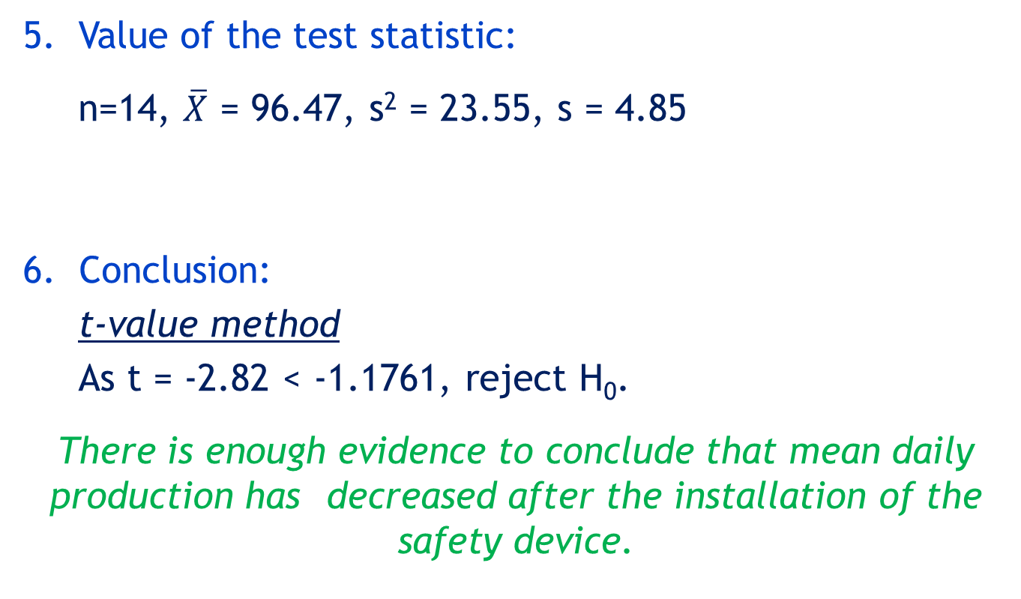
Example 3: Solution…
12.70
CALCULATE
5. Value of the test statistic:
n=14, $\overline{X}$ = 96.47, s² = 23.55, s = 4.85
Conclusion:
t-value method
As t = -2.82 < -1.1761, reject H₀.
There is enough evidence to conclude that mean daily production has decreased after the installation of the safety device.

Slide 71
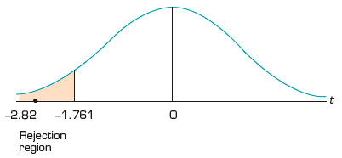
Example 3: Solution…
12.71
CALCULATE
6. Conclusion (cont.):
p-value method
From the Excel output (see below),
p-value (one tail) = 0.0068
Since p-value = 0.0068 < α = 0.05, we reject H₀.
p-value = 0.0068

Slide 72
Example 3: Solution…
12.72
INTERPRET
Interpreting the results
The manufacturer would be advised to look for ways to restore productivity with the safety device in place. Perhaps developing another safety device would help. We note that the results are valid only if the assumption that daily output is normally distributed is true.

Slide 73
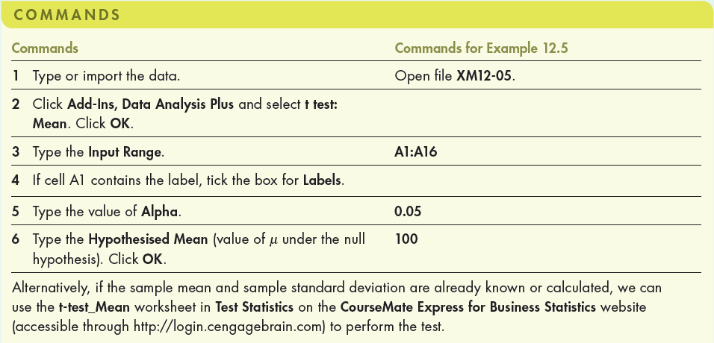
Example 3: Solution…
12.73
COMPUTE
Using Excel (Data Analysis Plus)

Slide 74
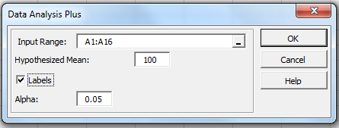
Example 3: Solution…
12.74
COMPUTE
Using Excel (Data Analysis Plus™)
In the Data Analysis Plus dialogue box (shown below), enter the input and the output is presented in the next slide.

Slide 75
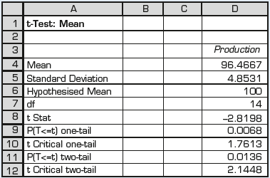
Example 3: Solution…
12.75
Using Excel (output)
Alternatively, if the sample mean and sample standard deviation are already known or calculated, we can use the Excel workbook, Test Statistics.xlsx, t-test_Mean worksheet.

Slide 76
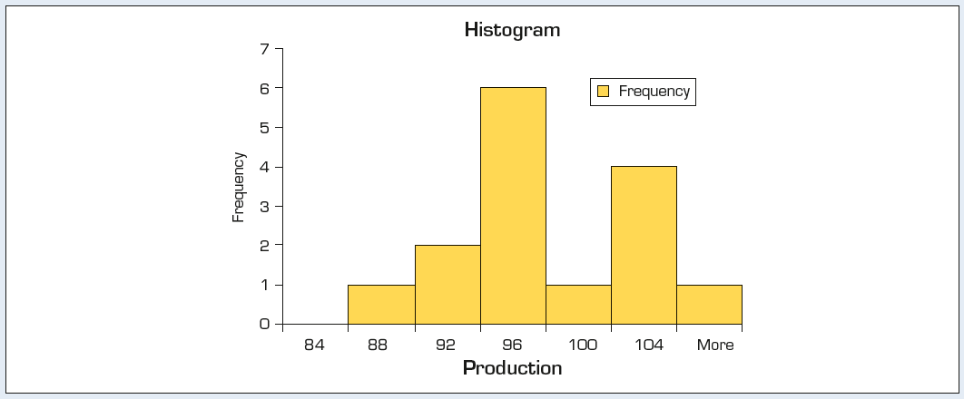
Example 3: Solution…
12.76
Checking the required condition
As before in Chapter 10, we check the required condition that the population is normal. The histogram of the data below indicates that the population is approximately normal. Hence, the t-test and the conclusion is valid.

Slide 77
12.5 Calculating the probability of a Type II error
12.77
As discussed earlier, in any hypothesis testing, we make two types of errors and their probabilities are α and β. We have already discussed in detail about α.
α = P (making Type I error)
β = P (making Type II error)
Now we consider the computation of the P(making Type II error), β.

Slide 78
Probability of a Type II error, β
12.78
It is important that that we understand the relationship between Type I and Type II errors; that is, how the probability of a Type II error is calculated and its interpretation.

Slide 79
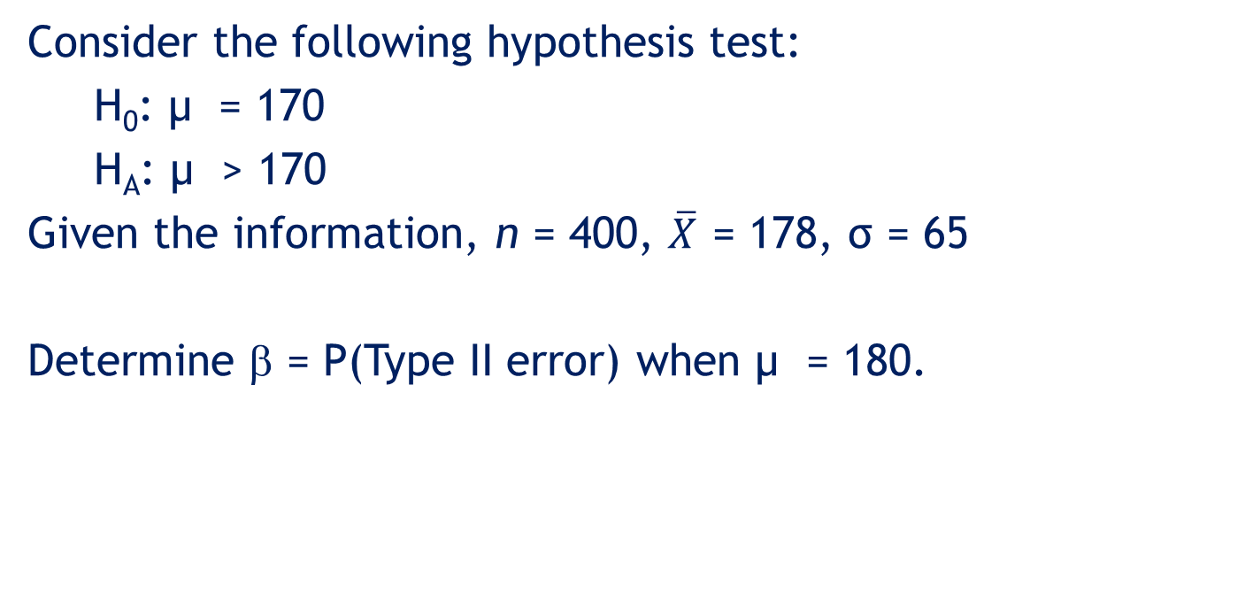
Example 4
12.79
Consider the following hypothesis test:
H₀: µ = 170
H_{A}: µ > 170
Given the information, n = 400, $\overline{X}$ = 178, σ = 65
Determine β = P(Type II error) when µ = 180.

Slide 80
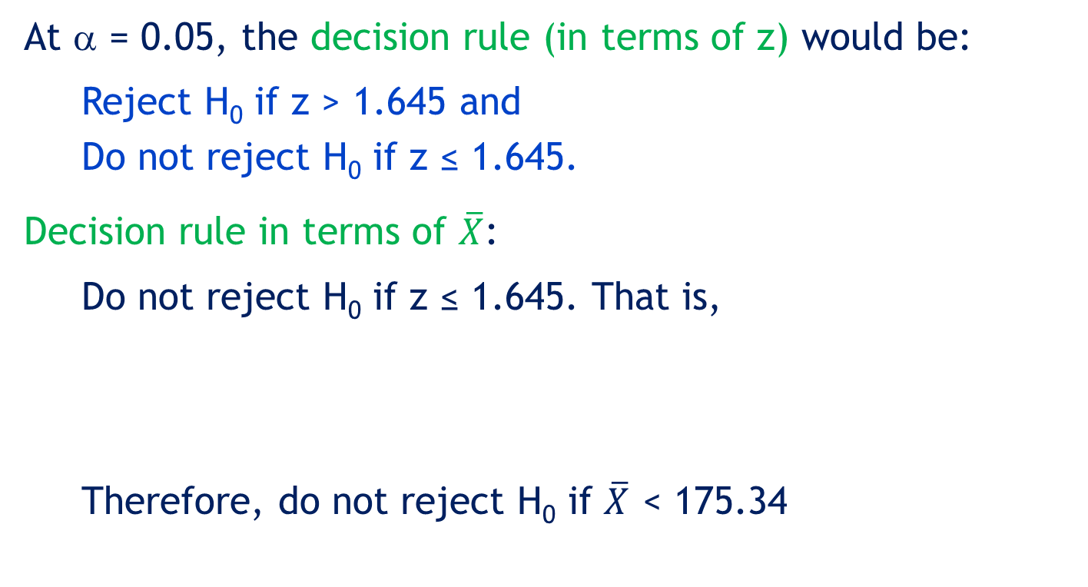
Example 4: Solution
12.80
At α = 0.05, the decision rule (in terms of z) would be:
Reject H₀ if z > 1.645 and
Do not reject H₀ if z ≤ 1.645.
Decision rule in terms of $\overline{X}$:
Do not reject H₀ if z ≤ 1.645. That is,
Therefore, do not reject H₀ if $\overline{X}$ < 175.34

Slide 81
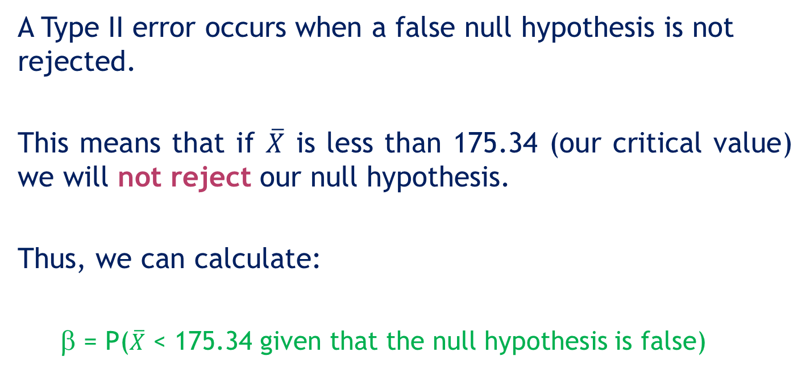
Example 4: Solution…
12.81
A Type II error occurs when a false null hypothesis is not rejected.
This means that if $\overline{X}$ is less than 175.34 (our critical value) we will not reject our null hypothesis.
Thus, we can calculate:
β = P($\overline{X}$ < 175.34 given that the null hypothesis is false)

Slide 82


Example 4: Solution…
12.82
H0: μ = 170
HA: μ > 170
=175.34
Reject H0 in favour of
=178

Slide 83
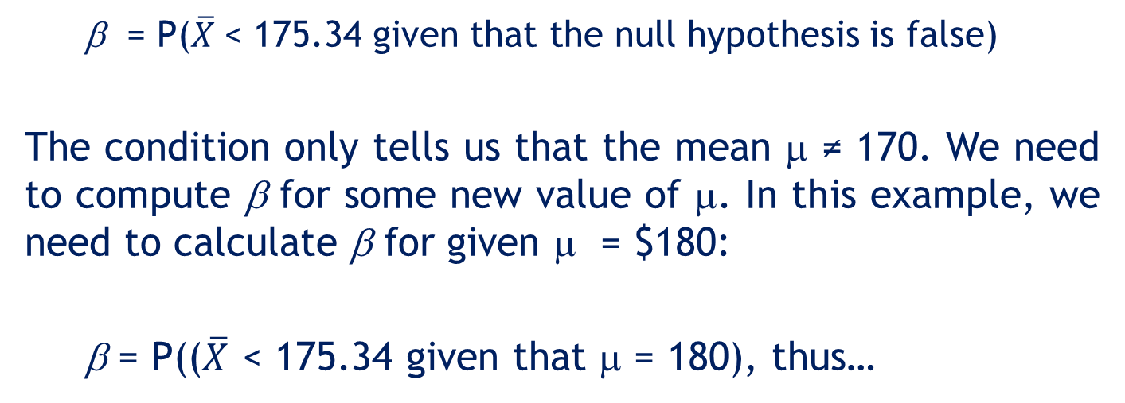
Example 4: Solution…
12.83
β = P($\overline{X}$< 175.34 given that the null hypothesis is false)
The condition only tells us that the mean μ ≠ 170. We need to compute β for some new value of μ. In this example, we need to calculate β for given μ = $180:
β = P(($\overline{X}$ < 175.34 given that μ = 180), thus…

Slide 84
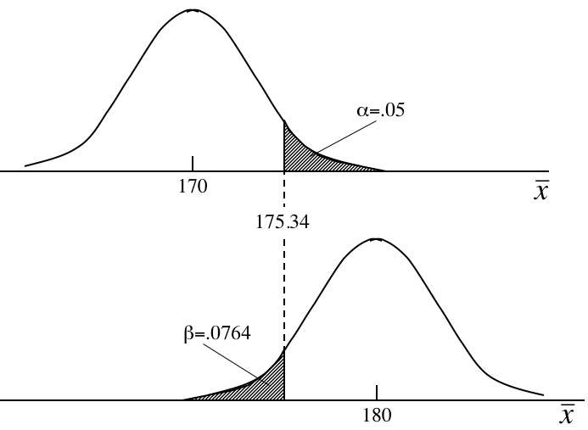
Example 4: Solution…
12.84
Our original hypothesis…
Our new assumption…

Slide 85
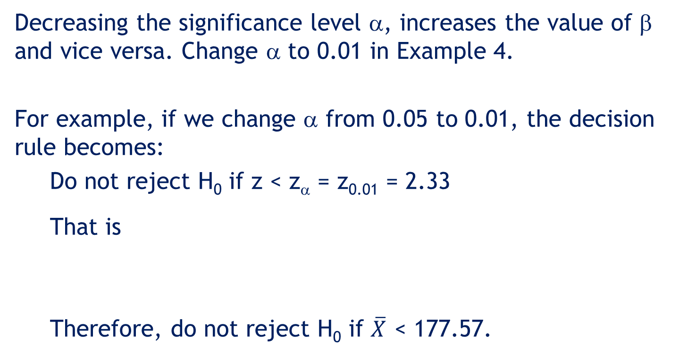
Effects on β of Changing α
12.85
Decreasing the significance level α, increases the value of β and vice versa. Change α to 0.01 in Example 4.
For example, if we change α from 0.05 to 0.01, the decision rule becomes:
Do not reject H₀ if z < z_{α} = z_{0.01} = 2.33
That is
Therefore, do not reject H₀ if $\overline{X}$ < 177.57.

Slide 86
12.86
Effects on β of changing α…
Now let us calculate the value of β (when μ = 180 as before), for α = 0.01.
Probability of a Type II error:
When we decrease α from 0.05 to 0.01, the value of β has increased from 0.0764 to 0.2266.

Slide 87
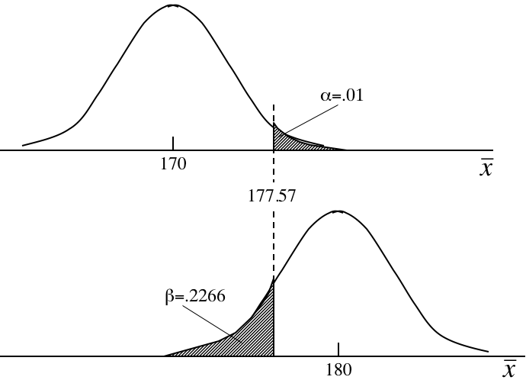
12.87
Effects on β of changing α…
Decreasing the significance level α increases the value of β and vice versa.
Consider this diagram again. Shifting the critical value line to the right (to decrease α) will mean a larger area under the lower curve for β… (and vice versa)

Slide 88
Judging the test
12.88
A statistical test of hypothesis is effectively defined by the significance level (α) and the sample size (n), both of which are selected by the statistics practitioner.
Therefore, if the probability of a Type II error (β) is judged to be too large, we can reduce it by
increasing α,
and/or
increasing the sample size, n.

Slide 89
Judging the test…
12.89
For example, suppose we increased n from a sample size of 400 account balances to 1,000 in Example 4.
Decision rule:
Do not reject H₀ if z < z_{α} = z_{0.05} = 1.645
That is,
Hence, do not reject H₀ if

Slide 90
Judging the test…
12.90
Probability of a Type II error

Slide 91
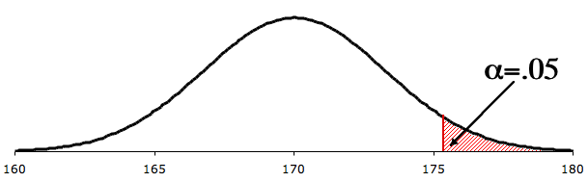
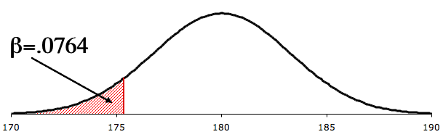
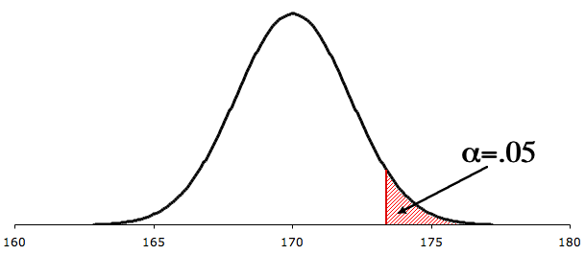
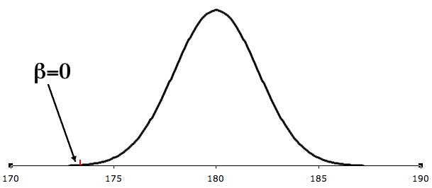
Compare β at n=400 and n=1,000
12.91
n=400
175.35
By increasing the sample size we reduce the probability of a Type II error:
173.38
n=1,000

Slide 92
Developing an understanding of statistical concepts
12.92
The calculation of the probability of a Type II error for n = 400 and for n = 1,000 illustrates a concept whose importance cannot be overstated.
By increasing the sample size we reduce the probability of a Type II error. By reducing the probability of a Type II error we make this type of error less frequently.
And hence, we make better decisions in the long run. This finding lies at the heart of applied statistical analysis and reinforces the book’s first sentence, ‘Statistics is a way to get information from data.’

Slide 93
12.93
Developing an understanding of statistical concepts
Throughout this book we introduce a variety of applications in finance, marketing, operations management, human resources management, and economics.
In all such applications the statistics practitioner must make a decision, which involves converting data into information. The more information, the better the decision.
Without such information decisions must be based on guesswork, instinct and luck. A famous statistician, W. Edwards Deming said it best: ‘Without data you’re just another person with an opinion.’

Slide 94
Power of a Test
12.94
Another way of expressing how well a test performs is to report its power: the probability of its leading us to reject the null hypothesis when it is false. Thus, the power of a test is, the probability the test correctly rejects a false null hypothesis,
Power = P(correctly reject H₀ | H₀ is false)
= 1 – P(Do not reject H₀ | H₀ is false)
= 1 – β

Slide 95
Judging the test
12.95
The power of a test = 1– β.
It represents the probability of rejecting the null hypothesis when it is false.
That is, when more than one test can be performed in a given situation, its is preferable to use the test that is correct more often. If one test has a higher power than a second test, the first test is said to be more powerful and the preferred test.

Slide 96
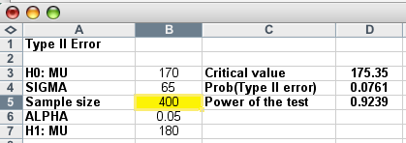
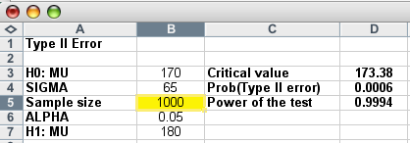
Using Excel…
12.96
The Beta-mean workbook is a handy tool for calculating β for any test of hypothesis. For example, comparing n=400 to n=1,000 for our department store example…
The power of the test
has increased by
increasing the sample size…

Slide 97
12.6 Testing the population proportion
12.97
When the population consists of nominal or categorical data, the only test we can perform is about the proportion of occurrence of a certain value.
The parameter p was used previously to calculate probabilities using the binomial distribution.

Slide 98
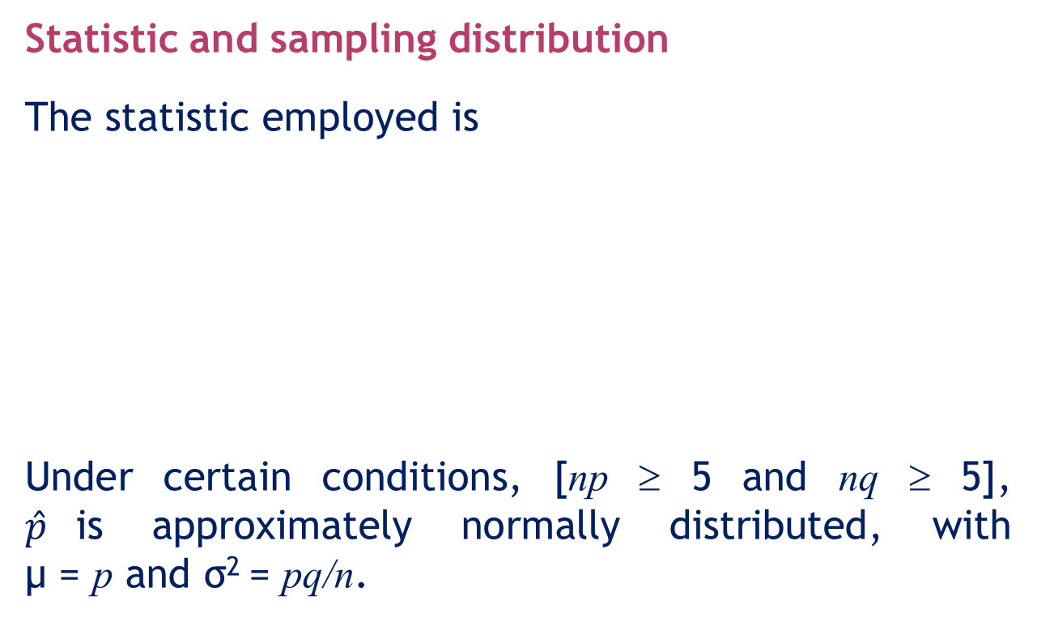
Testing the population proportion…
12.98
Statistic and sampling distribution
The statistic employed is
Under certain conditions, [np ≥ 5 and nq ≥ 5], $\hat{p}$is approximately normally distributed, with μ = p and σ² = pq/n.

Slide 99
Testing the population proportion…
12.99
Test statistic for p
where np ≥ 5 and nq ≥ 5.

Slide 100
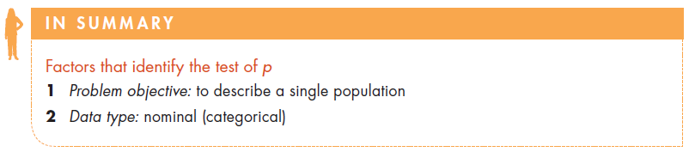
Factors that identify…
12.100

Slide 101
Example 5: Is the market share large enough to introduce a new product? (Example 12.7, page 509)
12.101
XM12-07 After careful analysis, a company contemplating the introduction of a new product has determined that it must capture a market share of 10% to break even. Anything greater than 10% will result in a profit for the company. In a survey, 400 potential customers are asked whether or not they would purchase the product and their responses were recorded. If 52 people respond affirmatively, is this enough evidence to enable the company to conclude that the product will produce a profit? (Use α = 0.05.)

Slide 102
Example 5: Solution
12.102
Identifying the technique
Data type: Nominal (survey responses, yes/no), single population
Problem objective: To describe the population of shoppers. We investigate whether the new product will capture a market share of more than 10%.
Parameter of interest: Population proportion p, proportion of shoppers who would purchase the new product.
The hypotheses are:
H₀: p = 0.10
H_{A}: p > 0.10
We want to show that the new product
would be profitable
Right-tail test.

Slide 103
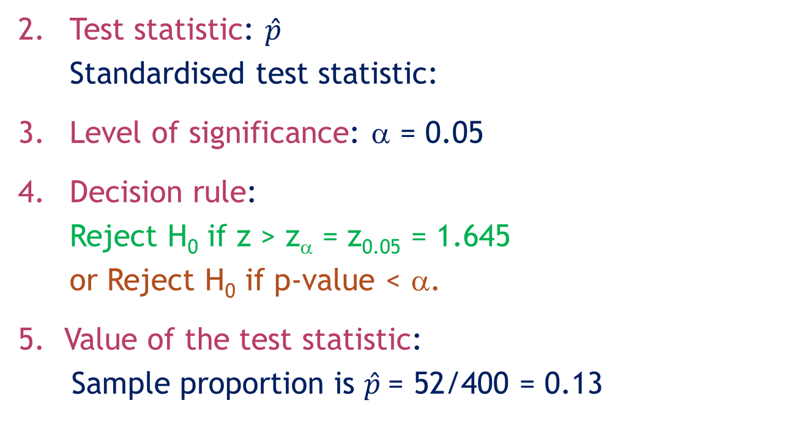
Example 5: Solution…
12.103
Test statistic: $\hat{p}$
Standardised test statistic:
Level of significance: α = 0.05
Decision rule:
Reject H₀ if z > z_{α} = z_{0.05} = 1.645
or Reject H₀ if p-value < α.
Value of the test statistic:
Sample proportion is $\hat{p}$= 52/400 = 0.13

Slide 104
Example 5: Solution…
12.104
Value of the test statistic…
The value of the test statistic is:
Conclusion:
z-value method:
Since z = 2.00 > 1.645, we reject H₀.

Slide 105
Example 5: Solution…
12.105
6. Conclusion (cont.):
p-value method:
p-value = P(z > 2.00) = 0.0228
Since p-value = 0.0228 < 0.05, we reject H_{o}.
There is sufficient evidence to reject the null hypothesis in favour of the alternative hypothesis.
At the 5% significance level we can conclude that at least 10% of shoppers will buy the product and the product would produce a profit.

Slide 106
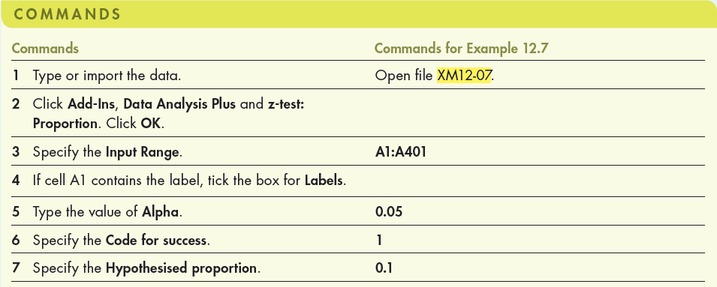
Hypothesis testing about p
12.106
Using Excel
If raw data are available, we can use Data Analysis Plus.
If only summary information is available, then we can use the z-test_Proportion worksheet of the Test Statistics Excel workbook.

Slide 107
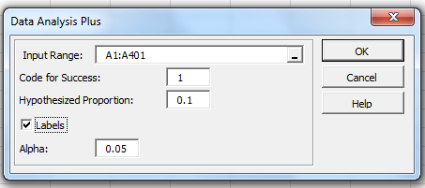
Hypothesis testing about p
12.107
Using Excel (Data Analysis Plus™)
In the Data Analysis Plus dialogue box (shown below), enter the input and the output is presented in the next slide.

Slide 108
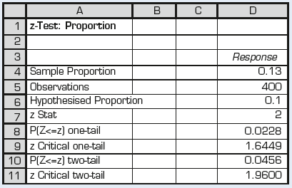
Hypothesis testing about p
12.108
Using Excel (Data Analysis Plus™)
The Data Analysis Plus output is presented below.

Slide 109
The Road Ahead
12.109
ICI approach
Identify
Compute
Interpret
The most difficult part of statistics (in real life and on final exams) is to identify the correct technique.

Slide 110
The Road Ahead…
12.110
There are several factors that identify the correct technique. The first two are:
Type of data
Numerical
Nominal
Ordinal
2. Problem objective.
1. Describe a population.
2. Compare two populations.
3. Compare two or more populations.
4. Analyse the relationship between two variables.
5. Analyse the relationship among two or more variables.

Slide 111
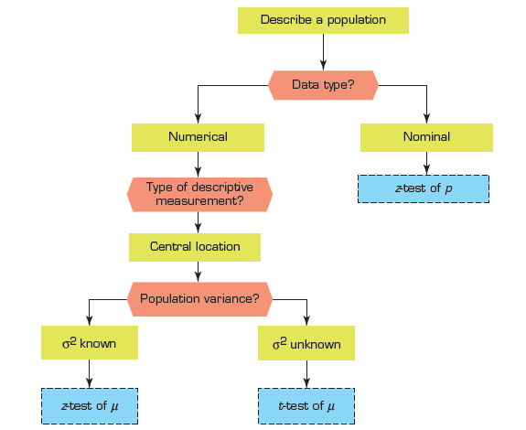
Summary of techniques –Single population parameter tests
12.111

