Slide 1


Slide 2
Chapter 17
Simple linear regression and correlation

Slide 3
Chapter outline
17.1 Model
17.2 Estimating the coefficients
17.3 Error variable: Required conditions
17.4 Assessing the model
17.5 Using the regression equation
17.6 Coefficients of correlation
17.7 Regression diagnostics – I

Slide 4
Learning objectives
LO1 Identify the dependent and the independent variables
LO2 Use the least squares method to derive estimators of simple linear regression model parameters
LO3 Understand the required conditions to perform statistical inferences about a linear regression model
LO4 Test the significance of the regression model parameters
LO5 Calculate measures used to assess the performance of a regression model

Slide 5
Learning objectives…
LO6 Use the regression equation for prediction
LO7 Calculate the prediction interval of the dependent variable
LO8 Calculate the coefficient of correlation between two variables and assess the strength of the relationship
LO9 Detect violations of required conditions using diagnostic checks on the regression model results.

Slide 6
Introduction
17.6
When the problem objective is to analyse the relationship between numerical variables, correlation and regression analysis is the first tool we will study. We briefly covered correlation and regression analysis, when we discussed descriptive graphical and numerical techniques in Chapters 4 and 5. We now extend that analysis further in this and the next few chapters.
Regression analysis is used to predict the value of one variable (the dependent variable) on the basis of other variables (the independent variables).
Dependent variable: denoted Y
Independent variables: denoted X₁, X₂, …, X_{k}

Slide 7
Correlation analysis
17.7
If we are interested only in determining whether a relationship exists, we employ correlation analysis, a technique introduced earlier.
This chapter will examine the relationship between two variables, sometimes called simple linear regression. We learn how to estimate such a relationship, measure the strength and make inferences on the relationship.
Mathematical equations describing these relationships are also called models, and they fall into two types: deterministic or probabilistic.

Slide 8
Model types
17.8
Deterministic Model: an equation or set of equations that allow us to fully determine the value of the dependent variable from the values of the independent variables.
Contrast this with…
Probabilistic Model: a method used to capture the randomness that is part of a real-life process.
E.g. do all houses of the same size (measured in square metre) sell for exactly the same price?

Slide 9
A model
17.9
To create a probabilistic model, we start with a deterministic model that approximates the relationship we want to model and add a random term that measures the error of the deterministic component.
Deterministic Model:
The cost of building a new house is about $800 per square metre and most lots sell for about $300 000. Hence the approximate selling price (y) would be:
y = $300 000 + $800(x)
(where x is the size of the house in square metres)

Slide 10
17.10
A model…
A model of the relationship between house size (independent variable) and house price (dependent variable) would be:
House
price
Building a house costs about
$800 per square metre.
House price = 300 000 + 800(Size)
In this model, the price of the house is completely determined by the size.
Most lots sell
for $300 000.
House size

Slide 11
17.11
A model…
In real life, however, the house cost will vary even among the same size of house:
Lower vs. higher
variability
House
price
Same house size, but different price points (e.g. décor options, portico upgrades, lot location…).
300K$
House price = 300 000 + 800(Size) + ε
x
House size

Slide 12
Random term
17.12
We now represent the price of a house as a function of its size in this probabilistic model:
y = 300 000 + 800x + ε
where ε (Greek letter epsilon) is the random term (also known as error variable). It is the difference between the actual selling price and the estimated price based on the size of the house. Its value will vary from house sale to house sale, even if the area of the house (i.e. x) remains the same due to other factors such as the location, age, décor etc of the house.

Slide 13

17.1 Model
17.13
A straight line model with one independent variable is called a first order linear model or a simple linear regression model. It is written as:
dependent
variable
independent
variable
slope of
the line
y-intercept
error variable

Slide 14
17.14
Simple linear regression model…
y
rise
run
β0
=y-intercept
β1=slope (=rise/run)
x
Note that both β0 and β1 are population parameters which are usually unknown, and hence estimated from the data.

Slide 15
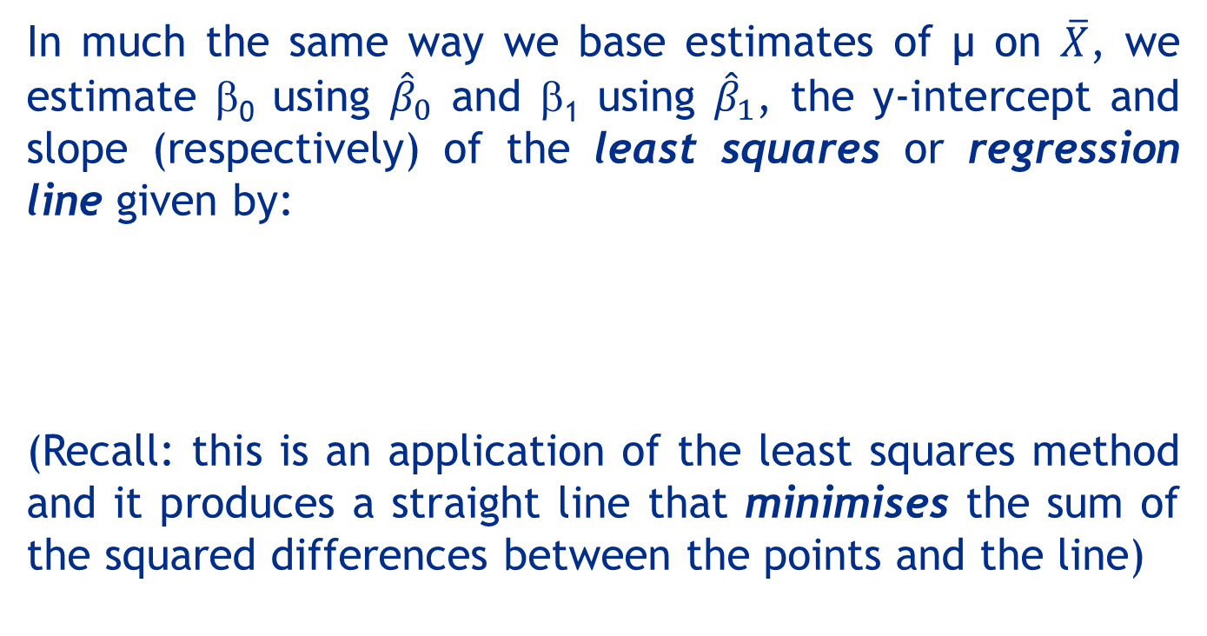
17.15
17.2 Estimating the coefficients
In much the same way we base estimates of µ on $\overline{X}$, we estimate β₀ using ${\hat{β}}_{0}$ and β₁ using ${\hat{β}}_{1}$, the y-intercept and slope (respectively) of the least squares or regression line given by:
(Recall: this is an application of the least squares method and it produces a straight line that minimises the sum of the squared differences between the points and the line)

Slide 16
Least squares method
17.16
The question is:
Which straight line fits best?
The least squares line minimises the sum of squared differences between the points and the line.
y
w
w
w
w
w
w
w
w w w w
w
w w
w w
w
x

Slide 17
Example 1
17.17
The annual bonuses ($1,000s) of six employees with different years of experience were recorded as follows. We wish to determine the straight line relationship between annual bonus and years of experience.
Years of experience x 1 2 3 4 5 6
Annual bonus y 6 1 9 5 17 12

Slide 18
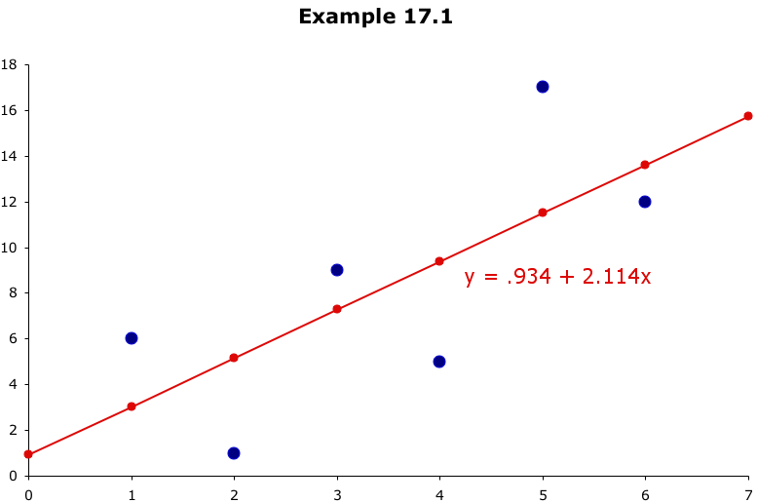
Least Squares Line
17.18
Annual bonus
Example 1
these differences are called residuals
This line minimizes the sum of the squared differences
between the points and the line…
Years of experience

Slide 19
17.19
Example 2: Which line fits best?
The best line is the one that minimises the sum of squared vertical differences between the points and the line.
Line 1: Sum of squared differences =
(2 – 1)² +
(4 – 2)² +
(1.5 – 3)² +
(3.2 – 4)² = 6.89
Line 2: Sum of squared differences =
(2 – 2.5)² +
(4 – 2.5)² +
(1.5 – 2.5)² +
(3.2–- 2.5)² = 3.99
Let us compare two lines.
4
(2, 4)
w
The second line is horizontal.
3
w
(4, 3.2)
Line 2
2.5
2
The smaller the sum of
squared differences,
the better the fit of the
line to the data.
w
(1, 2)
Line 1
(3, 1.5)
w
1
1
2
3
4

Slide 20
17.20
Least squares estimates
To calculate the estimates of the coefficients that minimise the differences between the data points and the line, use the formulas:

Slide 21
17.21
Least squares estimates…
Alternate Formula
We have already developed formulae for sample variances and covariances for two variables, X and Y:

Slide 22
17.22
Least squares estimates…
Then
The estimated simple linear regression equation that estimates the equation of the first-order linear model is:

Slide 23
17.23
Example 3 – Odometer readings and prices of used cars
(Example 17.3, p717)
A car dealer wants to find the relationship between the odometer reading and the selling price of used cars.
A random sample of 100 cars is selected and the data are recorded.
Estimate a linear relationship between price and odometer reading..
Independent
variable x
Dependent
variable y

Slide 24

17.24
Example 3 - Solution
To calculate ${\hat{β}}_{0}$ and ${\hat{β}}_{1}$, we need to calculate several statistics first:

Slide 25
17.25
Example 3 – Solution…
Therefore,
The estimated least squares regression line is

Slide 26
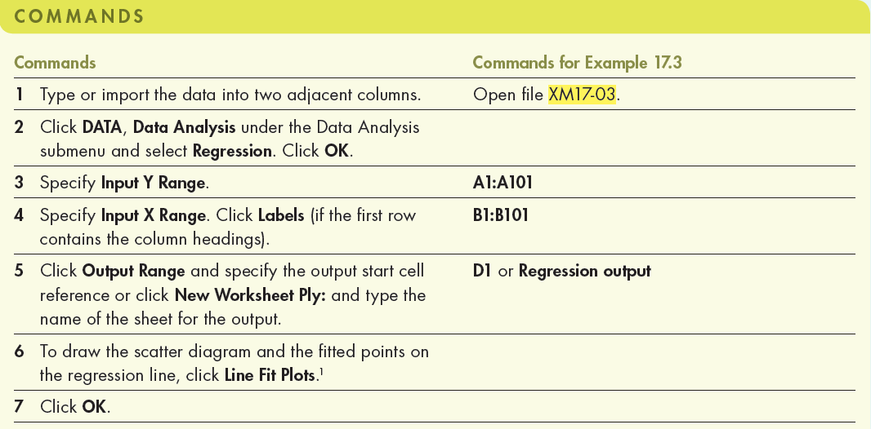
17.26
Example 3 – Solution…
Using Excel (Data Analysis)
We can use Data Analysis to come with the same results.

Slide 27
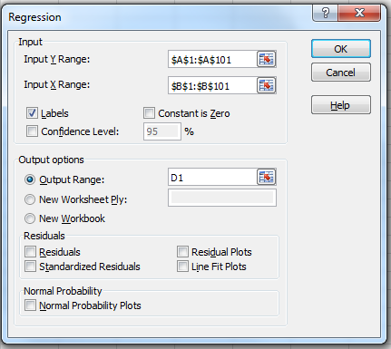
17.27
Example 3 – Solution…
Using Excel (Data Analysis)
In the Data Analysis dialogue box (shown below), enter the input and the output is presented in the next slide.

Slide 28
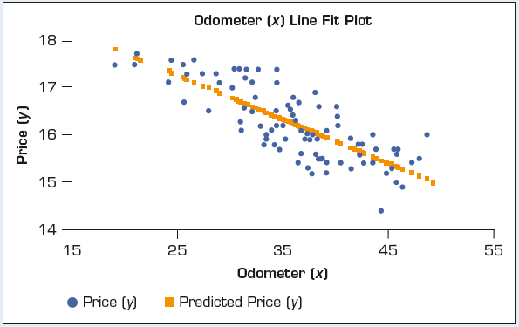
Example 3 – Solution…
17.28
Using Excel

Slide 29
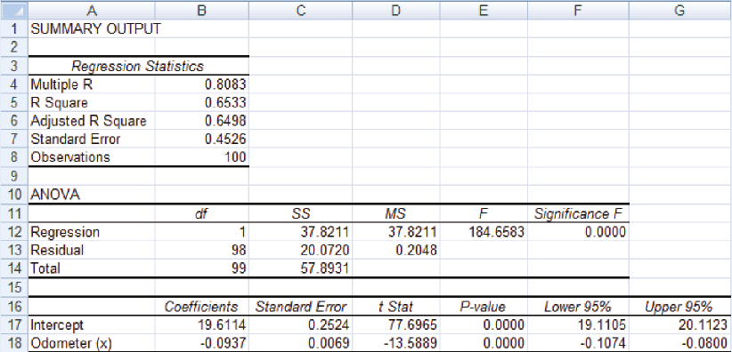
Example 3 – Solution…
17.29
Using Excel (Data Analysis): output

Slide 30
17.30
19.611
0
No data
The intercept is = 19.611.
This is the slope of the line.
For each additional kilometre on the odometer,
the price decreases by an average of $0.094
Do not interpret the intercept as the
‘price of cars that have not been driven’.

Slide 31
17.3 Error variable: Required conditions
17.31
The error ε is a critical part of the regression model,
Y = β_{o} + β₁x + ε.
Five requirements involving the distribution of e must be satisfied in order for the estimated coefficients to have desirable properties:
(1) The mean of e is zero: E(ε) = 0.
(2) The standard deviation of ε is a constant (σ_{ε}) for all values of x.
(3) The errors are independent.
(4) The errors are independent of the independent variable x.
(5) The probability distribution of e is normal.

Slide 32
17.4 Assessing the model
17.32
The least squares method will produce a regression line whether or not there is a linear relationship between x and y.
Consequently, it is important to assess how well the linear model fits the data.
Several methods are used to assess the model:
testing and/or estimating the regression model coefficients individually/jointly
using descriptive measurements such as the sum of squares for errors (SSE), standard error of estimate s_{ε} and coefficient of determination (R²).

Slide 33
Sum of squares for errors (SSE)
17.33
SSE is the sum of squared differences between the points and the regression line.
SSE can serve as a measure of how well the line fits the data.
The sum of squares for errors (SSE) is calculated as
or
SSE plays a role in every statistical technique we employ to assess the model.

Slide 34
Standard Error of Estimate
17.34
If σ_{ε} is small (i.e. the errors tend to be close to zero), the model fits the data well.
Therefore we can use σ_{ε} as a measure of the suitability of using a linear model.
An unbiased estimator of σ_{ε} is given by the standard error of estimate, s_{ε}, defined as
If s_{ε} = 0 (which is equivalent to saying SSE = 0), all the data points fall on the estimated regression line.

Slide 35
17.35
Example 3…
Calculate the standard error of estimate for Example 3 and describe what it tells you about the model fit.
Solution:
calculated before

Slide 36
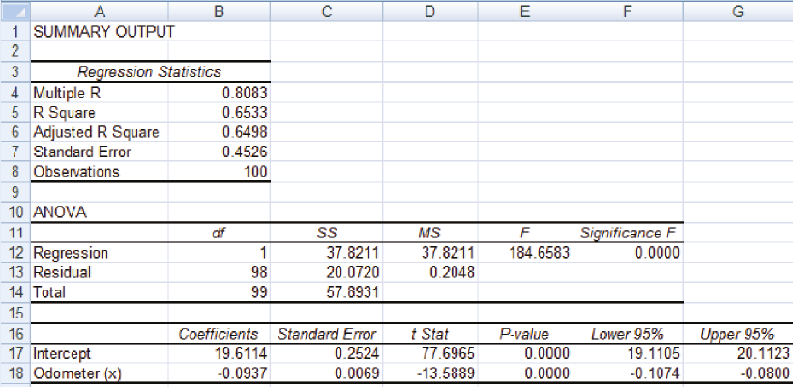
17.36
Example 3 – Solution…
If s_{ε} is small, the fit is excellent and the linear model should be used for forecasting. If s_{ε} is large, the model is poor…
But what is small and what is large?

Slide 37
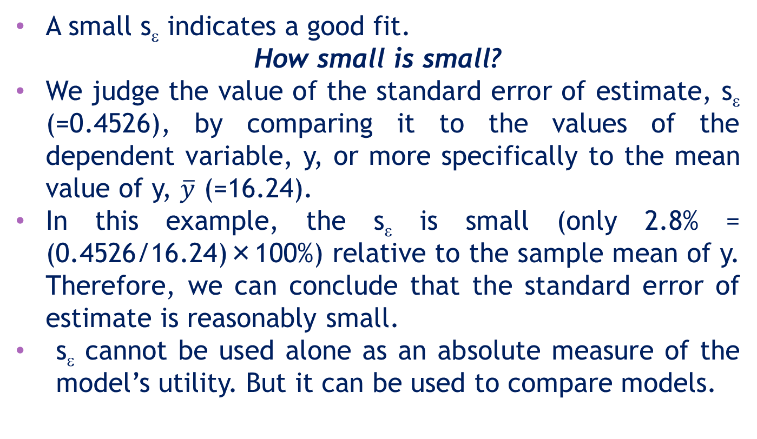
17.37
Example 3 - What is small?
A small sε indicates a good fit.
How small is small?
We judge the value of the standard error of estimate, sε (=0.4526), by comparing it to the values of the dependent variable, y, or more specifically to the mean value of y, $\overline{y}$ (=16.24).
In this example, the sε is small (only 2.8% = (0.4526/16.24)×100%) relative to the sample mean of y. Therefore, we can conclude that the standard error of estimate is reasonably small.
sε cannot be used alone as an absolute measure of the model’s utility. But it can be used to compare models.

Slide 38
Testing the slope
17.38
If no linear relationship exists between the two variables, we would expect the regression line to be horizontal, that is, to have a slope of zero.
We want to see if there is a linear relationship, i.e. we want to see if the slope (β₁) is something other than zero. Our research hypothesis becomes:
H_{A}: β₁ ≠ 0 (linear relationship exists)
Thus the null hypothesis becomes:
H₀: β₁ = 0 (no linear relationship exists)

Slide 39
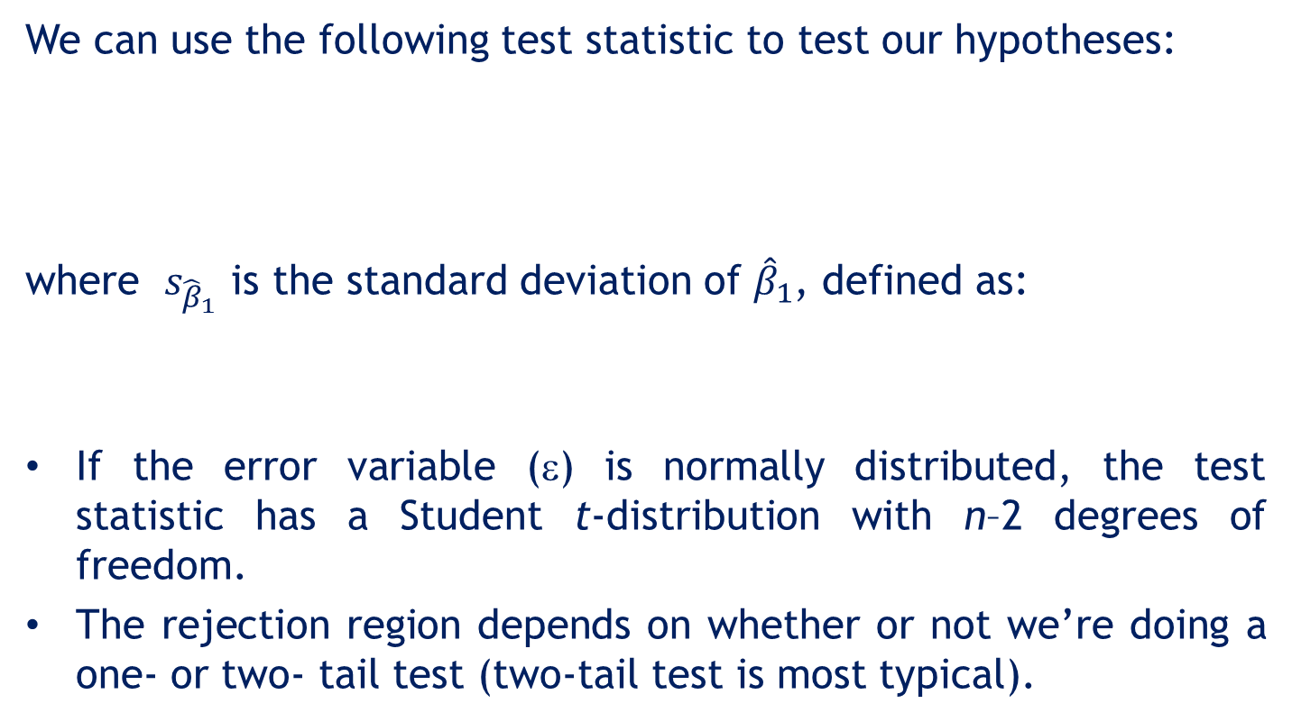
Testing the slope…
17.39
We can use the following test statistic to test our hypotheses:
where $s_{{\hat{β}}_{1}}$ is the standard deviation of ${\hat{β}}_{1}$, defined as:
If the error variable (ε) is normally distributed, the test statistic has a Student t-distribution with n–2 degrees of freedom.
The rejection region depends on whether or not we’re doing a one- or two- tail test (two-tail test is most typical).

Slide 40
Testing the slope…
17.40
If we wish to test for positive or negative linear relationships we conduct one-tail tests, i.e. our research alternate hypotheses become:
H_{A}: β₁ < 0 (testing for a negative slope)
or
H_{A}: β₁ >0 (testing for a positive slope)
Of course, the null hypothesis remains: H₀: β₁ = 0.

Slide 41
17.41
Example 3…
Test to determine whether there is enough evidence to infer that a linear relationship exists between the price and the odometer reading at the 5% significance level.

Slide 42
Example 3 – Solution…
17.42
We want to test the hypothesis
H₀: β₁= 0 (no linear relationship)
H_{A}: β₁ ≠ 0 (a linear relationship exists)
If the null hypothesis is rejected, we conclude that there is a significant linear relationship between price and odometer reading.
Test statistic:
has a t-distribution with 98 (=100–2) degrees of freedom.
Level of significance α = 0.05.

Slide 43
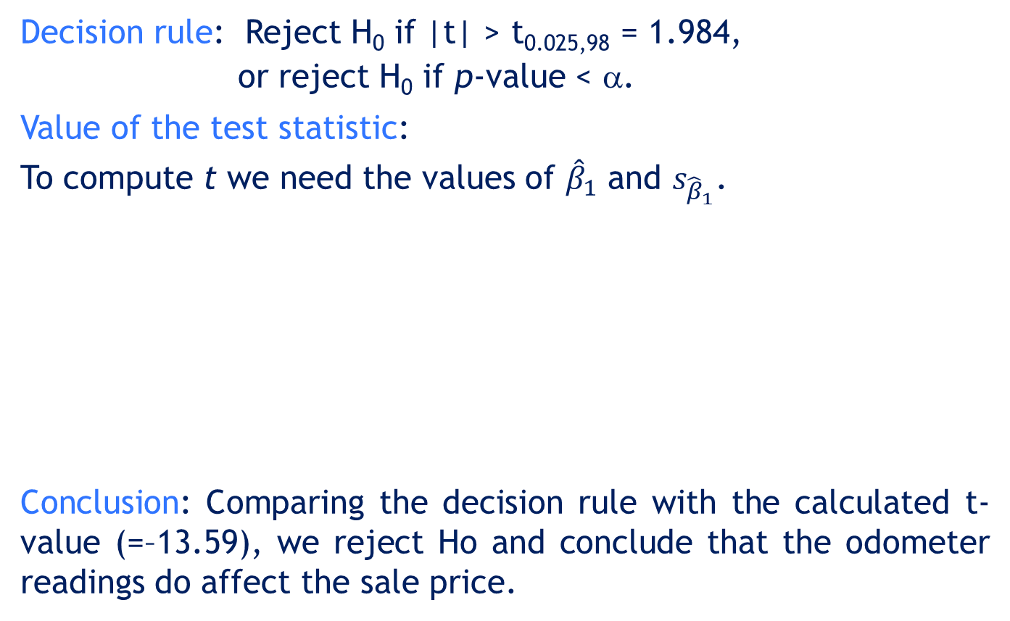
17.43
Example 3 – Solution…
Decision rule: Reject H0 if |t| > t0.025,98 = 1.984,
or reject H0 if p-value < α.
Value of the test statistic:
To compute t we need the values of ${\hat{β}}_{1}$ and $s_{{\hat{β}}_{1}}$.
Conclusion: Comparing the decision rule with the calculated t-value (=–13.59), we reject Ho and conclude that the odometer readings do affect the sale price.

Slide 44
17.44
Example 3 – Solution…
Using Excel:
Excel regression output:
t-value
p-value
Looking at the p-value of the slope coefficient, we conclude that there is overwhelming evidence to infer that the odometer reading affects the auction selling price.

Slide 45
Coefficient of determination, R²
17.45
The tests thus far are used to conclude whether a linear (positive or negative) relationship exists.
When we want to measure the strength of the linear relationship, we use the coefficient of determination, R², defined as follows.
For a simple linear regression model, the coefficient of determination is the squared value of the sample coefficient of correlation (r). i.e. R² = (r)².

Slide 46
17.46
Coefficient of determination…
As we did with analysis of variance, we can partition the total variation in y (SST) into two parts:
SST = SSE + SSR
SST = Sum of Squares Total
SSE = Sum of Squares Error
(measures the amount of variation in y that remains unexplained, i.e. due to error)
SSR = Sum of Squares Regression
(measures the amount of variation in y explained by variation in the independent variable x.)

Slide 47
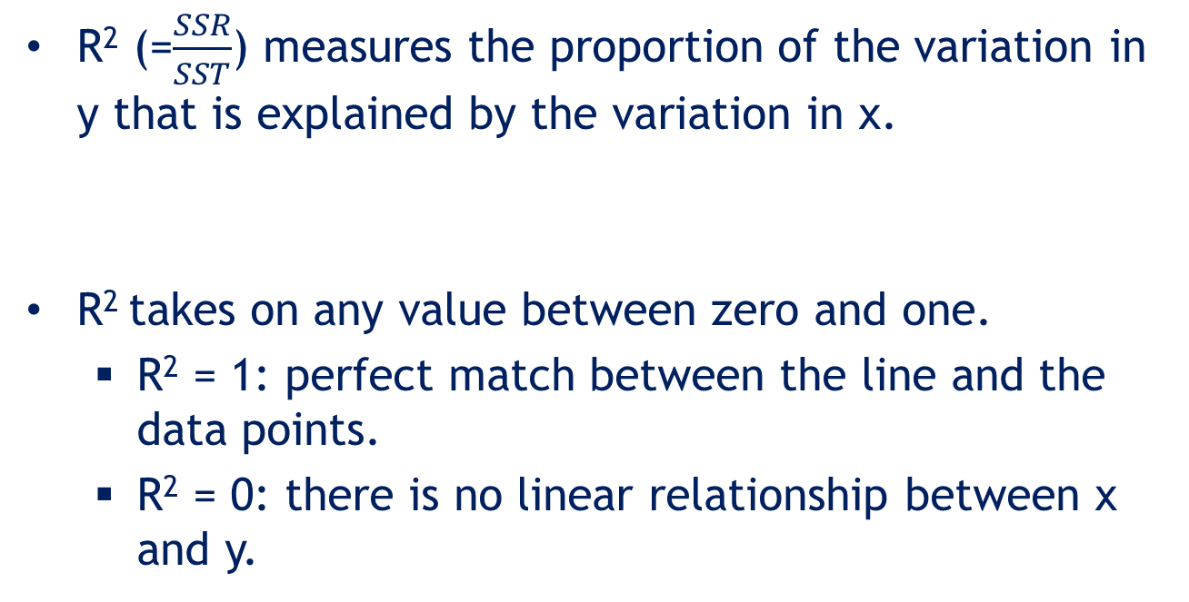
Coefficient of determination…
17.47
SST = SSE + SSR ⇒ 1 = $\frac{SSR}{SST}+\frac{SSE}{SST}$ ⇒ $\frac{SSR}{SST}=1−\frac{SSE}{SST}$
R² (=$\frac{SSR}{SST}$) measures the proportion of the variation in y that is explained by the variation in x.
R² takes on any value between zero and one.
R² = 1: perfect match between the line and the data points.
R² = 0: there is no linear relationship between x and y.

Slide 48
Coefficient of determination…
17.48
In general, the higher the value of R², the better the model fits the data.
Unlike the value of a test statistic, the coefficient of determination does not have a critical value that enables us to test hypotheses about R² and to draw conclusions.

Slide 49
17.49
Example 3…
Find the coefficient of determination for Example 3. What does this statistic tell you about the model?
Solution
Therefore, 65% of the variation in the selling price is explained by the variation in odometer reading. The rest (35%) remains unexplained by this model, i.e. due to error.

Slide 50
17.50
Example 3 – Solution…
Using the computer
From the regression output we have, R² = 0.6533:

Slide 51
More on Excel’s output
17.51
An analysis of variance (ANOVA) table for the simple linear regression model can be given by:
Source | Degrees of freedom | Sums of squares | Mean squares | F-statistic
Regression | 1 | SSR | MSR = SSR/1 | F=MSR/MSE
Error | n–2 | SSE | MSE = SSE/(n–2)
Total | n–1 | SST

Slide 52
17.5 Using the regression equation
17.52
Before using the regression model, we need to assess how well it fits the data.
If we are satisfied with how well the model fits the data, we can use it to make predictions for y.

Slide 53
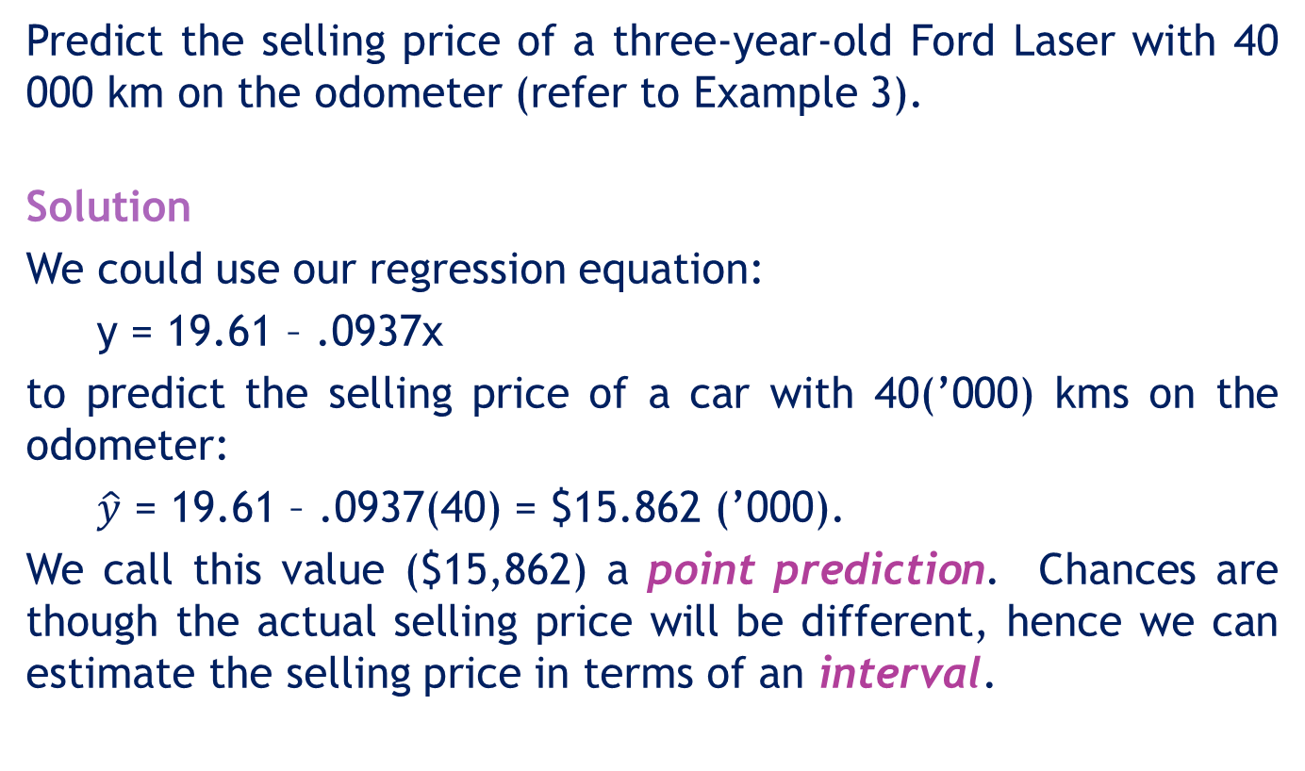
17.53
Example 3…
Predict the selling price of a three-year-old Ford Laser with 40 000 km on the odometer (refer to Example 3).
Solution
We could use our regression equation:
y = 19.61 – .0937x
to predict the selling price of a car with 40(’000) kms on the odometer:
$\hat{y}$ = 19.61 – .0937(40) = $15.862 (’000).
We call this value ($15,862) a point prediction. Chances are though the actual selling price will be different, hence we can estimate the selling price in terms of an interval.

Slide 54
Prediction interval and confidence interval
17.54
Two intervals can be used to discover how closely the predicted value will match the true value of y
prediction interval – for a particular value of y
confidence interval – for the expected value of y.
The prediction interval for y
The confidence interval for E(y)
The prediction interval is wider than the confidence interval.

Slide 55
17.55
Example 3…
Provide an interval estimate for the bidding price on a Ford Laser with 40 000 km on the odometer.
Solution
The dealer would like to predict the price of a single car. The 95% prediction interval:
We predict a selling price between $14 958 and $16 766.
t.025,98

Slide 56
17.56
Example 3…
The car dealer wants to bid on a lot of 250 Ford Lasers, where each car has been driven for about 40 000 km.
Solution
The dealer needs to estimate the mean price per car. The 95% confidence interval:
The lower and upper limits of the confidence interval estimates of the expected value of the selling price between $15 758 and $15 968.

Slide 57


What’s the Difference?
17.57
Prediction interval
Confidence interval
1
no 1
Used to estimate the value of one value of y (at given x)
Used to estimate the mean value of y (at given x)
The confidence interval estimate of the expected value of y will be narrower than the prediction interval for the same given value of x and confidence level. This is because there is less error in estimating a mean value as opposed to predicting an individual value.

Slide 58
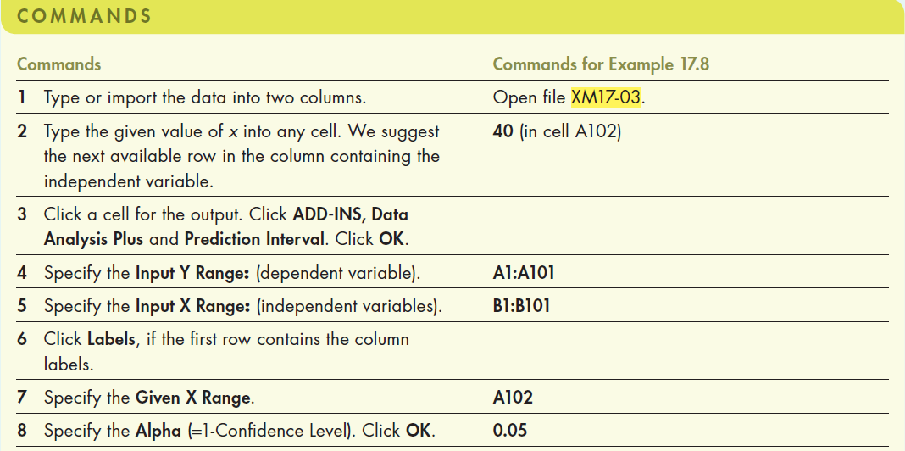
17.58
Example 3 – Solution…
Using Excel (Data Analysis Plus)
We can use Data Analysis Plus to obtain the prediction and confidence interval estimates.

Slide 59
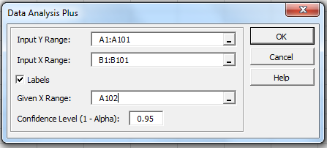
17.59
Example 3 – Solution…
Using Excel (Data Analysis Plus™)
In the Data Analysis Plus dialogue box (shown below), enter the input and the output is presented in the next slide.

Slide 60
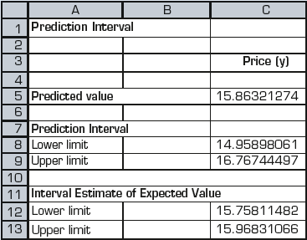
Intervals with Excel
17.60
INTERPRET
Using Excel (Data Analysis Plus): Output
Point prediction
Prediction interval
Confidence interval estimator of the mean price

Slide 61
17.6 Coefficient of correlation
17.61
The coefficient of correlation is used to measure the strength of a linear association between two variables.
The population coefficient of correlation is denoted ρ (rho).
The coefficient values range between –1 and 1.
If ρ = –1 (perfect negative linear association) or ρ = +1 (perfect positive linear association) every point falls on the regression line.
If ρ = 0 there is no linear association.
The coefficient can be used to test for linear relationships between two variables.

Slide 62

Coefficient of correlation…
17.62
We estimate its value from sample data with the sample coefficient of correlation:
We can conduct a t-test hypothesis testing of the coefficient of correlation (ρ) to determine whether Y and X are linearly related.

Slide 63
Testing the coefficient of correlation
17.63
When there is no linear relationship between two variables, ρ = 0.
The hypotheses are:
H₀: ρ = 0 (no linear relationship)
H_{A}: ρ ≠ 0 (a linear relationship exists)
The test statistic is:
The statistic is student t-distributed with d.f. = n – 2, provided the variables are bivariate normally distributed.

Slide 64
17.64
Example 3…
Test the coefficient of correlation to determine if a linear relationship exists in the data of Example 3 between the price and odometer reading (use α=0.05).
Solution
We test H0: ρ = 0
HA: ρ ≠ 0.
Test statistic:
Level of significance: α=0.05

Slide 65
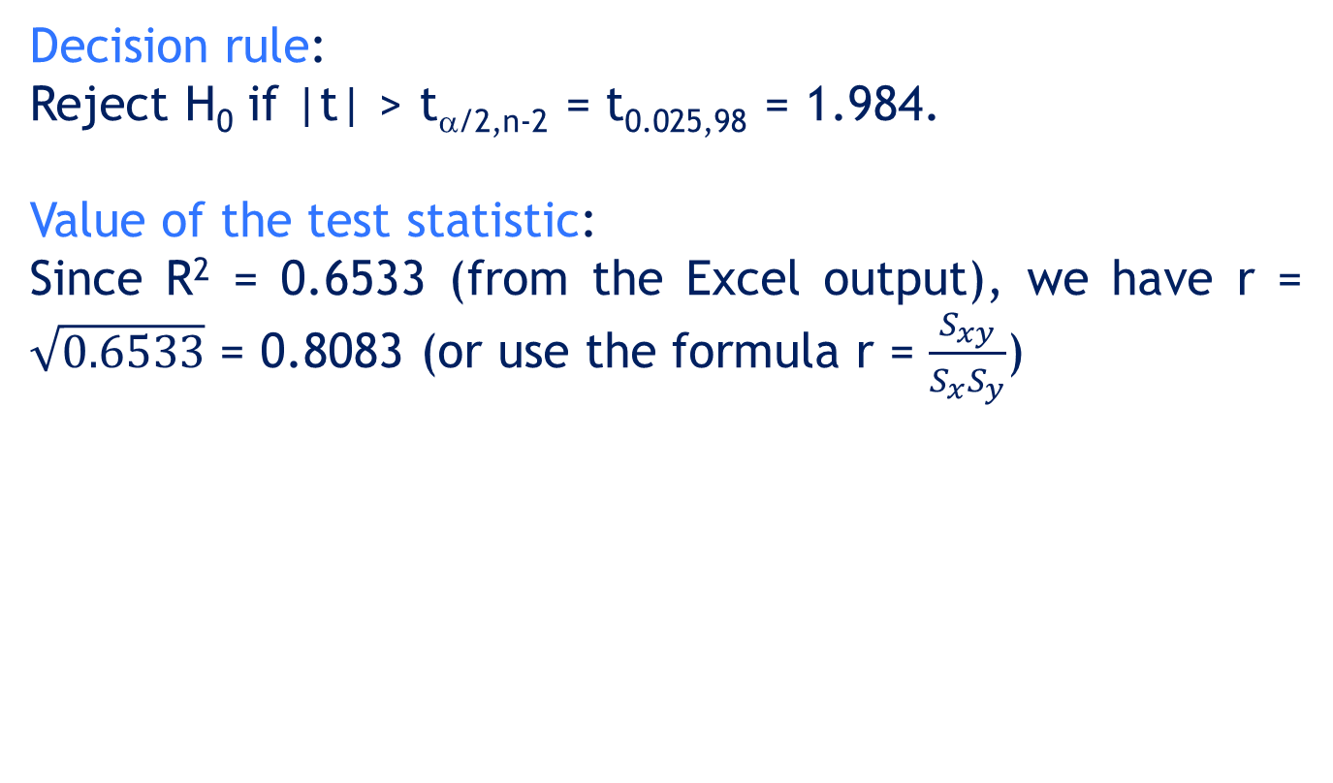
17.65
Example 3 – Solution…
COMPUTE
Decision rule:
Reject H0 if |t| > tα/2,n-2 = t0.025,98 = 1.984.
Value of the test statistic:
Since R² = 0.6533 (from the Excel output), we have r = $\sqrt{0.6533}$ = 0.8083 (or use the formula r = $\frac{S_{xy}}{S_{x}S_{y}}$)

Slide 66
17.66
Example 3 – Solution…
INTERPRET
Conclusion: Since t = -13.59 < -1.984, reject H0.
Therefore, there is sufficient evidence at the 5% level to infer that there is a linear relationship between the price and the odometer reading.

Slide 67
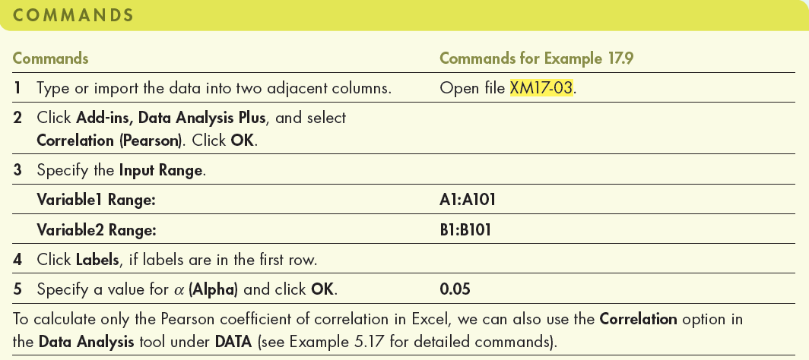
17.67
Example 3 - Solution…
Using Excel (Data Analysis Plus)
We can use Data Analysis Plus based on the large sample test.

Slide 68
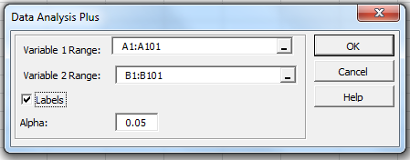
17.68
Example 3 - Solution…
Using Excel (Data Analysis Plus™)
In the Data Analysis Plus dialogue box (shown below), enter the input and the output is presented in the next slide.

Slide 69
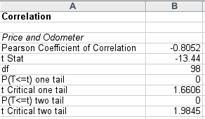
Example 3 - Using the Computer…
17.69
COMPUTE
We can also use Excel > Add-Ins > Data Analysis Plus and the Correlation (Pearson) tool to get this output:
Again, we reject the null hypothesis (that there is no linear correlation) in favour of the alternative hypothesis (that our two variables are in fact related in a linear fashion).
We can also perform a one-tail test for positive or negative linear relationships
p-value
compare

Slide 70
Spearman rank correlation coefficient
17.70
The Spearman rank test is used to test whether a relationship exists between variables in cases where
at least one variable is ranked, or
both variables are numerical but the normality requirement is not satisfied.

Slide 71
Spearman rank correlation coefficient…
17.71
The null and alternate hypotheses are:
H₀: ρ_{s} = 0
H_{A}: ρ_{s} ≠ 0
The test statistic is
a and b are the ranks of the data.
For a large sample (n ≥ 30) r_{s} is approximately normally distributed

Slide 72
17.72
Example 4: Performance vs aptitude test scores
(Example 17.10, p751)
A production manager wants to examine the relationship between
aptitude test score given prior to hiring, and
performance rating three months after starting work.
A random sample of 20 production workers was selected. Their test scores and performance ratings were recorded.
Analyse the relationship between the two variables.

Slide 73
17.73
Example 4 - Solution
The problem objective is to analyse the relationship between two variables.
Performance rating is ranked.
The hypotheses are:
H0: ρs = 0
HA: ρs ≠ 0
Scores range from 0 to 100
Scores range from 1 to 5
The test statistic is rs and the rejection region is |rs| > rcritical (taken from the Spearman rank correlation table).

Slide 74
17.74
Example 4 - Solution…
Ties are broken
by averaging
the ranks.

Slide 75
17.75
Example 4 - Solution…
Solving manually
Rank each variable separately.
Calculate sa = 5.92; sb = 5.50; Sab = 12.34
Thus rs = sab/[sa.sb] = 0.379.
The critical value for α = 0.05 and n = 20 is 0.450.
Since rs = 0.379 < 0.450, we do not reject H0.
Conclusion: We do not reject the null hypothesis. At the 5% level of significance there is insufficient evidence to infer that the two variables are related to one another.

Slide 76
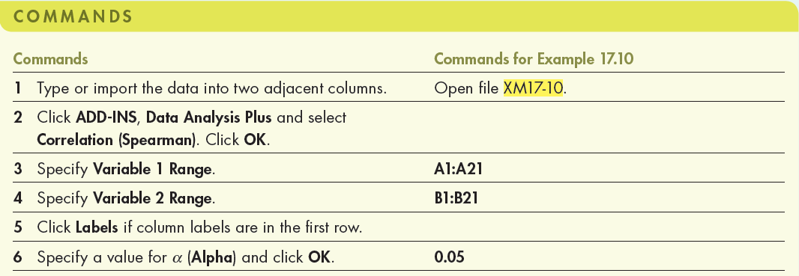
17.76
Example 4 - Solution…
Using Excel (Data Analysis Plus)
We can use Data Analysis Plus based on the large sample test.

Slide 77
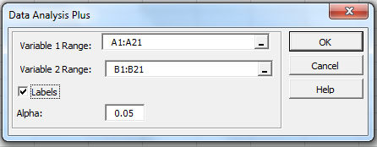
17.77
Example 4 - Solution…
Using Excel (Data Analysis Plus™)
In the Data Analysis Plus dialogue box (shown below), enter the input and the output is presented in the next slide.

Slide 78
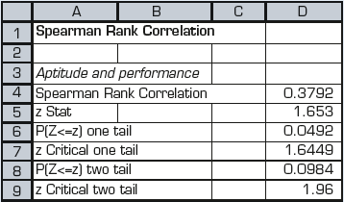
17.78
Example 4 - Solution…
INTERPRET
Using Excel (Data Analysis Plus™): Output
Since r_{s} = 0.379 < z_{0.025} = 1.96, we do not reject H₀.

Slide 79
17.7 Regression diagnostics – I
17.79
The three important conditions required for the validity of the regression analysis are:
The error variable is normally distributed.
The error variance is constant for all values of x.
The errors are independent of each other.
How can we diagnose violations of these conditions?
➔ Residual analysis, that is, examine the differences between the actual data points and those predicted by the linear equation…

Slide 80
Residual analysis
17.80
Recall the deviations between the actual data points and the regression line were called residuals. Excel calculates residuals as part of its regression analysis:
We can use these residuals to determine whether the error variable is non-normal, whether the error variance is constant, and whether the errors are independent…
Residual Ouput for Example 3

Slide 81
Residual analysis…
17.81
For each residual we calculate the standard deviation as follows:
Standardised residual i = residual i/standard deviation

Slide 82
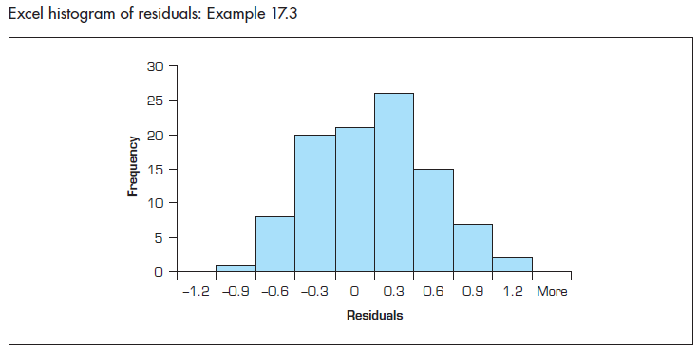
Example 3…
17.82
Non-normality
Use Excel to obtain the standardised residual histogram.
Examine the histogram and look for a bell-shaped diagram with mean close to zero.
As can be seen, the standardised residual histogram appear to be bell-shaped.
We can also apply the Lilliefors test or the χ² test of normality.

Slide 83
Heteroscedasticity
17.83
When the requirement of a constant variance is violated, we have heteroscedasticity.
+
^
y
+
+
Residual
+
+
+
+
+
+
+
+
+
+
+
+
+
+
+
+
+
+
+
+
+
+
+
+
^
+
+
+
+
+
y
+
+
+
+
+
+
+
+
+
+
+
+
+
+
+
^
The spread increases with y

Slide 84
Homoscedasticity
17.84
When the requirement of a constant variance is not violated, we have homoscedasticity.
+
^
y
+
+
Residual
+
+
+
+
+
+
+
+
+
+
+
+
+
+
+
+
+
+
+
+
+
+
+
+
+
+
^
+
+
+
+
y
+
+
+
+
+
+
+
+
+
+
+
+
+
+
+
+
+
+
+
+
+
+
+
+
+
+
+
+
+
+
+
+
+
+
+
The spread of the data points
does not change much.

Slide 85
Homoscedasticity…
17.85
When the requirement of a constant variance is not violated, we have homoscedasticity.
^
y
+
Residual
+
+
+
+
+
+
+
+
+
+
+
+
+
+
+
+
+
+
+
+
+
+
+
+
+
+
+
+
+
+
+
+
+
+
+
+
+
+
+
+
^
+
+
+
+
y
+
+
+
+
+
+
+
+
+
+
+
+
+
+
+
+
+
+
As far as the even spread, this is
a much better situation.
We can diagnose heteroscedasticity by plotting the residual against the predicted values of Y.

Slide 86
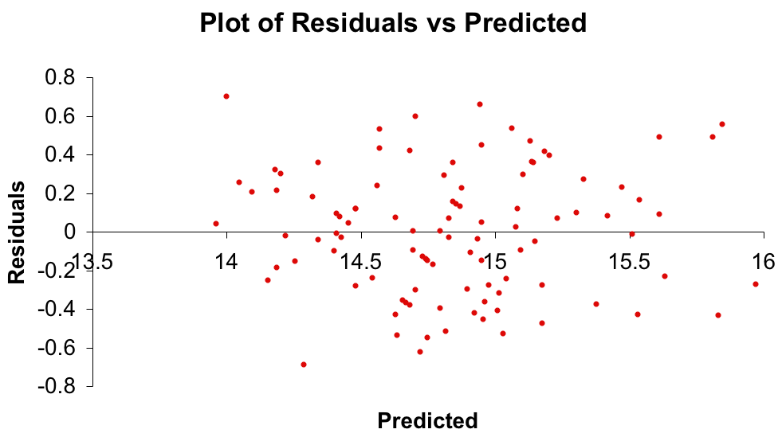

Heteroscedasticity…
17.86
If the variance of the error variable (${σ_{ε}}^{2}$) is not constant, then we have ‘heteroscedasticity’. Here is the plot of the residual against the predicted value of y for Example 3.
There doesn’t appear to be a change in the spread of the plotted points, therefore no heteroscedasticity
✓

Slide 87
Non-independence of the error variable
17.87
If we were to observe the auction price of cars every week for, say, a year, that would constitute a time series.
When the data are time series, the errors often are correlated. Error terms that are correlated over time are said to be autocorrelated or serially correlated.
We can often detect autocorrelation by graphing the residuals against the time periods. If a pattern emerges, it is likely that the independence requirement is violated.

Slide 88
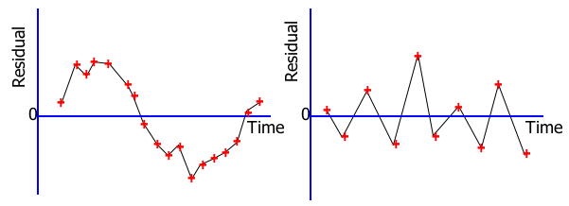
Non-independence of the error variable
17.88
Positive autocorrelation
Negative autocorrelation
Patterns in the appearance of the residuals over time
indicates that autocorrelation exists:
Note the runs of positive residuals,
replaced by runs of negative residuals.
Note the oscillating behaviour of the
residuals around zero.
Patterns in the appearance of the residuals over time indicate that autocorrelation exists.

Slide 89
Outliers
17.89
An outlier is an observation that is unusually small or large.
Several possibilities need to be investigated when an outlier is observed:
There was an error in recording the value.
The point does not belong in the sample.
The observation is valid.
Identify outliers from the scatter diagram.
It is customary to suspect an observation is an outlier if the absolute value of the standardised residual is > 2.
They need to be dealt with since they can easily influence the least squares line…

Slide 90
Procedure for regression diagnostics
17.90
An outlier
An influential observation
+
+
+
+
+
+
+
+
+
+
+
+
+
+
… but some outliers
may be very influential.
+
+
+
+
+
+
+
+
+
+
+
+
+
The outlier causes a shift
in the regression line ...

Slide 91
Procedure for regression diagnostics…
17.91
Develop a model that has a theoretical basis.
Gather data for the two variables in the model.
Draw the scatter diagram to determine whether a linear model appears to be appropriate. Identify possible outliers.
Determine the regression equation.
Calculate the residuals and check the required conditions
Assess the model’s fit.
If the model fits the data, use the regression equation to predict a particular value of the dependent variable and/or estimate its mean.

Slide 92
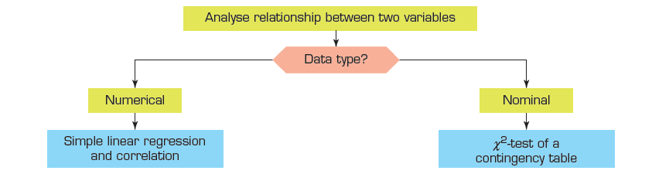
17.92
Summary of techniques – Linear relationship between two variables

