Slide 1
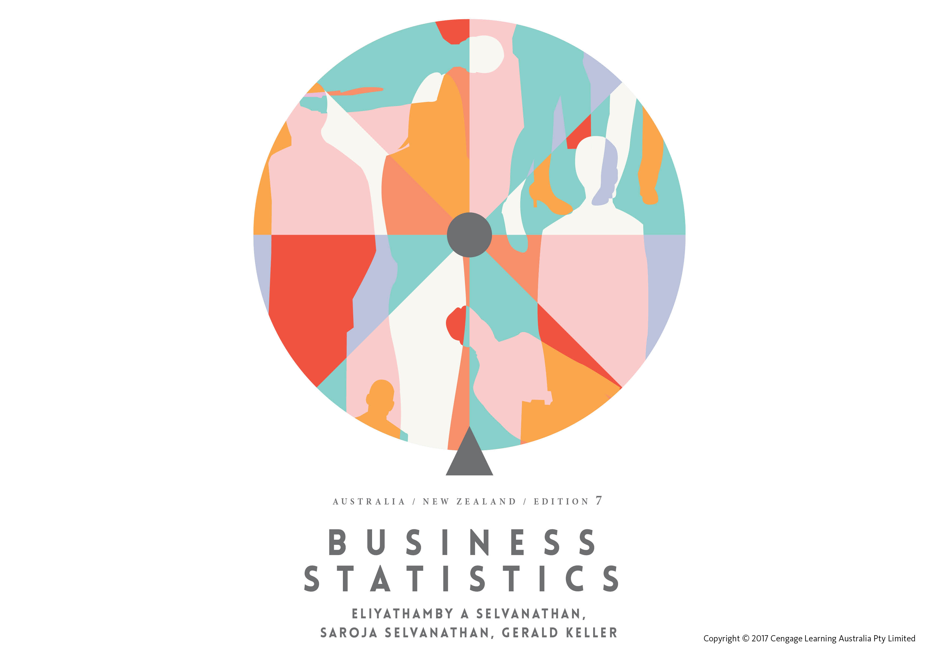

Slide 2
Chapter 3
Graphical descriptive techniques – Nominal data

Slide 3
Chapter outline
3.1 Graphical techniques to describe nominal data
3.2 Selecting the appropriate chart: Which chart is best?
3.3 Graphical techniques to describe ordinal data
3.4 Describing the relationship between two nominal variables

Slide 4
Learning Objectives
LO1 Construct charts to summarise nominal data
LO2 Use excel to draw appropriate charts for nominal data
LO3 Determine which chart is best for nominal data under a given circumstance
LO4 Use charts to describe ordinal data
LO5 Use various tabular and graphical techniques to analyse the relationships between two nominal variables.

Slide 5
Introduction
3.5
In this chapter, we introduce graphical and tabular statistical methods that allow managers to summarise data visually in order to produce useful information – a technique often used in decision making
We also discuss ways to use the techniques introduced in an effective and accurate way.

Slide 6
3.1 Graphical techniques to describe nominal data
3.6
The graphical presentations shown here are used primarily for nominal data.
These graphical tools are most appropriate when the raw data can be naturally categorised in a meaningful manner.

Slide 7
3.1 Graphical techniques to describe nominal data
3.7
The only allowable calculation on nominal data is to count the frequency of each value of the variable.
We can summarise the data in a table that presents the categories and their counts called a frequency distribution.
A relative frequency distribution lists the categories and the proportion with which each occurs.
The methods presented apply to both
the entire population, and
a sample selected from the population.

Slide 8
Bar charts
3.8
The bar chart is mainly used for nominal data.
A bar chart graphically represents the frequency of each category as a bar rising vertically from the horizontal axis.
The height of each bar is proportional to the frequency of the corresponding category.

Slide 9
Pie charts
3.9
Another useful chart to present nominal data is the pie chart.
The pie chart is a very popular tool used to represent the proportions of appearance for nominal data.
A pie chart is a circle that is subdivided into slices whose areas are proportional to the frequencies (or relative frequencies), thereby displaying the proportion of occurrences of each category.

Slide 10
Example 1 (Example 3.1, page 45)
3.10
XM03-01 A magazine readership survey carried out in New Zealand (Roy Morgan, March 2012) shows that women’s magazines are the most popular magazines, having the largest readership and increasing yearly sales. The survey results of 300 readers were recorded and are given below in coded form. The top six magazines considered here are (1) Australian Women’s Weekly (NZ Edition); (2) NZ Woman’s Weekly; (3) NZ Woman’s Day; (4) New Idea; (5) Next; and (6) That’s Life. The data, using the codes 1, 2, 3, 4, 5 and 6, are listed below. Create the frequency distribution table and construct a bar chart and a pie chart to summarise the data.

Slide 11
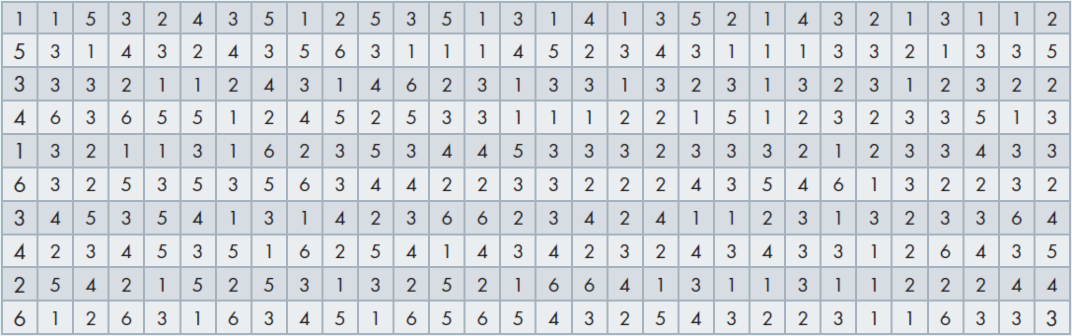
Example 1…
3.11
Women’s Magazine Readership, New Zealand, 2015

Slide 12
Example 1: Solution
3.12
Identifying the technique
As the data are nominal, the only technique is to count the number of occurrences (also known as frequencies) of each value and then convert these counts to proportions.
The frequencies are presented using a bar chart. The proportions (market share of each magazine) are presented in a pie chart.

Slide 13
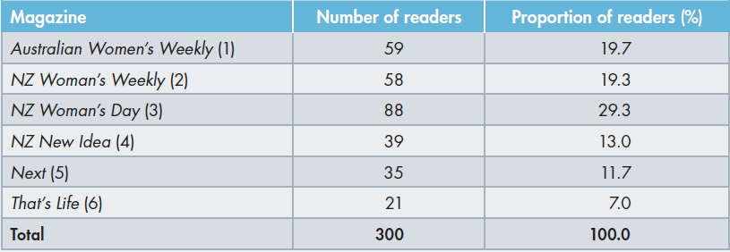
Example 1: Solution…
3.13

Slide 14
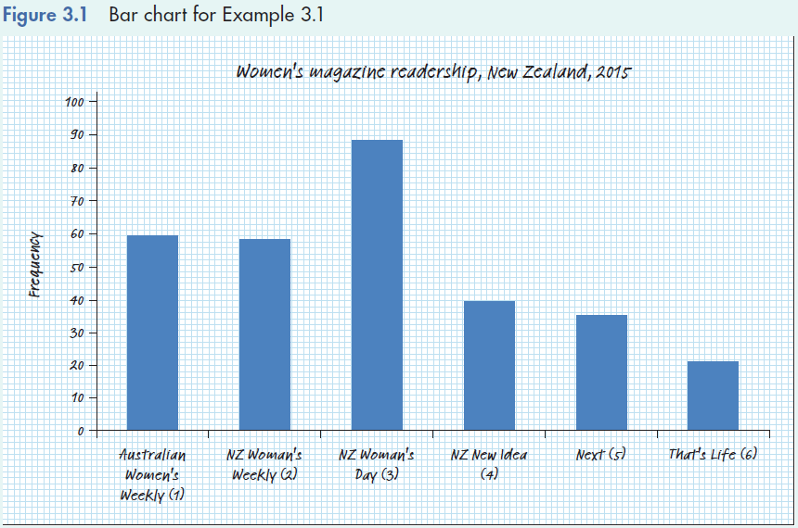
Example 1: Solution…
3.14
Bar chart - Using Excel

Slide 15
3.15
Example 1: Solution…
Pie chart - Calculating manually
In constructing a pie chart, the size of a slice of the circle is proportional to the percentage corresponding to that category.
For example, the angle between the lines demarcating the Australian Women’s Weekly (NZ Edition) readers is 19.7 × 3.6 = 70.8º.
The angles of the pie chart for the other five categories are calculated similarly, as shown in the table below:

Slide 16
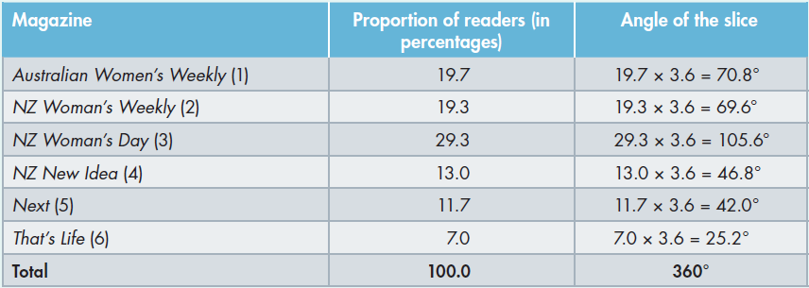
3.16
Example 1: Solution…
Pie chart - Calculating manually

Slide 17
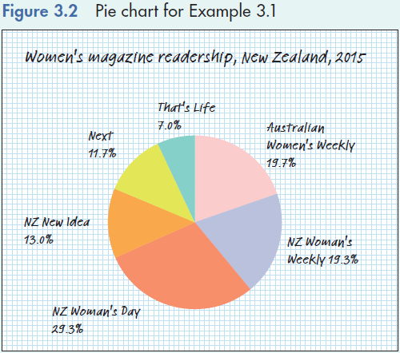
3.17
Example 1: Solution…
Pie chart – Manually/Using Excel
Angle = (11.7/100)(360⁰) = 42⁰

Slide 18
3.2 Selecting the appropriate chart: Which chart is best?
3.18
Which chart is best – bar or pie chart?
Depends on what you want to emphasize
If the focus is to compare the size or frequency of various categories, a bar chart may be appropriate
If the focus is on the distribution (or share) of each category, use a pie chart

Slide 19
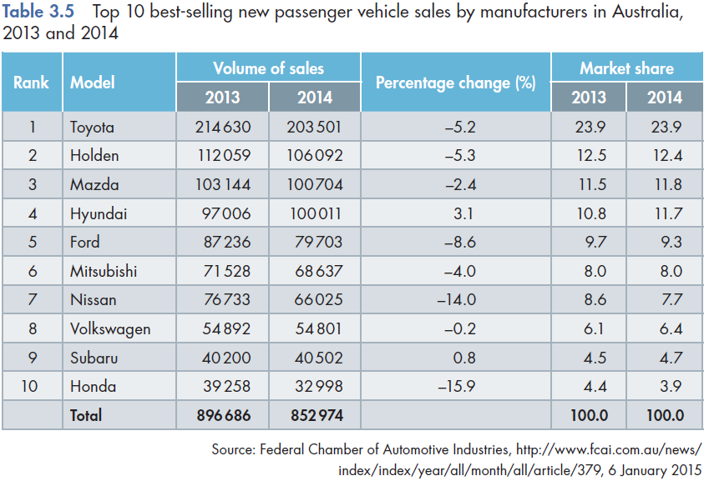
Example 2 (Table 3.5, page 53)
3.19

Slide 20
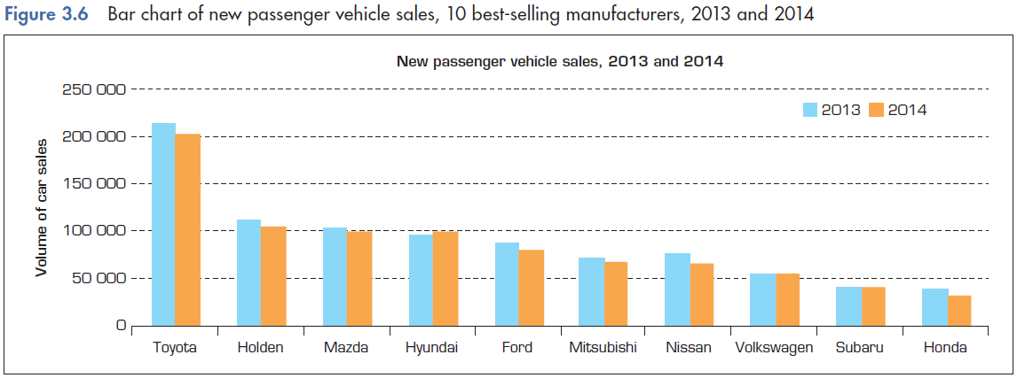
Example 2…
3.20
If the focus is to compare the size of frequency of various categories, a bar chart is more appropriate.

Slide 21
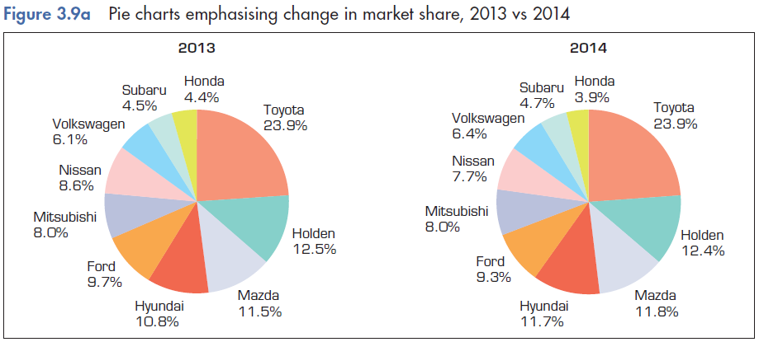
Example 2…
3.21
If the focus is on the distribution of each category either pie or bar chart may be appropriate.

Slide 22
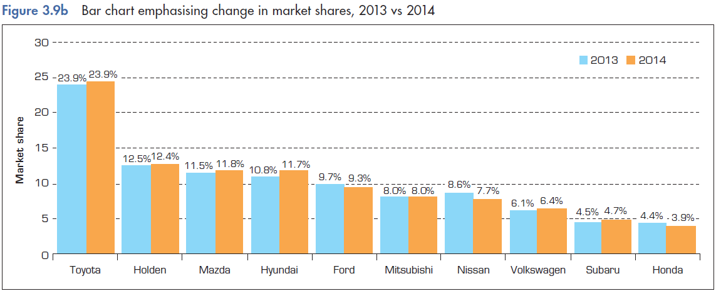
Example 2…
3.22
If the focus is on the change in market share between the two years, a bar chart may be appropriate.

Slide 23
Component bar chart
3.23
A component bar chart represents all categories within a single bar.
The bar is partitioned into components, with the height of each component proportional to the frequency of the category that it represents.
Component bar charts offer a good alternative to using two pie charts, when a comparison of two breakdowns is desired.

Slide 24
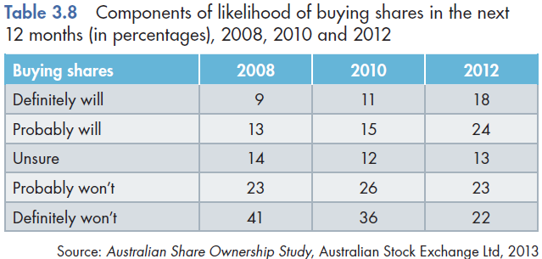
Example 3 (Table 3.8, page 59)
3.24

Slide 25
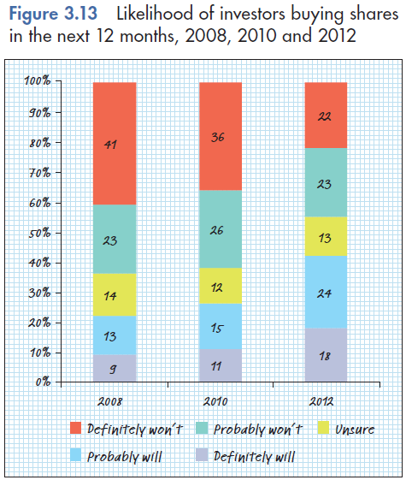
Example 3…
3.25
The shares of likelihood in 2008, 2010 and 2012 can be compared by displaying them in a component bar chart.

Slide 26
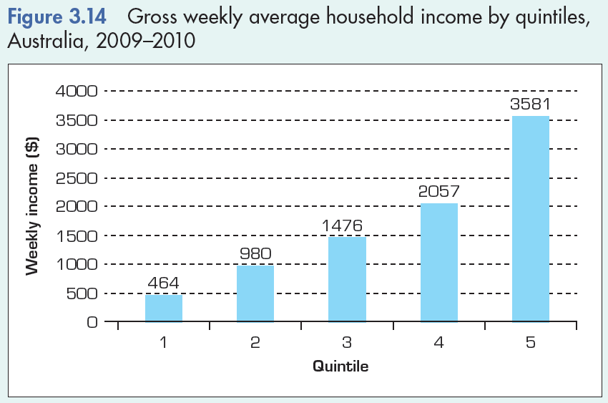
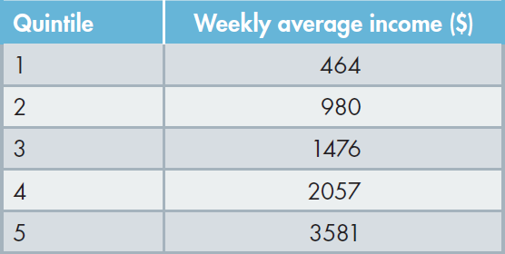
3.3 Graphical techniques to describe ordinal data
3.26
When the data are ordinal (or ranked), treat the data as nominal and use a bar or pie chart.
For example, consider the average weekly household income for the 5 income quintiles (Example 3.6, page 59).

Slide 27
3.4 Describing the relationship between two nominal variables
3.27
So far we’ve looked at tabular and graphical techniques for one nominal variable.
Now we will look at the relationship between two nominal variables using either tabular or graphical techniques.

Slide 28
Describing the relationship between two nominal variables…
3.28
Two ways to describe
A cross-classification table (or contingency table or cross-tabulation table)
A variation of a bar chart

Slide 29
Describing the relationship between two nominal variables…
3.29
A cross-classification table is used to describe the relationship between two nominal variables.
A cross-classification table lists the frequency of each combination of the values of the two nominal variables.

Slide 30
Example 4: Newspaper Readership Survey (Example 3.7, page 67)
3.30
XM03-07 In a major Australian city there are four competing newspapers: N1, N2, N3 and N4.
To help design advertising campaigns, the managers of the newspapers need to know which segments of the market are reading their newspapers.
A survey was conducted to determine whether the newspaper readership and occupation are related.
A sample of newspaper readers was asked to report which newspaper they read: N1, N2, N3, N4, and to indicate whether they were blue-collar worker (1), white-collar worker (2), or professional (3).

Slide 31
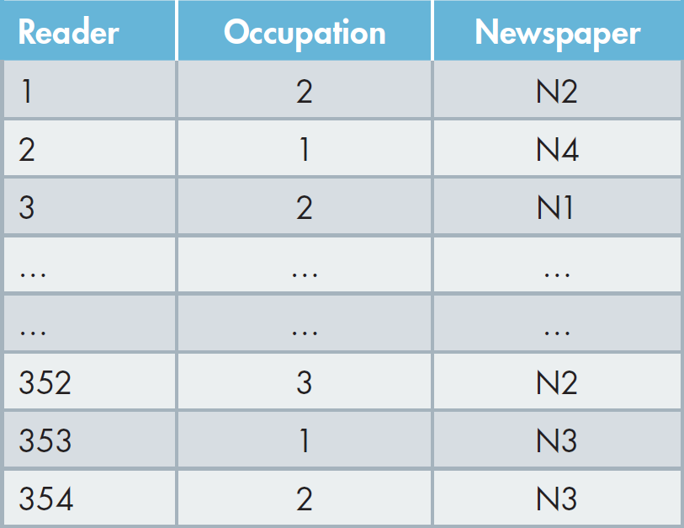
Example 4…
3.31
Newspaper readership and occupation

Slide 32
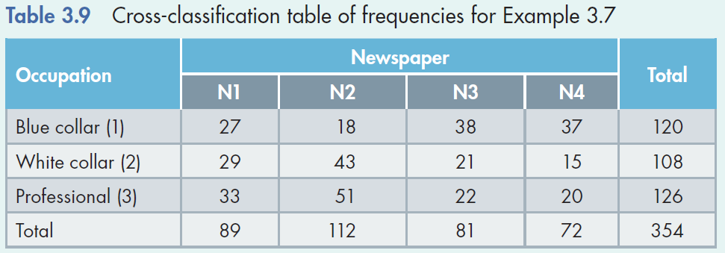
Example 4: Solution
3.32
By counting the number of times each of the 12 combinations occurs, we produce Table 3.9.

Slide 33
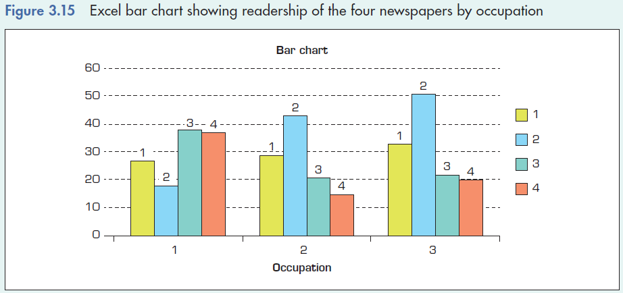
Example 4: Solution…
3.33
The frequencies can be depicted in graphical form using a bar chart.

Slide 34
Example 4: Solution…
3.34
If occupation and newspaper readership are related, then there will be differences in the newspapers read among the occupations.
An easy way to see this is to convert the frequencies in each row (or column) to relative frequencies using each row (or column) total.
That is, compute the row (or column) totals and divide each frequency by its row (or column) total.

Slide 35
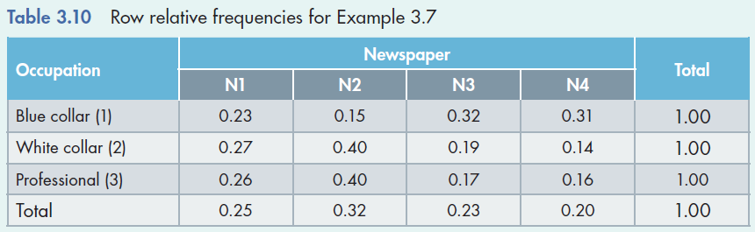
Example 4: Solution…
3.35

Slide 36
Example 4: Solution…
3.36
Interpretation:
Notice that the relative frequencies in the rows 2 (white-collar) and 3 (Professionals) are similar and that there are large differences between row 1 (blue-collar) and rows 2 and 3.
This tells us that:
blue collar workers tend to read different newspapers from both white-collar workers and professionals; and
white-collar workers and professionals are quite similar in their newspaper choices.

