Slide 1


Slide 2
Chapter 6
Probability

Slide 3
Chapter outline
6.1 Assigning probabilities to events
6.2 Joint, marginal and conditional probability
6.3 Rules of probability
6.4 Probability trees
6.5 Bayes’ law
6.6 Identifying the correct method

Slide 4
Learning objectives
LO1 Explain the importance of probability theory to statistical inference
LO2 Define the terms random experiment, sample space, elementary event, event, union of events, intersection of events, complement of an event and mutually exclusive events
LO3 Explain the different approaches to assigning probabilities to events
LO4 Define the terms joint, marginal and conditional probabilities and independent events

Slide 5
Learning objectives (cont.)
LO5 Calculate probabilities using the basic probability rules – complement rule, addition rule and multiplication rule of probabilities
LO6 Understand the use of probability trees in calculating complicated probabilities
LO7 Understand Bayes’ law as an alternative way of calculating conditional probabilities.

Slide 6
6.1 Assigning probabilities to events
6.6
Random experiment
A random experiment is a process or course of action whose outcome is uncertain.
Examples
Experiment Outcomes
Flip a coin Heads and tails
Record statistics test marks Numbers between 0 and 100
Measure the time to assemble Numbers from 0 and above
a computer

Slide 7
Sample Space
6.7
A list of all possible outcomes of a random experiment is called a sample space.
Sample Space: S = {O₁, O₂, …, O_{k}}

Slide 8
Sample Space: S = {O₁, O₂, …, O_{k}}
6.8
O1
O2
Sample space
A sample space of a random experiment
is a list of all possible outcomes of the
experiment. The outcomes must be
mutually exclusive and exhaustive.
Simple events
The individual outcomes are called simple events.
Simple events cannot be further decomposed
into constituent outcomes.
Event, A
An event is any collection of one
or more possible outcomes.
Our objective is to determine P(A), the probability that event A will occur.

Slide 9
Approaches to Assigning Probabilities…
6.9
There are three ways to assign a probability, P(O_{i}), to an outcome, O_{i}, namely:
Classical approach: based on equally likely events.
Relative frequency: assigning probabilities based on experimentation or historical data.
Subjective approach: Assigning probabilities based on the assignor’s (subjective) judgment.

Slide 10
Classical Approach
6.10
If an experiment has n possible outcomes, this method would assign a probability of 1/n to each outcome. It is necessary to determine the number of possible outcomes.
Experiment 1: Rolling a die
Outcomes {1, 2, 3, 4, 5, 6}
Probabilities: Each sample point has a 1/6 chance of occurring.

Slide 11
6.11
Classical Approach…
Experiment 2: Rolling two dice and observing the total (X)
Outcomes: {X} = {2, 3, …, 12}
Examples:
P(X=2) = 1/36
P(X=6) = 5/36
P(X=10) = 3/36
 | 1 | 2 | 3 | 4 | 5 | 6
1 | 2 | 3 | 4 | 5 | 6 | 7
2 | 3 | 4 | 5 | 6 | 7 | 8
3 | 4 | 5 | 6 | 7 | 8 | 9
4 | 5 | 6 | 7 | 8 | 9 | 10
5 | 6 | 7 | 8 | 9 | 10 | 11
6 | 7 | 8 | 9 | 10 | 11 | 12

Slide 12
6.12
Relative Frequency Approach
Bits & Bytes Computer Shop tracks the number of desktop computer systems it sells over a month (30 days):
For example,
10 days out of 30 days
2 desktops were sold.
From this we can construct
the probabilities of an event
(i.e. the number of desktops sold on a given day)…
Desktops Sold | Number of Days
0 | 1
1 | 2
2 | 10
3 | 12
4 | 5

Slide 13
6.13
Relative Frequency Approach…
Desktops Sold | Number of Days | P(Desktops Sold)
0 | 1 | 1/30 = 0.03
1 | 2 | 2/30 = 0.07
2 | 10 | 10/30 = 0.33
3 | 12 | 12/30 = 0.40
4 | 5 | 5/30 = 0.17
 | ∑ =30 | ∑ = 1.00
‘There is a 40% chance that 3 desktops will be sold on any given day.’

Slide 14
6.14
Subjective Approach
‘In the subjective approach we define probability as the degree of belief that we hold in the occurrence of an event.’
Example: Weather forecasting’s ‘P.O.P.’
‘Probability of Precipitation’ (or P.O.P.) is defined in different ways by different forecasters, but basically it’s a subjective probability based on past observations combined with current weather conditions.
POP 60% – based on current conditions, there is a 60% chance of rain (say).

Slide 15
Interpreting Probability
6.15
No matter which method is used to assign probabilities all will be interpreted in the relative frequency approach.
For example, a government lottery game where 6 numbers (of 49) are picked. The classical approach would predict the probability for any one number being picked as 1/49 = 2.04%.
We interpret this to mean that in the long run each number will be picked 2.04% of the time.

Slide 16
Assigning Probabilities
6.16
Given a sample space S = {O₁, O₂, …, O_{n}}, the following characteristics for the probability P(O_{i}) of the simple event O_{i} must hold:
Probability of an event: the probability P(A) of event A is the sum of the probabilities assigned to the simple events contained in A.

Slide 17
Complement, union and intersection of events
6.17
We study methods to determine probabilities of events that result from combining other events in various ways.
There are several types of combinations and relationships between events:
Complement of an event
Intersection of events
Union of events
Mutually exclusive events
Dependent and independent events
Conditional event

Slide 18
Probability of Combinations of Events
6.18
If A and B are two events, then
P(A ∪ B) = P(A occur or B occur or both)
P(A ∩ B) = P(A and B both occur)
P(Ā) = P(A does not occur)
P(A|B) = P(A occurs given that B has occurred)
The union of A and B
The intersection of A and B
The complement event of A
The conditional probability of A given B

Slide 19
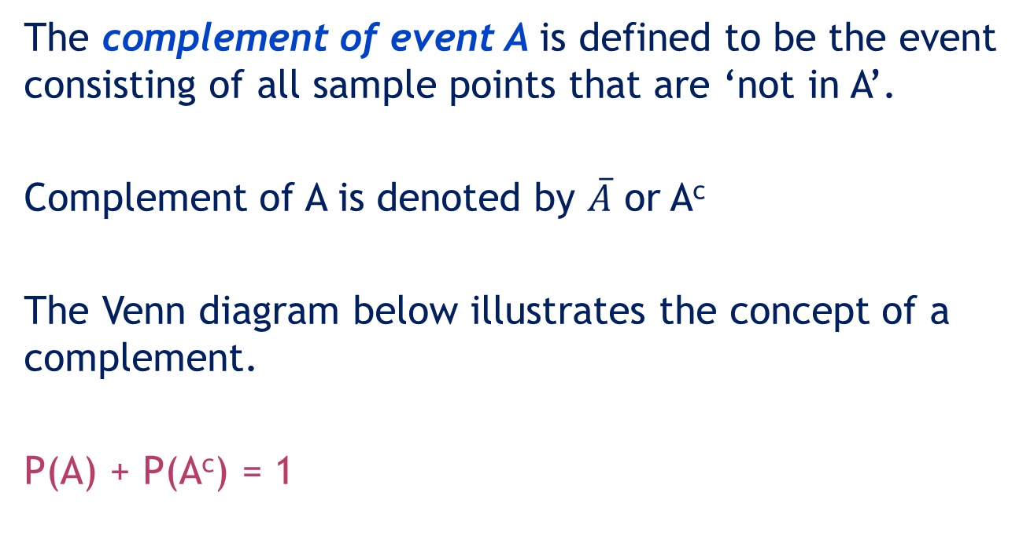
Complement of an Event
6.19
The complement of event A is defined to be the event consisting of all sample points that are ‘not in A’.
Complement of A is denoted by $\overline{A}$ or A^{c}
The Venn diagram below illustrates the concept of a complement.
P(A) + P(A^{c}) = 1
A
A^{c}

Slide 20
Complement of an Event…
6.20
For example, the rectangle stores all the possible tosses of 2 coins S = {(H,H), (H,T), (T,H), (T,T)}
Let A = observing at least one head
= {(H,H), (H,T), (T,H)}
A^{c} = {(T,T)}
P(A) = ¾ , P(A^{c}) = ¼
P(A) + P(A^{c}) = P(S) = 1
P(A^{c}) = 1 – P(A)
A
A^{c}

Slide 21
6.21
Intersection of two events
The intersection of events A and B is the set of all sample points that are in both A ∩ B.
The intersection is denoted: A ∩ B.
The joint probability of
A and B is the probability of
the intersection of A and B,
i.e. P(A ∩ B).
A
B

Slide 22
6.22
Intersection of two events…
For example, consider all possible tosses of two dice.
S = {(1,1),(1,2),…,(6,6)}.
Let A = tosses where first toss is 1
= {(1,1),(1,2),(1,3),(1,4),(1,5),(1,6)}
and B = tosses where the second toss is 5
= {(1,5),(2,5),(3,5),(4,5),(5,5),(6,5)}
The intersection, A ∩ B = {(1,5)}.
The joint probability of A and B is
The probability of the intersection
of A and B, i.e. P(A ∩ B) = 1/36
A
B

Slide 23
Union of two events
6.23
The union of two events A and B, is the event containing all outcomes that are in A or B or both:
Union of A and B is denoted: A ∪ B
A
B

Slide 24
Union of two events…
6.24
For example, consider all possible tosses of two dice.
S = {(1,1),(1,2), …,(6,6)}.
Let A = tosses where first toss is 1
= {(1,1),(1,2),(1,3),(1,4),(1,5),(1,6)}
and B = tosses where the second toss is 5
= {(1,5),(2,5),(3,5),(4,5),(5,5),(6,5)}
Union of A and B, A ∪ B is
A ∪ B = {(1,1),(1,2),(1,3),(1,4),(1,5), (1,6),(2,5),(3,5),(4,5),(5,5),(6,5)} (6,5)}
A
B
The probability of A ∪ B,
P(A ∪ B) = 11/36

Slide 25
Mutually exclusive events
6.25
When two events are mutually exclusive (that is the two events have no outcomes in common), their joint probability is 0, hence:
A and B are mutually exclusive; there are no outcomes in common…
A
B
For example, consider all possible tosses of two dice.
S = {(1,1),(1,2), …,(6,6)}.
A = tosses totalling 9 = {(3,6),(6,3),(4,5),(5,4)} and
B = tosses totalling 11 = {(5,6),(6,5)}
Therefore, A ∩ B = {} = Empty set. P(A ∩ B) = 0

Slide 26
Basic relationships of probability
6.26
Complement of event
Union of events
A
A^{c}
A
B
Intersection of events
Mutually exclusive events
A
B
A
B

Slide 27
Example 1
6.27
The number of spots turning up when a 6-sided die is tossed is observed.
Consider the following events:
A: The number observed is at most 2.
B: The number observed is an even number.
C: The number 4 turns up.
Answer the following questions.

Slide 28
Example 1
6.28
Define the sample space for this random experiment and assign probabilities to the simple events.
Find P(A).
Find P(A^{C}).
Are events A and C mutually exclusive?
Find P(A ∪ C).
Find P(A ∩ B).
Find P(A ∪ B).
Find P(C|B).

Slide 29
Example 1: Solution
6.29
Define the sample space for this random experiment and assign probabilities to the simple events.
Solution
S = {1, 2, 3, 4, 5, 6}
Each simple event is equally likely to occur, thus, P(1) = P(2) = … = P(6) = 1/6.
A Venn diagram
2
3
1
6
4
5

Slide 30
Example 1: Solution…
6.30
b) Find P(A).
Solution
A
2
3
1
6
4
5
P(A) = P{1, 2}

Slide 31
Example 1: Solution…
6.31
c) Find P(A^{c}).
Solution
A
2
3
1
6
4
5
The complement of event A is A^{C} = {3,4,5,6}

Slide 32
Example 1: Solution…
6.32
d) Are events A and C mutually exclusive?
Solution
A = {1,2}, C = {4}
A
2
3
There is no
overlap between
the two regions.
1
6
Events A and C are
mutually exclusive
because they cannot
occur simultaneously.
4
5
Event C

Slide 33
Example 1: Solution…
6.33
e) Find P(A ∪ C).
Solution
A = {1, 2}, C = {4}
A ∪ C = {1, 2, 4}
A or C
A
2
3
1
5
4
6
Event C
or, because A and C are mutually exclusive,

Slide 34

Example 1: Solution…
6.34
f) Find P(A ∩ B).
Solution
A = {1, 2}, B = {2, 4, 6}
A ∩ B = {2}
A ∩ B
1
3
1
A
2
2
2
2
B
6
6
4
4
5

Slide 35
Example 1: Solution…
6.35
g) Find P(A ∪ B).
Solution
A = {1, 2}, B = {2, 4, 6}
A ∪ B = {1, 2, 4, 6}
A ∪ B
1
3
1
1
A
2
2
2
2
B
6
6
6
4
4
4
5

Slide 36
Example 1: Solution…
6.36
h) Find P(C|B).
Solution
C = {4}, B = {2, 4, 6}
3
1
2
2
B
5
6
6
4
4
Event C
4

Slide 37
6.2 Joint, marginal and conditional probability
6.37
We have studied methods to determine probabilities of events that result from combining other events in various ways.
We have also learnt that there are several types of combinations and relationships between events:
intersection of events
union of events
dependent and independent events
complement events
conditional events

Slide 38
Intersection
6.38
The intersection of event A and B is the event that occurs when both A and B occur.
The intersection of events A and B is denoted by (A ∩ B) or (A and B) .
The joint probability of A and B is the probability of the intersection of A and B, and is denoted by P(A ∩ B).

Slide 39
Example 2
6.39
A potential investor examined the relationship between the performance of mutual funds and the university where the fund manager earned his/her MBA.
The following table describes the joint probabilities.
 | Mutual fund outperforms the market | Mutual fund doesn’t outperform the market
Top 20 MBA program | 0.11 | 0.29
Not top 20 MBA program | 0.06 | 0.54
E.g. This is the probability that a mutual fund outperforms AND the manager was in a top-20 MBA program; it’s a joint probability.

Slide 40
Example 2: Solution
6.40
The joint probability of [mutual fund outperforms …] and [… from a top 20 …] = 0.11.
P(A₁ ∩ B₁) = 0.11
 | Mutual fund outperforms the market (B₁) | Mutual fund doesn’t outperform the market (B₂)
Top 20 MBA program (A₁) | 0.11 | 0.29
Not top 20 MBA program (A₂) | 0.06 | 0.54
P(A1 ∩ B1)

Slide 41
Example 2: Solution
6.41
The joint probability of [mutual fund outperforms …] and [… not from a top 20 …] = 0.06
P(A₂ ∩ B₁) = 0.06
P(A2 ∩ B1)
 | Mutual fund outperforms the market (B₁) | Mutual fund doesn’t outperform the market (B₂)
Top 20 MBA program (A₁) | 0.11 | 0.29
Not top 20 MBA program (A₂) | 0.06 | 0.54

Slide 42
Marginal probabilities
6.42
Marginal probabilities are computed by adding across rows and down columns; that is they are calculated in the margins of the table.
Mutual fund outperforms the market (B1)
Mutual fund doesn’t outperform the market (B2)
Marginal prob.
P(Ai)
Top 20 MBA program (A1)
0.11
0.29
0.40
+
=
Not top 20 MBA program (A2)
0.06
0.54
0.60
+
=
Marginal probability P(Bj)
1.00

Slide 43
Marginal probabilities
6.43
These probabilities are computed by adding across rows and down columns.
Mutual fund outperforms the market
(B1)
Mutual fund doesn’t outperform the market
(B2)
Marginal prob.
P(Ai)
Top 20 MBA program (A1)
.11
.29
.40
+
+
Not top 20 MBA program (A2)
.06
.54
.60
Marginal probability P(Bj)
.17
.83
1.0

Slide 44
Marginal probabilities
6.44
“What’s the probability a fund
manager isn’t from a top school?”
P(A2) = 0.06 + 0.54
 | B₁ | B₂ | P(A_{i})
A₁ | 0.11 | 0.29 | 0.40
A₂ | 0.06 | 0.54 | 0.60
P(B_{j}) | 0.17 | 0.83 | 1.00
P(B1) = 0.11 + 0.06
BOTH margins must add to 1
(useful error check)
“What’s the probability a fund
outperforms the market?”

Slide 45
Conditional probability
6.45
Conditional probability is used to determine how two events are related; that is, we can determine the probability of one event given the occurrence of another related event.
Conditional probabilities are written as P(A|B) and read as ‘the probability of A given B’ and is calculated as:

Slide 46
Conditional probability…
6.46
Again, the probability of an event given that another event has occurred is called a conditional probability…
Note how ‘A given B’ and ‘B given A’ are related…

Slide 47
Example 2a (continued from Example 2)
6.47
Find the conditional probability that a randomly selected fund is managed by a top 20 MBA program graduate, given that it did not outperform the market.
 | Mutual fund outperforms the market | Mutual fund doesn’t outperform the market
Top 20 MBA program | 0.11 | 0.29
Not top 20 MBA program | 0.06 | 0.54

Slide 48
Example 2a…
6.48
Find the conditional probability that a randomly selected fund is managed by a top 20 MBA program graduate, given that it did not outperform the market.
Solution:
A₁ = Fund manager graduated from a top-20 MBA program
A₂ = Fund manager did not graduate from a top-20 MBA program
B₁ = Fund outperforms the market
B₂ = Fund does not outperform the market
We need to find P(A₁|B₂).

Slide 49
Example 2a: Solution
6.49
We need to find P(A₁|B₂).
For event A₁|B₂, the new information that B₂ is given reduces the relevant sample space for A₁|B₂ to 83% of event B₂..
Mutual fund does out-perfom the market (B1)
Mutual fund doesn’t out-perform the market (B2)
Marginal prob.
P(Ai)
Top 20 MBA program (A1)
0.11
0.29
0.40
Not top 20 MBA program (A2)
0.06
0.54
0.60
Marginal probability P(Bj)
0.17
0.83

Slide 50
Conditional probability…
6.50
Before the new information becomes available, we have
P(A₁) = 0.40
After the new information on B₂ becomes available, P(A₁) changes to
P(A₁| B₂) = 0.3494
Since the occurrence of B₂ has changed the probability of A₁, the two events are related (ie, A₁ and B₂ are not independent) and are called ‘dependent events’.

Slide 51
Independence
6.51
One of the objectives of calculating conditional probability is to determine whether two events are related.
In particular, we would like to know whether they are independent, that is, if the probability of one event is not affected by the occurrence of the other event.
Two events A and B are said to be independent if
P(A|B) = P(A)
or
P(B|A) = P(B)

Slide 52
Example 2b (continued from Example 2)
6.52
Is ‘Fund outperforms the market’ dependent on the event that the ‘Manager graduated from a top-20 MBA program’?
 | Mutual fund outperforms the market | Mutual fund doesn’t outperform the market
Top 20 MBA program | 0.11 | 0.29
Not top 20 MBA program | 0.06 | 0.54

Slide 53
Example 2b…
6.53
Is ‘Fund outperforms the market’ dependent on the event that the ‘Manager graduated from a top-20 MBA program’?
Solution:
A₁ = Fund manager graduated from a top-20 MBA program
A₂ = Fund manager did not graduate from a top-20 MBA program
B₁ = Fund outperforms the market
B₂ = Fund does not outperform the market
In order to answer this question, it suffices to show that, for at least one i and j, P(B_{i}| A_{j})≠ P(B_{j})
If B₂ and A₂ are independent, then P(B₂|A₂)=P(B₂)

Slide 54
Example 2b: Solution…
6.54
We have already seen the dependency between A₁ and B₂, as P(A₁|B₂) = 0.3494 ≠ P(A₁) = 0.40
Now, let us check the independence of A₂ and B₂.
P(B₂) = 0.83
P(B₂|A₂)=P(B₂ ∩ A₂)/P(A₂) = 0.54/0.60 = 0.90
Therefore, P(B₂|A₂) ≠ P(B₂)
Conclusion: A₂ and B₂ are dependent. That is, the probability of event B₂ is affected by the occurrence of the event A₂. This means that Fund outperforms the market does not depend on whether the manager graduated from a top-20-MBA program.

Slide 55
6.55
Note that independent events and
mutually exclusive events are not the same!
A and B are two mutually exclusive events and A can take place, that is, P(A) > 0. Can A and B be independent?
B
B
A
Let’s assume event B has occurred.
The conditional probability that A occurs given that B has occurred is zero, that is, P(A|B) = 0, because P(A ∩ B) = 0.
However, P(A)>0, thus P(A|B)≠P(A) and therefore events A and B cannot be independent.

Slide 56
Example 3
6.56
The personnel department of an insurance company has compiled data on promotion, classified by gender. Are promotion and gender dependent on each another?
Events of interest:
M: A manager is a male R: A manager is promoted
M^{c}: A manager is a female R^{c}: A manager is not promoted

Slide 57
Example 3: Solution
6.57
If gender has no effect on promotion, then R and M are independent and P(R|M) = P(R). If this equality holds, there is no difference in the probability of promotion between male and female managers.
46
230
54
270

Slide 58
Example 3: Solution…
6.58
P(R) = Number of promotions / total number of managers
= 54 /270 = 0.20
P(R|M) = P(Number of promotions | Only male managers are observed)
= 46 / 230 = 0.20.
Therefore, P(R|M) = P(R). That is, R is not influenced by M, and R and M are independent. Similarly, we can show that this results holds for all possibilities of conditional events in the table.
Conclusion: There is no gender discrimination in awarding promotions.

Slide 59
Union
6.59
As discussed earlier, the union event of A and B is the event that occurs when either A or B or both occur.
It is denoted (A ∪ B) or (A or B).

Slide 60
Example 3
6.60
Determine the probability that a randomly selected fund outperforms the market or the manager graduated from a top 20 MBA program.
That is, we want to calculate P (A₁ ∪ B₁).

Slide 61
Example 3: Solution
6.61
A1 or B1 occurs whenever: A1 and B1 occurs, A1 and B2 occurs, or A2 and B1 occurs…
Mutual fund outperforms the market (B1)
Mutual fund doesn’t outperform the market (B2)
A1 or B1 occurs
whenever either:
A1 and B1 occurs,
Top 20 MBA program (A1)
0.11
0.29
A1 and B2 occurs,
Not top 20 MBA program (A2)
0.06
0.54
A2 and B1 occurs.
P(A1 ∪ B1) = P(A1 ∩ B1) + P(A1 ∩ B2) + P(A2 ∩ B1)
= 0.11 + 0.29 + 0.06 = 0.46
Alternatively, P(A1 ∪ B1) = 1 – P(A2 ∩ B2) = 1 – 0.54 = 0.46

Slide 62
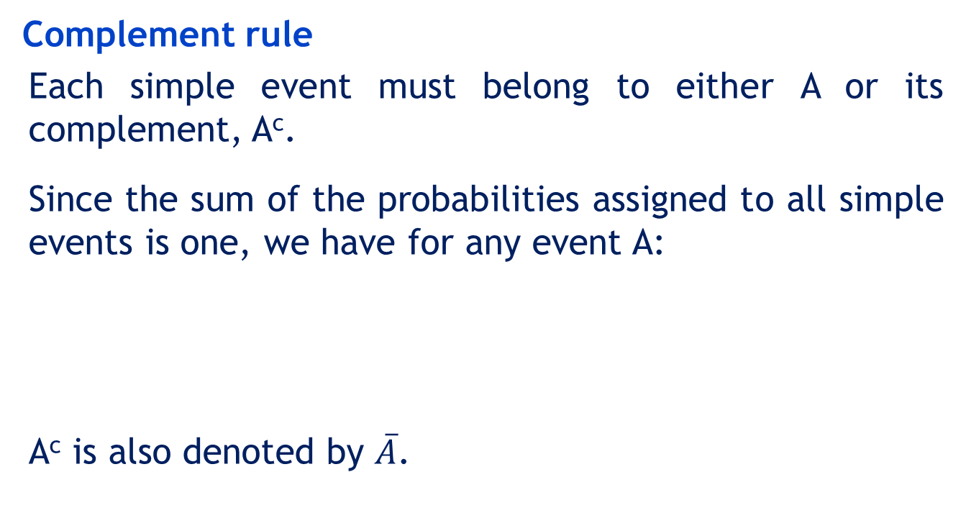
6.3 Rules of probability
6.62
Complement rule
Each simple event must belong to either A or its complement, A^{c}.
Since the sum of the probabilities assigned to all simple events is one, we have for any event A:
A^{c} is also denoted by $\overline{A}$.
P(A^{c}) = 1 – P(A)

Slide 63
Rules of Probability…
6.63
Addition rule
For any two events A and B
P(A ∪ B) = P(A) + P(B) – P(A ∩ B)
A

Slide 64
Rules of Probability…
6.64
Multiplication rule
For any two events A and B
When A and B are independent
P(A ∩ B) = P(B|A) P(A)
= P(A|B) P(B)
P(A ∩ B) = P(A)P(B)

Slide 65
Example 4
6.65
A stock market analyst feels that
The probability that a certain mutual fund will receive increased contributions from investors is 0.6.
The probability of receiving increased contributions from investors becomes 0.9 if the stock market goes up.
There is a probability of 0.5 that the stock market rises.
The events of interest are:
A: The stock market rises
B: The company receives increased contribution

Slide 66
Example 4…
6.66
Calculate the following probabilities
The probability that both A and B will occur, P(A ∩ B) [sharp increase in earnings].
The probability that either A or B will occur, P(A ∪ B)
[at least moderate increase in earnings].
Solution
P(A) = 0.5; P(B) = 0.6; P(B|A) = 0.9
P(A ∩ B) = P(B|A) P(A) = (0.9)(0.5) = 0.45
P(A ∪ B) = P(A) + P(B) – P(A and B)
= 0.5 + 0.6 – 0.45 =0.65

Slide 67
6.4 Probability Trees
6.67
An effective and simpler method of applying the probability rules is the probability tree, wherein the events in an experiment are represented by lines.
The resulting figure resembles a tree, hence the name.
We will illustrate the probability tree with several examples, including two that we addressed using the probability rules alone.

Slide 68
Probability Trees…
6.68
Consider the random experiment of flipping a coin twice.
H
HH
Stage 1
Stage 2
P(HH)=0.25
H
P(HT)=0.25
Second flip
P(TH)=0.25
T
P(TT)=0.25
HT
First flip
H
Simple events
Origin
TH
Second flip
T
T
TT

Slide 69
Probability Trees…
6.69
Calculate the probability of event A, where
A = {at least one outcome of heads}
= {HH, HT, TH}
HH
P(HH)=0.25
P(HT)=0.25
HT
The sample space =
P(TH)=0.25
P(TT)=0.25
TH
P(A) = 0.25 + 0.25 + 0.25
= 0.75
TT

Slide 70
Example 5
6.70
Suppose we are interested in the condition of a machine that produces a particular item.
From experience it is known that the machine is in good condition 90% of the time.
When in good condition, the machine produces a defective item 1% of the time.
When in bad condition, the machine produces a defective 10% of the time.
An item is selected at random from the current production run. What is the probability that the item was found to be defective?

Slide 71
Example 5…
6.71
With this additional information, what is the probability that the machine is in good condition?

Slide 72
Example 5: Solution…
6.72
Let us define the two events of interest:
A: The machine is in good condition.
B: The item is defective.
We need to calculate P(A|B).
The prior probability that the machine is in good condition is P(A) = 0.9. With the new information (the selected item is defective, i.e., event B has occurred) we can re-evaluate this probability by calculating P(A|B).

Slide 73
Example 5: Solution…
6.73
Outcome
Joint
probabilities
Prior probabilities
Conditional probabilities
B
A ∩ B
P(A ∩ B) = 0.009
P(B|A) = 0.01
A
Defective
Nondefective
P(A) = 0.9
P(B|A) = .99
B
Good
A ∩ B
B
A ∩ B
P( ) = 0.010
A ∩ B
Poor
P(B|A) = 0.1
P(A) = 0.1
A
Defective
A: Machine is in good condition
B: Item is defective
Nondefective
P(B|A) = 0.9
B
A ∩ B
P(B) = 0.019

Slide 74
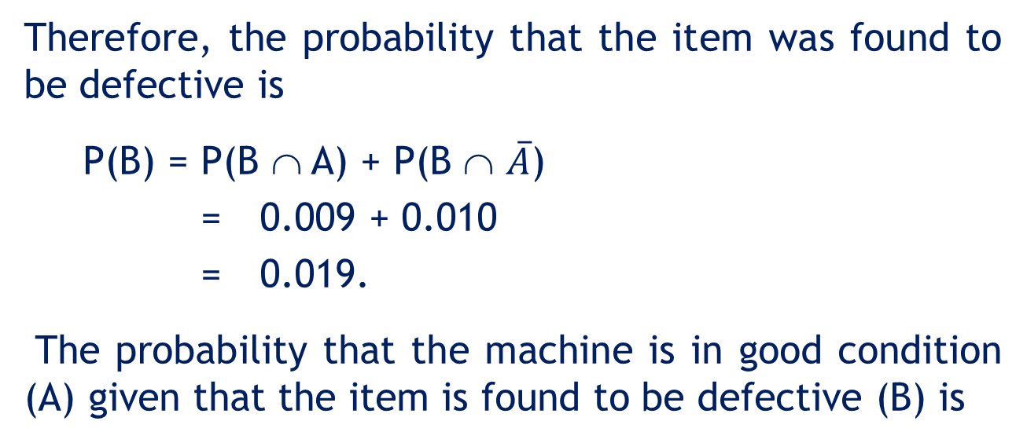
Example 5: Solution…
6.74
Therefore, the probability that the item was found to be defective is
P(B) = P(B ∩ A) + P(B ∩ $\overline{A}$)
= 0.009 + 0.010
= 0.019.
The probability that the machine is in good condition (A) given that the item is found to be defective (B) is

Slide 75
6.5 Bayes’ law
6.75
Conditional probability is used to find the probability of an event given that one of its possible causes has occurred.
We use Bayes’ law to find the probability of the possible cause given that an event has occurred.

Slide 76
Bayes’ law…
6.76
Bayes’ law is named for Thomas Bayes, an eighteenth century mathematician.
In its most basic form, if we know P(B|A), we can apply Bayes’ law to determine P(A|B)
P(B|A) P(A|B)

Slide 77
Example 6
6.77
Medical tests can produce false-positive or false-negative results.
A particular test is found to perform as follows:
correctly diagnoses ‘positive’ 94% of the time
correctly diagnoses ‘negative’ 98% of the time.
It is known that 4% of men in the general population suffer from the illness.
What is the probability that a man is suffering from the illness, if the test result were positive?

Slide 78
Example 6: Solution
6.78
Define the following events
D = has the disease
D^{C} = does not have the disease
PT = positive test results
NT = negative test results
The probabilities provided are:
P(D) = 0.04 P(D^{C}) = 0.96
P(PT|D) = 0.94 P(NT|D)= 0.06
P(PT|D^{C}) = 0.02 P(NT|D^{C}) = 0.98
The probability to be determined is: P(D|PT)

Slide 79
Example 6: Solution
6.79
Bayes’ law
P(D ∩ PT)
=0.0376
P(PT|D) = .94
+
P(D) = .04
P( NT|D) = .06
P(D^{C} ∩ PT)
=0.0192
P(PT|D^{C}) = .02
P(D^{C}) = .96
P( NT|D^{C}) = .98
P(PT) =0.0568

Slide 80
Example 6: Solution
6.80
Prior
probabilities
Likelihood
probabilities
P(PT|D) = .94
Posterior probabilities
P(D) = .04
P( NT|D) = .06
P(PT|D^{C}) = .02
P(D^{C}) = .96
P( NT|D^{C}) = .98

