Slide 1


Slide 2
Chapter 9
Statistical inference and
sampling distributions

Slide 3
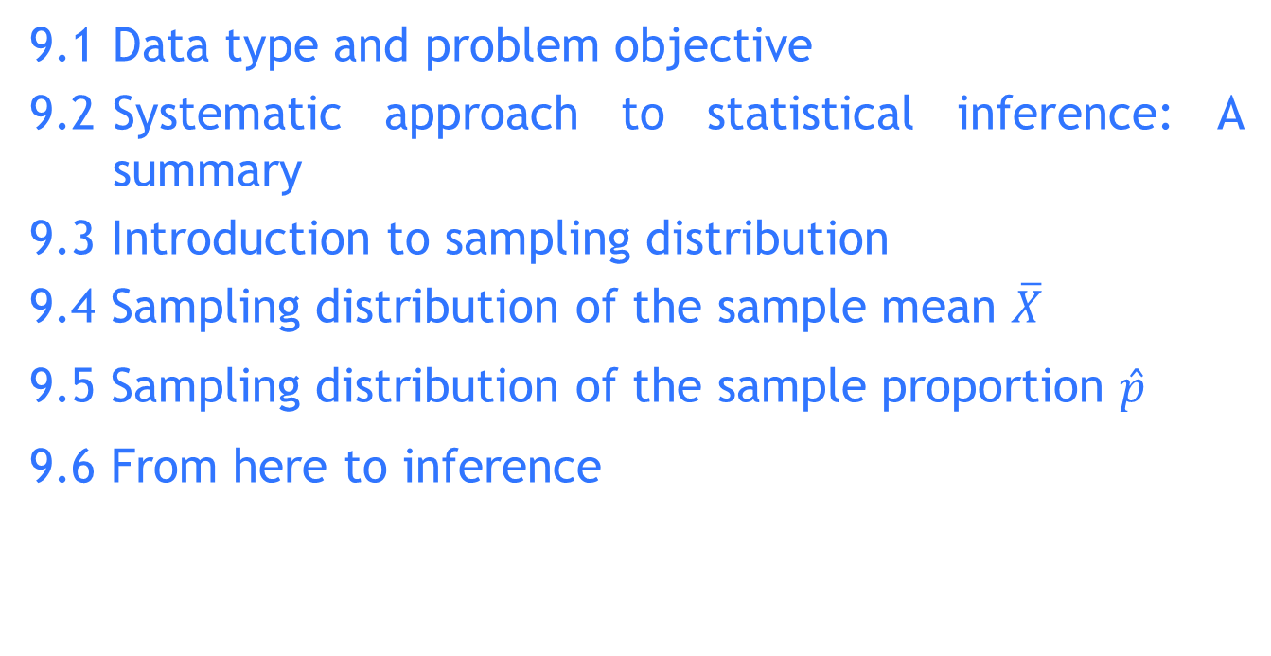
Chapter outline
9.1 Data type and problem objective
9.2 Systematic approach to statistical inference: A summary
9.3 Introduction to sampling distribution
9.4 Sampling distribution of the sample mean $\overline{X}$
9.5 Sampling distribution of the sample proportion $\hat{p}$
9.6 From here to inference

Slide 4
Learning objectives
LO1 Explain the importance of statistical inference
LO2 Explain how, when and why statistical inference is used
LO3 Understand the central limit theorem and the properties of the sampling distribution of the sample mean
LO4 Understand the properties of the sampling distribution of the sample proportion
LO5 Understand the probability link between sample statistics and population parameters
LO6 Apply various sampling distributions in practical applications.

Slide 5
Introduction
The process of drawing conclusions about the properties of a population based on information obtained from a sample is called statistical inference.
Examples of statistical inference include the following:
estimating the mean annual household income of families in Newcastle; and
determining whether or not a fuel additive is actually effective in decreasing fuel consumption.

Slide 6
Recall from Chapter 1
Descriptive measures of a population are called parameters, while descriptive measures calculated from a sample are called statistics.
In many applications of statistical inference, we draw conclusions about a parameter of a population by using a sample statistic.

Slide 7
9.1 Data type and problem objective
A number of factors determine which statistical technique should be used, but two of these are especially important:
Data type: The type of data being measured, and
Problem objective: the purpose of the statistical inference.

Slide 8
Data Type
The two most important types of data:
numerical (quantitative) and
nominal (categorical).
Numerical data are real numbers.
Nominal data have values that are categorical.

Slide 9
Problem Objective
You will find that every statistical method has some specific objective.
We will identify 5 such objectives.
Description of a single population.
Comparison of two populations.
Comparison of two or more populations.
Analysis of the relationships between two variables.
Analysis of the relationship among two or more variables.

Slide 10
9.2 Systematic approach to statistical inference: a summary
From here onwards, a number of techniques in inferential statistics will be introduced. As mentioned earlier after selecting the technique based on the data type and problem objective, it is also important to decide how, when and why a selected technique should be used in a particular application.
How to perform the calculations?
When is a particular technique applicable?
Why the selected statistical technique is most suitable to a specific application?

Slide 11
How, when and why use a particular technique?
How?
Either use manual or computer to perform the required calculations.
When?
Before using any technique, one needs to find out whether the selected technique satisfy the required conditions that need to be satisfied (for example, to use a t-distribution, the population distribution must be normal)
Why?
One needs to justify why the selected technique is the most appropriate one to be used in the particular application.

Slide 12
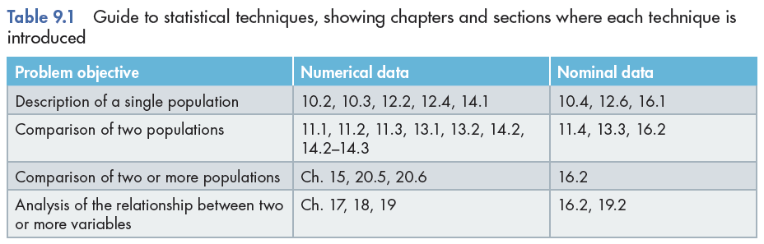
A guide to statistical techniques

Slide 13
9.3 Introduction to sampling distributions
In real life, calculating the parameters of populations is prohibitive because populations are very large.
Rather than investigating the whole population, we take a sample, calculate a statistic related to the parameter of interest and make an inference.
The sampling distribution of the statistic is the tool that tells us how close the statistic is to the parameter.

Slide 14
Sampling Distributions
A sampling distribution is created by, as the name suggests, sampling.
The method we will employ to derive the sampling distribution uses the rules of probability and the laws of expected value and variance.
For example, consider the roll of one and two dice…

Slide 15
9.4 Sampling distribution of the sample mean
Sampling distribution of a single die
A fair die is thrown infinitely many times, with the random variable X = Number of spots showing on any throw.
The probability distribution of X is:
and the mean and variance are calculated as follows:
x | 1 | 2 | 3 | 4 | 5 | 6
p(x) | 1/6 | 1/6 | 1/6 | 1/6 | 1/6 | 1/6

Slide 16


Sampling distribution of the sample mean…
Sampling distribution of a single die
The mean and variance are calculated as:

Slide 17

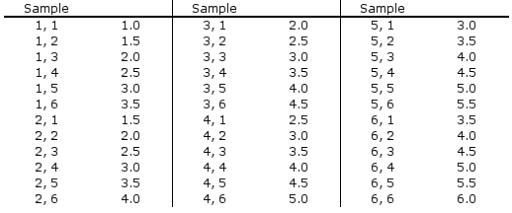
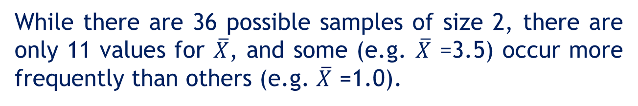
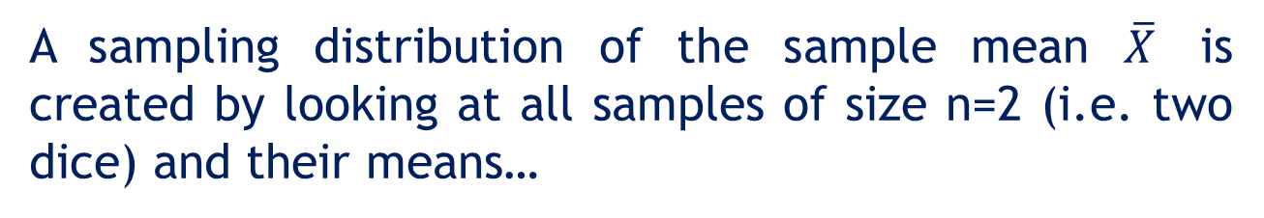
Sampling Distribution of Two Dice
A sampling distribution of the sample mean $\overline{X}$ is created by looking at all samples of size n=2 (i.e. two dice) and their means…
While there are 36 possible samples of size 2, there are only 11 values for $\overline{X}$, and some (e.g. $\overline{X}$ =3.5) occur more frequently than others (e.g. $\overline{X}$ =1.0).

Slide 18
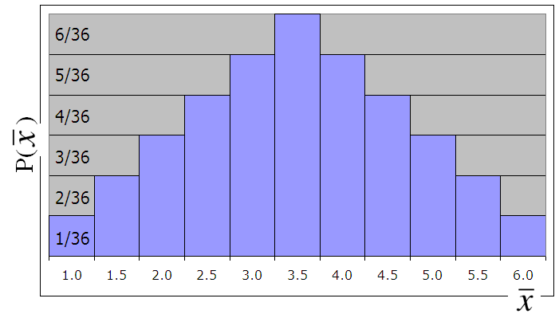




Sampling Distribution of Two Dice
The sampling distribution of $\overline{X}$ is shown below:
p( )

Slide 19

Compare…
Compare the distribution of X…
…with the sampling distribution of .
As well, note that:

Slide 20


Generalize…
We can generalize the mean and variance of the sampling of two dice:
…to n-dice:
The standard deviation of the sampling distribution of the sample mean is called the standard error.

Slide 21
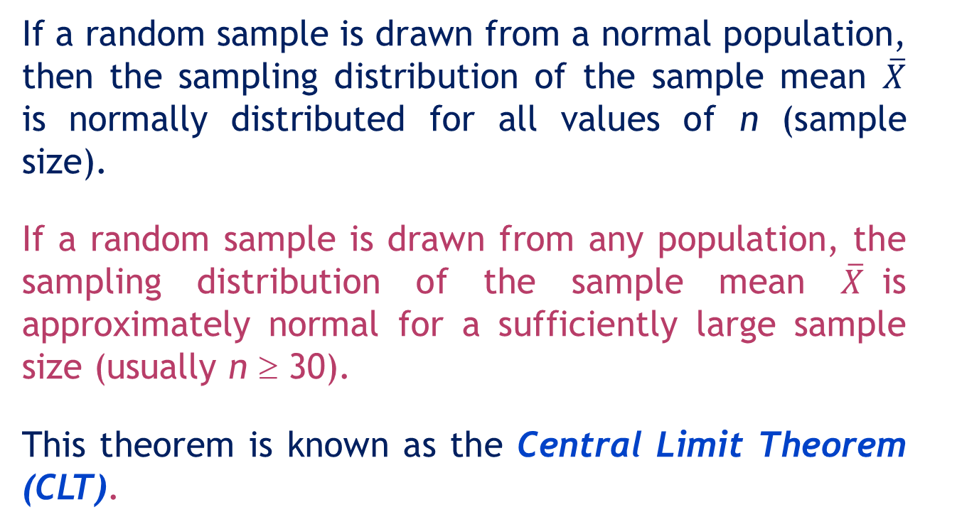
Central Limit Theorem
If a random sample is drawn from a normal population, then the sampling distribution of the sample mean $\overline{X}$ is normally distributed for all values of n (sample size).
If a random sample is drawn from any population, the sampling distribution of the sample mean $\overline{X}$is approximately normal for a sufficiently large sample size (usually n ≥ 30).
This theorem is known as the Central Limit Theorem (CLT).

Slide 22
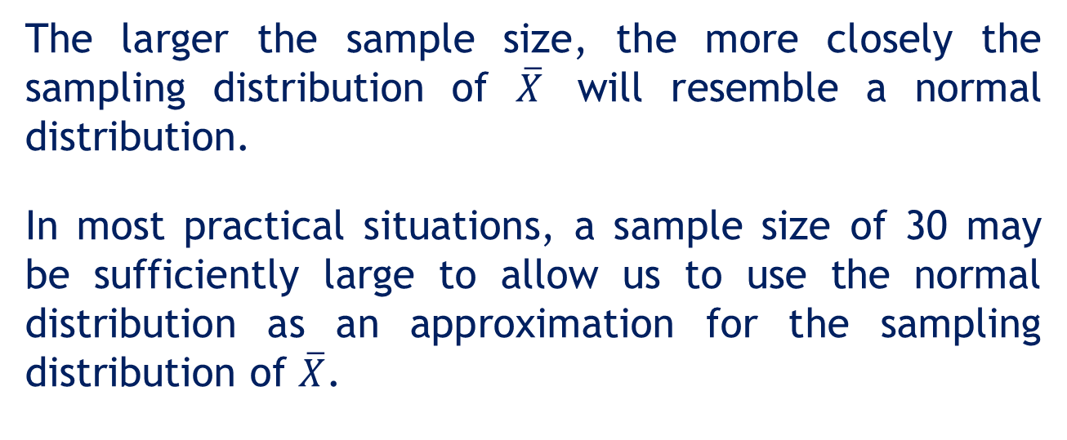
Central Limit Theorem…
The larger the sample size, the more closely the sampling distribution of $\overline{X}$ will resemble a normal distribution.
In most practical situations, a sample size of 30 may be sufficiently large to allow us to use the normal distribution as an approximation for the sampling distribution of $\overline{X}$.

Slide 23
Sampling Distribution of the Sample Mean

Slide 24
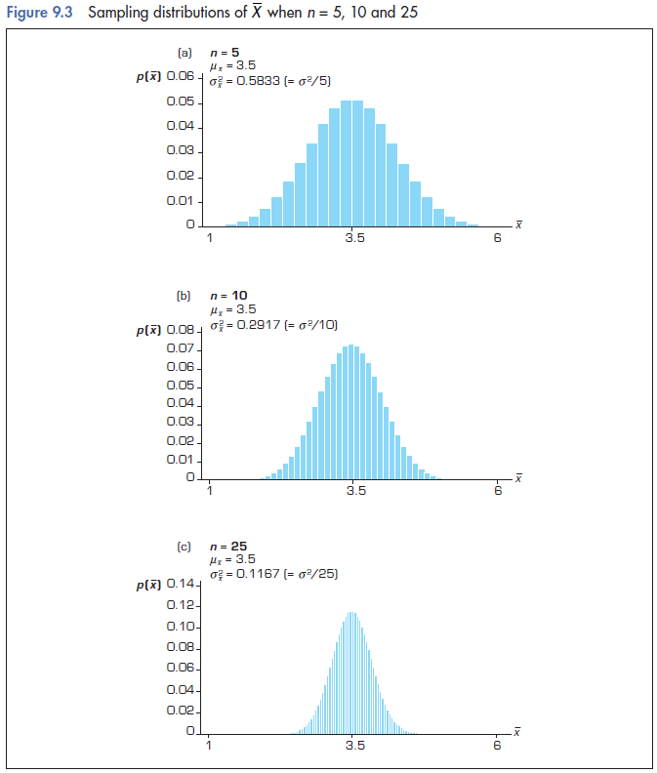

Slide 25
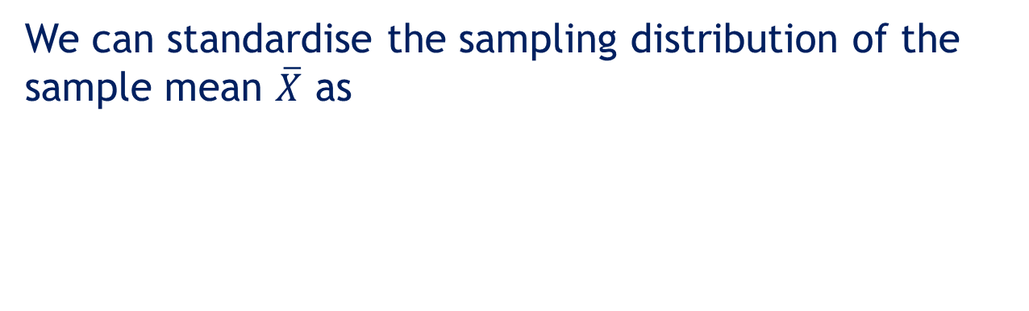
Sampling Distribution of the Sample Mean
We can standardise the sampling distribution of the sample mean $\overline{X}$ as

Slide 26
Sampling Distribution of the Sample Mean
The summaries above assume that the population is infinitely large. However, if the population is finite, the standard error is
where N is the population size and
is the finite population correction factor.

Slide 27
Sampling Distribution of the Sample Mean
If the population size is large relative to the sample size the finite population correction factor is close to 1 and can be ignored.
We will treat any population that is at least 20 times larger than the sample size as large.
In practice, most applications involve populations that qualify as large.
As a consequence the finite population correction factor is usually omitted.

Slide 28
Example 1
The weight of each ‘32g’ chocolate bar is normally distributed with a mean of 32.2 g and a standard deviation of 0.3 g.
Find the probability that, if a customer buys one chocolate bar, that bar will weigh more than 32 g.
Find the probability that, if a customer buys a pack of 4 bars, the mean weight of the bars will be more than 32 g.

Slide 29
Example 1: Solution
i. Find the probability that, if a customer buys one chocolate bar, that bar will weigh more than 32 g.
The random variable X is the weight of a chocolate bar which is normally distributed with μ_{X} = 32.2, σ_{X} = 0.3. Therefore,
0.7486
x = 32
μ = 32.2

Slide 30

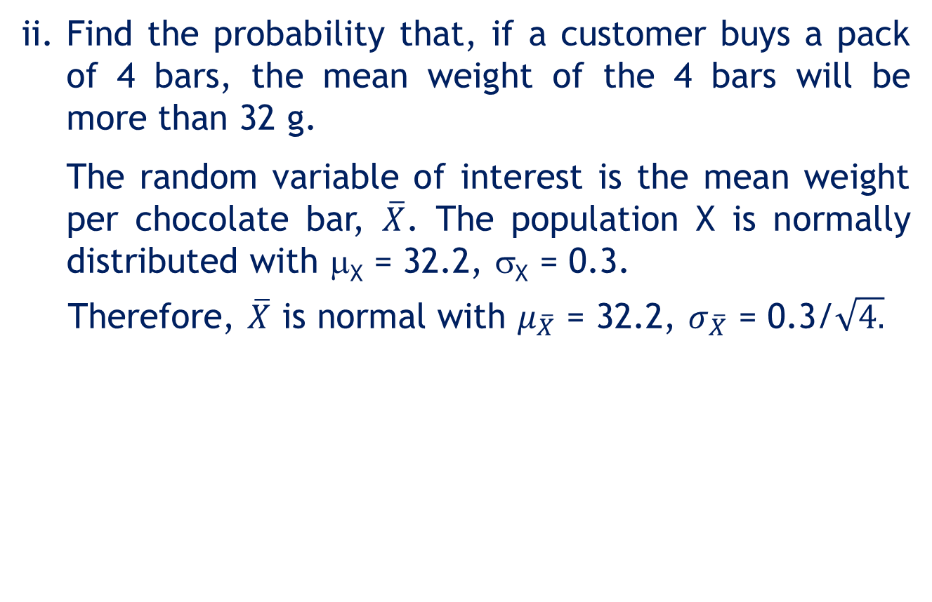
Example 1: Solution
ii. Find the probability that, if a customer buys a pack of 4 bars, the mean weight of the 4 bars will be more than 32 g.
The random variable of interest is the mean weight per chocolate bar, $\overline{X}$. The population X is normally distributed with μ_{X} = 32.2, σ_{X} = 0.3.
Therefore, $\overline{X}$ is normal with $μ_{\overline{X}}$ = 32.2, $σ_{\overline{X}}$ = 0.3/$\sqrt{4.}$
Sampling
distribution of $\overline{X}$
0.9082

Slide 31

Example 1: Solution
Graphical illustration of the two probabilities:
Sampling
distribution of $\overline{X}$
0.9082
Distribution
of X
0.7486
x = 32
μ = 32.2

Slide 32
Example 2
The average weekly income of graduates one year after graduation is $600. Suppose the distribution of weekly income is normally distributed with standard deviation of $100.
What is the probability that 25 randomly-selected graduates have an average weekly income of less than $550?
If a random sample of 25 graduates actually had an average weekly income of $550, what would you conclude about the validity of the claim that the average weekly income is $600?
Notes:
32

Slide 33
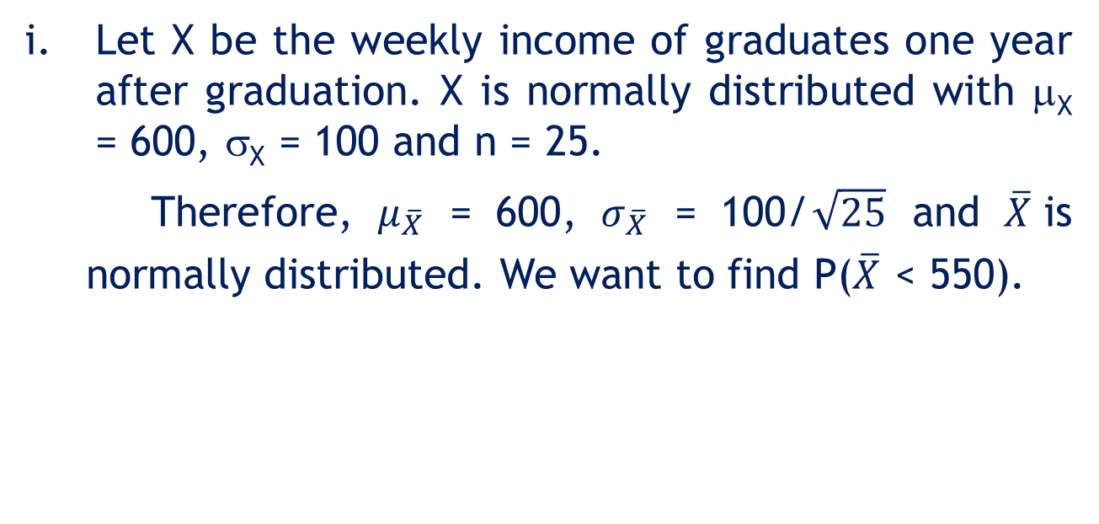
Example 2: Solution
Let X be the weekly income of graduates one year after graduation. X is normally distributed with μ_{X} = 600, σ_{X} = 100 and n = 25.
Therefore, $μ_{\overline{X}}$ = 600, $σ_{\overline{X}}$ = 100/$\sqrt{25}$ and $\overline{X}$is normally distributed. We want to find P($\overline{X}$ < 550).

Slide 34
Example 2: Solution
ii. With μ = 600, the probability of having a sample mean of 550 is very low (0.0062). So the claim that the average weekly income is $600 is probably unjustified.
It would be more reasonable to assume that μ is smaller than $600, because then a sample mean of $550 becomes more probable.

Slide 35
Creating the Sampling Distribution by Computer Simulation
By producing data sets of random numbers that come from given distributions, we can verify probabilistic and statistical characteristics.
We simulate a dice-tossing experiment (creating the distribution of the average).
Effects of an increasing sample size on the distribution of the mean are shown.

Slide 36
Simulation of Dice Tossing
Mean = 3.486
Stand. dev. = 1.215
Mean = 3.495
Stand. dev. = 0.749
n = 2
n = 5
Mean = 3.494
Stand. dev. = 0.544
n = 10

Slide 37
Using samples of size 2 calculate the sample means
Calculate the means.
Type the bin.
Excel
Creating a
simulated
distribution
of the mean
Create samples
of size two.
Create a histogram
for the distribution
of the mean.

Slide 38
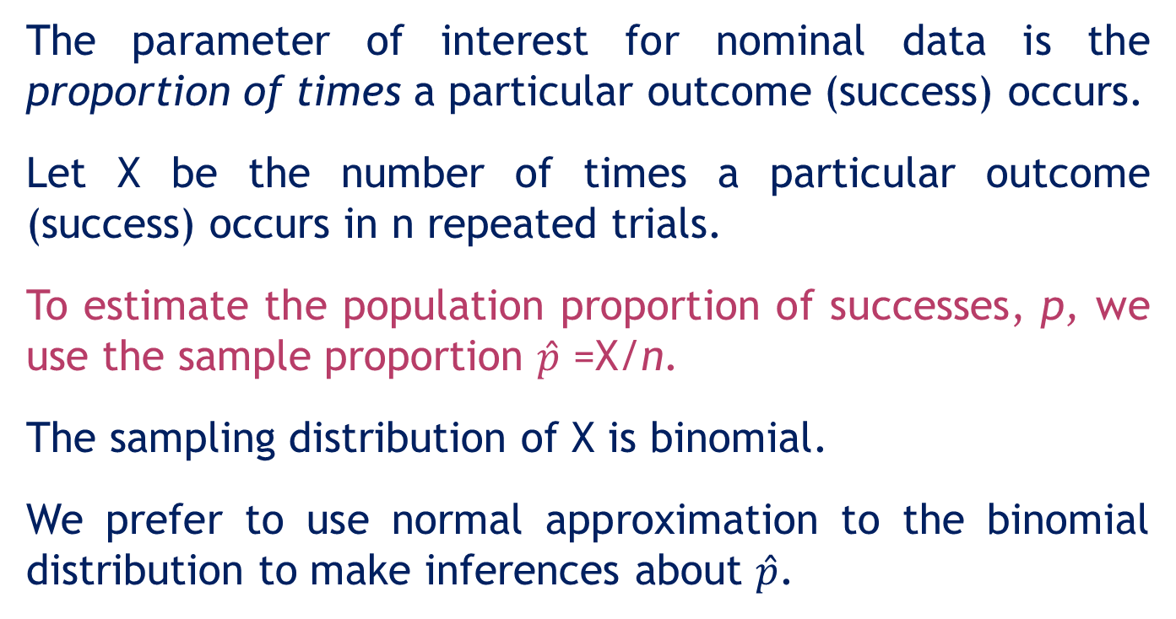
9.5 Sampling distribution of the sample proportion
The parameter of interest for nominal data is the proportion of times a particular outcome (success) occurs.
Let X be the number of times a particular outcome (success) occurs in n repeated trials.
To estimate the population proportion of successes, p, we use the sample proportion $\hat{p}$ =X/n.
The sampling distribution of X is binomial.
We prefer to use normal approximation to the binomial distribution to make inferences about $\hat{p}$.

Slide 39
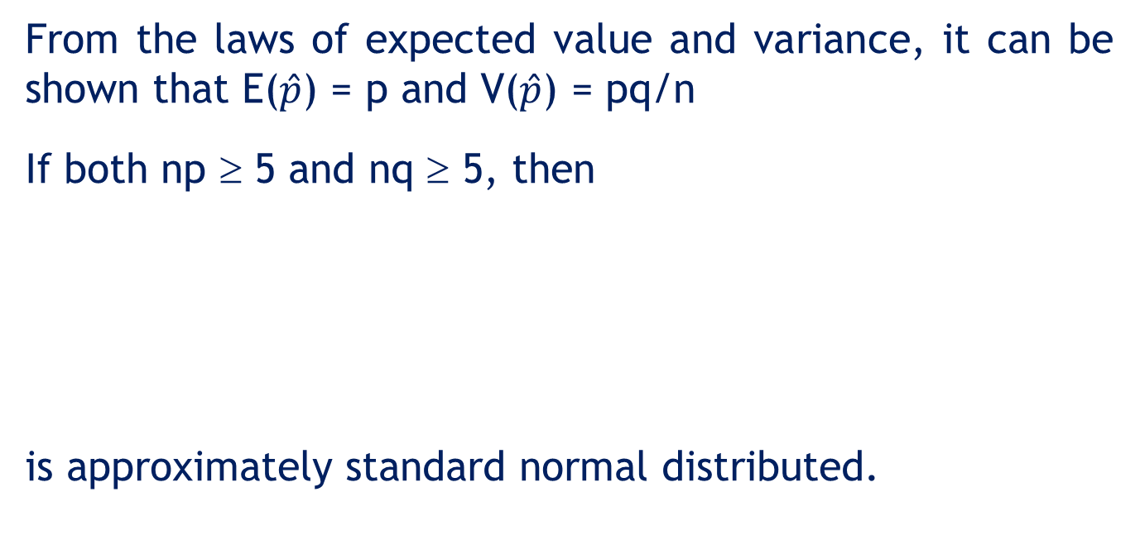
Sampling Distribution of a Sample Proportion $\hat{p}$
From the laws of expected value and variance, it can be shown that E($\hat{p}$) = p and V($\hat{p}$) = pq/n
If both np ≥ 5 and nq ≥ 5, then
is approximately standard normal distributed.

Slide 40
Example 3
The Laurier company’s brand has a market share of 30%. In a survey, 1000 consumers were asked which brand they prefer. What is the probability that more than 32% of the respondents say they prefer the Laurier brand?

Slide 41
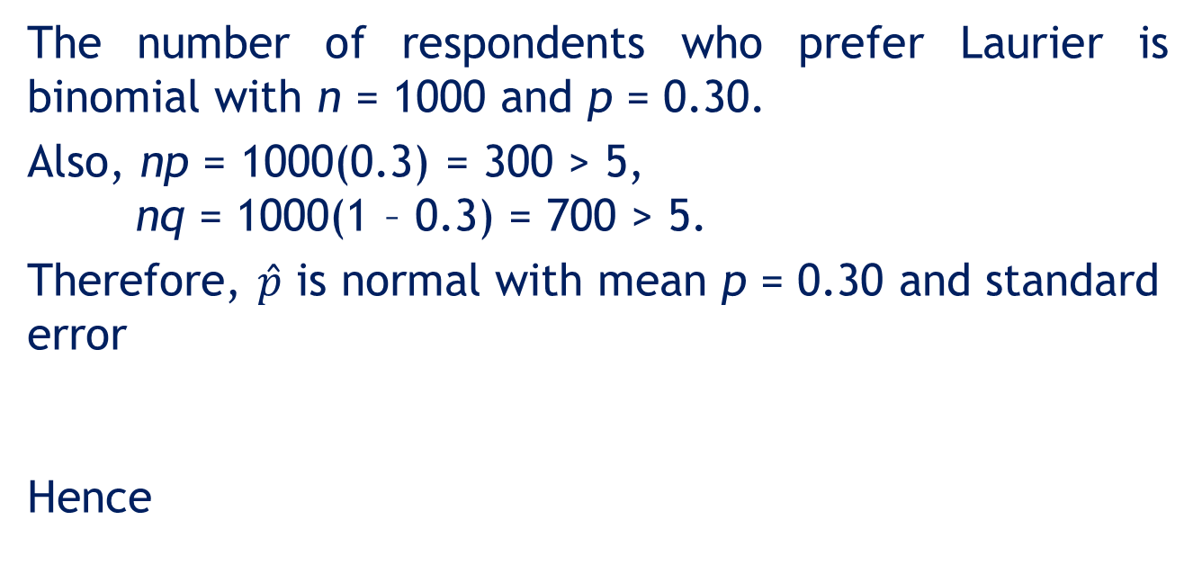
Example 3: Solution
The number of respondents who prefer Laurier is binomial with n = 1000 and p = 0.30.
Also, np = 1000(0.3) = 300 > 5, nq = 1000(1 – 0.3) = 700 > 5.
Therefore, $\hat{p}$ is normal with mean p = 0.30 and standard error
Hence
Notes:
41

Slide 42
9.6 From here to inference
In Chapters 7 and 8 we introduced probability distributions, which allowed us to make probability statements about values of the random variable.
A prerequisite of this calculation is knowledge of the distribution and the relevant parameters.

Slide 43
From here to inference
In Example 7.9 we used the binomial distribution to compute the probability of Pat Statsdud guessing correct answers of any number of quizzes.

Slide 44
From here to inference
In Example 8.3, we needed to know that the amount of time taken to assemble a computer is normally distributed with a mean of 60 minutes and a standard deviation of 8 minutes.
These three bits of information allowed us to calculate the probability of various values of the random variable.

Slide 45
From here to inference
Knowledge of the population and its parameter(s) allows us to use the probability distribution to make probability statements about individual members of the population.
In this chapter we developed the sampling distribution, wherein knowledge of the parameter(s) and some information about the distribution allow us to make probability statements about a sample statistic.

Slide 46
From here to inference
Starting in Chapter 10, we will assume that most population parameters are unknown.
The statistics practitioner will sample from the population and compute the required statistic.
The sampling distribution of that statistic will enable us to draw inferences about the parameter.

