Slide 1
Text mining & Topic modelling
Thuc Le
Advanced Analytic Techniques 2
University of South Australia
(The slides are based on David M. Blei’s slides, talks, and articles)

Slide 2
Outline
Text mining examples
Topic modelling
Latent Dirichlet Allocation (LDA)
Summary

Slide 3
Text mining
What are the causes of breast cancer?
Google: 88,600,000 results
PubMed: 317999 scientific articles
If a scientist read and understand 1 paper/day, it would take him 871 years to read all the papers.
Text mining tools wanted!!

Slide 4
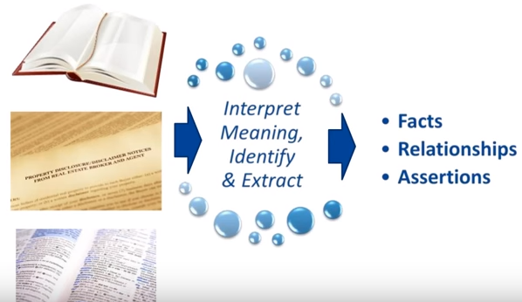
Text mining
Text mining refers to the process of extracting interesting and non-trivial information and knowledge from unstructured text

Slide 5
Text mining applications
Spam filtering
Creating suggestion and recommendations (like amazon)
Monitoring public opinions (Obama election campaign) https://www.youtube.com/watch?v=6ZOfnFCMHTM

Slide 6
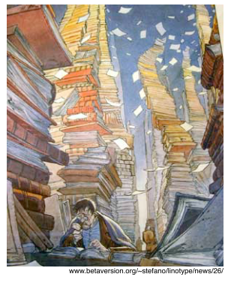
Topic modelling
Aim of Topic Models:
Large unstructured collection of document
Discover set of topics that generated the documents
Annotate documents with topics

Slide 7
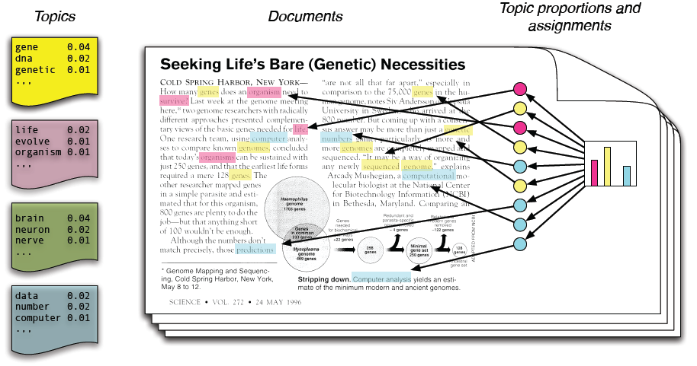

Topic modelling
Each document is a distribution of topics (different colors)
Each topic is a distribution of words

Slide 8
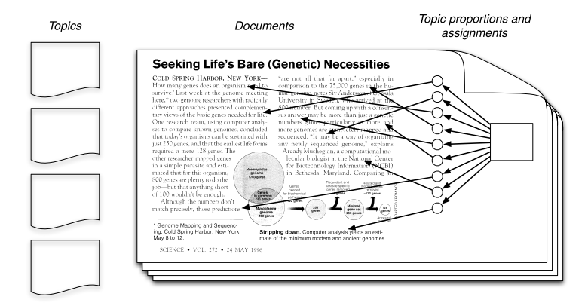

Topic modelling
Infer the hidden structure using posterior inference
P(hidden variables | observations, priors)
Situate new data into the estimated model
P(new document | learnt model)
φ^{(z)}
zi
θ^{(d)}
http://videolectures.net/mlss09uk_blei_tm/
In reality, we only observe the documents
Our goal is to infer the underlying topic structure

Slide 9
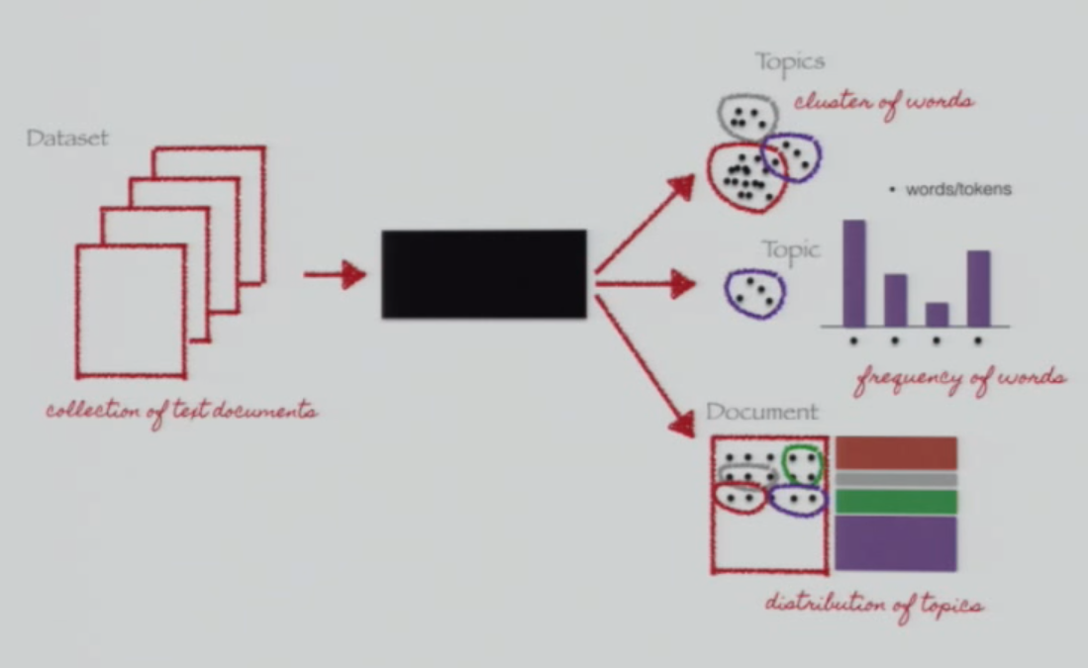

Topic modelling

Slide 10
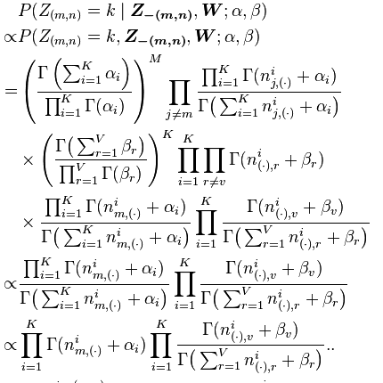
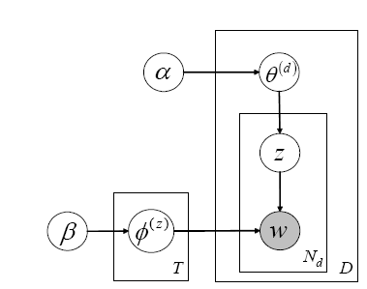

Latent Dirichlet Allocation (LDA)
P( w | z, φ ^{(z)} )
number of words
Draw θ^{(d)} from Dirichlet α
Draw φ^{(z)} from Dirichlet β
Draw a topic z from θ^{(d)}
Draw a word from φ^{(z)}
number of documents

Slide 11
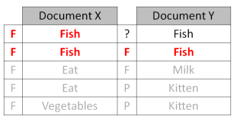
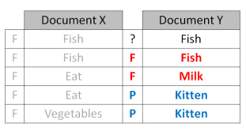
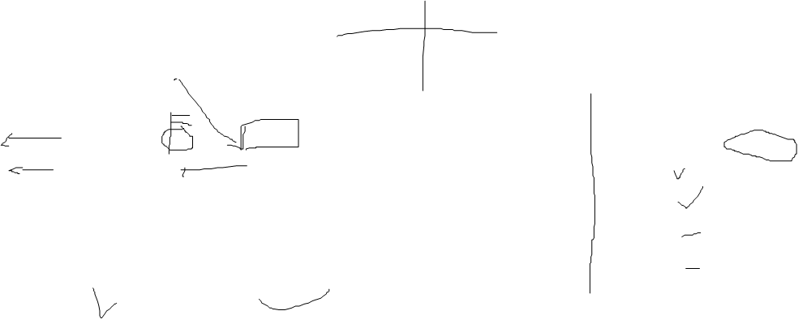
LDA
Initialise parameters: number of topics (K) and number of iterations (I)
Assign the topic randomly for each word in each document
I eat fish and vegetables → eat (F), fish(P), vegetables(F)
Fish are pets → fish(F), pets(P)
My kitten eats fish → kitten(F), eat(P), fish(F)
…
3. Iterate
For each word in each document do
resample topic for word, assuming that all other assignments are correct
check and update topic assignment
How prevalent is that word across topics?
How prevalent are topics in the document?

Slide 12
Summary
Text mining
Topic modelling
LDA
Link to download and watch David Blei’s lecture:
http://videolectures.net/mlss09uk_blei_tm/?q=topic%20models

Slide 13
Thank You.

