Slide 1
GeoSpatial data analysis
Thuc Le
Advanced Analytic Techniques 2
University of South Australia

Slide 2
Outline
Geospatial data
Geospatial analyses
Challenges of traditional data mining methods

Slide 3

Spatial data
Non spatial data: numbers, text-string
E.g: population, city name
Spatial (geographically referenced)
Location, e.g. longitude, latitude, elevation
Date | City | Event | Time | Postcode | longitude | latitude
11/02 | Washington | Homicide | 06:25 | 20001 | 38.9072° N | 77.0369° W
…

Slide 4
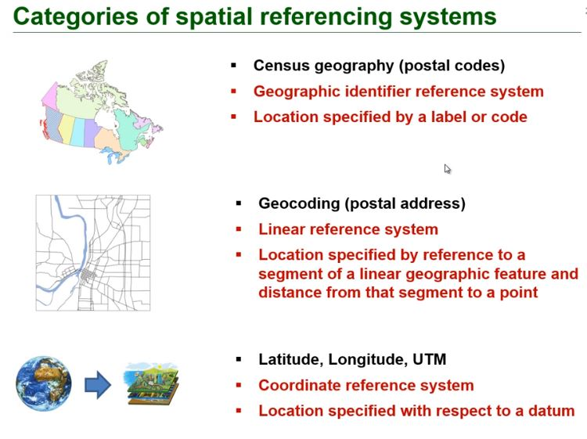

Geospatial data

Slide 5
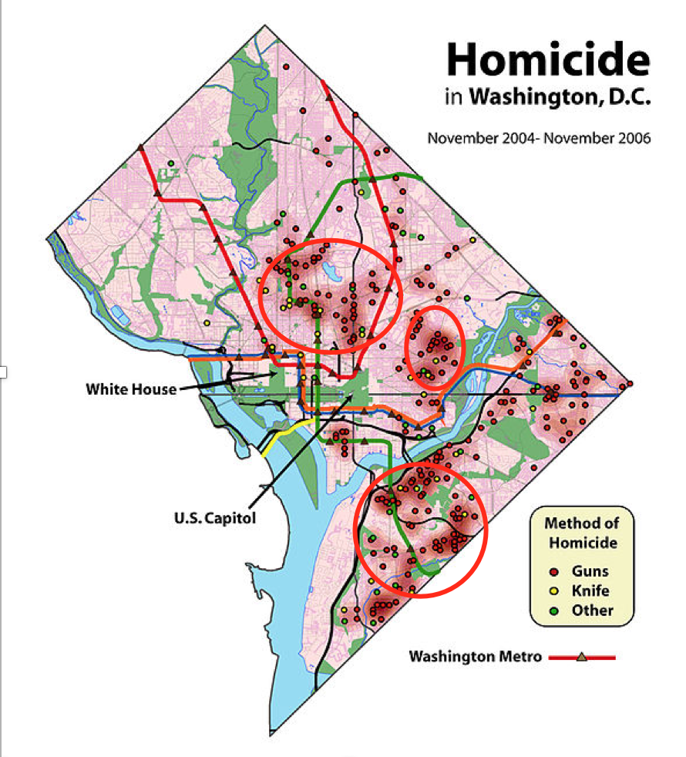

Non-spatial vs spatial tasks
Non-Spatial
Spatial
Where is the hot spots of homicide in Washington D.C?
Number of homicide in Washington D.C
100
How many of them involving guns?
60

Slide 6
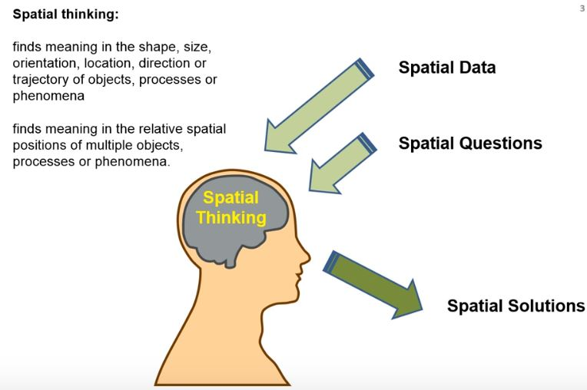
Spatial analysis

Slide 7
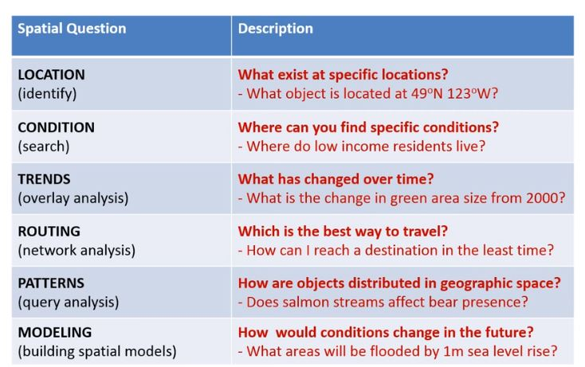
Geospatial questions

Slide 8
Spatial Queries vs Spatial Data Mining
Spatial Range Queries
Find all cities within 50 miles of Paris
Query has associated region (location, boundary)
Answer includes overlapping or contained data regions
Nearest-Neighbor Queries
Find the 10 cities nearest to Paris
Results must be ordered by proximity
Spatial Join Queries
Find all cities near a lake
Join condition involves regions and proximity.

Slide 9
Spatial Data Mining
Spatial Data Mining: the extraction of spatial patterns from both spatial and aspatial data, possibly stored in a spatial database
Spatial Pattern: a pattern showing the interaction of two or more spatial objects or space-depending attributes according to a particular spacing or set of arrangements
IF a large town intersects the motorway A14
THEN it is also close to the Adriatic sea (13%, 90%)

Slide 10
Families of Spatial Data Mining Patterns
Hot spot
Which locations are unusual or share commonalities?
Spatial Interactions
Co-location objects
Which subset of spatial phenomena interact?
Location Prediction:
Where will a phenomenon occur?

Slide 11
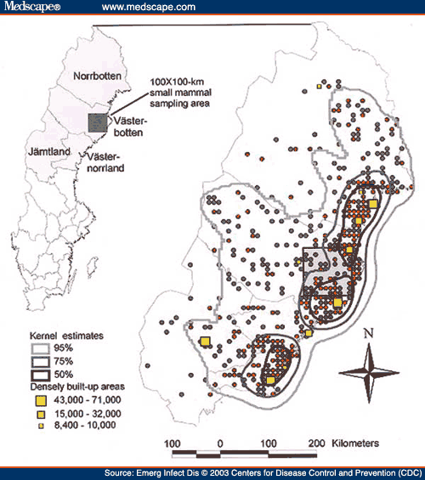

Hot spots
Is a phenomenon spatially clutered?
Which spatial entities are unusual or share common characteristics?
Examples
Crime hot spots to plan police patrols

Slide 12

Clustering vs hot spots detection

Slide 13
Spatial Interactions
Which spatial events are related to each other?
Which spatial phenomena depend on other phenomenon?
Examples
Earth science:
climate and disturbance => {wild fires, hot, dry, lightning}
Epidemiology:
Disease type and enviornmental events => {West Nile disease, stagnant water source, dead birds, mosquitoes}

Slide 14
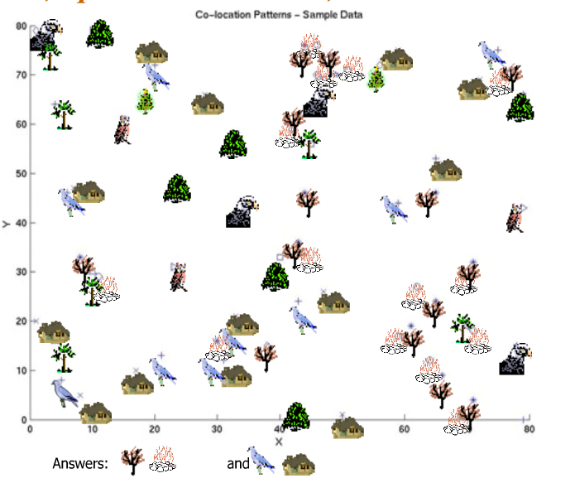
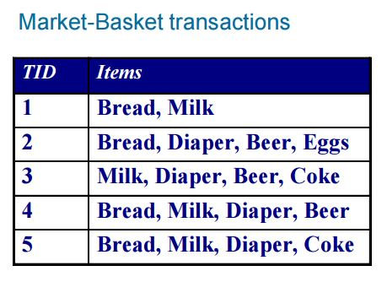
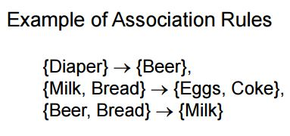
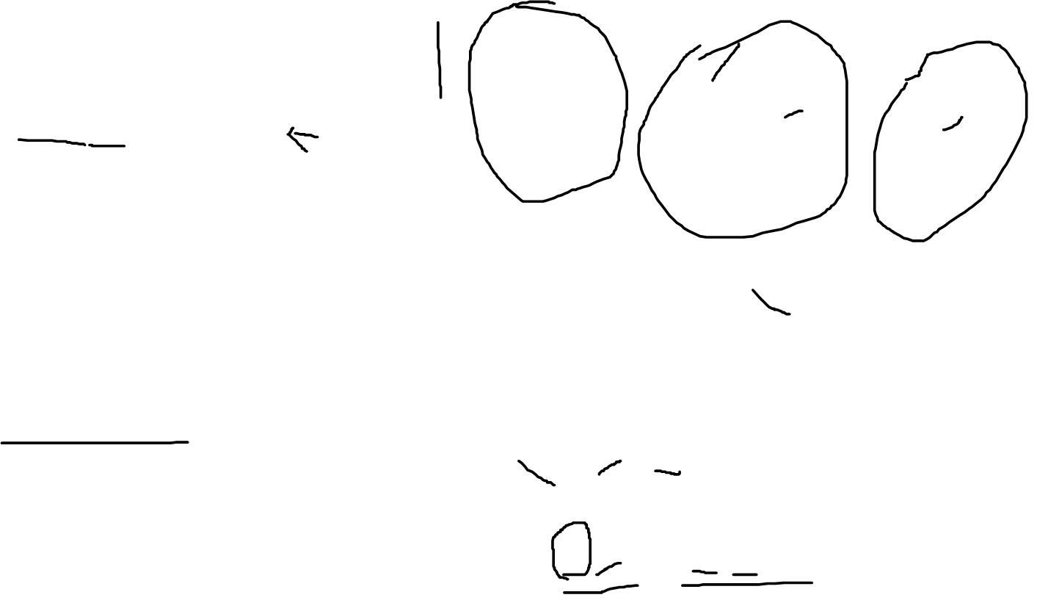
Association rules vs co-location

Slide 15
Location Prediction
Where will a phenomenon occur?
Which spatial events are predictable?
How can a spatial event be predicted from other spatial events?
Examples
Where will an endangered bird nest?
Which areas are prone to fire given maps of vegitation and drought?
What should be recommended to a traveler in a given location?

Slide 16
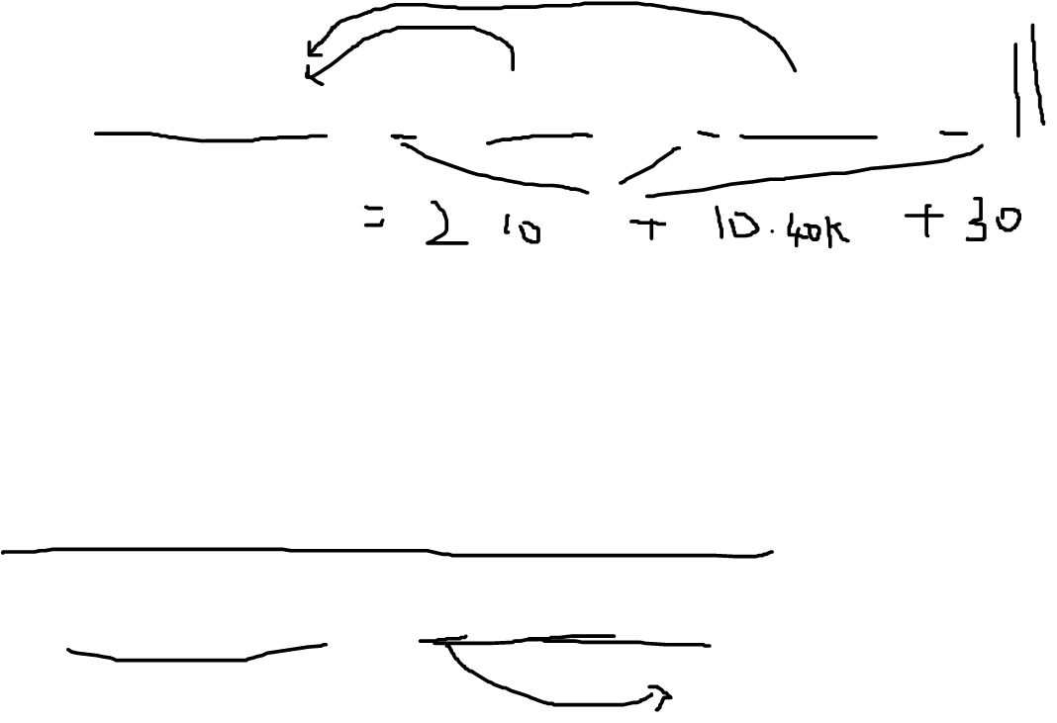
Regression vs location prediction
Regression
House price = a*#Schools + b*income + c
Where is the areas that the house price would crease in the next 5 years?
Spatial autoregressive model
House price = a*W*House price + b#Schools + c*income + d

Slide 17
Summary
Spatial data and spatial data mining
Challenges of applying traditional data mining methods to spatial data

Slide 18
Thank You.

