Slide 1
Data Mining:
Principles and Algorithms
— Chapter 10.1 —
— Mining Object, Spatial, and Multimedia Data—
©Jiawei Han
Department of Computer Science
University of Illinois at Urbana-Champaign
www.cs.uiuc.edu/~hanj
Data Mining: Principles and Algorithms

Slide 2

Data Mining: Principles and Algorithms

Slide 3
What Is a Spatial Database System?
Geometric, geographic or spatial data: space-related data
  Example: Geographic space (2-D abstraction of earth surface), VLSI design, model of human brain, 3-D space representing the arrangement of chains of protein molecule.
Spatial database system vs. image database systems.
  Image database system: handling digital raster image (e.g., satellite sensing, computer tomography), may also contain techniques for object analysis and extraction from images and some spatial database functionality.
  Spatial (geometric, geographic) database system: handling objects in space that have identity and well-defined extents, locations, and relationships.
Data Mining: Principles and Algorithms

Slide 4
GIS (Geographic Information System)
GIS (Geographic Information System)
  Analysis and visualization of geographic data
Common analysis functions of GIS
  Search (thematic search, search by region)
  Location analysis (buffer, corridor, overlay)
  Terrain analysis (slope/aspect, drainage network)
  Flow analysis (connectivity, shortest path)
  Distribution (nearest neighbor, proximity, change detection)
  Spatial analysis/statistics (pattern, centrality, similarity, topology)
  Measurements (distance, perimeter, shape, adjacency, direction)
Data Mining: Principles and Algorithms

Slide 5
Spatial DBMS (SDBMS)
SDBMS is a software system that
  supports spatial data models, spatial ADTs, and a query language supporting them
  supports spatial indexing, spatial operations efficiently, and query optimization
  can work with an underlying DBMS
Examples
  Oracle Spatial Data Catridge
  ESRI Spatial Data Engine
Data Mining: Principles and Algorithms

Slide 6
Modeling Spatial Objects
What needs to be represented?
Two important alternative views
  Single objects: distinct entities arranged in space each of which has its own geometric description
    modeling cities, forests, rivers
  Spatially related collection of objects: describe space itself (about every point in space)
    modeling land use, partition of a country into districts
Data Mining: Principles and Algorithms

Slide 7
Modeling Single Objects: Point, Line and Region
Point: location only but not extent
Line (or a curve usually represented by a polyline, a sequence of line segment):
  moving through space, or connections in space (roads, rivers, cables, etc.)
Region:
  Something having extent in 2D-space (country, lake, park). It may have a hole or consist of several disjoint pieces.
Data Mining: Principles and Algorithms

Slide 8
Modeling Spatially Related Collection of Objects
Modeling spatially related collection of objects: plane partitions and networks.
  A partition: a set of region objects that are required to be disjoint (e.g., a thematic map). There exist often pairs of objects with a common boundary (adjacency relationship).
  A network: a graph embedded into the plane, consisting of a set of point objects, forming its nodes, and a set of line objects describing the geometry of the edges, e.g., highways. rivers, power supply lines.
  Other interested spatially related collection of objects: nested partitions, or a digital terrain (elevation) model.
Data Mining: Principles and Algorithms

Slide 9
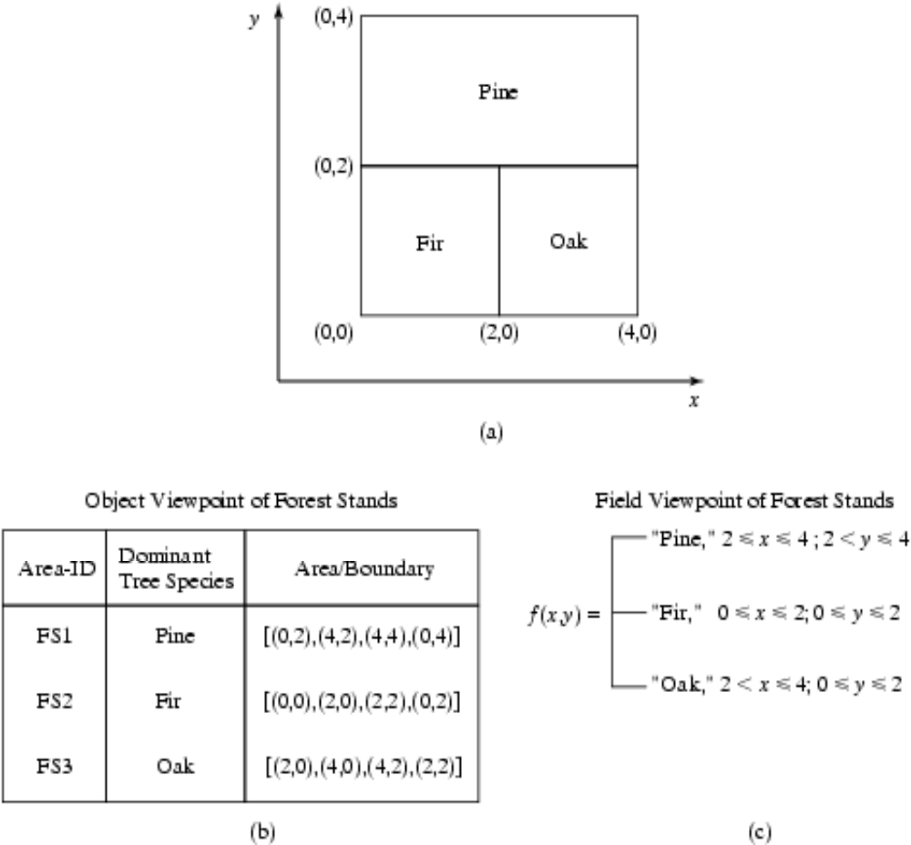
Spatial Data Types and Models
Field-based model: raster data
  framework: partitioning of space
Object-based model: vector model
  point, line, polygon, Objects, Attributes
Data Mining: Principles and Algorithms

Slide 10
Spatial Query Language
Spatial query language
  Spatial data types, e.g. point, line segment, polygon, …
  Spatial operations, e.g. overlap, distance, nearest neighbor, …
  Callable from a query language (e.g. SQL3) of underlying DBMS
    SELECT S.name
    FROM Senator S
    WHERE S.district.Area() > 300
Standards
  SQL3 (a.k.a. SQL 1999) is a standard for query languages
  OGIS is a standard for spatial data types and operators
  Both standards enjoy wide support in industry
Data Mining: Principles and Algorithms

Slide 11
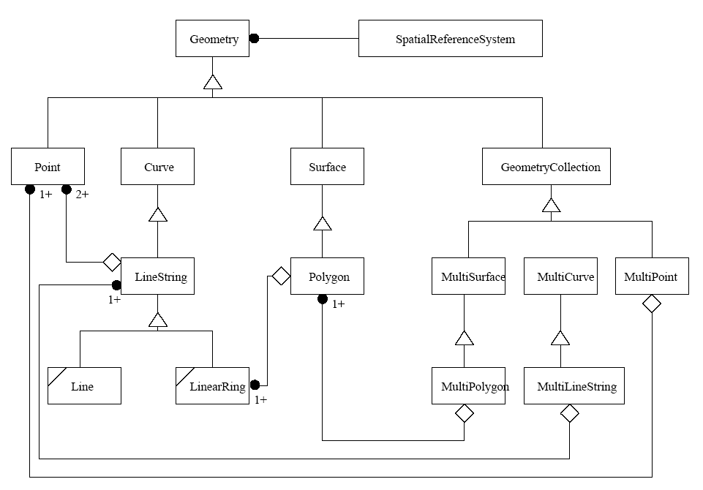
Spatial Data Types by OGIS
Data Mining: Principles and Algorithms

Slide 12
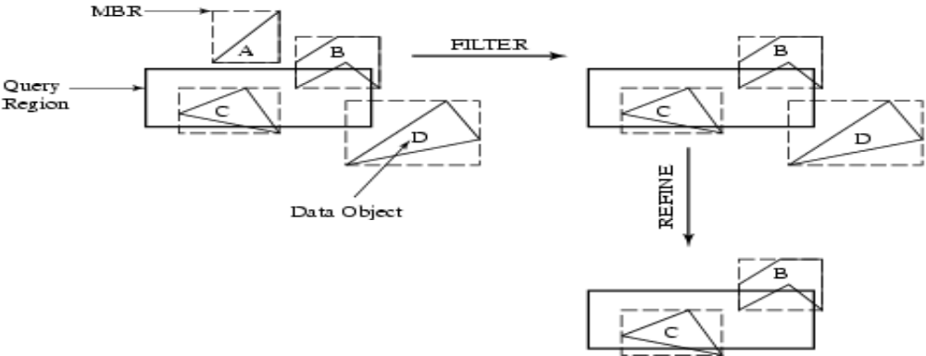
Query Processing
Efficient algorithms to answer spatial queries
Common Strategy: filter and refine
  Filter: Query Region overlaps with MBRs (minimum bounding rectangles) of B, C, D
  Refine: Query Region overlaps with B, C
Data Mining: Principles and Algorithms

Slide 13
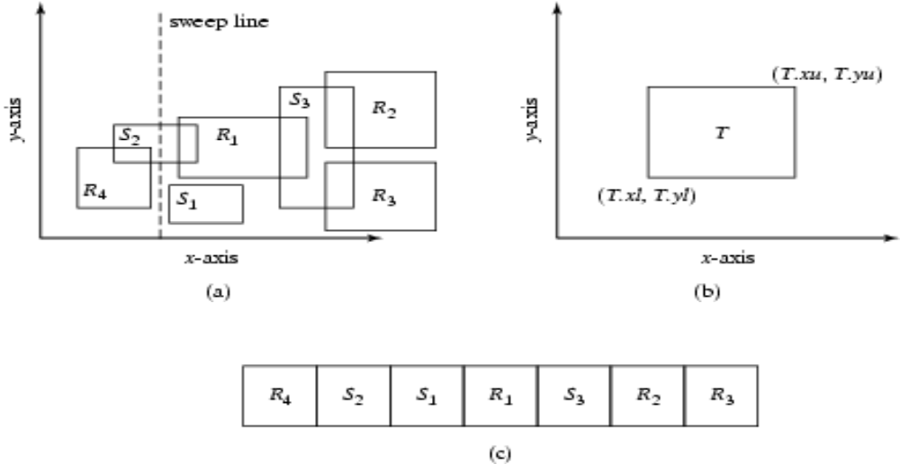
Join Query Processing
Determining Intersection Rectangle
Plane Sweep Algorithm
  Place sweep filter identifies 5 intersections for refinement step
Data Mining: Principles and Algorithms

Slide 14
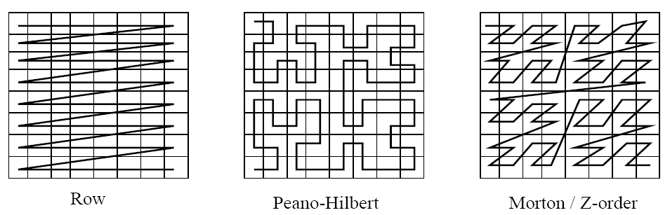
File Organization and Indices
SDBMS: Dataset is in the secondary storage, e.g. disk
Space Filling Curves: An ordering on the locations in a multi-dimensional space
  Linearize a multi-dimensional space
  Helps search efficiently
Data Mining: Principles and Algorithms

Slide 15
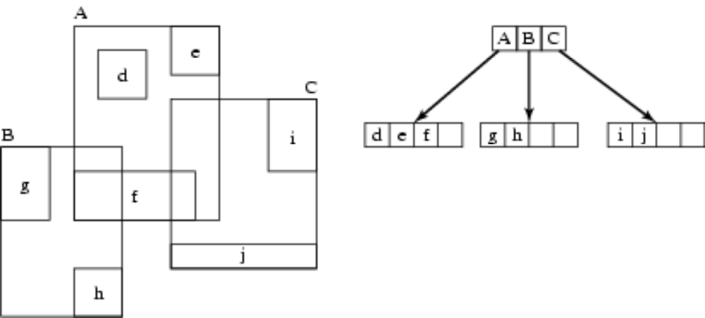
File Organization and Indices
Spatial Indexing
  B-tree works on spatial data with space filling curve
  R-tree: Heighted balanced extention of B+ tree
    Objects are represented as MBR
    provides better performance
Data Mining: Principles and Algorithms

Slide 16
Spatial Query Optimization
A spatial operation can be processed using different strategies
Computation cost of each strategy depends on many parameters
Query optimization is the process of
  ordering operations in a query and
  selecting efficient strategy for each operation
  based on the details of a given dataset
Data Mining: Principles and Algorithms

Slide 17
Spatial Data Warehousing
Spatial data warehouse: Integrated, subject-oriented, time-variant, and nonvolatile spatial data repository
Spatial data integration: a big issue
  Structure-specific formats (raster- vs. vector-based, OO vs. relational models, different storage and indexing, etc.)
  Vendor-specific formats (ESRI, MapInfo, Integraph, IDRISI, etc.)
  Geo-specific formats (geographic vs. equal area projection, etc.)
Spatial data cube: multidimensional spatial database
  Both dimensions and measures may contain spatial components
Data Mining: Principles and Algorithms

Slide 18
Dimensions and Measures in Spatial Data Warehouse
Dimensions
  non-spatial
    e.g. “25-30 degrees” generalizes to“hot” (both are strings)
  spatial-to-nonspatial
    e.g. Seattle generalizes to description “Pacific Northwest” (as a string)
  spatial-to-spatial
    e.g. Seattle generalizes to Pacific Northwest (as a spatial region)
Measures
  numerical (e.g. monthly revenue of a region)
    distributive (e.g. count, sum)
    algebraic (e.g. average)
    holistic (e.g. median, rank)
  spatial
    collection of spatial pointers (e.g. pointers to all regions with temperature of 25-30 degrees in July)
Data Mining: Principles and Algorithms

Slide 19
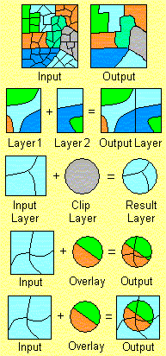
Spatial-to-Spatial Generalization
Generalize detailed geographic points into clustered regions, such as businesses, residential, industrial, or agricultural areas, according to land usage
Requires the merging of a set of geographic areas by spatial operations
Dissolve
Merge
Clip
Intersect
Union
Data Mining: Principles and Algorithms

Slide 20
Example: British Columbia Weather Pattern Analysis
Input
  A map with about 3,000 weather probes scattered in B.C.
  Daily data for temperature, precipitation, wind velocity, etc.
  Data warehouse using star schema
Output
  A map that reveals patterns: merged (similar) regions
Goals
  Interactive analysis (drill-down, slice, dice, pivot, roll-up)
  Fast response time
  Minimizing storage space used
Challenge
  A merged region may contain hundreds of “primitive” regions (polygons)
Data Mining: Principles and Algorithms

Slide 21
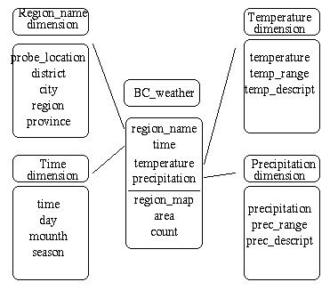
Star Schema of the BC Weather Warehouse
Spatial data warehouse
  Dimensions
    region_name
    time
    temperature
    precipitation
  Measurements
    region_map
    area
    count
Dimension table
Fact table
Data Mining: Principles and Algorithms

Slide 22
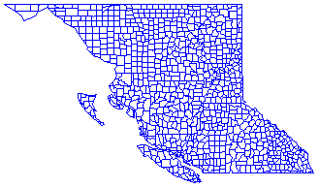
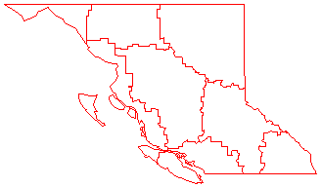
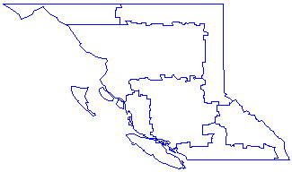
Dynamic Merging of Spatial Objects
Materializing (precomputing) all?—too much storage space
On-line merge?—slow, expensive
Precompute rough approximations?—accuracy trade off
A better way: object-based, selective (partial) materialization
Data Mining: Principles and Algorithms

Slide 23
Methods for Computing Spatial Data Cubes
On-line aggregation: collect and store pointers to spatial objects in a spatial data cube
  expensive and slow, need efficient aggregation techniques
Precompute and store all the possible combinations
  huge space overhead
Precompute and store rough approximations in a spatial data cube
  accuracy trade-off
Selective computation: only materialize those which will be accessed frequently
  a reasonable choice
Data Mining: Principles and Algorithms

Slide 24
Spatial Association Analysis
Spatial association rule: A ⇒ B [s%, c%]
  A and B are sets of spatial or non-spatial predicates
    Topological relations: intersects, overlaps, disjoint, etc.
    Spatial orientations: left_of, west_of, under, etc.
    Distance information: close_to, within_distance, etc.
  s% is the support and c% is the confidence of the rule
Examples
1) is_a(x, large_town) ^ intersect(x, highway) → adjacent_to(x, water)
[7%, 85%]
2) What kinds of objects are typically located close to golf courses?
Data Mining: Principles and Algorithms

Slide 25
Progressive Refinement Mining of Spatial Association Rules
Hierarchy of spatial relationship:
  g_close_to: near_by, touch, intersect, contain, etc.
  First search for rough relationship and then refine it
Two-step mining of spatial association:
  Step 1: Rough spatial computation (as a filter)
    Using MBR or R-tree for rough estimation
  Step2: Detailed spatial algorithm (as refinement)
    Apply only to those objects which have passed the rough spatial association test (no less than min_support)
Data Mining: Principles and Algorithms

Slide 26
Mining Spatial Co-location Rules
Co-location rule is similar to association rule but explore more relying spatial auto-correlation
It leads to efficient processing
It can be integrated with progressive refinement to further improve its performance
Spatial co-location mining idea can be applied to clustering, classification, outlier analysis and other potential mining tasks
Data Mining: Principles and Algorithms

Slide 27
Spatial Autocorrelation
Spatial data tends to be highly self-correlated
  Example: Neighborhood, Temperature
  Items in a traditional data are independent of each other, whereas properties of locations in a map are often “auto-correlated”.
First law of geography:
“Everything is related to everything, but nearby things are more related than distant things.”
Data Mining: Principles and Algorithms

Slide 28
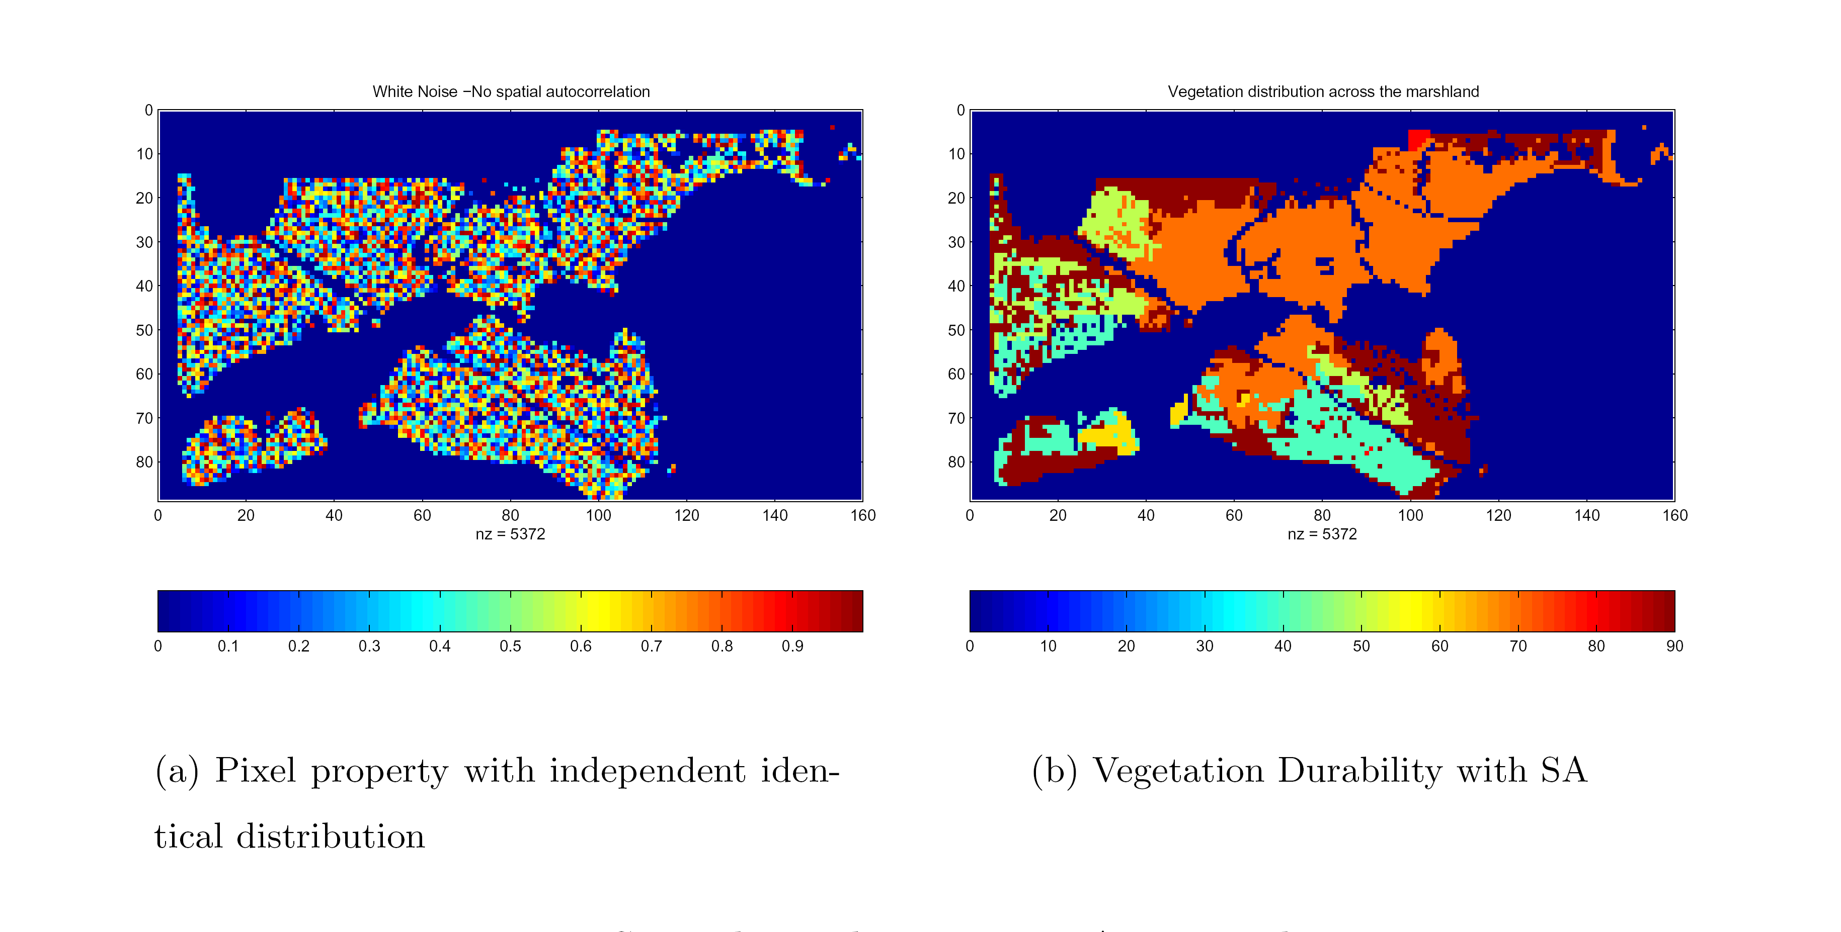
Spatial Autocorrelation (cont’d)
Data Mining: Principles and Algorithms

Slide 29
Spatial Classification
Methods in classification
  Decision-tree classification, Naïve-Bayesian classifier + boosting, neural network, logistic regression, etc.
  Association-based multi-dimensional classification - Example: classifying house value based on proximity to lakes, highways, mountains, etc.
Assuming learning samples are independent of each other
  Spatial auto-correlation violates this assumption!
Popular spatial classification methods
  Spatial auto-regression (SAR)
  Markov random field (MRF)
Data Mining: Principles and Algorithms

Slide 30
Spatial Auto-Regression
Linear Regression
  Y=Xβ + ε
Spatial autoregressive regression (SAR)
  Y = ρWY + Xβ + ε
  W: neighborhood matrix.
  ρ models strength of spatial dependencies
  ε error vector
The estimates of ρ and β can be derived using maximum likelihood theory or Bayesian statistics
Data Mining: Principles and Algorithms

Slide 31
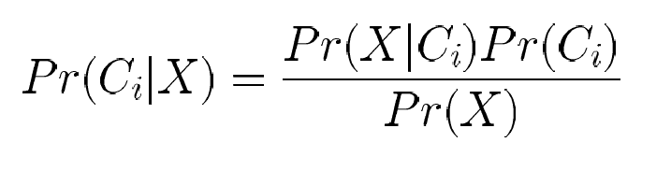
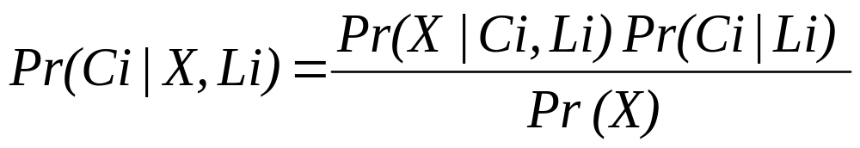
Markov Random Field Based Bayesian Classifiers
Bayesian classifiers
MRF
  A set of random variables whose interdependency relationship is represented by an undirected graph (i.e., a symmetric neighborhood matrix) is called a Markov Random Field.
  L_{i} denotes set of labels in the neighborhood of s_{i} excluding labels at s_{i}
  Pr(C_{i} | L_{i}) can be estimated from training data by examine the ratios of the frequencies of class labels to the total number of locations
  Pr(X|C_{i}, L_{i}) can be estimated using kernel functions from the observed values in the training dataset
Data Mining: Principles and Algorithms

Slide 32
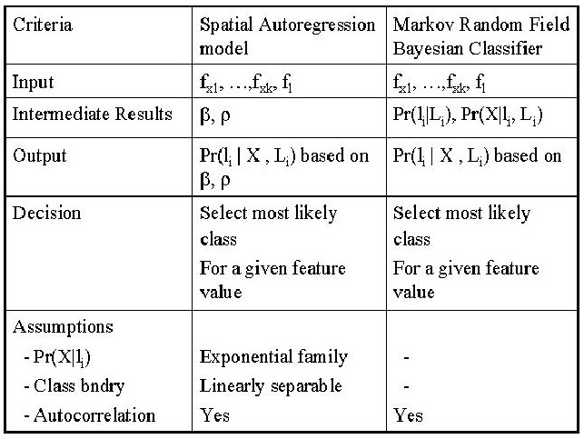



SAR v.s. MRF
Data Mining: Principles and Algorithms

Slide 33
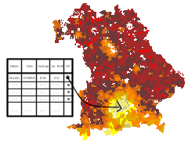
Spatial Trend Analysis
Function
  Detect changes and trends along a spatial dimension
  Study the trend of non-spatial or spatial data changing with space
Application examples
  Observe the trend of changes of the climate or vegetation with increasing distance from an ocean
  Crime rate or unemployment rate change with regard to city geo-distribution
Data Mining: Principles and Algorithms

Slide 34
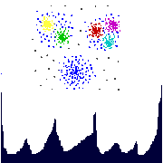
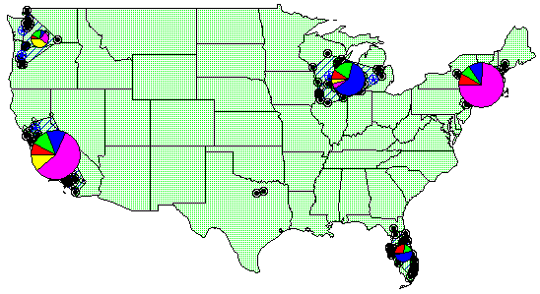
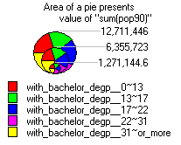
Spatial Cluster Analysis
Mining clusters—k-means, k-medoids, hierarchical, density-based, etc.
Analysis of distinct features of the clusters
Data Mining: Principles and Algorithms

Slide 35
Constraints-Based Clustering
Constraints on individual objects
  Simple selection of relevant objects before clustering
Clustering parameters as constraints
  K-means, density-based: radius, min-# of points
Constraints specified on clusters using SQL aggregates
  Sum of the profits in each cluster > $1 million
Constraints imposed by physical obstacles
  Clustering with obstructed distance
Data Mining: Principles and Algorithms

Slide 36
Constrained Clustering: Planning ATM Locations
C3
C2
Bridge
C1
River
Mountain
C4
Spatial data with obstacles
Clustering without taking
obstacles into consideration
Data Mining: Principles and Algorithms

Slide 37
Spatial Outlier Detection
Outlier
  Global outliers: Observations which is inconsistent with the rest of the data
  Spatial outliers: A local instability of non-spatial attributes
Spatial outlier detection
  Graphical tests
    Variogram clouds
    Moran scatterplots
  Quantitative tests
    Scatterplots
    Spatial Statistic Z(S(x))
  Quantitative tests are more accurate than Graphical tests
Data Mining: Principles and Algorithms

Slide 38
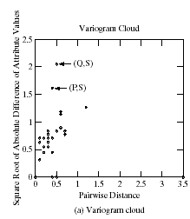
Spatial Outlier Detection─Variogram Clouds
Graphical method
  For each pair of locations, the square-root of the absolute difference between attribute values at the locations versus the Euclidean distance between the locations are plotted
  Nearby locations with large attribute difference indicate a spatial outlier
Quantitative method
  Compute spatial statistic Z(S(x))
Data Mining: Principles and Algorithms

Slide 39
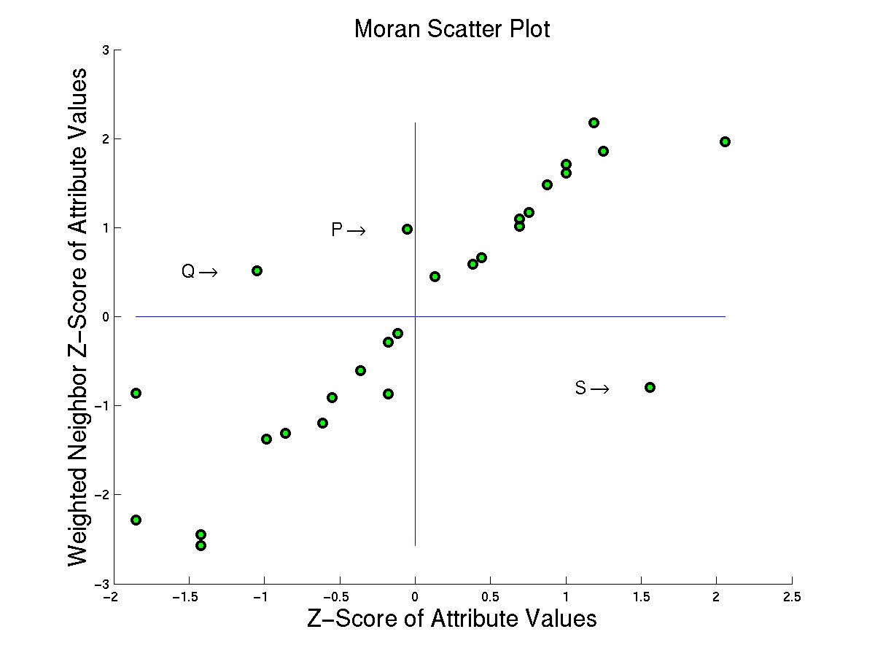
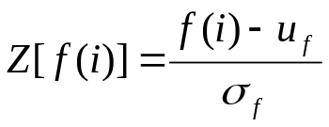
Spatial Outlier Detection—Moran Scatterplots
Graphical tests
  A plot of normalized attribute value Z against the neighborhood average of normalized attribute values (W•Z)
  The upper left and lower right quadrants indicate a spatial outlier
Computation method
  Fit a linear regression line
  Select points (e.g. P, Q, S) which are from the regression line greater than specified residual error θ
Data Mining: Principles and Algorithms

Slide 40
Mining Spatiotemporal Data
Spatiotemporal data
  Data has spatial extensions and changes with time
  Ex: Forest fire, moving objects, hurricane & earthquakes
Automatic anomaly detection in massive moving objects
  Moving objects are ubiquitous: GPS, radar, etc.
  Ex: Maritime vessel surveillance
  Problem: Automatic anomaly detection
Data Mining: Principles and Algorithms

Slide 41

Data Mining: Principles and Algorithms

