Slide 1
Deep Learning in Text Mining
Word to Vec
https://www.youtube.com/watch?v=5PL0TmQhItY

Slide 2
INDUSTRY CAREER
Know who’s who in the zoo and who can send you to the zoo
Good profile, i.e. experience (GPA, examples of codes and projects)
Presentation (speaking and writing)

Slide 3
RESEARCH CAREER
Know the requirements
Reading (summarising)
Writing
Presenting
Coding

Slide 4
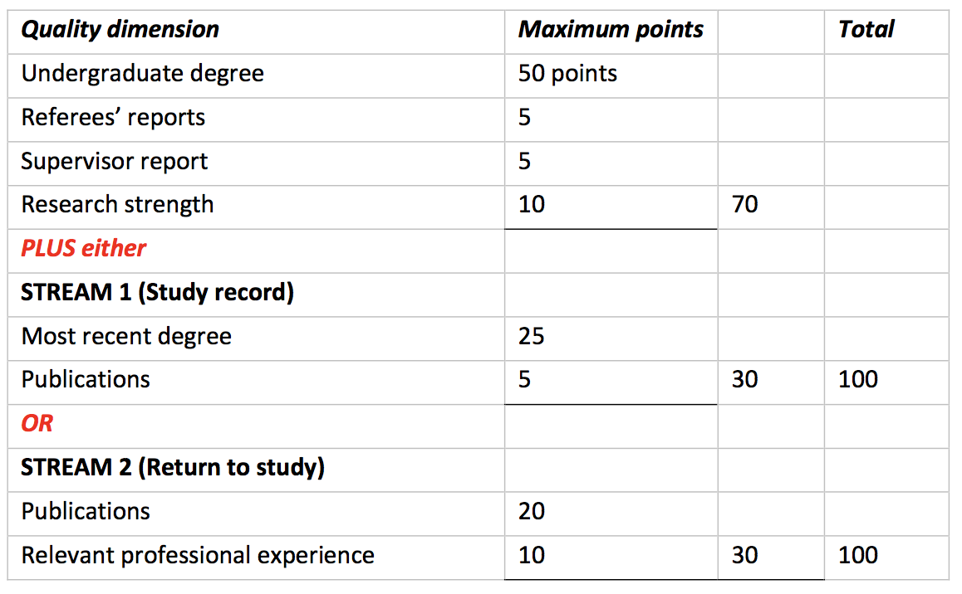
PhD Admission and Scholarships

