Slide 1
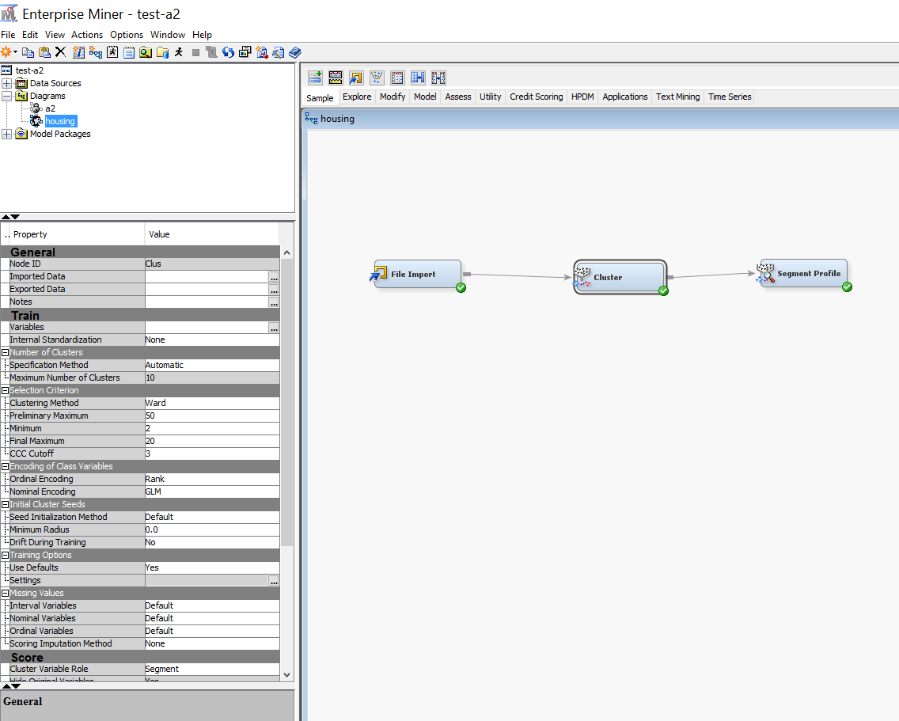
Click on the dots in the Exported Data row

Slide 2
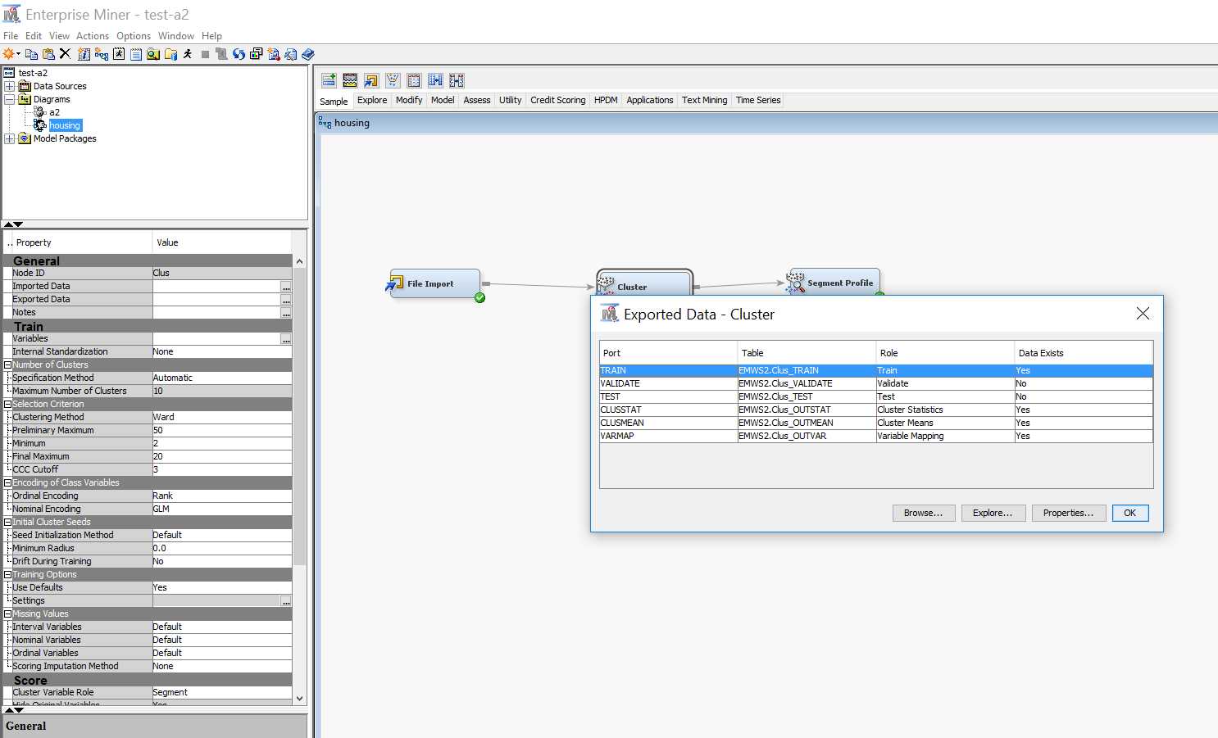
The Exported Data-Cluster window will show.
Click on Browse button at the left bottom of the window

Slide 3
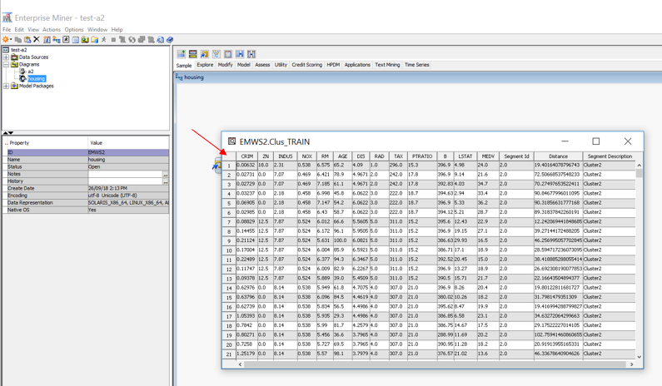
The data table will show, which contains the cluster number of each instance
Click on the empty cell at the top left corner of the table, as the red arrow points to. This will highlight the whole table
Then you can use either of the following two approaches to get the samples with cluster number (making sure that the whole table is highlighted):
Press Ctrl+C to copy the whole table, Open a blank Excel sheet, use Ctrl+V to paste the table into the spreadsheet (note that there will be no variable names copied and pasted. If you need variable names, you will need to insert a row and type the names in by yourself); or
Right click your mouse and select export to Excel, then a spreadsheet with the data will be opened automatically (with variable names included in the first row).
Save the spreadsheet.

