Slide 1
Bayesian networks
Thuc Le
Advanced Analytic Techniques 2
University of South Australia
(The slides are based on Neapolitan’s books)

Slide 2
Outline
Bayesian networks learning
Search and Score based methods
Constraint based methods & PC algorithm
Summary

Slide 3
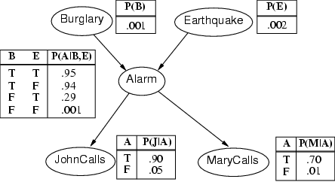
Bayesian networks
P(B|J)=?
B
E
B | E | A | J | M
1 | 0 | 1 | 1 | 1
1 | 1 | 1 | 1 | 0
0 | 1 |  | 1 | 0
… | … | … | … | …
?
A
J
M

Slide 4
Learning Bayesian network structure
‘Search and score’ approach
Search for all possible DAGs
Score each DAG with a scoring function
The DAG with the highest score (best fit the data)
NP-hard problem
Constraint based approach
Use statistical tests to evaluate the dependency between variables
Exponential to the number of nodes

Slide 5
Search and Score approach
B | E | A | J | M
1 | 0 | 1 | 1 | 1
1 | 1 | 1 | 1 | 0
0 | 1 |  | 1 | 0
… | … | … | … | …
Search
B
E
B
E
B
E
B
E
…
…
A
A
A
A
J
M
J
M
J
M
J
M
Score1 = 2.5
Score2 = 1.5
Score1 = 6.5
Score1 = 0.5

Slide 6
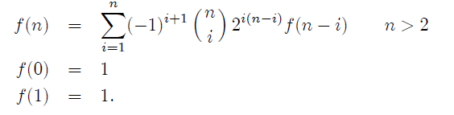
How Many DAGs Must We Score?

Slide 7
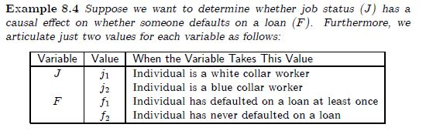
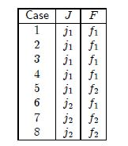


Search and Score approach
Search step:

Slide 8
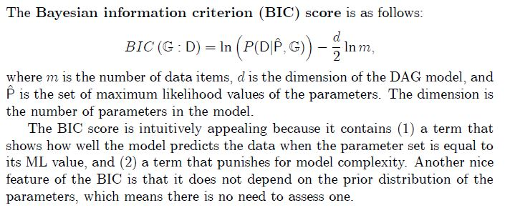
Search and Score approach
Score step:

Slide 9

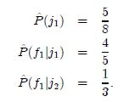
Search and Score approach
P(J=j₁)
J | P(F|J)
j₁
j₂

Slide 10
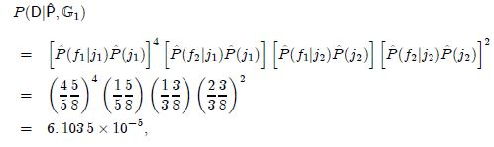
Search and Score approach
P(J,F)=P(F|J)P(J)

Slide 11

Search and Score approach

Slide 12

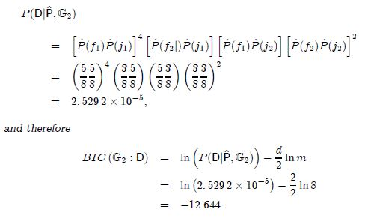
Search and Score approach

Slide 13
Search and Score approach
Search step:
Score step:
-12.823
-12.644

Slide 14
Learning Bayesian network structure
‘Search and score’ approach
Search for all possible DAGs
Score each DAG with a scoring function
The DAG with the highest score (best fit the data)
NP-hard problem
Constraint based approach
Use statistical tests to evaluate the dependency between variables
Exponential to the number of nodes

Slide 15
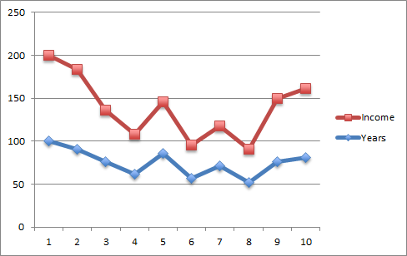
Correlation
Participant | Years of education | Income ($1000)
1 | 21 | 75
2 | 19 | 70
3 | 16 | 45
4 | 13 | 35
5 | 18 | 45
6 | 12 | 29
7 | 15 | 35
8 | 11 | 29
9 | 16 | 55
10 | 17 | 60
Pearson correlation coefficent =0.91
People with more years of education tend to have higher incomes.
People with fewer years of education tend to have lower income.

Slide 16
Correlation graph
A | B | C | D
1 | 1 | 1 | 1
2 | 2 | 3 | 1
3 | 1 | 2 | 2
3 | 1 | 1 | 1
2 | 1 | 2 | 2
1 | 2 | 2 | 1
… | … | … | …
1 | 2 | 1 | 1
2 | 1 | 2 | 1
3 | 1 | 2 | 1
A
B
C
D
Identify correlations between every pair of variables in
the dataset.
An edge bw 2 nodes represents the correlated pair

Slide 17
Correlation graph
A
A
B
C
B
C
True graph
correlation graph
Test whether B and C are correlated just because of common cause A, we use conditional independence test: I(B, C|A)
e.g. Partial correlation, Chi-square

Slide 18
Conditional independence tests
A
A
B
C
B
C
D
D
True graph
correlation graph
I(B, C|A)? – no (dependence)
C_{p}² x 2^{p-2} tests
I(B, C|D)? – no (dependence)
I(B, C|A,D)? – yes (independence)

Slide 19
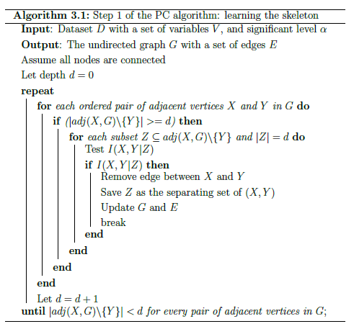
PC (Peter & Clark) algorithm - skeleton

Slide 20
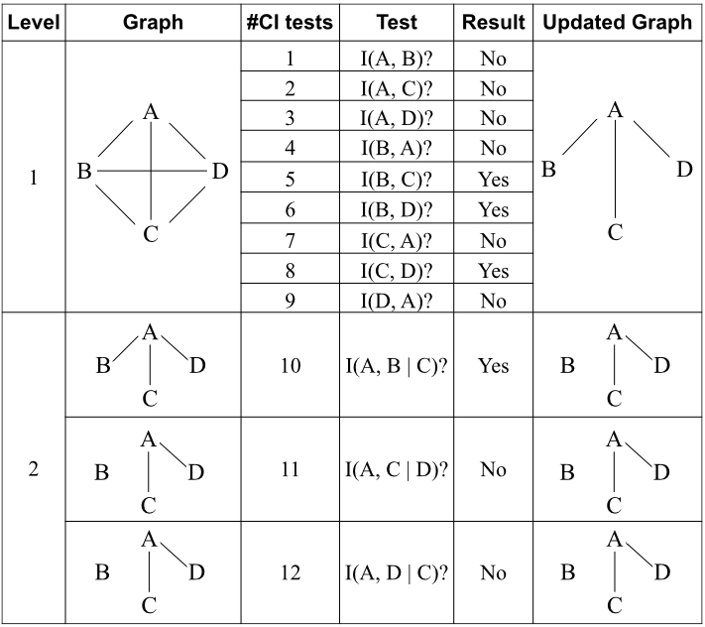
PC algorithm (Peter and Clark, 2000)
Order tests by levels
Update the graph after each test
Only condition on the neighbours of the testing nodes

Slide 21
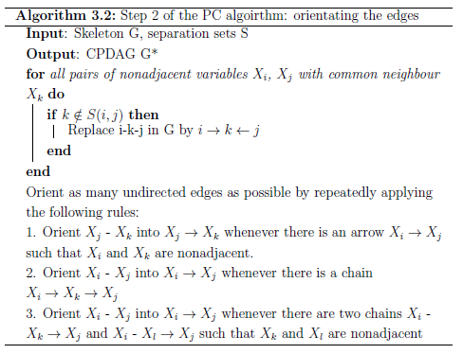
PC algorithm – orientating the edges
Notes:
Completed directed acyclic graph.

Slide 22
PC algorithm (Peter and Clark, 2000)
Order tests by levels
Update the graph after each test
Only condition on the neighbours of the testing nodes

Slide 23
Summary
Learning Bayesian networks from data
Search and score approach
Constraint based approach
Next week: causal inference and local structure learning

Slide 24
Thank You.

