Slide 1
Data Stream
Thuc Le
Advanced Analytic Techniques 2
University of South Australia

Slide 2
Outline
Stream data: definition and applications
Issues of mining data stream
Processing data stream: Summarising techniques

Slide 3
What is a data stream ?
Golab & Oszu (2003): “A data stream is a real-time, continuous, ordered (implicitly by arrival time or explicitly by timestamp) sequence of items. It is impossible to control the order in which items arrive, nor is it feasible to locally store a stream in its entirety.”
Massive volumes of data, records arrive at a high rate
Timestamp | E. usage (kW) | U 1 (V) | I 1 (A)
… | … | … | …
16/12/2006-17:26 | 5,374 | 233,29 | 23
16/12/2006-17:27 | 5,388 | 233,74 | 23
16/12/2006-17:28 | 3,666 | 235,68 | 15,8
16/12/2006-17:29 | 3,52 | 235,02 | 15
… | … | … | …

Slide 4
What is a data stream ?
Golab & Oszu (2003): “A data stream is a real-time, continuous, ordered (implicitly by arrival time or explicitly by timestamp) sequence of items. It is impossible to control the order in which items arrive, nor is it feasible to locally store a stream in its entirety.”
Massive volumes of data, records arrive at a high rate
Timestamp | Source | Destination | Duration | Bytes | Protocol
… | … | … | … | … | …
12342 | 10.1.0.2 | 16.2.3.7 | 12 | 20K | http
12343 | 18.6.7.1 | 12.4.0.3 | 16 | 24K | http
12344 | 12.4.3.8 | 14.8.7.4 | 26 | 58K | http
12345 | 19.7.1.2 | 16.5.5.8 | 18 | 80K | ftp
… | … | … | … | … | …

Slide 5
Applications of data stream processing
Data stream processing
Process queries (compute statistics, activate alarms)
Apply data mining algorithms
Real-time processing
One-pass processing
Bounded storage (no complete storage of streams)
Possibly consider several streams

Slide 6
Applications of data stream processing
Network management (Queries)
Information about IP sessions going through a router
Huge amounts of data (300 Go/day, 75000 records/second when sampling 1/100)
Typical queries:
100 most frequent (@S, @D) on router R1 …
How many different (@S, @D) seen on R1 but not R2 …
… during last month, last week, last day, last hour ?
Source | Destination | Duration | Bytes | Protocol
… | … | … | … | …
10.1.0.2 | 16.2.3.7 | 12 | 20K | http
18.6.7.1 | 12.4.0.3 | 16 | 24K | http
12.4.3.8 | 14.8.7.4 | 26 | 58K | http
19.7.1.2 | 16.5.5.8 | 18 | 80K | ftp
… | … | … | … | …

Slide 7
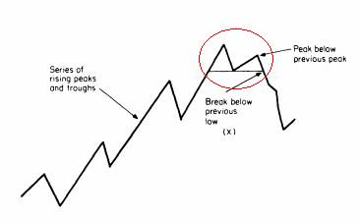
Applications of data stream processing
Stock monitoring (data analysis)
Stream of price and sales volume of stocks over time
Technical analysis/charting for stock investors
Support trading decisions
Notify me when the price of IBM is above $83, and the first MSFT price afterwards is below $27.
Notify me when some stock goes up by at least 5% from one transaction to the next.
Notify me when the price of any stock increases monotonically for ≥30 min.
Notify me whenever there is double top formation in the price chart of any stock
Notify me when the difference between the current price of a stock and its 10 day moving average is greater than some threshold value
Source: Gehrke 07 and Cayuga application scenarios (Cornell University)

Slide 8
Challenges of data stream processing
Computation of daily electric power consumption by customer market segment from customer meter data
Join between several streams
Join between stream data and customer database
Solution: incremental computation and definition of temporal windows for joins
100 most frequent @S IP adresses on a router
Maintain a table of IP addresses with frequencies ?
Sampling the stream ?
Face high (and varying) rate of arrivals
Exact versus approximate answers

Slide 9

Processing data streams
Windowing
Applying queries/mining tasks to the whole stream (from beginning to current time)
Applying queries/mining to a portion of the stream
Window on the stream
t
Beginning of the stream
Current date

Slide 10
Windowing
Definition of windows of interest on streams
Fixed windows: September 2007
Sliding windows: last 3 hours
Landmark windows: from September 1st, 2007
Window specification
Physical time: last 3 hours
Logical time: last 1000 items
Refreshing rate
Rate of producing results (every item, every 10 items, every minute, …)

Slide 11
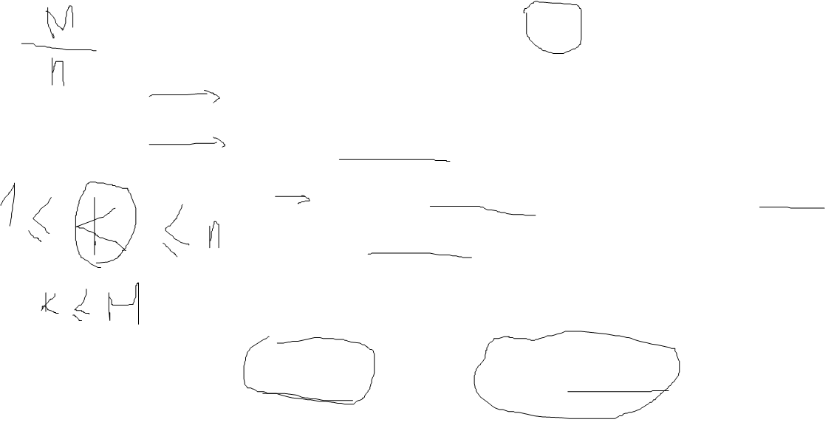
Reservoir sampling
Problem: maintaining a random sample from a stream
‘Reservoir’ sampling (Vitter 85)
Random sample of size M
Fill the reservoir with the first M elements of the stream
For element n (n > M)
Select element n with probability M/n
If element n is selected pick up randomly an element in the reservoir and replace it by element n
Random sampling from a sliding window: ‘Chain’ sampling (Babcock et al. 2002)

Slide 12
Summary
Data Stream
Applications and Challenges
Summarising/synopses

Slide 13
Thank You.
The slides are modified from: Georges Hebrail, Data Stream Management and Mining, 2007, NATO Advanced Study Institute on Mining Massive Data Sets for Security

