Slide 1
Data Stream
Thuc Le
Advanced Analytic Techniques 2
University of South Australia

Slide 2
Outline
Classification with data streams
Clustering with data streams

Slide 3
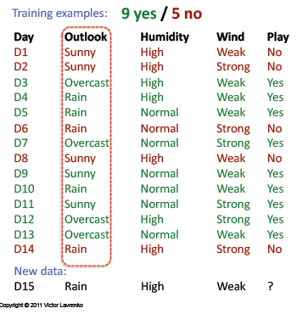
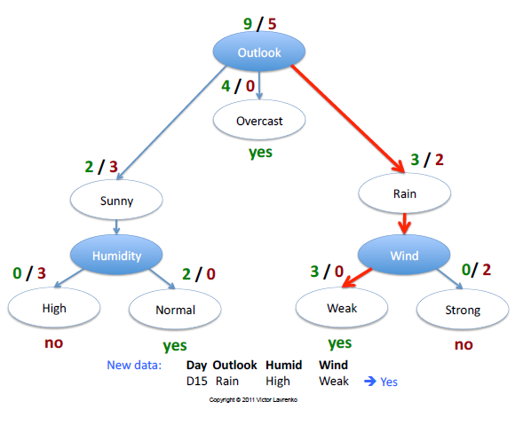
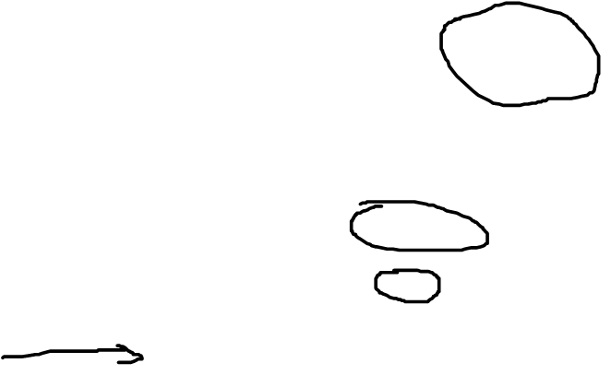
Decision tree

Slide 4
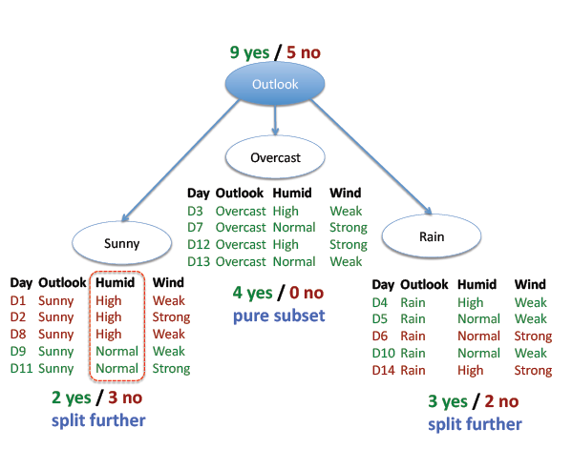
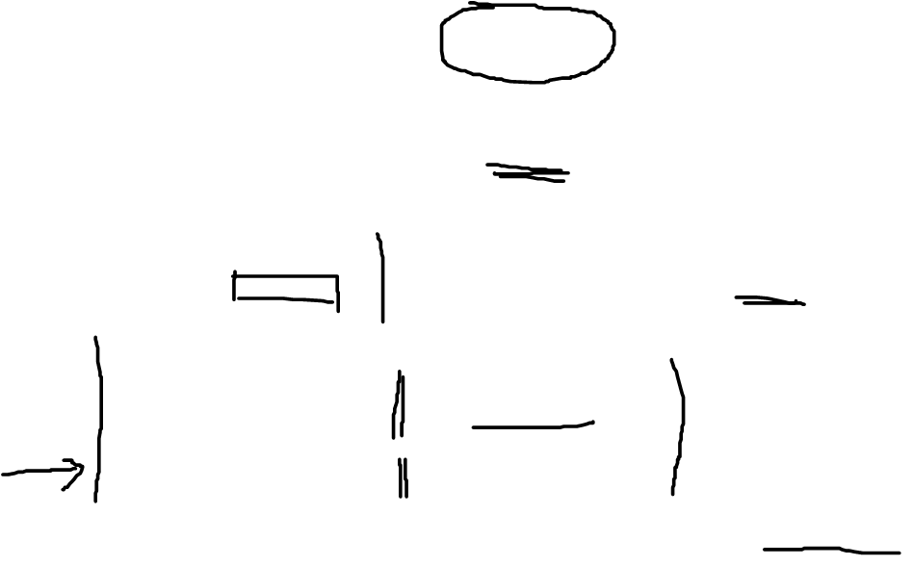
Decision tree

Slide 5
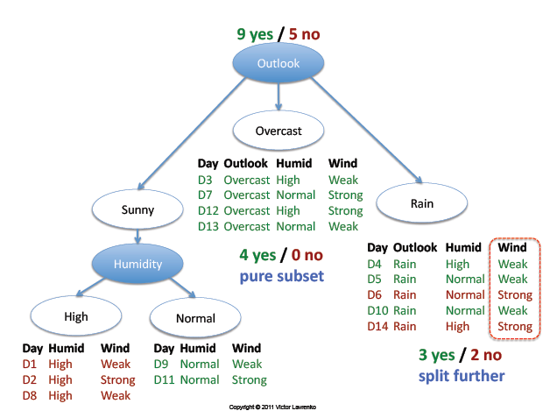
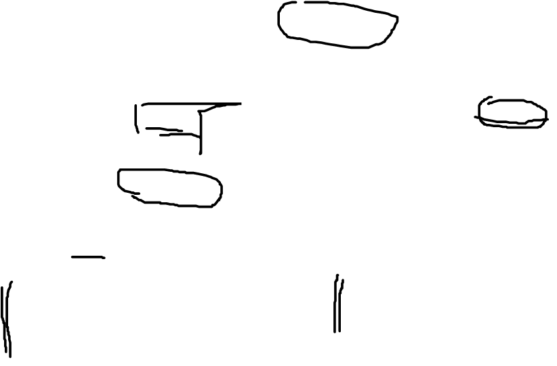
Decision tree

Slide 6
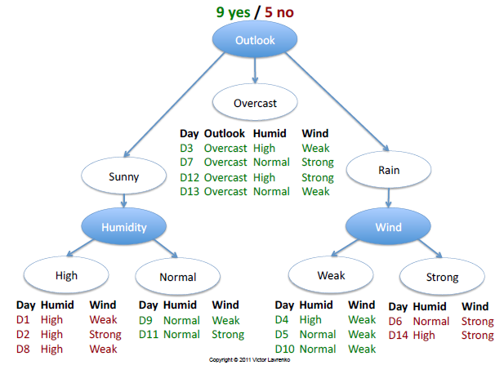
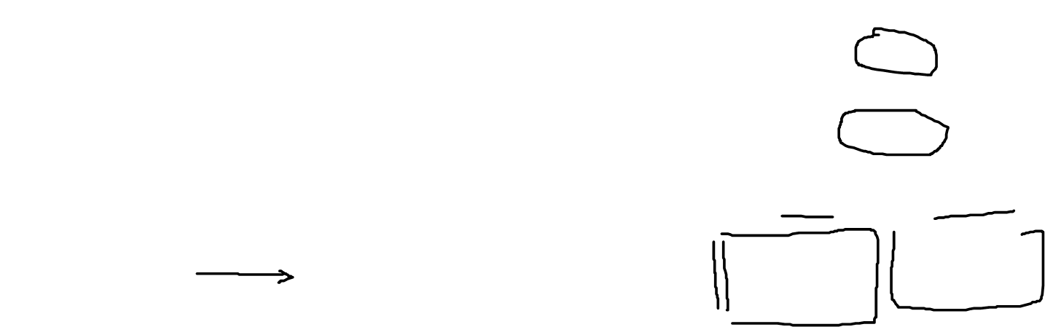
Decision tree

Slide 7
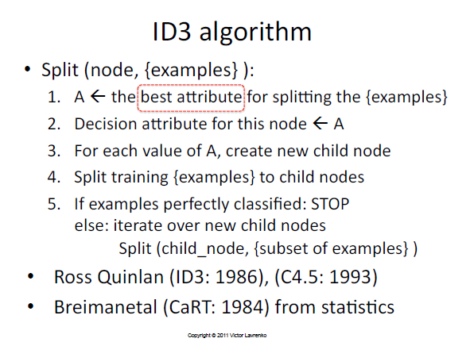
Decision tree

Slide 8
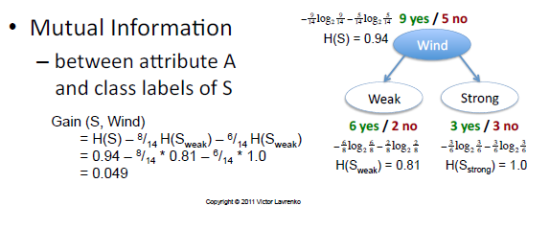

Decision tree

Slide 9
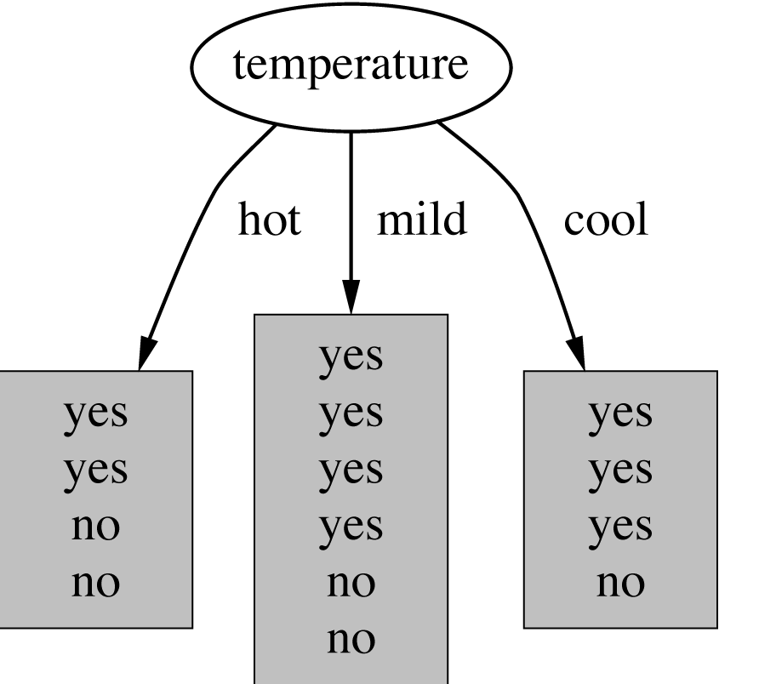
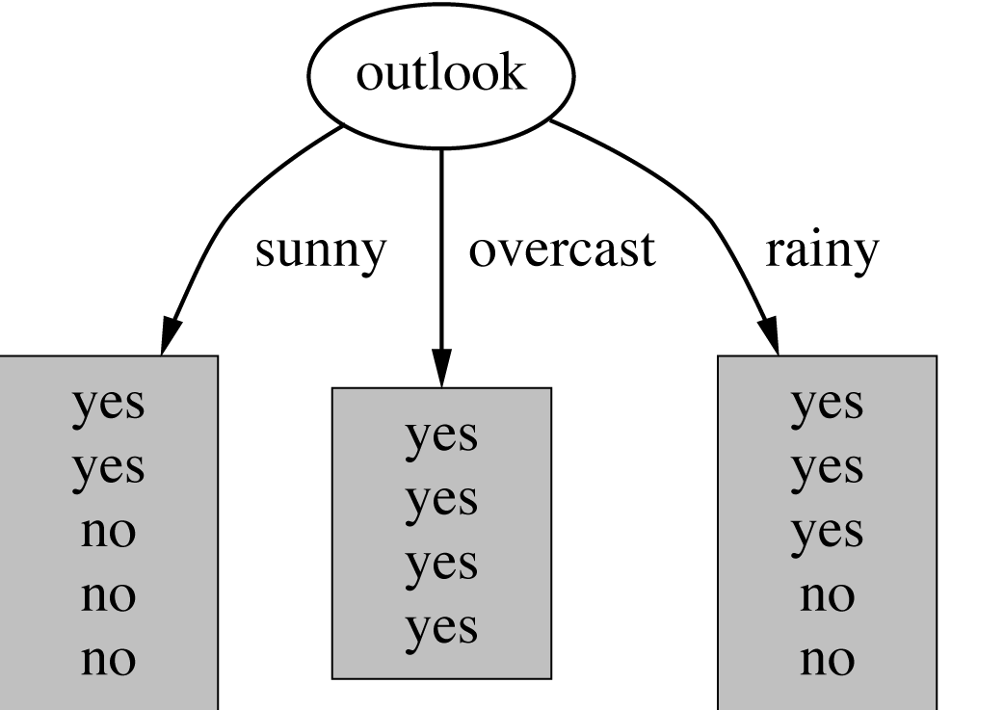
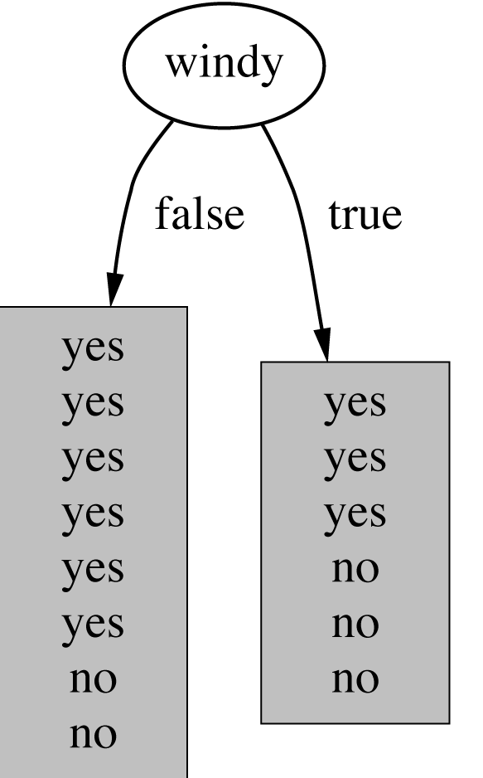
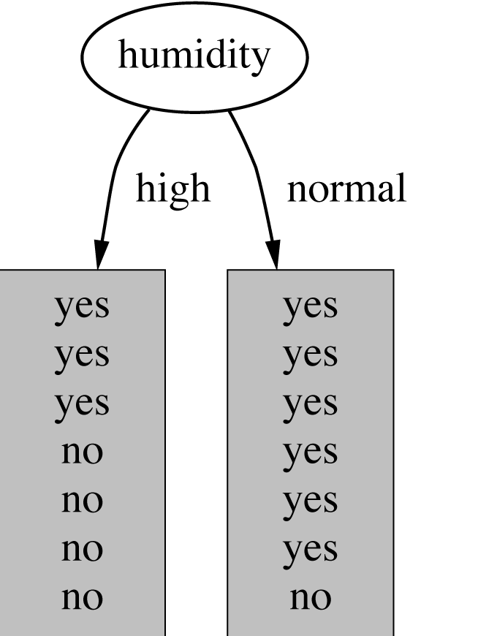
Which attribute to select?

Slide 10
A criterion for attribute selection
Which is the best attribute?
The one which will result in the smallest tree
Heuristic: choose the attribute that produces the “purest” nodes
Popular impurity criterion: information gain
Information gain increases with the average purity of the subsets that an attribute produces
Strategy: choose attribute that results in greatest information gain

Slide 11
Computing information
Information is measured in bits
Given a probability distribution, the info required to predict an event is the distribution’s entropy
Entropy gives the information required in bits (this can involve fractions of bits!)

Slide 12
Entropy
Formula for computing the entropy:

Slide 13
Example: fair coin throw
P (head) = 0.5
P (tail) = 0.5

Slide 14
Example: biased coin throw
P(head) | 0.5 | 0.25 | 0.1 | 0
P(tail) | 0.5 | 0.75 | 0.9 | 1
Entropy | 1 | 0.811 | 0.469 | 0.000

Slide 15
Entropy of a split
Information in a split with x items of one class, y items of the second class

Slide 16
Example: attribute “Outlook”
“Outlook” = “Sunny”: 2 and 3 split

Slide 17
Outlook = Overcast
“Outlook” = “Overcast”: 4/0 split
Note: log(0) is not defined, but we evaluate 0*log(0) as zero

Slide 18
Outlook = Rainy
“Outlook” = “Rainy”:

Slide 19
Expected Information
Expected information for attribute:

Slide 20
Computing the information gain
Information gain:
(information before split) – (information after split)
Information gain for attributes from weather data:

Slide 21
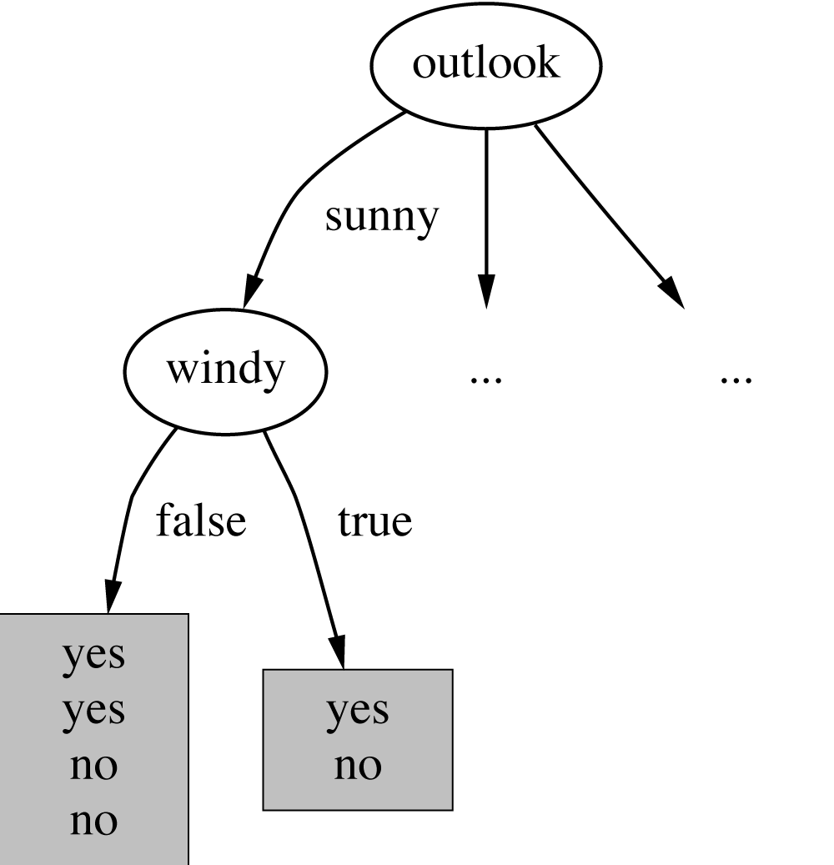
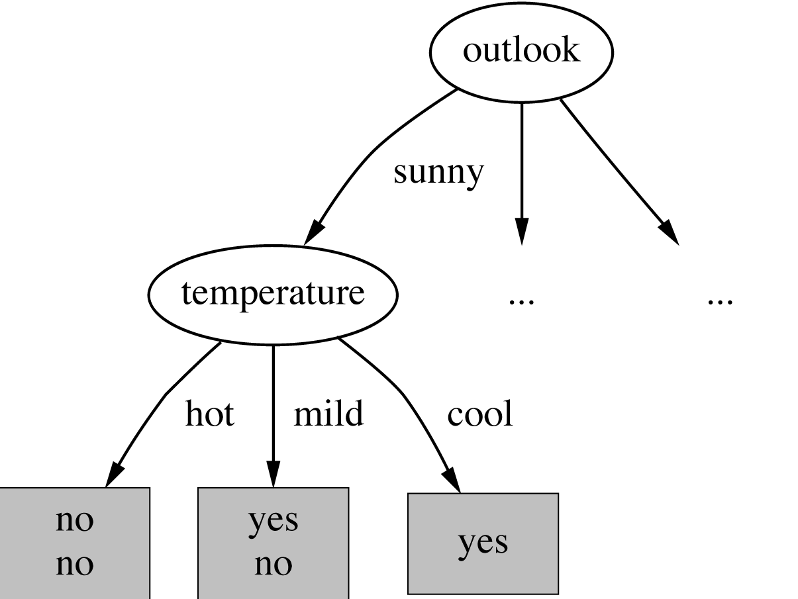
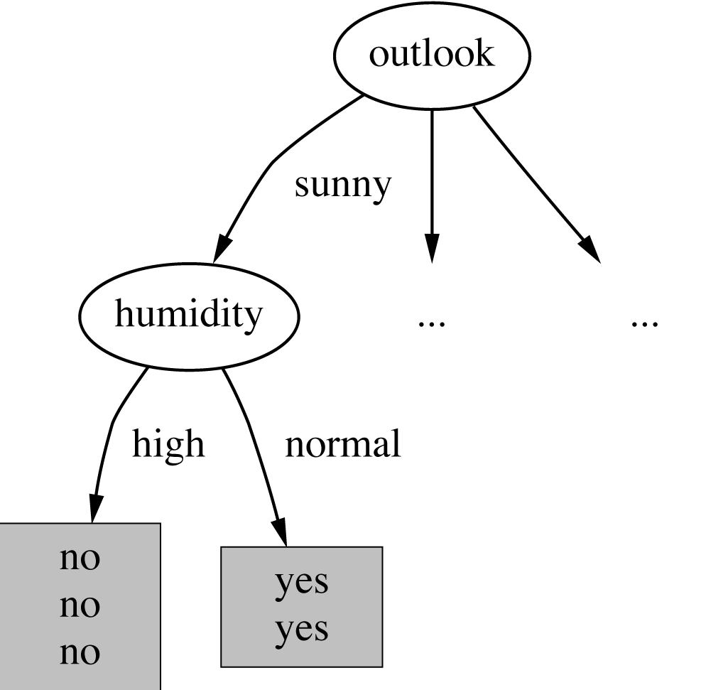
Continuing to split

Slide 22
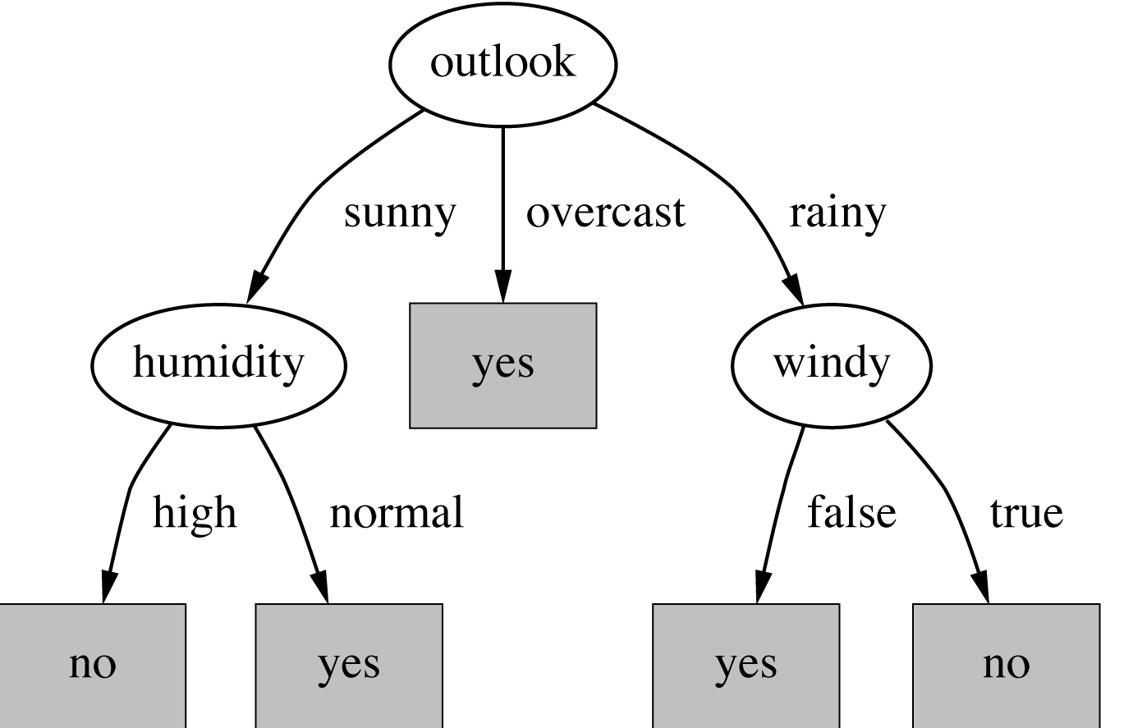
The final decision tree
Note: not all leaves need to be pure; sometimes identical instances have different classes
⇒ Splitting stops when data can’t be split any further

Slide 23

Data stream mining: decision tree
Non-additive methods: the example of decision trees
VFDT: Very Fast Decision Trees (Domingos & Hulten 2000)
X₁, X₂, …, X_{p}: discrete or continuous attributes
Y: discrete attribute to predict
Elements of the stream (x₁, x₂, …, x_{p}, y) are examples
G(X): measure to maximize to choose splits (ex. Gini, entropy, …)

Slide 24
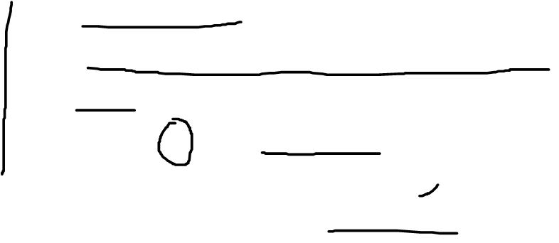
Data stream mining: decision tree
Hoeffding trees: not necessary to wait for all examples to choose a split
Algorithm
Maintain G(X_{j})
Wait for a minimum number of examples, n
Xj, Xk: the 2 variables with highest values of G
Split on X_{j} when G(X_{j}) - G(X_{k}) ≥ ε
Recursively apply the rule by pushing new examples in leaves of the tree
Notes:
Guarantees that chosen splits are the right ones
Quand une variable a été utilisée, elle est retirée des candidates dans les sous-arbres.
Quand une nouvelle feuille est créée, les statistiques sont remises à 0.
Refinements: poor attributes are detected, …

Slide 25
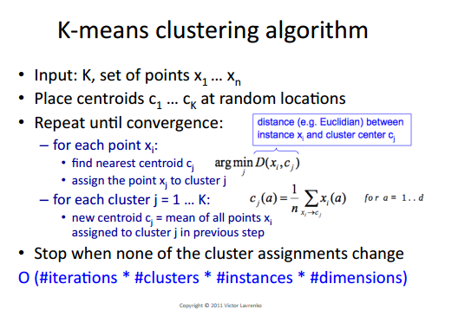
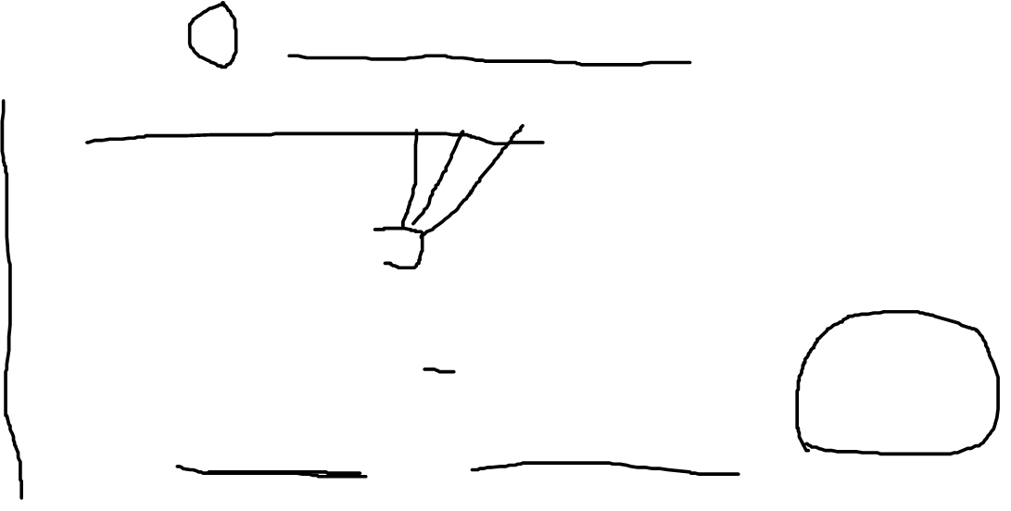

Slide 26
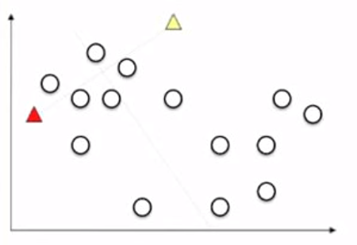
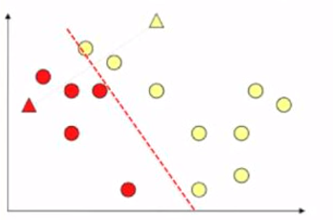
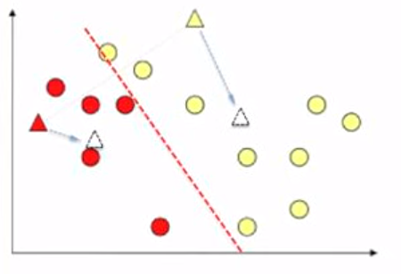
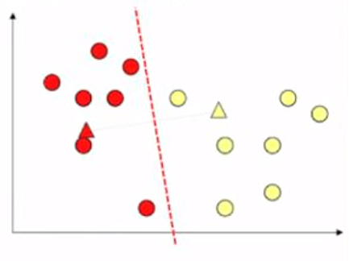
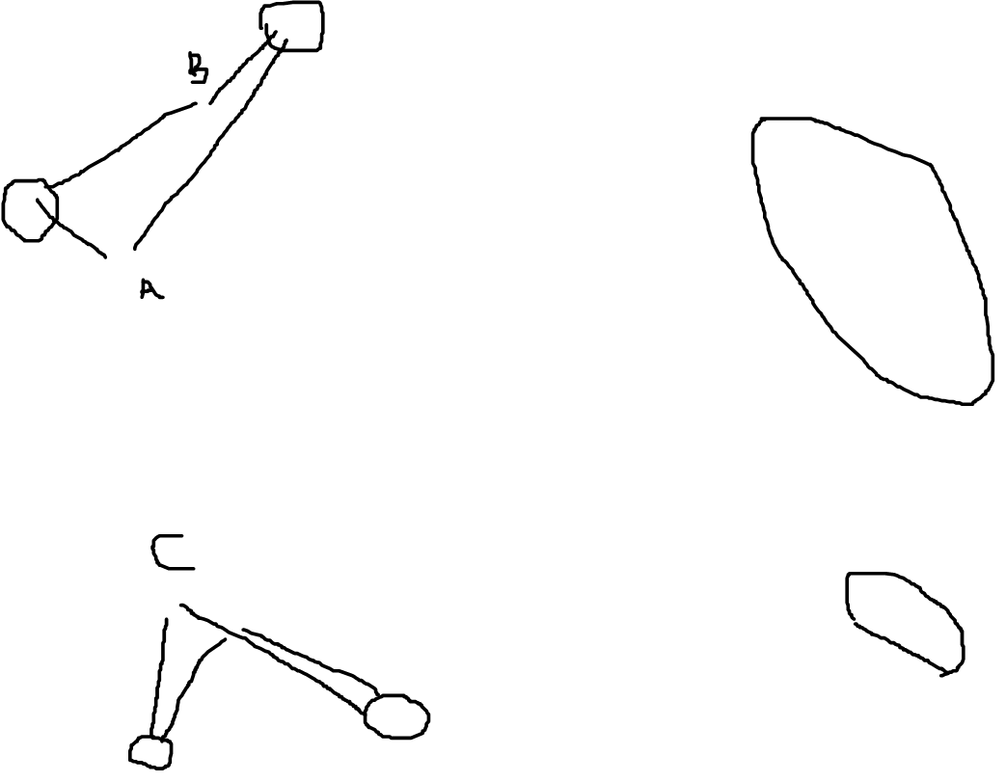

Slide 27
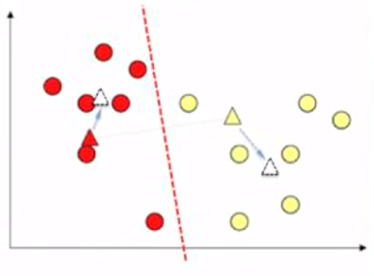
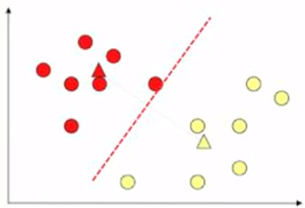
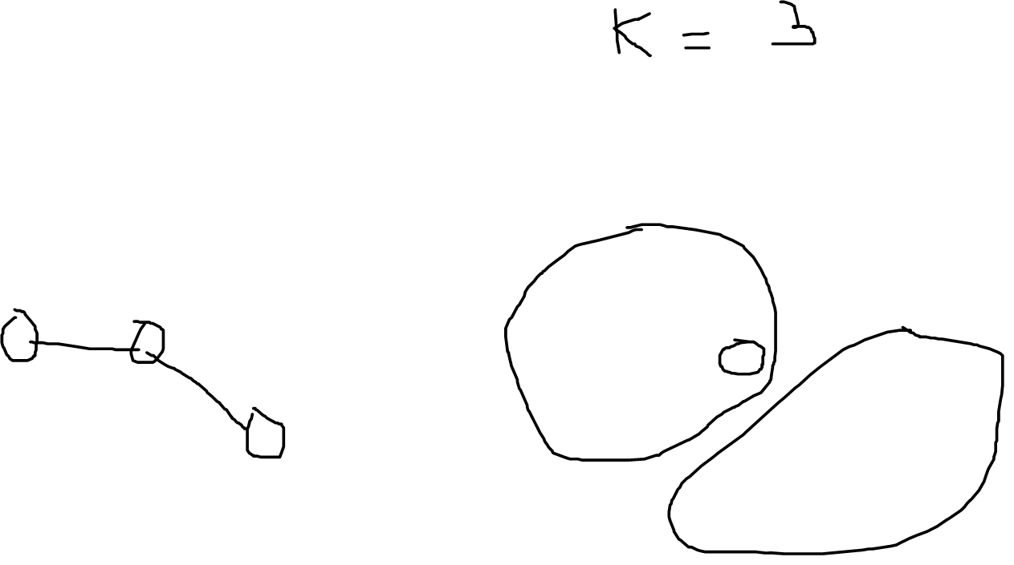
K means clustering

Slide 28
Data stream mining: clustering
Two distinct clustering problems
Maintain k centers of clusters (k-means)
Maintain k clusters with statistics on their contents (clustream)

Slide 29
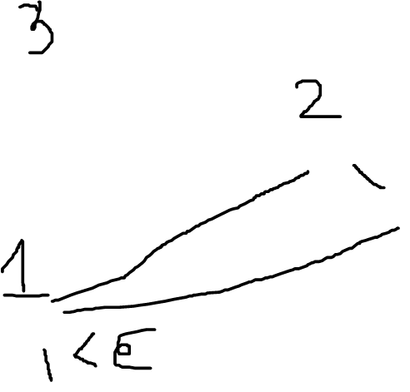
K-means for data stream

Slide 30
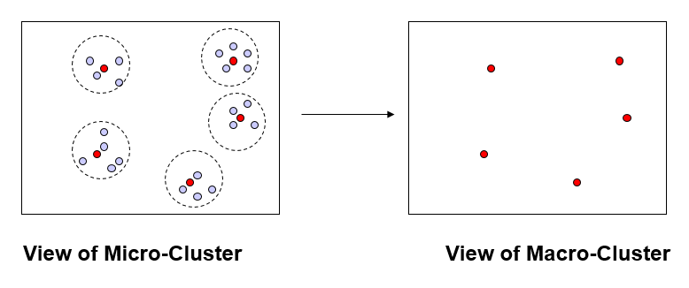
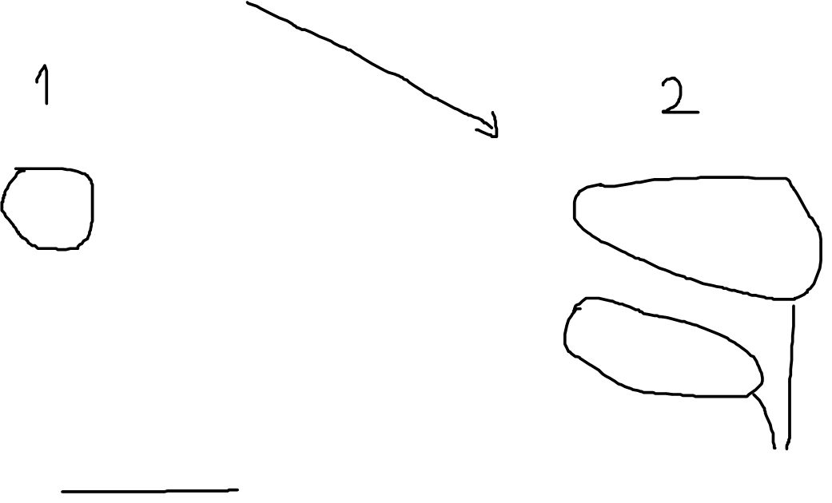
K-means for data stream

Slide 31
Data stream mining: clustering
Two distinct clustering problems
Maintain k centers of clusters (k-means)
Maintain k clusters with statistics on their contents (clustream)

Slide 32
Clustream
Clustream (Aggarwal et al. 2003)
Numerical variables
2 phases:
On-line phase: maintenance of a large number of ‘micro-clusters’ described by statistics of their contents
Off-line phase: use of micro-clusters to produce a final clustering
Mechanism to keep track of micro-clusters history

Slide 33
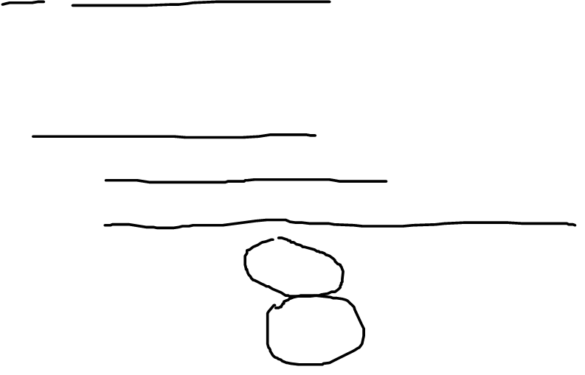
Clustream
Representation of micro-clusters
CVF: Cluster Feature Vector (BIRCH)
(n, CF1(T), CF2(T), CF1(X₁), CF2(X₂), …, CF1(X_{p}), CF2(X_{p}))
n: number of data points
CF1(T): sum of the time stamps T_{i1}…T_{in}
CF2(T): sum of the squares of the time stamps
Supports union/difference by addition/substraction
Incremental computation (elements are disgarded)

Slide 34
Thank You.

