Slide 1
GeoSpatial data analysis
Thuc Le
Advanced Analytic Techniques 2
University of South Australia

Slide 2
Outline
Association rules vs co-location analysis
Clustering vs hot spots analysis

Slide 3
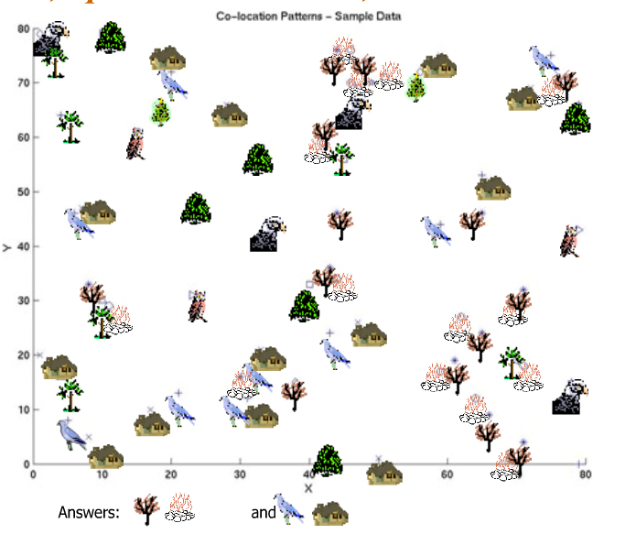
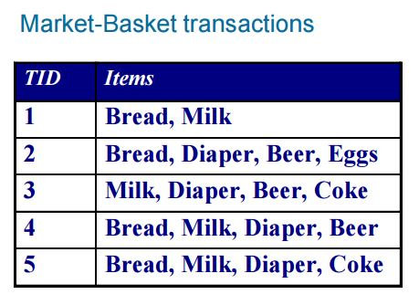
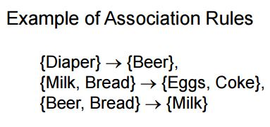
Association rules vs co-location

Slide 4


Association rule mining
Diaper→Beer
Support: P(Diaper, Beer) = 3/5 = 0.6
Confidence: P(Beer|Diaper) = 3/4 = 0.75

Slide 5

Spatial association rule mining
Spatial Association Rule (Han, 1995)
Create transactions by reference feature, e.g. C
(C1, B1)
(C2, B2)
2. Support (A, B) = 0
Support(B, C)= 2/2 = 1
3. Output = (B, C)
A1
C1
B1
A2
B2
C2
Input: Feature A, B, C & instances: A1, A2, B1, B2, C1, C2

Slide 6
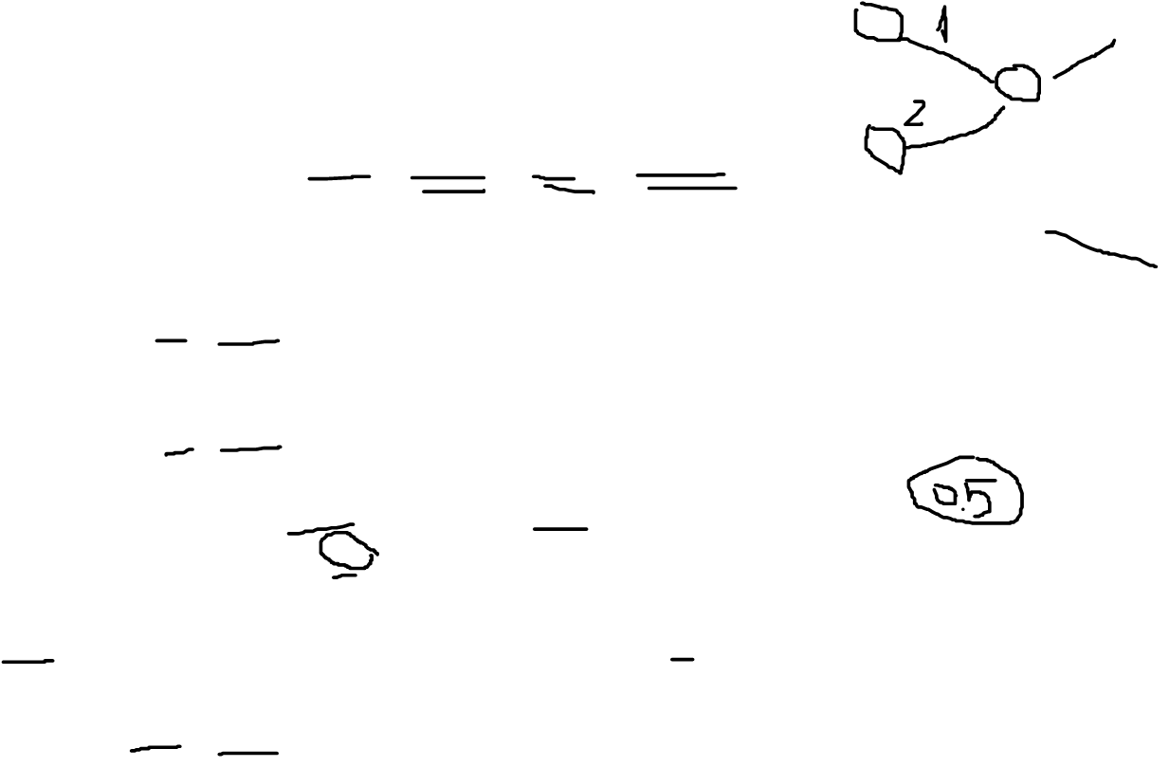
Spatial Colocation
Feature: A, B, C
Feature Instances: A1, A2, B1, B2, C1, C2
Feature subsets: (A, B), (A, C), (B, C), (A, B, C)
Participation ratio(Pr):
Pr(A, (A, B))= fraction of A instances neighbouring feature {B} = 2/2 = 1
Pr(B, (A, B)) = ½
A1
C1
B1
A2
B2
C2
2. Participation index (A, B) = pi(A, B) = min{pr(A, (A,B)), pr(B, (A,B)) = min {1, ½} = ½
Pi(B, C) = min{pr(B, (B,C)), pr(C, (B,C))} = min {1,1,}=1
3. Output: (A, B), (B,C)

Slide 7
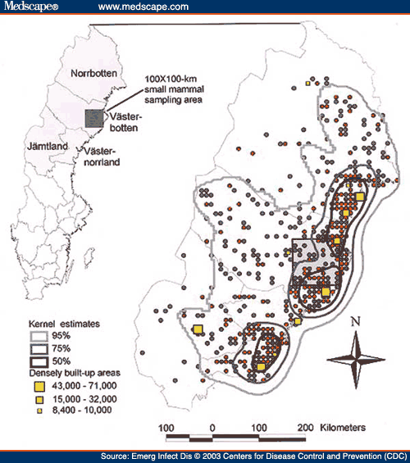
Clustering vs Hot spots
Is a phenomenon spatially clutered?
Which spatial entities are unusual or share common characteristics?
Examples
Crime hot spots to plan police patrols

Slide 8
Hot spots finding with DBScan
https://www.youtube.com/watch?v=6jl9KkmgDIw
For internal students, we watched this video and then took our turn to present our understanding and explain DBScan to others (Practicing our listening and presentation skills)

Slide 9
Summary
Colocation analysis
Hot spots analysis

Slide 10
Thank You.

