Slide 1
Bayesian networks
Thuc Le
Advanced Analytic Techniques 2
University of South Australia
(The slides are based on Neapolitan’s books)

Slide 2
Outline
Bayesian networks: examples, definition
Bayesian networks’ properties
Bayesian network inference
Summary

Slide 3
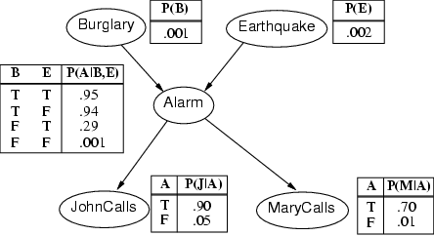
Bayesian networks

Slide 4
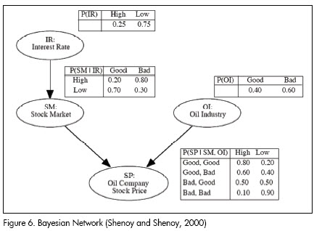
Bayesian networks

Slide 5
What is a BN?
A Bayesian network (BN) is a graphical model for depicting probabilistic relationships among a set of variables.
BN Encodes the conditional independence relationships between the variables in the graph structure.
Provides a compact representation of the joint probability distribution over the variables
A problem domain is modeled by a list of variables X1, …, Xn
Knowledge about the problem domain is represented by a joint probability P(X1, …, Xn)
Directed links represent causal direct influences
Each node has a conditional probability table quantifying the effects from the parents.
No directed cycles

Slide 6
A Bayesian Network
A Bayesian network is made up of:
1. A Directed Acyclic Graph
A
B
C
D
2. A set of tables for each node in the graph
A | P(A)
false | 0.6
true | 0.4
A | B | P(B|A)
false | false | 0.01
false | true | 0.99
true | false | 0.7
true | true | 0.3
B | D | P(D|B)
false | false | 0.02
false | true | 0.98
true | false | 0.05
true | true | 0.95
B | C | P(C|B)
false | false | 0.4
false | true | 0.6
true | false | 0.9
true | true | 0.1

Slide 7
A Directed Acyclic Graph
Each node in the graph is a random variable
A node X is a parent of another node Y if there is an arrow from node X to node Y eg. A is a parent of B
A
B
C
D
Informally, an arrow from node X to node Y means X has a direct influence on Y

Slide 8
A Set of Tables for Each Node
A | P(A)
false | 0.6
true | 0.4
A | B | P(B|A)
false | false | 0.01
false | true | 0.99
true | false | 0.7
true | true | 0.3
Each node X_{i} has a conditional probability distribution P(X_{i} | Parents(X_{i})) that quantifies the effect of the parents on the node
The parameters are the probabilities in these conditional probability tables (CPTs)
B | C | P(C|B)
false | false | 0.4
false | true | 0.6
true | false | 0.9
true | true | 0.1
A
B
B | D | P(D|B)
false | false | 0.02
false | true | 0.98
true | false | 0.05
true | true | 0.95
C
D

Slide 9
Bayesian Networks’ properties
Two important properties:
Encodes the conditional independence relationships between the variables in the graph structure
Is a compact representation of the joint probability distribution over the variables

Slide 10
1. Conditional Independence
The Markov condition: given its parents (P₁, P₂),
a node (X) is conditionally independent of its non-descendants (ND₁, ND₂).
P₁
P₂
I(X,ND_{X}|PA_{X})
ND₁
X
ND₂
C₁
C₂

Slide 11
1. Conditional independence

Slide 12
2. The Joint Probability Distribution
Due to the Markov condition, we can compute the joint probability distribution over all the variables X₁, …, X_{n} in the Bayesian net using the formula:
Where Parents(X_{i}) means the values of the Parents of the node X_{i} with respect to the graph

Slide 13
Using a Bayesian Network Example
Using the network in the example, suppose you want to calculate:
P(A = true, B = true, C = true, D = true)
= P(A = true) * P(B = true | A = true) *
P(C = true | B = true) P( D = true | B = true)
= (0.4)*(0.3)*(0.1)*(0.95)
This is from the graph structure
A
B
These numbers are from the conditional probability tables
C
D

Slide 14
Bayesian network inference
Using a Bayesian network to compute probabilities is called inference
In general, inference involves queries of the form:
P( X | E )
E = The evidence variable(s)
X = The query variable(s)

Slide 15
Bayesian network inference
Diagnostic (evidential, abductive): from effect to cause
P(Buglary|JonhCalls), P(B|J)=0.016
P(B|J,M)=0.29
P(A|J,M)=0.76
Causal (predictive): From cause to effect
P(J|B)=0.86
P(M|B)=0.67
Intercausal (explaining away): common effect
P(B|A)=0.38
P(B|A, E)=0.003
Mixed: two or more of the above combined
P(A|J,E’)=0.03
P(B|J,E’)=0.017

Slide 16
Bayesian network inference
In general, the problem of Bayesian network inference is NP-hard (exponential in the size of the graph)
Exact inference
Probability and Markov condition
Variable elimination
Clustering / join tree algorithms
Approximate inference
Stochastic simulation / sampling methods
Markov chain Monte Carlo methods
Genetic algorithms
Neural networks
Simulated annealing
Mean field theory

Slide 17
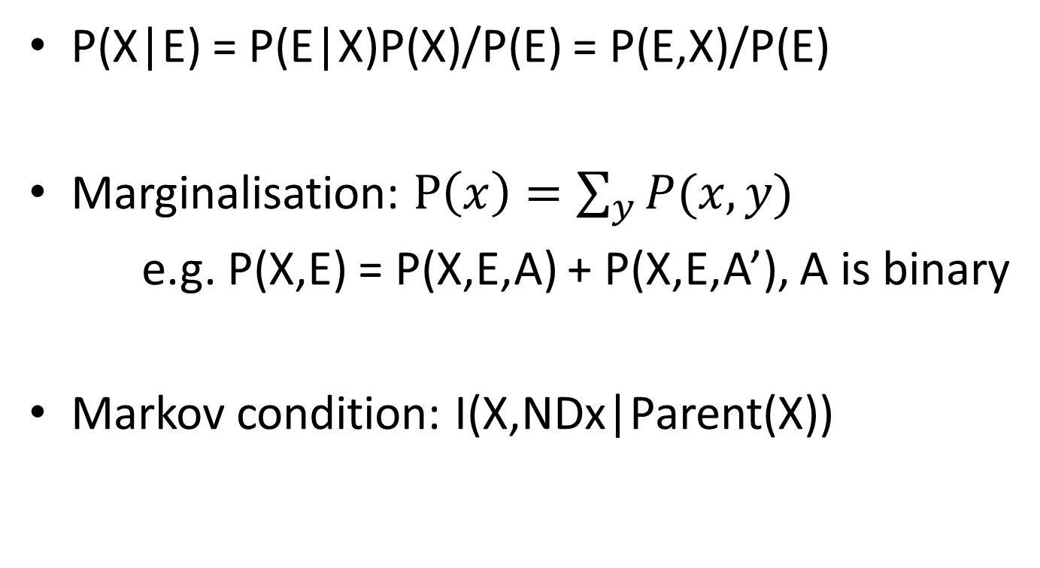
Bayesian network inference
P(X|E) = P(E|X)P(X)/P(E) = P(E,X)/P(E)
Marginalisation: $P\left(x\right)=\sum_{y}{P(x,y)}$
e.g. P(X,E) = P(X,E,A) + P(X,E,A’), A is binary
Markov condition: I(X,NDx|Parent(X))

Slide 18
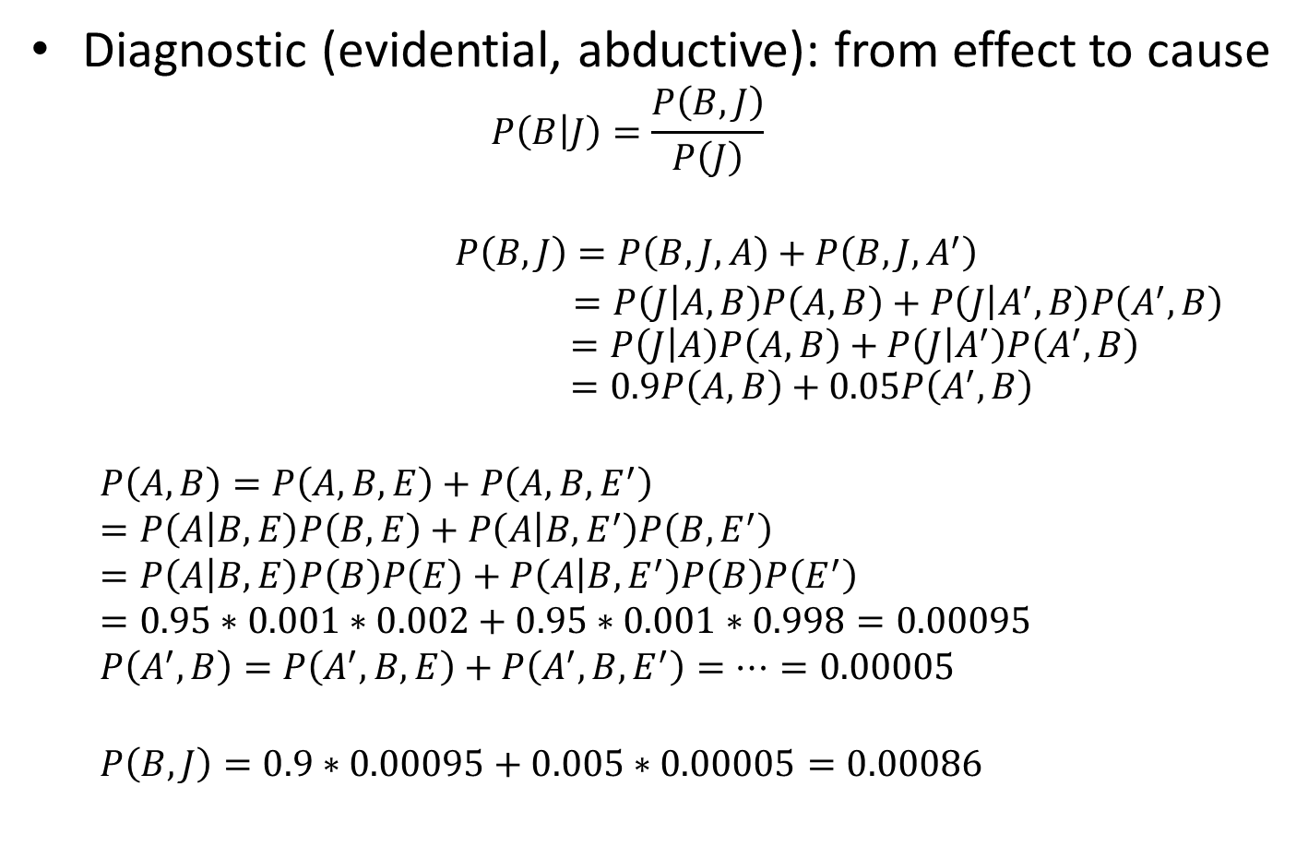
Bayesian network inference
Diagnostic (evidential, abductive): from effect to cause
$$P\left(B | J\right)=\frac{P\left(B,J\right)}{P\left(J\right)}$$
$$P\left(B,J\right)=P\left(B,J,A\right)+P\left(B, J,A^{′}\right)$$
$=P\left(J | A,B\right)P\left(A,B\right)+P\left(J | A^{′},B\right)P\left(A^{′},B\right)$ $$=P\left(J | A\right)P\left(A,B\right)+P\left(J | A^{′}\right)P\left(A^{′},B\right) \\ =0.9P\left(A,B\right)+0.05P\left(A^{′},B\right)$$
$$P\left(A,B\right)=P\left(A,B,E\right)+P\left(A,B,E^{′}\right) \\ =P\left(A | B,E\right)P\left(B,E\right)+P\left(A | B,E^{′}\right)P\left(B,E^{′}\right) \\ =P\left(A | B,E\right)P\left(B\right)P\left(E\right)+P\left(A | B,E^{′}\right)P\left(B\right)P\left(E^{′}\right) \\ =0.95∗0.001∗0.002+0.95∗0.001∗0.998=0.00095$$
$$P\left(A^{′},B\right)=P\left(A^{′},B,E\right)+P\left(A^{′},B,E^{′}\right)=…=0.00005$$
$$P\left(B,J\right)=0.9∗0.00095+0.005∗0.00005=0.00086$$

Slide 19
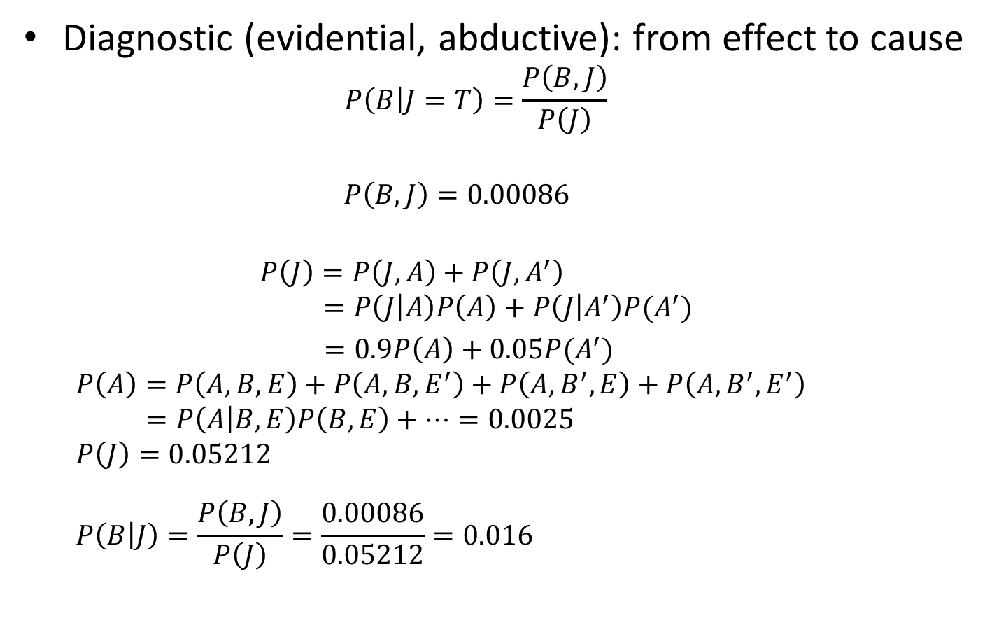
Bayesian network inference
Diagnostic (evidential, abductive): from effect to cause
$$P\left(B | J=T\right)=\frac{P\left(B,J\right)}{P\left(J\right)}$$
$$P\left(B,J\right)=0.00086$$
$$P\left(J\right)=P\left(J,A\right)+P\left(J,A^{′}\right) \\ =P\left(J | A\right)P\left(A\right)+P\left(J | A^{′}\right)P(A^{′})$$ $=0.9P\left(A\right)+0.05P(A^{′})$ $$P\left(A\right)=P\left(A,B,E\right)+P\left(A,B,E^{′}\right)+P\left(A,B^{′},E\right)+P\left(A,B^{′},E^{′}\right)$$ $$=P\left(A | B,E\right)P\left(B,E\right)+…=0.0025$$ $$P\left(J\right)=0.05212$$ $$P\left(B | J\right)=\frac{P\left(B,J\right)}{P\left(J\right)}=\frac{0.00086}{0.05212}=0.016$$ $$A=πr^{2}$$

Slide 20

Bayesian network inference
Causal (predictive): From cause to effect
$$P\left(J | B\right)=\frac{P\left(B,J\right)}{P\left(B\right)}$$
$$P\left(B,J\right)=P\left(B,J,A\right)+P\left(B, J,A^{′}\right)$$
$=0.00086$
$$P\left(B\right)=0.001 \\ P\left(J | B\right)=\frac{0.00086}{0.001}=0.86$$

Slide 21

Bayesian network inference
Intercausal (explaining away): common effect
$$P\left(B | A\right)=\frac{P\left(A,B\right)}{P\left(A\right)}$$
$$P\left(B,A\right)=0.00095$$
$$P\left(A\right)=0.0025 \\ P\left(B | A\right)=\frac{0.00095}{0.0025}=0.38$$

Slide 22
Summary
Bayesian networks
Definition
Properties: Markov condition, compact joint probability
Bayesian networks inference
Understand how to use probability theory and Markov condition to do the inference for different types of queries
In practice, we are going to use R (gRain package)
Next week, learning Bayesian networks from data

Slide 23
Thank You.

