Slide 1
Heavy-Hitter Detection on SmatNIC
Yevhenii Liubchyk, Maria Shestakova
Itzik Ashkenazi, Prof. Ori Rotenstreich

Slide 2

Goal
Track the K heaviest flows with high accuracy using limited available memory.

Slide 3
Motivation
“Heavy Hitters” flows are flows that contributing significant amounts of traffic to a link.
Detection “heavy hitters” flows is required, for example, for
DoS detection (anomalies and attack)
traffic engineering
relieve link congestion
flow-size aware routing

Slide 4

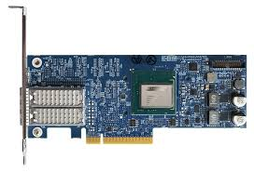
Background – Netronome SmartNIC
Agilio CX SmartNIC
Interfaces: 2x10Gb
Processor: NFP-4000
Memory: 2GB

Slide 5


Background – P4 Language
P4 is a programming language designed to allow programming of packet forwarding planes.
P4 is a domain-specific language with a number of constructs optimized around network data forwarding

Slide 6
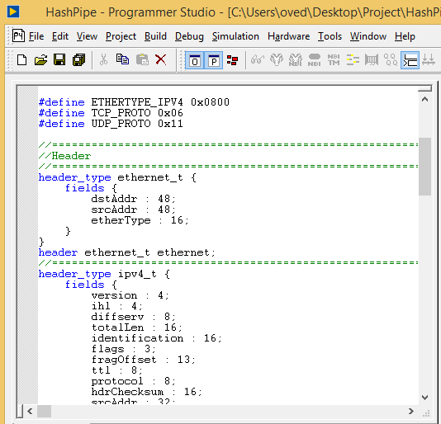
Background – Programmer Studio
Server
Windows
Programmer Studio
Compilation
P4
Netronome SmartNIC

Slide 7
Overview
Implement HashPipe algorithm on a programmable hardware Netronome SmartNic using P4 language.
Evaluate the accuracy and quality of the algorithm

Slide 8
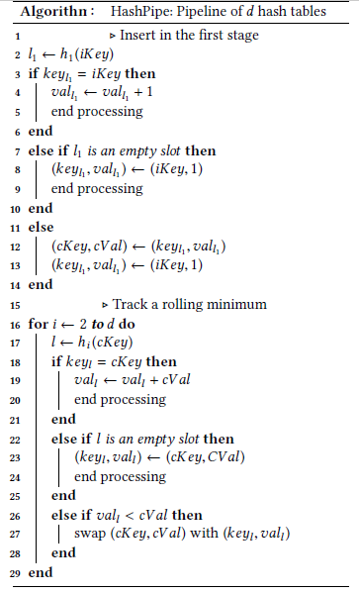
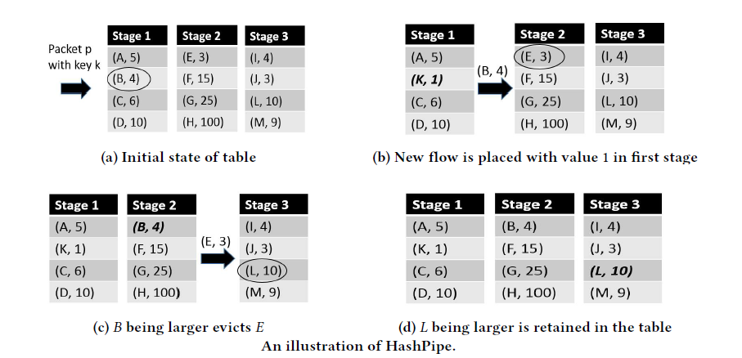
HashPipe Algorithm

Slide 9
Capture file
Real “Heavy-hitters” flows
vf0_0
vf0_1
Ingress
Traffic
P4
Memory
HashPipe alg’ flows

Slide 10
Code on the Netronome SmartNIC
hh.p4:
hashpipe_algorithm();
modify_field(standard_metadata.egress_spec, port);
plugin.c:
__export __mem static struct Heavy_Hitter sketch[NUM_SKETCH][SKETCH_COLUMN_COUNT];

Slide 11
Capture file
Real “Heavy-hitters” flows
vf0_0
vf0_1
Ingress
Traffic
Egress
Traffic
P4
HashPipe Alg’
Memory
HashPipe alg’ flows

Slide 12

Commands
tcpdump – is a type of packet analyzer software utility that monitors and logs TCP/IP traffic passing between a network and the computer on which it is executed.
tcpreplay – is a tool for replaying network traffic from files saved with tcpdump or other tools which write pcap files
nfp_rtsym – Read/write contents of runtime symbol

Slide 13
Capture file
tcpreplay
tcpdump
Real “Heavy-hitters” flows
vf0_0
vf0_1
Ingress
Traffic
Egress
Traffic
P4
HashPipe Alg’
Memory
nfp-rtsym
HashPipe alg’ flows
Compare:
Accuracy, Errors, Average

Slide 14

Testing – Input
NUM – number of sending packets
K – number of “heavy-hitter” flows which we want to check
AxBxC – memory size:
A=5 – number of cores
B – number of hash-tables
C – size of hash-table

Slide 15
Testing – Output
Accuracy of HashPipe Algorithm (Errors False Negative and False Positive)
Average place of packets from HashPipe Alg’ in sorted list of Real "Heavy-Hitter" flows start from heaviest
Optimal K = min(K, Number of HashPipe alg’ Flows, Number of Real “Heavy-hitter” Flows) – biggest number of “heavy-hitter” flows which we can check (not bigger than K)
Optimal Average = (Optimal K + 1) / 2 – Average which we get for Accuracy=100%

Slide 16
Testing – Output
Accuracy of HashPipe Algorithm (Errors False Negative and False Positive)
Average place of packets from HashPipe Alg’ in the sorted list of Real "Heavy-Hitter" flows starting from heaviest
Optimal K = min(K, Number of HashPipe alg’ Flows, Number of Real “Heavy-hitter” Flows) – the biggest number of “heavy-hitter” flows which we can check (not bigger than K)
Optimal Average = (Optimal K + 1) / 2 – Average which we get for Accuracy=100%

Slide 17
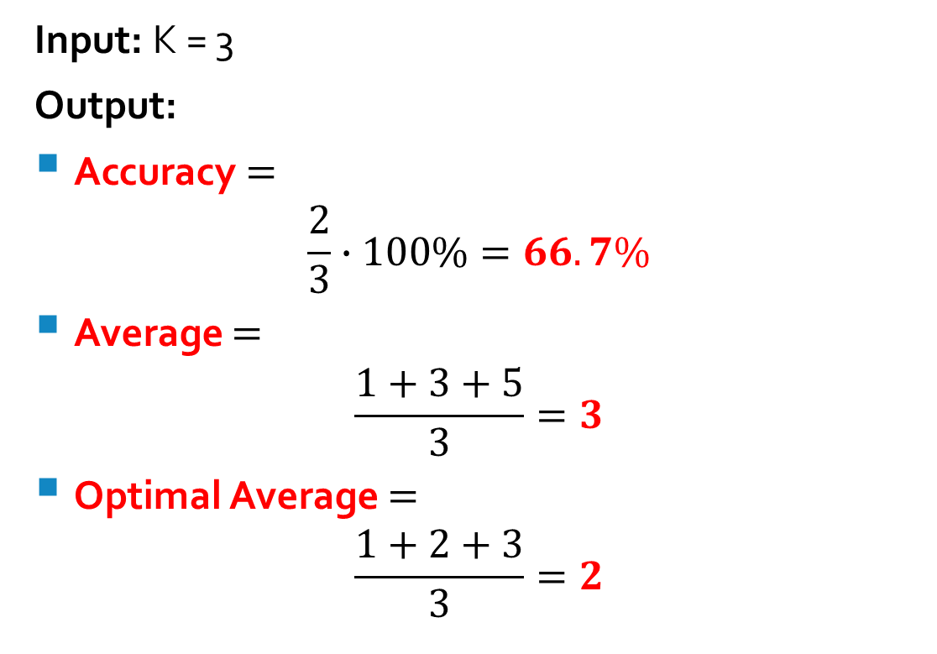
Example
HashPipe Alg’ Flows | Real Heavy-Hitter Flows
1 | 1
3 | 2
5 | 3
2 | 4
4 | 5
Input: K = 3
Output:
Accuracy $=$
$$\frac{2}{3}∙100\%=66.7\%$$
Average $=$
$$\frac{1+3+5}{3}=3$$
Optimal Average $=$
$$\frac{1+2+3}{3}=2$$

Slide 18

Makefile
.PHONY: tcpdump tcpreplay result
tcpdump:
sudo tcpdump -B 262144 -l -xx -n -v -i vf0_1 > RealHeavyHitterFlows
tcpreplay:
sudo tcpreplay -L$(NUM) -i vf0_0 $(CAPTURE)
sudo /opt/netronome/bin/nfp-rtsym i32._sketch.108 > HashPipeFlows
sudo /opt/netronome/bin/nfp-rtsym i33._sketch.108 >> HashPipeFlows
sudo /opt/netronome/bin/nfp-rtsym i34._sketch.108 >> HashPipeFlows
sudo /opt/netronome/bin/nfp-rtsym i35._sketch.108 >> HashPipeFlows
sudo /opt/netronome/bin/nfp-rtsym i36._sketch.108 >> HashPipeFlows
result:
python getResult.py $(K)

Slide 21

Conclusions
For NUM=100 000 packets and memory size 5x12x128 accuracy >60% for a big value of K such as 4000
As a result of the HashPipe Algorithm, we got less than 4000 packets, so for K more than 4000 the results will not change

Slide 24
Conclusions
Accuracy is highly dependent on memory size – for standard parameters (NUM=100 000 and K=2000):
for memory size 5x12x4 – accuracy ≈52%
for memory size 5x12x128 – accuracy ≈80%
for memory size 5x12x512 – accuracy ≈93%
For good results, it is important that the memory size (number of places for different packages) be significantly larger than K

Slide 27
Conclusions
For constant memory size best results are achieved when the number of hash-tables and the hash-table size are approximately equal:
for memory size 5x48x32 – accuracy ≈81%
And if one of the parameters is greatly reduced, then the results will deteriorate:
for memory size 5x3x512 – accuracy ≈60%
for memory size 5x384x4 – accuracy ≈76%

Slide 31
Conclusions
For a large number of packets, we can assume that the graphs, depending on the number of packets, are identical to the graphs of the processing time of these packets
The number of sent (NUM) packets affects the results much weaker than K or memory size
But NUM strongly affects the execution time of the program.

Slide 32

Learning
Learned to work with Netronome SmartNIC
Learned to use IDE Programmer Studio 6.0
Practiced writing code in the programming languages P4, C and Python
Practiced using console commands to work with traffic and with SmartNIC (tcpreplay, tcpdump, nfp-rtsym)

Slide 33
Thanks for watching!

