Slide 1
Capstone Project

Slide 2
Find the neighborhood for weekend activities in Shanghai
In this project we will try to find an optimal location for weekend activities. Specifically, this report will be targeted to people who are newly moved to Shanghai, China.
The location should have many choices of restaurants, gyms, coffee shops or bars and shopping possibilities. Except that there should be possibilities to go clubbing in the night and have metro station nearby for good transportation.
This is an interesting task to analyse with valid questions for anyone newly moving to Shanghai. The same method can be applied to explore other big cities as well. This case is also applicable for anyone interested in finding a new apartment to rent.

Slide 3
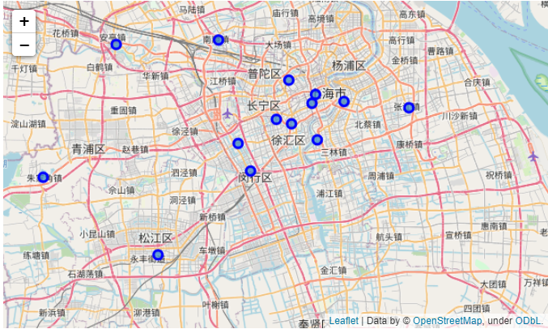
Data
List of neighbourhoods of Shanghai with their geodata (latitude and longitude)

Slide 4
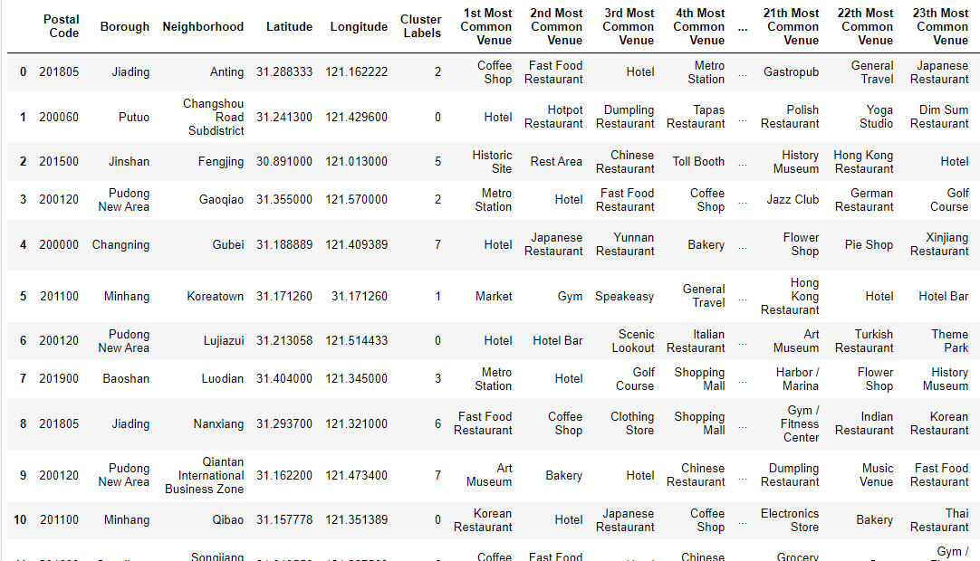
Use Foursquare and geopy data to map top 20 venues for all neighbourhoods and clustered in groups

Slide 5
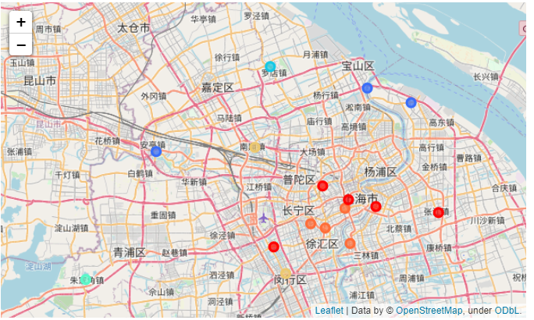
Data
Clustering of neighborhoods

Slide 6
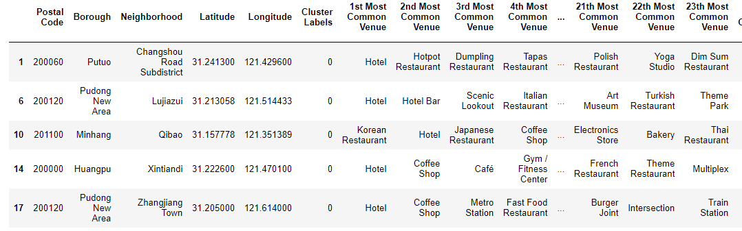
Results
Cluster ‘0’ is of our interest, it contains neighborhoods, which have restaurants, coffee shops, shopping malls and bars. The two neighborhood inside the Pudong New Area District have two metro stations nearby.

Slide 7
Conclusion and future directions
Xintiandi and Zhangjiang Town can be chosen as our promising candidate neighbourhood.
Final decision on optimal location will be made by stakeholders based on specific characteristics of neighbourhoods and locations in every recommended zone, taking into consideration additional attractive venues such as museums, art galleries, theme park or gyms etc.

