Slide 1

Introduction to Natural Language Processing
BUS 243 F: Spring 2023
Yeabin Moon
Lecture 1

Slide 2
Lecture Plan
Each lecture consists of two parts (10 mins break between)
Part 1
The course
NLP overview: what is it?
NLP application
Text representation
Part 2
OOP
Regular expression
Matrix Algebra

Slide 3
Logistics in Brief
Instructor: Yeabin Moon
TA: Jiawei Fan
Office hours: see the syllabus
We’ve put a lot of resources on the Latte page
Syllabus / Announcement / course materials / homework
Lecture materials uploaded before each lecture

Slide 4
Learning Goals
The foundations of the effective / popular methods applied to NLP
More focus on basic ideas
Vector space models
Rule-based approach
Semantic analysis in word counts
The challenges in understanding and producing human languages via computers
How to prepare text data for modeling using Python libraries
Limitation analysis
What deep learning is and how it is different from other methods
Distributed representation

Slide 5
Course work and grading policy
We have 6 meetings in total
3 x 2-week Assignments: 3 x 15 %: 45 %
HW1 is released today
Check every assignment due in the syllabus
1 % off a day late
No accepted more than a day late unless given permission in advance
5 in-class quizzes: 5 x 4 %: 20 %
15 mins at the beginning of every class (from next week)
Final exam: 30 %
May 9th, 6:00 pm – 9:00 pm

Slide 6
Note for assignments
Each assignment should be completed individually
There are only 3 assignments
Strongly encourage you to work alone to gain the maximum
Understand allowed collaboration and how to document it
Do not take code off from the web
Must acknowledge working with other students
Must write your own assignment solutions

Slide 7
Why there are quizzes?
Most of you have not taken any courses regarding NLP
Readings are mandatory for this course
Fundamental concepts in readings will be addressed in each quiz
Main text: Hapke, Lane and Howard, Natural Language Processing in Action, 2019, Manning Publications
Brandeis students have online access to this book
Additional readings are posted in the syllabus / Latte

Slide 8
Why there are quizzes?
Most of you have not taken any courses regarding NLP
Readings are mandatory for this course
Fundamental concepts in readings will be addressed in each quiz
Main text: Hapke, Lane and Howard, Natural Language Processing in Action, 2019, Manning Publications
Brandeis students have online access to this book
Additional readings are posted in the syllabus / Latte

Slide 9
How difficult this course would be?
This is not an introductory course to machine learning or deep learning
You will not learn how to write neural nets in mathematical terms
Thanks to modern ML libraries, you don’t really need to understand the math to build practical applications
However, I will explain some concepts as needed
If you are interested in learning the theories and the math behind, that’s enough
You do need to be at least comfortable enough to write in Python and know its ecosystems

Slide 10

Moneyball (2016)

Slide 11
Let’s Begin

Slide 12
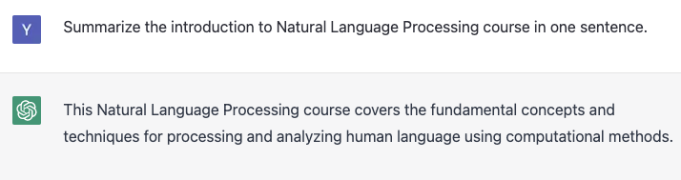
ChatGPT: Hmm…

Slide 13
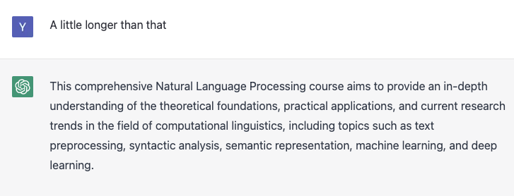
ChatGPT: More amazing features would be

Slide 14
What is natural language processing (NLP)?
NLP is a principled approach to processing human language
Formally, it is a subfield of artificial intelligence (AI) that refers to computational approaches to process, understand, and generate human language
language processing is considered a huge part of human intelligence
It might indicate a range of algorithms taking human-produced text as an input and producing some useful information

Slide 15
What does it mean for a language to be natural?
You might wonder
Are there any unnatural languages?
Is English natural?
Is Spanish more natural than Korean?
Another tricky term is a formal language
Is English formal?

Slide 16
Natural vs. Formal
The word natural is used to contrast natural languages with formal languages
all the languages humans speak are natural
On the other hand, formal languages are types of languages that are invented by humans
Have strictly and explicitly defined syntax (grammatical rules) and semantics (meaning)
Programming languages are examples
When you run a compiler or an interpreter on the code you write in those languages, you either get a syntax error or not
the behavior of your program is always the same if it’s run on the same code

Slide 17
Natural language is hardly formal
You can write a sentence that is maybe grammatical
Subjective, and worse, time varying
There are some grammar topics where even experts disagree with each other
This is what makes human languages interesting but challenging, and why the entire field of NLP even exists
Bottom line: human languages are ambiguous

Slide 18
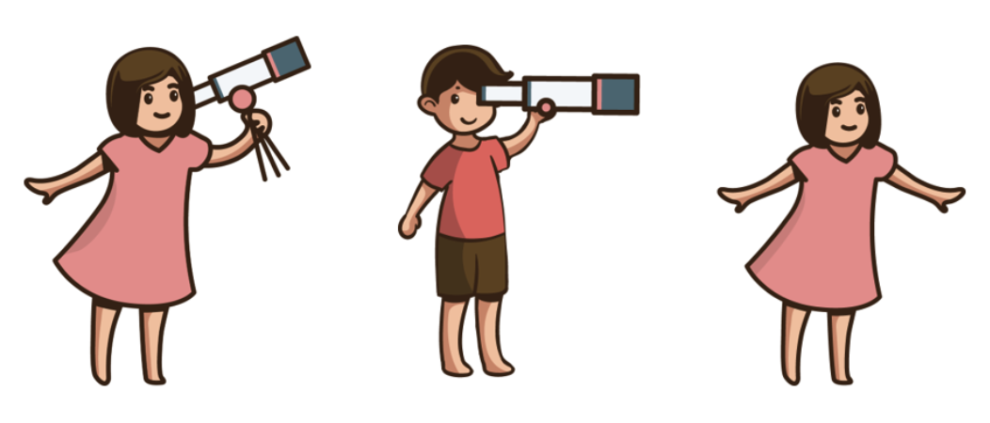
He saw a girl with a telescope

Slide 19
Source of ambiguity
Confused because you don’t know what “with a telescope” is about
Don’t know what this prepositional phrase (PP) modifies
PP-attachment problem is a classic example of syntactic ambiguity
A syntactically ambiguous sentence has more than one interpretation of how the sentence is structured
interpret the sentence in multiple ways
Another type is semantic ambiguity
I saw a bat
Meaning of a word is ambiguous, not its structure
Unless you are brutal enough

Slide 20
Welcome Remark
Ambiguity is what makes natural languages rich but also challenging to process
We can’t simply run a compiler or an interpreter on a piece of text and just get it
We need to face the complexities and subtleties of human languages
We need a scientific, principled approach to deal with them

Slide 21
Here comes a new challenger
Now let’s consider the following scenario and think how you’d approach this problem
You are working as a junior data scientist at a midsized company that has a consumer-facing product line
You got a giant TSV file containing all the responses to the survey questions about the product from the marketing team:
How did you know about our product?
How do you like our product?
a free-response question, where our customers can write whatever they feel about our product

Slide 22
Here comes a new challenger
The marketing team realized there was a bug in the online system and the answers to the second question were not recorded in the database at all
Your task is whether you could recover the lost data
Fortunately, data structure is fairly standard
It has several fields such as timestamps and submission IDs
At the end of each line is a lengthy field for the free-response question

Slide 23
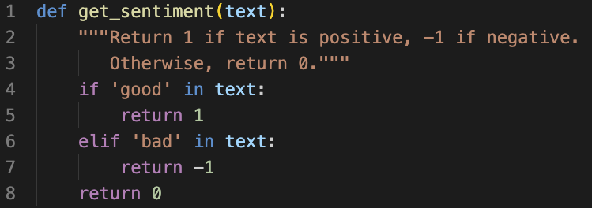
First try
Example responses:
A very good product!
Very bad. It crashes all the time!

Slide 24
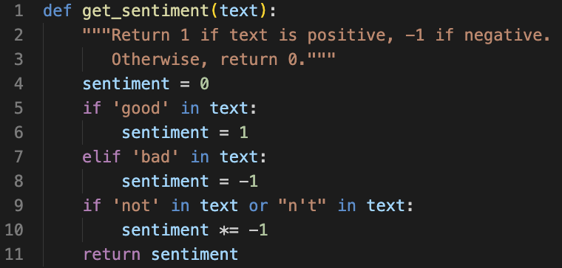
Again, natural language is ambiguous
The code filtered a decent amount of data
Alas, my code returns
I can’t think of a single good reason to use this product: positive
Not bad: negative
Right. Negation!

Slide 25
….
The product is not only cheap but also very good!: negative
Worse
I always wanted this feature badly!
It’s very badly made
How could a single word in a language have two completely opposite meanings?
This course will save you

Slide 26
This course will save you?
What does it mean? Another ambiguity
This course will save you because it will teach you either
How to deal with the problems described above
They are impossible to solve

Slide 27
Rule-base vs. DL approach
As you saw, a bunch of ifs and thens would mitigate the issues
It is a rule-based approach
controversial definition of NLP
You may also have heard of deep learning
a subfield of machine learning that usually uses deep neural networks
As the amount of available data and computational resources increases, modern NLP makes a heavier and heavier use of machine learning and deep learning

Slide 28
Scope of the class
Traditional methods such as counting words and measuring similarities between text are usually not considered to be machine learning techniques per se, although they can be important building blocks for ML-based models
Let’s see the syllabus
By the way, we only focus on English text documents and messages

Slide 29
We are not going to study
Other languages
Spoken statements
Text generation
Dialogue system

Slide 30
Readings
Almost every NLP textbook is outdated
For the beginners, class with a dedicated textbook is often helpful
The textbook is somewhat chat-bot-application oriented
However, most contents are useful
Recommend reading the assigned chapters top-to-bottom

Slide 31
Class overview
Besides an application, we will study Text Representation
The overall theme is to examine how the machine understands text
Roughly two ideas
Word counts
Locations (distributed representation)

Slide 32
Text representation
Consider how to classify the documents
Find the most frequent / unique words
Surprisingly high accuracy
What’s the potential problems?
Words have a range of forms
Synonym?
What does the model mean in NLP?
Why do we ever need a neural net?

Slide 33
Road Map
Count-based Text representation
Bag-of-words approach
Examine tokenizers
Information retrieval
TF-IDF
PCA analysis
Distributed representation
Find a meaning from the word usages
Word order matters

Slide 34
Google Colab
Some codes in the textbook are outdated
Do not work well
I will post the modified codes on Latte
Use Google Colab to run them
Fine to work on your machine if you know how to manage conda environment

