Slide 1
Telecom Dataset Analysis
Group 10
Yichen Ma, Yuxuan Zhang, Zhiwei Han

Slide 2

Introduction
Why we need to study customer churn rate?
Predict customer behavior
Develop customer retention programs
Where we get this dataset from?
Kaggle.com
Why are we using this fictional data?
Even its fictional, it’s implication can be profound
Audience
Telecom companies(e.g. Verizon,Xfinity)
Researchers in telecom field
Dataset Name:
Telco Customer Churn
Telco provided home phone and Internet services to 7043 customers in California in 2019 Quarter 3
Notes:
Acquiring a new customer is always more expensive than retaining an existing one. Hence, not letting them churn is the key to a sustained revenue stream.

Slide 3
Data Overview
We choose to analyze 13 out of 21 columns.
This dataset contains 7043 rows (customers) and 21 columns (features).
Datatype of our dataset: most of the columns contain binary values, followed by textual values, numeric values are the least.
c
Customers who left within the last month
Churn
Services that each customer has signed up for
online security
online backup
device protection
tech support
Other five services
Payment Method
paperless billing
monthly charges
total charges
contract type
Demographic info about customers
Gender
Age
Dependents
Partners
Notes:
We choose these columns because we believe that they are useful in helping us predict customer behavior.

Slide 4
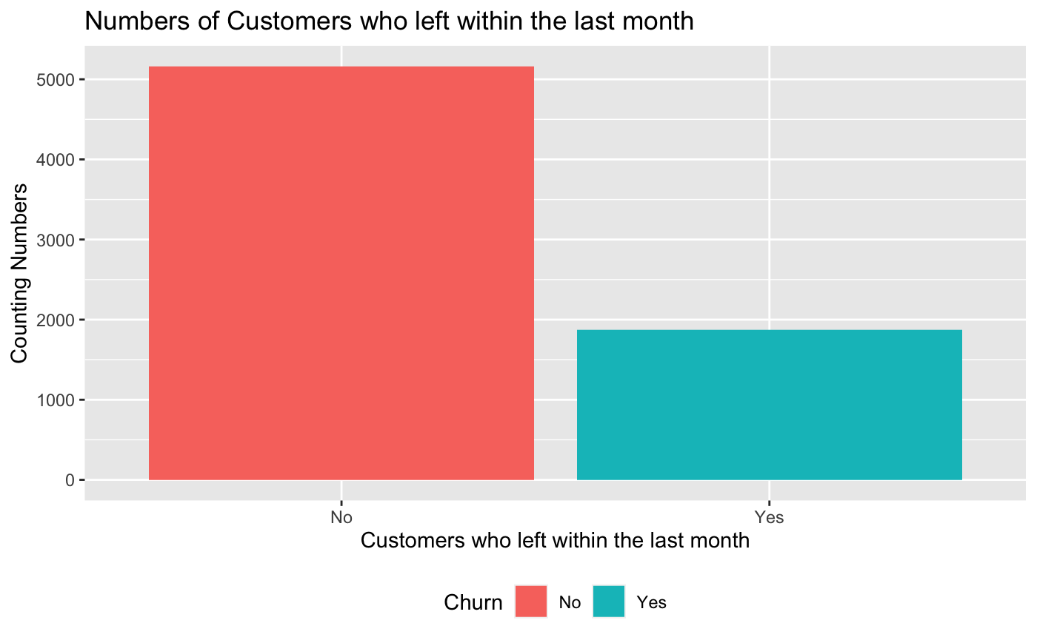
Data Overview: How Many Customers Left The Company
Total number of 7043 customer, out of which
More than 5000 stayed
Less than 2000 left the telco company
We want to see what kind of customer, what kind of service that might have a influence on churn number

Slide 5

Data Preparation
Data cleaning
Our Dataset is from kaggle, it has already been cleaned by author.
We replaced textual value ‘No Internet service’ with ‘No’ in certain columns
We omitted 11 NULL values from column ‘Total Charge’.
The goal is to keep columns’ values consistent, therefore it should be no textual values in columns of binary data…

Slide 6
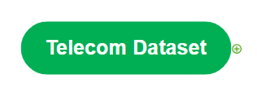
Let’s get started!

Slide 7
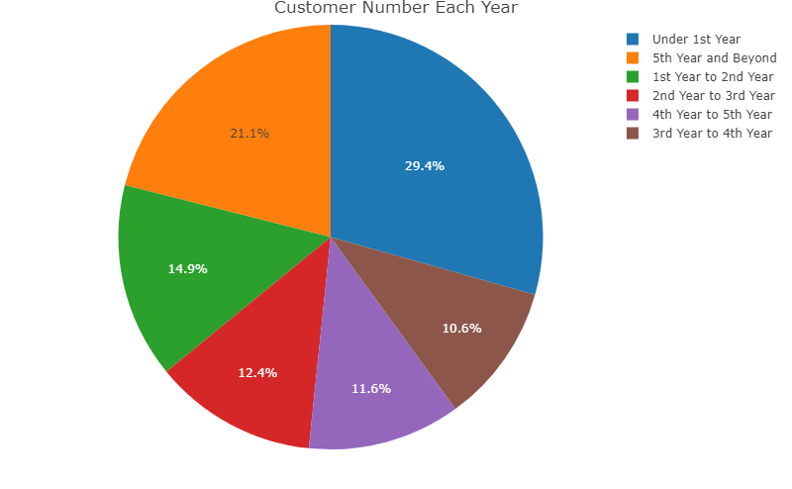
Group Ratio Of New And Existing Customers
Tenure:
1st year customers are relative new customers.
29.4% of current customer body are 1st year customers.
It means that many new customers join Telco’s customer pool this year than past years.
Notes:
Gender is not a factor of churn rate.

Slide 8
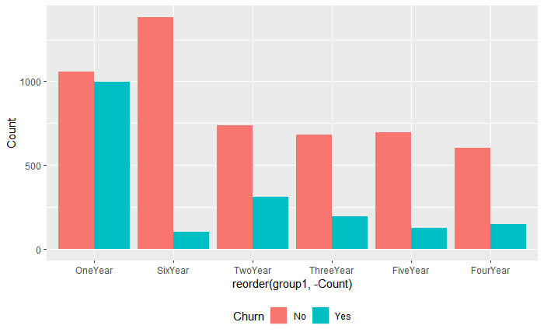
Churn Number Of New And Existing Customer
Customers tend to leave the company’s service within the 1st year whereas the churn rate is significantly reduced in 6th year.
Logically, it makes sense for a longer tenure time. Customers' loyalty is rewarded with perks and benefits; thus there are more incentives for customers to stay
The company may want to design strategies to increase the Not churned: churned ratio within the 1st year.

Slide 9
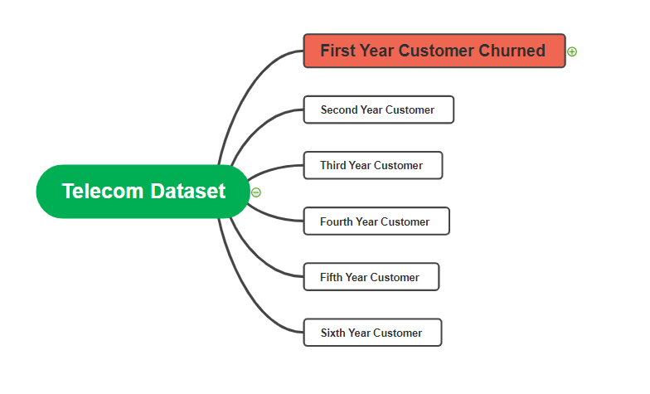
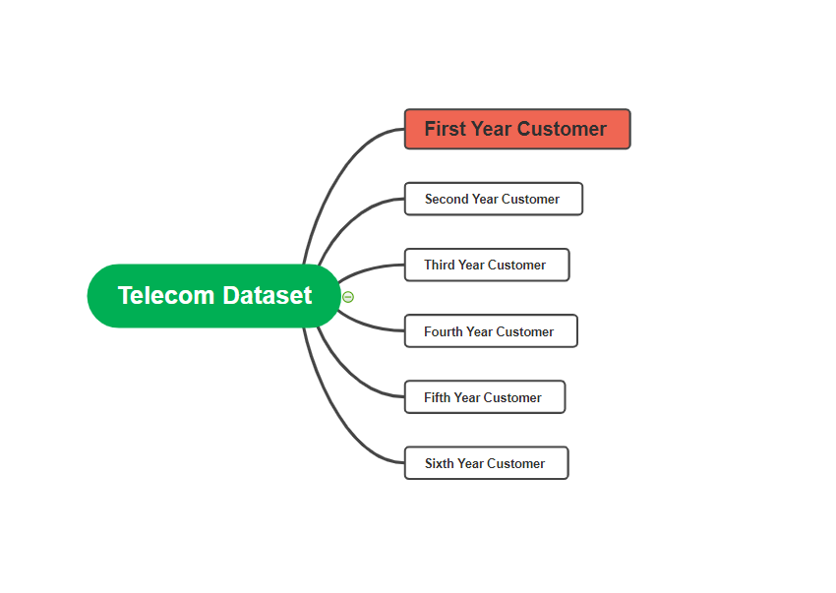

Slide 10
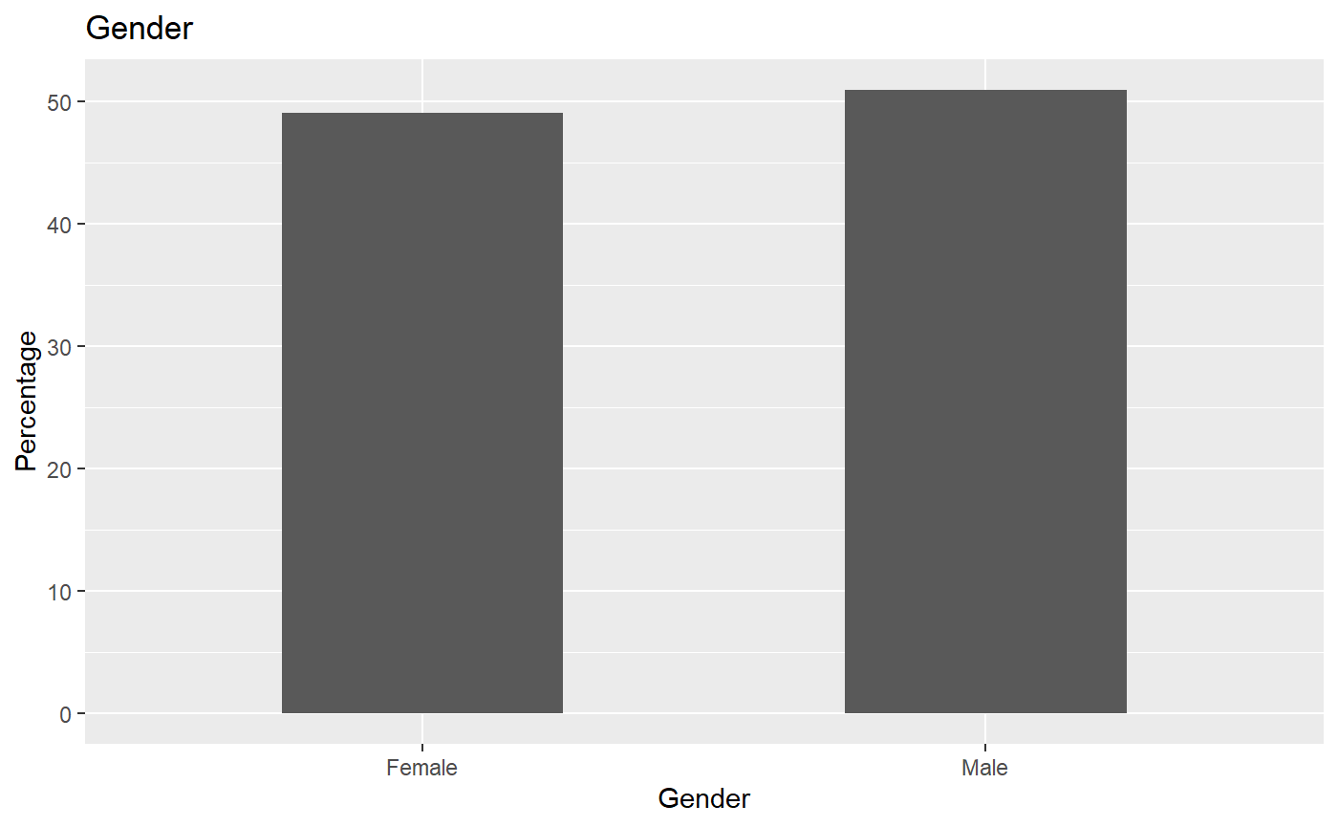
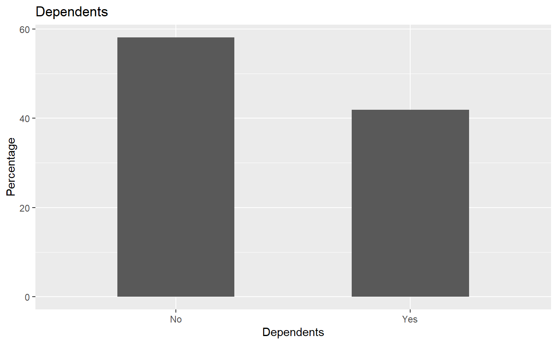
Demographic: First Year Customers Who Churned
Among the first-year customers who churned, the gender ratio is close to even.
Among the first-year customers who churned, individuals who have family members on the share plan are less likely to unsubscribe, compare to those who don’t
The difference rate is about 10%

Slide 11
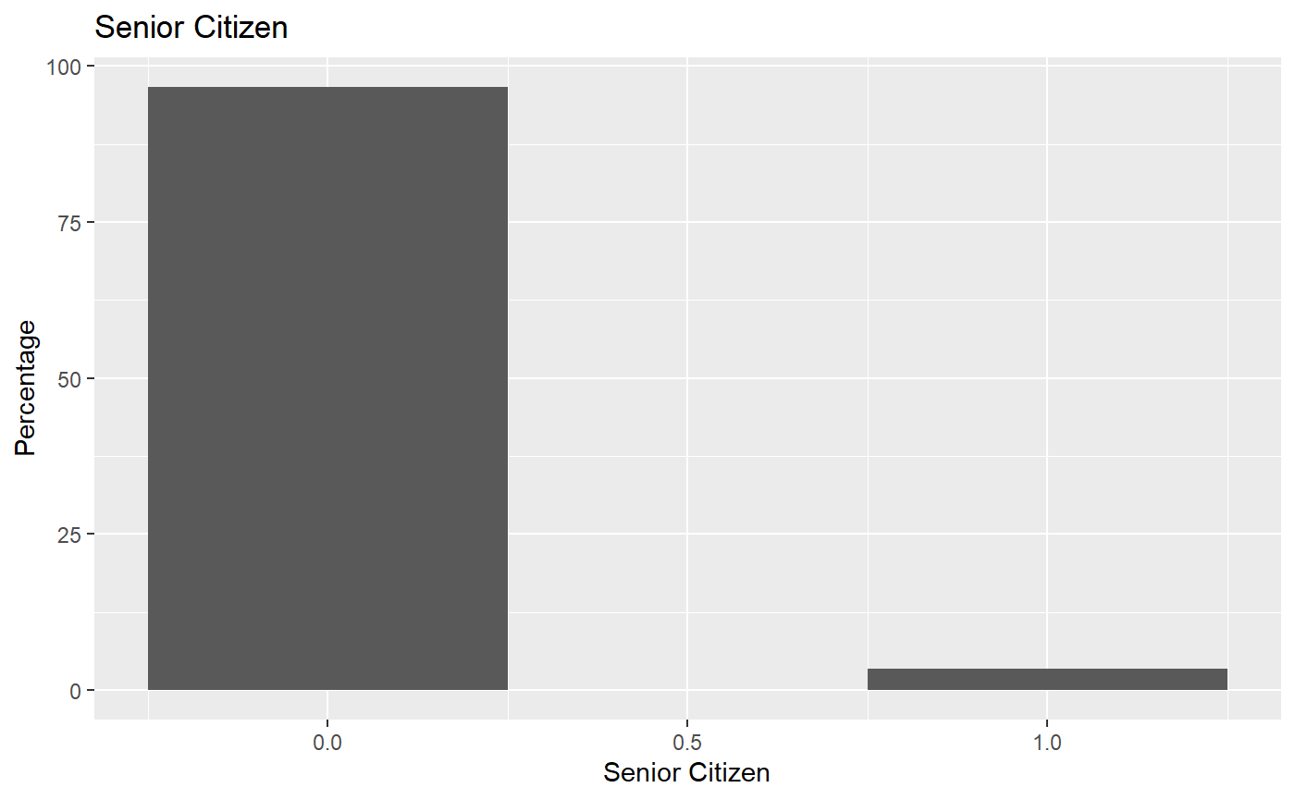
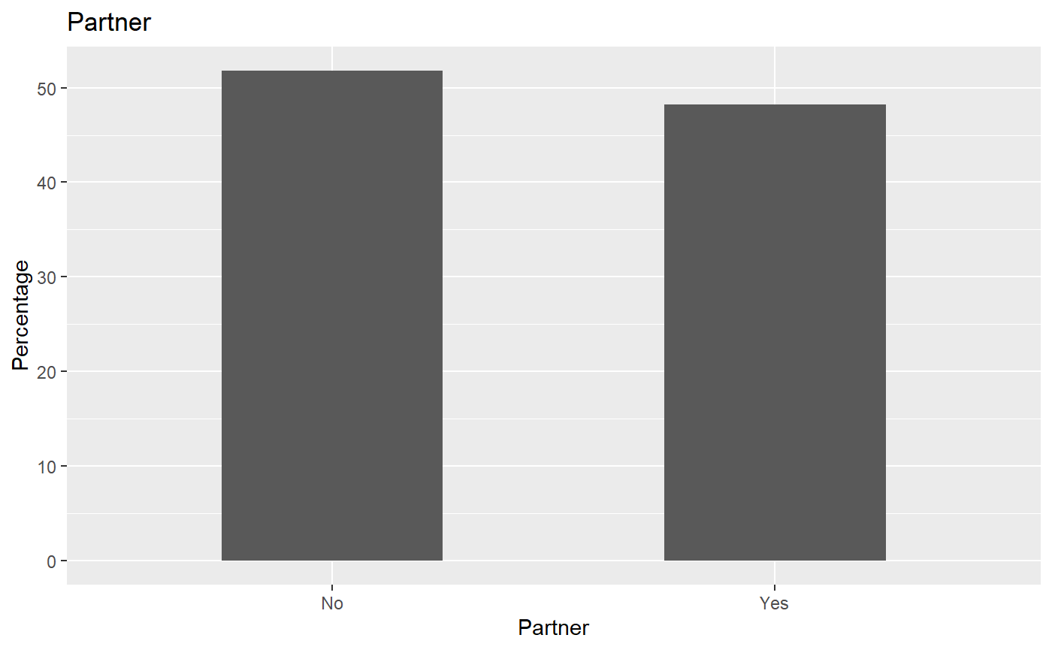
Demographic: First Year Customers who Churned
No
Yes
Among the first-year customers who churned, Non-senior citizens leave the company significantly more than senior citizens.
Younger generations are more prone to new options and less likely to commit to one Service
Senior citizens may find it convenient to stay with one service provider.
What does this imply?
Unlike the dependents demographic, customers with or without partners tend to churn at a similar percentage, those who are single are more likely to switch telecom providers.

Slide 12
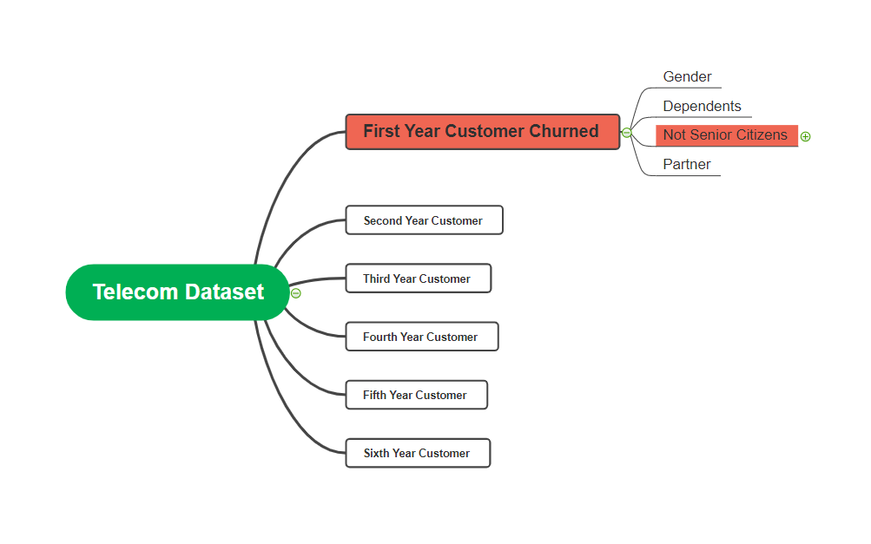
Target Group: first year users who are not senior citizens(<65) and churned

Slide 13
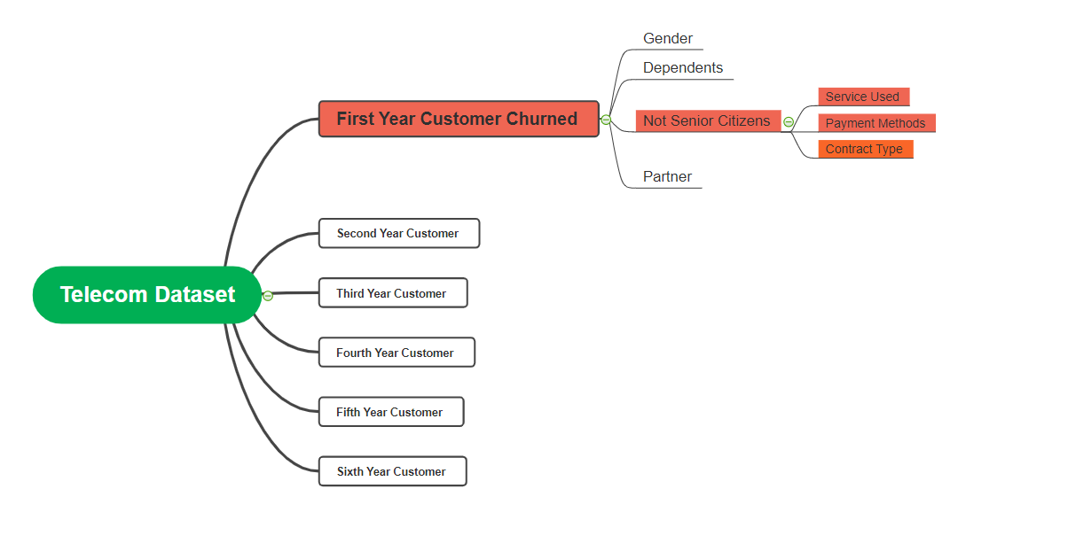
We want to know what potential factors caused them to churn.

Slide 14
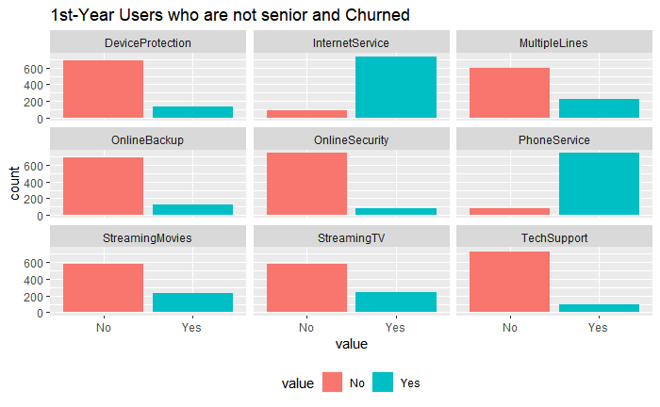
Target Group: Services Used
Internet and Phone Service are mostly used for this target group
These service needs improvement as they are considered core products(Internet: wifi, DSL, Fiber optic)
Service like protection, backup, security, tech support are less frequently used and are not considered as core products for telco.
Streaming Movies and TV services churn amount are about the same

Slide 15
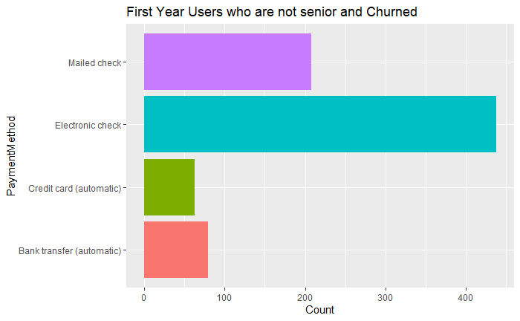
Target Group: Payment Methods
Among our target group，they prefer to select “Electronic Check ” as the 1st payment method.
Using Credit card to pay usually charge an addition fee.
It is surprising to see our target group using mailed check a lot.

Slide 16
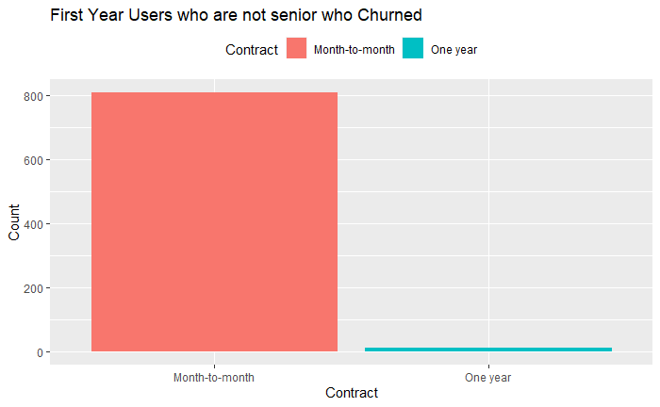
Target Group: Contract Types
Among our target group，nearly all people use month-to-month contract types.
Month-to-month is a more flexible contract type than year-to-year.
It can attract more customers, while giving them flexibilities to unsubscribe

Slide 17


Reflection: Pros and Cons
Potential Advantage
Make practical decision
Telecom companies want to understand customer profile, which group to focus on.
Reduce Cost
Companies can understand what product/service are more worth investing in.
Easy to access and based on reality
No constrained access
Limitation
Data quality
We don’t have Monetary analysis ` the dataset does not have price of each service.
No exactly causal effect
Fictional Data
May not reflect the reality

Slide 18
Advice for Telco Company
Design treatments for first year customers who are not senior and churned
Increase the quality of Internet service and phone service.
Optimize our electronic check payment and encourage target group to use easier payment methods.
Giving some perks at the beginning of each month for those who choose month-to-month contract type.

Slide 19
Thank you for your attention!

