Slide 1
Win In a Horse Race
By: Yijian Shen, Fangyi Wang, Li Liu

Slide 2
CONTENTS
Introduction and Overview
·History of horse racing
·Introduction of variable
Data Preparation
·Pre-Analysis and Forecasting
Figures
·Speed-Time in a race
·Analysis of data for the whole year
Conclusion
· Pros & Cons
· Potential Applications

Slide 3
Introduction and Overview

Slide 4
History of horse racing
Horse racing has a long history
Horse Racing Betting
The significance of analyzing horse racing data

Slide 5
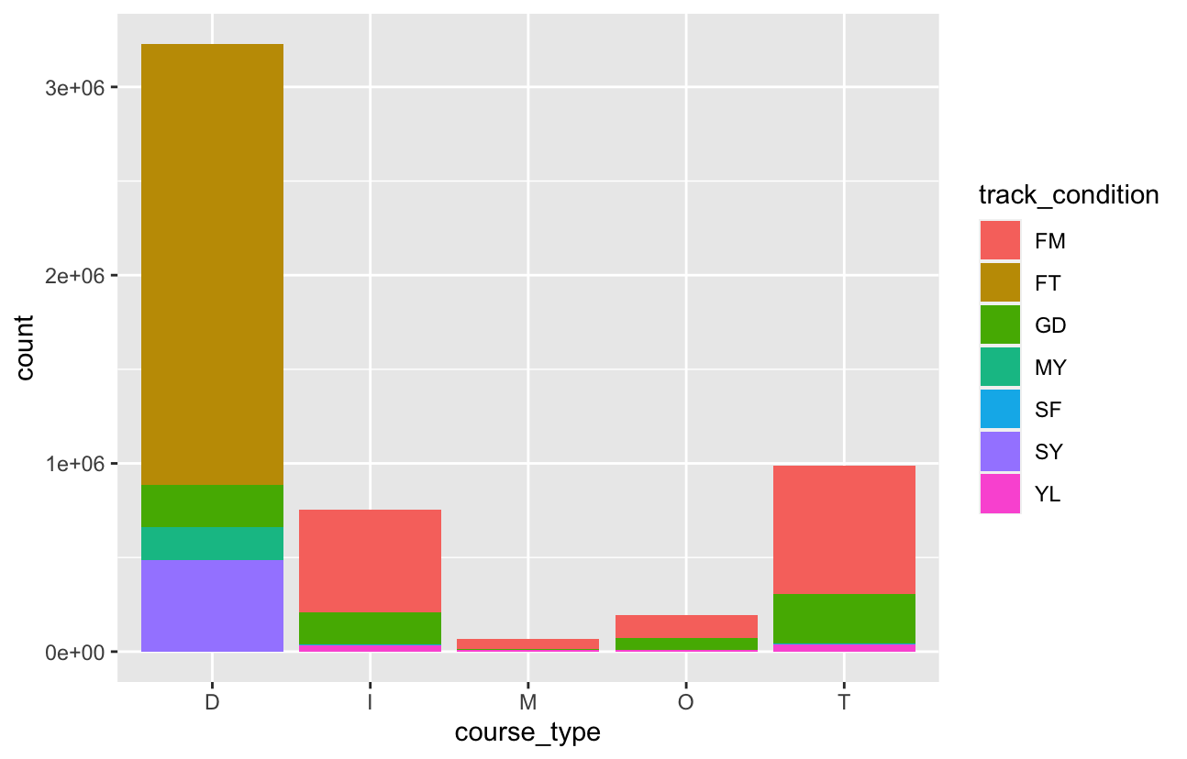
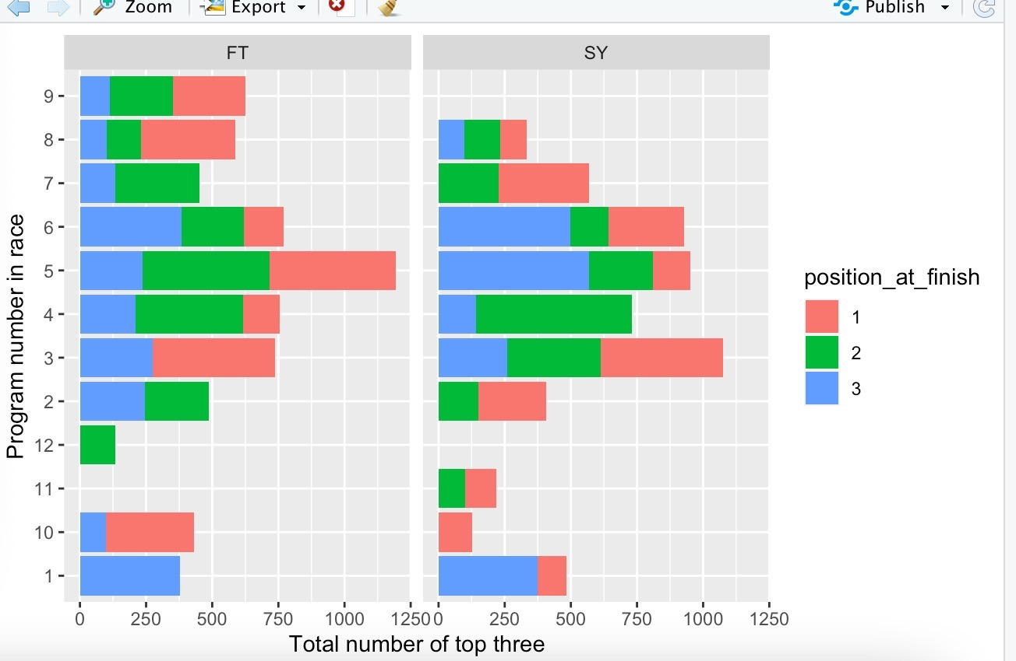
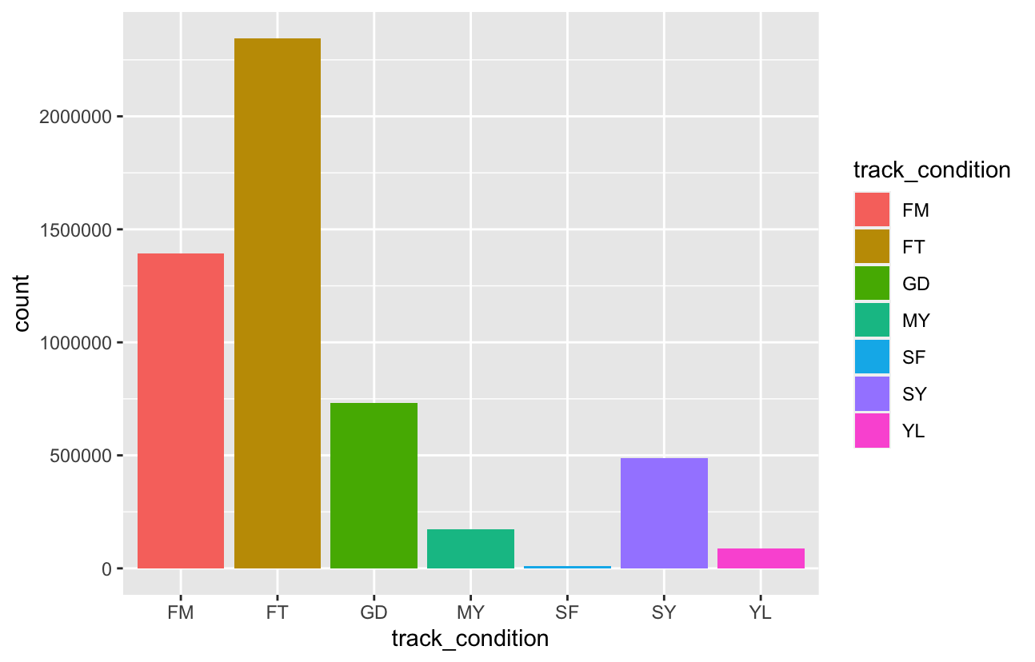
Introduction of variable
course_type ：The course the race was run over passed as one character. m - Hurdle, D - Dirt, O - Outer turf, I - Inner turf, T - turf.
track_condition ： The condition of the course the race was run on passed as three characters. MY-Muddy, SF - Soft.
weight_carried ：An integer of the weight carried by the horse in the race.
position_at_finish ： An integer of the horse's finishing position
Speed ：The speed of a horse race, we use kilometers per hour as the unit of measurement
Time: Time by Every 5s (0s, 5s, 10s … 75s)

Slide 6
Data Preparation
Focus on Christmas Season (12.28– 12.31) with 34 Races
1
Pre-Analysis and Forecasting
2
Speed and Jockey Performance
3
Thoroughbred Horsemen/Racing
4

Slide 7
Figures

Slide 8
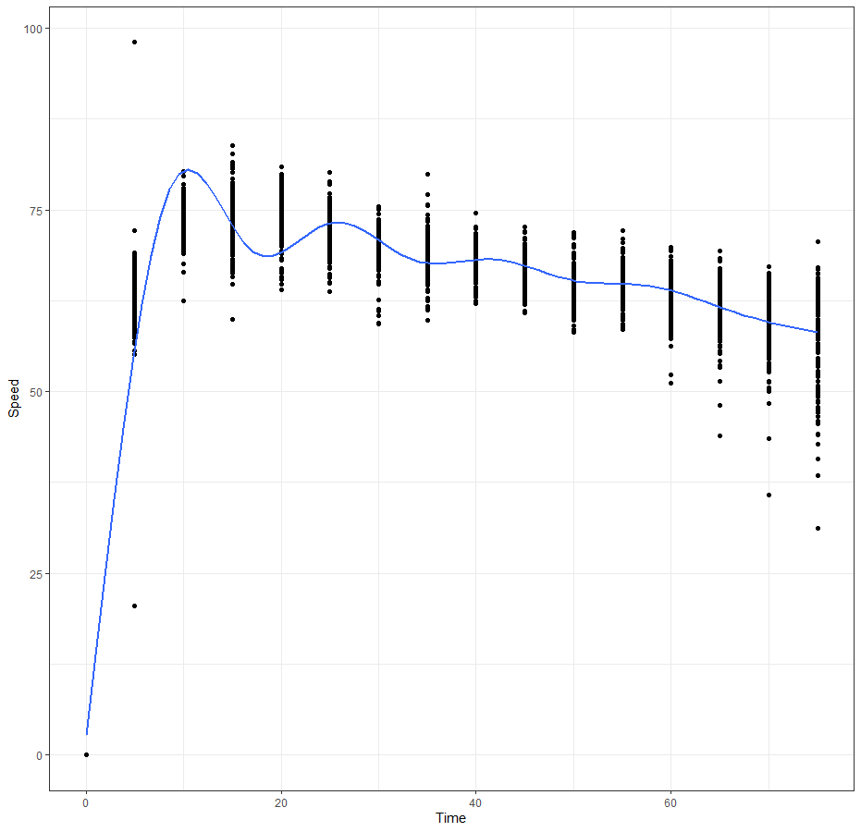
Figure 1 : Speed Via Time by Races
X : Time by Every 5s (0s, 5s, 10s … 75s)
Y: Speed (km/h)
34 races from 12.28 – 12.31
Scatter: Speed distribution in each race via time
Linear: Trend line
Deceasing / Peak at 10s

Slide 9
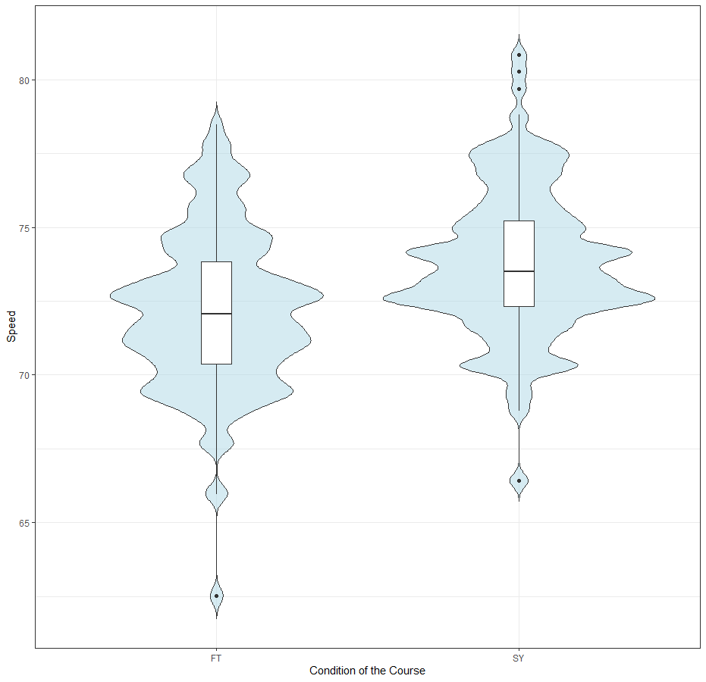
Figure 2 : Speed at 10s over Condition
FT : Fast and SY: Sloppy
Violin: Distribution of Peak Speed via Certain Course Condition
Boxplot: Median of Peak Speed via Certain Course Condition
Median speed on sloppy court is higher than fast court
Distinguish excellent racers from avg.

Slide 10
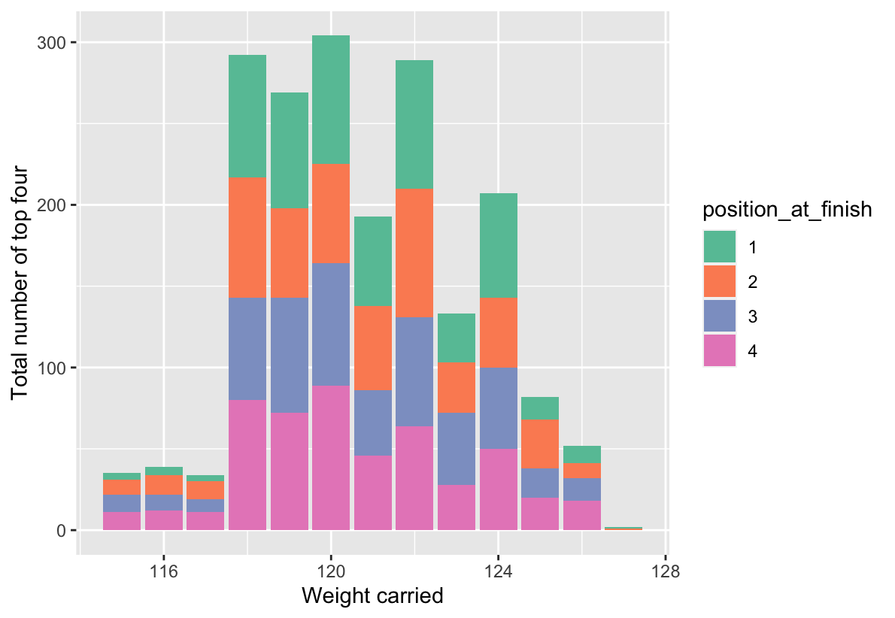
Figure3-Relationship between weight carried and ranking

Slide 11
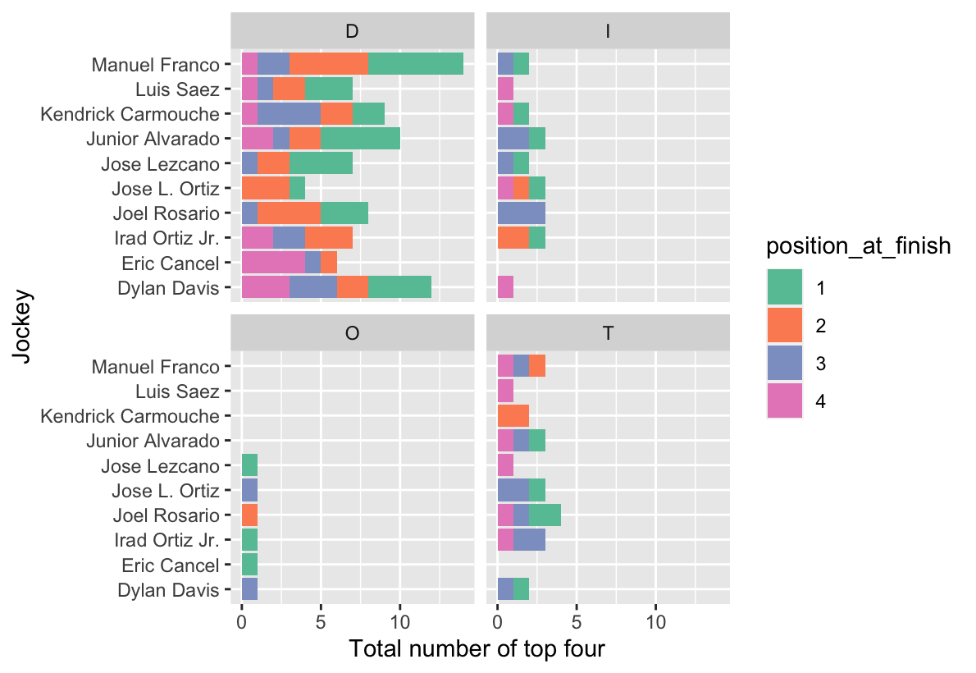
Figure4-Results of the top ten jockeys(by course type)

Slide 12
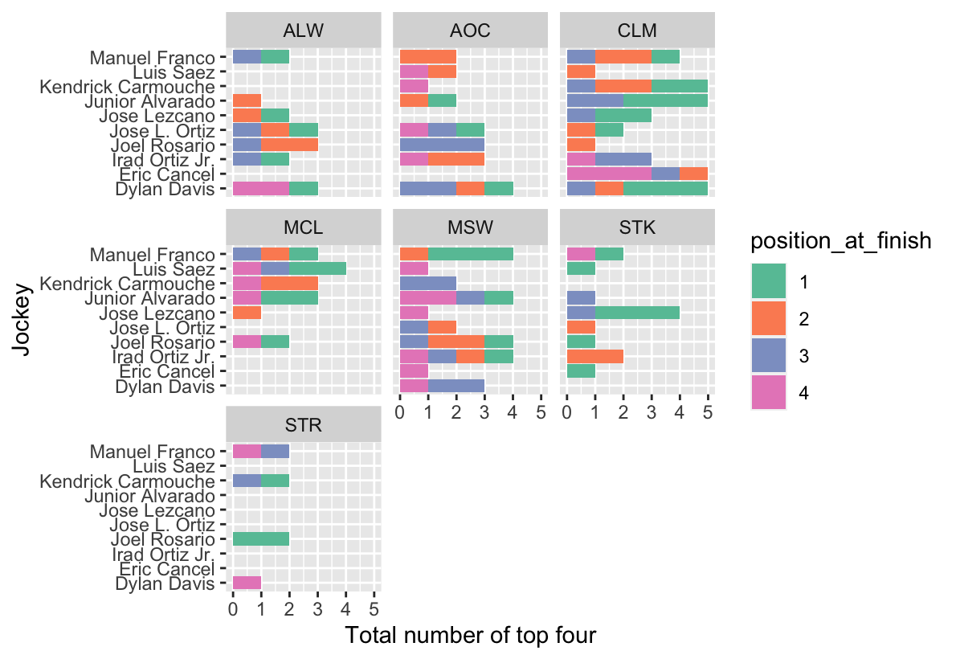
Figure5- Results of the top ten jockeys(by race type)

Slide 13
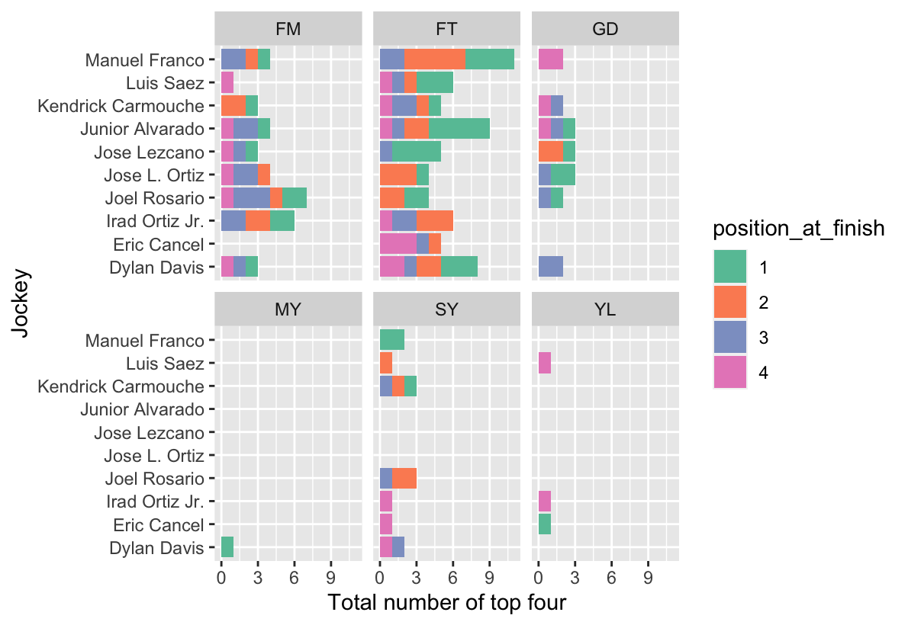
Figure6- Results of the top ten jockeys(by track condition)

Slide 14
Conclusion
Potential Applications
Instruction
For NYRA and NYTHA – Training guide
Prediction
Protection
Horse racing results in future race
Protect horses from being injured
Strategy
Betting
Racing tactics and path efficiency for coach and jockey
Yes I am the gambler

Slide 15
Conclusion
TOO LARGE!!!!!
Pros
Duplicate data
Huge amount of data: more than 550,000 rows
Less related to business
Reliable source:
NYRA and NYTHA
Cons
Comprehensive data:
Three csv files without NA
!

Slide 16
Q&A

