Slide 1

Introduction to Natural Language Processing
BUS 243 F: Spring 2023
Yeabin Moon
Lecture 6

Slide 2
Course evaluation
Please complete the course evaluation!
It’s your turn to give me your feedback on this course
Impossible to know who you are
Do not affect your grade so don’t worry on your brutal feedback
Good NLP resources for me

Slide 3
What are word embeddings?
Again, Word embeddings are one of the most important concepts in modern NLP
Technically, an embedding is a continuous vector representation of something that is usually discrete
represent each word with a 300-element array filled with float numbers

Slide 4
Discreteness of language
In the eyes of computers, “cat” is no closer to “dog” than it is to “pizza”
One way to deal with discrete words programmatically is to assign indices:
Index(“cat”) = 1
Index(“dog”) = 2
Index(“pizza”) = 3
But this method isn’t any better than dealing with raw words

Slide 5
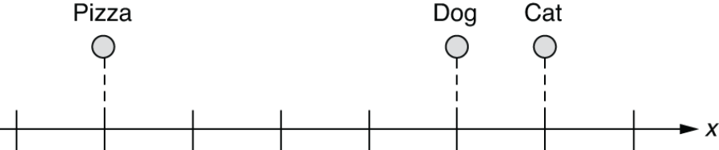
Word embeddings in a 1-D space
What if we can represent them on a numerical scale?
Any limitation?

Slide 6
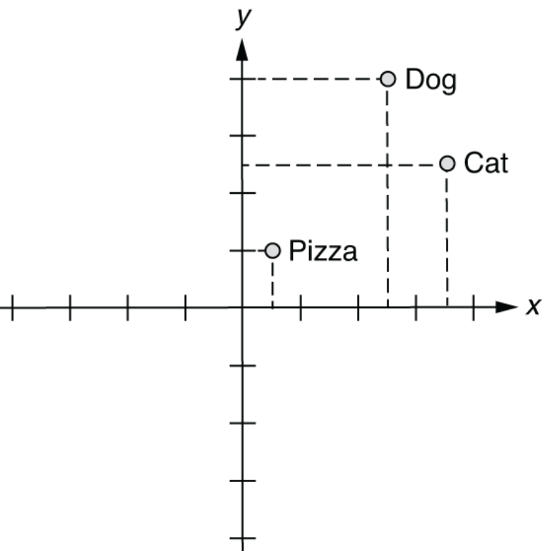
Word embeddings in a 2-D space

Slide 7
How about 3-D?
In this 3-D space, you can represent those three words as follows:
index(“cat”) = [0.7, 0.5, 0.1]
index(“dog”) = [0.8, 0.3, 0.1]
index(“pizza”) = [0.1, 0.2, 0.8]
Possibly attach meanings here
X-axis: some concept of animal-ness
Z-axis: food-ness
This is essentially what word embeddings are

Slide 8
Semantic queries and analogies
With word vectors, you can search for words or names that combine the meaning of the words
Who is to nuclear physics what Louis Pasteur is to germs.
wv['Louis_Pasteur'] - wv['germs'] + wv['physics']

Slide 9
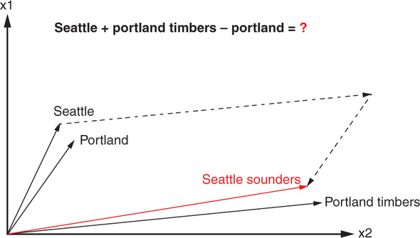
Word analogy?
Portland Timbers + Seattle - Portland = ?

Slide 10
So what?
How to get word embeddings?
Why do we need a neural network?
Efficient Estimation of Word Representations in Vector Space
Mikolov et al. 2013
Illustrate the main ideas using very simple examples

Slide 11
Let’s convert words into numbers just assigning each word to a random number
Consider: Avatar 2 is great!
For the illustrative purpose, we are going to treat Avatar 2 as a single word

Slide 12
Avatar 2
12
is
-3.05
great!
4.2

Slide 13
If the next person said Avatar 2 is awesome!...
Avatar 2
12
is
-3.05
great!
4.2

Slide 14
Then we could reuse the random numbers for Avatar 2 and is
And assign a new random number to the new word, awesome
Avatar 2
12
Avatar 2
is
-3.05
is
great!
4.2
awesome!
-32.1

Slide 15
Looks fine, but it means that even though great! and awesome! mean similar things and are used in similar ways
…they have very different numbers associated with them, 4.2 and -32.1
Avatar 2
12
Avatar 2
is
-3.05
is
great!
4.2
awesome!
-32.1

Slide 16
It would be nice if similar words that are used in similar ways could be given similar numbers…
So that learning how to use one word will help learn how to use the other at the same time
And because the same words can be used in different contexts, or made plural or used in some other way, it might be nice to assign each word more than one number

Slide 17
For example, the word great can be used in a positive way
The NLP course is great!
And it can also be used in a sarcastic, negative way, like
Homework 3 is terrible, great.
It would be nice if we had one number that could keep track of the positive ways that great is used
And a different number to keep track of the negative ways
Let’s see a super simple neural network could do this

Slide 18
Let’s imagine we have two phrases (training data)
Avatar 2 is great!
John Wick 4 is great!
Both movies received positive reviews, so both phrases are in similar contexts
Again Avatar 2 and John Wick 4 are treated as a single word
In order to create a neural net to figure out what number we should associate with each word, let’s create inputs for each unique word
We have 4 unique words in the training data, so 4 inputs!

Slide 19
Now we connect each input to at least 1 Activation Function
Avatar 2
is
great!
John Wick 4

Slide 20
Now we connect each input to at least 1 Activation Function
uses the identity function: the input value is the same as
the output value
Avatar 2
sum
is
y=x
great!
John Wick 4

Slide 21
Now we connect each input to at least 1 Activation Function
uses the identity function: so, this function doesn’t do anything except give us a
place to do addition.
Avatar 2
sum
is
y=x
great!
John Wick 4

Slide 22
The number of Activation functions corresponds to how many numbers we want to associate with each word
Avatar 2
sum
is
y=x
great!
John Wick 4

Slide 23
…and the Weights on these connections will, ultimately, be the numbers that we associate with each word
Avatar 2
sum
is
y=x
great!
John Wick 4

Slide 24
Now, in this example, we want to associate 2 numbers with each word.
Avatar 2
sum
is
y=x
great!
John Wick 4

Slide 25
So, we will use 2 Activation Functions
Avatar 2
0.38
sum
-0.12
is
-0.11
-0.24
great!
0.42
sum
John Wick 4
0.46
0.10
0.29

Slide 26
…and the Weights on the connection to the second Activation Function will be another number associated with each word
Avatar 2
0.38
sum
-0.12
is
-0.11
-0.24
great!
0.42
sum
John Wick 4
0.46
0.10
0.29

Slide 27
However, these weights start out with random values
Avatar 2
0.38
sum
-0.12
is
-0.11
-0.24
great!
0.42
sum
John Wick 4
0.46
0.10
0.29

Slide 28
… that we will optimize with Backpropagation
In order to do Backpropagation, we have to make predictions
Avatar 2
0.38
sum
-0.12
is
-0.11
-0.24
great!
0.42
sum
John Wick 4
0.46
0.10
0.29

Slide 29
We will use the input word
Avatar 2
0.38
sum
-0.12
is
-0.11
-0.24
great!
0.42
sum
John Wick 4
0.46
0.10
0.29

Slide 30
We will use the input word to predict the next word in the phrase
Avatar 2
Avatar 2
0.38
sum
-0.12
is
is
-0.11
-0.24
great!
great!
0.42
sum
John Wick 4
John Wick 4
0.46
0.10
0.29

Slide 31
We can use the word Avatar 2 to predict the word is.
Avatar 2
Avatar 2
0.38
sum
-0.12
is
is
-0.11
-0.24
great!
great!
0.42
sum
John Wick 4
John Wick 4
0.46
0.10
0.29

Slide 32
In other words, if the input word is Avatar 2 and we indicate that by putting a 1 into the Avatar 2 input and 0s into all of the other inputs
Avatar 2
Avatar 2
0.38
1
sum
-0.12
is
is
-0.11
0
-0.24
great!
great!
0
0.42
sum
John Wick 4
John Wick 4
0.46
0
0.10
0.29

Slide 33
…then we want to the output for the next word, is, to have the largest value
Avatar 2
Avatar 2
0.38
1
sum
0.00
-0.12
is
is
-0.11
0
1.00
-0.24
great!
great!
0
0.42
0.00
sum
John Wick 4
John Wick 4
0.46
0
0.10
0.00
0.29

Slide 34
And if the input word is is…
Avatar 2
Avatar 2
0.38
0
sum
-0.12
is
is
-0.11
1
-0.24
great!
great!
0
0.42
sum
John Wick 4
John Wick 4
0.46
0
0.10
0.29

Slide 35
Then we want the output for the next word, great!, to have the largest value
Avatar 2
Avatar 2
0.38
0
sum
0.00
-0.12
is
is
-0.11
1
0.00
-0.24
great!
great!
0
0.42
1.00
sum
John Wick 4
John Wick 4
0.46
0
0.10
0.00
0.29

Slide 36
In order to make these predictions, we connect the Activation functions to outputs
Avatar 2
Avatar 2
0.38
sum
sum
-0.12
is
is
-0.11
sum
-0.24
great!
great!
0.42
sum
sum
John Wick 4
John Wick 4
0.46
sum
0.10
0.29

Slide 37
…and we add Weights to those connections with random initialization values
Avatar 2
Avatar 2
0.38
0.44
sum
sum
-0.12
-0.37
is
is
-0.11
0.43
sum
-0.24
0.09
great!
great!
0.42
0.37
sum
sum
John Wick 4
0.07
John Wick 4
0.46
sum
0.10
0.24
0.29
-0.07

Slide 38
…and then we run the outputs through the SoftMax function because we have multiple outputs for classification
Avatar 2
Avatar 2
0.38
0.44
sum
sum
-0.12
-0.37
is
is
-0.11
0.43
sum
-0.24
0.09
SoftMax
great!
great!
0.42
0.37
sum
sum
John Wick 4
0.07
John Wick 4
0.46
sum
0.10
0.24
0.29
-0.07

Slide 39
…and that means we can use the Cross Entropy loss function for Backpropagation
Avatar 2
Avatar 2
0.38
0.44
sum
sum
-0.12
-0.37
is
is
-0.11
0.43
sum
-0.24
0.09
SoftMax
great!
great!
0.42
0.37
sum
sum
John Wick 4
0.07
John Wick 4
0.46
sum
0.10
0.24
0.29
-0.07

Slide 40
Again, the goal is to train this Neural Network so that it correctly predicts the next word in a phrase
Avatar 2
Avatar 2
0.38
0.44
sum
sum
-0.12
-0.37
is
is
-0.11
0.43
sum
-0.24
0.09
SoftMax
great!
great!
0.42
0.37
sum
sum
John Wick 4
0.07
John Wick 4
0.46
sum
0.10
0.24
0.29
-0.07

Slide 41
And now, before training, if we plug the word Avatar 2 into the input
Avatar 2
Avatar 2
0.38
0.44
1
sum
sum
-0.12
-0.37
is
is
-0.11
0.43
sum
0
-0.24
0.09
SoftMax
great!
great!
0
0.42
0.37
sum
sum
John Wick 4
0.07
John Wick 4
0.46
sum
0
0.10
0.24
0.29
-0.07

Slide 42
…we get lucky and correctly predict the next word, is, but just barely
Avatar 2
Avatar 2
0.38
0.44
1
sum
sum
0.01
0.23
-0.12
-0.37
is
is
-0.11
0.43
sum
0
0.20
0.27
-0.24
0.09
SoftMax
great!
great!
0
0.42
0.37
sum
0.17
0.26
sum
John Wick 4
0.07
John Wick 4
0.46
sum
0.06
0.24
0
0.10
0.24
0.29
-0.07

Slide 43
However, when we plug the word is into the input, we fail to correctly predict the next word, great!, and instead predict is ☹
Avatar 2
Avatar 2
0.38
0.44
0
sum
sum
-0.22
0.22
-0.12
-0.37
is
is
-0.11
0.43
sum
1
-0.01
0.27
-0.24
0.09
SoftMax
great!
great!
0
0.42
0.37
sum
-0.01
0.26
sum
John Wick 4
0.07
John Wick 4
0.46
sum
-0.06
0.25
0
0.10
0.24
0.29
-0.07

Slide 44
So we need to train this Neural Network
Avatar 2
Avatar 2
0.38
0.44
0
sum
sum
-0.22
0.22
-0.12
-0.37
is
is
-0.11
0.43
sum
1
-0.01
0.27
-0.24
0.09
SoftMax
great!
great!
0
0.42
0.37
sum
-0.01
0.26
sum
John Wick 4
0.07
John Wick 4
0.46
sum
-0.06
0.25
0
0.10
0.24
0.29
-0.07

Slide 45
Before we optimize all of the weights, remember that these weights would be the numbers associated with each word
Avatar 2
Avatar 2
0.38
0.44
sum
sum
-0.12
-0.37
is
is
-0.11
0.43
sum
-0.24
0.09
SoftMax
great!
great!
0.42
0.37
sum
sum
John Wick 4
0.07
John Wick 4
0.46
sum
0.10
0.24
0.29
-0.07

Slide 46
And since, in this example, we have 2 weights for each word
Avatar 2
Avatar 2
0.38
0.44
sum
sum
-0.12
-0.37
is
is
-0.11
0.43
sum
-0.24
0.09
SoftMax
great!
great!
0.42
0.37
sum
sum
John Wick 4
0.07
John Wick 4
0.46
sum
0.10
0.24
0.29
-0.07

Slide 47
We can plot each word on a graph
Avatar 2
0.38
sum
-0.12
is
-0.11
-0.24
great!
0.42
sum
John Wick 4
0.46
0.10
0.29

Slide 48
The Weight values to the top activation function on the x-axis
Avatar 2
0.38
sum
-0.12
is
-0.11
-0.24
great!
0.42
sum
John Wick 4
0.46
0.10
0.29

Slide 49
The Weight values to the bottom activation function on the y-axis
Avatar 2
0.38
sum
-0.12
is
-0.11
-0.24
great!
0.42
sum
John Wick 4
0.46
0.10
0.29

Slide 50
Then, relatively plot them
is
Avatar 2
Avatar 2
0.38
sum
-0.12
is
John Wick 4
-0.11
-0.24
great!
0.42
great!
sum
John Wick 4
0.46
0.10
0.29

Slide 51
Now, with this graph, we see that the words Avatar 2 and John Wick 4 are no more similar to each other as they are to any of the other words
is
Avatar 2
Avatar 2
0.38
sum
-0.12
is
John Wick 4
-0.11
-0.24
great!
0.42
great!
sum
John Wick 4
0.46
0.10
0.29

Slide 52
However, because both words appear in the same context in the training data, we hope that backpropagation will make their weights more similar
is
Avatar 2
Avatar 2
0.38
sum
-0.12
is
John Wick 4
-0.11
-0.24
great!
0.42
great!
sum
John Wick 4
0.46
0.10
0.29

Slide 53
So we start with these weights
Avatar 2
Avatar 2
0.38
0.44
sum
sum
-0.12
-0.37
is
is
-0.11
0.43
sum
-0.24
0.09
SoftMax
great!
great!
0.42
0.37
sum
sum
John Wick 4
0.07
John Wick 4
0.46
sum
0.10
0.24
0.29
-0.07

Slide 54
…and we end up with these new
Avatar 2
Avatar 2
2.02
1.16
sum
sum
-2.17
-1.72
is
is
-2.13
3.22
sum
1.73
1.32
SoftMax
great!
great!
1.98
-1.67
sum
sum
John Wick 4
0.86
John Wick 4
2.48
sum
-2.23
-1.69
1.99
3.39

Slide 55
The new Weights on the connections from the inputs to the Activation Functions are the Word Embeddings
Avatar 2
2.02
sum
-2.17
is
-2.13
1.73
great!
1.98
sum
John Wick 4
2.48
-2.23
1.99

Slide 56
And when we plot the words using the new weights, which are now the embeddings
is
Avatar 2
Avatar 2
John Wick 4
2.02
sum
-2.17
is
-2.13
1.73
great!
1.98
great!
sum
John Wick 4
2.48
-2.23
1.99

Slide 57
…we see that Avatar 2 and John Wick 4 are now relatively close to each other
is
Avatar 2
Avatar 2
John Wick 4
2.02
sum
-2.17
is
-2.13
1.73
great!
1.98
great!
sum
John Wick 4
2.48
-2.23
1.99

Slide 58
Now that we’ve trained the neural network, we can see how well it predicts the next word
Avatar 2
Avatar 2
2.02
1.16
sum
sum
-2.17
-1.72
is
is
-2.13
3.22
sum
1.73
1.32
SoftMax
great!
great!
1.98
-1.67
sum
sum
John Wick 4
0.86
John Wick 4
2.48
sum
-2.23
-1.69
1.99
3.39

Slide 59
For example, if we plug the word Avatar 2 into the input
Avatar 2
Avatar 2
2.02
1.16
1
sum
sum
-2.17
-1.72
is
is
-2.13
3.22
sum
0
1.73
1.32
SoftMax
great!
great!
1.98
-1.67
sum
0
sum
John Wick 4
0.86
John Wick 4
2.48
sum
0
-2.23
-1.69
1.99
3.39

Slide 60
…then the output for the next word, is, 1 and everything else is 0
Avatar 2
Avatar 2
2.02
1.16
1
sum
sum
-1.06
0.00
-2.17
-1.72
is
is
-2.13
3.22
sum
0
9.12
1.00
1.73
1.32
SoftMax
great!
great!
1.98
-1.67
sum
-1.67
0.00
0
sum
John Wick 4
0.86
John Wick 4
2.48
sum
-10.1
0
-2.23
-1.69
0.00
1.99
3.39

Slide 61
Other word inputs produce the outputs well!
Avatar 2
Avatar 2
2.02
1.16
1
sum
sum
-1.06
0.00
-2.17
-1.72
is
is
-2.13
3.22
sum
0
9.12
1.00
1.73
1.32
SoftMax
great!
great!
1.98
-1.67
sum
-1.67
0.00
0
sum
John Wick 4
0.86
John Wick 4
2.48
sum
-10.1
0
-2.23
-1.69
0.00
1.99
3.39

Slide 62
Let’s summarize what we’ve learned so far
Avatar 2
Avatar 2
2.02
1.16
1
sum
sum
-1.06
0.00
-2.17
-1.72
is
is
-2.13
3.22
sum
0
9.12
1.00
1.73
1.32
SoftMax
great!
great!
1.98
-1.67
sum
-1.67
0.00
0
sum
John Wick 4
0.86
John Wick 4
2.48
sum
-10.1
0
-2.23
-1.69
0.00
1.99
3.39

Slide 63
First, rather than just assign random numbers to words…
Avatar 2
12
Avatar 2
is
-3.05
is
great!
4.2
awesome!
-32.1

Slide 64
…we can train a relatively simple Neural Network to assign numbers for us
Avatar 2
Avatar 2
2.02
1.16
1
sum
sum
-2.17
-1.72
is
is
-2.13
3.22
sum
0
1.73
1.32
SoftMax
great!
great!
1.98
-1.67
sum
0
sum
John Wick 4
0.86
John Wick 4
2.48
sum
0
-2.23
-1.69
1.99
3.39

Slide 65
The advantage of using a neural network is that it can use the contexts of words in the training dataset
Avatar 2
Avatar 2
2.02
1.16
1
sum
sum
-2.17
-1.72
is
is
-2.13
3.22
sum
0
1.73
1.32
SoftMax
great!
great!
1.98
-1.67
sum
0
sum
John Wick 4
0.86
John Wick 4
2.48
sum
0
-2.23
-1.69
1.99
3.39

Slide 66
…to optimize Weights that can be used for the embeddings…
Avatar 2
Avatar 2
2.02
1.16
1
sum
sum
-2.17
-1.72
is
is
-2.13
3.22
sum
0
1.73
1.32
SoftMax
great!
great!
1.98
-1.67
sum
0
sum
John Wick 4
0.86
John Wick 4
2.48
sum
0
-2.23
-1.69
1.99
3.39

Slide 67
… this can result in similar words ending up with similar embeddings
is
Avatar 2
Avatar 2
John Wick 4
2.02
sum
-2.17
is
-2.13
1.73
great!
1.98
great!
sum
John Wick 4
2.48
-2.23
1.99

Slide 68
Lastly, having similar words with similar embeddings means training a neural network to process language is easier…
is
Avatar 2
Avatar 2
John Wick 4
2.02
sum
-2.17
is
-2.13
1.73
great!
1.98
great!
sum
John Wick 4
2.48
-2.23
1.99

Slide 69
…because learning how one word is used helps learn how similar words are used
is
Avatar 2
Avatar 2
John Wick 4
2.02
sum
-2.17
is
-2.13
1.73
great!
1.98
great!
sum
John Wick 4
2.48
-2.23
1.99

Slide 70
Now, so far, we’ve shown we can train a neural network to predict the next word in each phrase…
is
Avatar 2
Avatar 2
John Wick 4
2.02
sum
-2.17
is
-2.13
1.73
great!
1.98
great!
sum
John Wick 4
2.48
-2.23
1.99

Slide 71
…but just predicting the next word doesn’t give us a lot of context to understand each one
is
Avatar 2
Avatar 2
John Wick 4
2.02
sum
-2.17
is
-2.13
1.73
great!
1.98
great!
sum
John Wick 4
2.48
-2.23
1.99

Slide 72
So, now let’s learn about the 2 strategies that word2vec, a popular method for creating word embeddings, uses to include more context
is
Avatar 2
Avatar 2
John Wick 4
2.02
sum
-2.17
is
-2.13
1.73
great!
1.98
great!
sum
John Wick 4
2.48
-2.23
1.99

Slide 73
Now we have the last quiz

Slide 74
The first method, called Continuous Bag of Words, increases the context by using the surrounding words to predict what occurs in the middle
Avatar 2
Avatar 2
1
sum
sum
0.00
is
is
0
sum
1.00
SoftMax
great!
great!
1
sum
0.00
sum
John Wick 4
John Wick 4
sum
0
0.00

Slide 75
For example, the Continuous Bag of Words method could use the words Avatar 2 and great! to predict the word that occurs between them, is.
Avatar 2
Avatar 2
1
sum
sum
0.00
is
is
0
sum
1.00
SoftMax
great!
great!
1
sum
0.00
sum
John Wick 4
John Wick 4
sum
0
0.00

Slide 76
The second method, called Skip Gram, increases the context by using the word in the middle to predict the surrounding words
Avatar 2
Avatar 2
0
sum
sum
0.33
is
is
1
sum
0.00
SoftMax
great!
great!
0
sum
0.33
sum
John Wick 4
John Wick 4
sum
0
0.33

Slide 77
For example, the Skip Gram method could use the word is to predict the surrounding words, Avatar 2, great!, and John Wick 4.
Avatar 2
Avatar 2
0
sum
sum
0.33
is
is
1
sum
0.00
SoftMax
great!
great!
0
sum
0.33
sum
John Wick 4
John Wick 4
sum
0
0.33

Slide 78
Lastly, just know that in practice, instead of using just 2 activation functions to create 2 Embeddings per word…
Avatar 2
Avatar 2
sum
sum
is
is
sum
SoftMax
great!
great!
sum
sum
John Wick 4
John Wick 4
sum

Slide 79
…people often use 100 or more activation functions to create a lot of Embeddings per word
Avatar 2
Avatar 2
sum
sum
is
is
sum
SoftMax
great!
great!
sum
sum
John Wick 4
John Wick 4
sum

Slide 80
And instead of using two sentences to for training, they use the entire Wikipedia
Avatar 2
Avatar 2
sum
is
is
sum
SoftMax
great!
great!
sum
John Wick 4
John Wick 4
sum

Slide 81
Thus, instead of just having a vocabulary of 2 words and phrases
Avatar 2
Avatar 2
sum
is
is
sum
SoftMax
great!
great!
sum
John Wick 4
John Wick 4
sum

Slide 82
…word2vec might have a vocabulary of about 3,000,000 words and phrases
A
A
sum
aardvark
aardvark
sum
SoftMax
abandon
abandon
sum
…
…
sum

Slide 83
Therefore, the total number of weights in this neural network that we need to optimize is
A
A
sum
aardvark
aardvark
sum
SoftMax
abandon
abandon
sum
…
…
sum

Slide 84
3,000,000 words and phrases
A
A
sum
aardvark
aardvark
sum
SoftMax
abandon
abandon
sum
…
…
sum

Slide 85
Times at least 100, the number weights each word has going to the activation functions…
A
A
sum
aardvark
aardvark
sum
SoftMax
abandon
abandon
sum
…
…
sum

Slide 86
…times 2, for the weights that get us from the activation functions to the outputs
A
A
sum
aardvark
aardvark
sum
SoftMax
abandon
abandon
sum
…
…
sum

Slide 87
3,000,000 X 100 X 2 = 600,000,000 weights
So, training can be slow.
A
A
sum
aardvark
aardvark
sum
SoftMax
abandon
abandon
sum
…
…
sum

Slide 88
However, one way that word2vec speeds things up is to use something called negative sampling.
A
A
sum
aardvark
aardvark
sum
SoftMax
abandon
abandon
sum
…
…
sum

Slide 89
Negative sampling works by randomly selecting a subset of words we don’t want to predict for optimization
A
A
sum
aardvark
aardvark
sum
SoftMax
abandon
abandon
sum
…
…
sum

Slide 90
For example, say like we wanted the word aardvark to predict the word A.
A
A
sum
aardvark
aardvark
sum
SoftMax
abandon
abandon
sum
…
…
sum

Slide 91
That means that only the word aardvark has a 1 in it, and all the other words have 0s
A
A
0
sum
aardvark
aardvark
1
sum
SoftMax
abandon
abandon
0
sum
…
…
0
sum

Slide 92
… and that means we can ignore the weights coming from every word but aardvark, because the other words multiply their weights by 0
A
A
0
sum
aardvark
aardvark
1
sum
SoftMax
abandon
abandon
0
sum
…
…
0
sum

Slide 93
However, we still have 300,000,000 weights after the activation function
A
A
0
sum
aardvark
aardvark
1
sum
SoftMax
abandon
abandon
0
sum
…
…
0
sum

Slide 94
So, because we want to predict the word A…
A
A
0
sum
aardvark
aardvark
1
sum
SoftMax
abandon
abandon
0
sum
…
…
0
sum

Slide 95
…then we don’t want to predict aardvark, abandon and all of the other words
A
A
0
sum
aardvark
aardvark
1
sum
SoftMax
abandon
abandon
0
sum
…
…
0
sum

Slide 96
So, for this example, let’s imagine word2vec randomly selects abandon as a word we don’t want to predict
A
A
0
sum
aardvark
aardvark
1
sum
SoftMax
abandon
abandon
0
sum
…
…
0
sum

Slide 97
Note: In practice, word2vec would select between 2 and 20 words that we don’t want to predict
A
A
0
sum
aardvark
aardvark
1
sum
SoftMax
abandon
abandon
0
sum
…
…
0
sum

Slide 98
However, in this example, we just select one, abandon.
A
A
0
sum
aardvark
aardvark
1
sum
SoftMax
abandon
abandon
0
sum
…
…
0
sum

Slide 99
So now, word2vec only uses the output values for A and abandon.
A
A
0
sum
aardvark
aardvark
1
sum
SoftMax
abandon
abandon
0
sum
…
…
0
sum

Slide 100
And that means for this round of backpropagation, we can ignore the weights that lead to the all of the other possible outputs
A
A
0
sum
aardvark
aardvark
1
sum
SoftMax
abandon
abandon
0
sum
…
…
0
sum

Slide 101
So, in the end, out of the 600,000,000 total weights in this neural network, we only optimize 300 per step
A
A
0
sum
aardvark
aardvark
1
sum
SoftMax
abandon
abandon
0
sum
…
…
0
sum

Slide 102
And this is one way that word2vec can efficiently create lots of word embeddings for each word in a large vocabulary
A
A
0
sum
aardvark
aardvark
1
sum
SoftMax
abandon
abandon
0
sum
…
…
0
sum

Slide 103
What are word embeddings?
Again, Word embeddings are one of the most important concepts in modern NLP
Technically, an embedding is a continuous vector representation of something that is usually discrete
A word embedding is a continuous vector representation of a word
In simpler terms, word embeddings are a way to represent each word with a 300-element array filled with nonzero float numbers

Slide 104
Discreteness of language
In the eyes of computers, “cat” is no closer to “dog” than it is to “pizza”
One way to deal with discrete words programmatically is to assign indices:
Index(“cat”) = 1
Index(“dog”) = 2
Index(“pizza”) = 3
But this method isn’t any better than dealing with raw words

Slide 105
Word embeddings in a 1-D space
What if we can represent them on a numerical scale?
This is a step forward.
What if you wanted to place it somewhere that is equally far from “cat” and “dog?”

Slide 106
Word embeddings in a 2-D space

Slide 107
How about 3-D?
In this 3-D space, you can represent those three words as follows:
index(“cat”) = [0.7, 0.5, 0.1]
index(“dog”) = [0.8, 0.3, 0.1]
index(“pizza”) = [0.1, 0.2, 0.8]
Possibly attach meanings here
X-axis: some concept of animal-ness
Z-axis: food-ness
This is essentially what word embeddings are
if you wanted to identify animal names, then you would just look at the first element of each word vector and see if the value is high enough

Slide 108
How about one-hot vectors, then?
By the way, we have a much simpler method to “embed” words into a multidimensional space
index(“cat”) = [1, 0, 0]
index(“dog”) = [0, 1, 0]
index(“pizza”) = [0, 0, 1]
Not very useful in representing semantic relationship between them
All at equal distance from each other
They are often used as the input when embeddings are not available

Slide 109
Semantic queries and analogies
With word vectors, you can search for words or names that combine the meaning of the words
Analogy questions: Who is to nuclear physics what Louis Pasteur is to germs.
wv['Louis_Pasteur'] - wv['germs'] + wv['physics']

Slide 110
Word analogy?
Portland Timbers + Seattle - Portland = ?

Slide 111
Word2vec
In 2012, Thomas Mikolov, an intern at Microsoft, found a way to encode the meaning of words in a modest number of vector dimension
Mikolov trained a neural network to predict word occurrences near each target word
Word2vec learns the meaning of words merely by processing a large corpus of unlabeled text

Slide 112
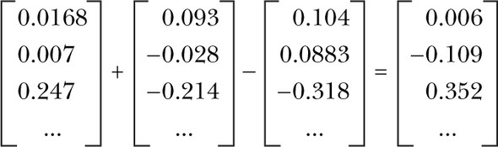
Vector-oriented reasoning
The Word2vec model contains information about the relationships between words
After adding and subtracting word vectors, your resultant vector will almost never exactly equal one of the vectors in your word vector vocabulary

Slide 113
Very high accuracy
Word2vec allows you to transform your natural language vectors of token occurrence counts and frequencies into the vector space of much lower-dimensional Word2vec vectors.
In this lower-dimensional space, you can do your math and then convert back to a natural language space, very successfully
The reference implementation was trained on the 100 billion words from the Google News Corpus
Also discover the distance between the singular and plural versions of a word quite similar

Slide 114
Application first: Gensim
For looking at word vectors, we’ll use Gensim
We also use it in homework for word vectors
Gensim isn’t really a deep learning package.
It's a package for for word and text similarity modeling, which started with (LDA-style) topic models and grew into SVD and neural word representations.
But its efficient and scalable, and quite widely used
See the code

Slide 115
How to compute word vectors?
Calculate word embeddings from large textual data using two popular algorithms
Skip-gram and CBOW
Where word embeddings come from?
index(“cat”) = [0.7, 0.5, 0.1]
index(“dog”) = [0.8, 0.3, 0.1]
index(“pizza”) = [0.1, 0.2, 0.8]
More importantly, what should those numbers look like?

Slide 116
Word associations
The answer is that those numbers are also trained using a training dataset and a machine learning model like any other model
I’ll introduce and implement one of the most popular models to train word embeddings—the Skip-gram model.
First, let’s step back and think how humans learn concepts such as “a dog.”
You did not learn it by definition
What’s the definition of a dog by the way?
You acquire the concept through a large amount of physical, cognitive, and linguistic interactions with the external world

Slide 117
How about a computer?
One possible way to do this without teaching the computer what “dog” means is to use association relative to other words.
What words tend to appear together with the word “dog” if you look at its appearances in a large text corpus?
“Pet,” “tail,” “smell,” “bark,” “puppy”, etc.
How about ”cat”?
Because “dog” and “cat” have a lot in common conceptually, these two sets of context words also have large overlap

Slide 118
Distributional hypothesis
You can guess how close two words are to each other by looking at what other words appear in the same context
This is called the distributional hypothesis
Word2vec led to a lot of work (both pure and applied) in the direction of learning text representations using neural networks
Let’s build an intuition of how they work and how to use them to represent text

Slide 119
Word2vec revisit
The aim is to learn embeddings for every word in the corpus such that the word vector in the embedding space best captures its meaning
That is, it derives the meaning of a word from its context: words that appear in its neighborhood in the text
words that appear in its neighborhood in the text

Slide 120
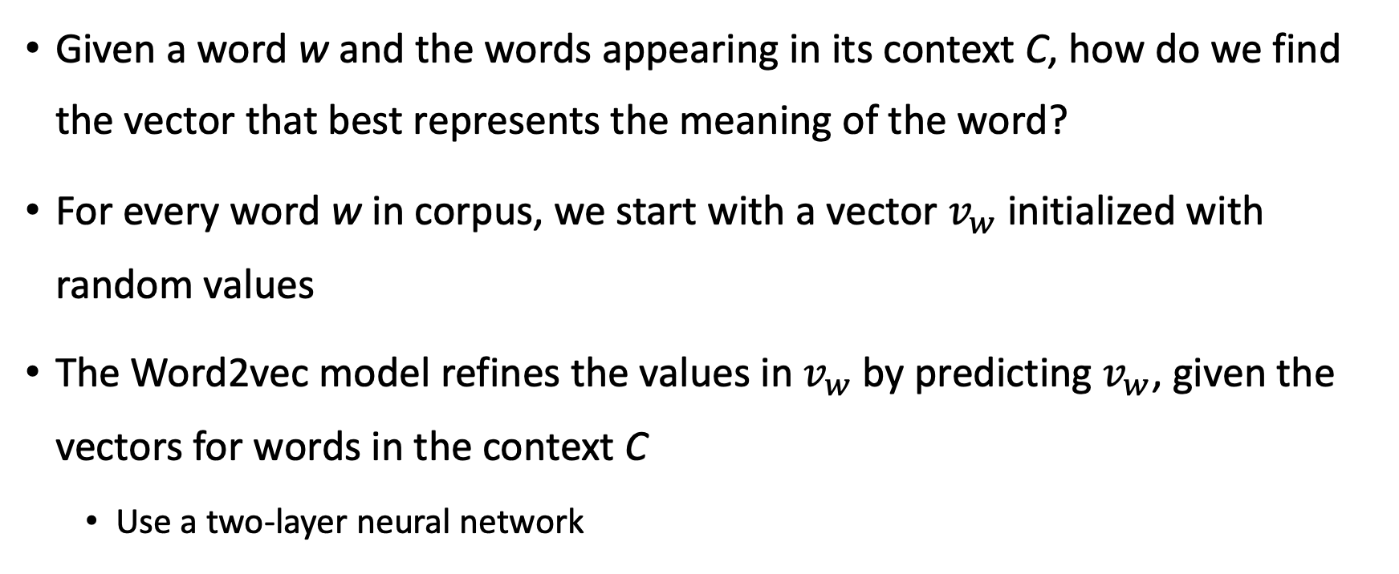
Given a word w and the words appearing in its context C, how do we find the vector that best represents the meaning of the word?
For every word w in corpus, we start with a vector $v_{w}$ initialized with random values
The Word2vec model refines the values in $v_{w}$by predicting $v_{w}$, given the vectors for words in the context C
Use a two-layer neural network

Slide 121
Training your own word embeddings is a pretty expensive process
Thankfully, it’s not necessary to train your own embeddings, and using pre-trained word embeddings often suffices
Someone has done the hard work of training word embeddings on a large corpus
Word2vec by Google
GloVe by Stanford
Fasttext by Facebook
See the code earlier!

Slide 122
Application in practice
NLP develops really fast
Pretty obsess with methodology, but more important criteria is the logic
Nature paper

