Slide 1


BUS 243
Lecture 6: Distributional Semantics

Slide 2
Word vectors
One of the most exciting recent advancements in NLP is the discovery of word vectors
In the previous lectures, we understood the semantics in a statistical way
Now, introduce the effect the neighbors of a word
have on its meaning
how those relationships affect the overall meaning of a statement

Slide 3
Problem with words as discrete symbols
E.g: in web search, if a user searches for “Seattle motel”, we’d like to match documents containing “Seattle hotel”
But see: [0 0 0 0 1 0 0 0] , [0 0 1 0 0 0 0 0]
Theses two vectors are orthogonal
No natural notion of similarity for one-hot vectors
Could try to rely on WordNet’s list of synonyms to get similarity?
But it is well-known to fail badly
Instead, learn to encode similarity in the vectors themselves

Slide 4
Representing words by their context
Distributional semantics: A word’ meaning is given by the words that frequently appear close-by
J. R. Firth 1957: You shall know a word by the company it keeps
One of the most successful ideas of modern statistical NLP
When a word w appears in a text, its context is the set of words that appear nearby
Within a fixed-size window

Slide 5
Context, context, context
We use the many contexts of w to build up a representation of w
The following context words will represent banking
…government debt problems turning into banking crises as happened in 2009…
…saying that Europe needs unified banking regulation to replace the hodgepodge…
…India has just given its banking system a shot in the arm…

Slide 6
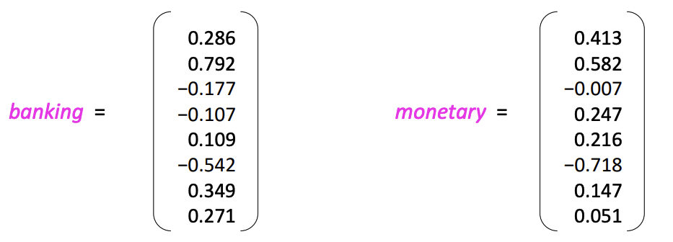
Word vectors
We will build a dense vector for each word, chosen so that it is similar to vectors of words that appear in similar contexts, measuring similarity as the vector dot (scalar) product
Note: word vectors are also called (word) embeddings or (neural) word representations
They are a distributed representation

Slide 7
What are word embeddings?
Again, Word embeddings are one of the most important concepts in modern NLP
Technically, an embedding is a continuous vector representation of something that is usually discrete
A word embedding is a continuous vector representation of a word
In simpler terms, word embeddings are a way to represent each word with a 300-element array filled with nonzero float numbers

Slide 8
Discreteness of language
In the eyes of computers, “cat” is no closer to “dog” than it is to “pizza”
One way to deal with discrete words programmatically is to assign indices:
Index(“cat”) = 1
Index(“dog”) = 2
Index(“pizza”) = 3
But this method isn’t any better than dealing with raw words

Slide 9
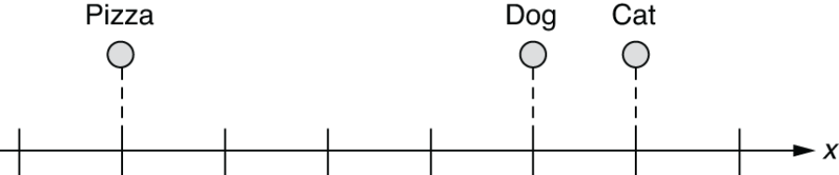
Word embeddings in a 1-D space
What if we can represent them on a numerical scale?
This is a step forward.
What if you wanted to place it somewhere that is equally far from “cat” and “dog?”

Slide 10
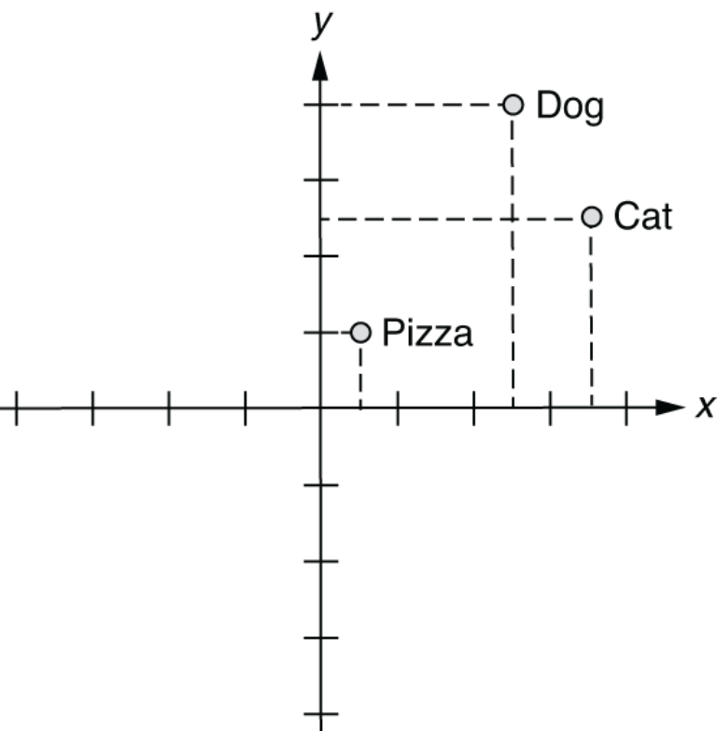
Word embeddings in a 2-D space

Slide 11
How about 3-D?
In this 3-D space, you can represent those three words as follows:
index(“cat”) = [0.7, 0.5, 0.1]
index(“dog”) = [0.8, 0.3, 0.1]
index(“pizza”) = [0.1, 0.2, 0.8]
Possibly attach meanings here
X-axis: some concept of animal-ness
Z-axis: food-ness
This is essentially what word embeddings are
if you wanted to identify animal names, then you would just look at the first element of each word vector and see if the value is high enough

Slide 12
How about one-hot vectors, then?
By the way, we have a much simpler method to “embed” words into a multidimensional space
index(“cat”) = [1, 0, 0]
index(“dog”) = [0, 1, 0]
index(“pizza”) = [0, 0, 1]
Not very useful in representing semantic relationship between them
All at equal distance from each other
They are often used as the input when embeddings are not available

Slide 13
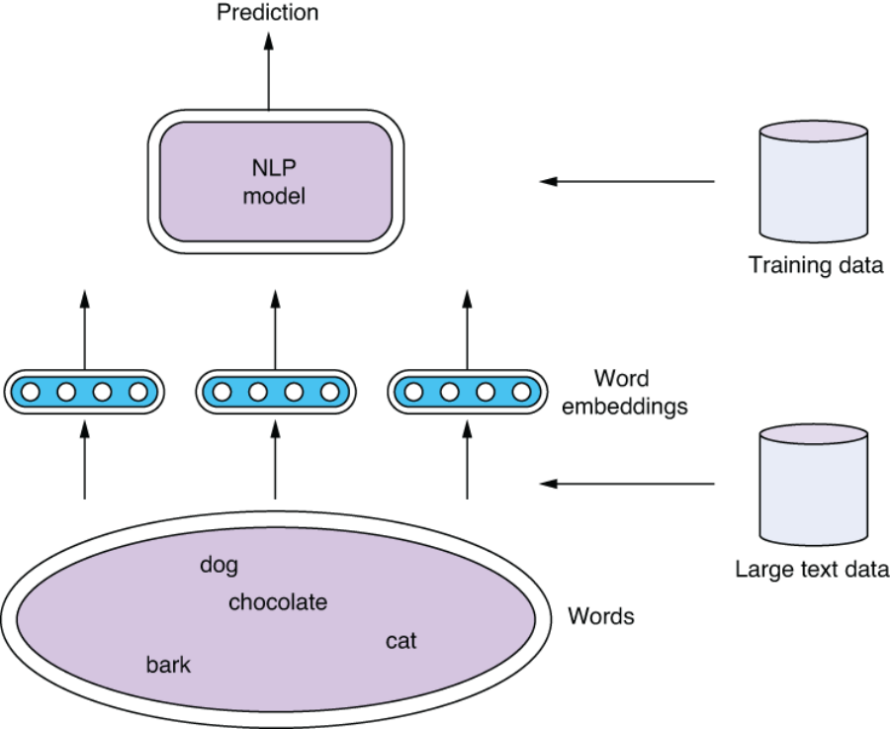

Slide 14
Word2vec
In 2012, Thomas Mikolov, an intern at Microsoft, found a way to encode the meaning of words in a modest number of vector dimension
Mikolov trained a neural network to predict word occurrences near each target word
Word2vec learns the meaning of words merely by processing a large corpus of unlabeled text

Slide 15
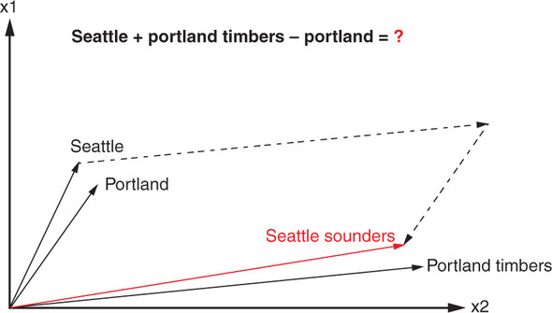
Remarkable accuracy
Portland Timbers + Seattle - Portland = ?

Slide 16
Very high accuracy
Word2vec allows you to transform your natural language vectors of token occurrence counts and frequencies into the vector space of much lower-dimensional Word2vec vectors.
In this lower-dimensional space, you can do your math and then convert back to a natural language space, very successfully
The reference implementation was trained on the 100 billion words from the Google News Corpus
Also discover the distance between the singular and plural versions of a word quite similar

Slide 17
Common methods for getting short dense vectors
“Neural Language Model”-inspired models
Word2vec (skip-gram, CBOW), GloVe
Singular Value Decomposition (SVD)
A special case of this is called LSA – Latent Semantic Analysis
Alternative to these "static embeddings”
Contextual Embeddings (ELMo, BERT, GPT)
Compute distinct embeddings for a word in its context
Separate embeddings for each token of a word

Slide 18
Why Word2vec?
Yes, popular
Fast to train
Code available on the web
Archive: https://code.google.com/archive/p/word2vec/
Easy way: Gensim
Hard way: https://www.tensorflow.org/tutorials/text/word2vec
Word2vec provides various options
We focus on skip-gram

Slide 19
Why Word2vec?
Yes, popular
Fast to train
Code available on the web
Archive: https://code.google.com/archive/p/word2vec/
Easy way: Gensim
Hard way: https://www.tensorflow.org/tutorials/text/word2vec
Word2vec provides various options
We focus on skip-gram

Slide 20
Let’s see what we want, first

Slide 21
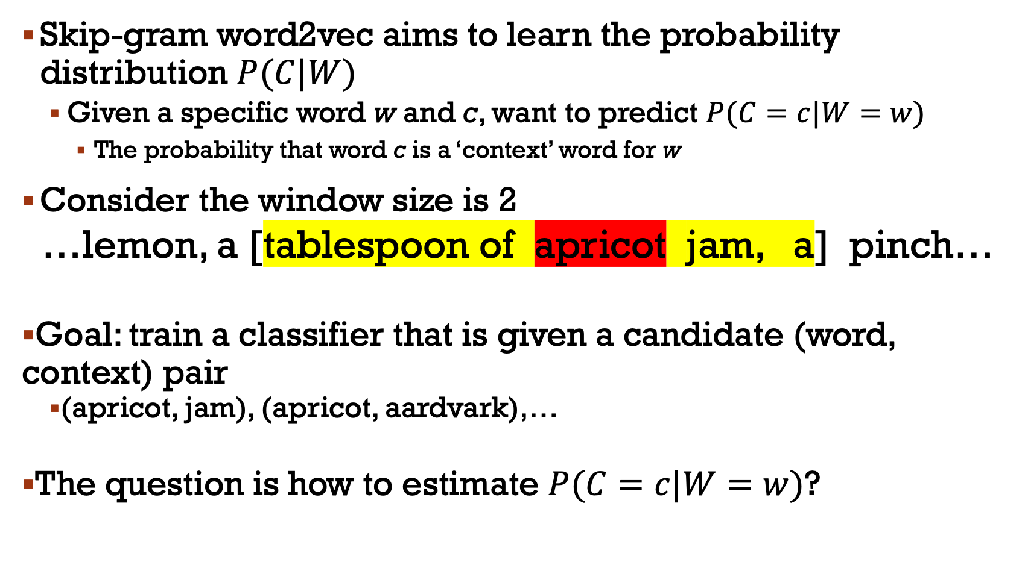
Skip-gram word2vec aims to learn the probability distribution $P(C|W)$
Given a specific word w and c, want to predict $P(C=c|W=w)$
The probability that word c is a ‘context’ word for w
Consider the window size is 2
…lemon, a [tablespoon of apricot jam, a] pinch…
Goal: train a classifier that is given a candidate (word, context) pair
(apricot, jam), (apricot, aardvark),…
The question is how to estimate $P(C=c|W=w)$?

Slide 22
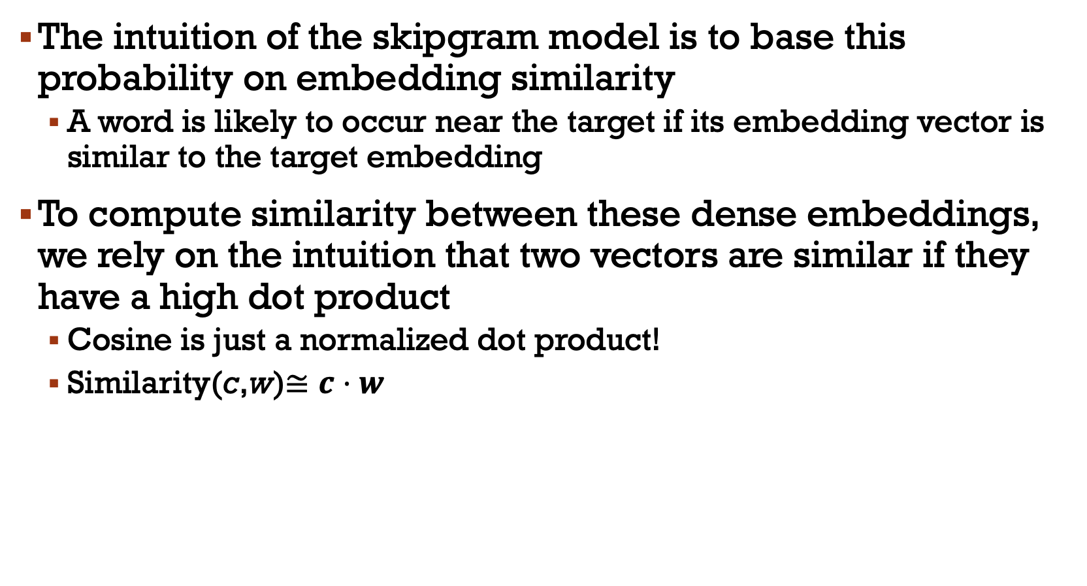
The intuition of the skipgram model is to base this probability on embedding similarity
A word is likely to occur near the target if its embedding vector is similar to the target embedding
To compute similarity between these dense embeddings, we rely on the intuition that two vectors are similar if they have a high dot product
Cosine is just a normalized dot product!
Similarity(c,w)$≅c⋅w$

Slide 23
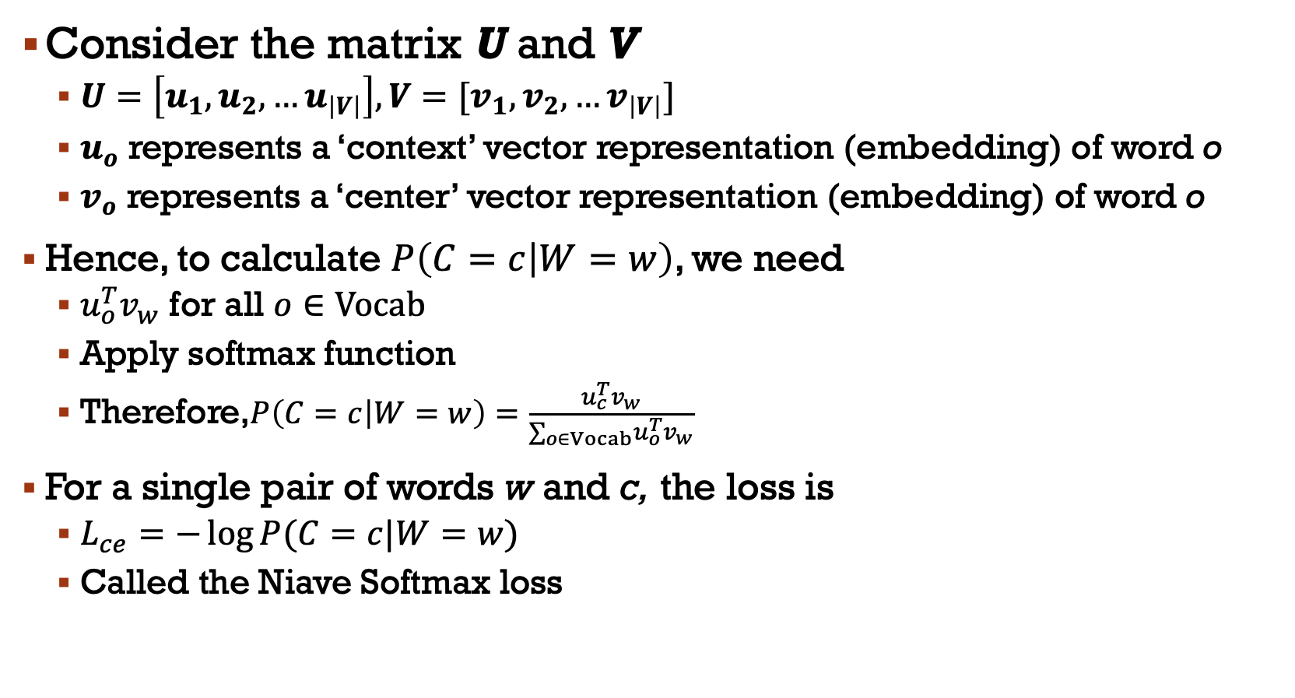
Consider the matrix U and V
$U=\left[u_{1},u_{2},…u_{\left|V\right|}\right],V=[v_{1},v_{2},…v_{\left|V\right|}]$
$u_{o}$ represents a ‘context’ vector representation (embedding) of word o
$v_{o}$ represents a ‘center’ vector representation (embedding) of word o
Hence, to calculate $P\left(C=c | W=w\right)$, we need
$u_{o}^{T}v_{w}$ for all $o∈Vocab$
Apply softmax function
Therefore,$P\left(C=c | W=w\right)=\frac{u_{c}^{T}v_{w}}{∑_{o∈Vocab}u_{o}^{T}v_{w}}$
For a single pair of words w and c, the loss is
$L_{ce}=−\log{P(C=c|W=w)}$
Called the Niave Softmax loss

Slide 24
Word2vec uses the Negative Sampling loss
Treat the target (center) word w and a context word c as positive examples
Randomly sample other words in the lexicon to get negative examples
Use logistic (sigmoid) to train a classifier to distinguish those two cases
Use the learned weights as the embeddings

Slide 25
Skip-Gram Training data
…lemon, a [tablespoon of apricot jam, a] pinch…
Notes:
Here's the setting where k = 2, so we’ll have 2 negative examples in the negative training set − for each positive example w,cpos. The noise words are chosen according to their weighted unigram frequency.

Slide 26
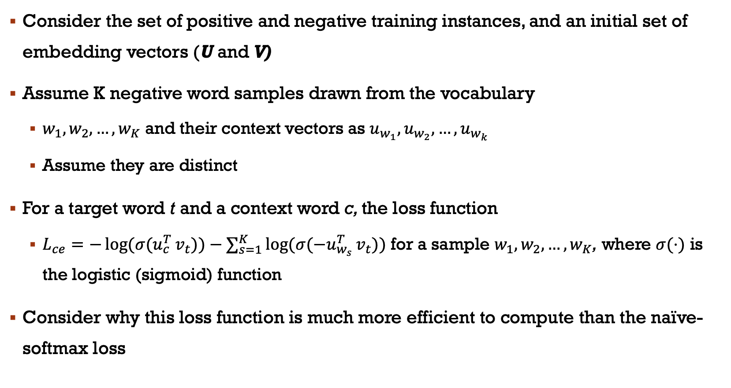
Consider the set of positive and negative training instances, and an initial set of embedding vectors (U and V)
Assume K negative word samples drawn from the vocabulary
$w_{1},w_{2},…,w_{K}$ and their context vectors as $u_{w_{1}},u_{w_{2}},…,u_{w_{k}}$
Assume they are distinct
For a target word t and a context word c, the loss function
$L_{ce}=−{\log{(σ(u}}_{c}^{T}v_{t}))−∑_{s=1}^{K}{\log{(σ(−u}}_{w_{s}}^{T}v_{t}))$ for a sample $w_{1},w_{2},…,w_{K}$, where $σ(⋅)$ is the logistic (sigmoid) function
Consider why this loss function is much more efficient to compute than the naïve-softmax loss

Slide 27
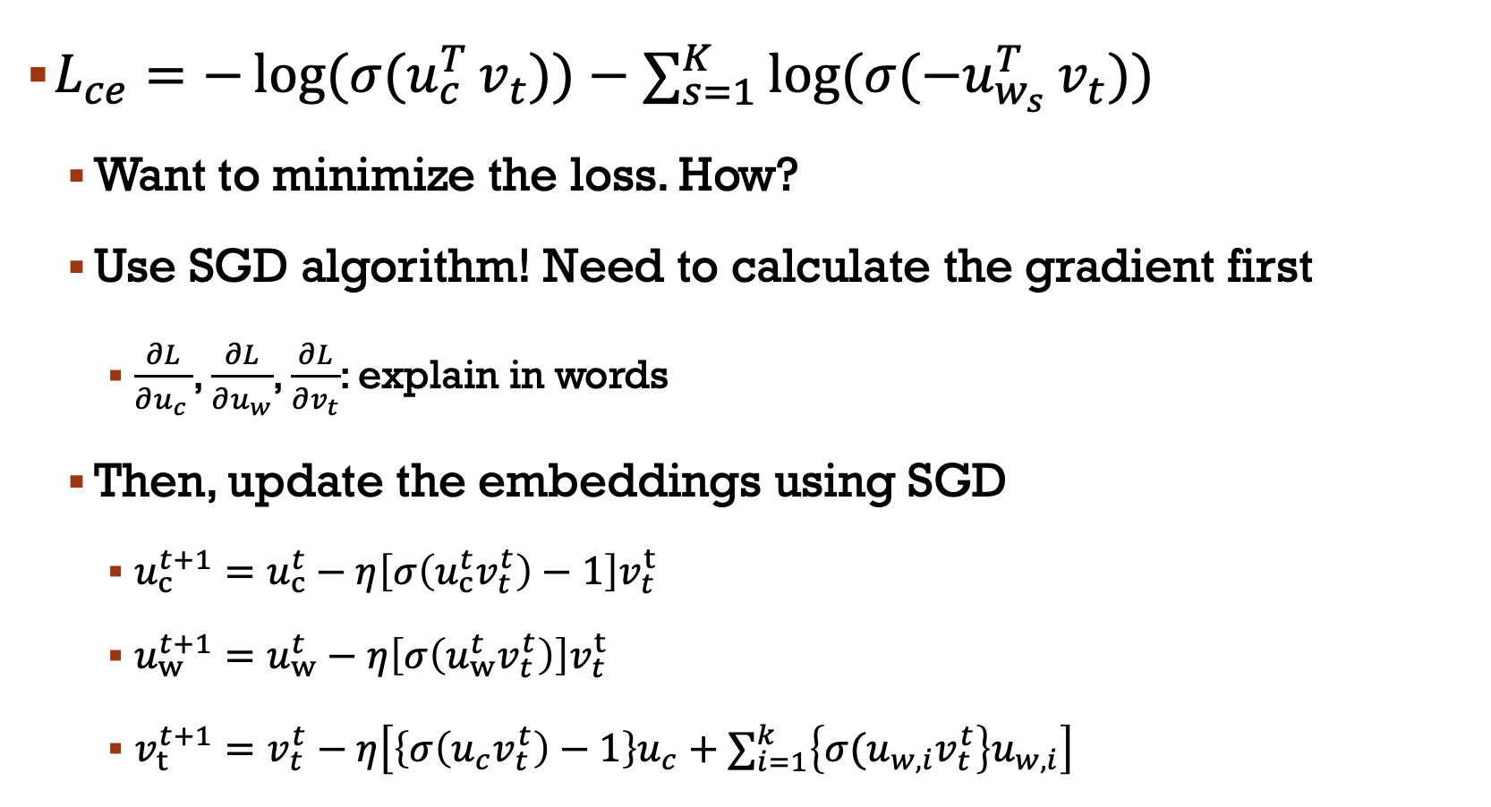
$L_{ce}=−{\log{(σ(u}}_{c}^{T}v_{t}))−∑_{s=1}^{K}{\log{(σ(−u}}_{w_{s}}^{T}v_{t}))$
Want to minimize the loss. How?
Use SGD algorithm! Need to calculate the gradient first
$\frac{∂L}{∂u_{c }}$, $\frac{∂L}{∂u_{w}}$, $\frac{∂L}{∂v_{t}}$: explain in words
Then, update the embeddings using SGD
$u_{c}^{t+1}=u_{c}^{t}−η\left[σ\left(u_{c}^{t}v_{t}^{t}\right)−1\right]v_{t}^{t}$
$u_{w}^{t+1}=u_{w}^{t}−η\left[σ\left(u_{w}^{t}v_{t}^{t}\right)\right]v_{t}^{t}$
$v_{t}^{t+1}=v_{t}^{t}−η\left[\left\{σ\left(u_{c}v_{t}^{t}\right)−1\right\}u_{c}+∑_{i=1}^{k}\left\{σ(u_{w,i}v_{t}^{t}\right\}u_{w,i}\right]$

Slide 28
Application: Gensim
For looking at word vectors, we’ll use Gensim
We also use it in homework for word vectors
Gensim isn’t really a deep learning package.
It's a package for for word and text similarity modeling, which started with (LDA-style) topic models and grew into SVD and neural word representations.
But its efficient and scalable, and quite widely used

Slide 29
Discussions
What’s the size of window in the previous example?
Small windows (C= +/- 2)
nearest words are syntactically similar words in same taxonomy
Hogwarts nearest neighbors are other fictional schools
Sunnydale, Evernight, Blandings
Large windows (C= +/- 5)
nearest words are related words in same semantic field
Hogwarts nearest neighbors are Harry Potter world:
Dumbledore, half-blood, Malfoy

Slide 30
Word analogy, again?
Portland Timbers + Seattle - Portland = ?

Slide 31
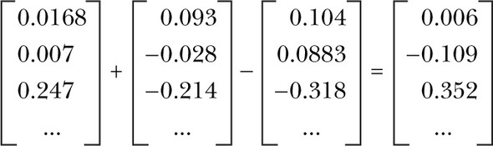
Vector-oriented reasoning
The Word2vec model contains information about the relationships between words
After adding and subtracting word vectors, your resultant vector will almost never exactly equal one of the vectors in your word vector vocabulary

Slide 32
Prosperities of Embeddings
We will review this in the exercise

