Slide 1


BUS 243
Lecture 8: Text classification review

Slide 2
The non-linearity of the network, as well as the ability to easily integrate pre-trained word embeddings, often lead to superior classification accuracy – Yoav Goldberg

Slide 3
Convolution Neural nets
However, you will see that the model with pre-trained embedding in homework 5 perform worse
It is not because the embedding, but because the modeling choice
So far, the NNs considered have all been fully connected
Certainly imagine doing a forward pass where a linear unit feeds its output to only some of the next layer’s units
One specially case of partially connected NNs is convolutional neural networks

Slide 4
Consider image classification task
Fully connected model
Absolute value of light intensities at global level
Hardly make sense in general
Differences in pixel values at local level
CNN is in essence a feature-extracting model

Slide 5
Despite little tuning of hyperparameters, a simple CNN with one layer of convolution performs remarkably well. Our results add to the well-established evidence that unsupervised pre-training of word vectors is an important ingredient in deep learning for NLP – Yoon Kim

Slide 6
You can get good results for document classification with a single layer CNN
A filter in a Convolutional Neural Network (CNN) is a small-sized matrix that is used to perform the convolution operation on an input image or feature map.
The convolution operation involves sliding the filter over the input data, performing element-wise multiplication between the filter and the overlapping portion of the input, and then summing up the results to produce an output feature map.

Slide 7
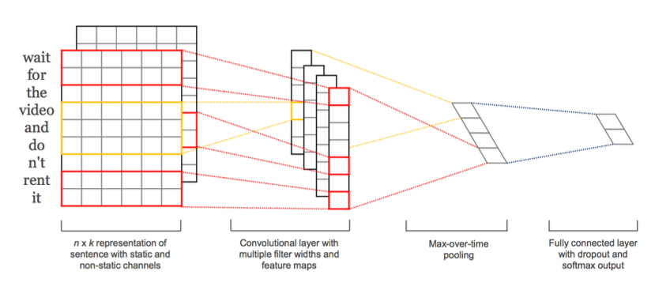

Slide 8
Some hyperparameters matter more than others when tuning a convolutional neural network on your document classification problem
Unfortunately, a downside to CNN-based models - even simple ones - is that they require practitioners to specify the exact model architecture to be used and to set the accompanying hyperparameters.

Slide 9
Using IMDB movie review data, let’s see all the necessary steps for CNN classification
Good for review what we have learned and check where CNN could be used

Slide 10
CNN (or general) pipeline
You will see that major part of text classification is on data preparation thanks to deep learning platform
You have to think 3 steps at least
Validation method
how to split data?
Normalization
Data!
Vocabulary

Slide 11
Data preparation

