Slide 1

Introduction to Natural Language Processing
BUS 243 F: Spring 2023
Yeabin Moon
Lecture 4

Slide 2
Review
What have we done?
Text representation
One-hot encoding
Bag-of-words representation
TF-IDF
Vector reasoning
Dot product
Cosine similarity
Text classification
Naïve Bayes approach

Slide 3
Problem of vocabulary
Frequency based representation has a large vocab
Zipf’s law: a few words are dominating, and most words (tokens) used once
Overfitting is inevitable
What are we assuming?
If the frequency of the tokens matters, why not the combinations of words?
If so, can we attach some meanings to them?

Slide 4
Goal of today
Study the latent semantic analysis (LSA)
Data Dimensionality reduction technique (PCA)
Understand the resulting topic vectors
Textbook is rather ambitious
Represent meaning?
Don’t be scared about the math

Slide 5
Simple Idea, eventually
We are going to reduce the size of the matrix
Entire vocabulary → a set of columns
Benefit?
Cost?
The terms “topic,” “semantic,” and “meaning” have used interchangeably in this chapter
I am not a fan ☹

Slide 6
Need to tone down
Frequency based approach fails to catch similar texts with different spellings
LSA technique tries to solve this problem by constructing topics vectors
However, “topic” has hardly intrinsic meaning
Need to discuss later

Slide 7
This is it!
Keeping these challenges in mind, can you imagine how you might squash a TF-IDF vector with one million dimensions (terms) down to a vector with 200 or so dimensions (topics)? This is like identifying the right mix of primary colors to try to reproduce the paint color in your apartment so you can cover over those nail holes in your wall.

Slide 8
Thought experiment
Textbook shows the thought experiment in 4.1.3
This is a unicorn version of topic modeling
Keep in mind that this is what we want to achieve
See whether the PCA actually does this job
Let’s see the code

Slide 9
What are we doing?
We have 6X1 TF-IDF vector
Forget about the weights now
We need to decide
The number of topics
Assign the weights corresponding to the topics

Slide 10
Human approach
Consider you are doing the two tasks manually
What’s you rule?
The number of topics
How about weights?
Probably you perform a semantic approach
How about a machine?

Slide 11
The relationships can be flipped
3X1 topic vector → 6X1 TF-IDF
Need to have 6X3 weights
Human approach: no problem
See the code and make sense of it
If we have the weights, possible to represent each words in terms of topics

Slide 12
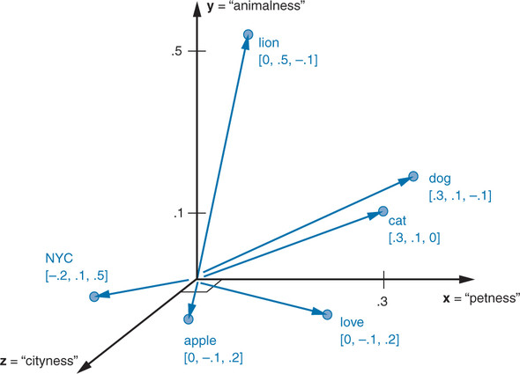
Represent each word in terms of topics

Slide 13
Wonderful topic vectors
Using three topics animal, pet, and NYC, we can represent all the words in our corpus, then.
In the thought experiment, you compressed six dimensions (TF-IDF normalized frequencies) into three dimensions (topics)
This subjective, labor-intensive approach to semantic analysis relies on human intuition and common sense to break down documents into topics
Topics mean really something here

Slide 14
Machine Approach
How could we deal with common sense and intuition?
That is, what’s the algorithm to generate topic vectors?
Textbook borrows the idea:
You shall know a word by the company it keeps
Well, not necessary true here
Let’s start with Linear discriminant analysis
Discuss whether we could find the topics

Slide 15
Linear discriminant analysis (LDA)
It is not a topic modeling
Remember what we need to do for the topic modeling
The number of topics
The corresponding weights
An LDA classifier is a supervised algorithm, so you do need labels for your document classes
The document classes should be given!
Supervised learning
Let’s see the code

Slide 16
What are we doing?
Still frequency matters
Calculate the TF-IDF
Calculate the centroid of each token by class
Assume each word has some certain frequencies depending on the class
Consider: tfidf_docs.dot(spam_centroid - ham_centroid)
Explain in words
E.g. what’s the meaning of 0 for a token?
Try to compare it with Naïve Bayes (optional: see the code)

Slide 17
Latent semantic analysis
LDA is not very interesting in terms of a topic modeling
We are wondering how machines understand a topic!
Remember human intuition and common sense?
Let’s pause here and explore the concept of PCA
PCA is essentially the Latent semantic analysis

Slide 18
Principal Component Analysis
Note we assume we do not know any class about data
That is, we do not have any label for the data: only features

Slide 19
The meaning of Normalized count
What’s the idea behind of power law?
What’s the assumption of the count-base representation?
Now we consider a relative count in document vectors
Inverse document frequency, or IDF, is your window through Zipf law
Let’s go back to the Wikipedia document regarding a kite

Slide 20
What are we doing?
Term Frequency of "kite" in intro is: 0.0441
Term Frequency of "kite" in history is: 0.0202
Term Frequency of "and" in intro is: 0.0275
Term Frequency of "and" in history is: 0.0303

Slide 21
Text data structure
Meaning unit of text
Token(s) → Sentence(s) → Document(s) → Corpus (Corpora)
But it could be
Token(s) → Corpus (Corpora)
Token(s) → Sentence(s) → Corpus (Corpora)
Token(s) → Documents(s) → Corpus (Corpora)
Tokens are the basic units of meaning in a text
Words, numbers, punctuation marks,…
A corpus consists of tokens, which are the building blocks of the text data
Let’s apply this concept to the Kite example

Slide 22
What’s the denominators?
We have a text corpus about “Kite” from Wikipedia
2 documents: Intro and History
How did we calculate Term Frequency of "kite" in each document?
What if we divide each "kite” by the number of tokens in the corpus?
If so, how do we interpret the number?
Let’s go back to the code

Slide 23
Term’s inverse document frequency
We calculate the ratio of the total number of documents to the number of documents the term appears in
Called a term’s inverse document frequency
What’s the motivation?
Term frequency alone (normalized frequency of a word) is not enough

Slide 24
Example
There are two documents
Both documents contain the words “and” and “kite”
Only one document contains the word “china”
So, IDF of
”and”: 1, “kite”: 1, ”china”: 2
Make sure of what it means!

Slide 25
Think about this statement in the textbook
A good way to think of a term’s inverse document frequency is this:
How strange is it that this token is in this document?
If a term appears in one document a lot of times, but occurs rarely in the rest of the corpus, one could assume it’s important to that document specifically.

Slide 26
IDF itself is not document-specific number
IDF of three tokens in the Kite Corpus
”and”: 1, “kite”: 1, ”china”: 2
It does not change by documents
It does not mean that the word “china” is rarely used
Even if one document contains the word “china” one million times and the other document does not contain it, IDFs are the same

Slide 27
TF-IDF
Previously, we only focus on the frequency for each word (term)
Now, for a given term t, in a given document d in a corpus D
TF-IDF(t,d,D) = tf(t,d) * idf(t,D)
The base of log function is not important
Assign weights to words (terms) based on
Frequency of words in a certain document
Distribution of words over documents in the corpus
You won’t likely ever have to implement the preceding formulas for computing TF-IDF

Slide 28
Interpretation of TF-IDF
The more times a word appears in the document, the TF (and hence the TF-IDF) will go up
At the same time, as the number of documents that contain that word goes up, the IDF (and hence the TF-IDF) for that word will go down
It relates a specific word or token to a specific document in a specific corpus, and then it assigns a numeric value to the importance of that word in the given document, given its usage across the entire corpus.

Slide 29
Is this topic modeling?
TF-IDF is used to identify the most important words or terms in a document or corpus by assigning weights to them
It presents the word’s rarity across the corpus
Possible to collect or filter the keywords based on the distribution of TF-IDF
Are they (important words) topics?

Slide 30
Relevance ranking
Let’s go back to the code again
Let’s explain in words what this example describes
What’s 0 mean?
What’s 0.5235048549676834 mean?
Let’s revisit the Question 5 on Homework 1

