Slide 1

Introduction to Natural Language Processing
BUS 243 F: Spring 2023
Yeabin Moon
Lecture 3

Slide 2
Meaning of relative counts
Bag-of-words representation has a lot of interesting applications
Now we are going to consider the counts in relation to the rest of the documents
Careful on the readings
Note that the TF-IDF representation is not an improvement from the BOW representation
They are different
Also, it is not certain that whether TF-IDF represents the meaning of words

Slide 3
Popular representation?
TF-IDF stands for term frequency times inverse document frequency
Term frequencies are the counts of each word in a document
Inverse document frequency means that you’ll divide each of those word counts by the number of documents in which the word occurs
Popular representation of the text
Not much popular in the front end
Somewhat overrated, need to have a discussion

Slide 4
Assumption
Vector representation of the text based on the frequency of each word in the given text
Assume that the more times a word occurs, the more meaning it must contribute to that document
Each word has some innate sentiment
Idea of text classification based on BOW representation
The main question is whether we need to normalize the counts
Let’s see the first example code

Slide 5
0.1818?
What does this number mean?
Sentence: The faster Harry got to the store, the faster Harry, the faster, would get home.
`Harry’ used twice (after case folding)
The number of unique tokens is 11
Not clear why do we ever need the normalization
Worse yet, why do we need the number of unique tokens as the normalizer (denominator)?
Not exactly sure of the meaning of 0.1818

Slide 6
Textbook example: why “temper” it all?
TF(“dog,” document A) = 3/30 = .1
TF(“dog,” document B) = 100/580000 = .00017
What’s the meaning of TF(“dog,” document A), 0.1?
I see the reasoning behind the normalization
But still not clear why do we need the unique tokens in the previous example
Am I too picky?

Slide 7
What are we missing?
For a long text, the normalized count of a word would mean more
The Dog example would make sense
Not just conceptually, the calculation result (term frequency) would be robust
Normalizer: the number of tokens used vs. the number of unique tokens used
Strong assumption?
However, for a short text, each approach would result in very different outcomes
Think about tokenizers
For most NLP applications, there would be no definitive formula
More important thing is to understand the concepts
Let’s see Kite example in the code

Slide 8
What are we doing?
document_vectors is the python list
Each item is the Ordered dictionary
Data type is in fact not very important here
Let’s interpret each item
What’s the denominator?
Does it make sense to you?
Why not using the number of unique tokens in the corresponding sentence?
Why not using the number of every tokens?

Slide 9
Understanding the construction
Each of your three document vectors will need to have 18 values, even if the document for that vector doesn’t contain all 18 words in your lexicon
Each token is assigned a slot in your vectors corresponding to its position in your lexicon
You have three vectors, one for each document. So what? What can you do with them?

Slide 10
Vector spaces
Vectors are the primary building blocks of linear algebra, or vector algebra
Python Tuples
A tuple is a collection which is ordered and unchangeable
Order means there is a particular direction of a vector and possible to measure the distance between vectors
What’s the meaning of dimensionality?

Slide 11
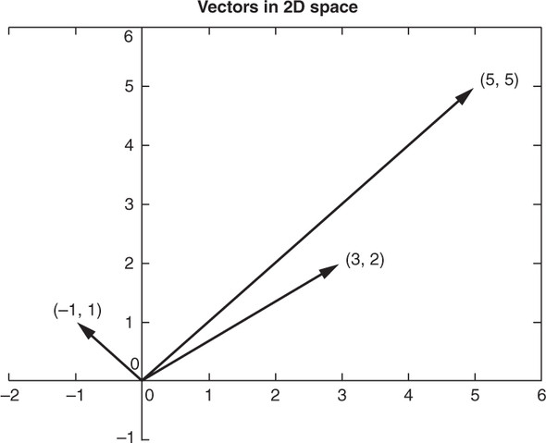
What can we tell about the following 3 vecs?

Slide 12
Dimensionality
More dimensionality means more information
The linear algebra all works out the same!
You might need more computing power as the dimensionality grows
Curse of dimensionality issues
For a natural language document vector space, the dimensionality of your vector space is the count of the number of distinct words that appear in the entire corpus
You can then describe each document within this K-dimensional vector space by a K-dimensional vector

Slide 13
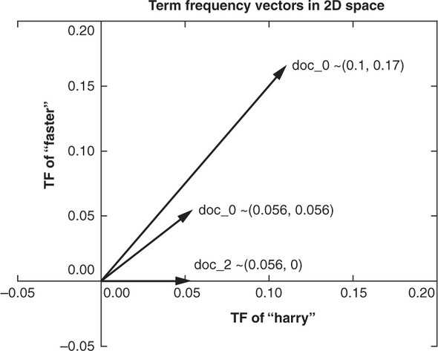
Vector algebra
Now that you have a representation of each document and know they share a common space, you have a path to compare them

Slide 14
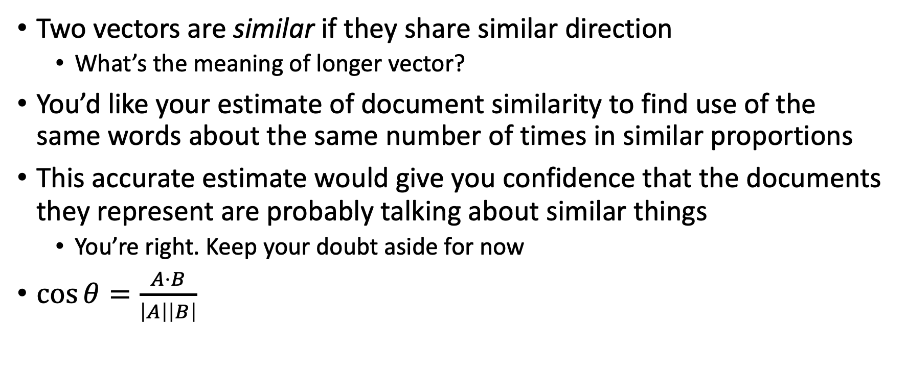
Similarity
Two vectors are similar if they share similar direction
What’s the meaning of longer vector?
You’d like your estimate of document similarity to find use of the same words about the same number of times in similar proportions
This accurate estimate would give you confidence that the documents they represent are probably talking about similar things
You’re right. Keep your doubt aside for now
$\cos{θ}=\frac{A⋅B}{\left|A\right|\left|B\right|}$

Slide 15
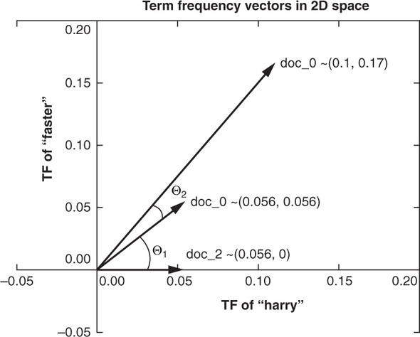
Cosine Similarity

Slide 16
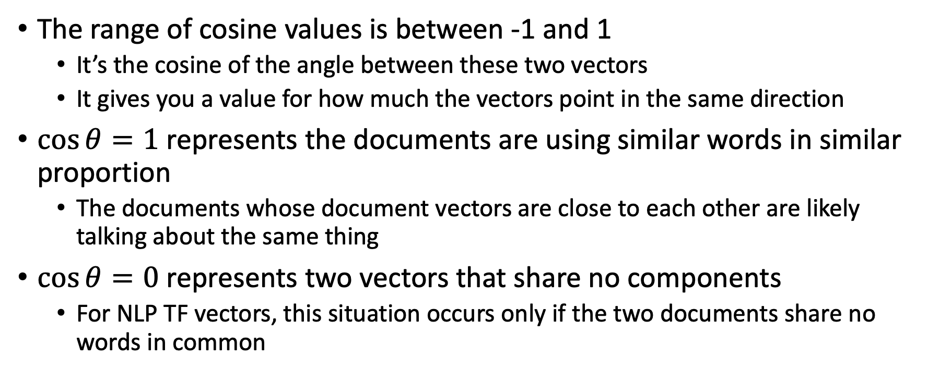
Cosine representation
The range of cosine values is between -1 and 1
It’s the cosine of the angle between these two vectors
It gives you a value for how much the vectors point in the same direction
$\cos{θ}=1$ represents the documents are using similar words in similar proportion
The documents whose document vectors are close to each other are likely talking about the same thing
$\cos{θ}=0$ represents two vectors that share no components
For NLP TF vectors, this situation occurs only if the two documents share no words in common

Slide 17
Assumptions?
What do we need to assume to conclude the meaning of cosine values?
They just use either completely same (different) words
What about synonyms and antonyms?
Hard to infer semantics or meanings in general
A cosine similarity of -1 represents two vectors that are anti-similar, completely opposite
Impossible for TF since every component should be non-negative values

Slide 18
Zipf’s Law

