Slide 1


BUS 243
Lecture 1: Information Retrieval

Slide 2
Course logistics
Instructor: Yeabin Moon
Office hours: After class or online
check the syllabus
Latte Page is the main correspondence
Lecture materials uploaded before each lecture

Slide 3
Learning goals
This is not a full-fledged NLP course
CS / Linguistic department offer it
Want to lean NLP skills in business & finance settings
Don’t need to have a degree in statistics to apply stats to your tasks
How about NLP?

Slide 4
What do you want to learn?
In statistics / econometrics
Learn a regression technique to analyze the elasticity of demand
In NLP
Learn _____________________ to analyze _____________?

Slide 5
What is your data?
What industry are you interested in?
Finance
Entertainment and Sports
Living
What does your data look like?
Let’s see the latest 10-Q report for Apple: Link

Slide 6
Questions
What makes you think that the text has contains (or better) information than numbers?
Or opposite?
If so, how could we extract information from text?
Wait, do machines understand text?
Why is it necessary to have knowledge of machine learning to perform this task?
Specifically, why is "deep learning" prevalent in most natural language processing (NLP) applications?

Slide 7
The scope of the course
Again, this is not the typical introductory course for NLP
Delve into the text categorization task, with a particular focus on sentiment analysis, and explore some business-oriented examples
Early part of the class covers the text representation, and then move on to the classification task
Frequency-based representation vs. word embeddings
Traditional ML models: Naïve Bayes and Logistic Regression
Deep learning application
Transfer learning

Slide 8
More logistics
Readings are mandatory
Check the syllabus
Weekly assignment: 55 %
5 in total
No accepted more than a day late (10 % off a day late)
Final exam: 40 %
Participation / Attendance: 5 %

Slide 9
Note for Assignments
Each assignment should be completed individually
Strongly encourage you to work alone to gain the maximum
Understand allowed collaboration and how to document it
Do not take code off from the web
Must acknowledge working with other students
Must write your own assignment solutions

Slide 10
Let’s Begin

Slide 11
Definition?
NLP is a principled approach to processing human language
What does it mean?
It is a subfield of artificial intelligence (AI) that refers to computational approaches to process, understand, and generate human language
Again, what is AI?
Need to examine some definitions

Slide 12
What does it mean for a language to be natural?
You might wonder
Are there any unnatural languages?
Is English natural?
Is Spanish more natural than Korean?
Another tricky term is a formal language
Is English formal?

Slide 13
Natural vs. Formal
The word natural is used to contrast natural languages with formal languages
all the languages humans speak are natural
On the other hand, formal languages are types of languages that are invented by humans
Have strictly and explicitly defined syntax (grammatical rules) and semantics (meaning)
Programming languages are examples
When you run a compiler or an interpreter on the code you write in those languages, you either get a syntax error or not
the behavior of your program is always the same if it’s run on the same code

Slide 14
Natural language is hardly formal
You can write a sentence that is maybe grammatical
Subjective, and worse, time varying
There are some grammar topics where even experts disagree with each other
This is what makes human languages interesting but challenging, and why the entire field of NLP even exists
Bottom line: human languages are ambiguous

Slide 15

He saw a girl with a telescope

Slide 16
Here comes a new challenger
Now let’s consider the following scenario and think how you’d approach this problem
You are working as a junior data scientist at a midsized company that has a consumer-facing product line
You got a giant TSV file containing all the responses to the survey questions about the product from the marketing team:
How did you know about our product?
How do you like our product?
a free-response question, where our customers can write whatever they feel about our product

Slide 17
Here comes a new challenger
The marketing team realized there was a bug in the online system and the answers to the second question were not recorded in the database at all
Your task is whether you could recover the lost data
Fortunately, data structure is fairly standard
It has several fields such as timestamps and submission IDs
At the end of each line is a lengthy field for the free-response question

Slide 18
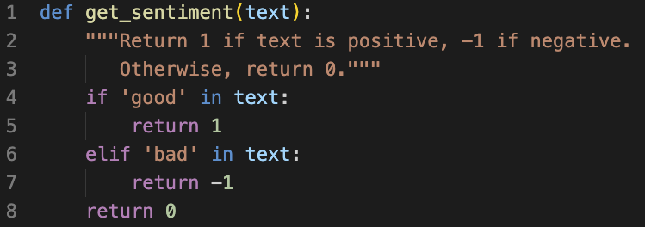
First try
Example responses:
A very good product!
Very bad. It crashes all the time!

Slide 19
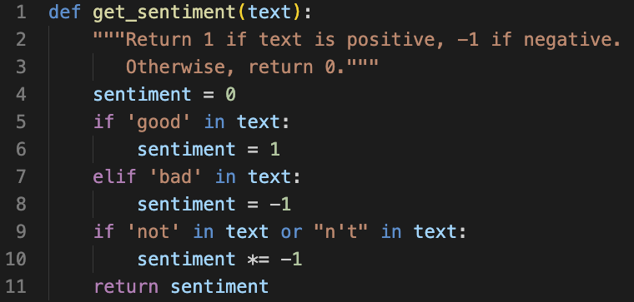
Again, natural language is ambiguous
The code filtered a decent amount of data
Alas, my code returns
I can’t think of a single good reason to use this product: positive
Not bad: negative
Right. Negation!

Slide 20
….
The product is not only cheap but also very good!: negative
Worse
I always wanted this feature badly!
It’s very badly made
How could a single word in a language have two completely opposite meanings?
This course will save you

Slide 21
This course will save you?
What does it mean? Another ambiguity
This course will save you because it will teach you either
How to deal with the problems described above
They are impossible to solve

Slide 22
Information Retrieval

Slide 23
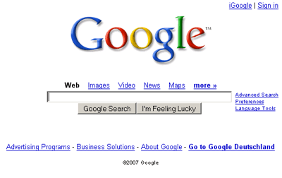

Slide 24
Information retrieval can money
Search engines are the most visited websites in most countries
Google, Bing, Baidu, Yahoo, AOL, Naver
Discussion platforms
Reddit, Quora, Stack Exchange
Shared knowledge
Wikipedia
Have you heard of Britannica?

Slide 25
We start here
Why IR?
Simple to understand
But hard to implement
Important to the world
Building block for the course project

Slide 26
Information retrieval is finding material (usually documents) of an unstructured nature (usually text) that satisfies an information need from within large collections (usually stored on computers)

Slide 27

Suppose you want to learn Gradient Descent
Suppose you love a textbook treatment
Control + F: Gradient Descent

Slide 28
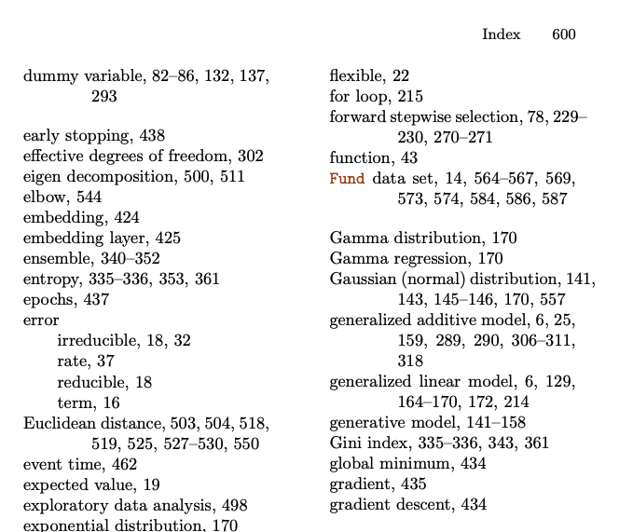
Assumption?
Why is this preferred?

Slide 29
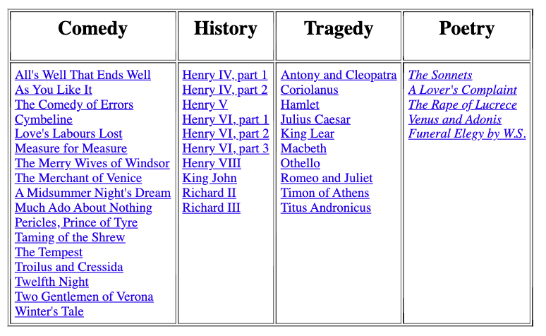
Which plays of Shakespeare contain the words Brutus AND Caesar AND NOT Calpurnia?

Slide 30
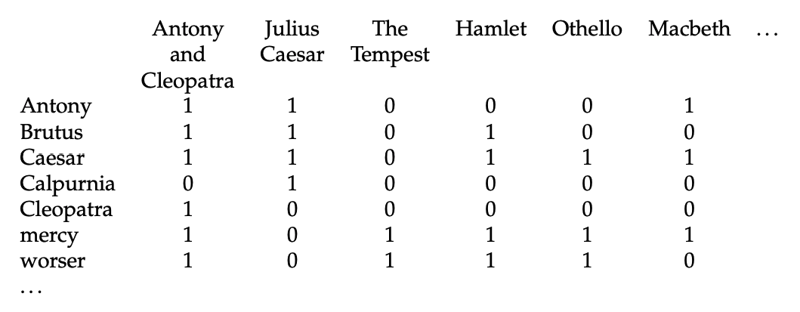
Let’s index each play
Use Terms (think it as a word for now)
This is called a term-document incidence matrix

Slide 31
To answer the question:
110100 AND 110111 AND 101111 = 100100
What’s the answer?

Slide 32
Boolean retrieval
The Boolean retrieval model is an IR model
Formulate queries using Boolean expressions
AND, OR, and NOT
Can be arbitrarily nested
The model views each document as just a set of words
Any given query divides the collection into two sets: retrieved, not-retrieved
Pure Boolean systems do not define an ordering of the results
What does it mean?

Slide 33
Strengths and Weaknesses
Strengths
Precise, if you know the right strategies
Precise, if you have an idea of what you’re looking for
Implementations are fast and efficient
Weaknesses
Users must learn Boolean logic
Boolean logic insufficient to capture the richness of language
No control over size of result set: either too many hits or none 
When do you stop reading? All documents in the result set are considered “equally good”
What about partial matches? Documents that “don’t quite match” the query may be useful also

Slide 34
Terminology alert
Write your own definition and list the corresponding examples in the Shakespeare’s works
Terms
Documents
Corpus

Slide 35
Main tasks in IR
Information need
Query Formulation
Assessment

Slide 36

Evaluating Results: Intrinsic
TREC: set of ‘gold’ relevant documents
How many of the documents found?
Annual bake-off of IR systems

Slide 37
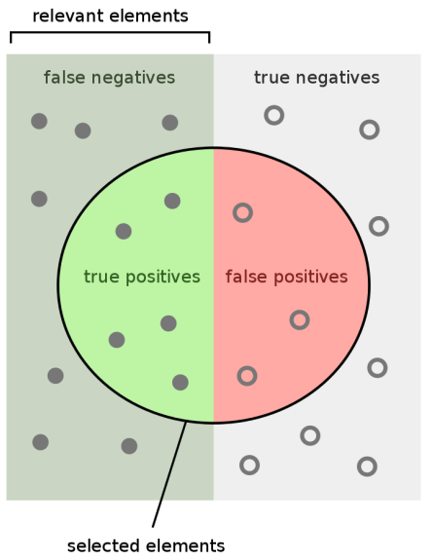
Relevance Terminology
TP: True Positive
FP: False Positive
TN: True Negative
FN: False Negative

Slide 38
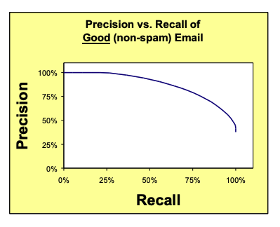
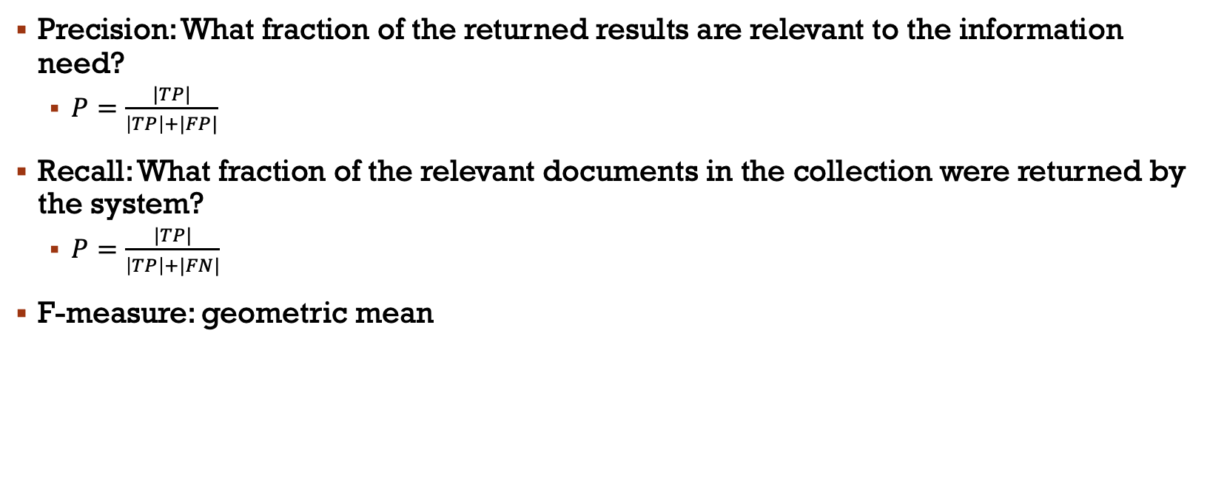
Precision and Recall
Precision: What fraction of the returned results are relevant to the information need?
$P=\frac{|TP|}{\left|TP\right|+|FP|}$
Recall: What fraction of the relevant documents in the collection were returned by the system?
$P=\frac{|TP|}{\left|TP\right|+|FN|}$
F-measure: geometric mean

Slide 39
Evaluating Results: Extrinsic
IR is often used to find answers to questions
But it takes a human to read the results
If you know what answer is, you can search for similar questions
Build machines to read the answer
We will see both later
Programming?

