Slide 1


BUS 243
Lecture 3: Classification Primer

Slide 2
What is a spam?
Consider how do you identify a spam email
What’s your rule?
…we have a strong spam filtering system…
What does it mean?

Slide 3
Text classification (categorization)
Assign a label or category to corpus or document
Spam detection
Sentiment analysis
Language ID
Topic modeling

Slide 4
Some words are indicative
Emotion, mood, attitudes: angry, nervous, great
Unique signal: Michael Jordan
Domain words: Monetary policy, Alzheimer’s
Frequency of these words might imply something
Any concern?

Slide 5
Focus on supervised machine learning
Wait, what is it?
With labeled data, learn how to produce the goal
Simple sentiment analysis task

Slide 6
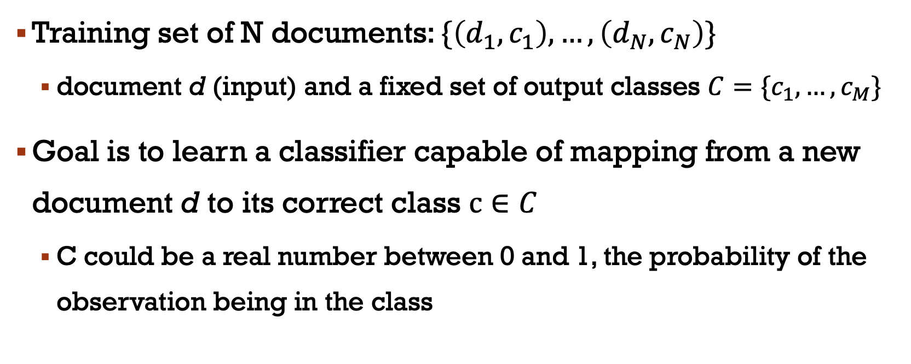
Definition
Training set of N documents: $\{\left(d_{1},c_{1}\right),…,\left(d_{N}, c_{N}\right)\}$
document d (input) and a fixed set of output classes $C=\{c_{1},…,c_{M}\}$
Goal is to learn a classifier capable of mapping from a new document d to its correct class $c∈C$
C could be a real number between 0 and 1, the probability of the observation being in the class

Slide 7
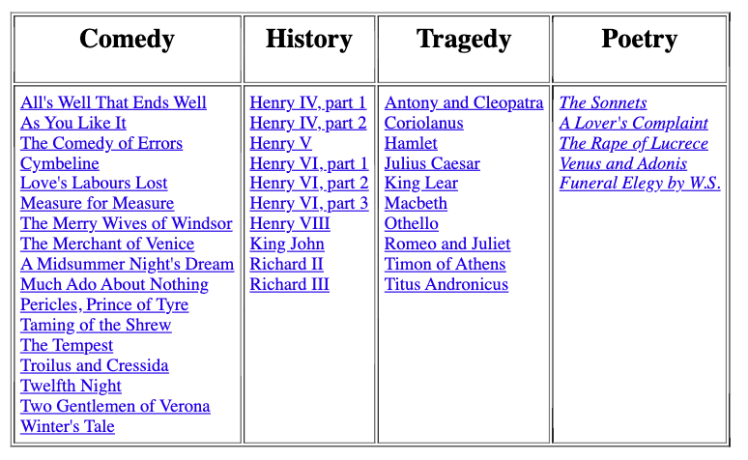

Slide 8
Today, we study generative classifiers
Naïve Bayes
Next class, we turn to discriminative classifiers
Linear regression / Logistic regression

Slide 9
Naïve Bayes
Let’s review Naïve Bayes in code
Now think about the text application

Slide 10
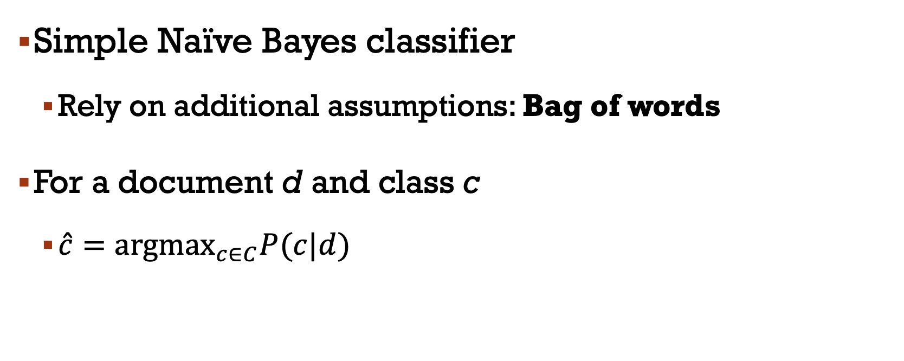
Naïve Bayes
Simple Naïve Bayes classifier
Rely on additional assumptions: Bag of words
For a document d and class c
$\hat{c}={argmax}_{c∈C}P(c|d)$

Slide 11
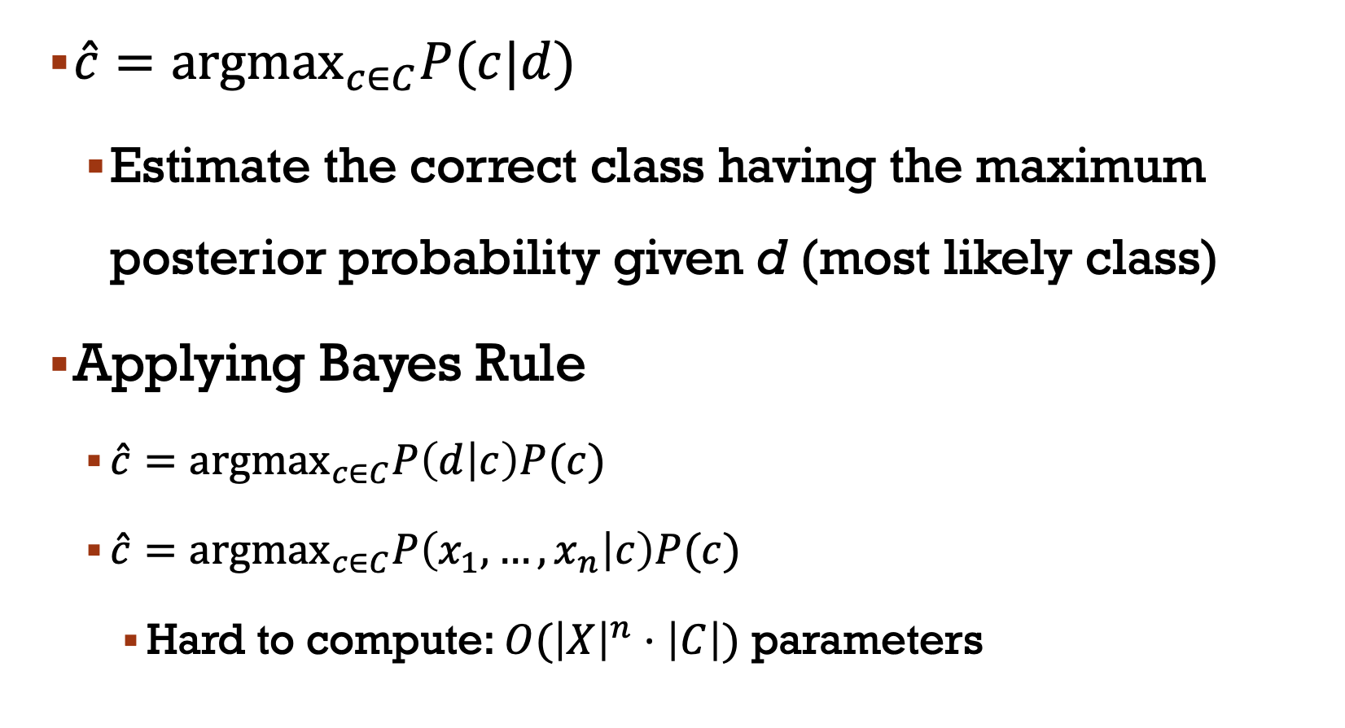
$\hat{c}={argmax}_{c∈C}P(c|d)$
Estimate the correct class having the maximum posterior probability given d (most likely class)
Applying Bayes Rule
$\hat{c}={argmax}_{c∈C}P\left(d | c\right)P(c)$
$\hat{c}={argmax}_{c∈C}P\left(x_{1},…,x_{n} | c\right)P(c)$
Hard to compute: $O({\left|X\right|}^{n}⋅\left|C\right|)$ parameters

Slide 12
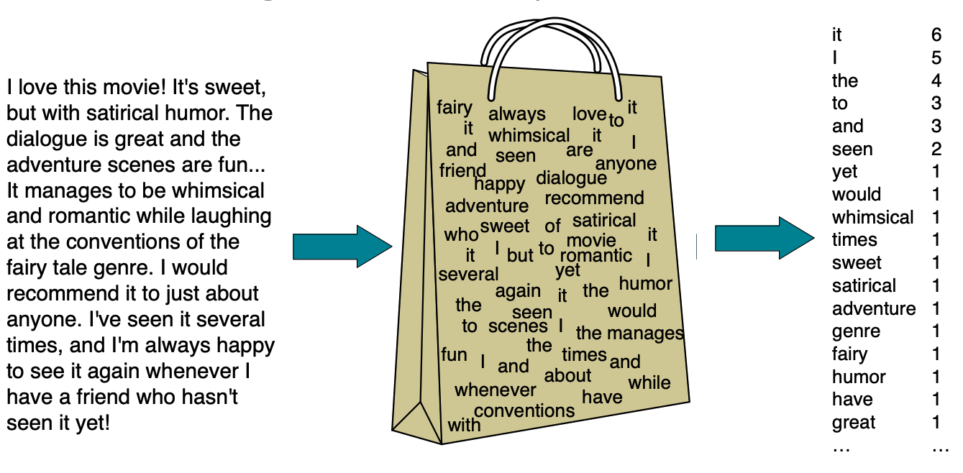
Bag of Words assumptions: ignore the word positions

Slide 13
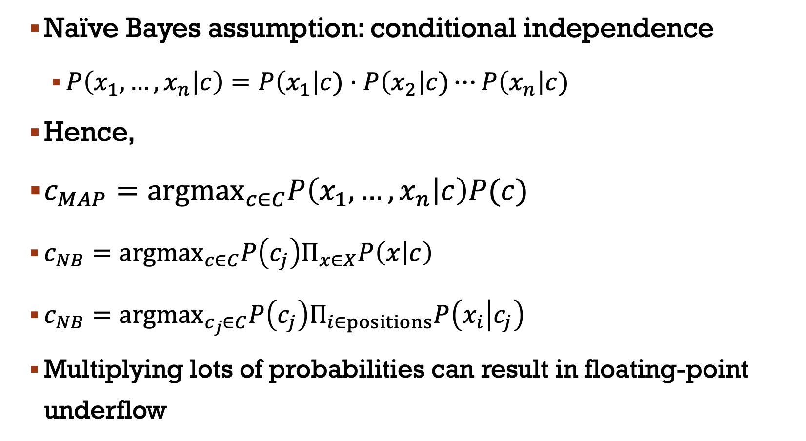
Naïve Bayes assumption: conditional independence
$P\left(x_{1},…,x_{n} | c\right)=P\left(x_{1}\right|c)⋅P\left(x_{2}\right|c)⋯P\left(x_{n}\right|c)$
Hence,
$c_{MAP}={argmax}_{c∈C}P\left(x_{1},…,x_{n} | c\right)P(c)$
$c_{NB}={argmax}_{c∈C}P\left(c_{j}\right)Π_{x∈X}P\left(x | c\right)$
$c_{NB}={argmax}_{c_{j}∈C}P\left(c_{j}\right)Π_{i∈positions}P\left(x_{i} | c_{j}\right)$
Multiplying lots of probabilities can result in floating-point underflow

Slide 14
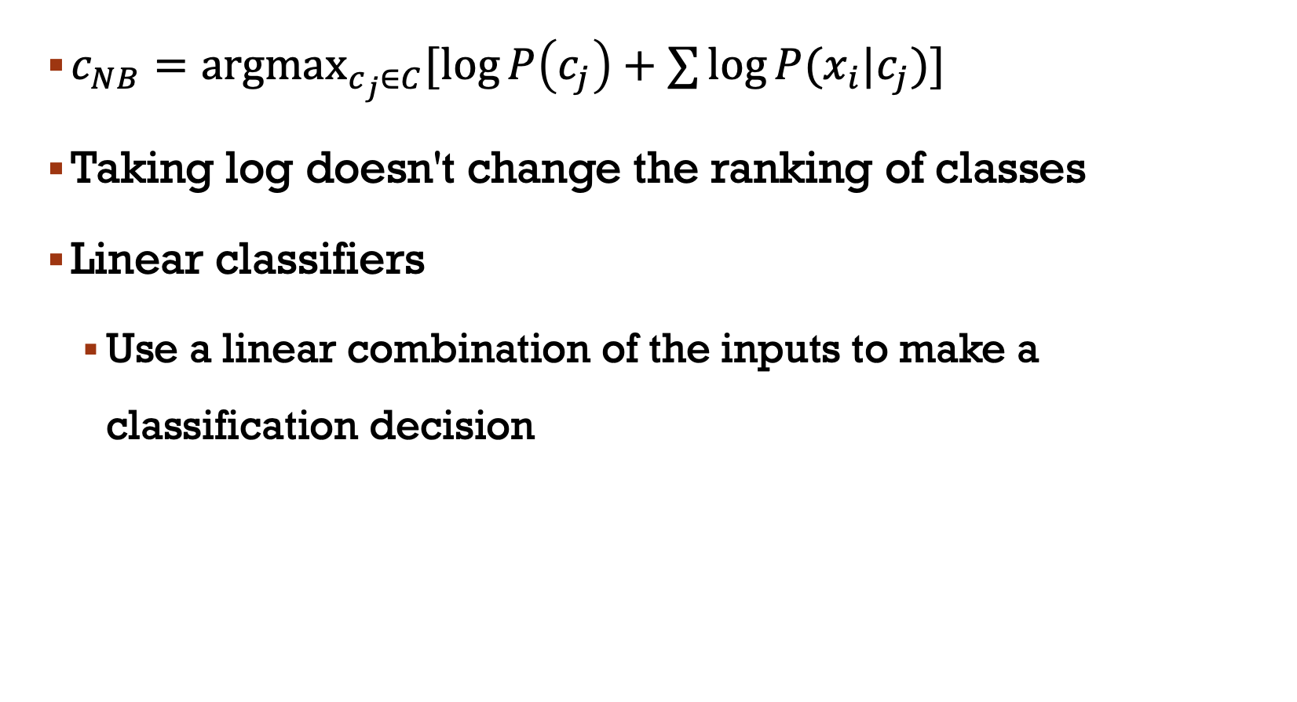
$c_{NB}={argmax}_{c_{j}∈C}[\log{P\left(c_{j}\right)+∑{\log{P(x_{i}|c_{j})}}]}$
Taking log doesn't change the ranking of classes
Linear classifiers
Use a linear combination of the inputs to make a classification decision

Slide 15
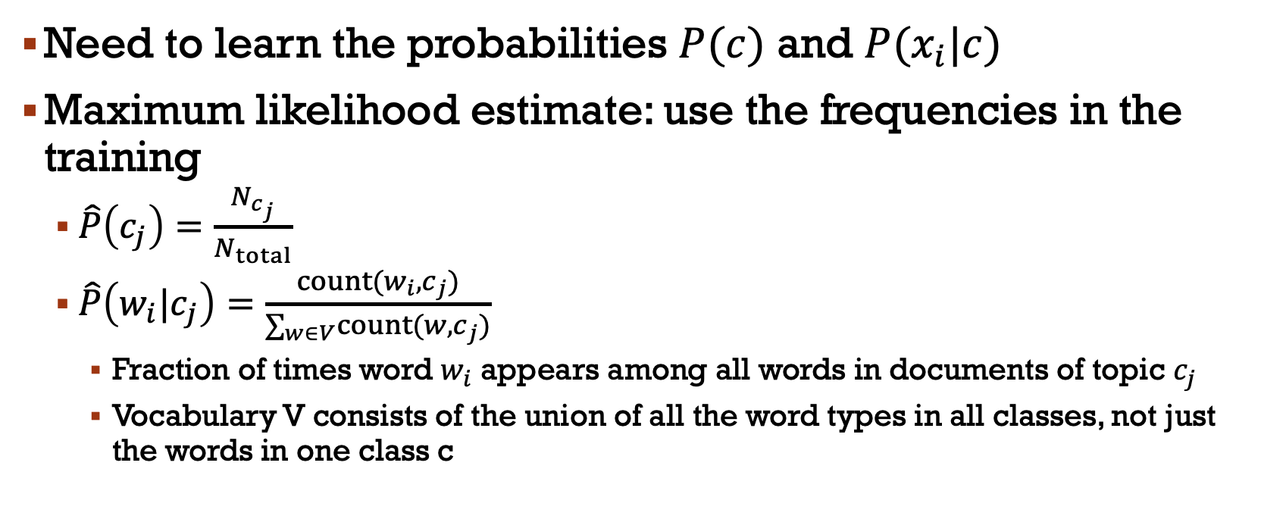
Training the classifier
Need to learn the probabilities $P(c)$ and $P(x_{i}|c)$
Maximum likelihood estimate: use the frequencies in the training
$\hat{P}\left(c_{j}\right)=\frac{N_{c_{j}}}{N_{total}}$
$\hat{P}\left(w_{i}|c_{j}\right)=\frac{count(w_{i},c_{j})}{∑_{w∈V}count(w,c_{j})}$
Fraction of times word $w_{i}$ appears among all words in documents of topic $c_{j}$
Vocabulary V consists of the union of all the word types in all classes, not just the words in one class c

Slide 16
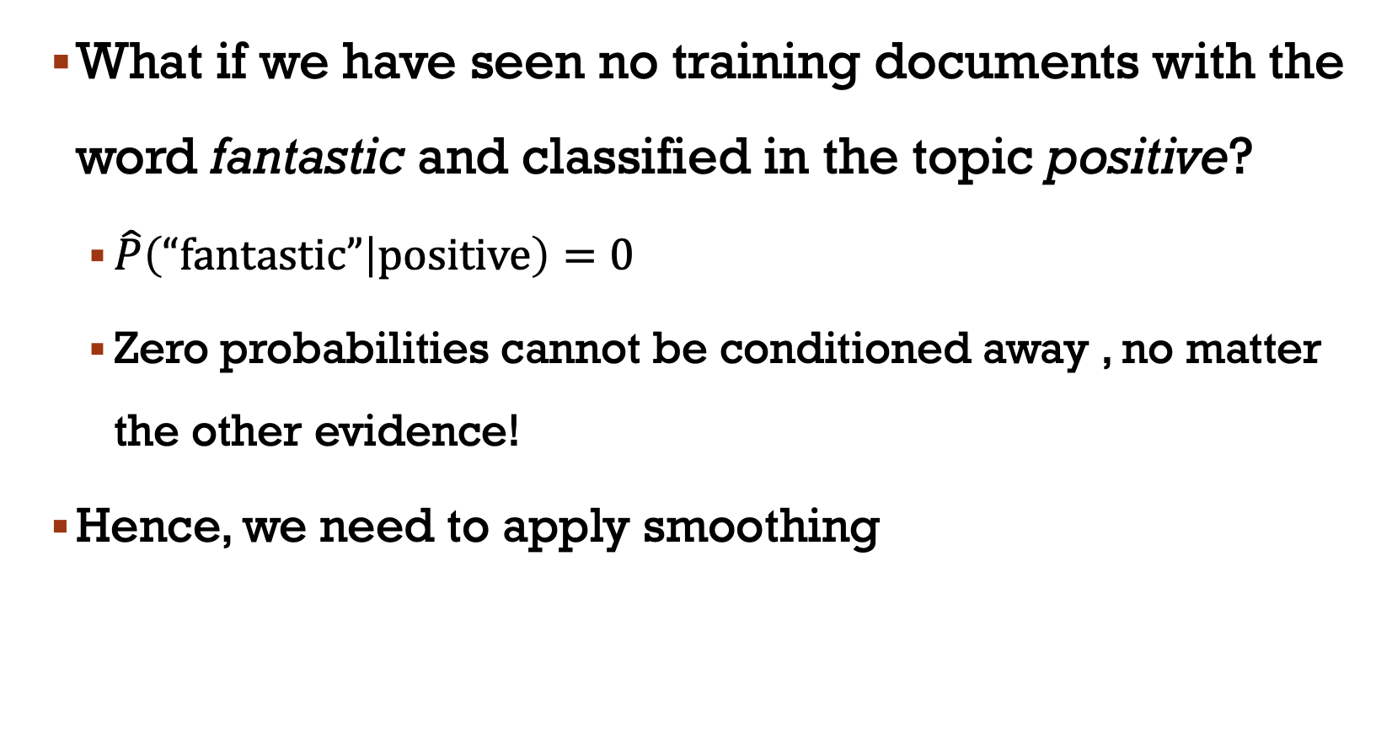
What if we have seen no training documents with the word fantastic and classified in the topic positive?
$\hat{P}\left(“fantastic” | positive\right)=0$
Zero probabilities cannot be conditioned away , no matter the other evidence!
Hence, we need to apply smoothing

Slide 17
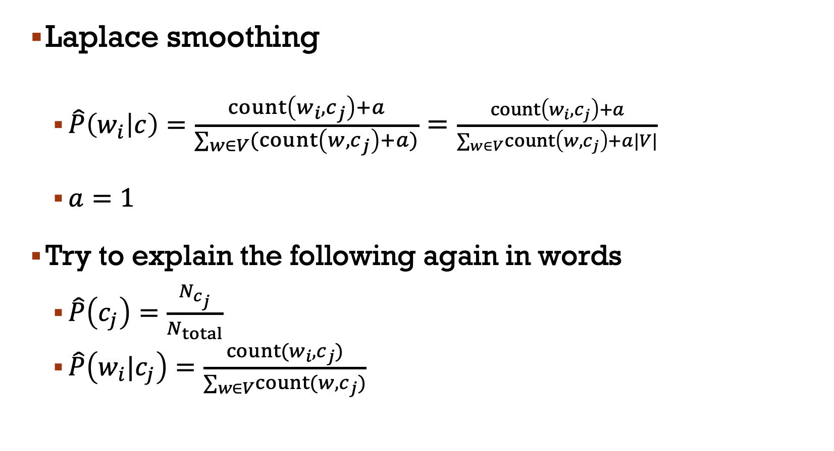
Laplace smoothing
$\hat{P}\left(w_{i} | c\right)=\frac{count\left(w_{i},c_{j}\right)+a}{∑_{w∈V}(count\left(w,c_{j}\right)+a)}=\frac{count\left(w_{i},c_{j}\right)+a}{∑_{w∈V}count\left(w,c_{j}\right)+a|V|}$
$a=1$
Try to explain the following again in words
$\hat{P}\left(c_{j}\right)=\frac{N_{c_{j}}}{N_{total}}$
$\hat{P}\left(w_{i}|c_{j}\right)=\frac{count(w_{i},c_{j})}{∑_{w∈V}count(w,c_{j})}$

Slide 18
Unknown words
Some words appear in test data but not in training data (or vocabulary)
Ignore them
Remove them from the test document
Don’t include any probability for them at all
Why don’t we build an unknown word model?
It doesn’t help
Knowing which class has more unknown words is not generally helpful

Slide 19
Stop words
Some systems ignore stop words
What’s the stop words?
Very frequent words like the and a
Call the top 10 or 50 words the stopword list
Remove all stop words from both training and test sets
However, removing stop words doesn’t usually help
So in practice most NB algorithms use all words and don’t use stopword lists
When do stop words play a role?

Slide 20
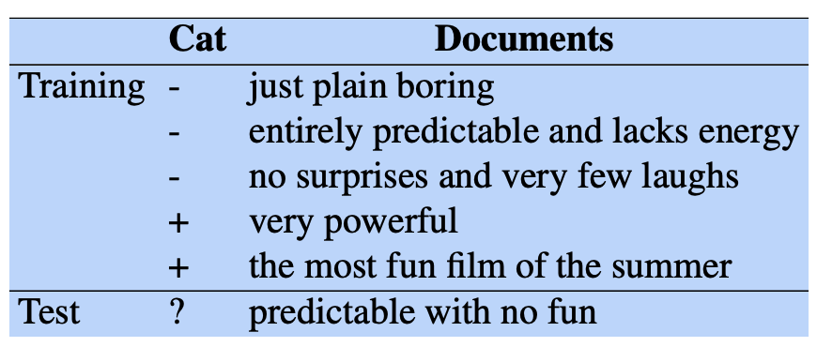
Example
What’s the goal?

Slide 21
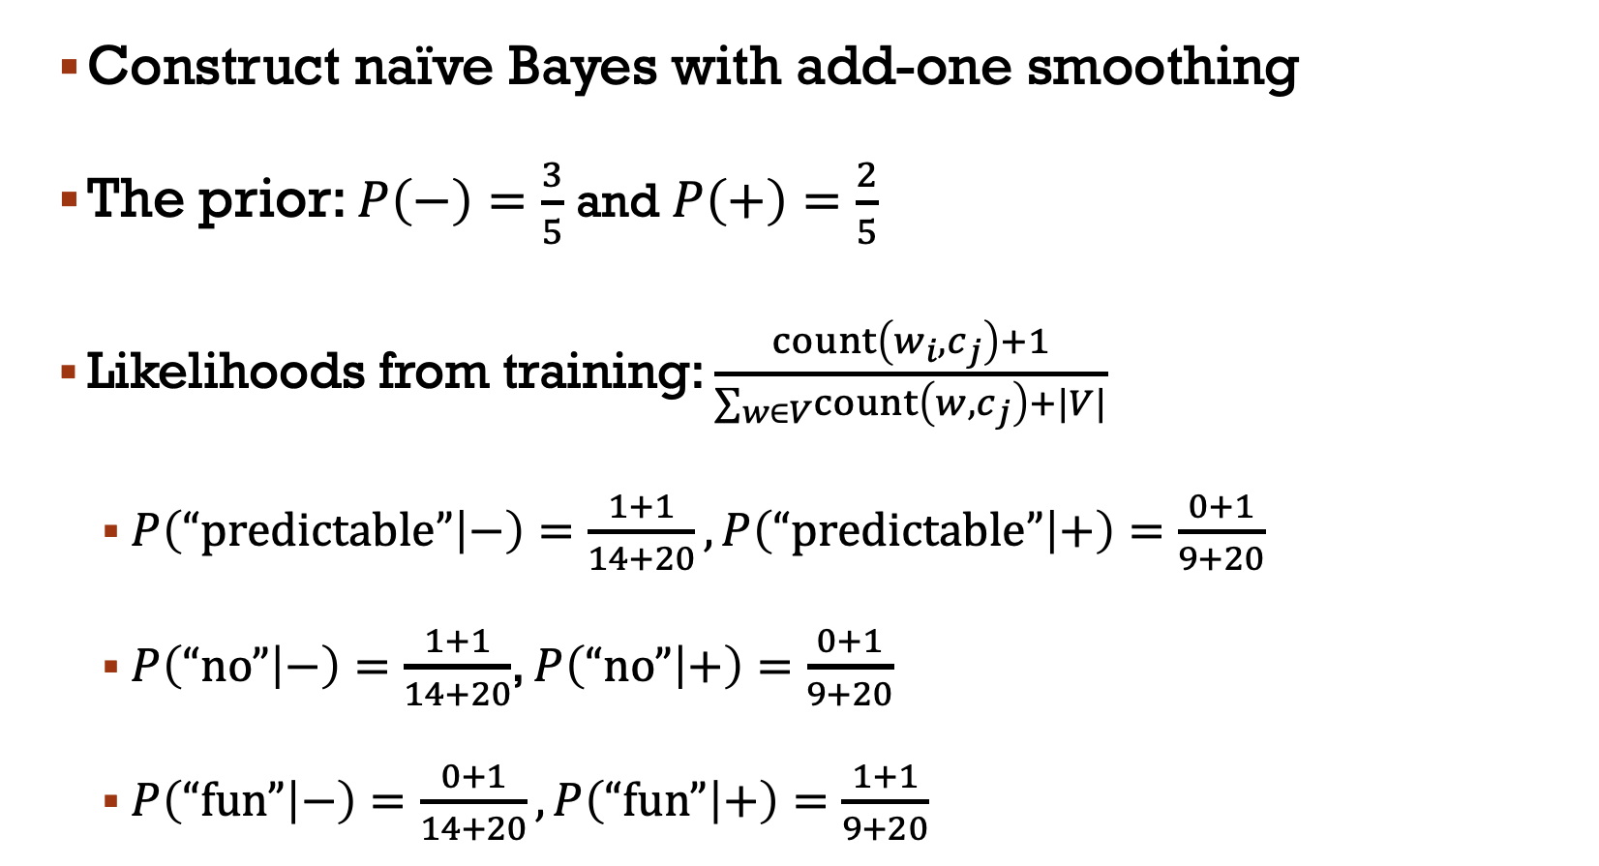
Construct naïve Bayes with add-one smoothing
The prior: $P\left(−\right)=\frac{3}{5}$ and $P\left(+\right)=\frac{2}{5}$
Likelihoods from training: $\frac{count\left(w_{i},c_{j}\right)+1}{∑_{w∈V}count\left(w,c_{j}\right)+|V|}$
$P\left(“predictable” | −\right)=\frac{1+1}{14+20},P\left(“predictable” | +\right)=\frac{0+1}{9+20}$
$P\left(“no” | −\right)=\frac{1+1}{14+20}$, $P\left(“no” | +\right)=\frac{0+1}{9+20}$
$P\left(“fun” | −\right)=\frac{0+1}{14+20},P\left(“fun” | +\right)=\frac{1+1}{9+20}$

Slide 22
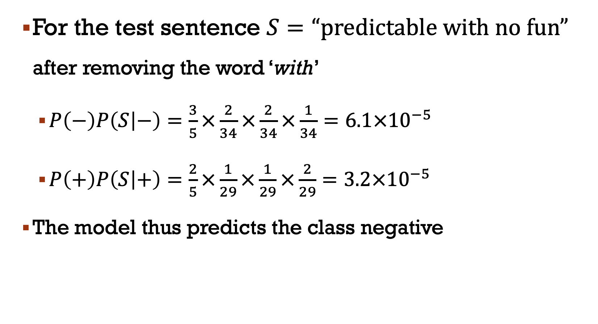
For the test sentence $S=“predictable with no fun”$ after removing the word ‘with’
$P\left(−\right)P\left(S | −\right)=\frac{3}{5}×\frac{2}{34}×\frac{2}{34}×\frac{1}{34}=6.1×{10}^{−5}$
$P\left(+\right)P\left(S | +\right)=\frac{2}{5}×\frac{1}{29}×\frac{1}{29}×\frac{2}{29}=3.2×{10}^{−5}$
The model thus predicts the class negative

Slide 23
Summary: NB is not so naïve
Very fast, low storage requirements
Work well with very small amounts of training data
Robust to irrelevant features
Irrelevant features cancel each other without affecting results
Very good in domains with many equally important features
Optimal if the independence assumption hod
If so, then it is the bayes Optimal classifier for problem
A good dependable baseline for text classification
But we will see other classifiers that give better accuracy

Slide 24
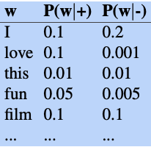

Generative model
$P\left(“I love this fun film” | +\right)>P\left(“I love this fun film” | −\right)$
What does it mean?
Naïve Bayes has an important similarity to language modeling
Consider a naïve Bayes model with the classes + and – and following params

Slide 25
Evaluation
Need a metric for knowing how well our model is doing
Revisit
Precision: What fraction of the returned results are relevant to the information need?
Recall: What fraction of the relevant documents in the collection were returned by the system?
Consider building a confusion matrix

Slide 26
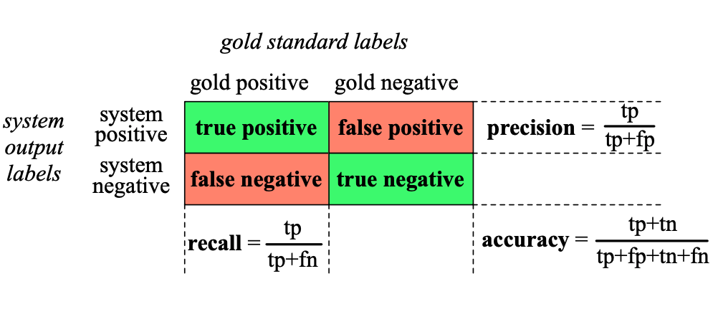
Why don’t we use accuracy as our metric?

Slide 27
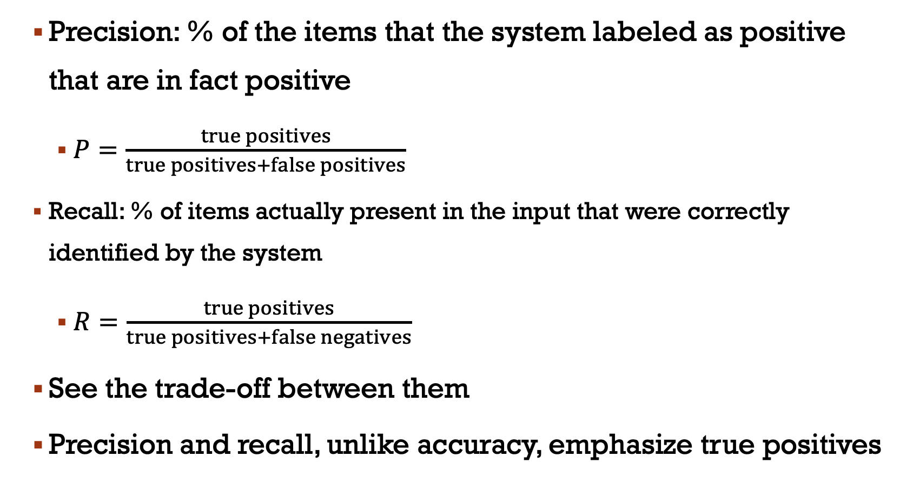
Precision: % of the items that the system labeled as positive that are in fact positive
$P=\frac{true positives}{true positives+false positives}$
Recall: % of items actually present in the input that were correctly identified by the system
$R=\frac{true positives}{true positives+false negatives}$
See the trade-off between them
Precision and recall, unlike accuracy, emphasize true positives

Slide 28
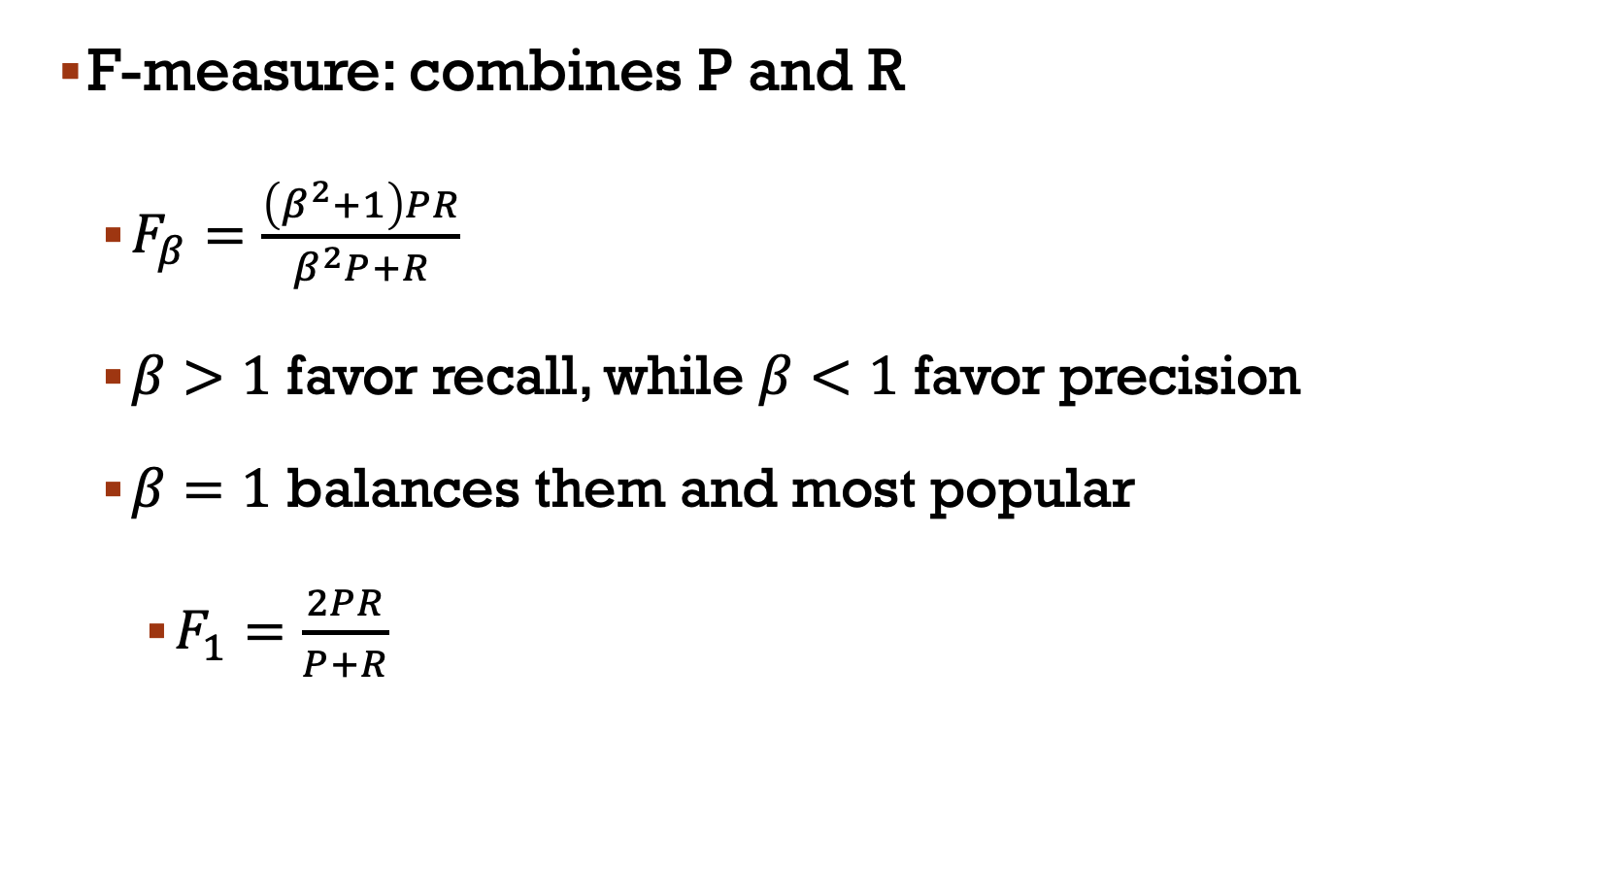
F-measure: combines P and R
$F_{β}=\frac{\left(β^{2}+1\right)PR}{β^{2}P+R}$
$β>1$ favor recall, while $β<1$ favor precision
$β=1$ balances them and most popular
$F_{1}=\frac{2PR}{P+R}$

Slide 29
Validation
Supply your intuition on
training set, development set, and test set
Cross-validation
K-fold cross validation

Slide 30
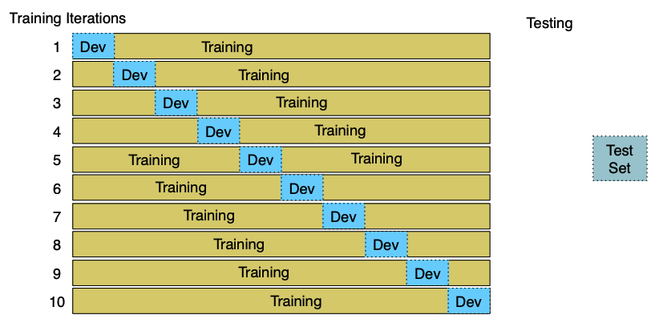

Slide 31
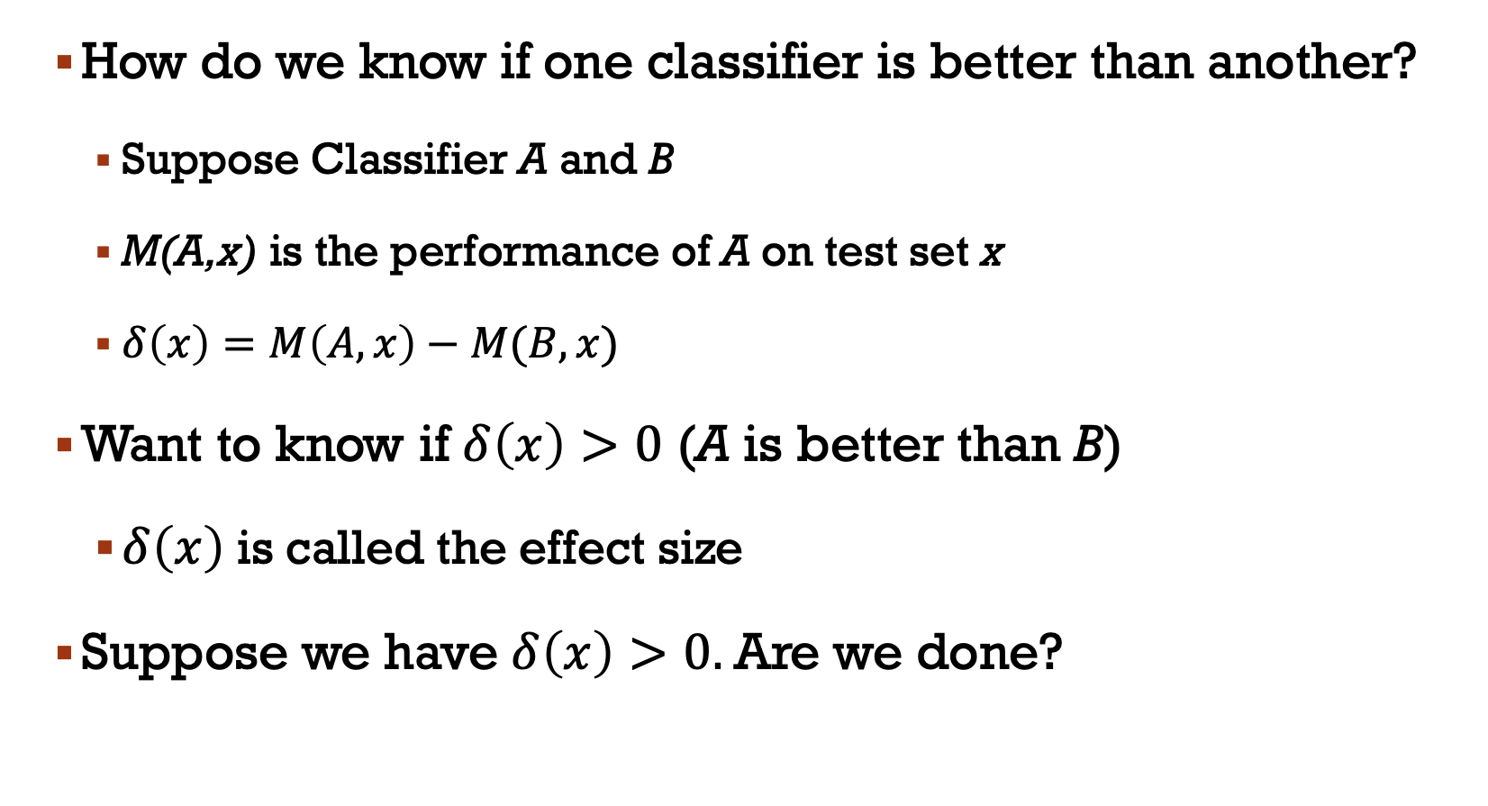
How do we know if one classifier is better than another?
Suppose Classifier A and B
M(A,x) is the performance of A on test set x
$δ\left(x\right)=M\left(A,x\right)−M(B,x)$
Want to know if $δ\left(x\right)>0$ (A is better than B)
$δ\left(x\right)$ is called the effect size
Suppose we have $δ\left(x\right)>0.$Are we done?

Slide 32
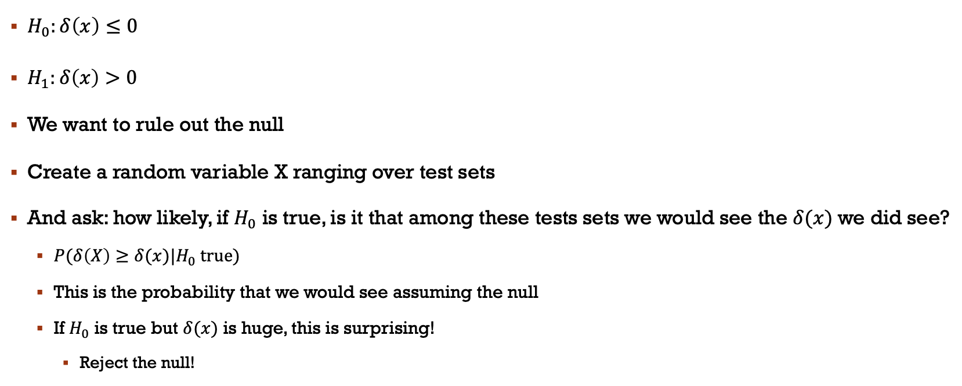
Statistical Hypothesis testing
$H_{0}:δ\left(x\right)≤0$
$H_{1}:δ\left(x\right)>0$
We want to rule out the null
Create a random variable X ranging over test sets
And ask: how likely, if $H_{0}$ is true, is it that among these tests sets we would see the $δ(x)$ we did see?
$P(δ\left(X\right)≥δ(x)|H_{0} true)$
This is the probability that we would see assuming the null
If $H_{0}$ is true but $δ(x)$ is huge, this is surprising!
Reject the null!

Slide 33
In NLP, we don’t tend to use parametric tests like t-tests
Instead, we use non-parametric tests based on sampling
artificially creating many versions of the setup
Two popular approaches: approximation randomization and bootstrap test

Slide 34
Bootstrap test
Can apply to any metric (accuracy, precision, recall, F1,…)
Bootstrap means to repeatedly draw large numbers of smaller samples with replacement (called bootstrap samples) from an original larger sample
This method only makes the assumption that the sample is representative of the population

Slide 35
Consider a baby classification example with a test set x of 10 documents, using accuracy as metric
Now consider constructing bootstrap samples, say b=10,000 from test sets

Slide 36
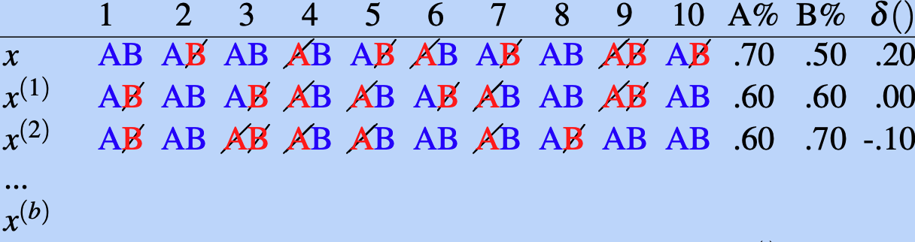
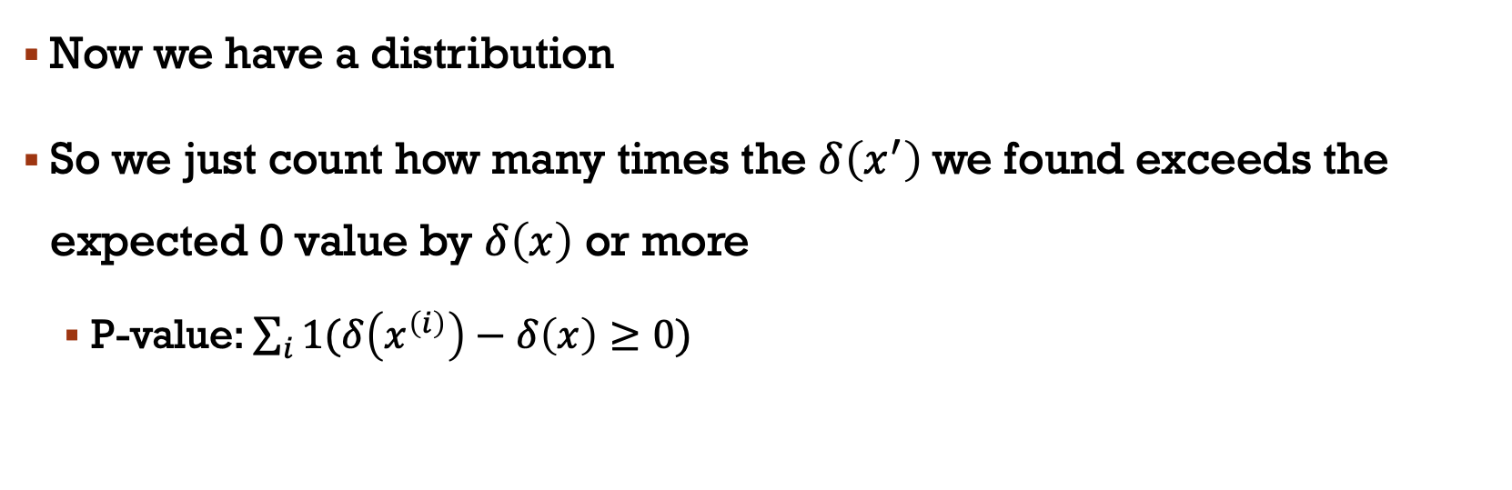
Now we have a distribution
So we just count how many times the $δ\left(x^{′}\right)$we found exceeds the expected 0 value by $δ\left(x\right)$ or more
P-value: $\sum_{i}{1(δ\left(x^{\left(i\right)}\right)−δ\left(x\right)≥0)}$

Slide 37
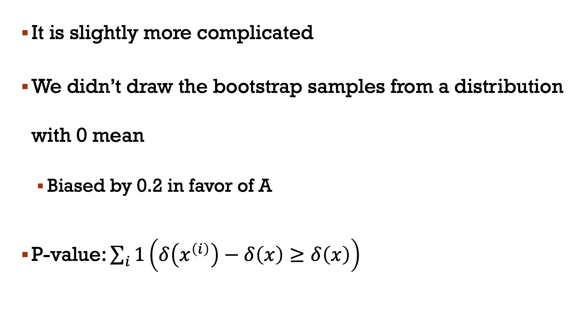
It is slightly more complicated
We didn’t draw the bootstrap samples from a distribution with 0 mean
Biased by 0.2 in favor of A
P-value: $\sum_{i}{1\left(δ\left(x^{\left(i\right)}\right)−δ\left(x\right)≥δ\left(x\right)\right)}$

Slide 38
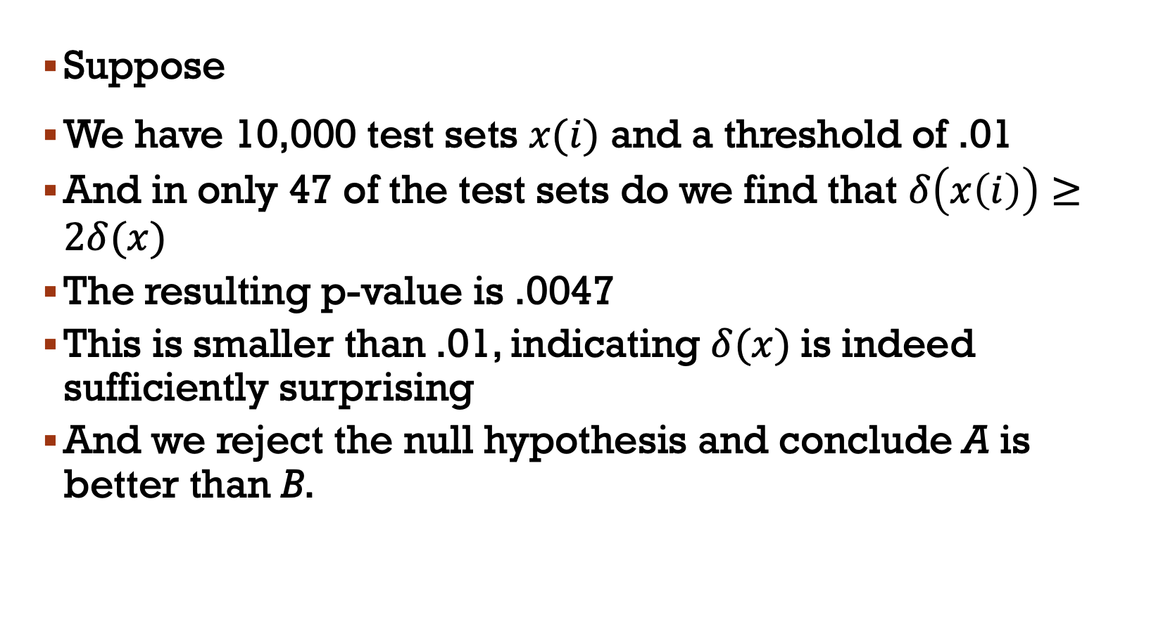
Suppose
We have 10,000 test sets $x(i)$ and a threshold of .01
And in only 47 of the test sets do we find that $δ\left(x\left(i\right)\right)≥2δ(x)$
The resulting p-value is .0047
This is smaller than .01, indicating $δ(x)$is indeed sufficiently surprising
And we reject the null hypothesis and conclude A is better than B.

Slide 39
