Slide 1

Introduction to Natural Language Processing
BUS 243 F: Spring 2023
Yeabin Moon
Lecture 2

Slide 2
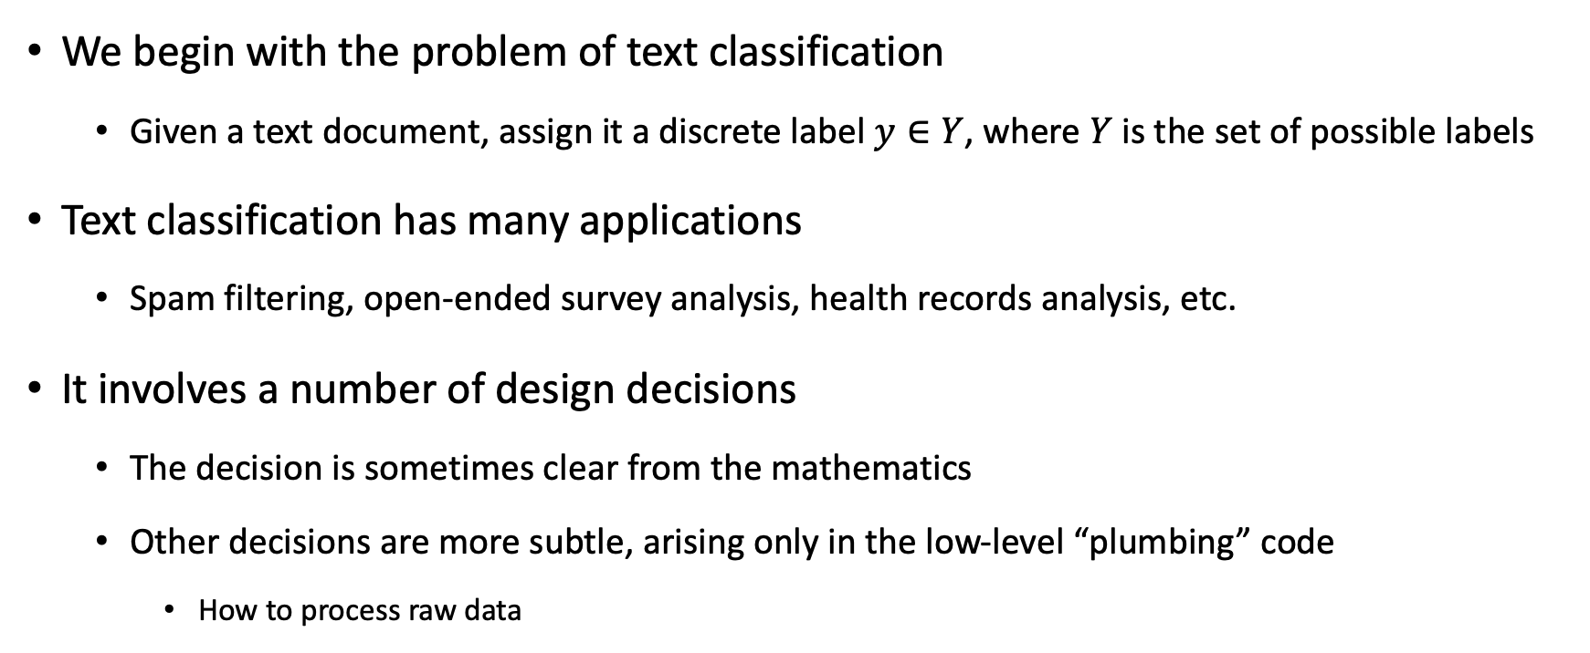
Text Classification
We begin with the problem of text classification
Given a text document, assign it a discrete label $y∈Y$, where $Y$ is the set of possible labels
Text classification has many applications
Spam filtering, open-ended survey analysis, health records analysis, etc.
It involves a number of design decisions
The decision is sometimes clear from the mathematics
Other decisions are more subtle, arising only in the low-level “plumbing” code
How to process raw data

Slide 3
What is a Word?

