Slide 1

Introduction to Natural Language Processing
BUS 243 F: Spring 2023
Yeabin Moon
Lecture 6

Slide 2
Word vectors
One of the most exciting recent advancements in NLP is the discovery of word vectors
In the previous lectures, we understood the semantics in a statistical way
Idea of Latent semantic analysis
Now, introduce the effect the neighbors of a word
have on its meaning
how those relationships affect the overall meaning of a statement

Slide 3
Problem with words as discrete symbols
E.g: in web search, if a user searches for “Seattle motel”, we’d like to match documents containing “Seattle hotel”
But see: [0 0 0 0 1 0 0 0] , [0 0 1 0 0 0 0 0]
Theses two vectors are orthogonal
No natural notion of similarity for one-hot vectors
Could try to rely on WordNet’s list of synonyms to get similarity?
But it is well-known to fail badly
Instead, learn to encode similarity in the vectors themselves

Slide 4
Representing words by their context
Distributional semantics: A word’ meaning is given by the words that frequently appear close-by
J. R. Firth 1957: You shall know a word by the company it keeps
One of the most successful ideas of modern statistical NLP
When a word w appears in a text, its context is the set of words that appear nearby
Within a fixed-size window

Slide 5
Context, context, context
We use the many contexts of w to build up a representation of w
The following context words will represent banking
…government debt problems turning into banking crises as happened in 2009…
…saying that Europe needs unified banking regulation to replace the hodgepodge…
…India has just given its banking system a shot in the arm…

Slide 6
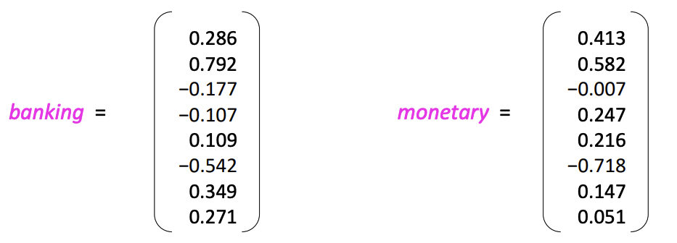
Word vectors
We will build a dense vector for each word, chosen so that it is similar to vectors of words that appear in similar contexts, measuring similarity as the vector dot (scalar) product
Note: word vectors are also called (word) embeddings or (neural) word representations
They are a distributed representation

Slide 7
What are word embeddings?
Again, Word embeddings are one of the most important concepts in modern NLP
Technically, an embedding is a continuous vector representation of something that is usually discrete
A word embedding is a continuous vector representation of a word
In simpler terms, word embeddings are a way to represent each word with a 300-element array filled with nonzero float numbers

Slide 8
Discreteness of language
In the eyes of computers, “cat” is no closer to “dog” than it is to “pizza”
One way to deal with discrete words programmatically is to assign indices:
Index(“cat”) = 1
Index(“dog”) = 2
Index(“pizza”) = 3
But this method isn’t any better than dealing with raw words

Slide 9
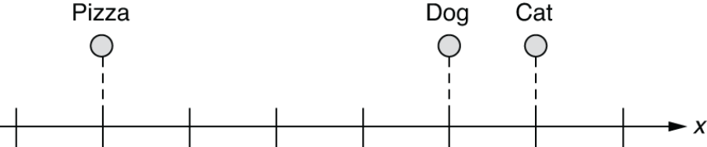
Word embeddings in a 1-D space
What if we can represent them on a numerical scale?
This is a step forward.
What if you wanted to place it somewhere that is equally far from “cat” and “dog?”

Slide 10
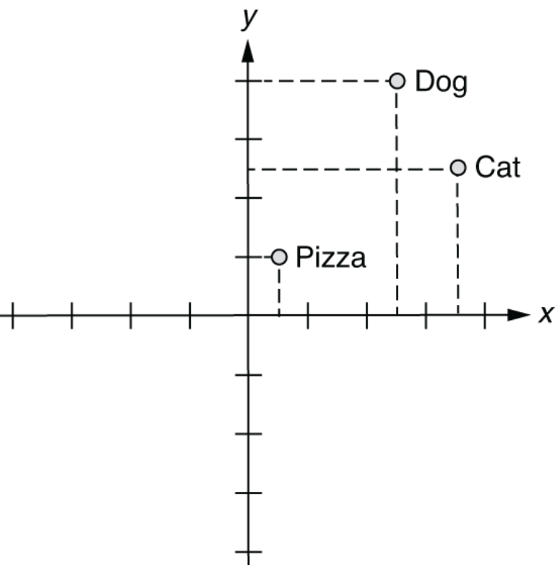
Word embeddings in a 2-D space

Slide 11
How about 3-D?
In this 3-D space, you can represent those three words as follows:
index(“cat”) = [0.7, 0.5, 0.1]
index(“dog”) = [0.8, 0.3, 0.1]
index(“pizza”) = [0.1, 0.2, 0.8]
Possibly attach meanings here
X-axis: some concept of animal-ness
Z-axis: food-ness
This is essentially what word embeddings are
if you wanted to identify animal names, then you would just look at the first element of each word vector and see if the value is high enough

Slide 12
How about one-hot vectors, then?
By the way, we have a much simpler method to “embed” words into a multidimensional space
index(“cat”) = [1, 0, 0]
index(“dog”) = [0, 1, 0]
index(“pizza”) = [0, 0, 1]
Not very useful in representing semantic relationship between them
All at equal distance from each other
They are often used as the input when embeddings are not available

Slide 13
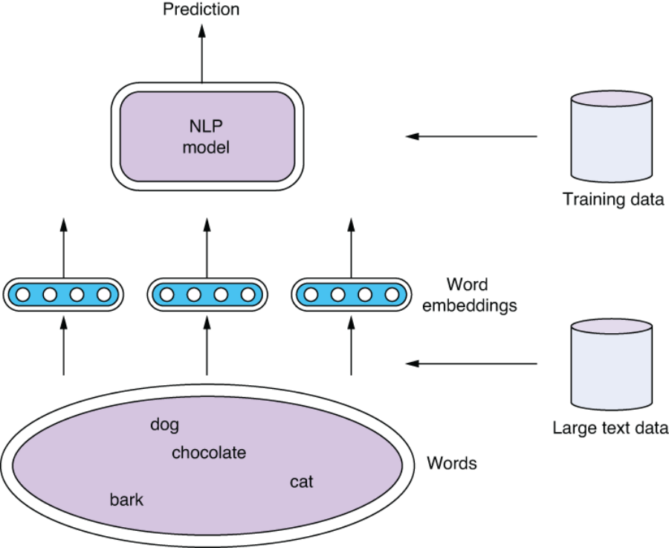

Slide 14
Semantic queries and analogies
With word vectors, you can search for words or names that combine the meaning of the words
Analogy questions: Who is to nuclear physics what Louis Pasteur is to germs.
wv['Louis_Pasteur'] - wv['germs'] + wv['physics']

Slide 15
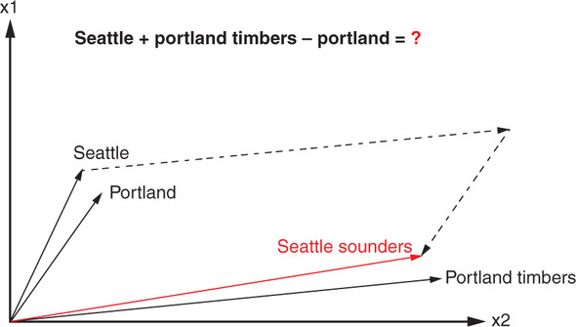
Word analogy?
Portland Timbers + Seattle - Portland = ?

Slide 16
Word2vec
In 2012, Thomas Mikolov, an intern at Microsoft, found a way to encode the meaning of words in a modest number of vector dimension
Mikolov trained a neural network to predict word occurrences near each target word
Word2vec learns the meaning of words merely by processing a large corpus of unlabeled text

Slide 17
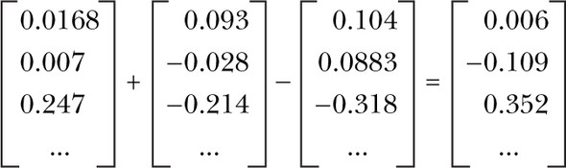
Vector-oriented reasoning
The Word2vec model contains information about the relationships between words
After adding and subtracting word vectors, your resultant vector will almost never exactly equal one of the vectors in your word vector vocabulary

Slide 18
Very high accuracy
Word2vec allows you to transform your natural language vectors of token occurrence counts and frequencies into the vector space of much lower-dimensional Word2vec vectors.
In this lower-dimensional space, you can do your math and then convert back to a natural language space, very successfully
The reference implementation was trained on the 100 billion words from the Google News Corpus
Also discover the distance between the singular and plural versions of a word quite similar

Slide 19
Application first: Gensim
For looking at word vectors, we’ll use Gensim
We also use it in homework for word vectors
Gensim isn’t really a deep learning package.
It's a package for for word and text similarity modeling, which started with (LDA-style) topic models and grew into SVD and neural word representations.
But its efficient and scalable, and quite widely used
See the code

Slide 20
How to compute word vectors?
Calculate word embeddings from large textual data using two popular algorithms
Skip-gram and CBOW
Where word embeddings come from?
index(“cat”) = [0.7, 0.5, 0.1]
index(“dog”) = [0.8, 0.3, 0.1]
index(“pizza”) = [0.1, 0.2, 0.8]
More importantly, what should those numbers look like?

Slide 21
Word associations
The answer is that those numbers are also trained using a training dataset and a machine learning model like any other model
I’ll introduce and implement one of the most popular models to train word embeddings—the Skip-gram model.
First, let’s step back and think how humans learn concepts such as “a dog.”
You did not learn it by definition
What’s the definition of a dog by the way?
You acquire the concept through a large amount of physical, cognitive, and linguistic interactions with the external world

Slide 22
How about a computer?
One possible way to do this without teaching the computer what “dog” means is to use association relative to other words.
What words tend to appear together with the word “dog” if you look at its appearances in a large text corpus?
“Pet,” “tail,” “smell,” “bark,” “puppy”, etc.
How about ”cat”?
Because “dog” and “cat” have a lot in common conceptually, these two sets of context words also have large overlap

Slide 23
Distributional hypothesis
You can guess how close two words are to each other by looking at what other words appear in the same context
This is called the distributional hypothesis
Word2vec led to a lot of work (both pure and applied) in the direction of learning text representations using neural networks
Let’s build an intuition of how they work and how to use them to represent text

Slide 24
Word2vec revisit
The aim is to learn embeddings for every word in the corpus such that the word vector in the embedding space best captures its meaning
That is, it derives the meaning of a word from its context: words that appear in its neighborhood in the text
words that appear in its neighborhood in the text

Slide 25
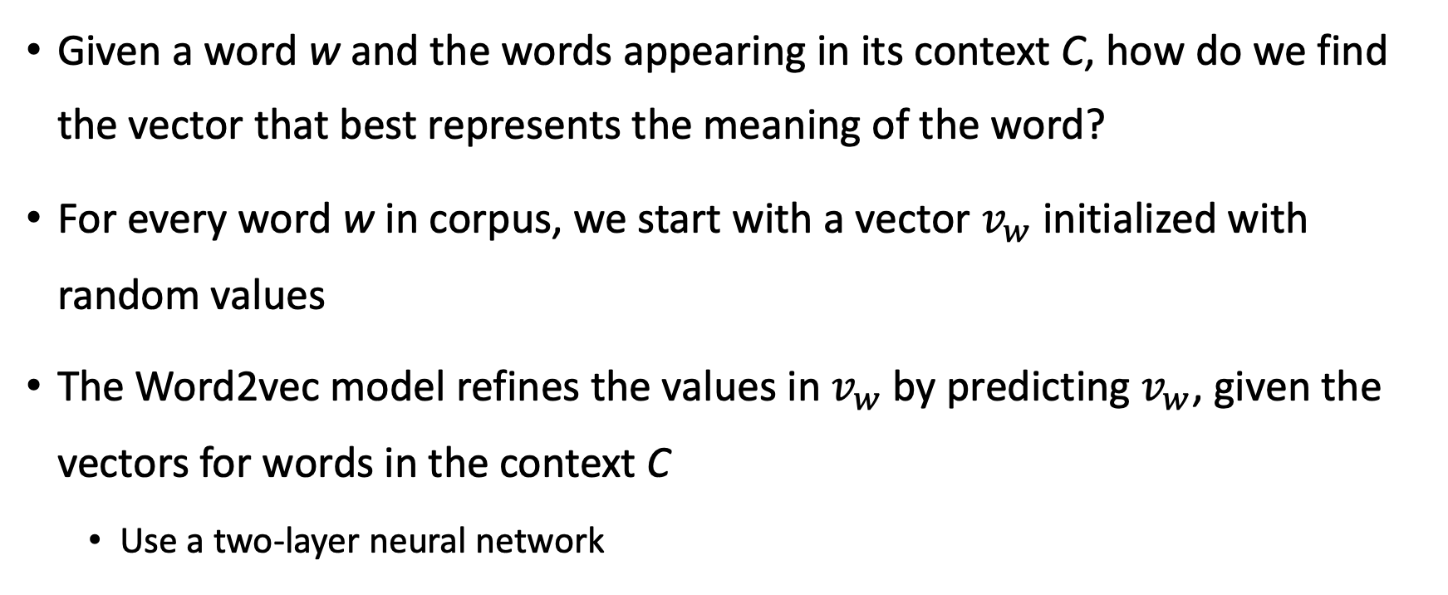
Given a word w and the words appearing in its context C, how do we find the vector that best represents the meaning of the word?
For every word w in corpus, we start with a vector $v_{w}$ initialized with random values
The Word2vec model refines the values in $v_{w}$by predicting $v_{w}$, given the vectors for words in the context C
Use a two-layer neural network

Slide 26
Training your own word embeddings is a pretty expensive process
Thankfully, it’s not necessary to train your own embeddings, and using pre-trained word embeddings often suffices
Someone has done the hard work of training word embeddings on a large corpus
Word2vec by Google
GloVe by Stanford
Fasttext by Facebook
See the code earlier!

Slide 27
Training our own embeddings
Now we’ll focus on training our own word embeddings
Continuous bag of words (CBOW) and SkipGram
Both of these have a lot of similarities in many respects
Consider the sentence
“The quick brown fox jumps over the lazy dog”
But, let’s discuss when do we need to train our own embeddings?

Slide 28
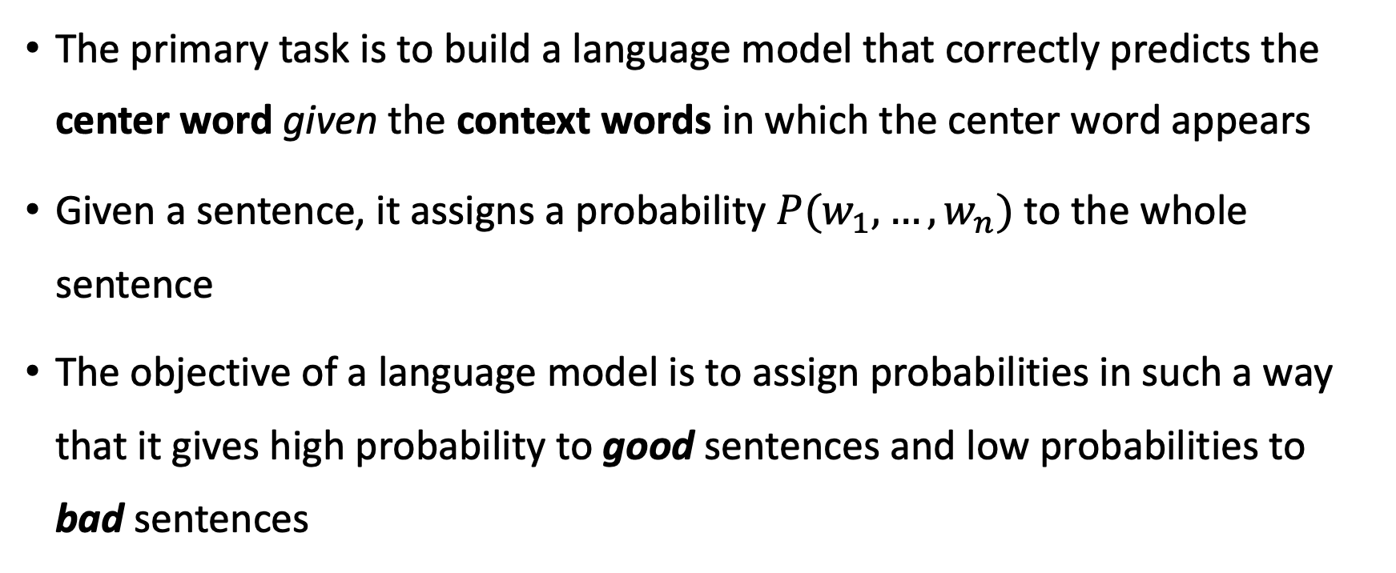
Language model
The primary task is to build a language model that correctly predicts the center word given the context words in which the center word appears
Given a sentence, it assigns a probability $P(w_{1},…,w_{n})$ to the whole sentence
The objective of a language model is to assign probabilities in such a way that it gives high probability to good sentences and low probabilities to bad sentences

Slide 29
By good, we mean sentences that are semantically and syntactically correct
By bad, we mean sentences that are incorrect—semantically or syntactically or both.
For a sentence like “The cat jumped over the dog” it will try to assign a probability close to 1.0
Whereas for a sentence like “jumped over the the cat dog,” it tries to assign a probability close to 0.0.

Slide 30
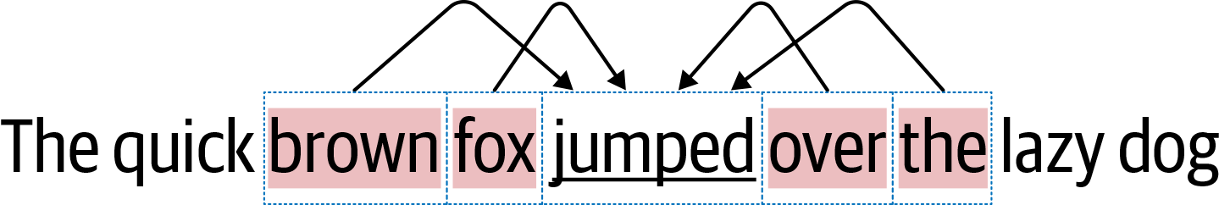
CBOW
CBOW tries to learn a language model that tries to predict the “center” word from the words in its context
CBOW tries to do this for every word in the corpus

Slide 31
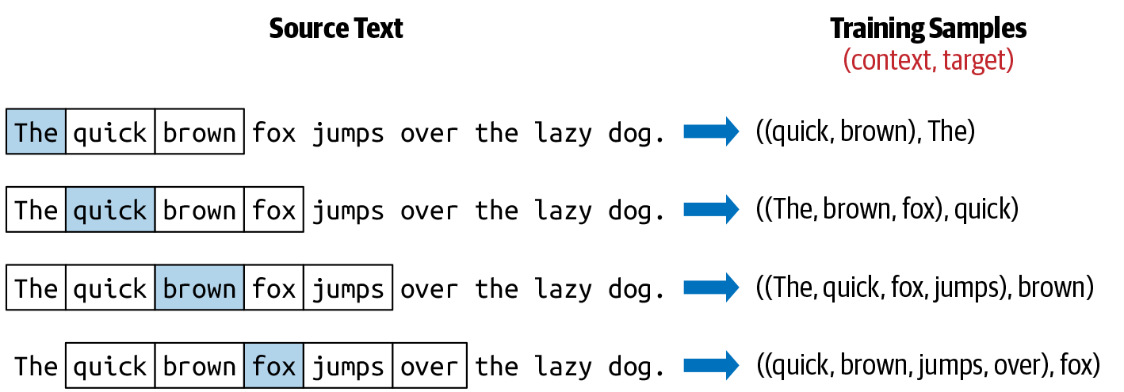
Preparing a dataset for CBOW

Slide 32
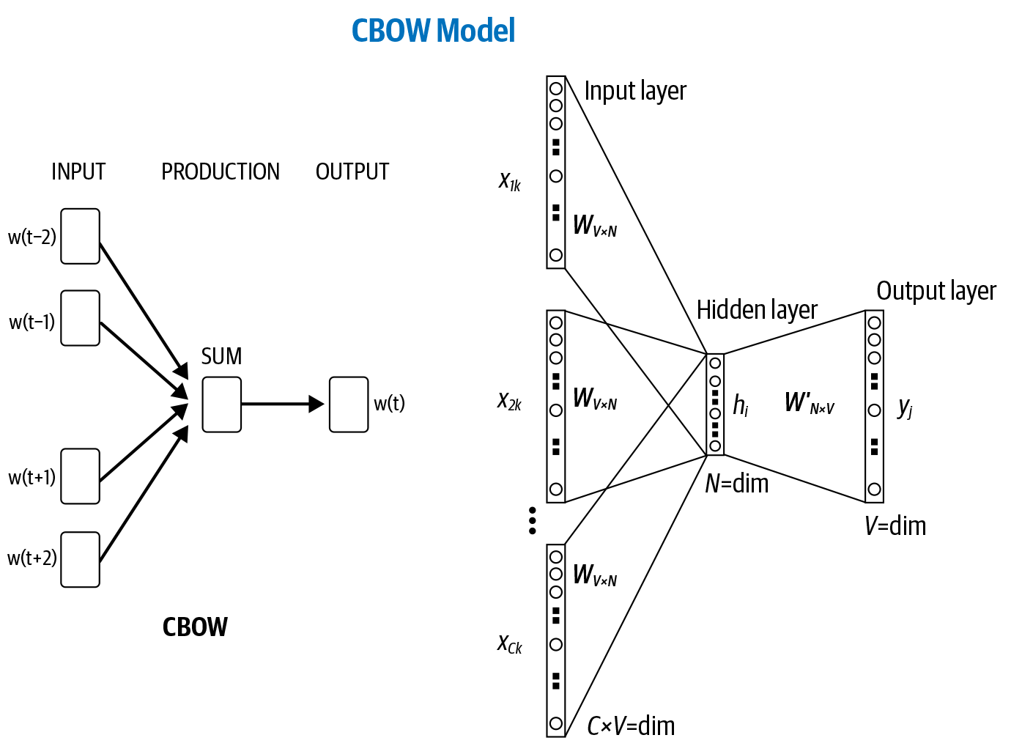

Slide 33

The objective is to learn an embedding matrix $E_{\left|V\right|×d}$
$|V|$ is the size of corpus vocabulary
d is the dimension of the embedding
At the end of the training, E is the embedding matrix we wanted to learn

Slide 34
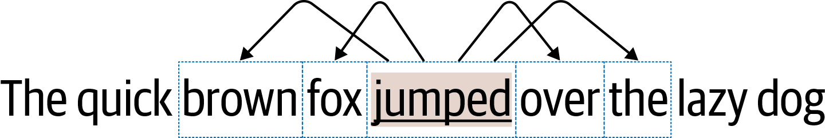
SkipGram
In SkipGram, the task is to predict the context words from the center word
Unlike CBOW, this gives us 2k data points. A single data point consists of a pair: (index of the center word, index of a target word)

Slide 35
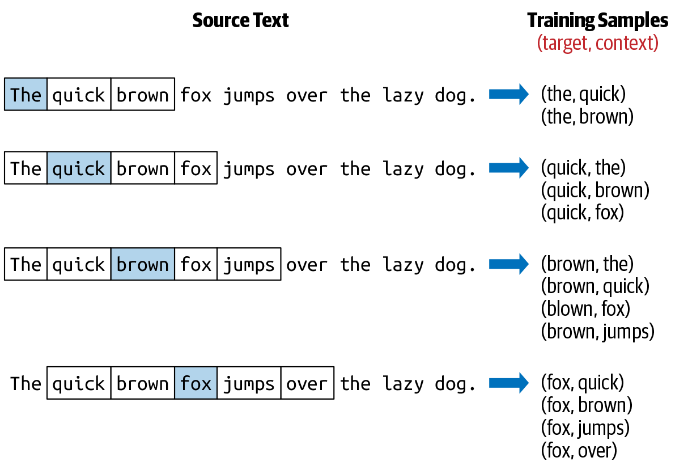

Slide 36
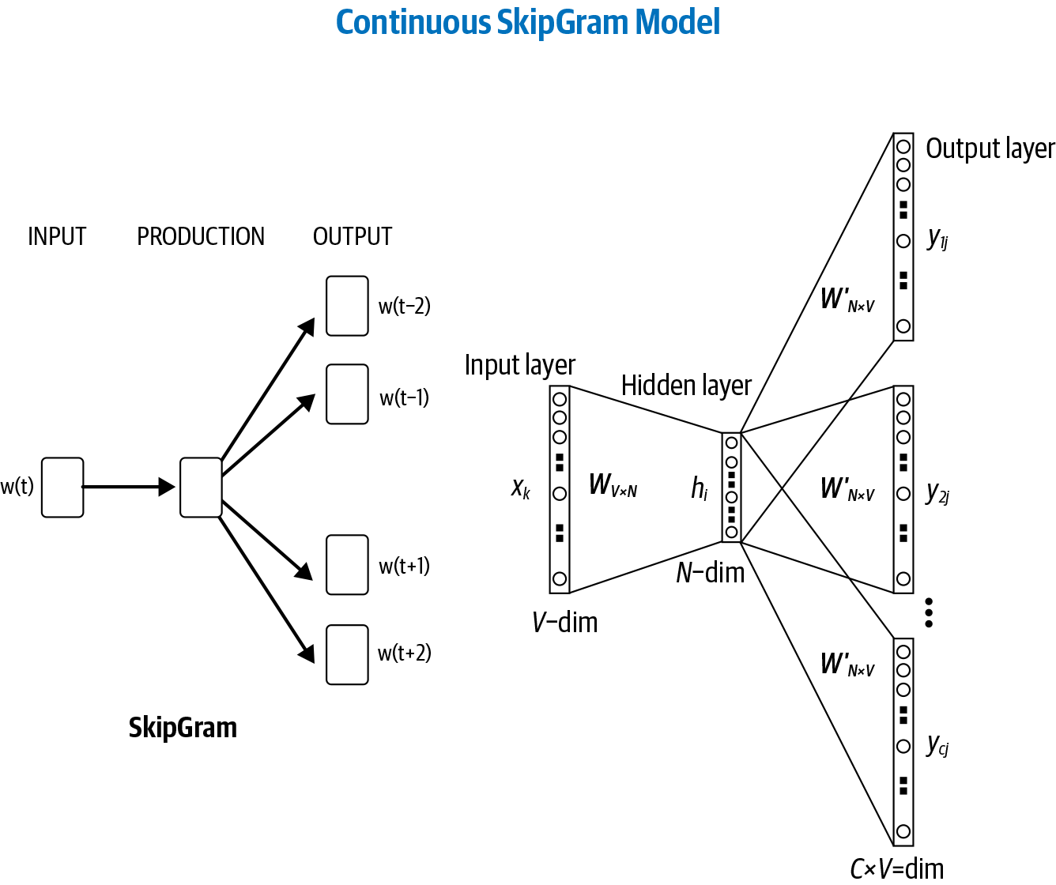

Slide 37
Application in practice
NLP develops really fast
Pretty obsess with methodology, but more important criteria is the logic
Nature paper

