Slide 1

Introduction to Natural Language Processing
BUS 243 F: Spring 2023
Yeabin Moon
Lecture 6

Slide 2
Homework 2
Question 4b
Many of you used the similar approach
Calculate the centroids of the positives and negative
Have two vectors
Compare the cosine similarity between the test sentence and this twos
Looks like LDA analysis
Really?
What’d we missing here?

Slide 3
Course evaluation
Please complete the course evaluation!
It’s your turn to give me your feedback on this course
Impossible to know who you are
Do not affect your grade so don’t worry on your brutal feedback
Good NLP resources for me

Slide 4
What are word embeddings?
Again, Word embeddings are one of the most important concepts in modern NLP
Technically, an embedding is a continuous vector representation of something that is usually discrete
represent each word with a 300-element array filled with float numbers

Slide 5
Discreteness of language
In the eyes of computers, “cat” is no closer to “dog” than it is to “pizza”
One way to deal with discrete words programmatically is to assign indices:
Index(“cat”) = 1
Index(“dog”) = 2
Index(“pizza”) = 3
But this method isn’t any better than dealing with raw words

Slide 6
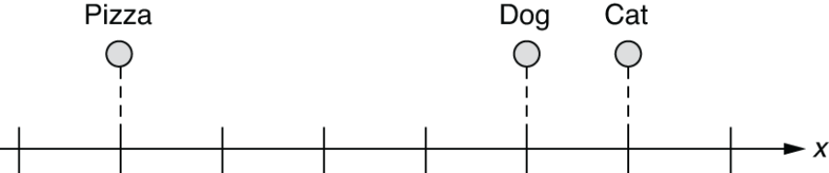
Word embeddings in a 1-D space
What if we can represent them on a numerical scale?
Any limitation?

Slide 7
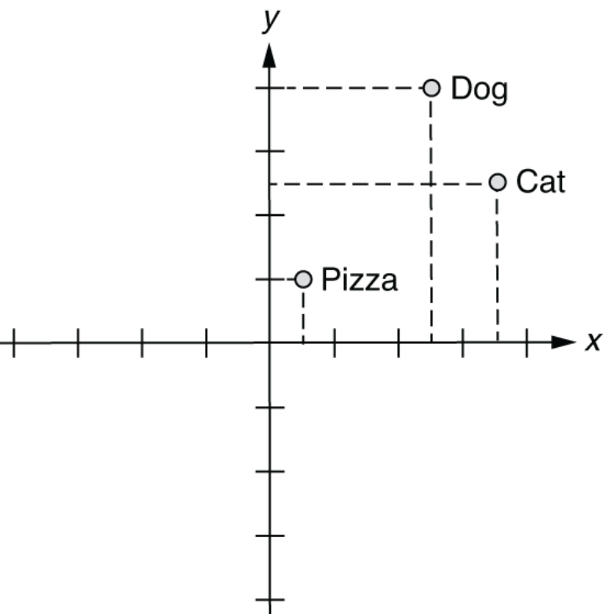
Word embeddings in a 2-D space

Slide 8
How about 3-D?
In this 3-D space, you can represent those three words as follows:
index(“cat”) = [0.7, 0.5, 0.1]
index(“dog”) = [0.8, 0.3, 0.1]
index(“pizza”) = [0.1, 0.2, 0.8]
Possibly attach meanings here
X-axis: some concept of animal-ness
Z-axis: food-ness
This is essentially what word embeddings are

Slide 9
Semantic queries and analogies
With word vectors, you can search for words or names that combine the meaning of the words
Who is to nuclear physics what Louis Pasteur is to germs.
wv['Louis_Pasteur'] - wv['germs'] + wv['physics']

Slide 10
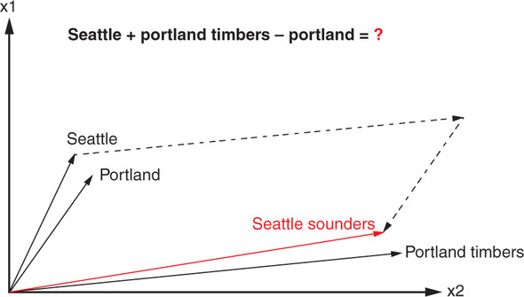
Word analogy?
Portland Timbers + Seattle - Portland = ?

Slide 11
So what?
How to get word embeddings?
Why do we need a neural network?
Efficient Estimation of Word Representations in Vector Space
Mikolov et al. 2013
Illustrate the main ideas using very simple examples

Slide 12
Let’s convert words into numbers just assigning each word to a random number
Consider: Avatar 2 is great!
For the illustrative purpose, we are going to treat Avatar 2 as a single word

Slide 13
Avatar 2
12
is
-3.05
great!
4.2

Slide 14
If the next person said Avatar 2 is awesome!...
Avatar 2
12
is
-3.05
great!
4.2

Slide 15
Then we could reuse the random numbers for Avatar 2 and is
And assign a new random number to the new word, awesome
Avatar 2
12
Avatar 2
is
-3.05
is
great!
4.2
awesome!
-32.1

Slide 16
Looks fine, but it means that even though great! and awesome! mean similar things and are used in similar ways
…they have very different numbers associated with them, 4.2 and -32.1
Avatar 2
12
Avatar 2
is
-3.05
is
great!
4.2
awesome!
-32.1

Slide 17
It would be nice if similar words that are used in similar ways could be given similar numbers…
So that learning how to use one word will help learn how to use the other at the same time
And because the same words can be used in different contexts, or made plural or used in some other way, it might be nice to assign each word more than one number

Slide 18
For example, the word great can be used in a positive way
The NLP course is great!
And it can also be used in a sarcastic, negative way, like
Homework 3 is terrible, great.
It would be nice if we had one number that could keep track of the positive ways that great is used
And a different number to keep track of the negative ways
Let’s see a super simple neural network could do this

Slide 19
Let’s imagine we have two phrases (training data)
Avatar 2 is great!
John Wick 4 is great!
Both movies received positive reviews, so both phrases are in similar contexts
Again Avatar 2 and John Wick 4 are treated as a single word
In order to create a neural net to figure out what number we should associate with each word, let’s create inputs for each unique word
We have 4 unique words in the training data, so 4 inputs!

Slide 20
Now we connect each input to at least 1 Activation Function
Avatar 2
is
great!
John Wick 4

Slide 21
Now we connect each input to at least 1 Activation Function
uses the identity function: the input value is the same as
the output value
Avatar 2
sum
is
y=x
great!
John Wick 4

Slide 22
Now we connect each input to at least 1 Activation Function
uses the identity function: so, this function doesn’t do anything except give us a
place to do addition.
Avatar 2
sum
is
y=x
great!
John Wick 4

Slide 23
The number of Activation functions corresponds to how many numbers we want to associate with each word
Avatar 2
sum
is
y=x
great!
John Wick 4

Slide 24
…and the Weights on these connections will, ultimately, be the numbers that we associate with each word
Avatar 2
sum
is
y=x
great!
John Wick 4

Slide 25
Now, in this example, we want to associate 2 numbers with each word.
Avatar 2
sum
is
y=x
great!
John Wick 4

Slide 26
So, we will use 2 Activation Functions
Avatar 2
0.38
sum
-0.12
is
-0.11
-0.24
great!
0.42
sum
John Wick 4
0.46
0.10
0.29

Slide 27
…and the Weights on the connection to the second Activation Function will be another number associated with each word
Avatar 2
0.38
sum
-0.12
is
-0.11
-0.24
great!
0.42
sum
John Wick 4
0.46
0.10
0.29

Slide 28
However, these weights start out with random values
Avatar 2
0.38
sum
-0.12
is
-0.11
-0.24
great!
0.42
sum
John Wick 4
0.46
0.10
0.29

Slide 29
… that we will optimize with Backpropagation
In order to do Backpropagation, we have to make predictions
Avatar 2
0.38
sum
-0.12
is
-0.11
-0.24
great!
0.42
sum
John Wick 4
0.46
0.10
0.29

Slide 30
We will use the input word
Avatar 2
0.38
sum
-0.12
is
-0.11
-0.24
great!
0.42
sum
John Wick 4
0.46
0.10
0.29

Slide 31
We will use the input word to predict the next word in the phrase
Avatar 2
Avatar 2
0.38
sum
-0.12
is
is
-0.11
-0.24
great!
great!
0.42
sum
John Wick 4
John Wick 4
0.46
0.10
0.29

Slide 32
We can use the word Avatar 2 to predict the word is.
Avatar 2
Avatar 2
0.38
sum
-0.12
is
is
-0.11
-0.24
great!
great!
0.42
sum
John Wick 4
John Wick 4
0.46
0.10
0.29

Slide 33
In other words, if the input word is Avatar 2 and we indicate that by putting a 1 into the Avatar 2 input and 0s into all of the other inputs
Avatar 2
Avatar 2
0.38
1
sum
-0.12
is
is
-0.11
0
-0.24
great!
great!
0
0.42
sum
John Wick 4
John Wick 4
0.46
0
0.10
0.29

Slide 34
…then we want to the output for the next word, is, to have the largest value
Avatar 2
Avatar 2
0.38
1
sum
0.00
-0.12
is
is
-0.11
0
1.00
-0.24
great!
great!
0
0.42
0.00
sum
John Wick 4
John Wick 4
0.46
0
0.10
0.00
0.29

Slide 35
And if the input word is is…
Avatar 2
Avatar 2
0.38
0
sum
-0.12
is
is
-0.11
1
-0.24
great!
great!
0
0.42
sum
John Wick 4
John Wick 4
0.46
0
0.10
0.29

Slide 36
Then we want the output for the next word, great!, to have the largest value
Avatar 2
Avatar 2
0.38
0
sum
0.00
-0.12
is
is
-0.11
1
0.00
-0.24
great!
great!
0
0.42
1.00
sum
John Wick 4
John Wick 4
0.46
0
0.10
0.00
0.29

Slide 37
In order to make these predictions, we connect the Activation functions to outputs
Avatar 2
Avatar 2
0.38
sum
sum
-0.12
is
is
-0.11
sum
-0.24
great!
great!
0.42
sum
sum
John Wick 4
John Wick 4
0.46
sum
0.10
0.29

Slide 38
…and we add Weights to those connections with random initialization values
Avatar 2
Avatar 2
0.38
0.44
sum
sum
-0.12
-0.37
is
is
-0.11
0.43
sum
-0.24
0.09
great!
great!
0.42
0.37
sum
sum
John Wick 4
0.07
John Wick 4
0.46
sum
0.10
0.24
0.29
-0.07

Slide 39
…and then we run the outputs through the SoftMax function because we have multiple outputs for classification
Avatar 2
Avatar 2
0.38
0.44
sum
sum
-0.12
-0.37
is
is
-0.11
0.43
sum
-0.24
0.09
SoftMax
great!
great!
0.42
0.37
sum
sum
John Wick 4
0.07
John Wick 4
0.46
sum
0.10
0.24
0.29
-0.07

Slide 40
…and that means we can use the Cross Entropy loss function for Backpropagation
Avatar 2
Avatar 2
0.38
0.44
sum
sum
-0.12
-0.37
is
is
-0.11
0.43
sum
-0.24
0.09
SoftMax
great!
great!
0.42
0.37
sum
sum
John Wick 4
0.07
John Wick 4
0.46
sum
0.10
0.24
0.29
-0.07

Slide 41
Again, the goal is to train this Neural Network so that it correctly predicts the next word in a phrase
Avatar 2
Avatar 2
0.38
0.44
sum
sum
-0.12
-0.37
is
is
-0.11
0.43
sum
-0.24
0.09
SoftMax
great!
great!
0.42
0.37
sum
sum
John Wick 4
0.07
John Wick 4
0.46
sum
0.10
0.24
0.29
-0.07

Slide 42
And now, before training, if we plug the word Avatar 2 into the input
Avatar 2
Avatar 2
0.38
0.44
1
sum
sum
-0.12
-0.37
is
is
-0.11
0.43
sum
0
-0.24
0.09
SoftMax
great!
great!
0
0.42
0.37
sum
sum
John Wick 4
0.07
John Wick 4
0.46
sum
0
0.10
0.24
0.29
-0.07

Slide 43
…we get lucky and correctly predict the next word, is, but just barely
Avatar 2
Avatar 2
0.38
0.44
1
sum
sum
0.01
0.23
-0.12
-0.37
is
is
-0.11
0.43
sum
0
0.20
0.27
-0.24
0.09
SoftMax
great!
great!
0
0.42
0.37
sum
0.17
0.26
sum
John Wick 4
0.07
John Wick 4
0.46
sum
0.06
0.24
0
0.10
0.24
0.29
-0.07

Slide 44
However, when we plug the word is into the input, we fail to correctly predict the next word, great!, and instead predict is ☹
Avatar 2
Avatar 2
0.38
0.44
0
sum
sum
-0.22
0.22
-0.12
-0.37
is
is
-0.11
0.43
sum
1
-0.01
0.27
-0.24
0.09
SoftMax
great!
great!
0
0.42
0.37
sum
-0.01
0.26
sum
John Wick 4
0.07
John Wick 4
0.46
sum
-0.06
0.25
0
0.10
0.24
0.29
-0.07

Slide 45
So we need to train this Neural Network
Avatar 2
Avatar 2
0.38
0.44
0
sum
sum
-0.22
0.22
-0.12
-0.37
is
is
-0.11
0.43
sum
1
-0.01
0.27
-0.24
0.09
SoftMax
great!
great!
0
0.42
0.37
sum
-0.01
0.26
sum
John Wick 4
0.07
John Wick 4
0.46
sum
-0.06
0.25
0
0.10
0.24
0.29
-0.07

Slide 46
Before we optimize all of the weights, remember that these weights would be the numbers associated with each word
Avatar 2
Avatar 2
0.38
0.44
sum
sum
-0.12
-0.37
is
is
-0.11
0.43
sum
-0.24
0.09
SoftMax
great!
great!
0.42
0.37
sum
sum
John Wick 4
0.07
John Wick 4
0.46
sum
0.10
0.24
0.29
-0.07

Slide 47
And since, in this example, we have 2 weights for each word
Avatar 2
Avatar 2
0.38
0.44
sum
sum
-0.12
-0.37
is
is
-0.11
0.43
sum
-0.24
0.09
SoftMax
great!
great!
0.42
0.37
sum
sum
John Wick 4
0.07
John Wick 4
0.46
sum
0.10
0.24
0.29
-0.07

Slide 48
We can plot each word on a graph
Avatar 2
0.38
sum
-0.12
is
-0.11
-0.24
great!
0.42
sum
John Wick 4
0.46
0.10
0.29

Slide 49
The Weight values to the top activation function on the x-axis
Avatar 2
0.38
sum
-0.12
is
-0.11
-0.24
great!
0.42
sum
John Wick 4
0.46
0.10
0.29

Slide 50
The Weight values to the bottom activation function on the y-axis
Avatar 2
0.38
sum
-0.12
is
-0.11
-0.24
great!
0.42
sum
John Wick 4
0.46
0.10
0.29

Slide 51
Then, relatively plot them
is
Avatar 2
Avatar 2
0.38
sum
-0.12
is
John Wick 4
-0.11
-0.24
great!
0.42
great!
sum
John Wick 4
0.46
0.10
0.29

Slide 52
Now, with this graph, we see that the words Avatar 2 and John Wick 4 are no more similar to each other as they are to any of the other words
is
Avatar 2
Avatar 2
0.38
sum
-0.12
is
John Wick 4
-0.11
-0.24
great!
0.42
great!
sum
John Wick 4
0.46
0.10
0.29

Slide 53
However, because both words appear in the same context in the training data, we hope that backpropagation will make their weights more similar
is
Avatar 2
Avatar 2
0.38
sum
-0.12
is
John Wick 4
-0.11
-0.24
great!
0.42
great!
sum
John Wick 4
0.46
0.10
0.29

Slide 54
So we start with these weights
Avatar 2
Avatar 2
0.38
0.44
sum
sum
-0.12
-0.37
is
is
-0.11
0.43
sum
-0.24
0.09
SoftMax
great!
great!
0.42
0.37
sum
sum
John Wick 4
0.07
John Wick 4
0.46
sum
0.10
0.24
0.29
-0.07

Slide 55
…and we end up with these new
Avatar 2
Avatar 2
2.02
1.16
sum
sum
-2.17
-1.72
is
is
-2.13
3.22
sum
1.73
1.32
SoftMax
great!
great!
1.98
-1.67
sum
sum
John Wick 4
0.86
John Wick 4
2.48
sum
-2.23
-1.69
1.99
3.39

Slide 56
The new Weights on the connections from the inputs to the Activation Functions are the Word Embeddings
Avatar 2
2.02
sum
-2.17
is
-2.13
1.73
great!
1.98
sum
John Wick 4
2.48
-2.23
1.99

Slide 57
And when we plot the words using the new weights, which are now the embeddings
is
Avatar 2
Avatar 2
John Wick 4
2.02
sum
-2.17
is
-2.13
1.73
great!
1.98
great!
sum
John Wick 4
2.48
-2.23
1.99

Slide 58
…we see that Avatar 2 and John Wick 4 are now relatively close to each other
is
Avatar 2
Avatar 2
John Wick 4
2.02
sum
-2.17
is
-2.13
1.73
great!
1.98
great!
sum
John Wick 4
2.48
-2.23
1.99

Slide 59
Now that we’ve trained the neural network, we can see how well it predicts the next word
Avatar 2
Avatar 2
2.02
1.16
sum
sum
-2.17
-1.72
is
is
-2.13
3.22
sum
1.73
1.32
SoftMax
great!
great!
1.98
-1.67
sum
sum
John Wick 4
0.86
John Wick 4
2.48
sum
-2.23
-1.69
1.99
3.39

Slide 60
For example, if we plug the word Avatar 2 into the input
Avatar 2
Avatar 2
2.02
1.16
1
sum
sum
-2.17
-1.72
is
is
-2.13
3.22
sum
0
1.73
1.32
SoftMax
great!
great!
1.98
-1.67
sum
0
sum
John Wick 4
0.86
John Wick 4
2.48
sum
0
-2.23
-1.69
1.99
3.39

Slide 61
…then the output for the next word, is, 1 and everything else is 0
Avatar 2
Avatar 2
2.02
1.16
1
sum
sum
-1.06
0.00
-2.17
-1.72
is
is
-2.13
3.22
sum
0
9.12
1.00
1.73
1.32
SoftMax
great!
great!
1.98
-1.67
sum
-1.67
0.00
0
sum
John Wick 4
0.86
John Wick 4
2.48
sum
-10.1
0
-2.23
-1.69
0.00
1.99
3.39

Slide 62
Other word inputs produce the outputs well!
Avatar 2
Avatar 2
2.02
1.16
1
sum
sum
-1.06
0.00
-2.17
-1.72
is
is
-2.13
3.22
sum
0
9.12
1.00
1.73
1.32
SoftMax
great!
great!
1.98
-1.67
sum
-1.67
0.00
0
sum
John Wick 4
0.86
John Wick 4
2.48
sum
-10.1
0
-2.23
-1.69
0.00
1.99
3.39

Slide 63
Let’s summarize what we’ve learned so far
Avatar 2
Avatar 2
2.02
1.16
1
sum
sum
-1.06
0.00
-2.17
-1.72
is
is
-2.13
3.22
sum
0
9.12
1.00
1.73
1.32
SoftMax
great!
great!
1.98
-1.67
sum
-1.67
0.00
0
sum
John Wick 4
0.86
John Wick 4
2.48
sum
-10.1
0
-2.23
-1.69
0.00
1.99
3.39

Slide 64
First, rather than just assign random numbers to words…
Avatar 2
12
Avatar 2
is
-3.05
is
great!
4.2
awesome!
-32.1

Slide 65
…we can train a relatively simple Neural Network to assign numbers for us
Avatar 2
Avatar 2
2.02
1.16
1
sum
sum
-2.17
-1.72
is
is
-2.13
3.22
sum
0
1.73
1.32
SoftMax
great!
great!
1.98
-1.67
sum
0
sum
John Wick 4
0.86
John Wick 4
2.48
sum
0
-2.23
-1.69
1.99
3.39

Slide 66
The advantage of using a neural network is that it can use the contexts of words in the training dataset
Avatar 2
Avatar 2
2.02
1.16
1
sum
sum
-2.17
-1.72
is
is
-2.13
3.22
sum
0
1.73
1.32
SoftMax
great!
great!
1.98
-1.67
sum
0
sum
John Wick 4
0.86
John Wick 4
2.48
sum
0
-2.23
-1.69
1.99
3.39

Slide 67
…to optimize Weights that can be used for the embeddings…
Avatar 2
Avatar 2
2.02
1.16
1
sum
sum
-2.17
-1.72
is
is
-2.13
3.22
sum
0
1.73
1.32
SoftMax
great!
great!
1.98
-1.67
sum
0
sum
John Wick 4
0.86
John Wick 4
2.48
sum
0
-2.23
-1.69
1.99
3.39

Slide 68
… this can result in similar words ending up with similar embeddings
is
Avatar 2
Avatar 2
John Wick 4
2.02
sum
-2.17
is
-2.13
1.73
great!
1.98
great!
sum
John Wick 4
2.48
-2.23
1.99

Slide 69
Lastly, having similar words with similar embeddings means training a neural network to process language is easier…
is
Avatar 2
Avatar 2
John Wick 4
2.02
sum
-2.17
is
-2.13
1.73
great!
1.98
great!
sum
John Wick 4
2.48
-2.23
1.99

Slide 70
…because learning how one word is used helps learn how similar words are used
is
Avatar 2
Avatar 2
John Wick 4
2.02
sum
-2.17
is
-2.13
1.73
great!
1.98
great!
sum
John Wick 4
2.48
-2.23
1.99

Slide 71
Now, so far, we’ve shown we can train a neural network to predict the next word in each phrase…
is
Avatar 2
Avatar 2
John Wick 4
2.02
sum
-2.17
is
-2.13
1.73
great!
1.98
great!
sum
John Wick 4
2.48
-2.23
1.99

Slide 72
…but just predicting the next word doesn’t give us a lot of context to understand each one
is
Avatar 2
Avatar 2
John Wick 4
2.02
sum
-2.17
is
-2.13
1.73
great!
1.98
great!
sum
John Wick 4
2.48
-2.23
1.99

Slide 73
So, now let’s learn about the 2 strategies that word2vec, a popular method for creating word embeddings, uses to include more context
is
Avatar 2
Avatar 2
John Wick 4
2.02
sum
-2.17
is
-2.13
1.73
great!
1.98
great!
sum
John Wick 4
2.48
-2.23
1.99

Slide 74
Now we have the last quiz

Slide 75
The first method, called Continuous Bag of Words, increases the context by using the surrounding words to predict what occurs in the middle
Avatar 2
Avatar 2
1
sum
sum
0.00
is
is
0
sum
1.00
SoftMax
great!
great!
1
sum
0.00
sum
John Wick 4
John Wick 4
sum
0
0.00

Slide 76
For example, the Continuous Bag of Words method could use the words Avatar 2 and great! to predict the word that occurs between them, is.
Avatar 2
Avatar 2
1
sum
sum
0.00
is
is
0
sum
1.00
SoftMax
great!
great!
1
sum
0.00
sum
John Wick 4
John Wick 4
sum
0
0.00

Slide 77
The second method, called Skip Gram, increases the context by using the word in the middle to predict the surrounding words
Avatar 2
Avatar 2
0
sum
sum
0.33
is
is
1
sum
0.00
SoftMax
great!
great!
0
sum
0.33
sum
John Wick 4
John Wick 4
sum
0
0.33

Slide 78
For example, the Skip Gram method could use the word is to predict the surrounding words, Avatar 2, great!, and John Wick 4.
Avatar 2
Avatar 2
0
sum
sum
0.33
is
is
1
sum
0.00
SoftMax
great!
great!
0
sum
0.33
sum
John Wick 4
John Wick 4
sum
0
0.33

Slide 79
Lastly, just know that in practice, instead of using just 2 activation functions to create 2 Embeddings per word…
Avatar 2
Avatar 2
sum
sum
is
is
sum
SoftMax
great!
great!
sum
sum
John Wick 4
John Wick 4
sum

Slide 80
…people often use 100 or more activation functions to create a lot of Embeddings per word
Avatar 2
Avatar 2
sum
sum
is
is
sum
SoftMax
great!
great!
sum
sum
John Wick 4
John Wick 4
sum

Slide 81
And instead of using two sentences to for training, they use the entire Wikipedia
Avatar 2
Avatar 2
sum
is
is
sum
SoftMax
great!
great!
sum
John Wick 4
John Wick 4
sum

Slide 82
Thus, instead of just having a vocabulary of 2 words and phrases
Avatar 2
Avatar 2
sum
is
is
sum
SoftMax
great!
great!
sum
John Wick 4
John Wick 4
sum

Slide 83
…word2vec might have a vocabulary of about 3,000,000 words and phrases
A
A
sum
aardvark
aardvark
sum
SoftMax
abandon
abandon
sum
…
…
sum

Slide 84
Therefore, the total number of weights in this neural network that we need to optimize is
A
A
sum
aardvark
aardvark
sum
SoftMax
abandon
abandon
sum
…
…
sum

Slide 85
3,000,000 words and phrases
A
A
sum
aardvark
aardvark
sum
SoftMax
abandon
abandon
sum
…
…
sum

Slide 86
Times at least 100, the number of weights each word has going to the activation functions…
A
A
sum
aardvark
aardvark
sum
SoftMax
abandon
abandon
sum
…
…
sum

Slide 87
…times 2, for the weights that get us from the activation functions to the outputs
A
A
sum
aardvark
aardvark
sum
SoftMax
abandon
abandon
sum
…
…
sum

Slide 88
3,000,000 X 100 X 2 = 600,000,000 weights
So, training can be slow.
A
A
sum
aardvark
aardvark
sum
SoftMax
abandon
abandon
sum
…
…
sum

Slide 89
However, one way that word2vec speeds things up is to use something called negative sampling.
A
A
sum
aardvark
aardvark
sum
SoftMax
abandon
abandon
sum
…
…
sum

Slide 90
Negative sampling works by randomly selecting a subset of words we don’t want to predict for optimization
A
A
sum
aardvark
aardvark
sum
SoftMax
abandon
abandon
sum
…
…
sum

Slide 91
For example, we wanted the word aardvark to predict the word A.
A
A
sum
aardvark
aardvark
sum
SoftMax
abandon
abandon
sum
…
…
sum

Slide 92
That means that only the word aardvark has a 1 in it, and all the other words have 0s
A
A
0
sum
aardvark
aardvark
1
sum
SoftMax
abandon
abandon
0
sum
…
…
0
sum

Slide 93
… and that means we can ignore the weights coming from every word but aardvark, because the other words multiply their weights by 0
A
A
0
sum
aardvark
aardvark
1
sum
SoftMax
abandon
abandon
0
sum
…
…
0
sum

Slide 94
However, we still have 300,000,000 weights after the activation function
A
A
0
sum
aardvark
aardvark
1
sum
SoftMax
abandon
abandon
0
sum
…
…
0
sum

Slide 95
So, because we want to predict the word A…
A
A
0
sum
aardvark
aardvark
1
sum
SoftMax
abandon
abandon
0
sum
…
…
0
sum

Slide 96
…then we don’t want to predict aardvark, abandon and all of the other words
A
A
0
sum
aardvark
aardvark
1
sum
SoftMax
abandon
abandon
0
sum
…
…
0
sum

Slide 97
So, for this example, let’s imagine word2vec randomly selects abandon as a word we don’t want to predict
A
A
0
sum
aardvark
aardvark
1
sum
SoftMax
abandon
abandon
0
sum
…
…
0
sum

Slide 98
Note: In practice, word2vec would select between 2 and 20 words that we don’t want to predict
A
A
0
sum
aardvark
aardvark
1
sum
SoftMax
abandon
abandon
0
sum
…
…
0
sum

Slide 99
However, in this example, we just select one, abandon.
A
A
0
sum
aardvark
aardvark
1
sum
SoftMax
abandon
abandon
0
sum
…
…
0
sum

Slide 100
So now, word2vec only uses the output values for A and abandon.
A
A
0
sum
aardvark
aardvark
1
sum
SoftMax
abandon
abandon
0
sum
…
…
0
sum

Slide 101
And that means for this round of backpropagation, we can ignore the weights that lead to the all of the other possible outputs
A
A
0
sum
aardvark
aardvark
1
sum
SoftMax
abandon
abandon
0
sum
…
…
0
sum

Slide 102
So, in the end, out of the 600,000,000 total weights in this neural network, we only optimize 300 per step
A
A
0
sum
aardvark
aardvark
1
sum
SoftMax
abandon
abandon
0
sum
…
…
0
sum

Slide 103
And this is one way that word2vec can efficiently create lots of word embeddings for each word in a large vocabulary
A
A
0
sum
aardvark
aardvark
1
sum
SoftMax
abandon
abandon
0
sum
…
…
0
sum

Slide 104
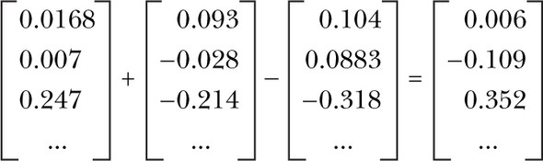
Vector-oriented reasoning
The Word2vec model contains information about the relationships between words
After adding and subtracting word vectors, your resultant vector will almost never exactly equal one of the vectors in your word vector vocabulary

Slide 105
Very high accuracy
Word2vec allows you to transform your natural language into the much lower-dimensional vectors.
In this lower-dimensional space, you can do your math and then convert back to a natural language space, very successfully
The reference implementation was trained on the 100 billion words from the Google News Corpus
Accuracy keeps improving

Slide 106
Application: Gensim
For looking at word vectors, we’ll use Gensim
We also use it in homework for word vectors
Gensim isn’t really a deep learning package.
It's a package for for word and text similarity modeling, which started with (LDA-style) topic models and grew into SVD and neural word representations.
But its efficient and scalable, and quite widely used
See the code

Slide 107
Future path?
GPT vs BERT?
Transfer learning
Go on to online: now you will feel more comfortable on understanding them
Natural Language Processing with Transformers, Revised Edition
Manageable challenge
Reading based Top-to-bottom course
https://people.ischool.berkeley.edu/~dbamman//nlp23.html
PyTorch vs. Tensorflow
Time investment

Slide 108
Now can have a talk about NLP
In fact, theory and skills are just a prerequisite
Beyond, it is just all about of ideas…
Russell Funk et al (2023) argue
Academic research is becoming less disruptive over time
Nature (2023)
Research, largely speaking, has evolved in two ways
Reinforce the previous ideas
Refute the existing ideas

Slide 109
Just focus on methods
Because they create departures from the status quo, disruptive papers and patents are likely to introduce new words
Therefore, if disruptiveness is declining, we would expect a decline in the diversity of words used in science and technology
To evaluate this, … documents the unique/total words of paper and patent tiles over time

Slide 110
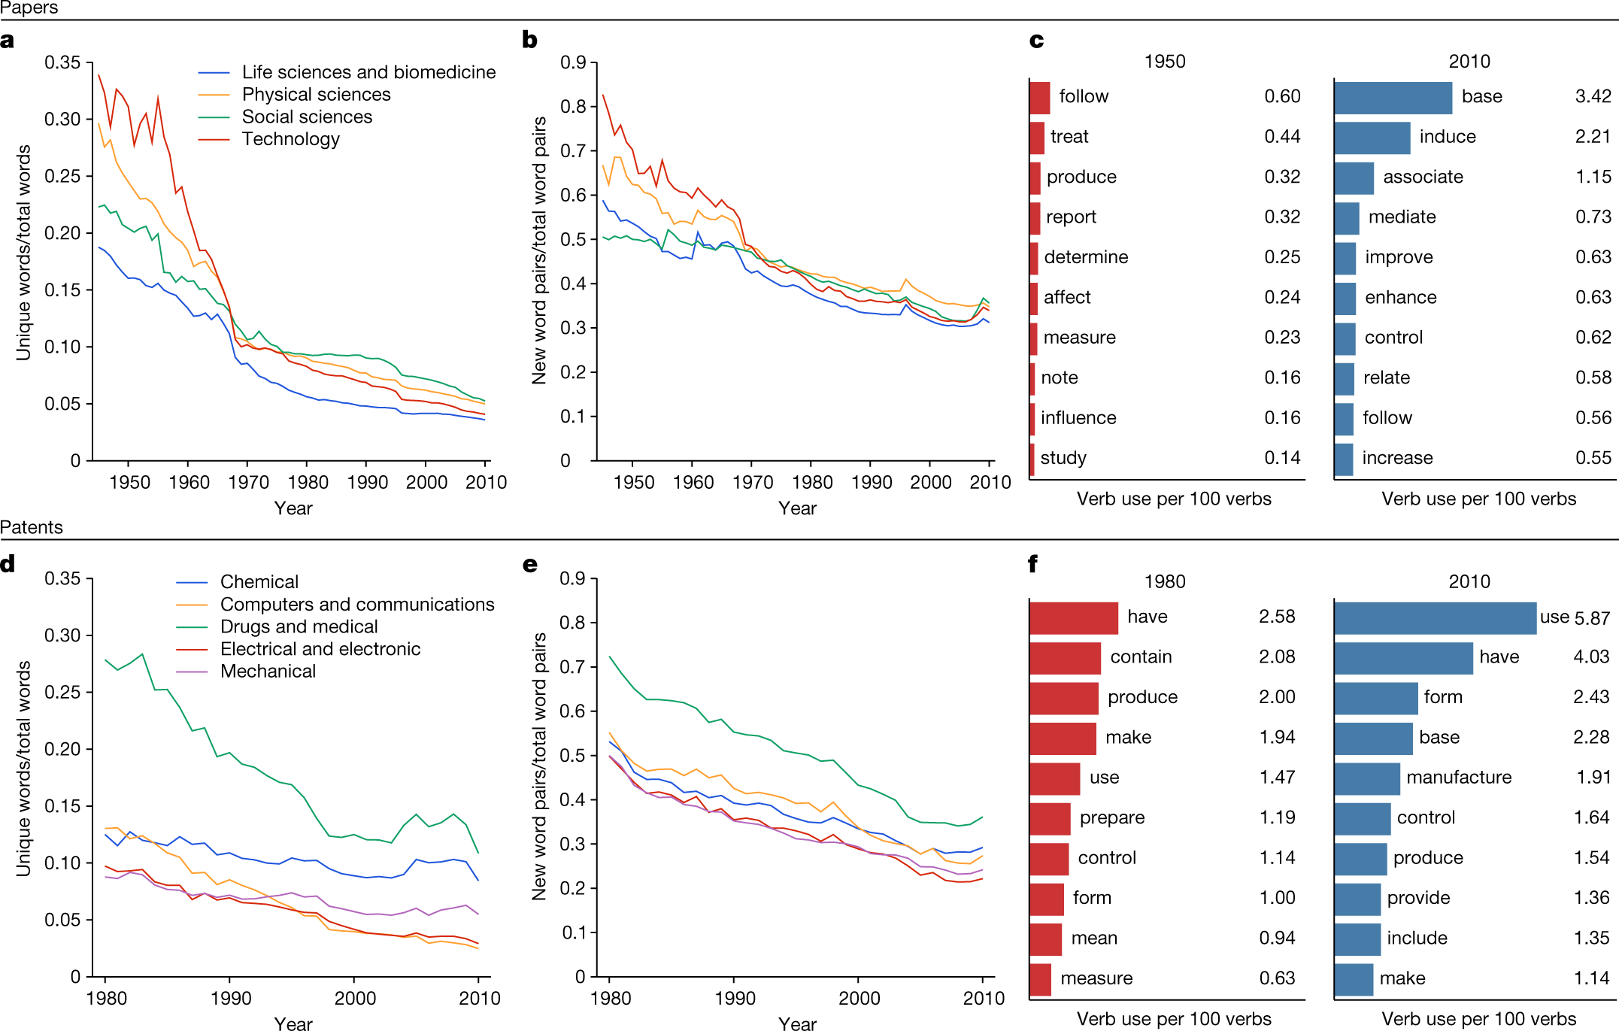

Slide 111
Let’s say we have all the text on research in every field
How do you like to approach?
Could we know whether research is evolving or declining?
Getting access to data is not impossible
News, policy statements
Systematic ways (big markets here)
Now is all about idea

