Slide 1

Introduction to Natural Language Processing
BUS 243 F: Spring 2023
Yeabin Moon
Lecture 5

Slide 2
Hmm. So what?
Text classification and topic modeling may seem like all we need for natural language processing
Technically speaking, we have done linear classification
What do you know about linear classification (model)?

Slide 3
Linear classification
The BOW representation is inherently high dimensional
Usually possible to find a linear classifier that perfectly fits the training data
even to fit any arbitrary labeling of the training instances
Moving to nonlinear classification may therefore only increase the risk of overfitting
Word frequencies are meaningful in isolation
Can offer independent evidence about the instance label
NLP has historically focused on linear classification

Slide 4
Now what?
But in recent years, nonlinear classifiers have swept through NLP, and are now the default approach for many tasks (Manning, 2015)
There are at least three reasons for this change

Slide 5
Technological progress: method
There have been rapid advances in deep learning
a family of nonlinear methods that learn complex functions of the input through multiple layers of computation
Goodfellow et al., 2016

Slide 6
Technological progress: resource
While CPU speeds have plateaued, there have been rapid advances in specialized hardware called graphics processing units (GPUs) thanks to gaming industry
which have become faster, cheaper, and easier to program
Many deep learning models can be implemented efficiently on GPUs, offering substantial performance improvements over CPU-based computing

Slide 7
Word embeddings
Deep learning facilitates the incorporation of word embeddings
Dense vector representations of words
Dense vector?
Word embeddings can be learned from large amounts of unlabeled data, and enable generalization to words that do not appear in the annotated training data
Kind of unsupervised learning

Slide 8
How do we represent the meaning of a word?
Definition: meaning
What is meant by a word, text, concept, or action
Commonest linguistic way of thinking of meaning:
Signifier (symbol) ←→ signified (idea or thing)
Denotational semantics

Slide 9
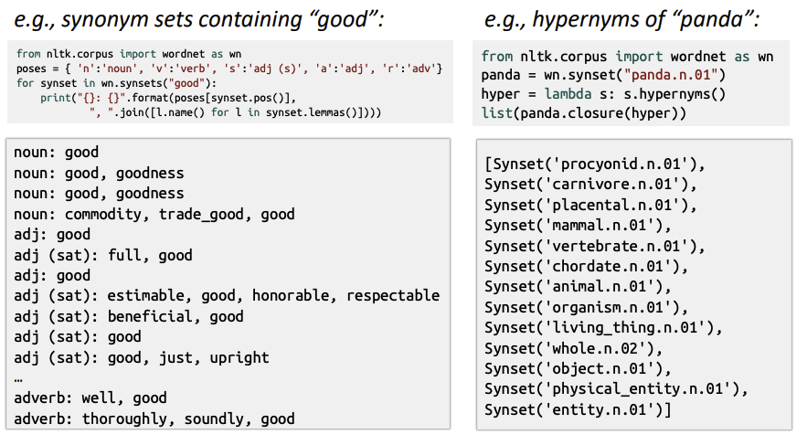
How do we have usable meaning in a machine?
Previously commonest NLP solution: Use, e.g. WordNet, a thesaurus containing lists of synonym sets and hypernyms

Slide 10
Problems with resources like WordNet
A useful resource but missing nuance:
Proficient is listed as a synonym for good
Only correct in some contexts
Missing new meanings of words
Subjective
Requires human labor to create and adapt
Can’t be used to accurately compute word similarity

Slide 11
Representing words as discrete symbols
In traditional NLP, we regard words as discrete symbols
Hotel, conference, motel – a localist representation
Such symbols for words can be represented by one-hot vectors
motel: [0 0 0 0 1 0 0 0]
Hotel: [0 0 1 0 0 0 0 0]
Vector dimension issue

Slide 12
Problem with words as discrete symbols
E.g: in web search, if a user searches for “Seattle motel”, we’d like to match documents containing “Seattle hotel”
But see: [0 0 0 0 1 0 0 0] , [0 0 1 0 0 0 0 0]
Theses two vectors are orthogonal
No natural notion of similarity for one-hot vectors
Could try to rely on WordNet’s list of synonyms to get similarity?
But it is well-known to fail badly
Instead, learn to encode similarity in the vectors themselves

Slide 13
Representing words by their context
Distributional semantics: A word’ meaning is given by the words that frequently appear close-by
J. R. Firth 1957: You shall know a word by the company it keeps
One of the most successful ideas of modern statistical NLP
When a word w appears in a text, its context is the set of words that appear nearby
Within a fixed-size window

Slide 14
Context, context, context
We use the many contexts of w to build up a representation of w
The following context words will represent banking
…government debt problems turning into banking crises as happened in 2009…
…saying that Europe needs unified banking regulation to replace the hodgepodge…
…India has just given its banking system a shot in the arm…

Slide 15
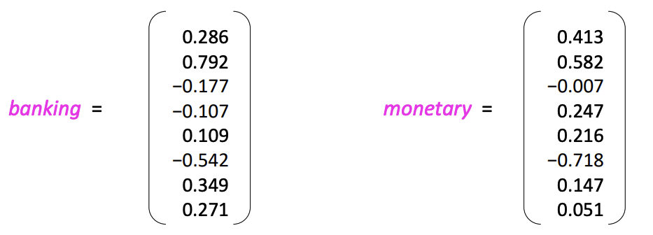
Word vectors
We will build a dense vector for each word, chosen so that it is similar to vectors of words that appear in similar contexts, measuring similarity as the vector dot (scalar) product
Note: word vectors are also called (word) embeddings or (neural) word representations
They are a distributed representation

Slide 16
What is Neural Network?
This is an extremely active field of artificial computer intelligence often referred to as deep learning
Super popular these days, but many fail to understand this correctly
What is your understanding?
What kind of problems can this solve in particular?

Slide 17
Limits of Traditional Computer Programs
Why exactly are certain problems so difficult for computers to solve?
Machines are good
Performing arithmetic really fast
Following explicitly a list of instructions
Suppose need to do some heavy financial number crunching
You cannot beat the machine at all!

Slide 18
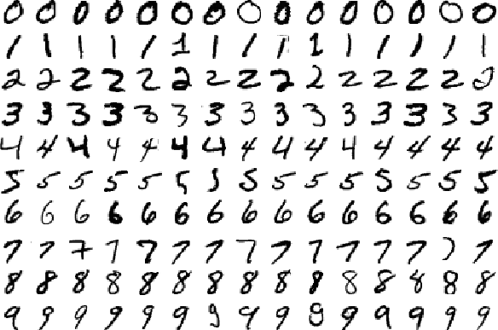
Can we beat the machine for image recognition?

Slide 19
How to recognize zero?
Suppose we want to know how to recognize 0 image
What rules could we use to tell one digit from another?
We might state that we have a zero if our image has only a single, closed loop
Is this sufficient condition?

Slide 20

How about this: zero or six

Slide 21
Don’t know how it’s done by our brains
Establish some cutoff between the starting and ending point of the loop?
How about threes and fives? Fours and nines?
We can add more and more rules, or features, through careful observation and months of trial and error
But it’s quite clear that this isn’t going to be an easy process
Wait, how did we learn?
Did you ever learn those rules?

Slide 22
Mechanics of Machine Learning
A lot of the things we learn in school growing up have much in common with traditional computer programs

