Slide 1


BUS 243
Lecture 1: Information Retrieval

Slide 2
Course logistics

Slide 3
Brief introduction

Slide 4
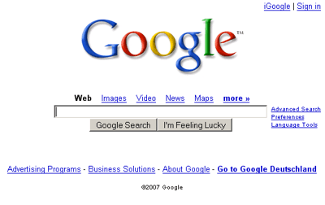

Slide 5
Information retrieval can money
Search engines are the most visited websites in most countries
Google, Bing, Baidu, Yahoo, AOL, Naver
Discussion platforms
Reddit, Quora, Stack Exchange
Shared knowledge
Wikipedia
Have you heard of Britannica?

Slide 6
We start here
Why IR?
Simple to understand
But hard to implement
Important to the world
Building block for the course project

Slide 7
Information retrieval is finding material (usually documents) of an unstructured nature (usually text) that satisfies an information need from within large collections (usually stored on computers)

Slide 8
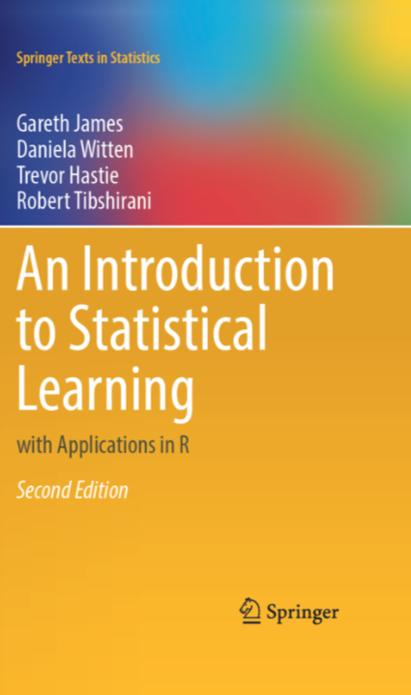
Suppose you want to learn Gradient Descent
Suppose you love a textbook treatment
Control + F: Gradient Descent

Slide 9
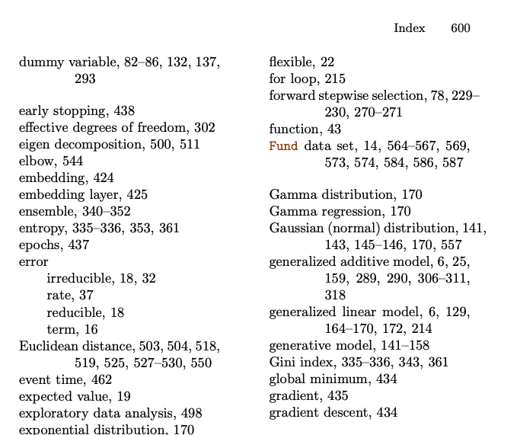
Assumption?
Why is this preferred?

Slide 10
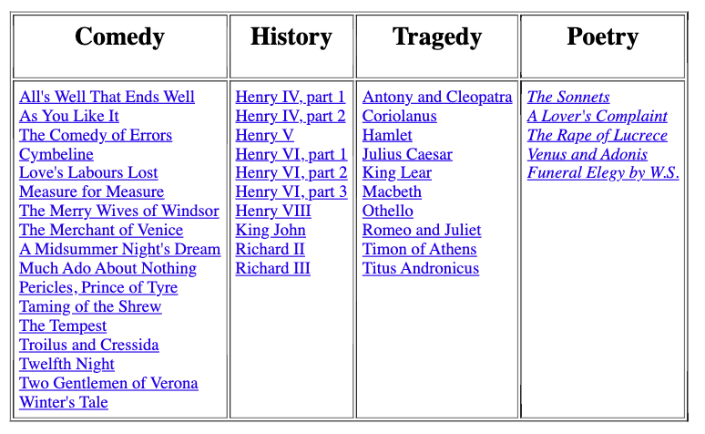
Which plays of Shakespeare contain the words Brutus AND Caesar AND NOT Calpurnia?

Slide 11
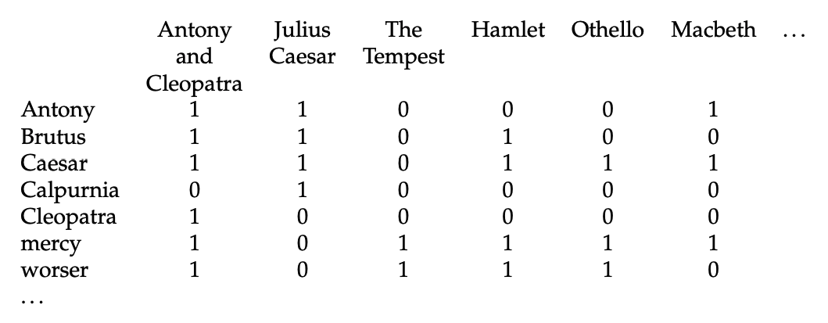
Let’s index each play
Use Terms (think it as a word for now)
This is called a term-document incidence matrix

Slide 12
To answer the question:
110100 AND 110111 AND 101111 = 100100
What’s the answer?

Slide 13
Boolean retrieval
The Boolean retrieval model is an IR model
Formulate queries using Boolean expressions
AND, OR, and NOT
Can be arbitrarily nested
The model views each document as just a set of words
Any given query divides the collection into two sets: retrieved, not-retrieved
Pure Boolean systems do not define an ordering of the results
What does it mean?

Slide 14
Strengths and Weaknesses
Strengths
Precise, if you know the right strategies
Precise, if you have an idea of what you’re looking for
Implementations are fast and efficient
Weaknesses
Users must learn Boolean logic
Boolean logic insufficient to capture the richness of language
No control over size of result set: either too many hits or none 
When do you stop reading? All documents in the result set are considered “equally good”
What about partial matches? Documents that “don’t quite match” the query may be useful also

Slide 15
Terminology alert
Write your own definition and list the corresponding examples in the Shakespeare’s works
Terms
Documents
Corpus

Slide 16
Main tasks in IR
Information need
Query Formulation
Assessment

Slide 17

Evaluating Results: Intrinsic
TREC: set of ‘gold’ relevant documents
How many of the documents found?
Annual bake-off of IR systems

Slide 18
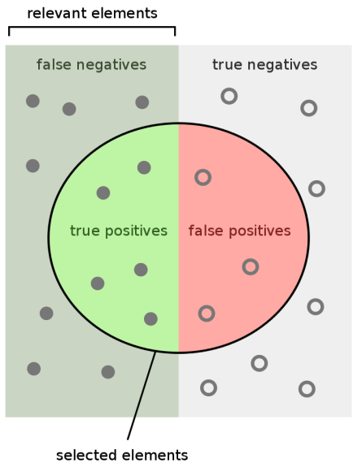
Relevance Terminology
TP: True Positive
FP: False Positive
TN: True Negative
FN: False Negative

Slide 19
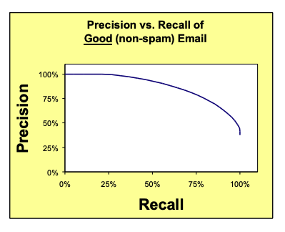
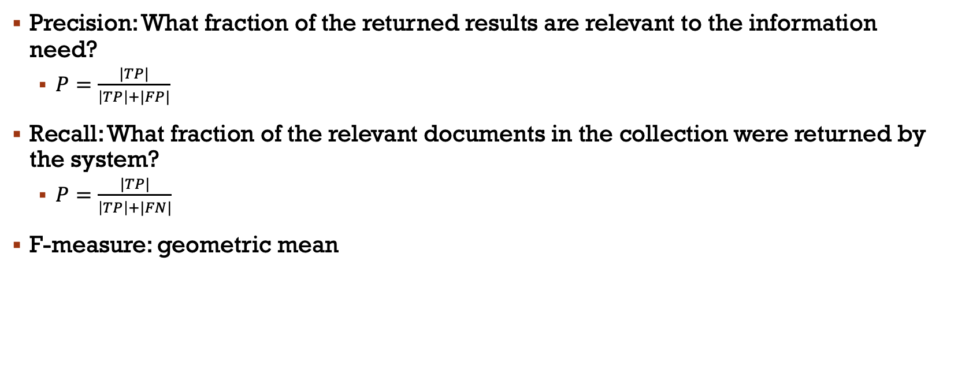
Precision and Recall
Precision: What fraction of the returned results are relevant to the information need?
$P=\frac{|TP|}{\left|TP\right|+|FP|}$
Recall: What fraction of the relevant documents in the collection were returned by the system?
$P=\frac{|TP|}{\left|TP\right|+|FN|}$
F-measure: geometric mean

Slide 20
Evaluating Results: Extrinsic
IR is often used to find answers to questions
But it takes a human to read the results
If you know what answer is, you can search for similar questions
Build machines to read the answer
We will see both later

Slide 21
NLP job search?
What’s job qualifications?

