Slide 1


BUS 243
Lecture 9: CNN and review

Slide 2
The non-linearity of the network, as well as the ability to easily integrate pre-trained word embeddings, often lead to superior classification accuracy – Yoav Goldberg

Slide 3
Convolution Neural nets
However, you will see that the model with pre-trained embedding in homework 5 perform worse
It is not because the embedding, but because the modeling choice
So far, the NNs considered have all been fully connected
What’s the meaning?

Slide 4
Consider image classification task
Fully connected model
Absolute value of light intensities at global level
Hardly make sense in general
Differences in pixel values at local level
CNN is taking account kind of window!

Slide 5
Despite little tuning of hyperparameters, a simple CNN with one layer of convolution performs remarkably well. Our results add to the well-established evidence that unsupervised pre-training of word vectors is an important ingredient in deep learning for NLP – Yoon Kim

Slide 6
You can get good results for document classification with a single layer CNN
In a convolutional layer, you can specify the size of the window, often referred to as the kernel size or filter size
small matrix that slides over the input data
determines the receptive field or the area of input that the kernel considers at each step

Slide 7
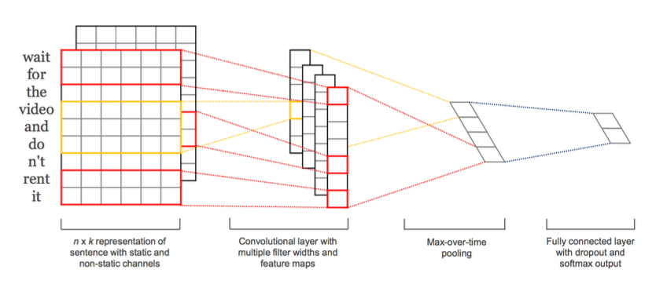

Slide 8
Some hyperparameters matter more than others
Unfortunately, a downside is that they require practitioners to specify the exact model architecture to be used and to set the accompanying hyperparameters.
Same as demining the size of window

Slide 9
Using IMDB movie review data, let’s see all the necessary steps for CNN classification
Good for review what we have learned and check where CNN could be used

Slide 10
CNN (or general) pipeline
You will see that major part of text classification is on data preparation thanks to deep learning platform
You have to think 3 steps at least
Validation method
how to split data?
Normalization
Data!
Vocabulary

