Slide 1

Introduction to Natural Language Processing
BUS 243 F: Spring 2023
Yeabin Moon
Lecture 3

Slide 2
Meaning of relative counts
Bag-of-words representation has a lot of interesting applications
Now we are going to consider the counts in relation to the rest of the documents
Careful on the readings
Note that the TF-IDF representation is not an improvement from the BOW representation
They are different
Also, it is not certain that whether TF-IDF represents the meaning of words

Slide 3
Popular representation?
TF-IDF stands for term frequency times inverse document frequency
Term frequencies are the counts of each word in a document
Inverse document frequency means that you’ll divide each of those word counts by the number of documents in which the word occurs
Popular representation of the text
Not much popular in the front end
Somewhat overrated, need to have a discussion

Slide 4
Assumption
Vector representation of the text based on the frequency of each word in the given text
Assume that the more times a word occurs, the more meaning it must contribute to that document
Each word has some innate sentiment
Idea of text classification based on BOW representation
The main question is whether we need to normalize the counts
Let’s see the first example code

Slide 5
0.1818?
What does this number mean?
Sentence: The faster Harry got to the store, the faster Harry, the faster, would get home.
`Harry’ used twice (after case folding)
The number of unique tokens is 11
Not clear why do we ever need the normalization
Worse yet, why do we need the number of unique tokens as the normalizer (denominator)?
Not exactly sure of the meaning of 0.1818

Slide 6
Textbook example: why “temper” it all?
TF(“dog,” document A) = 3/30 = .1
TF(“dog,” document B) = 100/580000 = .00017
What’s the meaning of TF(“dog,” document A), 0.1?
I see the reasoning behind the normalization
But still not clear why do we need the unique tokens in the previous example
Am I too picky?

Slide 7
What are we missing?
For a long text, the normalized count of a word would mean more
The Dog example would make sense
Not just conceptually, the calculation result (term frequency) would be robust
Normalizer: the number of tokens used vs. the number of unique tokens used
Strong assumption?
However, for a short text, each approach would result in very different outcomes
Think about tokenizers
For most NLP applications, there would be no definitive formula
More important thing is to understand the concepts
Let’s see Kite example in the code

Slide 8
What are we doing?
document_vectors is the python list
Each item is the Ordered dictionary
Data type is in fact not very important here
Let’s interpret each item
What’s the denominator?
Does it make sense to you?
Why not using the number of unique tokens in the corresponding sentence?
Why not using the number of every tokens?

Slide 9
Understanding the construction
Each of your three document vectors will need to have 18 values, even if the document for that vector doesn’t contain all 18 words in your lexicon
Each token is assigned a slot in your vectors corresponding to its position in your lexicon
You have three vectors, one for each document. So what? What can you do with them?

Slide 10
Vector spaces
Vectors are the primary building blocks of linear algebra, or vector algebra
Python Tuples
A tuple is a collection which is ordered and unchangeable
Order means there is a particular direction of a vector and possible to measure the distance between vectors
What’s the meaning of dimensionality?

Slide 11
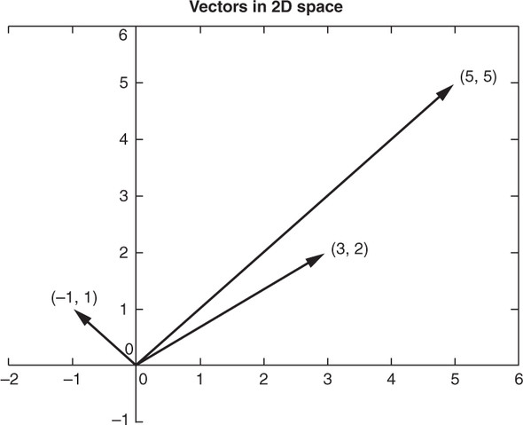
What can we tell about the following 3 vecs?

Slide 12
Dimensionality
More dimensionality means more information
The linear algebra all works out the same!
You might need more computing power as the dimensionality grows
Curse of dimensionality issues
For a natural language document vector space, the dimensionality of your vector space is the count of the number of distinct words that appear in the entire corpus
You can then describe each document within this K-dimensional vector space by a K-dimensional vector

Slide 13
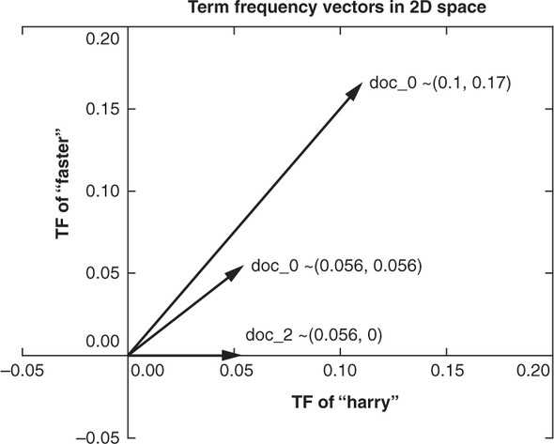
Vector algebra
Now that you have a representation of each document and know they share a common space, you have a path to compare them

Slide 14
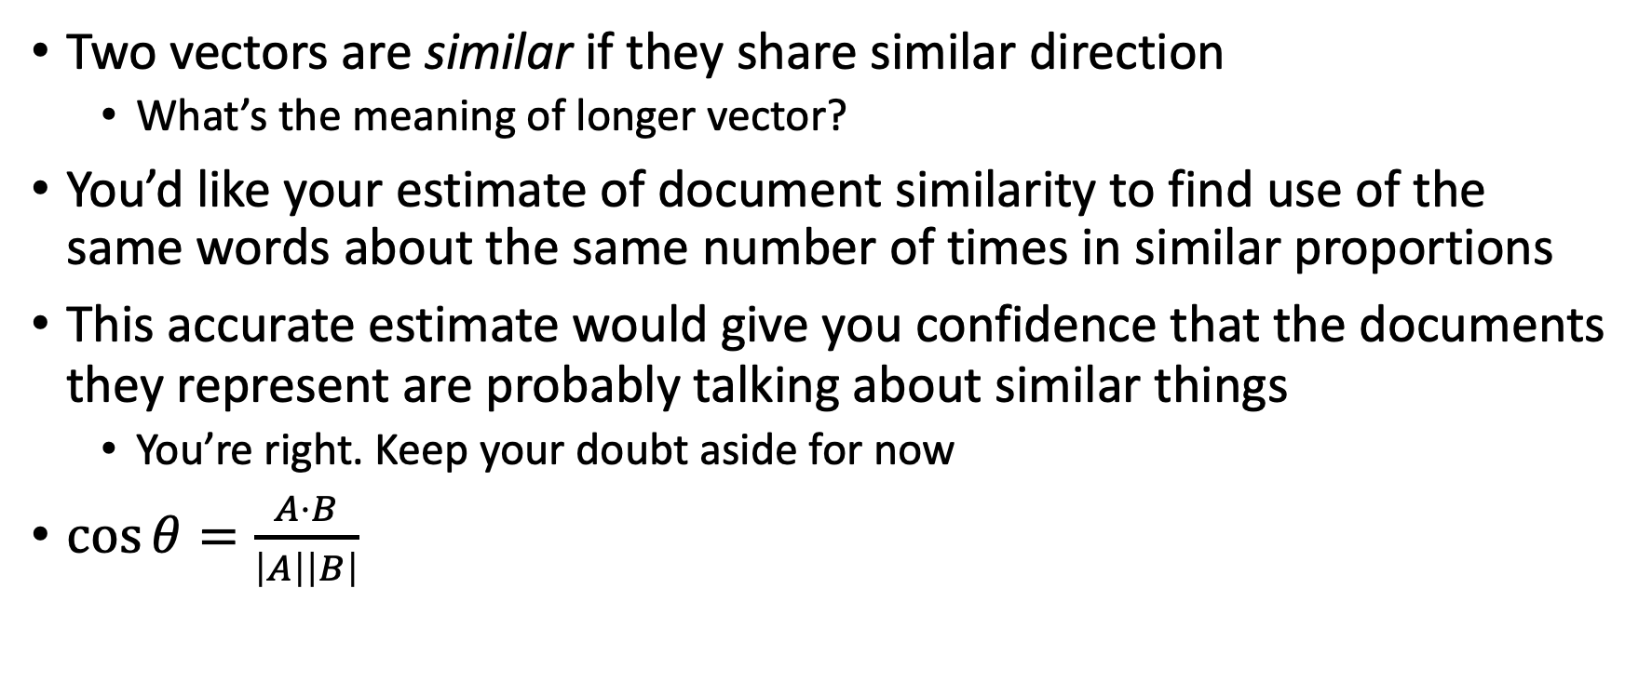
Similarity
Two vectors are similar if they share similar direction
What’s the meaning of longer vector?
You’d like your estimate of document similarity to find use of the same words about the same number of times in similar proportions
This accurate estimate would give you confidence that the documents they represent are probably talking about similar things
You’re right. Keep your doubt aside for now
$\cos{θ}=\frac{A⋅B}{\left|A\right|\left|B\right|}$

Slide 15
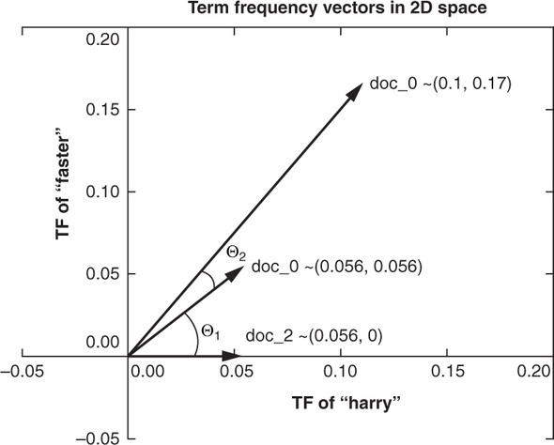
Cosine Similarity

Slide 16
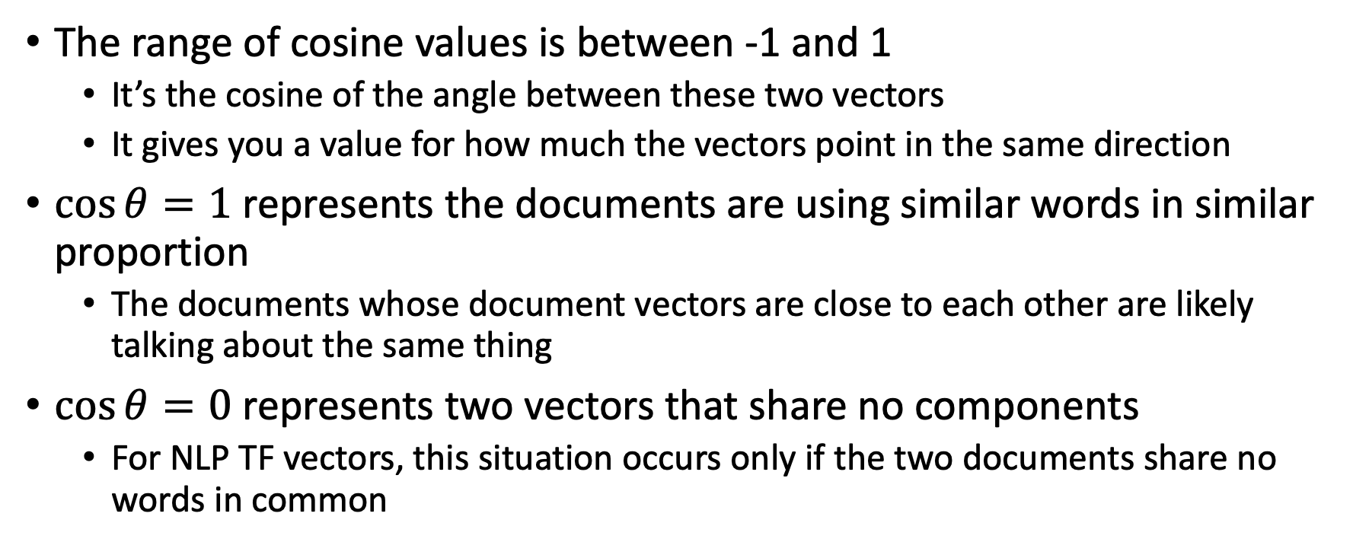
Cosine representation
The range of cosine values is between -1 and 1
It’s the cosine of the angle between these two vectors
It gives you a value for how much the vectors point in the same direction
$\cos{θ}=1$ represents the documents are using similar words in similar proportion
The documents whose document vectors are close to each other are likely talking about the same thing
$\cos{θ}=0$ represents two vectors that share no components
For NLP TF vectors, this situation occurs only if the two documents share no words in common

Slide 17
Assumptions?
What do we need to assume to conclude the meaning of cosine values?
They just use either completely same (different) words
What about synonyms and antonyms?
Hard to infer semantics or meanings in general
A cosine similarity of -1 represents two vectors that are anti-similar, completely opposite
Impossible for TF since every component should be non-negative values

Slide 18
Zipf’s Law
… the frequency of occurrence of any given word in a language is inversely proportional to its rank in the frequency table. In other words, the most frequently occurring word in a language (such as "the" in English) will occur approximately twice as often as the second most frequent word (such as "of"), three times as often as the third most frequent word, and so on…
ChatGPT

Slide 19
Application
Inverse proportionality refers to a situation where an item in a ranked list will appear with a frequency tied explicitly to its rank in the list
If you see any outliers that don’t fall along a straight line in a log-log plot, it may be worth investigating
Let’s take look the code on the relationship between the population of US cities and the rank of that population and the Brown corpus

Slide 20
Ok, so what does it describe?
The distribution over words (and other linguistic elements) resembles that of a power law
There will be a few words that are very frequent, and a long tail of words that are rare
A consequence is that NLP algorithms must be especially robust to observations that do not occur in the training data

Slide 21
The meaning of Normalized count
What’s the idea behind of power law?
What’s the assumption of the count-base representation?
Now we consider a relative count in document vectors
Inverse document frequency, or IDF, is your window through Zipf law
Let’s go back to the Wikipedia document regarding a kite

Slide 22
What are we doing?
Term Frequency of "kite" in intro is: 0.0441
Term Frequency of "kite" in history is: 0.0202
Term Frequency of "and" in intro is: 0.0275
Term Frequency of "and" in history is: 0.0303

Slide 23
Text data structure
Meaning unit of text
Token(s) → Sentence(s) → Document(s) → Corpus (Corpora)
But it could be
Token(s) → Corpus (Corpora)
Token(s) → Sentence(s) → Corpus (Corpora)
Token(s) → Documents(s) → Corpus (Corpora)
Tokens are the basic units of meaning in a text
Words, numbers, punctuation marks,…
A corpus consists of tokens, which are the building blocks of the text data
Let’s apply this concept to the Kite example

Slide 24
What’s the denominators?
We have a text corpus about “Kite” from Wikipedia
2 documents: Intro and History
How did we calculate Term Frequency of "kite" in each document?
What if we divide each "kite” by the number of tokens in the corpus?
If so, how do we interpret the number?
Let’s go back to the code

Slide 25
Term’s inverse document frequency
We calculate the ratio of the total number of documents to the number of documents the term appears in
Called a term’s inverse document frequency
What’s the motivation?
Term frequency alone (normalized frequency of a word) is not enough

Slide 26
Example
There are two documents
Both documents contain the words “and” and “kite”
Only one document contains the word “china”
So, IDF of
”and”: 1, “kite”: 1, ”china”: 2
Make sure of what it means!

Slide 27
Think about this statement in the textbook
A good way to think of a term’s inverse document frequency is this:
How strange is it that this token is in this document?
If a term appears in one document a lot of times, but occurs rarely in the rest of the corpus, one could assume it’s important to that document specifically.

Slide 28
IDF itself is not document-specific number
IDF of three tokens in the Kite Corpus
”and”: 1, “kite”: 1, ”china”: 2
It does not change by documents
It does not mean that the word “china” is rarely used
Even if one document contains the word “china” one million times and the other document does not contain it, IDFs are the same

Slide 29
TF-IDF
Previously, we only focus on the frequency for each word (term)
Now, for a given term t, in a given document d in a corpus D
TF-IDF(t,d,D) = tf(t,d) * idf(t,D)
The base of log function is not important
Assign weights to words (terms) based on
Frequency of words in a certain document
Distribution of words over documents in the corpus
You won’t likely ever have to implement the preceding formulas for computing TF-IDF

Slide 30
Interpretation of TF-IDF
The more times a word appears in the document, the TF (and hence the TF-IDF) will go up
At the same time, as the number of documents that contain that word goes up, the IDF (and hence the TF-IDF) for that word will go down
It relates a specific word or token to a specific document in a specific corpus, and then it assigns a numeric value to the importance of that word in the given document, given its usage across the entire corpus.

Slide 31
Is this topic modeling?
TF-IDF is used to identify the most important words or terms in a document or corpus by assigning weights to them
It presents the word’s rarity across the corpus
Possible to collect or filter the keywords based on the distribution of TF-IDF
Are they (important words) topics?

Slide 32
Relevance ranking
Let’s go back to the code again
Let’s explain in words what this example describes
What’s 0 mean?
What’s 0.5235048549676834 mean?
Let’s revisit the Question 5 on Homework 1

