Slide 1
Lecture ?
BUS 212
I just make this slide a few hours ago

Slide 2
Original Plan
Study Algorithm chains and Pipelines
Pipeline (python) class simplifies the pre processing data
As long as knowing the brief data structure, easy to apply this framework
Process data
Apply the model
It is a kind of one-shot algorithm
Its usage is a bit controversial

Slide 3
Let’s talk about the exam
I think we need to talk about the exam
5 Questions
2 questions are the past interview questions from Lyft and Goldman Sachs
1 question is the screening interview from the postdoc program
Please email me if you have questions on your score

Slide 4
Give me your intuition
Average is 88.94 and median is 91
Homework average is around 94
Even better on conceptual questions
We will have
Tree based methods: most advanced
Unsupervised learning: probably new
Let’s review the questions

Slide 5
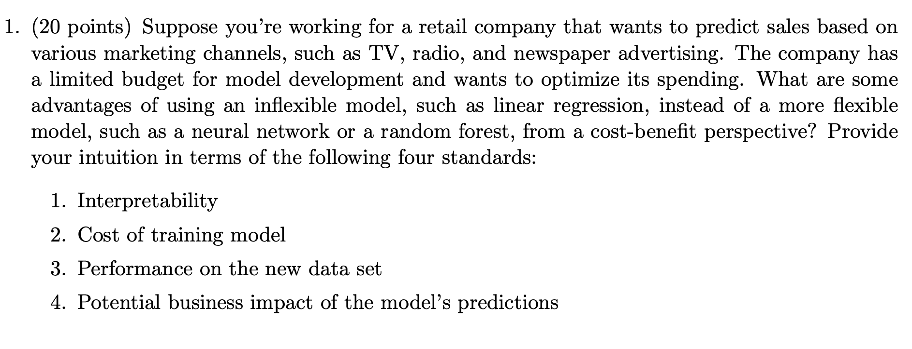
How do we need to approach this question?

Slide 6
Question 1
What’s the question?
You have to defend in terms of favoring inflexible models
Not interested in how much you know about this subject
Have to know Definition / basic characteristics
Linear models, inflexible models, simple models
Non linear models, flexible models, complex models
It is easy to answer, but what’s your story of the application?
Think about if you are asked the same question in face-to-face interview

Slide 7
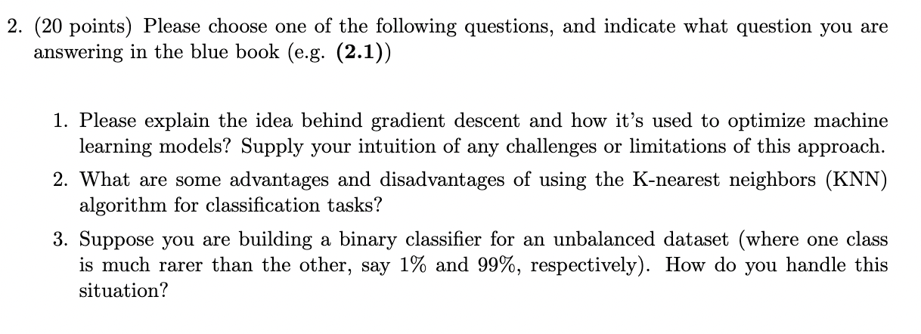
Question 2

Slide 8
Question 2
Most answered the question 1 and 2
I saw so many creative figures and fancy equations
For the question 2.1
Fine, but how to explain your understanding in words?
For the question 2.2
KNN is simple and intuitive
Is it easy to compute?
Think about the algorithms

Slide 9
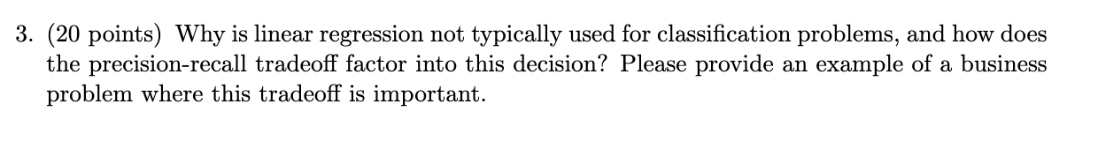
Your example is boring…

Slide 10
Question 3
Why do we need a classification model?
How do we test the model?
Why not R-squared is the bad one here?
Think about the example
You want to build a classifier filter which classifies adult contents in streaming videos
Do we need to focus on raising precision or recall?
Think about there is a trade-off

Slide 11
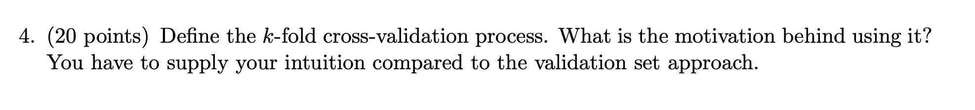
Not interested in whether you know LOOCV

Slide 12
Question 4
Again, let’s talk about how we implement k-fold cross-validation process
Data split in k folds
Use k-1 folds for training and 1 fold for validation
What’s the next?
What’ the intuition behind the validation set approach?
Random split?

Slide 13
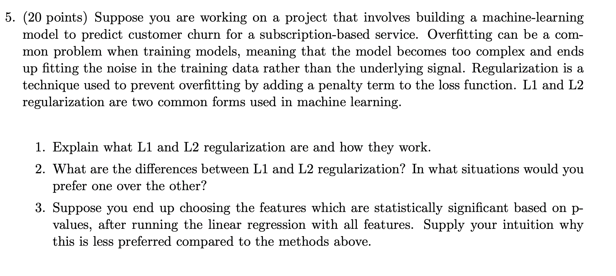
We need to have a talk

Slide 14
Class end here but office hour start
I’d like to discuss with you!
I will be at my office 209 B
Please come and discuss how we proceed
Strongly recommend the students who feel behind
Not going to dispute with you on your scores (email only)

